Slide 1
ORIGINAL ARTICLE
Rivaroxaban in Rheumatic Heart Disease–
Associated Atrial Fibrillation
Dr. Subhransu M , JR1

Slide 2
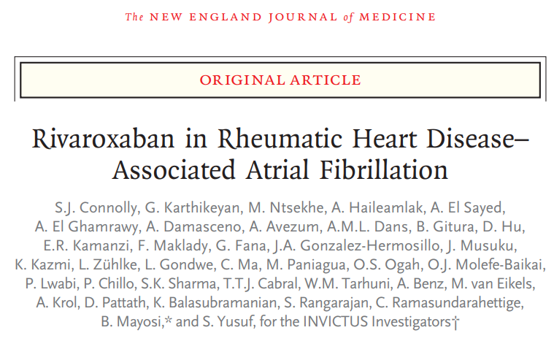

Slide 3
Introduction
On Average, Patients with atrial fibrillation have a five fold
Increased risk for embolic stroke owing to formation of thrombus in the left atrium, which can
embolize and occlude branches of the intracerebral circulation.

Slide 4
Efficacy of vitamin K antagonists for stroke prevention in patients with atrial fibrillation is already well established
VKAs reduce the rate of stroke by approximately 60%, whereas antiplatelet therapy is much less efficacious (reducing the event rate by approximately 20%)

Slide 5
Vitamin K Antagonist
4-hydroxycoumarin derivatives
Vitamin K acts as a cofactor in the post-translational carboxylation of glutamate residues to γ-carboxylglutamates in the N-terminal regions of the vitamin K-dependent protein
VKAs exert their anticoagulant effect by inhibiting vitamin K epoxide reductase
Thereby limiting synthesis of vitamin K-dependent coagulation factors II, VII, IX, and X.

Slide 6
VKAs are mostly used as long-term anticoagulant therapy,
Including for the prevention of stroke in patients with atrial fibrillation (AF)
Treatment of venous thromboembolism (VTE).
Can be used in patients with severe renal impairment.
Narrow therapeutic range thus needing regular INR monitoring
Drug and food interactions

Slide 7
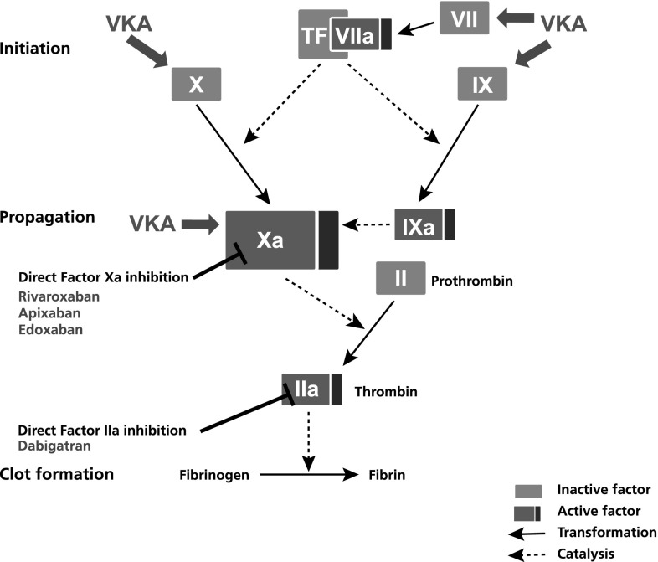

Slide 8
Non Vitamin K Antagonist Oral Anticoagulants (NOACs)
Developed to overcome the limitations of VKA therapy
Approved worldwide for the prevention of stroke and systemic embolism in patients with non-valvular AF, as well as for other thromboembolic disorders
Selective for one specific coagulation factor
Direct Thrombin Inhibitor – Dabigatran
Factor Xa Inhibitor – Rivaroxaban, Apixaban, Edoxaban

Slide 9
Advantages of DOAC over VKAs
much faster effective anticoagulation effect—within 0.5-4 h; hence bridging with a parenteral anticoagulant is not necessary
predictable pharmacokinetics and pharmacodynamics and a lower potential for food and drug interactions ; therefore, can be given at fixed dosing schedules

Slide 10
Rivaroxaban

Slide 11
Randomized clinical trials have shown that these non–vitamin K antagonist oral anticoagulants are as effective as vitamin K antagonist therapy for stroke prevention and have a lower risk of intracerebral hemorrhage

Slide 12
However, the randomized trials that have established the efficacy and safety of both vitamin K antagonist and non–vitamin K antagonist oral anticoagulants for stroke prevention in patients with atrial fibrillation excluded patients who had atrial fibrillation due to rheumatic heart disease.

Slide 13
Patients with atrial fibrillation due to rheumatic heart disease differ substantially from other patients with atrial fibrillation
They are usually
much younger,
more often female,
and often have advanced valvular disease
Mostly belong from low and middle income groups where regular monitoring of INR is a challenge

Slide 14
METHODS
Trial design : randomized, double-blind, open label
Written informed consent was obtained from all the patients before randomization.

Slide 15
Patients
Inclusion Criteria :
18 years of age or older
Echocardiographically proven RHD
Documented atrial fibrillation or atrial flutter at any time.

Slide 16
For patients to be eligible,
At least one of the following criteria was additionally required
CHA2 DS2 VASc score of at least 2
Mitral stenosis with a mitral-valve area of no more than 2 cm2
Echocardiographic evidence of either left atrial spontaneous echo contrast or left atrial thrombus

Slide 17
Key exclusion criteria
Presence of a mechanical heart valve or the likelihood of receiving one within the next 6 months,
Use of dual antiplatelet therapy,
Treatment with dual strong inhibitors of CYP3A4 and P-glycoprotein,
Presence of severe renal insufficiency
Women of Reproductive age – if Pregnant or Not using contraceptive

Slide 18
Randomisation and clinical regimen
Patients were
Randomly assigned in a 1:1 ratio,
With the use of Web-based randomization system
To receive either rivaroxaban or a locally available vitamin K antagonist

Slide 19
Randomisation and clinical regimen
Rivaroxaban was administered
20 mg daily if Cr.CL >50 ml/min or
15 mg Daily if Cr.CL<50 ml/min
Vitamin K antagonist
Dose adjustment in order to maintain the INR in the range of 2.0 to 3.0. Patients were seen in follow-up at 1 month after randomization and every 6 months thereafter.

Slide 20
Efficacy end points of the study
The efficacy analyses were performed on the basis of the intention-to-treat principle
Analysis would include events that occurred up to 5 days after permanent discontinuation of trial medication
Primary efficacy outcome was a composite of total stroke or systemic embolism.
Key secondary outcomes were myocardial infarction and death from vascular (cardiac or noncardiac) causes

Slide 21
Adherence to rivaroxaban therapy was assessed with the pill counts made at subsequent visits.
No pill counts were done for the vitamin K antagonist group, but regular INR monitoring was done; at least 6 monthly

Slide 22
Safety
The primary safety outcome was major bleeding
as defined by the International Society of Thrombosis and Hemostasis (ISTH)
Symptomatic presentation and
Fatal bleeding, and/or
Bleeding in a critical area or organ, such as intracranial, intraspinal, intraocular, retroperitoneal, intra-articular or pericardial, or intramuscular with compartment syndrome, and/or
Bleeding causing a fall in hemoglobin level of 2.0 g dL or more, or leading to transfusion of two or more units of whole blood or red cells.

Slide 23
Results
Patient enrolment
From August 2016 through September 2019, a total of 4565 patients were enrolled from 138 trial sites across 24 countries
2292 patients were assigned to the rivaroxaban group, and 2273 to the vitamin K antagonist group

Slide 24
The intention-to-treat analysis included 4531 patients:
2275 in the rivaroxaban group and
2256 in the vitamin K antagonist group
A total of 136 patients were lost to follow-up,
and 16 patients withdrew consent

Slide 25
Final vital status was known for 4379 patients
2194 in the rivaroxaban group and
2185 in the vitamin K antagonist group
On February 4, 2022, the data and safety monitoring board recommended that the trial be terminated because the primary question addressed by the trial had been satisfactorily answered.

Slide 26
The mean (±SD) duration of follow-up was 3.1±1.2 years.
Patients were enrolled in Africa, Asia, and Latin America.

Slide 27
The mean age of the patients was 50.5 years,
72.3% were women.
Moderate-to-severe mitral stenosis (valve area, ≤2.0 cm2 ) was present in 81.9% of the patients.
Vitamin K antagonist therapy was being used before enrollment in 52.8% of the patients.

Slide 28
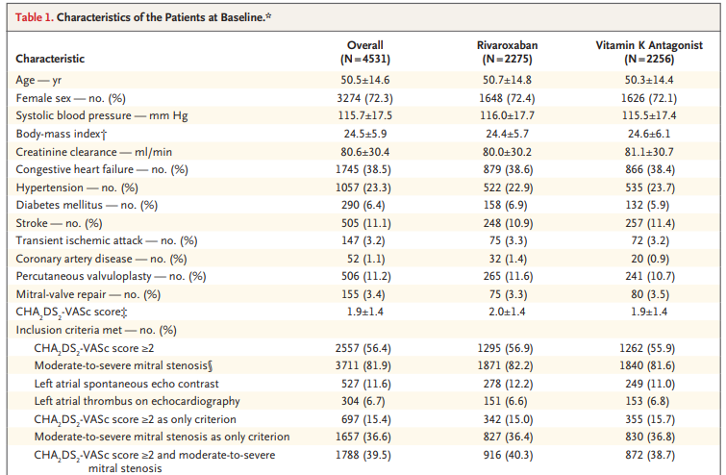

Slide 29
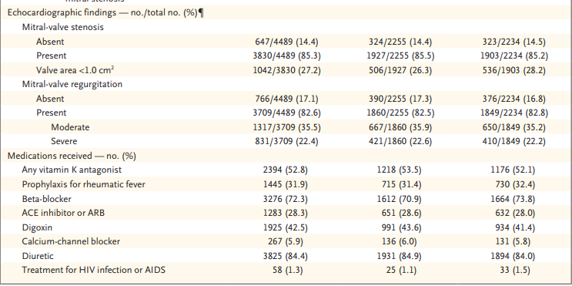

Slide 30
Delivery of Trial Treatment
In the vitamin K antagonist group, warfarin was used in 79% to 85%. Acenocoumarol was used in almost all the other patients.
The INR that was recorded immediately before trial enrollment was in the therapeutic range (2.0 to 3.0) in 33.2%
56.1% of the patients at 6 months, in 59.0% at 1 year, in 65.3% at 2 years, in 65.1% at 3 years, and in 64.1% at 4 years.

Slide 31
Percentage of patients with permanent discontinuation of trial medication was higher in the rivaroxaban group
Most common reasons being valve surgery requiring use of VKA ( 161 – 31.4% out of 516 ) and decision by the patient.
Mean adherence to rivaroxaban therapy was 83.7±16.5%

Slide 32
Efficacy and Safety Outcomes
A primary-outcome event (stroke, systemic embolism, myocardial infarction, or death from vascular or unknown causes)
occurred in
560 of 2275 patients in the rivaroxaban group and in
446 of 2256 patients in the vitamin K antagonist group
Stroke : More patients in the rivaroxaban group(90 vs. 65 patients)

Slide 33
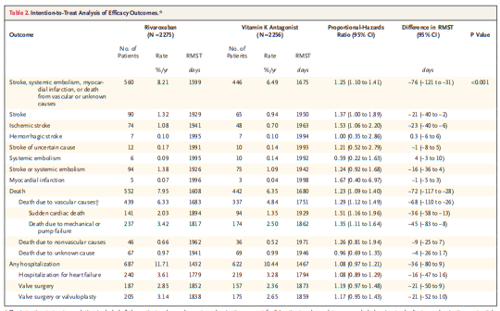

Slide 34
DEATH - 552 patients in the rivaroxaban group and in 442 in the VKA group died
No between-group differences in the rate of hospitalization for heart failure were observed
The rates of valve-replacement surgery or mitral valvuloplasty did not differ significantly between the two groups.
The between-group differences in the rates of stroke and death were similar in the on-treatment analyses and the intention-to-treat analyses

Slide 35
Rates of major bleeding did not differ significantly between the treatment groups
However, the rate of fatal bleeding was lower with Rivaroxaban than with vitamin K antagonists.

Slide 36
Discussion
In Atrial fibrillation NOT related to RHD, treatment with rivaroxaban or other factor Xa inhibitors has been shown to be noninferior to warfarin therapy for stroke prevention, with large reduction in the risk of hemorrhagic stroke.

Slide 37
However, The patients in the present trial were
much younger (mean age, 50.5 years)
more likely to be women - 72%
patients with rheumatic heart disease
A lower percentage of Hypertension (23%)

Slide 38
Expectation from the study
Expected to find a similar or higher risk of stroke because mitral stenosis has been associated with a high risk of stroke.
Not expected to observe a difference in mortality

Slide 39
Previous randomized trials comparing rivaroxaban with vitamin K antagonist therapy in patients with atrial fibrillation and bioprosthetic mitral valves showed a lower risk with rivaroxaban of stroke at 1 year of follow-up and no significant difference in mortality.
Thus, the results of the present trial were unexpected.

Slide 40
Possible Explanations
Patients in the vitamin K antagonist group had more physician interactions than those in the rivaroxaban group because of the need for monthly monitoring of INR control.
This situation could have resulted in better overall care and fewer strokes and deaths
It is possible that adherence to rivaroxaban therapy was worse because patients in the rivaroxaban group knew that they were not having the INR monitored

Slide 41
The lower mortality observed with VKA therapy than with rivaroxaban therapy in this trial is also clearly NOT related to any effect on bleeding,
Given that bleeding was not less common with vitamin K antagonist therapy than with rivaroxaban therapy.

Slide 42
The use of a vitamin K antagonist led to a lower rate of death from vascular causes than rivaroxaban therapy
Along with lower rates of both sudden cardiac death and death from mechanical or pump failure.

Slide 43
Conclusion
This trial showed that as compared with rivaroxaban, vitamin K antagonist therapy
led to a lower rate of ischemic stroke among patients with rheumatic heart disease–associated atrial fibrillation and
lower mortality due to vascular causes,
without significantly increasing the rate of major bleeding.

Slide 44
The results of this trial support current guidelines, which recommend vitamin K antagonist therapy for the prevention of stroke in patients with rheumatic heart disease in whom atrial fibrillation develops

Slide 45


