Slide 1
Neuromyelitis Optica Spectrum Disorder
Dean M. Wingerchuk, M.D., and Claudia F. Lucchinetti, M.D.
NEJM Aug 18,2022

Slide 2
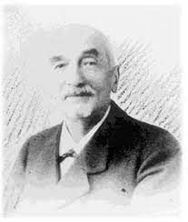
Introduction
Rare autoimmune disorder
Multifocal central nervous system inflammation primarily affecting the optic nerves and spinal cord
First described by Devic in 19th century

Slide 3
Initially thought to be a severe monophasic optic and spinal variant of multiple sclerosis that has spread to the brain
Discovery of IgG-class antibodies that bind to the water channel aquaporin-4 (AQP4-IgG) in serum from patients with Devic’s disease, but not from those with typical multiple sclerosis, established neuromyelitis optica as a distinct entity with a chronic, relapsing course

Slide 4
NMOSD accounts for 1 to 2% of all cases of CNS inflammatory demyelinating disease in the United States and Europe and one third or more of cases of CNS inflammation in Asian and other non-White populations.
Median age at onset of the disorder is 40 years, but can affect people at any age
Up to 20% of cases are in children or in adults over the age of 65 years
The AQP4-IgG autoantibody is detectable in more than 80% of patients with NMOSD.

Slide 5
Seropositive disease has a 90 % female preponderance whereas seronegative cases have an equal sex distribution
Up to 3% of cases are familial
Approximately one third of cases are preceded by an infection, which is often viral, and in rare cases, an acute attack follows vaccination
No specific infection or vaccine has been strongly implicated as a trigger of disease activity
The initial attack has been associated with the use of immune checkpoint inhibitor therapies

Slide 6
Clinical characteristics
Six core clinical syndromes which are classified by their location:
Optic nerve
Spinal cord
Area postrema of the dorsal medulla
Other brain-stem regions
Diencephalon
Cerebrum
most common syndromes are optic neuritis, transverse myelitis, area postrema syndrome

Slide 7
The sentinel attack involves the optic nerve or spinal cord in more than 85% of affected adults.
Patients with optic neuritis present with unilateral or bilateral visual loss or scotoma, dyschromatopsia and ocular pain exacerbated by eye movement
Not distinguishable from optic neuritis in multiple sclerosis or from an idiopathic form

Slide 8
Acute transverse myelitis causes limb weakness, numbness, sensory loss or pain below the lesion level, and bladder and bowel dysfunction.
Other myelitis symptoms include:
Lhermitte’s sign - trunk or limb paresthesia elicited by neck flexion
Episodes of paroxysmal tonic spasms lasting 15 to 60 seconds, with painful contraction of agonist and antagonist muscle which is often mistaken for convulsions
Severe high cervical myelitis can cause neurogenic respiratory muscle paralysis

Slide 9
Area postrema syndrome is the presenting feature of NMOSD in 10% of patients
Occurs at some time during the disease in 15 to 40% of patients
Vomiting lasts a median of 2 weeks
In up to two thirds of cases, presages an attack of optic neuritis or myelitis
The syndrome can accompany myelitis when a destructive cervical lesion ascends into the brain stem, or it may be isolated and caused by nondestructive dorsal medullary lesions

Slide 10
Cerebral syndromes are common in children
It causes generalized or focal signs, including encephalopathy, hemiparesis, hemianopia, or seizures
Brain-stem lesions may cause oculomotor dysfunction, hearing loss, vertigo, dysarthria, or other cranial-nerve symptoms
Lesions in diencephalic structures such as the thalamus and hypothalamus causes narcolepsy-like symptoms, endocrinopathies, temperature dysregulation, eating disorders, and a syndrome of inappropriate antidiuretic hormone secretion

Slide 11
Neuroimaging
Confirmation of diagnosis is aided by MRI
Acute phase:
T2-weighted MRI sequences : enlarging inflammatory lesions
T1-weighted sequences with gadolinium : enhancement of actively inflamed lesions

Slide 12
Orbital MRI lesions are seen in the optic chiasm or the adjacent posterior optic nerve but may occupy the full length of the nerve
MRI of the spinal cord typically shows longitudinally extensive transverse myelitis defined as a lesion that is at least three contiguous vertebral segments in length
15% of sentinel myelitis attacks are associated with a shorter lesion that simulates multiple sclerosis
Detection of a dorsal medullary lesion with the use of MRI is confirmatory of area postrema syndrome, but the lesion is small and visible for only a few days

Slide 13
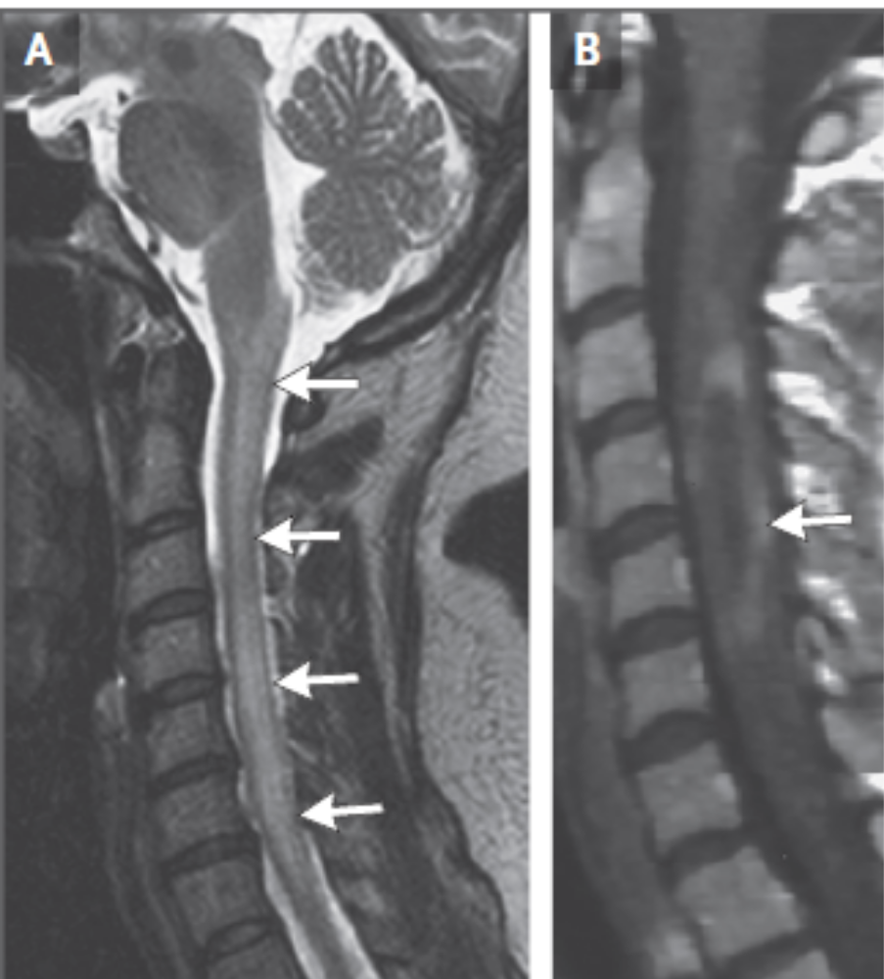
A : A sagittal T2-weighted scan shows a longitudinally extensive cervical spinal cord lesion that extends into the medulla
B : an area of ringlike contrast enhancement on T1-weighted imaging

Slide 14
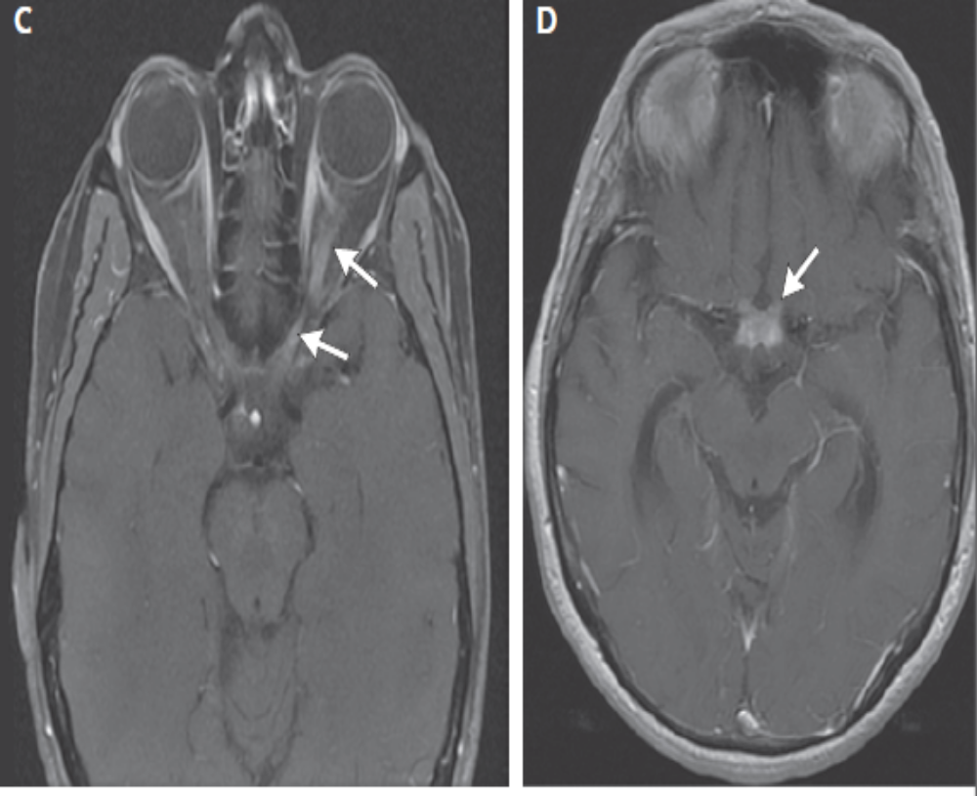
Axial T1-weighted sequences with contrast material show increased signal along the length of the left optic nerve (C) and optic chiasm (D)

Slide 15
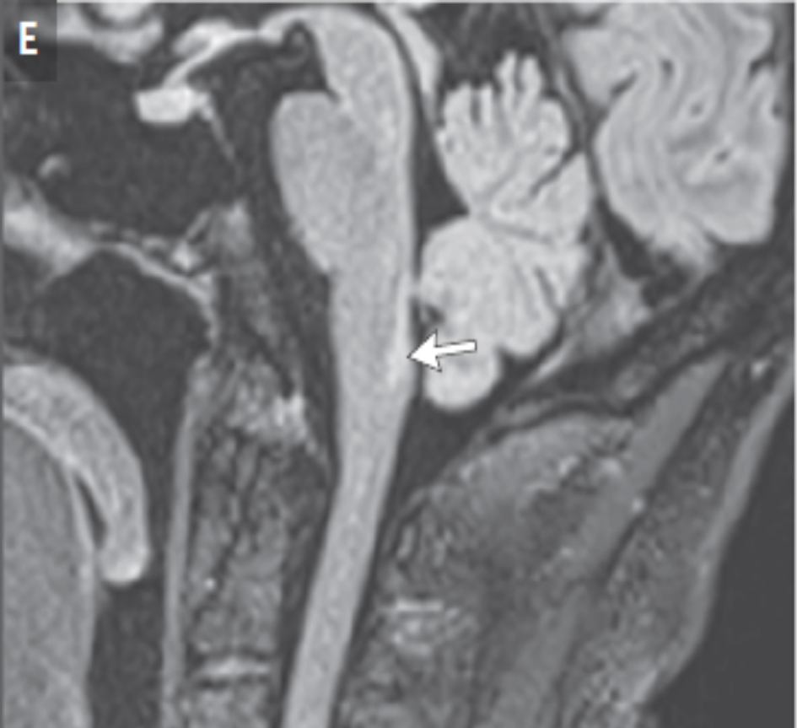
A sagittal fluid-attenuated inversion recovery (FLAIR) sequence shows increased signal in the dorsal medulla (E), which is associated with area postrema syndrome.

Slide 16
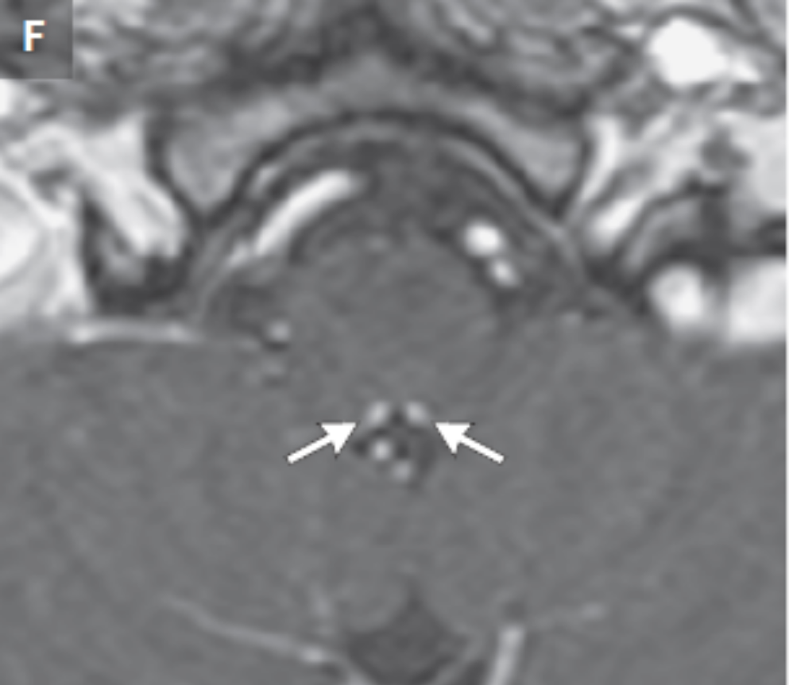
A pair of small foci of contrast enhancement on T1-weighted sequences confirms a relapse of acute area postrema syndrome (F).

Slide 17
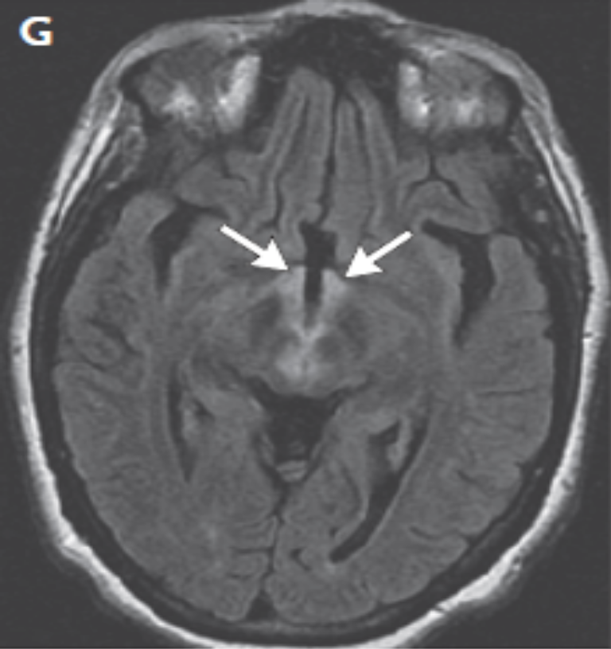
An axial FLAIR sequence shows diencephalic lesions involving the hypothalamus

Slide 18
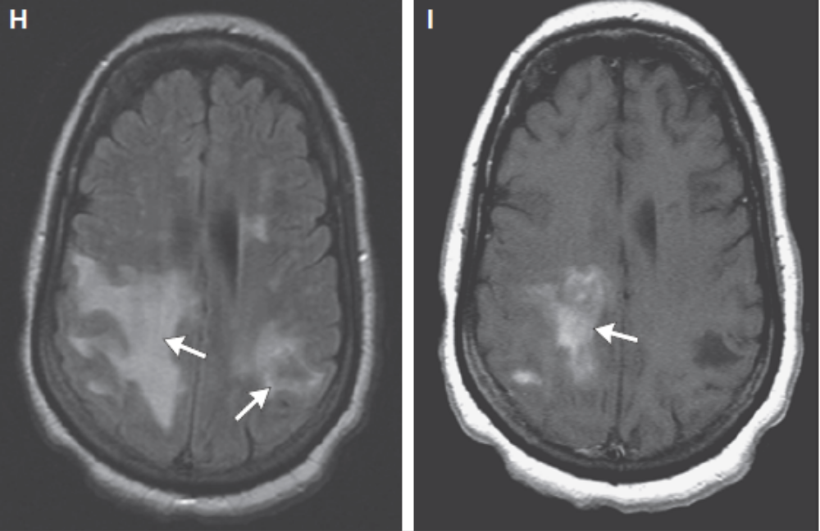
Large, confluent white-matter lesions, seen on an axial FLAIR sequence (H)
Cloudlike contrast enhancement on an axial T1-weighted, contrast-enhanced sequence (I)

Slide 19
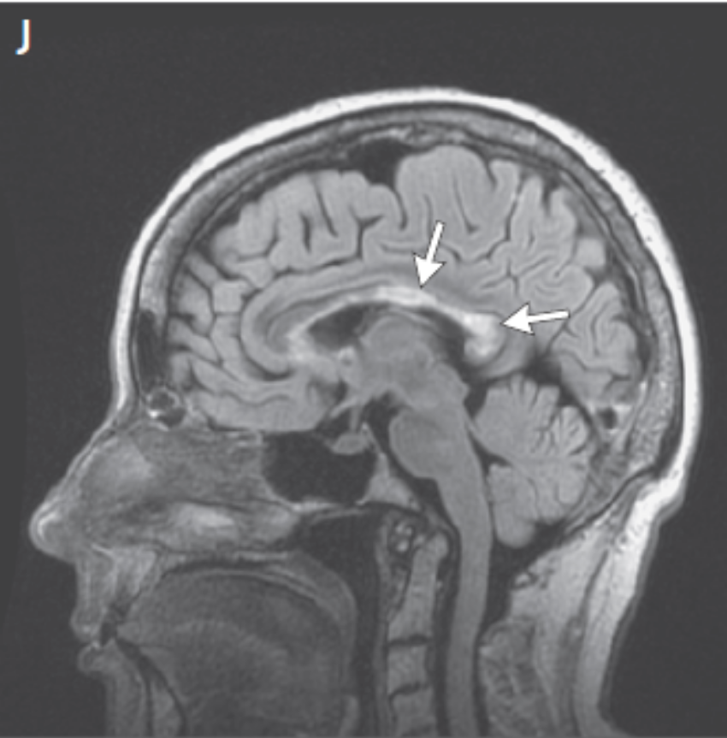
lesions involving the long axis of the corpus callosum, seen on a sagittal FLAIR sequence (J).

Slide 20
Diagnosis
International consensus–based criteria for the diagnosis of NMOSD requires the manifestation of one or more of the six typical syndrome and a positive serologic test for AQP4-IgG
80% of cases are seropositive

Slide 21
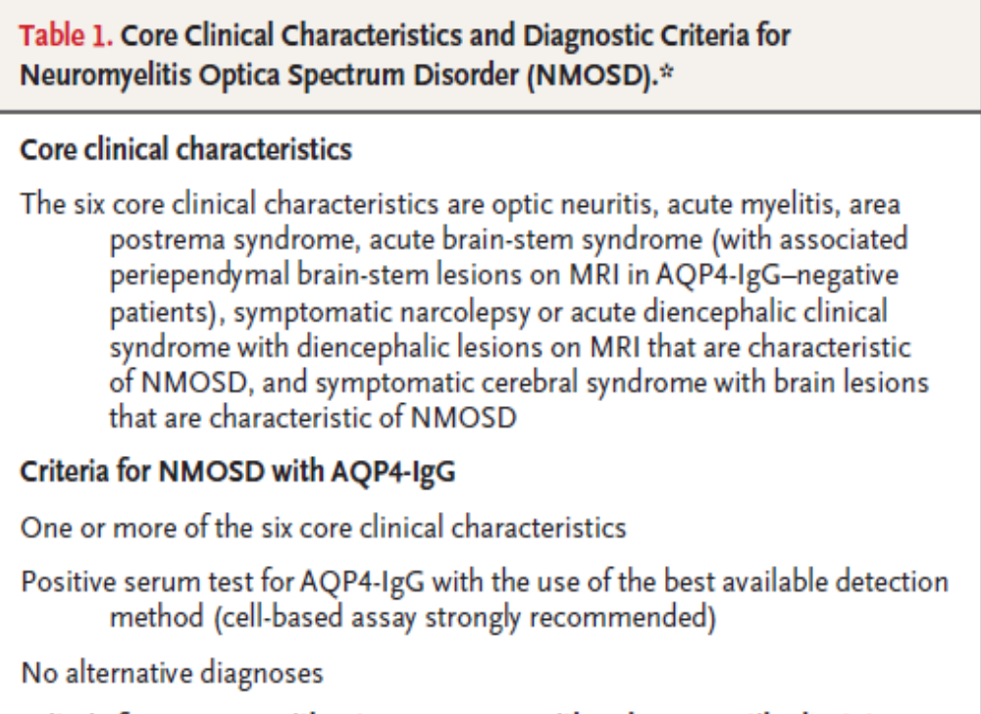

Slide 22
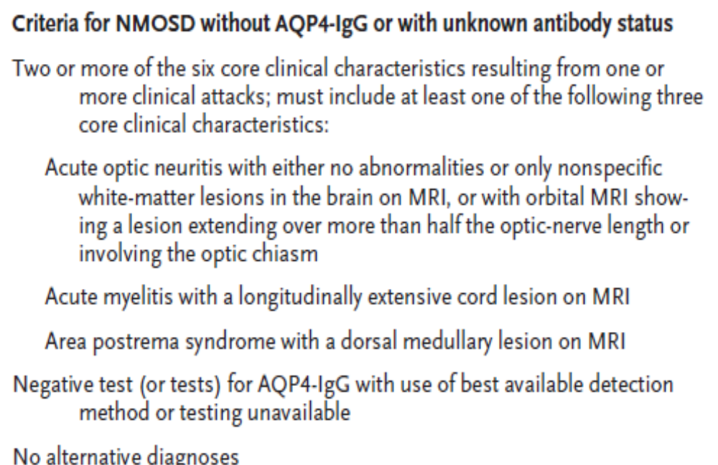

Slide 23
The standard serum AQP4-IgG reference test is a live cell–based flow-cytometric assay with more than 80% sensitivity and more than 99% specificity
False positive low-titer results may occur with the use of enzyme-linked immunosorbent assays
False negative AQP4-IgG results can occur if serum is sampled during immunosuppressive drug treatment or after plasma exchange
Testing for cerebrospinal fluid AQP4-IgG is relatively insensitive.

Slide 24
Disease course
Attacks of NMOSD usually reach peak severity in several days, plateau, and then spontaneously subside, frequently leaving moderate-to-severe and permanent functional deficits
90% of cases have a relapsing course
Among women with seropositive NMOSD, relapse rates are higher during the first 3 months post partum than in the period before or during pregnancy, and the risk of miscarriage is increased.

Slide 25
Five years after the onset of disease:
25% untreated AQP4-IgG–seropositive patients require gait assistance
40% are blind in at least one eye
10% mortality

Slide 26
Association with other diseases
Up to half of patients with NMOSD and AQP4-IgG have other detectable serum autoantibodies (e.g., thyroperoxidase, antinuclear, and Ro/SS-A antibodies)
one third have an autoimmune disease, most commonly thyroiditis, systemic lupus erythematosus, or Sjogren’s syndrome
5% cases are paraneoplastic

Slide 27
Pathogenesis
AQP4 is an integral membrane water channel protein expressed by many cell types, including gastrointestinal, lung, retinal, renal, and muscle cells
In the CNS, AQP4 is expressed on astrocytic end-feet that abut endothelial cells, which form the glia limitans component of the blood brain barrier

Slide 28
When the barrier is breached, or in regions such as the area postrema where it is lacking, circulating AQP4-IgG gains access and binds to its target antigen, initiating inflammatory responses that generate NMOSD lesions
The pathological hallmark of NMOSD with AQP4-IgG is a focal inflammatory CNS lesion with marked or complete loss of AQP4

Slide 29
Therefore NMOSD is an autoimmune astrocytopathy where AQP4-specific autoantibodies initiate lytic and sublytic astrocyte disease with variable potential for reversibility
A potential explanation as to why CNS is selectively affected is that CNS lacks protective complement regulatory proteins that are coexpressed with AQP4 in peripheral tissues such as the kidney

Slide 30
Treatment

Slide 31
Acute relapse
IV steroids
For moderate to severe cases which respond incompletely to sterois plasma exchange maybe tried

Slide 32
Preventive immunotherapy
Goal of NMOSD management : prevention of relapse
Prevention of relapse will preserve long-term neurologic function
Secondary progressive course of NMOSD, independent of relapses, is rare

Slide 33
Most frequently used drugs are rituximab, mycophenolate mofetil, and azathioprine
Low-dose prednisone (or another glucocorticoid), methotrexate, mitoxantrone, or cyclophosphamide are also used

Slide 34
Monoclonal Antibodies
Eculizumab
Inebilizumab
Satralizumab;

Slide 35
Eculizumab
Inhibits C5 and presumably the formation of the membrane attack complex mediated by C5b
Reduces risk of relapse by 94% as compared with placebo in AQP4-IgG–seropositive adults
The reduction in the risk of relapse in eculizumab monotherapy group was similar to the reduction in the group of patients who received eculizumab in addition to an established immunosuppressive therapy
Upper respiratory tract infections and headache were more common in the eculizumab group
No infections by encapsulated organisms such as Neisseria meningitidis; infections are a known risk of complement inhibition. One death occurred from pulmonary empyema.

Slide 36
Inebilizumab
Targets CD19
Depletes a broad spectrum of the B-cell lineage, including antibody-producing plasmablasts and plasma cells than rituximab
In a phase 2–3 trial that included AQP4-IgG–seropositive and AQP4- IgG–seronegative patients and did not permit concomitant treatment with immunosuppressive drugs, the risk of relapse was reduced by 73% overall and by 77% among seropositive patients
Two patients died, one from a relapse of NMOSD and the other from an indeterminate CNS cause.

Slide 37
Satralizumab
Targets the interleukin-6 receptor
Two trials of satralizumab for the treatment of patients who have NMOSD with or without AQP4-IgG have been completed, one of which allowed concurrent immunosuppressive therapy
Efficacy was achieved only in the seropositive groups in the two studies, with a 74% and a 79% reduction in relapse risk, and no deaths or cancers occurred.

Slide 38
Monitoring of AQP4-IgG titers or lesions seen on MRI is not currently recommended for therapeutic decision making, but serum biomarkers such as glial fibrillary acidic protein are being studied for confirming or predicting clinical relapse

Slide 39
Thank you

