Slide 1
APPROACH TO MOVEMENT DISORDERS
DEVIKA
DEPARTMENT OF INTERAL MEDICINE

Slide 2
INTRODUCTION
Parkinson disease (PD), tremor, tics and dystonia, are common conditions.
The overall prevalence of PD, is 1% in people aged 65–85 years, increasing to 4.3% above the age of 85 years.
Essential tremor—the most common form of tremor—is 4% in people aged over 40 years, increasing to 14% in people over 65 years of age.
Tics in school-age children and adolescents can be as high as 21%.

Slide 3
The clinical presentation of movement disorders is complex, often variable, and sometimes even bizarre.
Establishing the correct diagnosis can, therefore, be difficult
However, accurate recognition based on clinical acumen is important for several reasons.

Slide 4
No specific biological marker is available that can unambiguously diagnose the underlying disease.
Many diagnostic tests are expensive and time- consuming, and sometimes invasive.
Moreover, the diagnostic value of these tests (over and above clinical judgment) is often limited, especially in early stages of the disease

Slide 5
Adequate classification—as a means to establish the correct diagnosis—often has prognostic implications.
For example, essential tremor is sometimes mistaken for early PD, but the prognosis is clearly different.

Slide 6
MAIN CATEGORIES OF MOVEMENT DISORDERS
Insufficient movement
Akinetic, hypokinetic or bradykinetic syndromes
Too much movement (hyperkinesias or dyskinesias)
Jerky movements
Myoclonus (including excessive startle)
Chorea (including ballism)
Tic disorders
Non-jerky movements
Dystonia (including athetosis)
Tremor

Slide 7
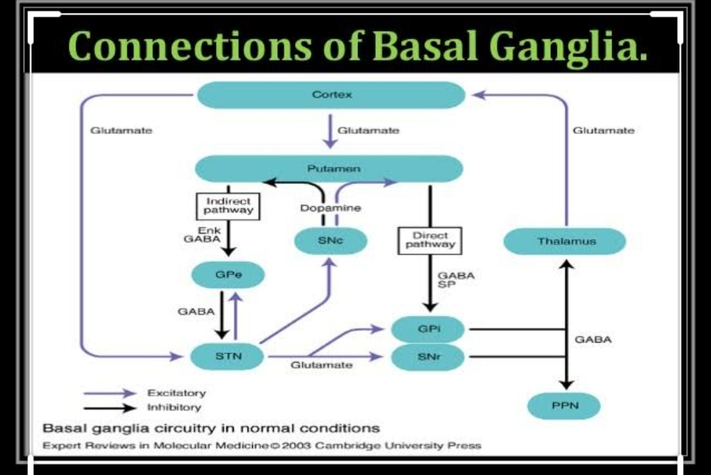

Slide 8
AKINETIC RIGID SYNDROMES
Akinesia involves both bradykinesia and hypokinesia
Bradykinesia is the slowness of movement
Hypokinesia is the poverty of movement, and movements that are smaller than intended
In the widely used Queen square Brain Bank Criteria for the diagnosis of parkinsonism, bradykinesia is defined as including fatiguing and decrement of repetitive alternating movements, which we would consider under the broader rubric of akinesia

Slide 9
IMP OF IDENTIFYING FATIGUE AND DECREMENT
patients with an UMN presentation of ALS (with pyramidal slowing, and increased tone due to spasticity) can, in rare cases, be misdiagnosed as having parkinsonism
Ie pyramidal and cerebellar disease can have slowness with extra clumsiness but not fatigue

Slide 10
PARKINSONISM
6 Cardinal Features of Parkinsonism:
Tremor at rest
Bradykniesia/Hypokinesia/akinesia
Rigidity
Flexed posture of the neck, trunk and limbs
Loss of postural reflexes
Freezing

Slide 11
JERKY HYPERKINETIC SYNDROMES
MYOCLONUS
CHOREA
TICS

Slide 12
myoclonic movements are sudden, brief, shock-like involuntary movements
Positive or negative
Positive is caused by muscle contraction
Negative is due to loss of muscle tone----asterixis

Slide 13
Myoclonus -likened to stimulating the nerve supplying the muscle with a single electric shock (or with a train of shocks, because the myoclonic jerks can occur repetitively within the same muscle).
Therefore, the keywords in identifying myoclonus are ‘shock-like movements’

Slide 14
Mistaken for irregular tremor
In polyminimyoclonus
Fine irregular finger jerks in outstretched hand
Can be benign/severe
Benign while waking up or falling asleep---hypnagogic reflex

Slide 15
Due to
Abnormal discharges from cortical, sub,brainstem/sc regions
Particularly in hypoxemia
Post cardiac arrest resuscitation

Slide 16
Treated with combination of GABA nergic agents
Valproic acid
Piracetam
clonazepa,m
leviteracetam

Slide 17
CHOREA
May not be appreciated as being a jerky movement disorder perhaps because the word chorea (Greek for ‘dance’) suggests a certain grace rather than abrupt, jerky movements.
Individually they are jerky in nature.
Thus, chorea can be defined as involuntary movements that are abrupt, unpredictable and non rhythmic, resulting from a continuous random flow of muscle contractions.

Slide 18
DIFFERENCE FROM MYOCLONUS
A key difference from myoclonus is that the pattern of movements randomly changes from one body part to another, conveying the impression of ‘fidgeting’ to the observer.
Key word to describe it is randomly flowing jerks.

Slide 19
Can be partially suppressed or camouflaged into semi-purposeful voluntary movements
Prototypical example is Huntington’s disease
The velocity of chorea can vary. The flowing component of chorea is usually faster than that of dystonia but not as fast as the jerking component of myoclonus.

Slide 20
SIGNS IN CHOREA
Motor impersistence.
Milkmaid’s grip-inability to maintain muscle contraction
Jack in the box or lizard sign- Pt is asked to keep the tongue protruded ,it retracts involuntary due to superimposed chorea

Slide 21
difficulties in chorea
patients frequently try to mask their chorea by incorporating the jerks into voluntary movements.
choreatic patients often have relatively few subjective complaints, especially in early stages

Slide 22
approach
Age of onset
Infancy/childhood onset
acute or sub acute mc is sydenham’s
insidious in pediatric metabolic disorder

Slide 23
Adult onset
insidious-AD disorders
acute/subacute in SLE,CNS VASCULITIS,NON KETOTIC HYPERGLYCEMIA

Slide 24
MEDICAL HISTORY
CHOREA GRAVIDARUM | Change in level of reproductive hormones
Polycythemia rubra vera | Hyperviscosity causing Basal ganglia ischaemia
Liver disease | Wilsons to look for slit lamp examination
cardiomyopathy | Seen in Fredereich”sataxia

Slide 25
DiSTRIBUTION OF CHOREA
HD-predominantly proximal
Neuroleptic induced-mainly facial muscles
Structural lesions –unilateral chorea

Slide 26
HUNTINGTON DISEASE
Progressive fatal
25 to 45 years
Primarily affect striatum
Etiology is increase in polyglutamines(CAG repeats)> 40 in coding sequence of short arm of chromosome 4

Slide 27
Treatment is dopamine blocking agents that may control choreatic movements
Tetrabenazine
Presynaptic dopamine blocking agent
Can cause secondary parkinsonism

Slide 28
BALLISMUS
Ballistic movements are uncontrollable, severe, mainly proximal, large-amplitude choreatic movements.
they are usually unilateral (hemiballism),
classically described after an acute lesion in the region of the contralateral subthalamic nucleus

Slide 29
Keywords…violent flinging movements
Causes
cerebral infarct –MCC
medications-levodopa, phenytoin
metabolic abnormalities
Treatment dopamine antagonists

Slide 30
tics
Consist of abnormal movements and abnormal sounds
Vary in severity over time
Usually preceded by uncomfortable feeling or sensory urge that is relieved by carrying out the movement
“involuntary”
May be simple or complex
Often suppressible

Slide 31
keyword for recognition is the ‘stereotyped’ character of the recurrent movements.
another fundamental difference from myoclonus and chorea is that patients report that their tics are preceded by rising discomfort or urge (‘sensory tic’) that is relieved by the actual movement (‘itch and scratch’ analogy.

Slide 32
suppression of tics typically comes at the expense of mounting inner tension, leading to a ‘rebound’ of tics afterwards

Slide 33
CLASSIFICATION
simple tics ( eye blinking, nose wrinkling, shoulder shrugging ) or complex tics ( touching things, smelling objects, jumping).
motor tics (such as stereotyped head jerks) or phonic tics (repetitive sniffs or sounds, words or even sentences).

Slide 34
DIAGNOSTIC PITFALLS
that tics are often less prominent or even absent in the clinical examination room as the anxiety associated with being examined suppresses the phenomenon.
videotaping the patient without an examiner present can, therefore, be very helpful.

Slide 35
Occasionally, a motor tic can have an abrupt onset, but the subsequent movement or posture might be slow or prolonged rather than jerky.
This phenomenon is referred to as a dystonic tic, but the suppressibility and stereotyped nature are the clinical clues to classifying such movements as a tic

Slide 36
Gilles de la tourette’s syndrome
Both multiple motor and one or more vocal tics
Tics occur many times a day or have occurred intermittently for >1 year
During this period of one year , a tic free period of >3 consecutive months have never occurred
Assosciated behavioural disturbances
Treatment- haloperidol

Slide 37
Genetic usually
Autoimmune re response to beta hemolytic streptococci

Slide 38
NON JERKY HYPERKINETIC SYNDROMES
TREMOR DYSTONIA

Slide 39
TREMORS
By involuntary, rhythmic and sinusoidal alternating movements of one or more body parts.
The movement does not necessarily involve a limb, as tremor can affect almost any body part, including the head, chin and soft palate.
Rhythmic alternating contractions of agonists and antagonist muscles.

Slide 40
The keyword in identifying tremor is ‘rhythmicity’; that is, the oscillations occur at a regular frequency

Slide 41
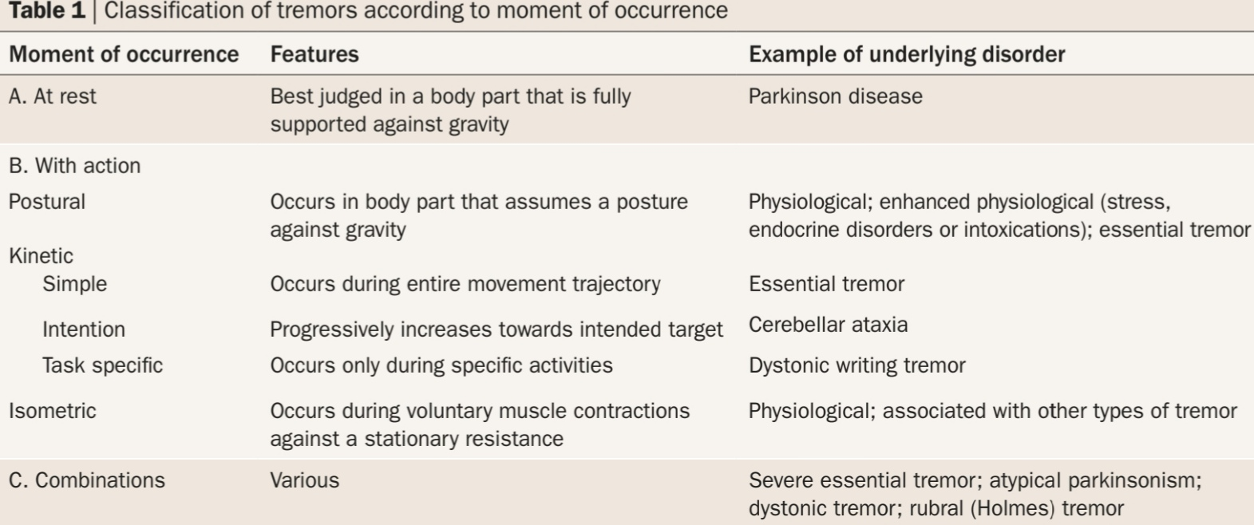

Slide 42
Many disorders are characterized by the presence of ‘mixed’ tremors.
Patients with PD, for example, not only have resting tremor, but commonly also show a postural tremor with a higher frequency.
Another example is Holmes tremor (also known as midbrain or rubral tremor), which typically has resting, postural and intention components, often at an unusually low frequency of around 2–3 Hz.

Slide 43
Essential tremor
MC movement disorder
6-10 hz
More on upper extremities
More in 70 yrs
Typically bilaterally symmetrical
Can begin in one side and remain asyymetrical
d/d is dystonic tremor and parkinsons disease

Slide 44
Abnormal activation of cerebellum and its connections
Typical presentation is tremor in one or both hands on maintaining a posture when holding a cup or glass

Slide 45
Beta blockers are effective in 50 to 70 % of cases, some patients require large doses
Sterotactic thalamotomy and deep brain stimulation of ventral intermediate nucleus of thalamus

Slide 46
Frequency of tremors
2-5Hz | Cerebellar and rubral tremors
4-6Hz | Parkinsonism
6-10Hz | ET
7-12Hz | Physiological tremors
14-20Hz | Orthostatic tremors

Slide 47
dystonic tremor
When tremor superimpose dystonia
Dystonic tremor can mimic the tremor of PD.
People with dystonic tremor do not have true akinesia.
However they also show normal dopamine transporter imaging, in contrast to patients with PD.

Slide 48
Dinner-fork’ posture of the outstretched hand, or a tendency for the ulnar fingers or thumb to point downwards with the arms held out, are characteristics of dystonia.

Slide 49
PARKINSONS DISEASE | ESSENTIAL TREMOR
May have postural tremor | May have rest tremor
stops at the onset of voluntary activity | develop after a latency of few seconds called as emergent tremor
assosciated with bradykinesia, rigidity
micrographia | large handwriting
cog wheel rigidity

Slide 50
DRUGS CAUSING TREMORS
LITHIUM
SSRI
NEUROLEPTICS
SODIUM VALPORATE
BETA AGONISTS
THYROXINE
AMINOPHYLLINE

Slide 51
DYSTONIA
An involuntary abnormal co-contraction of antagonistic muscles, which may cause sustained abnormal postures or twisting and repetitive movements.
Another definition is “abnormal characteristic postures and movements, produced by slow sustained muscle contraction, which distort limbs, trunk, neck, face or mouth.”

Slide 52
KEYWORD… abnormal posture

Slide 53
IN CONTRAST TO CHOREA
Agonist and antagonists muscle contract simultaneously(co contraction)
Slow- athetotic dystonia
Shock like-myoclonic dystonia
< than 1 second-dystonic spasms

Slide 54
Dystonias
distribution (focal, segmental, multi focal, generalized, or hemidystonia),
age at onset (early, ≤26 years; or late, ≥26 years)
cause (primary, dystonia-plus, degenerative or secondary)

Slide 55
PRIMARY DYSTONIA
Dystonia as the only clinical feature with or without tremor
No secondary cause and brain imaging should be normal

Slide 56
ANATOMICAL DISTRIBUTION
Very much dependent on age of onset
<28 years - starts in the limb
never affect face and bulbar muscles
30-40 yrs - focal dystonia of hand(witer”s cramp)
>40 yrs - focal dystonia of cranio-cervical muscles

Slide 57
DYSTONIA PLUS SYNDROME
DOPA RESPONSIVE DYSTONIA
SEGAWA DISEASE
Lower limb dystonia with progression in childhood
Diurnal fluctuation
Dramatic and sustained response to levodopa
No dyskinesia and fluctuations as seen in parkinson’s disease
Levodopa trial should be given in all young onset dystonia

Slide 58
secondary dystonia
Putamen lesions
Usually hemidystonia
Brain imaging in hemidystonia
Drugs-dopamine receptor blocking drugs
These drugs alson cause choreiform movt of face(tardive dyskinesias)

Slide 59
It should be treated as medical emergency as bulbar dystonias can be disastorous and can cause respiratory distress
Treatment
withdraw the offending drug
change to atypical dopamine blocker-best is clozapine

Slide 60
the abnormal posturing typically has a consistent directionality (a torticollis with rightward head rotation will not usually change suddenly to a leftward torticollis, for example).
the abnormal movements are patterned and repeatedly involve the same muscle groups. in early stages, the dystonia is typically ‘mobile
but the dystonia might become more fixed with further disease progression

Slide 61
A further typical feature of dystonia is the presence of a sensory trick, or ‘geste antagoniste’, which is a mechanism (usually identified and used by the patient) to reduce dystonia
for example, gently touching the cheek to correct torticollis, or chewing gum to reduce oromandibular dystonia.

Slide 62
Anticholinergics-trihexyphenydine,dopamine depletors like tetrabenazine
Benzodiazepines like clonazepam
Injection botulism in focal dystonia
Deep brain stimulation in intractable dystonias

Slide 63
DRUG INDUCED MOVEMENT DISORDERS
Neuroleptics-block dopamine receptors
Metaclopramide
prochlorperazine

Slide 64
Acute
Dystonia(MC)
Blepharospasms, torticollis
Severe spasm may be confused with seizures
But there wont be any LOC/post ictal confusion
Others include chorea/tics especially with cocaine/amphetamine

Slide 65
subacute
Akathesia
Motor restlesness with need to move that is alleivated by movement
Treatment –BZD,beta blockers,dopamine agonists

Slide 66
TARDIVE SYNDROMES
Choreiform/dystonic movement including mouth, lips and tongue
If sev –even respiratory muscles can be affected
May stop within 3 months of stopping the drugs
Atypical antipsychotics low risk

Slide 67
Treatment
Stop offending drugs
Replace with atypical antipsychotics
Drugs used are baclofen, clonazepam,valproic acid
Botulinm toxin

Slide 68
RESTLESS LEG SYNDROME
FOUR CORE SYMPTOMS
Urge to move the legs caused by unpleasant sensation in the legs
Symptoms that begin /worsen with rest
Partial/complete relief by movement
Worsen during evening/right

Slide 69
Primary is due to genetic component
AD inheritance ,in age around 27 years
Secondary-pregnancy, anaemia, renal failure
Disordered dopamine function in assosciation with abnormality of iron metabolism
Treatment---opiatesanticonvulsants,ropinirole,pramipexole

Slide 70
Unpleasant sensation-creepy crawling feeling
Paraesthesia /burning
Movements are brief lasting no more than few seconds
Recur every 5 to 90 seconds causing sleep disturbance

Slide 71
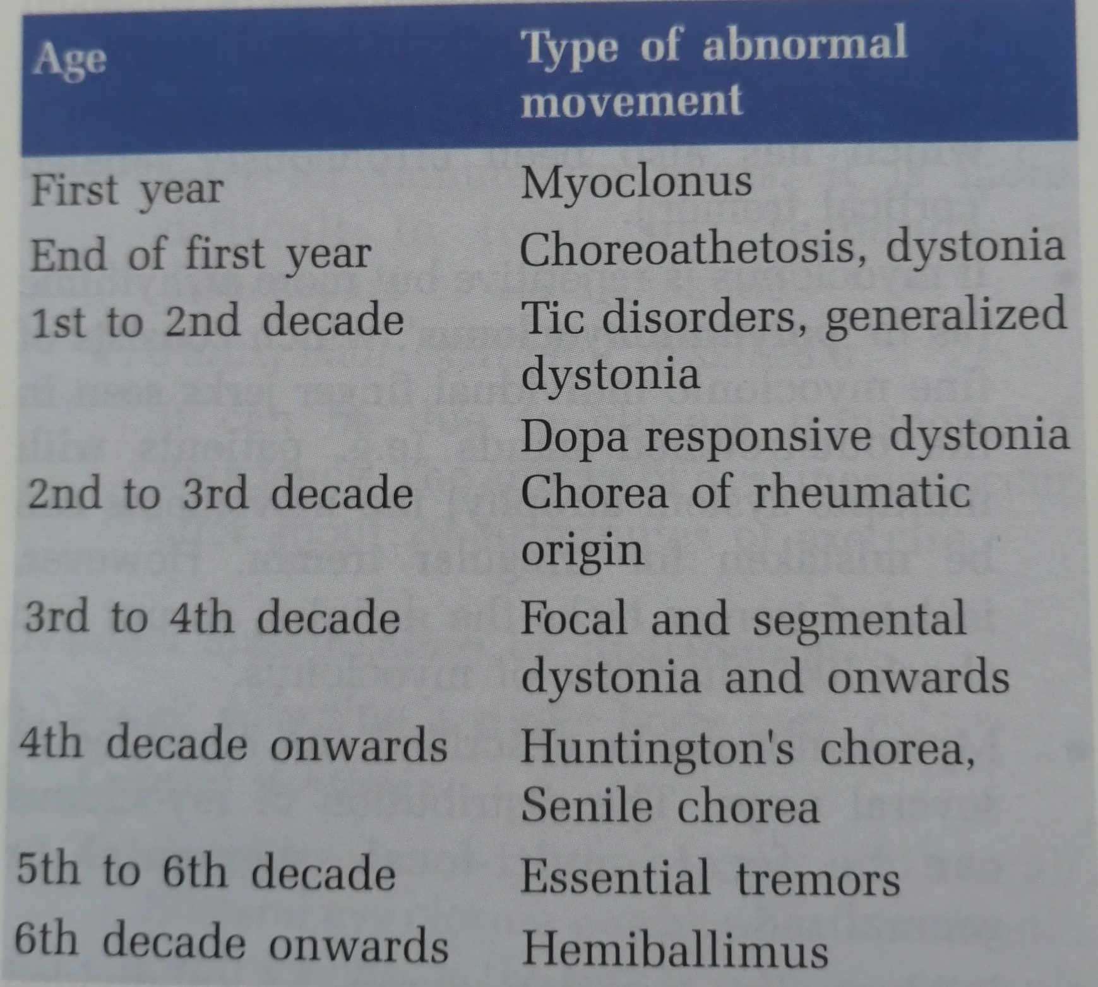
what is the age of onset

Slide 72
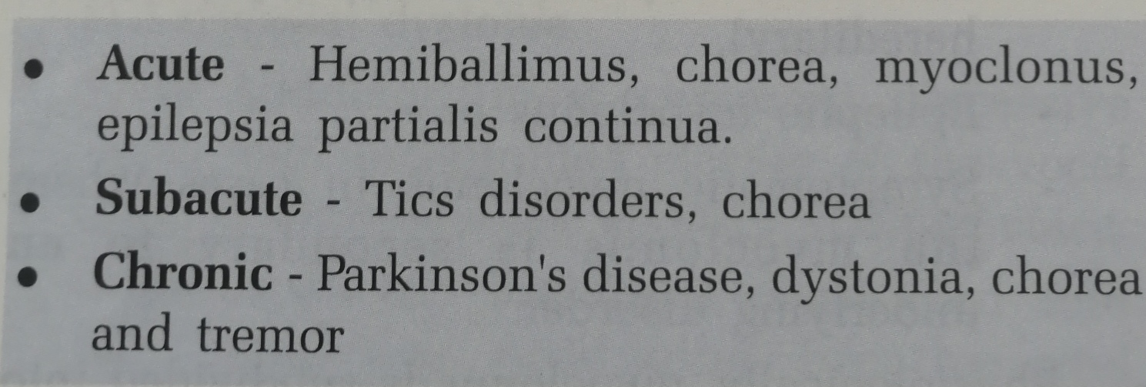
HOW IS THE ONSET

Slide 73
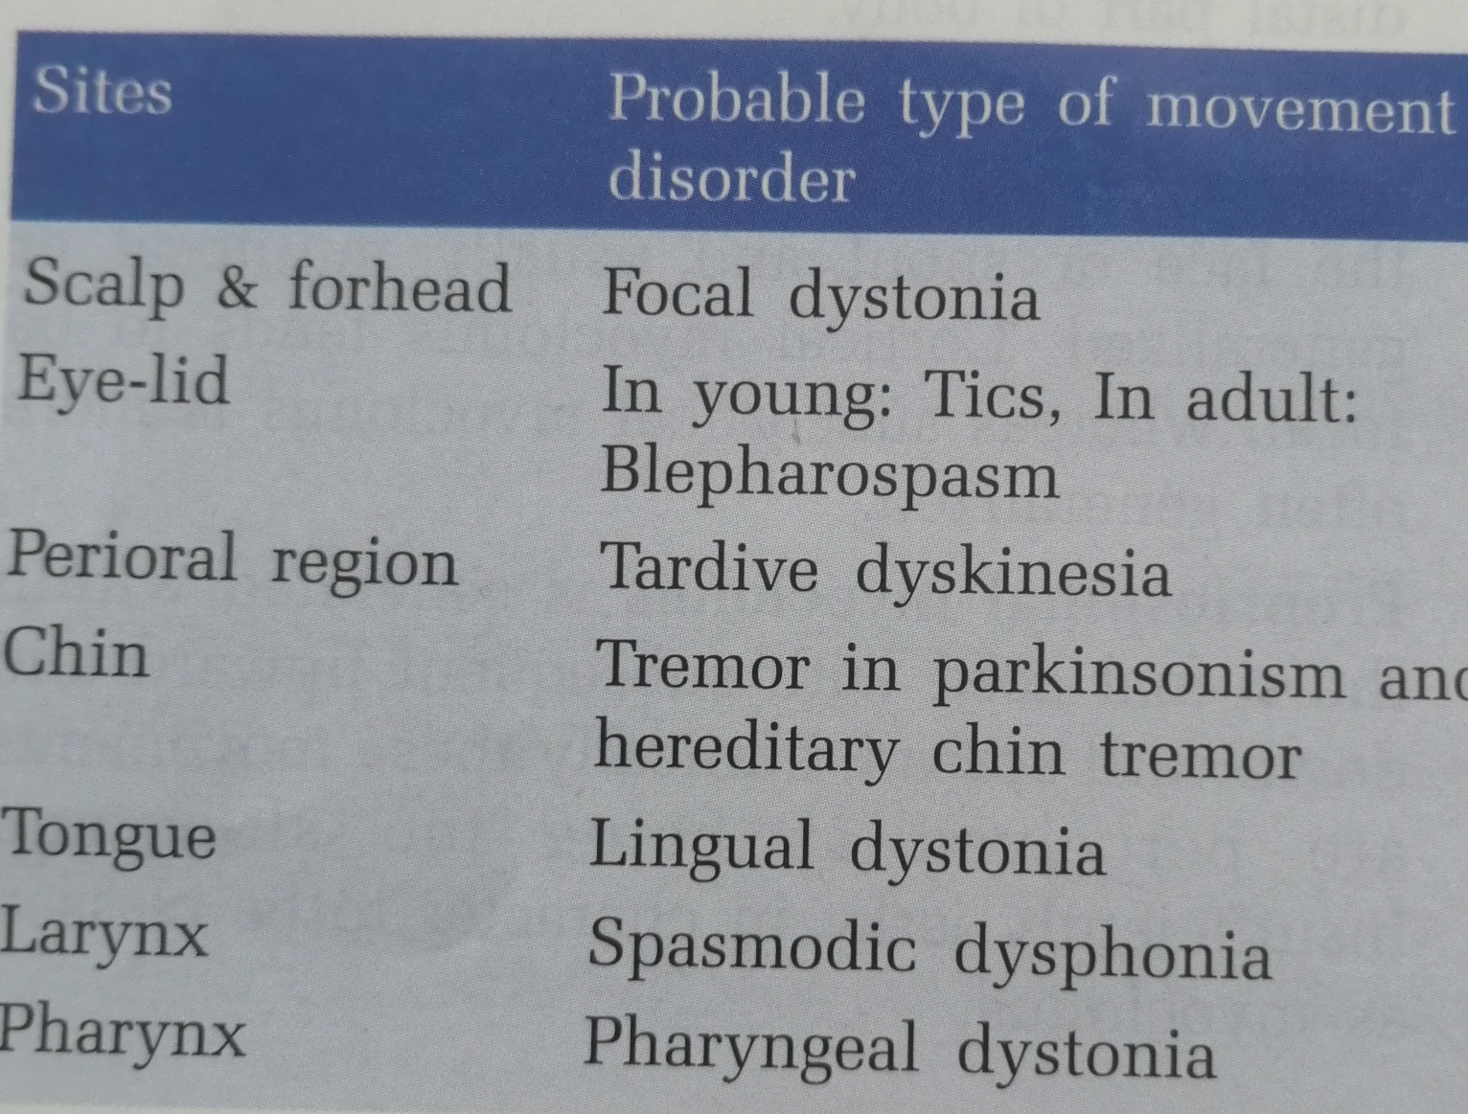
COMMON LOCATIONS OF ABNORMAL MOVEMENTS

Slide 74
Specific distribution
RLS
Parkinson’s disease - asymmetric in onset.
Blepharospasm B/L
Hemifacial spasm U/L

Slide 75
Speed of movement
slow – parkin ,dystonia
intermediate – chorea , tremor
fast – myoclonus ,tics
Rhythm
Continuous (e.g. tremor) or intermittent e.g.asterixis (‘negative myoclonus’).
Relation to posture
eg. orthostatic tremor (presents as unsteadiness when standing still, but suppressed by walking).

Slide 76
ASSOSCIATED SENSORY SYMPTOMS
Restless limb syndrome - with pain or discomfort;
tics - vague discomfort or sensation in the prodrome before the movement

Slide 77
Ameliorating factors
Alcohol may dramatically improve essential tremor and myoclonic dystonia.
Running or walking backwards may improve a dystonic gait
Distractibility and inconsistency- suggestive of a non-organic (functional) cause

Slide 78
PAROXYSMAL OR CONTINUOUS
PAROXYSMAL | CONTINUOUS
TICS | CHOREA
AKATHASIA | DYSTONIA
 | TREMOR
 | BLEPHAROSPASM

Slide 79
REGULAR/IRREGULAR
REGULAR | IRREGULAR
Tremor | chorea
myoclonus | athetosis
 | ballismus
 | tics

Slide 80
character of movement disorder
Jerky,brief | Myoclonus,tics and chorea
Slow,twisting | dystonia
Rhythmic ,alternating | tremors
Wild and flinging | ballismus
Repetitive and sterotypic | Tics, akathesia

Slide 81
What happens during sleep
Persist during sleep
Hemiballismus
Palatal myoclonus
Spinal myoclonus
Severe tics

Slide 82
All other movement disorders diminishes during sleep

Slide 83
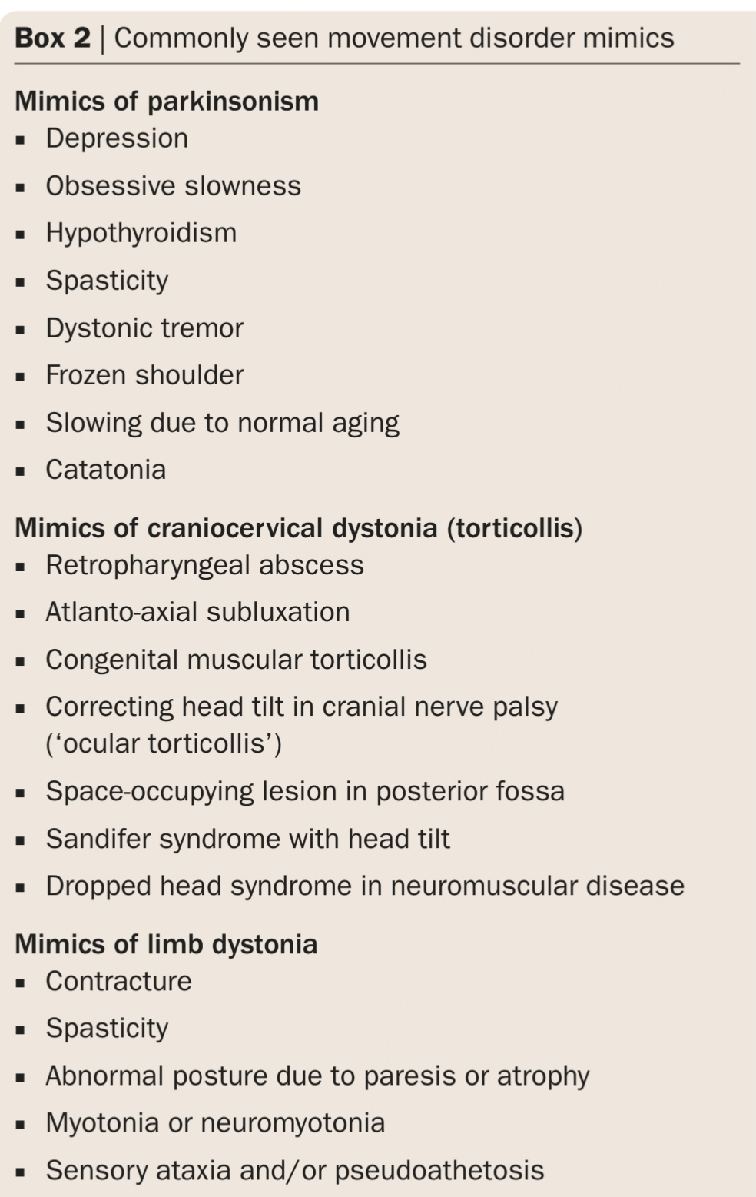

Slide 84
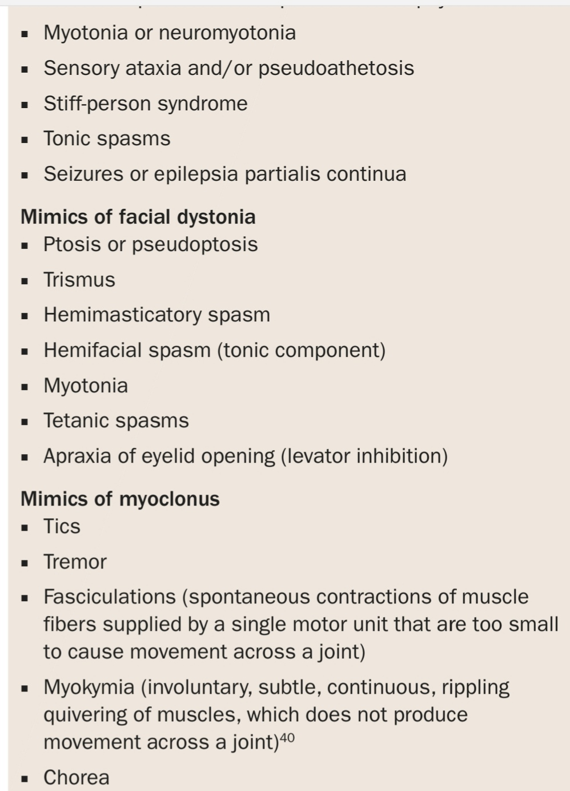

Slide 85
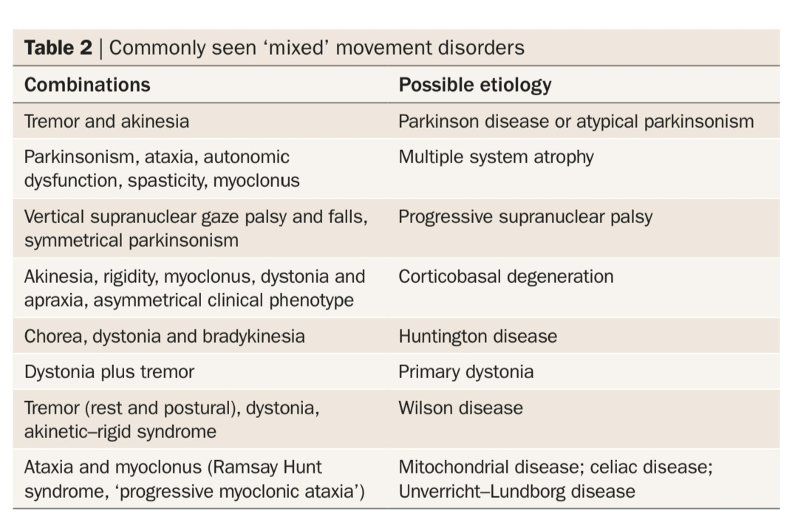

Slide 86
thank u

