Slide 1
MITRAL REGURGITATION
Dr Jatheesh mohanan K J
jr3

Slide 2
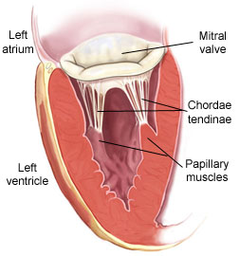
Anatomy of mitral valves
Funnel shaped structure with apex in left ventricle
Normal mitral orifice 4-6 sq cm
Mitral valve apparatus consists of mitral annulus, two leaflets (anterior mitral leaflet, posterior mitral leaflet) attached by about 120 chordae tendinae to two papillary muscles

Slide 3
Mitral regurgitation is a disorder of heart due to incomplete closure of mitral valves during ventricular systole
During left ventricular contraction there is abnormal leakage of blood from left ventricle through the diseased mitral valve into left atrium

Slide 4
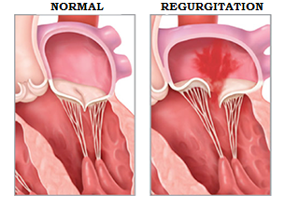

Slide 5
Acute mitral regurgitation
Chronic mitral regurgitation
Acute on chronic mitral regurgitation ( rupture of chordae tendinae in patients with myxomatous degeneration of valve apparatus )

Slide 6
Etiology-
Chronic mitral regurgitation
Rheumatic heart disease
-Commonest cause of chronic MR
-Fibrosis, calcification, thickening, shortening of mitral leaflets and chordae tendinae
Rupture of chordae tendinae
Mitral valve prolapse
Ischemic papillary muscle dysfunction
Infective endocarditis

Slide 7
Other causes:
Congenital mitral regurgitation
Mitral annulus calcification( renal disease, elderly women with diabetes & hypertension)
Ischaemia of myocardium
Marked LV enlargement of any cause
Cardiomyopathies( obstructive and hypertrophic)
Systemic lupus erythematosus, rheumatoid arthritis, ankylosing spondylitis
Marfan’s syndrome

Slide 8
Drugs causing MR
Ergotamine
Bromocriptine
Pergolide
Carbergoline

Slide 9
Types of MR
Primary | Secondary
Degenerative / organic | Functional/ ischemic
Papillary muscle rupture | Ischemic cardiomyopathy
MVP | Dilated cardiomyopathy
Leaflet perforation | No structural problems in valve itself

Slide 10
Primary MR
1)DEGENERATIVE
MVP – Primary (non syndromic)
secondary
Marfan syndrome , EDS , MASS phenotype , SLE , osteogenesis imperfecta , pseudoxanthoma elasticum

Slide 11
2)CONGENITAL
Isolated cleft of mitral valve, double orifice mitral valve , parachute mitral valve
3)Infectious / Rheumatic

Slide 12
Secondary MR
1) Papillary muscle rupture
Myocardial infarction , infective endocarditis
2) Ischemic MR
papillary muscle displacement – “seagull sign”

Slide 13
3) Congestive heart failure associated
4) Atrial fibrillation associated
5) Hypertrophic cardiomyopathy

Slide 14
Acute mitral regurgitation
Infective endocarditis
Acute myocardial infarction with rupture of papillary muscle
Chest trauma
Cardiac surgery
Acute rheumatic fever with carditis
Prosthetic valve dysfunction

Slide 15
 | Acute MR | Chronic MR
Murmur | Early, decrescendo systolic | Pansystolic
Location of Murmur | Heard at the base, radiated to the back | Heard at the apex, radiates to the axilla
JVP | V wave prominent | Less / no obvious prominent
AF | _ | +
LA Size | Normal | Dilated (compliant)
LV Size | Normal | Dilated
LA pressure | High | Normal
Pulmonary Pressure | High | Normal

Slide 16
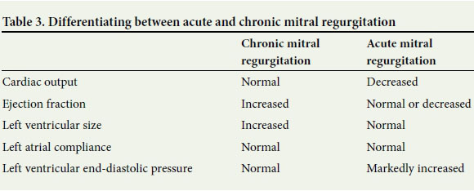
Hemodynamic consequences of Acute and chronic MR.
7-Mar-19
JD

Slide 17
Timing of murmur in Acute MR.
The murmur of acute MR may be early systolic, mid systolic. However, since the pressure within the LA markedly increases during ventricular systole and the pressure gradient between the LA and LV diminished or disappears by the end of systole, the systolic murmur is often soft, low pitched and decrescendo, often ending well before A2.

Slide 18
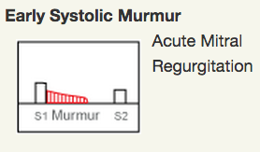
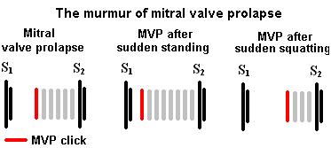
What is the timing of murmur in Acute MR and MVPS
7-Mar-19
JD

Slide 19
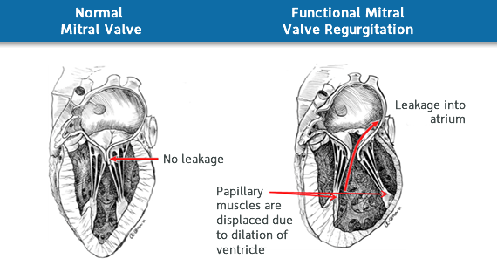
Functional vs organic mitral regurgitation
Functional MR: ischemic and nonischemic heart disease ( cardiomyopathy), valve is normal

Slide 20
Organic mitral regurgitation: structural abnormalities of valve leaflets and subvalvular apparatus

Slide 21
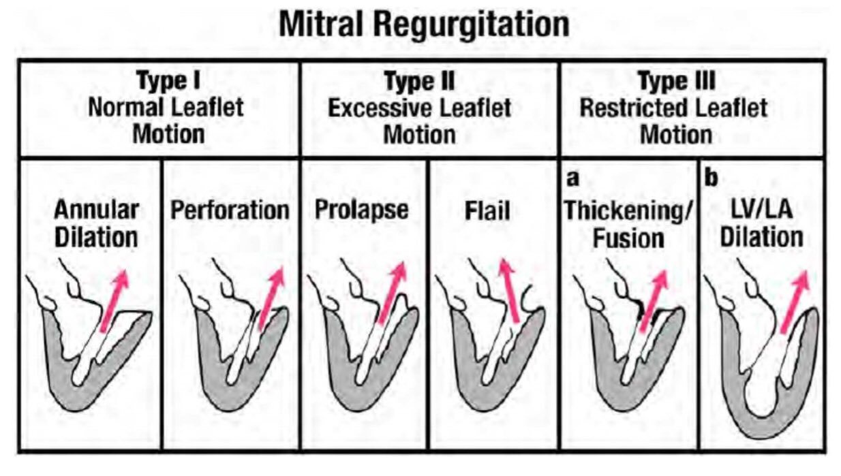
Carpentier’s Classification

Slide 22
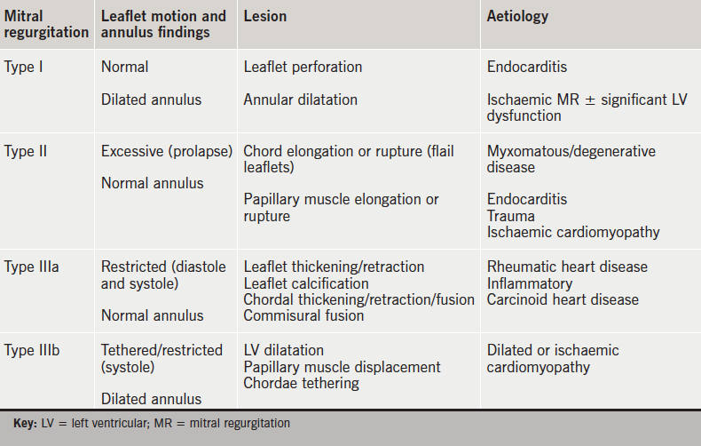

Slide 23
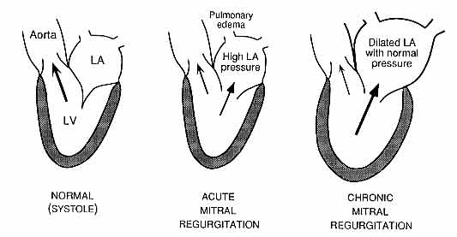
Pathophysiology:

Slide 24
Acute Mitral Regurgitation
Sudden onset mitral regurgitation
Non compliant left atrium left ventricle unable
Acute elevation of left atrial to increase cardiac
pressure and pulmonary output
arterial pressure
Pulmonary edema Cardiogenic
shock

Slide 25
Chronic mitral regurgitation
Mitral regurgitation
Part of left ventricular blood regurgitates into left atrium during systole
LA blood volume increases
LA size increases (giant left atrium)
Volume of blood returning from LA to LV is increased
Diastolic overfilling of LV

Slide 26
LV hypertrophy and dilatation
Left ventricular failure
Pulmonary hypertension reduction in cardiac
output
Right ventricular failure

Slide 27
Symptoms:
May remain asymptomatic for years
Palpitation ( at onset of AF)
Reduced cardiac output - fatigueability, weakness, exhaustion, weight loss
LV failure (late) - exertional dyspnoea, orthopnoea, PND
RV failure (uncommon)- tender hepatomegaly, peripheral edema, functional tricuspid regurgitation
Severe MR sudden death occur due to chordae tendinae rupture

Slide 28
Acute MR symptoms are due to acute pulmonary edema and cardiogenic shock

Slide 29
Physical findings:
Pulse
- normal volume but collapsing
- irregular rhythm and varying volume in AF
JVP
- normal
- AF- a wave disappear
- Pulmonary hypertension- a wave prominent
Blood Pressure
- normal BP
- Wide pulse pressure in severe MR
- Hypotension with narrow pulse pressure in acute MR

Slide 30
Inspection and palpation:
Hyperdynamic apical impulse which is shifted downwards and laterally
Systolic thrill at apex
Left parasternal heave and palpable pulmonary component of of second heart sound (P2) in pulmonary hypertension

Slide 31
Auscultation :
First heart sound (S1) soft or absent
in severe MR widely split second heart sound
Pulmonary component of S2 is loud in pulmonary hypertension
Low pitched S3 in severe MR (due to sudden tensing of chordae tendinae and papillary muscles)
S4 audible in acute MR with sinus rhythm

Slide 32
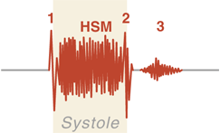
Murmur:
Systolic murmur of grade III or IV
High pitched , blowing usually holosystolic best heard at the apex commonly radiating to axilla
Anterior mitral leaflet- axilla
Posterior mitral leaflet- base of heart ( confused with murmur of AS)
Ruptured chordae tendinae- cooing or seagull quality
Flail leaflet- musical quality

Slide 33
In elderly to differentiate between gallavardian phenomenon of AS( systolic murmur of AS conducted to apex) and murmur of MR
Hand grip exercise
-murmur of MR except due to MVP increases
-AS murmur decreases

Slide 34
Mitral flow murmur- a short rumbling mid diastolic murmur may be audible at the apex in severe MR due to increased flow across mitral valve
OTHER MURMURS-
Ejection systolic murmur at pulmonary area due to pulmonary hypertension
Pan systolic murmur at lower left sternal border due to functional tricuspid regurgitation

Slide 35
How will you differentiate a MR murmur from TR murmur?
Parameter | MR | TR
Murmur Heard best | Apex | LLSB
Respiration | > expiration | > inspiration
Conduction | Axilla and back | LLSB
JVP |  | Elevated , V wave
Heart failure | Left sided | Right sided
7-Mar-19
JD

Slide 36
Differentiate murmur of MR to other systolic murmur
MVP – early systolic murmur with mid systolic click hear best in cardiac apex
VSD- holosystolic , the larger the VSD ,the quieter the murmur
AS- mid systolic , crescendo- descresendo in character radiating towards the neck. Quieter with Valsalva or standing

Slide 37
PS- mid systolic crescendo-decrescendo murmur that increases intensity with inspiration . In severe PS S2 is widely split
ASD- mid systolic ,S2 heart sound is fixed –split and doesnot change with inspiration
HSM- midsystolic , also radiates and is heard best in left sternal border . Louder with Valsalva and standing

Slide 38
Signs indicating severity of mitral regurgitation:
Cardiomegaly with hyperdynamic apex
Left ventricular third heart sound
Wide split second heart sound
Loud pan systolic murmur
Mid diastolic flow murmur at apex

Slide 39
Signs in acute mitral regurgitation
Pulse- thready low volume tachycardic pulse if in shock
BP-hypotension with narrow pulse pressure
Normal apical impulse
Fourt heart sound (S4) may be audible in acute MR with sinus rhythm
Early or pansystolic murmur

Slide 40
Investigations :
Electrocardiogram
Left ventricular hypertrophy
Left atrial hypertrophy
Atrial fibrillation
Chest Radiography
Cardiomegaly
Giant left atrium
Calcification of mitral valve
Pulmonary edema (if acute)
Pulmonary venous congestion

Slide 41
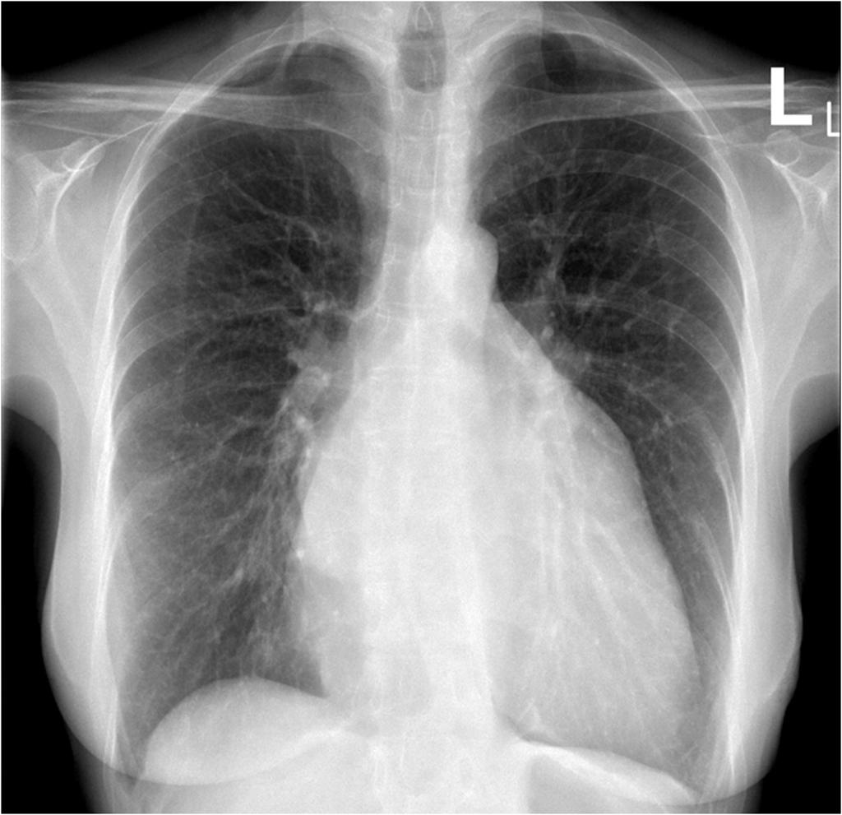

Slide 42
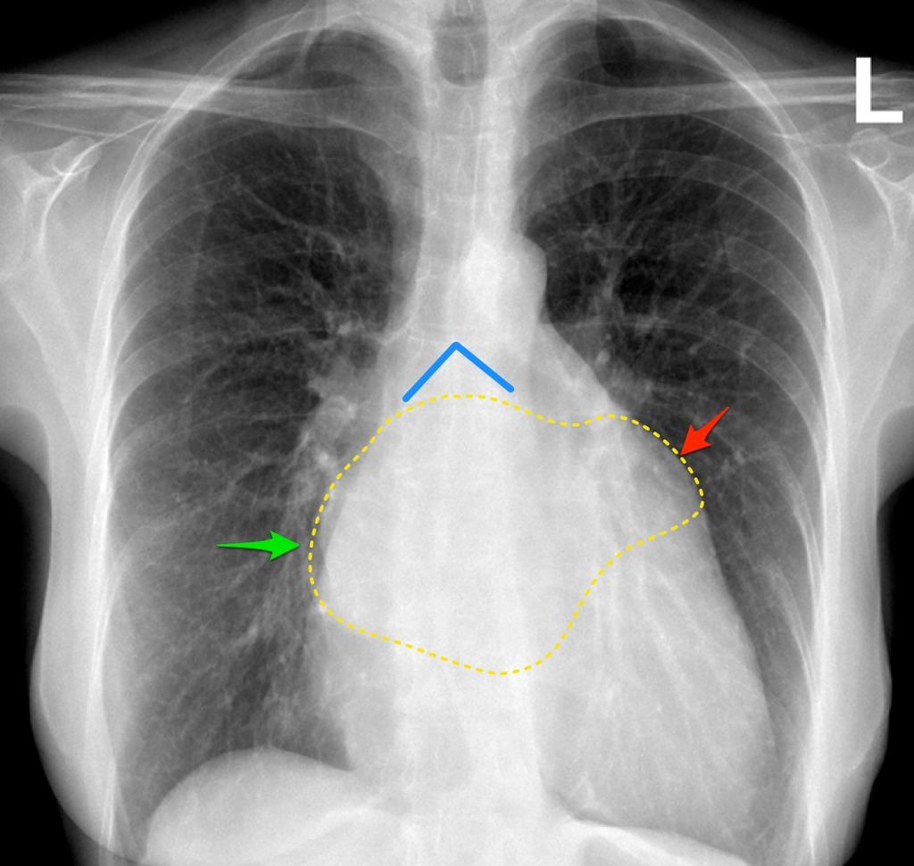

Slide 43
Doppler echocardiogram
Dilated LA, LV
Dynamic LV
structural abnormalities of mitral valve
Detects and quantifies mitral regurgitation
Cardiac catheterisation
pulmonary hypertension
Coexisting coronary artery disease

Slide 44
Echocardiogram
Vena contracta – width of the regurgitant jet as it escapes the regurgitant orifice
Quantification of MR- doppler volumetric method
ERO ( effective regurgitant volume) x MR velocity time integral = Regurgitant volume

Slide 45
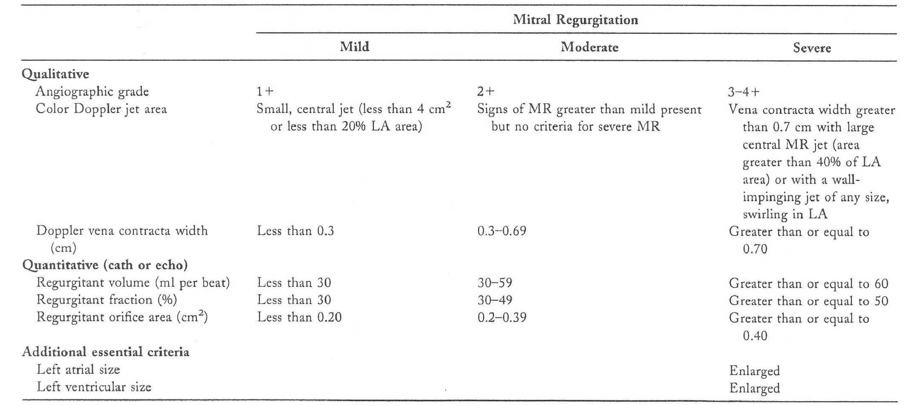
Echo parameters to assess severity of MR.
7-Mar-19
JD

Slide 46
Quantitative Echo parameters to assess severity of MR
    Vena contracta width >= 0.7 cm.
    Effective regurgitant orifice area >= 0.40 square cm.
    Regurgitant volume >= 60 ml.
    Regurgitant fraction >= 50%.
    Regurgitant jet area >40% of left atrial area, or a holosystolic eccentric jet.

Slide 47
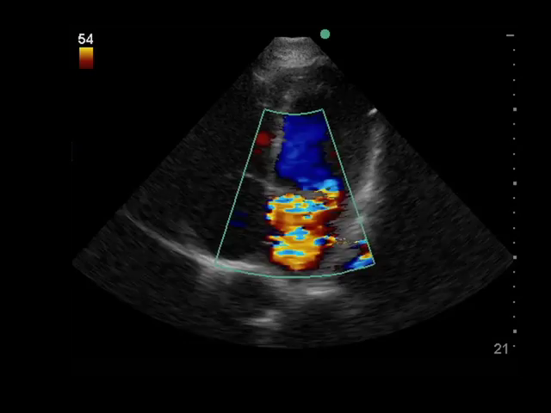

Slide 48
Prognostic indicators
Beta natriuretic peptide
Global longitudinal strain
Exercise capacity
Right ventricular systolic pressure

Slide 49
Complications :
Atrial fibrillation
Infective endocarditis
Left ventricular failure
Pulmonary hypertension
Right ventricular failure
Systemic embolism

Slide 50
Treatment :
MEDICAL
restriction of physical activity
Follow up of asymptomatic patients with echocardiography to assess LV dilatation and systolic dysfunction
Heart failure- salt restriction, digoxin, diuretics, ACE inhibitors and vasodilators
Atrial fibrillation- digoxin, verapamil, anticoagulation, cardioversion
Acute MR –nitrates and diuretics to reduce filling pressure

Slide 51
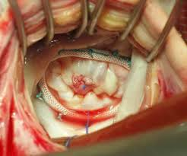
SURGICAL
Reconstruction of mitral valve apparatus by mitral valvuloplasty and mitral annuloplasty
(Preferred to MVR whenever feasible)
Mitral valve replacement with a prosthesis

Slide 52
Indications for surgery (ACC/AHA guildlines)
Acute mitral regurgitation (failure of medical therapy)
Chronic severe mitral regurgitation and NYHA functional class II, III or IV symptoms in the absence of severe LV dysfunction (EF< 30%)
Asymptomatic or symptomatic patients with mild(EF<60%) or moderate(EF 30-50%) LV dysfunction
Asymptomatic severe mitral regurgitation with normal LV size and function (EF>60%) only if likelihood of successful mitral valve repair is high

Slide 53
Indications of MVR in MR
Symptomatic patients with chronic severe primary MR (stage D) and LVEF >30% (Class I recommendation).
Asymptomatic patients with chronic severe primary MR and LV dysfunction (LVEF 30 to 60% and/or LVESD ≥40 mm, stage C2) (Class I recommendation).

Slide 54
Indications of MV repair in an asymptomatic patient with MR (preserved LVEF i.e. >60% and LVESD <40mm.)
New onset AF
Resting pulmonary HTN >50 mmhg
Evidence of progressive increase in LV size or decrease in LVEF

Slide 55
Two aims of MVR
Have an acceptable surface area of mitral valve leaftlet coaptation – 5-8mm being essential
correct annular dilatation

Slide 56
ACC and AHA recommend mitral valve repair over replacement due to decreased recurrence of MR after repair.
Mitral valve replacement- extensive tissue destruction – infective endocarditis

Slide 57
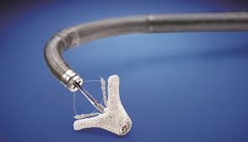
MITRACLIP
Decrease mitral valve area leading to stenosis.

Slide 58
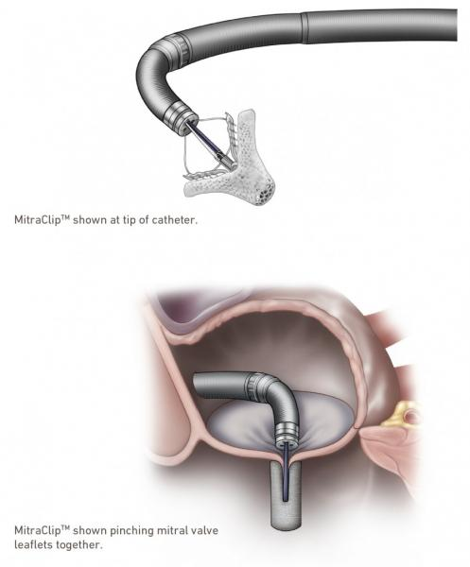

Slide 59
Relative contraindications
Aortic calcification
Rv dysfunction
Severe MAC
Severe LV dysfunction
Severe emphysema
Restrictive lung disease
Pulmonary artery hypertension

Slide 60


