Slide 1
MITRAL STENOSIS AND MITRAL REGURGITATION
Muhammed Fazil K

Slide 2
A combined stenotic and regurgitant lesion is suspected when there is alterations:
- natural history
- clinical findings

Slide 3
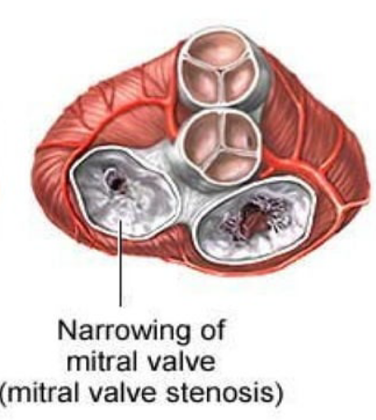
MITRAL STENOSIS - symptoms
The major symptom of mitral stenosis is shortness of breath.
This occurs initially only during tough exercise
Eventually, patient is liable to attacks of PND, later on orthopnoea
Recurrent respiratory infections
Hemoptysis occurs in some 10 – 20% of patients
lower limb swelling , right hypochondrial pain
palpitations can develop in A.fib dvelops

Slide 4
MITRAL STENOSIS - signs
Mitral fascies
Arterial pulse : low volume , ( irregularly irregular and varying volume if in AF)
Apex beat : tapping , normal in position . ( can go outwards if RVH +)
Diastolic thrill, with patient in left lateral position
palpable P2 and LPH

Slide 5
A wave on JVP , will be prominent if pulmonary hypertension develops
A wace absent in A.fib

Slide 6
MITRAL STENOSIS - auscultation
S1 will be loud if mitral valve is pliable
muffled in calcified MS
loud P2 ( PAH )
Opening snap – S2 OS gap decreases with severity of MS
Low pitchd rough rumbling mid diastolic murmur with presystolic accentuation.

Slide 7
MITRAL REGURGITATION - symptoms
In case of chronic MR, the signs and symptoms are developing after many years.
palpitations – d/e volume overload state
Dyspnoea on exertion, PND and orthopnoea
When acute MR arise d/e perforation of cusp, rupture of chordae tendineae or papillary muscles
- develops acute pulmonary edema

Slide 8
MITRAL REGURGITATION - signs
Pulse : normal or high volume - (irregularly irregular and varying in AF)
Arterial pressure : normal or can increase ( with wide pulse pressure)
Apex beat : forceful , downwards and outwards , systolic thrill

Slide 9
S1 usually soft
Apical pansystolic murmur, which radiates to axilla
S3 – in severe cases

Slide 10
MITRAL STENOSIS AND REGURGITATION
The two lesions frequently coexists
Usually one lesion dominates.
The etiology is almost always rheumatic heart disease
MS doesn’t significantly influence the hemodynamics and clinical finding of MR, however
increase in mitral inflow in MR can enhance the features of MS.

Slide 11
When to diagnose MS in a case of severe MR?
loud S1
Presence of diastolic thrill
OS and presystolic murmur.

Slide 12
One should find out if the early diastolic sound is an opening snap or an LVS3.
OS - Classically opening snap is a loud high pitched widely audible crisp sound
- audible with maximum intensity midway between apex and left sternal border
LVS3 - is a low pitched sound best appreciated in the left lateral position with the bell of the
stethoscope. It is very often localized and may be palpable.
Presence of S3 practically rules out any significant MS.

Slide 13
The mid diastolic murmur heard in chronic severe MR follows the LVS3 and is decrescendo and
does not have a pre systolic component.
First heart sound tends to be loud in MS but is often soft in MR
Significant MR in the presence of MS is suggested by the presence of LV type of forceful apex
beat (shifted down and out) and pan systolic murmur over the apex.
Widely split second heart sound may suggest significant MR.

Slide 14
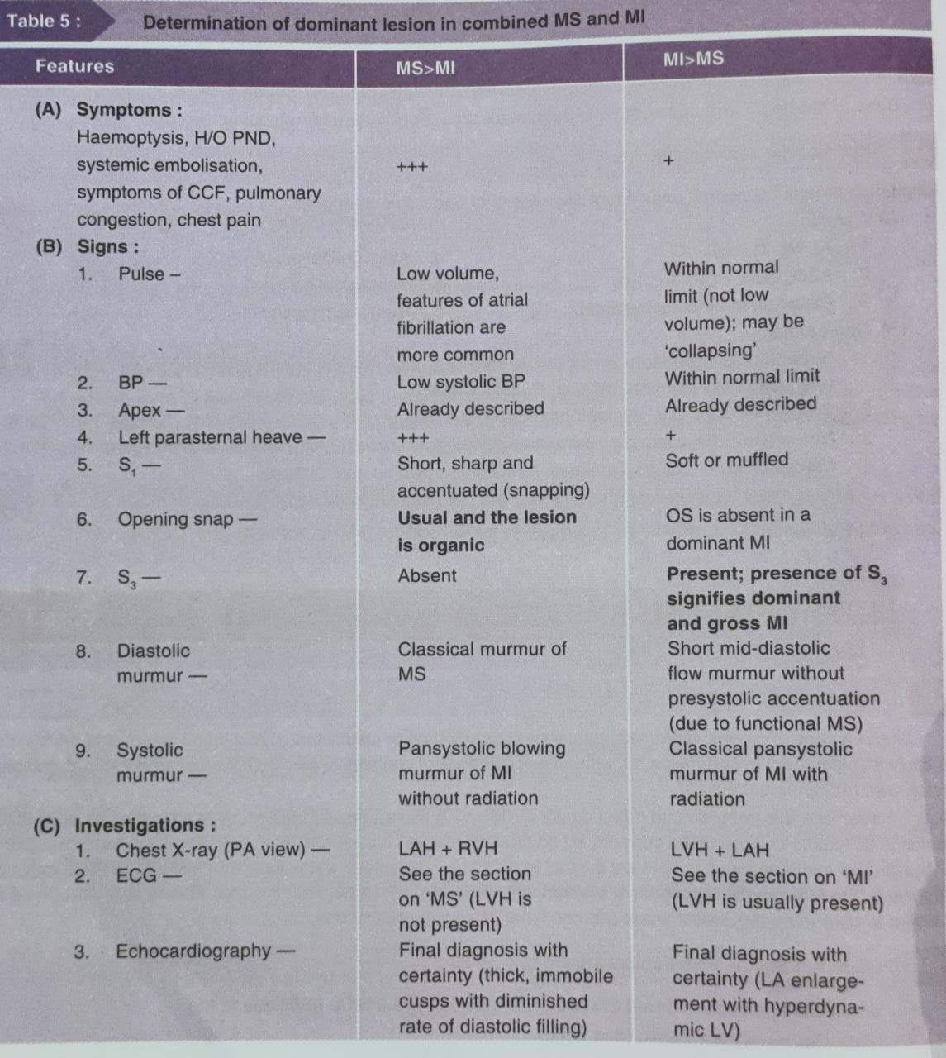

Slide 15
TREATMENT
Medical
Surgical

Slide 16
Medical management
treatment of CHF
treatment of AF
Anticoagulation if AF and LA clot
Antibiotic prophylaxis against rheumatic fever

Slide 17
SURGICAL MANGEMENT
Valvotomy or commissurotomy ( closed or open)
PBMV
MVR

Slide 18
THANK YOU

