Slide 1
MORTALITY MEETING
DR. NITHYA RAMANUJAN
JR3 GENERAL MEDICINE

Slide 2
49 years
Female

Slide 3
Presenting complaint
Fever – 1 month
Vomiting -1 week
Yellowish discolouration of eyes and urine-3 days
Altered sensorium – 2 days
Skin rashes – 2days

Slide 4
History of present illness
Fever on and off (lasting 4-5 days) for past I month. Moderate grade associated with chills. Relieved with antipyretics.
H/o excessive tiredness+
Anorexia +
Myalgia +
Consulted doctor on opd basis and took oral medications.
Vomiting- 1 week. Non projectile, 4-5 episodes/day. Vomitus contained food particles and clear fluid. Not blood stained or bilious. No h/o loose stools, food intake from outside.

Slide 5
For past 5 days fever is high grade continuous.
She noticed yellowish discolouration of eyes 3 days back. Urine was yellow coloured. No h/o itching over body.
Associated abdominal pain colicky in nature.
She noticed rashes 2 days back. Reddish rashes over both lower limbs and left upperlimb.
Taken to local hospital and referred to MCH Alpy.

Slide 6
At casualty she was examined, investigated. Found having deranged blood reports.
Surgery consultaion done from casualty for abdominal pain.
She was admitted in ward 17. Started on iv and oral medications. But fever persisted.
Altered sensorium- 1 day. Patient having decreased response and talk. Confined to bed all the time.
Next day she was shifted to MICU.

Slide 7
No h/o headache, rhinitis, sorethroat, ear ache, ear discharge, cough, breathlessness, dysuria, increased frequency or urgency of urination, hematuria.
No h/o seizures, weakess of limbs or any neurological deficit.
No h/o swelling or redness of limbs.
No h/o chest pain, dyspnea on exertion.

Slide 8
No h/o any indigenous medicine intake.
No h/o any drug ingestion or poison ingestion.
No h/o contact with dirty water.
No h/o contact with cattles.
No h/o travel outside kerala.

Slide 9
Past history
S. HTN – 5 years on treatment ( T. Amlo 5 BD)
Right forearm both bone fracture- type 1 open fracture s/p internal fixation with DCP (Dynamic compression plate) on 1/7/22.
Patient is having fever since discharge (after surgery). Consulted orthopedician. Took analgesics, antipyretics.
No history of pain or redness of right forearm, no discharge from wound.
She was said having normal wound healing.
Covid vaccine- 2 doses taken.

Slide 10
Family history
No history of similar illness in family.

Slide 11
Personal history
Predominantly non vegetarian diet.
Sleep and apetite reduced for one month.
Bladder and bowel habits unaltered.
No addictions.
No high risk behaviour.

Slide 12
Socioeconomic status
Belong to middle class.
KASP holder.

Slide 13
General examination
Day 1
She was conscious oriented.
Moderately built and nourished.
No pallor.
Icterus +
No cyanosis, clubbing, lymphadenopathy, pedel oedema.

Slide 14
Vitals
PR- 110/min regular, normal volume and character. No radiofemoral or radio-radial delay. No vessel wall thickening. All peripheral pulsations felt equal bilaterally.
BP- 130/80 mmHg in right upperlimb in supine position.
RR- 2o/min. Thoraco abdominal
Febrile (temp-101 degree farenheit )

Slide 15
GRBS- 70mg/dl
Spo2 -95RA
Dehydrated

Slide 16
Systemic examination
GIT
Abdomen not distended
Skin over abdomen normal
Soft
Tenderness in right hypochondrium
No hepatospleenomegaly
No free fluid
Normal bowel sounds+

Slide 17
Respiratory system
Normal vesicular breath sounds+
Air entry equal bilaterally
No adventitious sounds
CVS
S1, S2 +
No murmur

Slide 18
CNS
Conscious oriented
Pupil –equal and B/L reacting to light
No focal neurological deficit
Plantar – B/L flexor
No neck stiffness
Next day she was shifted to MICU following deterioration in GCS

Slide 19
DAY 2
Patient received in MICU
Drowsy
PR- 120/min regular
BP- 140/90 mmHg
Spo2 –93 RA
Temp- 102 degree F
Icterus +
Reddish macular rashes around 1cm in diameter over both lowerlimbs and left upperlimb

Slide 20
CNS
Drowsy
E3V2M5
PEARL
Moving all limbs
Plantar – B/L flexor
Generalised hypertonia
Neck stiffness+

Slide 21
Chest
Normal vesicular breath sounds
Air entry equal
No adventitious sounds
CVS
S1, S2 +
No murmur
GIT
Soft
No organomegaly, no mass palpable
BS+

Slide 22
Investigations
Hb-11.8g/dl
TC- 17100
DC- P:88.7 L:7.6
Platelet-2.73L
ESR-20
Hct-36
MCV-70.7
MCH-23.6
MCHC-33.3

Slide 23
RBS-220 mg/dl
Ur/Cr- 67/3.7
Na/K- 130/3.9
Bil- 14.3
D.Bil-8
TP/Alb-5.7/2.5
OT/PT- 1652/1112
ALP-328
Ca-8.4 (corrected ca-9.6)
Phos- 3.6
Uric acid- 13.2

Slide 24
PT-53.3
INR-5.5
APTT- 69.6
ECG- NSR 90/min T inv V1
CXR PAV- normal
URE
Alb –nil
Sug- nil
E.C-1-2

Slide 25
ABG
pH- 7.434
pCO2- 24.5mmHg
HCO3- 16.4mmol/L
SO2-97%
PaO2- 81mmHg
Respiratory alkalosis + metabolic acidosis

Slide 26
CT brain- falx calcifications
Usg abdomen
Liver size- 15.6cm. Increased liver echogenicity with mildly dilated portal vein(14mm)
Spleenomegaly- 14cm
Pancreatic head appears mildy prominent
B/L mild pleual effusion
Mild free fluid in pelvis
Cholelithiasis

Slide 27
Blood group- O +
CRP- 70.5(<6)
Procalcitonin- 9.24
C3- 44(90-180)
Amylase- 34
Lipase- 64
GGT- 105 (<36)
S. Ammonia- 273(12-41)

Slide 28
HIV- negative
HBsAg-negative
Anti HCV- negative
VDRL- negative
Urine C&S- no bacteruria
Blood culture
1- Methicillin resistant CoNS
2- sterile
3- sterile

Slide 29
Igm lepto- negative
Igm dengue- negative
Igm scub- negative
Widal test- negative
Igm HAV- negative
Igm & G HEV- negative

Slide 30
DCT- 1+
LDH- 1766 (<245)
CPK- 721(<174)
U. Myoglobin - negative
Peripheral smear
NCNC RBC
WBC- count increased. Neutrophil predominant with shift to left and toxic granules, cytoplasmic vacuoles.
Myelocyte-2, metamyelocyte-1, band-1, N-69, L-17
Platelet normal
No evidence of active hemolysis
No parasites

Slide 31
Iron studies
Ferritin-
TSAT- 23
TIBC- 299
Iron- 70
Rapid malaria test- negative

Slide 32
Covid RAT- negative
S. HSV PCR- negative
S . Paracetamol level- normal
Toxicology analysis- no toxins identified

Slide 33
Course in MICU
MICU day 1 (3/8/22)
Supportive care- RTF, CBD, head end elevation
Antibiotics
Inj. Ceftriaxone 2g iv bd
Inj. Vancomycin 1g iv bd
Inj. Ampicillin 2g iv Q6H
Anti hepatic coma measures- bowel wash, T. Rifaximine, Syp. Lactulose, Inj. Hepamers

Slide 34
Inj. Pantop 40mg iv od
Inj. Vitamin K 1amp iv od* 3days
NAC infusion followed by T.NAC 600 bd
T. Udiliv 300 bd
T. Sobisis 500 tds
T. Febuxostat 40mg hs
4 pint FFP
Routines and PT INR

Slide 35
Nephrology consultation
Patient was started on hemodialysis via FC
Advised RFT/SE monitoring
I/O monirtoring

Slide 36
MICU day 2 (4/8/22)
Routines, PT INR, CRP
TC- 34800
Ur/Cr- 36/2
Bil- 16.2
OT/PT- 1481/834
PT- 45.1
INR- 4.57
APTT- 91.8
CRP- positive

Slide 37
CT brain taken
Usg abdomen taken
Ortho consultation
Right forearem- healed scar. Distal pulses normal
No features of infected implant or surgical site infection

Slide 38
Neurology consultation
Metabolic encephalopathy- sepsis/ hepatic
? Non convulsive status epilepticus
Advised CT brain
Toxicology screen
Portable EEG
MRI Brain

Slide 39
Cardiology consultation
Screening echo- no e/o vegetation, no RWMA. Poor echo window
Advised CRP ESR monitoring, blood cultures
Gastroenterologty consultation
Advised tropical fever workup, anti HBC, viral markers, peripheral smear retic count, blood culture, widal test, CPK, U. Myoglobin, GGT, USG abdomen
LP was planned, deferred due to prolonged INR
4 pint FFP

Slide 40
Surgery consultation (2/8/22)
Done from casualty
Advised usg abdomen, S.Amylase, S.Lipase

Slide 41
MICU day 3 (5/8/22)
Patient drowsy.
Developed desaturation and breathing difficulty
Chest- b/l conducted sounds+
O2 given via face mask
Elective intubation advised, but deferred as bystander not willing

Slide 42
TC- 38,820
K – 5.4
OT/PT- 1778/805
PT/INR – 41.5/4.21
CRP- positive
Added T. Doxy 100 bd
Inj. Dexa 4mg iv Q8H
Hemodialysis deferred due to hypotension, started noradrenaline inf.
Hypoglycemic episodes- D25 given

Slide 43
MICU day 4 (6/8/22)
Patient became stuperous
On ionotrope
4 pint FFP
Hypoglycemic episode- D25 given
Hb- 10.4
TC- 27300
Ur/Cr- 48/4.2
Bil- 18
OT/PT- 1462/628
CRP- positive

Slide 44
SLED taken when BP improved with ionotrpe. Could not complete due to hemodynamic instability.
Patient shifted to MICU. Intubation done.
Dual ionotropic support.

Slide 45
MICU day 5 (7/8/22)
Patient became comatose
TC- 39,400
Ur/Cr- 59/5.6
Na/K- 127/ 5.4
OT/PT- 1143/535

Slide 46
Patient developed hyperkalemia. Antihyperkalemics given.
Dialysis deferred due to hemodynamic instability.
Developed GTCS, Inj. Levipill, Inj. Midaz given. Found having low GRBS (60mg/dl), D25 given.
Attemped central line insertion.
Patient deteriorated, became unresponsive. Inspite of all resuscitative measures patient expired.

Slide 47
Provisional diagnosis
Sepsis / MODS- non oliguric AKI- fulminant hepatitis- encephalopathy/ probably nosocomial infection
? Gram negative sepsis

Slide 48
Differential diagnosis
Infective
Non infective
1. Meningiococcal septicaemia
2. Infective endocarditis
1. Aleukemic leukemia
2. Lymphoma
3. Vasculitis/ AI condition with superadded infection
4. Wilsons disease
5. AI hepatitis
6. Multiple myeloma
7. Macrophage activation syndrome
8. Disseminated fat embolism

Slide 49
Limitations
Lp could not be done due to persistently prolonged INR
EEG , MRI brain could not be done
USG of right upperlimb not done as there was no clinical evidence of infected implant/ surgical site infection
SARS cov 2 antibody report not obtained

Slide 50
What else could be done??
Early starting of steroids within 6 hours
IVIG- if not contraindicated

Slide 51
Sepsis
Definition- life threatening organ dysfunction due to a dysregulated host response to infection (sepsis 3)
In septic patients the normal immune-pathological host response become maladaptive creating disturbance in hemeostatic mileu→ life threatening organ dysfunction and death
SIRS criteria in definition of sepsis was removed
Severe sepsis- removed (sepsis with evidence of organ dysfunction)

Slide 52
If not recognized early and managed promptly, can lead to septic shock, multiple organ failure and death.
Most frequently a serious complication of infection, particularly in low- and middle-income countries where it represents a major cause of maternal and neonatal morbidity and mortality.
In the community setting, sepsis often presents as the clinical deterioration of common and preventable infections.
Sepsis also frequently results from infections acquired in health care settings (one of the most frequent adverse events during care delivery).

Slide 53
Healthcare-associated infections are often resistant to antibiotics and can rapidly deteriorate.
Antimicrobial resistance is a major factor determining unresponsiveness to treatment and rapid evolution to sepsis and septic shock.
Sepsis patients with resistant pathogens have been found to have a higher risk of hospital mortality.
SOFA score
Quick SOFA criteria

Slide 54
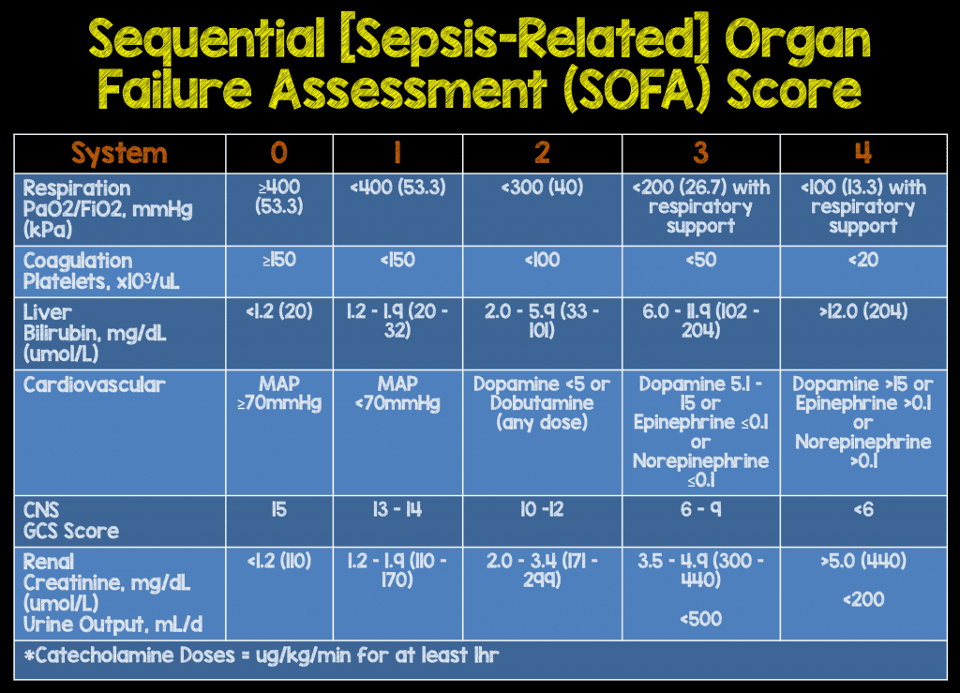

Slide 55
SOFA score ≥ 2 + suspected infection → sepsis
qSOFA score
2 or more of:
Hypotension : Systolic BP≤ 100mmHg
Altered mental status : GCS less than 15
Tachypnoea : RR ≥ 22/min

Slide 56
Septic shock
Sepsis with following
Persistent hypotension in spite of fluid resuscitation or requiring vasopressors to maintain MAP ≥ 65mmHg +
Serum lactate > 2mmol/L (18mg/dl) despite adequate volume resuscitation

Slide 57
Risk factors strongly associated with sepsis
Age > 65
Underlying malignancy
Pregnancy
Hemodialysis
Alcoholic patients
Diabetes mellitus

Slide 58
Usual sources of infection in sepsis
Pneumonia
Upper UTI
Intraabdominal infection (emphysematous cholecystitis, peritonitis)
Skin and soft tissue infection
Undifferentiated or vascular access device infection

Slide 59
Evaluation
CBC
RBS
RFT
LFT
SE
Chest xray
Coagulation profile
ABG
Serum. Lactate (tissue hypoperfusion). Prognostic also
Markers of inflammation- CRP, procalcitonin. Prognostic also

Slide 60
Blood cultures
Sputum culture, stool culture, urine culture as indicated
LP- csf study if meningitis suspected
If pneumonia suspected- tracheal aspirate, BAL culture
Pus culture if needed

Slide 61
Sepsis mimickers
Acute pancreatitis
Disseminated malignancy
Adverse effects of drugs
Acute mesenteric ischemia
Acute adrenal insufficiency
Pulmonary embolism

Slide 62
Management
Initial resuscitation using fluids
Hemodynamic support as and when required
Antimicrobial therapy
Other supportive therapy

Slide 63
Fluid resuscitation
Begin immediately in pts with hypotension
30ml/kg bolus given over 1-3 hours
RL>NS
Smaller bolus if PaO2/FiO2 < 200 or if there h/o cardiac disease
Goals :
MAP >70mmHG
Urine output > 0.5ml/kg/hour
Patient showing features of fluid responsiveness (improvement in sensorium, increase in urine output, increase in MAP, increase in CVP (target 8-12cm of water), IVC collapsibility)

Slide 64
2. Vasopressors
1st choice- noradrenaline (NAD) 0.05-0.5 ug/kg/min
Vasopressin – added to maintain MAP or decrease dose of NAD. 0.01- 0.04 u/min
Dopamine – alternative to NAD in selected pts (eg: low risk of tachyarrythmias, absolute/relative bradycardia)
Dobutamine- considered if ongoing signs of hypooerfusion despite achieving adequate IV volume and MAP [sepsis can depress myocardial contractility, global LV hypokinesia on echo]

Slide 65
3. Antimicrobial therapy
E. coli, Staph. aureus, Klebsiella, Acimetobactor, Pneumococci, Pseudomonas, Enterococci
Staph. aureus- vancomycin, linezolid, daptomycin, ceftaroline (VRSA)
Pneumococci- 3rd generation cephalosporin, piperacillin, azithromycin, levofloxacin, meropenem
E. coli, Klebsiella- 3rd gen. cephalosporin, ciplox, piperacillin, mreopenem
Pseudomonas- fluroquinolones, piperacillin, ceftazidime, cefipime

Slide 66
4. Other supportive therapy
Blood sugar control
Insulin if GRBS> 180mg/dl
Target 140-180mg/dl
2. Blood products
Hb > 8g/dl
FFP if bleeding+ or invasive procedure planned
Platelet if < 10,000/mm3 or bleeding risk +
3. Mechanical ventilation
Usual indications
TV : 6ml/kg

Slide 67
4. Sedation in MV patients
Continuos or intermittent
To prevent occurence of VAP
5. Renal replacement therapy
Acute renal failure
6. Bicarbonate therapy
If pH < 7
7. DVT prophylaxis
Pharmacological
Mechanical – graduated compression stockings

Slide 68
8. Stress ulcer prophylaxis
PPI or H2 blockers
9. Nutrition
Oral or enteral feedings within 1st 48hrs
10. To prevent aspiration
Head end elevation 30-45 degree

Slide 69
Estimates of Sepsis Prevalence and Outcomes in Adult Patients in the ICU in India ( in chest journal on January 26, 2022)
High burden of sepsis using both Sepsis-2 and Sepsis-3 criteria, with associated high rates of antimicrobial resistance and mortality.
Total of 35 ICUs, enrolling 680 patients (median age, 60 years.
Most common primary diagnosis was renal disease
Common comorbidities- diabetes (44.0%) and CRF (11.6%).
The sepsis prevalence was 382 of 677 patients (56.4%).
Most common microorganisms -bacterial (77.9%) > fungal (14.1%) infections.
Approximately 45% of infections were caused by multidrug-resistant organisms.
Mortality at 30 days (27.6% vs 5.3%) and rates of discharge against medical advice were significantly higher in the sepsis cohort compared with the cohort without sepsis.

Slide 70
THANK YOU

