Slide 1
MORTALITY CLUB
Dr,bibymol
jr3

Slide 2
21/F
Mrs.X
DOA:18/10/2022
DOE: 6/11/22

Slide 3
PRESENTING COMPLAINTS
Fever with chills & rigor x 2 weeks
Nausea and vomiting x 2weeks
a/w headcahe
a/w dysuria
Decreased appetite and decreased food intake

Slide 4
HISTORY OF PRESENT ILLNESS
Fever – intermittent high grade fever a/w chills and rigor
Generalised fatigue
a/w joint pain-small joints
Loss of appetite
a/w pain during voiding and increased frequency of micturition
Nausea and vomiting-non projectile,non bilious vomiting

Slide 5
She was admitted at a private hospital at Thrissur
Outside investigations showed
TC:3900 PLt:1.6 lakhs
URE: numerous pus cells
She was treated as case of sepsis-UTI and was on iv antibiotics
She was discharged at request and got admitted at TDMCH alappuzha with the same complaints

Slide 6
PAST HISTORY
H/O recurrent episodes of UTI
First episode at 16 years of age
h/o multiple episodes of UTI 8-10 episodes in last 2 years
h/o incomplete treatment for the same
3 episodes were a/w haematuria

Slide 7
Evaluation of joint pain- vit D deficeincy
No h/o hospital admisions in past
No h/o pTB/BA
No h/o any abortions

Slide 8
Family history
First daughter of non-consanguinous marriage
Married 2 years back
mother of 1child
No significant FH

Slide 9
PERSONAL HISTORY
Sleep decreased
Loss of appetite
Loss of weight
No addictions
LMP:23/9/22

Slide 10
On examination
Patient was conscious oriented
PR:120/min regular BP:130/70 mm Hg
Pallor + No Icterus,cyanosis/clubbing/lymphadenopathy
P/A:soft,non tender ,No hepatosplenomegaly,no free fluid
CVS:S1 S2 normal ,no added sounds
RESP:normal breath sounds heard ,no ALS
CNS:no focal neurological deficit

Slide 11
INVESTIGATIONS
18/10/22
Hb:10.3
TC:4550
DC:N87L15E5
Plt:1.94
ESR:140
RBS:115
RFT:28/0.7
SE:136/4.4
TB:0.5
TP/ALB:6/2.8
OT/PT/AlP:88/39/277
MCV:79.3
MCH:26
MCHC:32
URE:pus cells 10-15
RBCs:6-8
Alb:1+
CXRAY:normal
ECG:tachycardia @ 100/min,T inv aVL,V4-V6

Slide 12
Dengue NS1 Ag:negative
Ig M dengue/lepto:negative
Widal test:negative
USG Abdomen:
liver:17cm,spleen:normal,urinary bladder contains echogenic particles,left kidney appears heteroechoic and bulky possibilty of pyelonephritis is considered
Urine C&S (23/10/22)
Pseudomonas species
Sensitive:3rd and 4th generation cephalosporins
Amikacin
Piptaz

Slide 13
Treated with inj.Cefaperazone sulbactam
Changed to inj.Piptaz as per urine C&S report

Slide 14
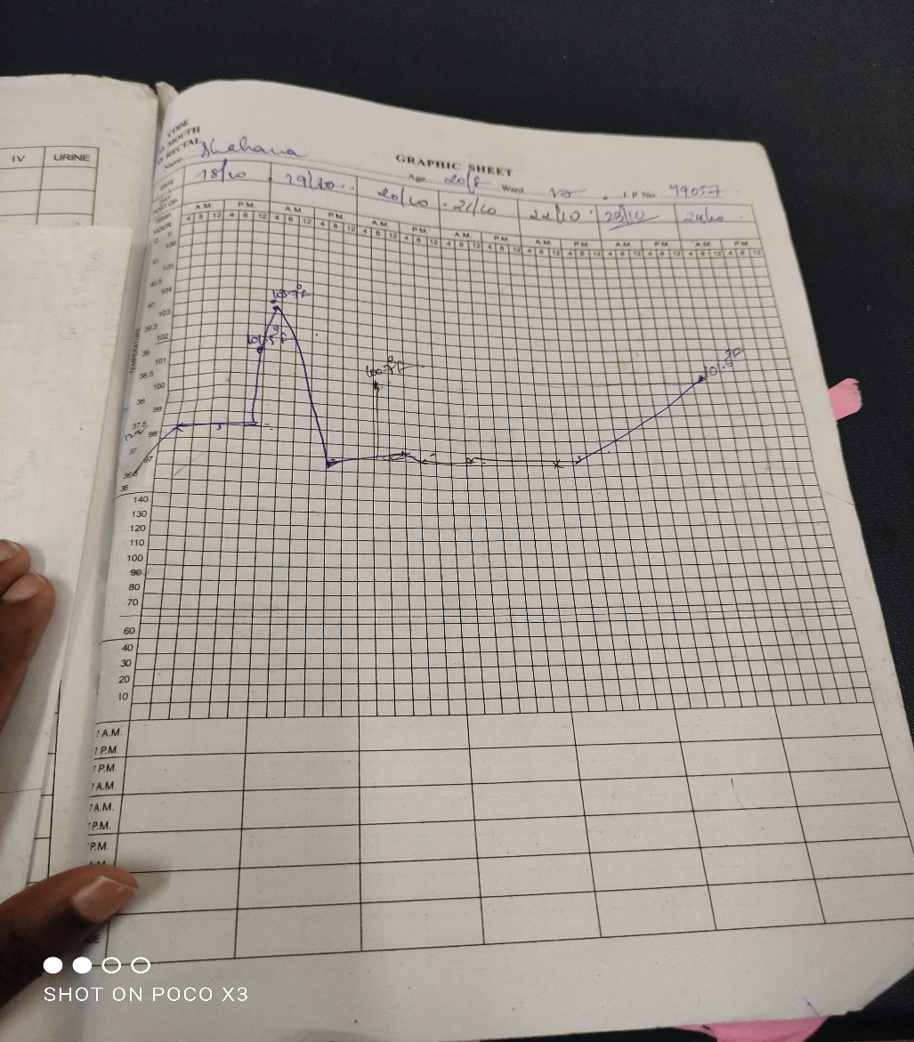

Slide 15
24/10/22 6th day of admission
Patient c/o fever spikes – high grade a/w chills & rigor
Daily fever spikes despite of IV antibiotics
a/w severe headache
a/w nausea & vomiting
Scrutinised her fever history:
c/o fever intermitent episodes for past 3 months
a/w joint pain- small joints
a/w fatigue/tiredness
2 weeks back they got admitted at private hospital

Slide 16
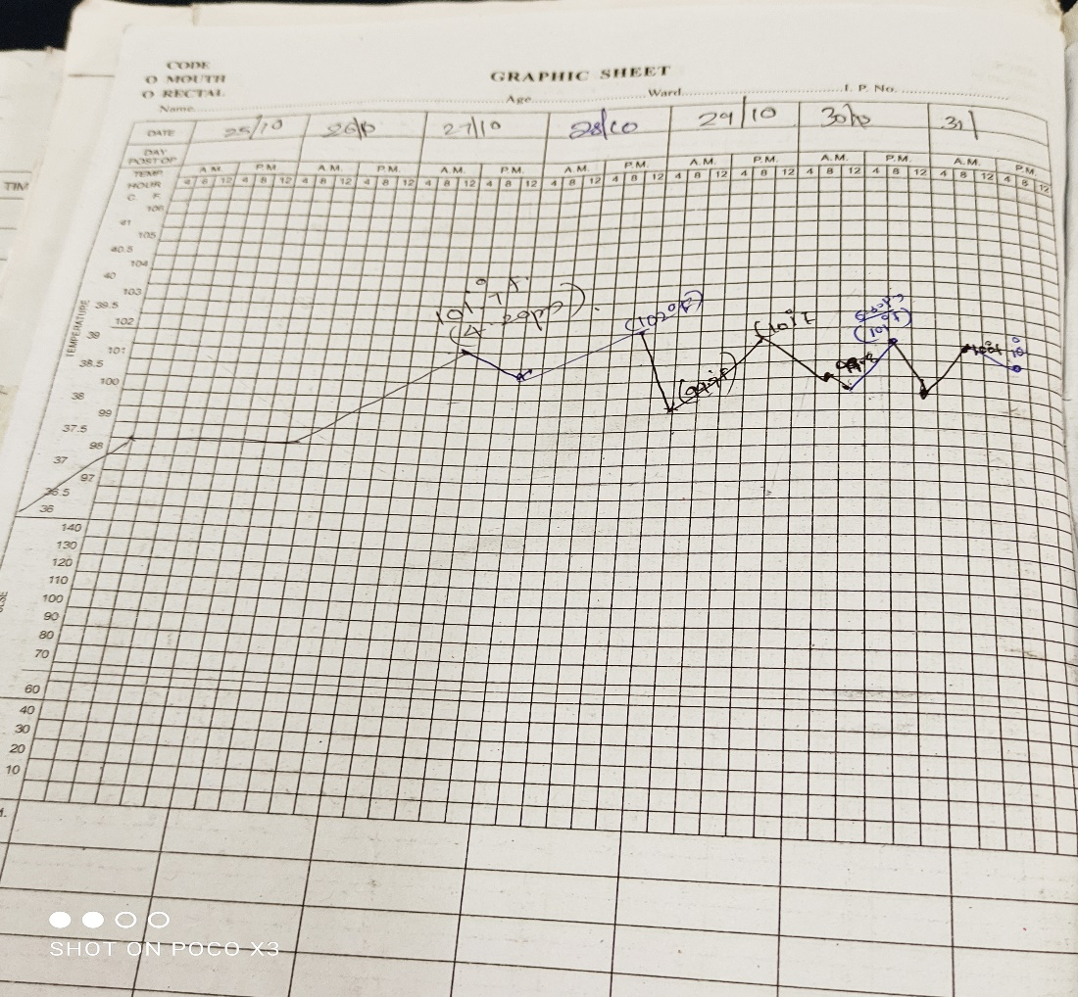

Slide 17
24/10/22
28/10/22
Hb : 8.4
TC: 3060
DC:N75L20M5
Plt: 1.64
ESR: 140
RFT:18/0.7
SE:127/3.9
HIV :neg
HBsAg/HCV:neg
RAT:neg
LP study
TC/DC:no cells
sugar:52(grbs:110)
protein:20
albumin:53.4(<300)
ADA:12(<10)

Slide 18
PS: normocytic hypochromic anaemia
leukopenia
No schistocytes
DCT:negative
LDH: 1228 (245)
Trop I : 0.02
Fasting triglyceride : 973
UPCR: 6.5:1

Slide 19
ECHO(29/10/22)
Cect abdomen &thorax(29/10/22)
Good LV function
EF 60%
Mild TR/MR
No clot/effusions
No vegetations seen
b/l mild pleural effusion
Ascites
Fluid collection around kidneys
Fluid in POD
s/o serositis

Slide 20
Ophthal consultation done in v/o persistent headache
Multifocal disc retinitis
b/l papilledema
Mri brain (1/11/22):no abnormality detected

Slide 21
ANA – IF : 3+ homogenous pattern
ANA profile
nRNP/sm positive
dsDNA positive
histone positive
nucleosome : borderline
C3 level : 23.9 (90-180)
C4 level : 4 ( 10-40)
APLA work up: negative

Slide 22
Anti Ds DNA titre : 276.3 IU/ml (<100)
ESR:120
CRP : 1.1 (<6)
C-ANCA : neg
P-ANCA :neg

Slide 23
Patient was shifted to SDICU on 29/10/22 at 2:30 PM
Patient was started on high dose steroids INJ.METHYLPRED 1GM IV OD on 30/10/22
Started on T.AZORAN 50 MG OD on 1/11/22
Nephrology consulation done & planned for renal biopsy

Slide 24
2/11/22
PR:110/min BP:120/70
CVS : S1 S2 heard,S4 gallop rhythm
Chest: clear ,no ALS

Slide 25
3/11/22
patient c/o chest pain,cough and breathkessness
PR:114/min BP:126/70
RESP: coarse insp creps left lower zone
b/l basal creps
CVS: gallop rhythm
CNS : no e/o focal neurological deficit

Slide 26
ECHO REPEATED on 3/11/22
Global LV hypokinesia with preserved thickness
DCM with severe LV dysfunction ( 30-35%)
Modereate MR
Thin rim of pericardial effusion

Slide 27
5/11/22
Hb: 8.2
TC:14,200
DC:N85L13
Plt:2.07
RFT:54/0.9
SE: 114/4.4
TP/Alb: 4.8/2.2
OT/PT/ALP:49/42/121
TROP I(repeat) :0.021
D-Dimer : 2 (< 0.5)
PT-INR:11.6/0.83
APTT:23.7
CRP (repeat): 4.4 (<6)

Slide 28
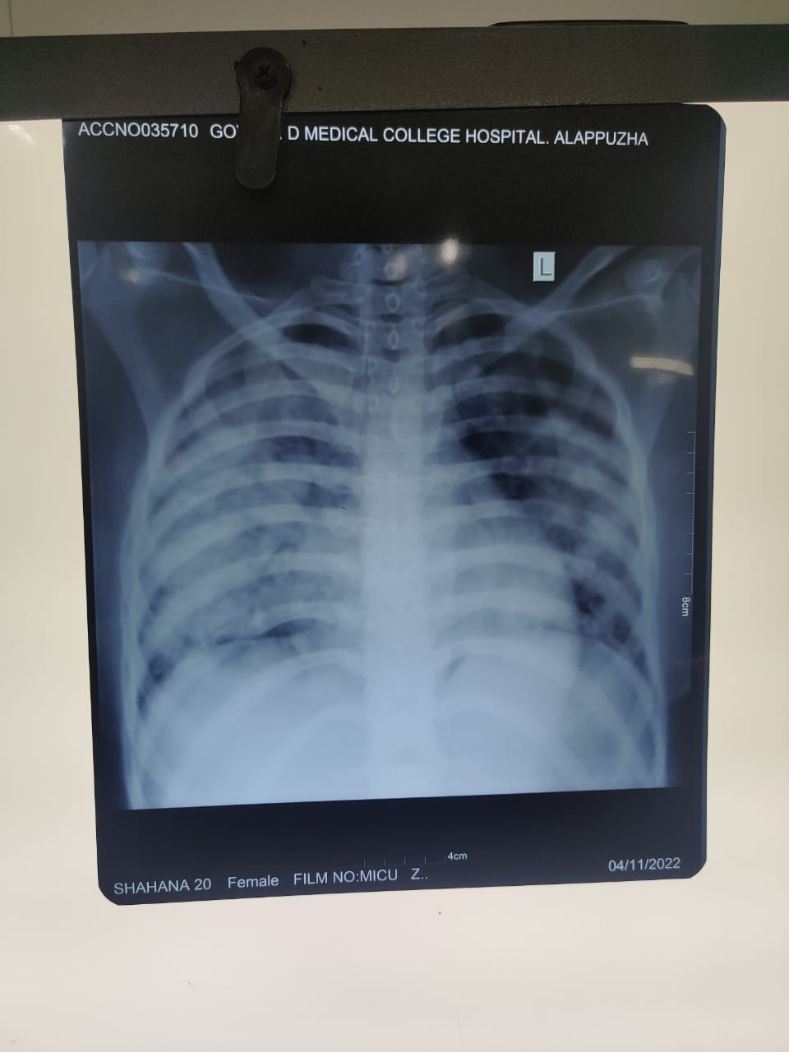

Slide 29
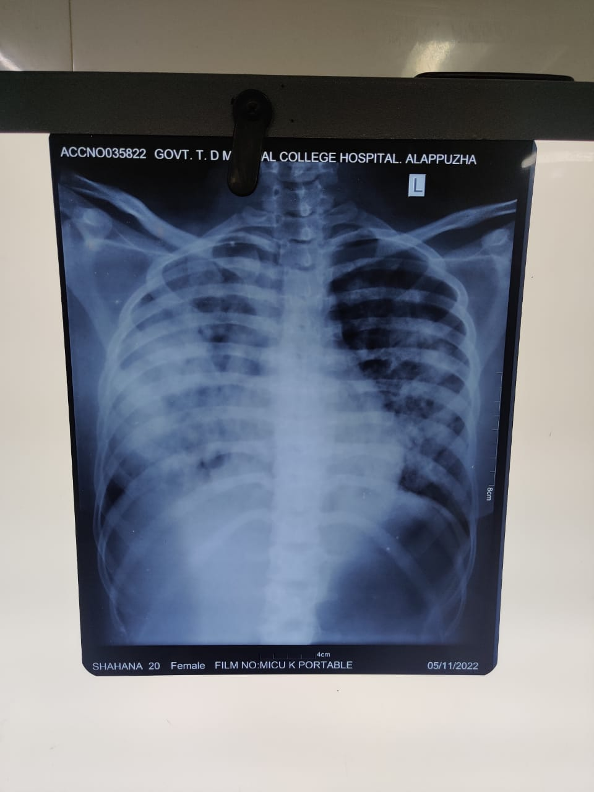

Slide 30
O2 INHALATION - CPAP
INJ.MEROPENEM 1 GM IV Q8H
INJ.LINEZOLID 600MG IV BD
INJ.LASIX 20 MG IV Q6H
T.ALDACTONE 25 MG
T.MMF 500 BD
T.HCQ 200 MG BD
T.WYSOLONE 40 MG OD
T.CARDIVAS 3.125 MG BD
T.SEPTRAN DS

Slide 31
IV IG 15G/DAY started
Despite all these measures patient breathlessness worsened,hypotension and patient was intubated and put on CMV
Dual ionotropic support
Despite all resuscitative measures patient expired on 6/11/22at 1:30 PM

Slide 32
DISCUSSION…..

Slide 33
Patients with disease more than 10 years have accelerated atherosclerosis
ACS is the most common cause of death in SLE after 10years
With the first 10 years ,other causes such as infevtions,CNS vasculitis,renal failure,diffuse alveolar haemorrhage are more common
APLA related thrombosis is common
Increased risk of TIA& stroke
MI equivalent

Slide 34
PULMONARY MANIFESTATIONS OF SLE
Systemic lupus erythematosus (SLE) is a chronic, autoimmune disorder that can present with a wide array of clinical and immunological abnormalities.
Pulmonary manifestations of the disease include disorders of the lung parenchyma, pleura, and pulmonary vasculature. Furthermore, some SLE therapies predispose to an increased risk of respiratory infections.

Slide 35
Clinical assessment of patients with SLE should routinely consider careful evaluation for respiratory involvement.
Symptoms including dyspnea, pleuritic chest pain, reduced exercise tolerance, cough, and hemoptysis should prompt investigation for potential underlying lung disease.
Some asymptomatic patients may also present with incidental findings of abnormal chest imaging or lung function tests in the absence of overt respiratory symptoms ..

Slide 36
It is also important to consider whether these symptoms are occurring in the context of active SLE involving other organ systems.
Serological evidence of increased disease activity including elevated erythrocyte sedimentation rate (ESR), low complement, and increased double-stranded DNA (dsDNA) antibody titers should also prompt the clinician to consider whether new respiratory symptoms are directly attributed to lupus

Slide 37
Pleural disease
Chronic interstitial pneumonitis(CIP)
Acute lupus pneumonitis
ILD
Pulmonary arterial hypertension
Pulmonary embolism
Pulmonary vasculitis and pulmonary haemorrage
Shrinking lung syndrome

Slide 38
Diffuse alveolar hemorrhage
Pulmonary haemorrhage is a rare but potentially catastrophic complication of SLE.
Mortality has ranged from 50% to 90%.
Clinical features are non-specific but diffuse alveolar infiltrates, hypoxaemia, dyspnoea, and anaemia are characteristic

Slide 39
Alveolar haemorrhage usually occurs in patients with a known history of SLE, higher titres of circulating anti-DNA antibody, and active extrapulmonary disease.
However, in up to 20% of cases alveolar haemorrhage may be the initial clinical manifestation of SLE.
Similar to other pulmonary haemorrhage syndromes, glomerulonephritis is often present in SLE associated alveolar haemorrhage.

Slide 40
Lung biopsy specimens demonstrate extensive haemorrhage within alveolar spaces and “capillaritis”; these features are non-specific.
Deposits of IgG, C3, or immune complexes have been found in up to 50% of patients with alveolar haemorrhage complicating SLE.
Because of the potential morbidity we rarely advise surgical (thoracoscopic or open) lung biopsies to diagnosis alveolar haemorrhage

Slide 41
. Fibreoptic bronchoscopy with bronchoalveolar lavage (BAL) and transbronchial lung biopsies can be performed with minimal morbidity and is usually adequate to substantiate the diagnosis in patients with suspected alveolar haemorrhage
The presence of gross blood in the airways, serosanguinous BAL fluid, haemosiderin laden macrophages, absence of purulent sputum, and lack of infectious organisms by appropriate stains

Slide 42
The treatment of choice is high dose steroids with or without cyclophosphamide.
Plasmapheresis should be reserved for patients with severe alveolar haemorrhage refractory to corticosteroids and cytotoxic agents.

Slide 43
CVS manifestations
Pericardial effusion without tamponade is th most common
Myocarditis is not very common
Valvular lesions:MR is the most common
Libmann sacks endocarditis

