Slide 1
MEGALOBLASTIC ANEMIAS
Dr. Alby Maria Mathews

Slide 2
Megaloblastic anemias are group of disorders characterized by the presence of distinctive morphological appearances of the developing red cells in the bone marrow.
Marrow is usually hypercellular and the anemia is based on ineffective erythropoiesis.

Slide 3
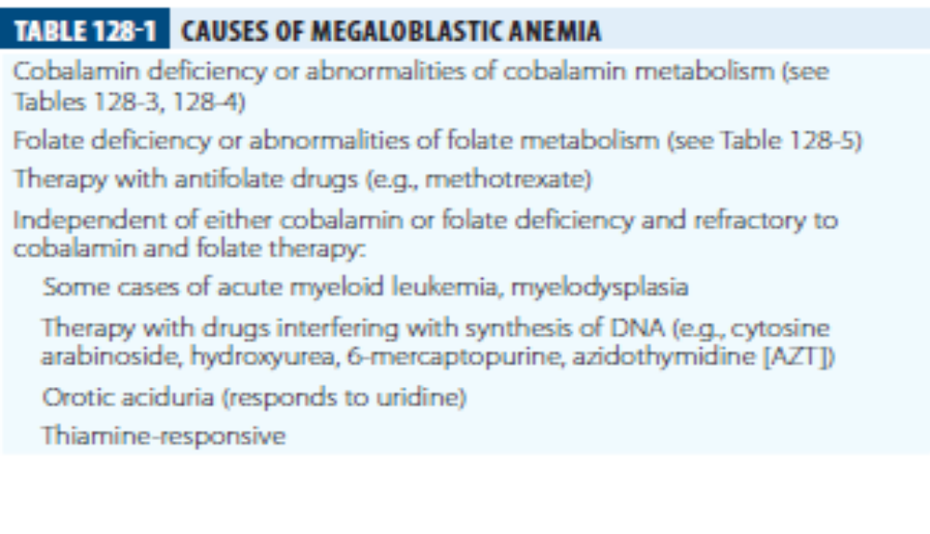

Slide 4
COBALAMIN
3 FORMS :
In nature its mainly in 2 deoxy adenosyl form ( Ado ) – located in mitochondria and cofactor for the enzyme L-methylmalonyl Coenzyme A mutase
Methylcobalamin – form in human plasma and cell cytoplasm. Cofactor for methionine synthase
Methyl and ado cobalamin are converted to hydroxocobalamin rapidly by exposure to light.

Slide 5
Dietary sources:
Only source for humans : animal products such as meat, fish and dietary products
Adult daily requirement : 1 to 3 mcg per day

Slide 6
ABSORPTION
active and passive
Dietary cobalamin is released from protein complexes by enzymes
Binds with salivary glycoprotein- haptocorrin
Haptocorrin is digested in the intestine and cobalamin is transferred to IF.
IF attaches to it specific receptor (cubulin) on enterocytes.

Slide 7
Transport
2 main transport proteins-
Transcobalamin 1 : encoded by gene TCNL, derived from specific granules in neutrophils
Binds with cobalamin and plays a role in the transport of cobalamin analogues in the liver for excretion in bile.
Transcobalamin 2: transport of cobalamin to the marrow , placenta and other tissues via receptor mediated endocytosis involving the transcobalamin receptor and megalin.

Slide 8
FOLATE
DIETARY FOLATE
Highest conc. In liver, yeast, spinach and nuts.
Daily adult requirement 1000 ug/day

Slide 9
ABSORPTION
Dietary folate converted to 5 methyl THF in enterocytes.
Monoglutamates are actively transported across the enterocyte by a proton coupled folate transporter(PCFT).
60 to 90 ug enters the bile

Slide 10
TRANSPORT
One third is loosely bound to albumin and two thirds unbound.
3 types of transporters
Reduced folate transporter- delivery of plasma folate to tissues.
Folate receptors FR2 and FR3 transport folate into cell
PCFT transports folate from vesicle to the cell cytoplasm.

Slide 11
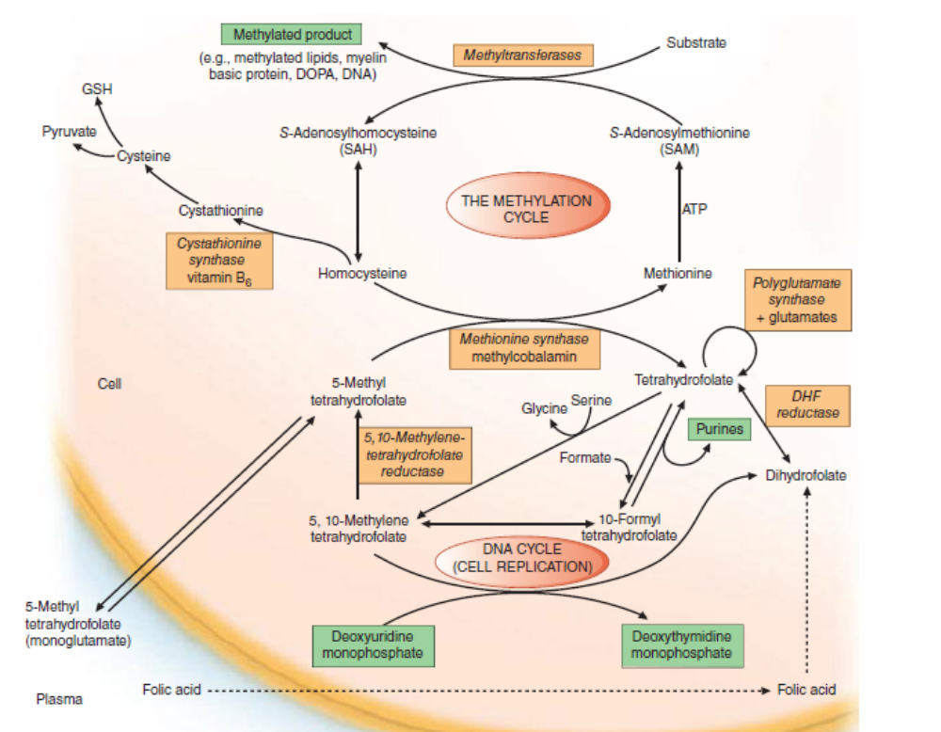
ROLE OF FOLATES IN DNA SYNTHESIS

Slide 12
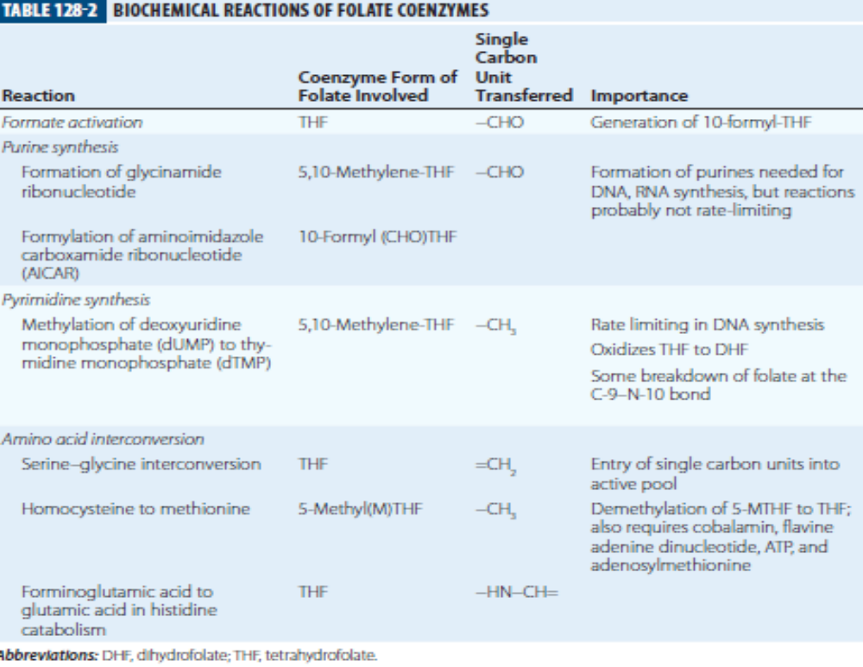

Slide 13
BIOCHEMICAL BASIS OF MEGALOBLASTIC ANEMIA
Disparity in the rate of synthesis or availability of the immediate precursors of DNA.
In deficiencies of either folate or cobalamin, there is failure to convert deoxyuridine monophosphate (dUMP) to deoxythymidine monophosphate (dTMP) .
Folate is needed as the coenzyme 5, 10-methylene- THF polyglutamate for the conversion of dUMP to dTMP.

Slide 14
DNA replication from multiple origins is slower.
Failure of joining of incomplete replicons.

Slide 15
CLINICAL FEATURES
EPITHELIAL SURFACES:
Epithelial cell surfaces of the mouth (glossitis), stomach and small intestine and the respiratory, urinary and female genital tracts.
Cells show macrocytosis, with increased numbers of epithelial and dying cells.
Deficiencies may cause cervical smear abnormalities.

Slide 16
Gonads- infertility is common in both men and women.
Maternal folate and cobalamin deficiency- prematurity, recurrent fetal loss and neural tube defects.

Slide 17
NEURAL TUBE DEFECTS:
FA supplements has reduced the incidence of neural tube defects
(anencephaly, meningomyelocele, encephalocele and spina bifida)
Incidence of cleft lip and palate can also be reduced.
Polymorphism in the MTHFR gene leading to reduced activity of 5, 10 methylene THF Reductase.

Slide 18
Cardiovascular disease-
Patients with deficiency of one of the three enzymes, methionine synthase, MTHFR, or cystathionine synthase with homocystinuria have increased incidence of vascular disease like IHD, cerebrovascular disease or pulmonary embolus.
Venous thrombosis is found to be more common in folate or b12 deficient subjects.

Slide 19
MALIGNANCY-
Prophylactic folic acid has been found to have reduced the incidence of ALL and leukemias with mixed lineage leukemias.
Other tumors associated with folate polymorphisms include follicular lymphoma, breast cancer and gastric cancer.
Because FA may “feed” tumors, it probably should be avoided in those with established tumors unless there is severe megaloblastic anemia due to folate deficiency.

Slide 20
HEMATOLOGIC FINDINGS
PERIPHERAL BLOOD
Oval macrocytes with considerable anisocytosis and poikilocytosis
MCV usually> 100 fL
Hypersegmented neutrophils
There may be leukopenia due to reduction in granulocytes and lymphocytes
Platelet count may be moderately reduced
In a non anemic patient, the presence of a few macrocytes and hypersegmented neutrophils may be the only indication of the underlying disorder.

Slide 21
BONE MARROW
Hypercellular marrow
Erythroblast nucleus appears primitive despite maturation and hemoglobinization of the cytoplasm.
Giant and abnormally shaped metamyelocytes and enlarged hyperploid megakaryocytes are characteristic.

Slide 22
CHROMOSOMES
Bone marrow cells, transformed lymphocytes and other proliferating cells in the body show random breaks reduced contraction, spreading of the centromere, and exaggeration of secondary chromosomal constrictions and overprominent satellites.
Similar abnormalities may be caused by antimetabolite drugs (e.g: cytosine arabinoside, hydroxyurea, and methotrexate)

Slide 23
INEFFECTIVE HEMATOPOIESIS
Accumulation of unconjugated bilirubin, raised urine urobilinogen, reduced haptoglobins and positive urine hemosiderin
Raised s. LDH
A weakly positive direct antiglobulin test due to complement can lead to false diagnosis of autoimmune hemolytic anemia.

Slide 24
CAUSES OF COBALAMIN DEFICIENCY
Inadequate dietary intake- vegans
Deficiency usually does not progress to megaloblastic anemia as the vegan diet is not completely lacking in cobalamin and the enterohepatic circulation is intact.
Infants born to severely cobalamin-deficient mothers have shown growth retardation, impaired psychomotor development, and other neurological sequelae. MRI shows delayed myelination and atrophy.

Slide 25
GASTRIC CAUSES OF COBALAMIN DEFICIENCY
Pernicious anemia
Juvenile pernicious anemia- one half have associated endocrinopathy
Congenital IF deficiency or functional abnormality- antibodies are absent. Child usually presents with megaloblastic anemia in the first to third yr. autosomal recessive.
Gastrectomy
Food cobalamin malabsorption- failure of release of cobalamin from binding proteins.

Slide 26
PERNICIOUS ANEMIA
severe lack of IF due to gastric atrophy;
Occurs more commonly in persons with other autoimmune diseases
Gastric output of pepsin, hydrochloric acid and IF is severely reduced.
Gastric biopsy- atrophy of all layers of the body and the fundus, with loss of glandular elements, absence of parietal and chief cells replaced by mucus cells, a mixed inflammatory cell infiltrate and intestinal metaplasia.
H. pylori infection occurs infrequently in PA.

Slide 27
IF immunoglobulin antibodies:
“blocking” or type 1 antibody- prevents combination of IF and cobalamin
Type II antibody – prevents attachment of IF to ileal mucosa.

Slide 28
INTESTINAL CAUSES OF COBALAMIN MALABSORPTION
Intestinal stagnant loop syndrome
Ileal resection
Selective malabsorption of cobalamin with proteinuria (Imerslund syndrome; congenital cobalamin malabsorption; autosomal recessive megaloblastic anemia; MGA1)
Tropical sprue
Fish tapeworm infestation
Gluten induced enteropathy

Slide 29
severe pancreatitis,
HIV infection
Radiotherapy
Zollinger Ellison syndrome
Drugs -colchicine, para aminosalicylic acid, neomycin, slow release potassium chloride, anticonvulsant drugs, metformin, cytotoxic drugs
Graft versus host disease.
Alcohol

Slide 30
ABNORMALITIES OF COBALAMIN METABOLISM
Congenital transcobalamin II deficiency or abnormality
Congenital methyl melonic acidemia or aciduria
Acquired abnormality of cobalamin metabolism: nitrous oxide inhalation.

Slide 31
CAUSES OF FOLATE DEFICIENCY
NUTRITIONAL: Nutritional folate deficiency occurs in infants with repeated infections, solely fed by goats milk, kwashiorkor, scurvy
MALABSORPTION:
tropical sprue, gluten induced enteropathy
jejunal resection, partial gastrectomy
sulfasalazine, cholestyramine and triamterene.

Slide 32
EXCESS UTILIZATION OR LOSS
pregnancy
prematurity
Hematologic disorders- chronic hemolytic anemia
Chronic inflammatory disease
Homocystinuria
Long term dialysis
Congestive heart failure, liver disease- release of folate from damaged liver cells

Slide 33
ANTIFOLATE DRUGS
PHENYTOIN OR PRIMIDONE
Alcohol
Methotrexate, pyrimethamine and trimethoprim
CONGENITAL ABNORMALITIES OF FOLATE METABOLISM

Slide 34
DIAGNOSIS OF COBALAMIN AND FOLATE DEFICIENCIES

Slide 35
COBALAMIN DEFICIENCY
Serum cobalamin: (ELISA)
Normal levels range from 118-148 to 738 pmol/L
Serum methyl malonate and homocysteine:
Serum MMA levels can be used for the early diagnosis of cobalamin deficiency, even in the absence of hematological abnormalities.
S. homocysteine is raised both in early cobalamin and folate deficiency

Slide 36
TESTS FOR THE CAUSE OF COBALAMIN DEFICIENCY
Studies of cobalamin absorption- obsolete
Tests to diagnose PA- raised s.gastrin, reduced s. pepsinogen 1, gastric endoscopy, IF and parietal cell antibodies.

Slide 37
FOLATE DEFICIENCY
S. folate- 11 to 82 nmol/L
S folate rises in severe cobalamin deficiency.
Red cell folate- 880 to 3520 umol/L

Slide 38
TESTS FOR THE CAUSE OF FOLATE DEFICIENCY
Diet history
Transglutaminase antibodies.

Slide 39
TREATMENT

Slide 40
COBALAMIN DEFICIENCY
Indications for starting cobalamin deficiency – well documented megaloblastic anemia or other hematologic abnormalities and neuropathy due to deficiency
Replenishment of body stores- six 1000ug im inj of hydroxocobalamin given at 3 to 7 day intervals
More frequent doses in neuropathy
Large oral doses 1000- 2000 ug of cyanocobalamin are used in PA for replacement.

Slide 41
Vitamin b12 injections are used in a wide variety of diseases often neurologic, despite normal b12 and folate levels and normal blood counts.
These conditions include multiple sclerosis and chronic fatigue syndrome / myalgic encephalomyelitis.

Slide 42
FOLATE DEFICIENCY
Oral doses of 5 to 15mg folic acid daily for about 4 months till all folate deficient red cells have been eliminated and replaced.
Long term folic acid therapy is required when underlying cause cannot be corrected or is likely to recur
FOLINIC ACID – given orally or parenterally to overcome the toxic effects of methotrexate or other DHF reductase inhibitors

Slide 43
PROPHYLACTIC FOLIC ACID
Pregnancy –
400mcg daily before and through out pregnancy to prevent megaloblastic anemia and neural tube defects
Folic acid reduces risk of birth defect in babies born to diabetic mothers
In women who have had a previous fetus with NTD 5mg daily folic acid is recommended

Slide 44
Infancy & childhood –
Folic acid should be given routinely to premature babies and who develop feeding difficulties, infections or vomiting and diarrhoea
Routine dose is 1mg daily

Slide 45
THANK YOU

