Slide 1
Localisation of the lesion
Dr Jatheesh

Slide 2
Case summary
43/M
K/C/O Systemic hypertension and type 2 Diabetes melllitus from 2016 on regular medication , post-covid (cat B) on 2021
Now presented with headache ,diplopia and swaying to left side since 3 days
And slurring of speech for 1 day duration

Slide 3
Headache is acute onset, continuous ,dull aching and diffuse
Double vision is acute onset ,painless, more towards looking to left , near objects and objects appear horizontally duplicated.
Swaying to left side , walk with support. No weakness,
no earache,discharge,
no worsening of symptom on dark / narrow passage

Slide 4
From history
Diplopia on looking left and near indicates lesion involving function of medial rectus/MLF
Ataxia indicates involvement of cerebellum or its connections
Hence lesion within brainstem
Headache can be due to vascular occlusion

Slide 5
General examination
Conscious oriented
Bmi 26.7
Pulse 112/min regular
Bp- 160/90 mmhg right arm .
Rr-18/min. abdominothoracic

Slide 6
Examination of nervous system
Higher mental function
Normal
Speech – comprehension , repitation , wordoutput normal, dysarthia + (staccato)

Slide 7
Examination of cranial nerves
1 ,2 – normal
3,4,6- No squint
Right eye adduction lost with left gaze evoked nystagmus – right INO
Binocular diploplia+
Right skew deviation +

Slide 8


Slide 9


Slide 10


Slide 11
pupil- size and shape normal
Covergence normal
Reflex – normal
5,7,8,9,10,12 – normal

Slide 12
Motor system
Bulk – normal b/l
Tone – hypotonia b/l
Reflex – plantar – b/l flexor
DTR – 2+ b/l
Coordination-
Upperlimb- finger nose – b/l dysmetria lower limb- heel knee test- incordination+
Finger-finger nose- past pointing +
Dysdiadakokinesia - + b/l

Slide 13


Slide 15
Resting tremor+ both ul, ll and tongue
Gait ataxia +, wide based gait

Slide 16
Sensory system examniantion – wnl
No autonomic signs
Skull and spine – normal
No signs of meningeal irritation

Slide 17
Cvs- inspection –normal
Palpation –apex 5th ic space mcl
Auscultation- HS- normal
No murmur or added sounds

Slide 18
Respiratory system- wnl
Git- wnl

Slide 19
diagnosis
Right internuclear ophthalmoplegia with bilateral cerebellar signs
Cerebrovascular accident – infarct- right midbrain at the level inferior colliculus , superior cerebellar peduncle deccusation – paramedian perferorating branches of posterior cerebral artery
t2dm , hypertension

Slide 20
investigation
Hb – 15.9
Tc-7600
Plt- 1.9l
Esr -10

Slide 21
Bu,cr- 28/1.2
Se- 141/3.8
Rbs-169
Tb-0.8
Ot/pt- 35/39
Alp-75

Slide 22
Mri brain
Acute non hemorrhagic infarct in the midbrain in the right paramedian location
Few chronic ischemic foci in bilateral frontoparietal ischemia
Old lacunar infarct in the left thalamus

Slide 23
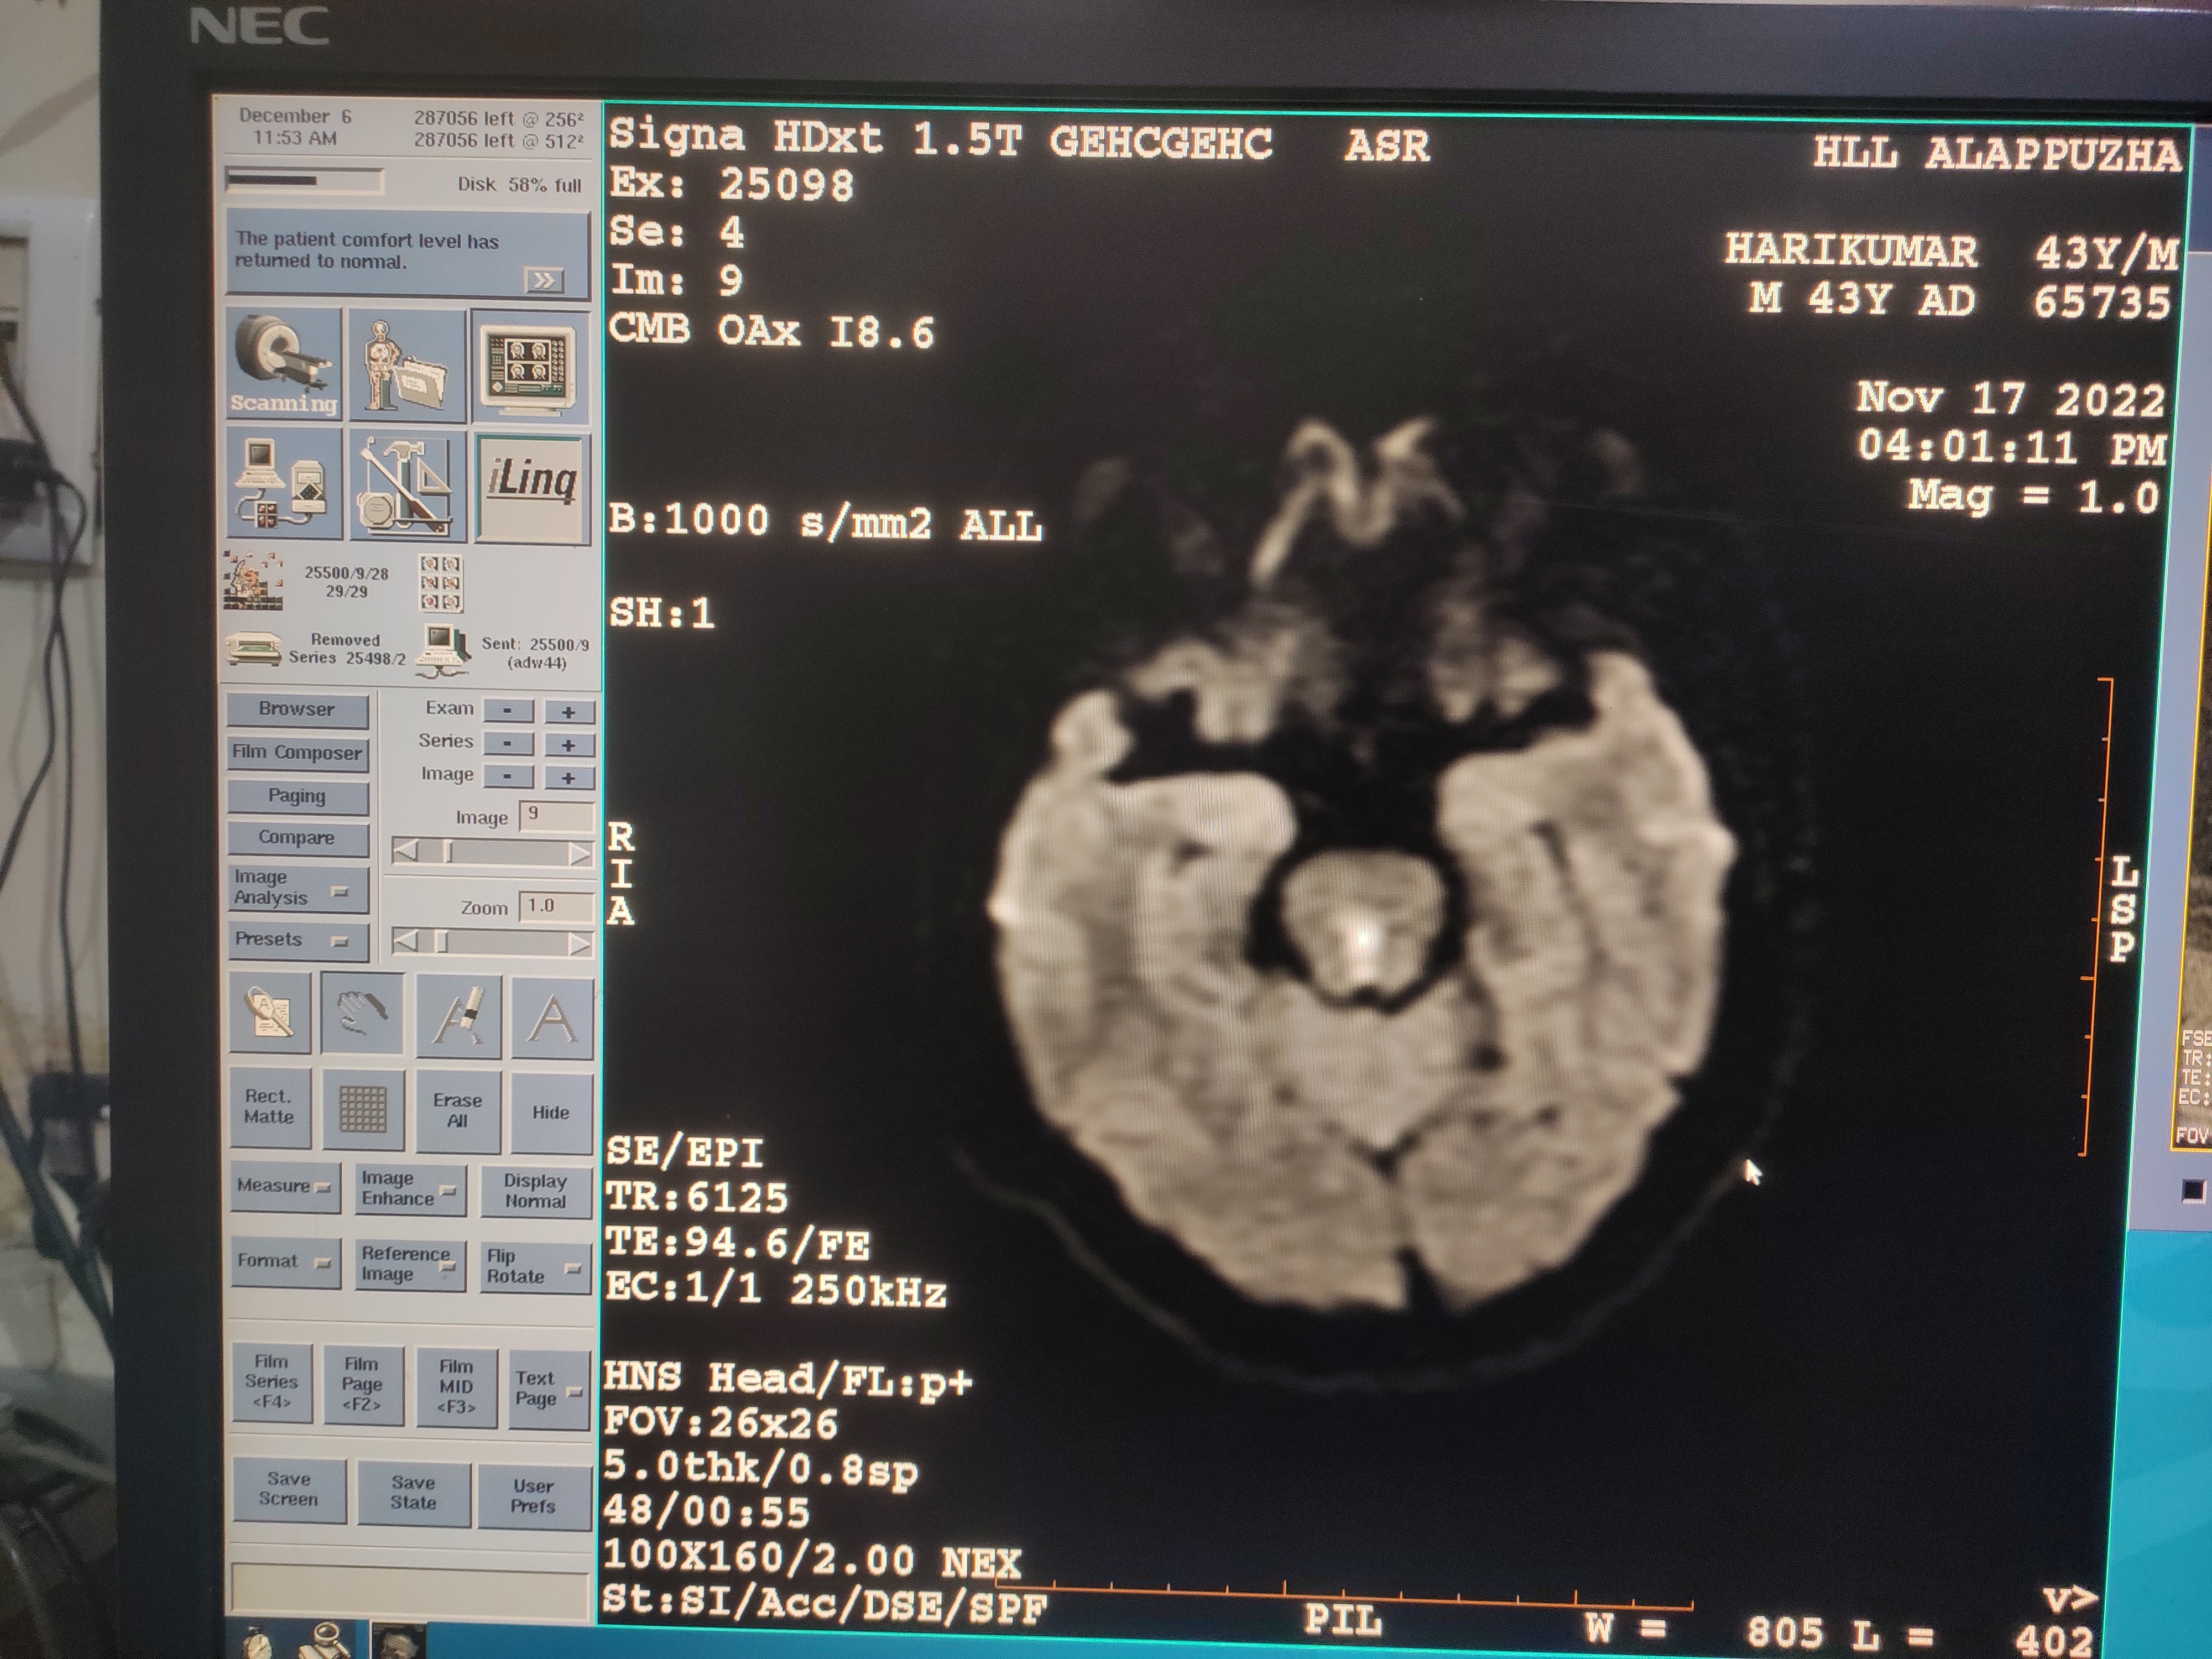

Slide 24
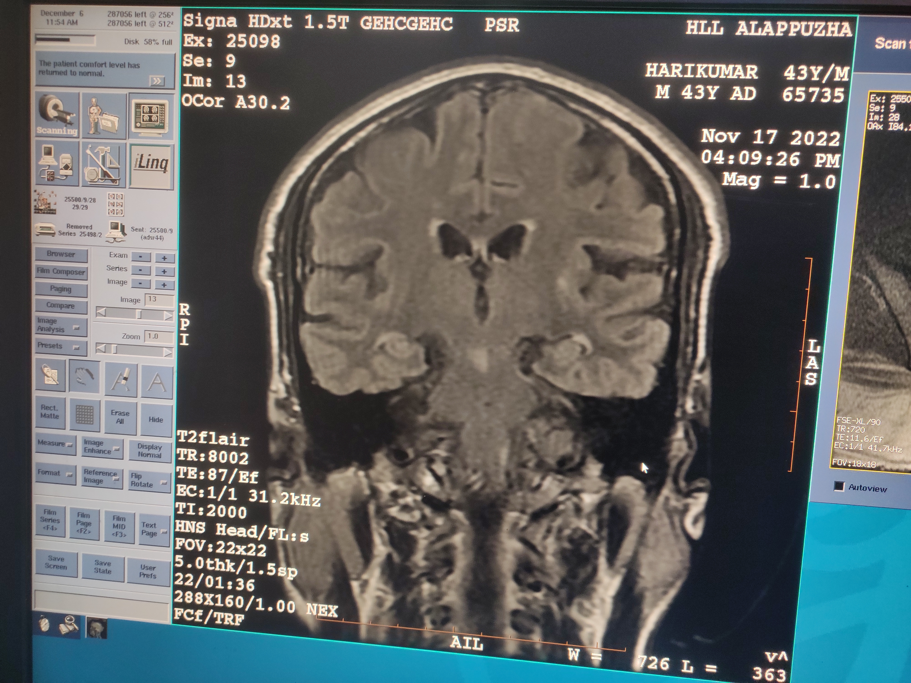

Slide 25
discussion
Small infarcts of the brainstem and especially of the mesencephalon can cause numerous clinical syndromes.
These syndromes constitute the atypical lacunar syndromes

Slide 26
Cases presenting with the combined features of cerebellar ataxia and INO have been infrequently reported in the literature, and in our patient, cerebellar ataxia was associated to INO.

Slide 27
INO results from the interruption of the internuclear pathway (MLF) connecting the nucleus of the abducens nerve with the contralateral medial rectus muscles nucleus of the oculomotor nerve

Slide 28
All previously reported patients present with dysarthric speech, truncal ataxia, and ataxic movements of all four limbs and bilateral cerebellar dysfunction. It is very clear that bilateral cerebellar dysfunction can be attributed to decussation of the brachium conjunctivum interruption

Slide 29
Adjacent to the MLF, the lesion in the brachium conjunctivum caused the bilateral appendicular and truncal cerebellar ataxia and was probably also responsible for the slurred speech

Slide 30
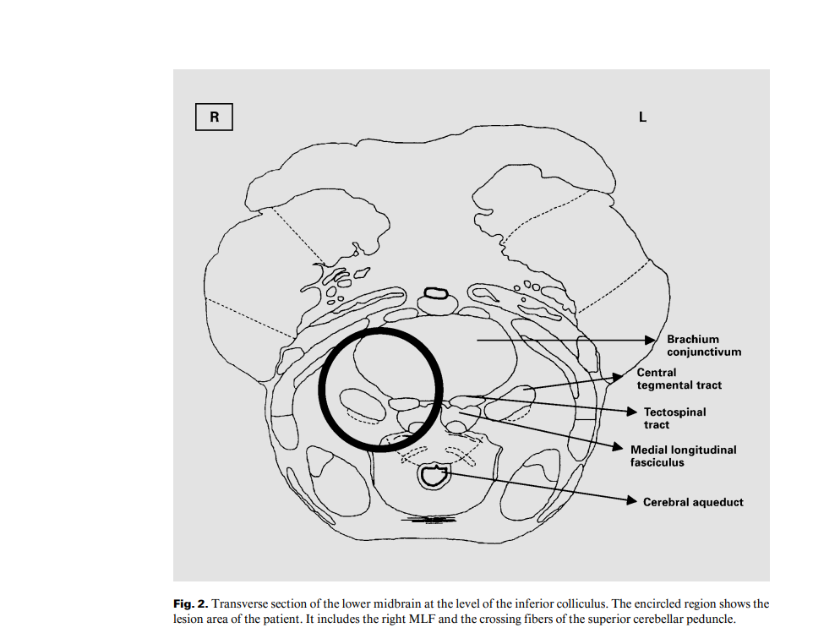

Slide 31
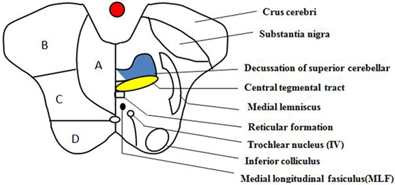

Slide 32
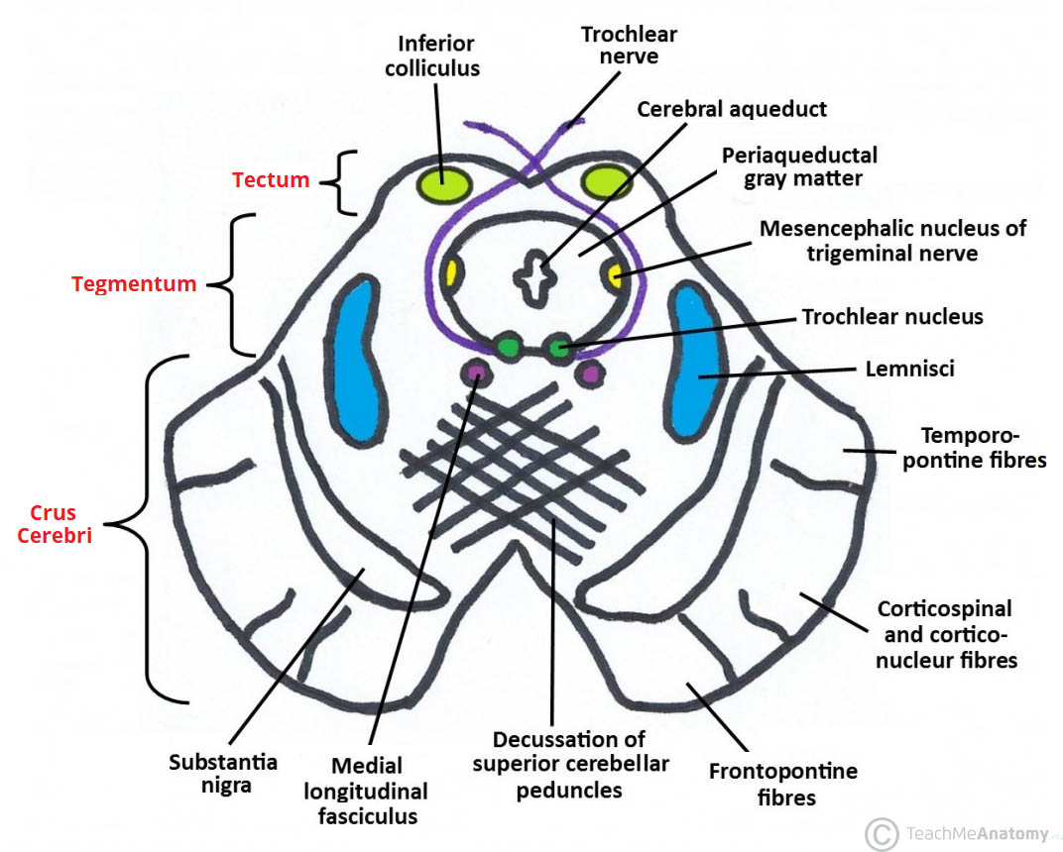

Slide 33
Wernekink commissure syndrome
The Wernekink commissure syndrome (sometimes spelled Wernekinck) is a rare brainstem syndrome caused by lesions (usually infarcts) involving the decussation of the superior cerebellar peduncles (Wernekink commissure) at the caudal midbrain.

Slide 34
The syndrome is characterized by bilateral cerebellar dysfunction . This can manifest as gait and truncal ataxia, dysmetria on finger-nose-finger and heel-knee-shin tests, and dysdiadochokinesis. In addition, marked dysarthria is a consistent finding . Variable eye movement disorders and holmes tremor are also described .

Slide 35
Midbrain lesions may involve the nearby medial longitudinal fasciculus, resulting in internuclear ophthalmoplegia . In some patients, involvement of the dentatorubral fibers, part of the triangle of Guillain and Mollaret, can manifest as delayed onset palatal tremor/myoclonus

Slide 36
Thank you

