Slide 1
Thank you…

Slide 2
Happy Woman’s Day!
I’m proud to be a woman because…
we are kind, compassionate and have loving souls.
we are incredible at multi-tasking.
we are nurturing and caring.
We are beautiful inside and out!!

Slide 3
The dilemmas!!
Dr.Ambili N.R,MD,DNB
Associate Professor of Medicine

Slide 4
Not understanding is the beginning of learning
Confusion is the reflection of growth

Slide 5
On..
February 13th ,2023

Slide 6
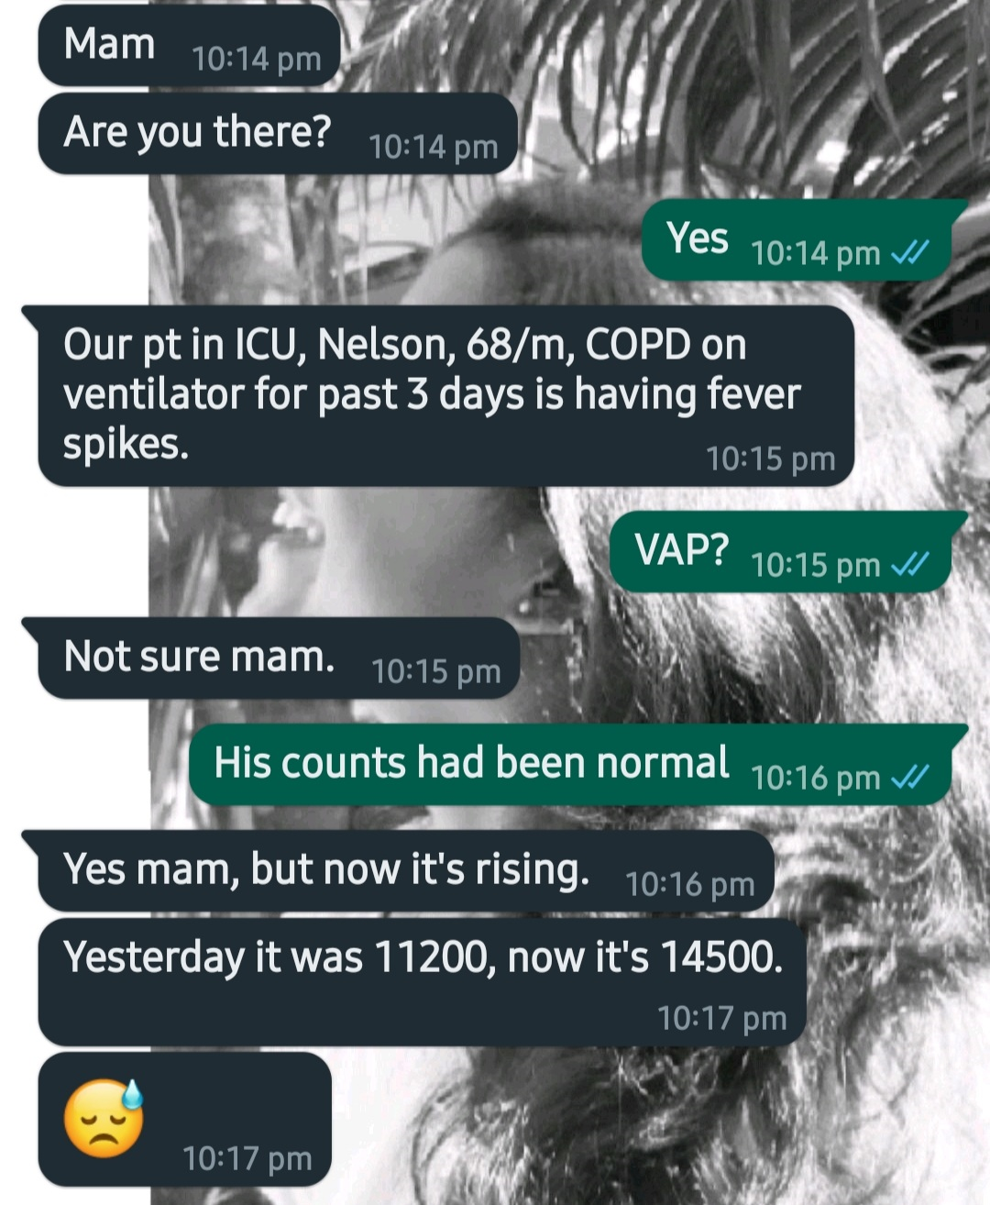
February 13th 2023…

Slide 7
So…
What’s VAP?

Slide 8
The dilemma starts here !
Which criteria ?
Johanson criteria
Clinical Pulmonary Infection Score (CPIS)
Centers for Disease Control and Prevention (CDC)

Slide 9
JOHANSON CRITERIA
Presence of a new or progressive radiographic infiltrate
+ 2/3
fever > 38°C
leukocytosis or leukopenia
purulent secretions

Slide 10
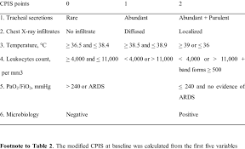
CPIS SCORE
>6 POINTS SUGGEST VAP

Slide 11
A practical diagnostic criteria
VAP is a clinical diagnosis made in a patient who has been mechanically ventilated for ≥48 hours who develops a new or progressive lung infiltrate on imaging with clinical evidence that the infiltrate is of infectious origin (eg, fever, purulent sputum, leukocytosis, and decline in oxygenation), together with a positive pathogen identified on microbiologic respiratory sample
2016 Clinical Practice Guidelines by the Infectious Diseases Society of America and the American Thoracic Society, Clinical Infectious Diseases, Volume 63, Issue 5, 1 September 2016, Pages e61–e111, https://doi.org/10.1093/cid/ciw353

Slide 12

Look alike but different!.

Slide 13
May be sound alike too…!!
Hospital acquired pneumonia [HAP]- Patients who are in the hospital for >48 hrs when they develop pneumonia.
Patients with severe HAP who require mechanical ventilation after the onset of infection do not meet the definition of VAP. This is termed Ventilated hospital-acquired pneumonia (VHAP)
A positive microbiologic sample in a patient with a normal chest radiograph is a simple tracheobronchitis.

Slide 14
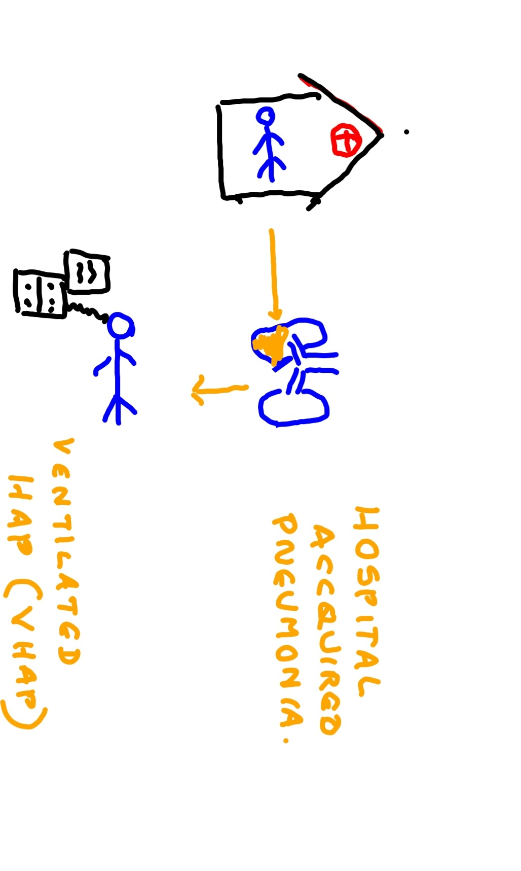

Slide 15
Ventilator-associated condition (VAC)
Patients with a period of sustained respiratory deterioration (changes in positive end-expiratory pressure [PEEP] ≥3 cm H₂O or fraction of inspired oxygen [FiO₂] ≥0.2 [ie, 20 points] for two days) following a sustained period of stability or improvement on the ventilator (greater than or equal to two days)

Slide 16
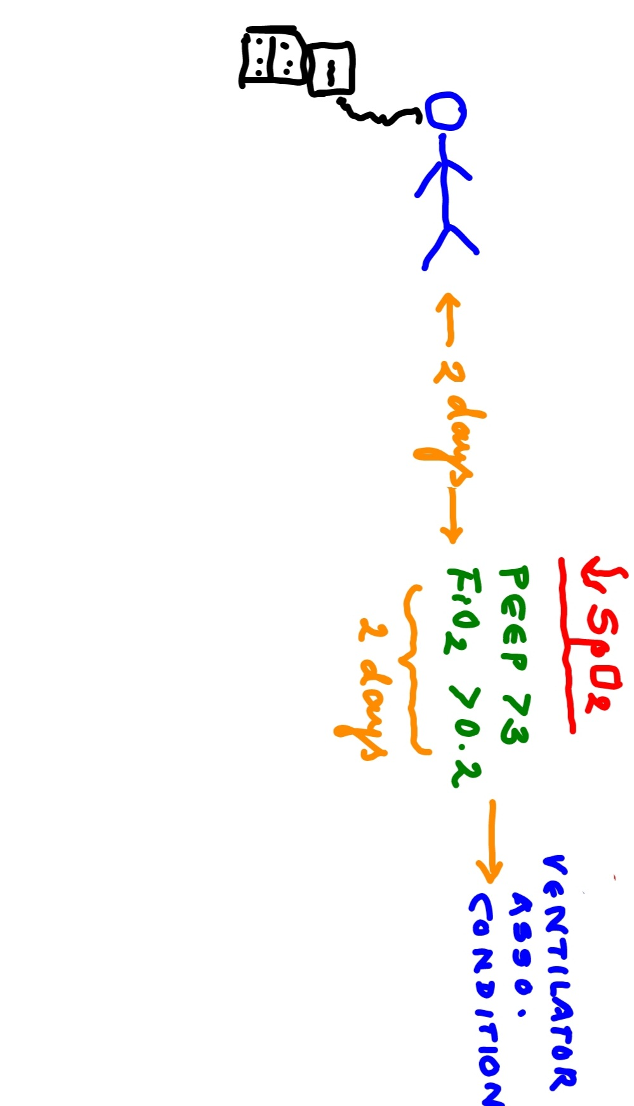

Slide 17
Ventilator associated conditions
Ventilator-associated pneumonia (VAP)
Sepsis
ARDS
Pulmonary embolism
Barotrauma
Pulmonary edema

Slide 18
Infection-related ventilator-associated complication (IVAC)
Patients with VAC also have an abnormal temperature (below 36°C or above 38°C) or white blood cell count (≤4000 or ≥12,000 cells/mm³) and be started on one or more new antibiotics that continue for four or more days

Slide 19
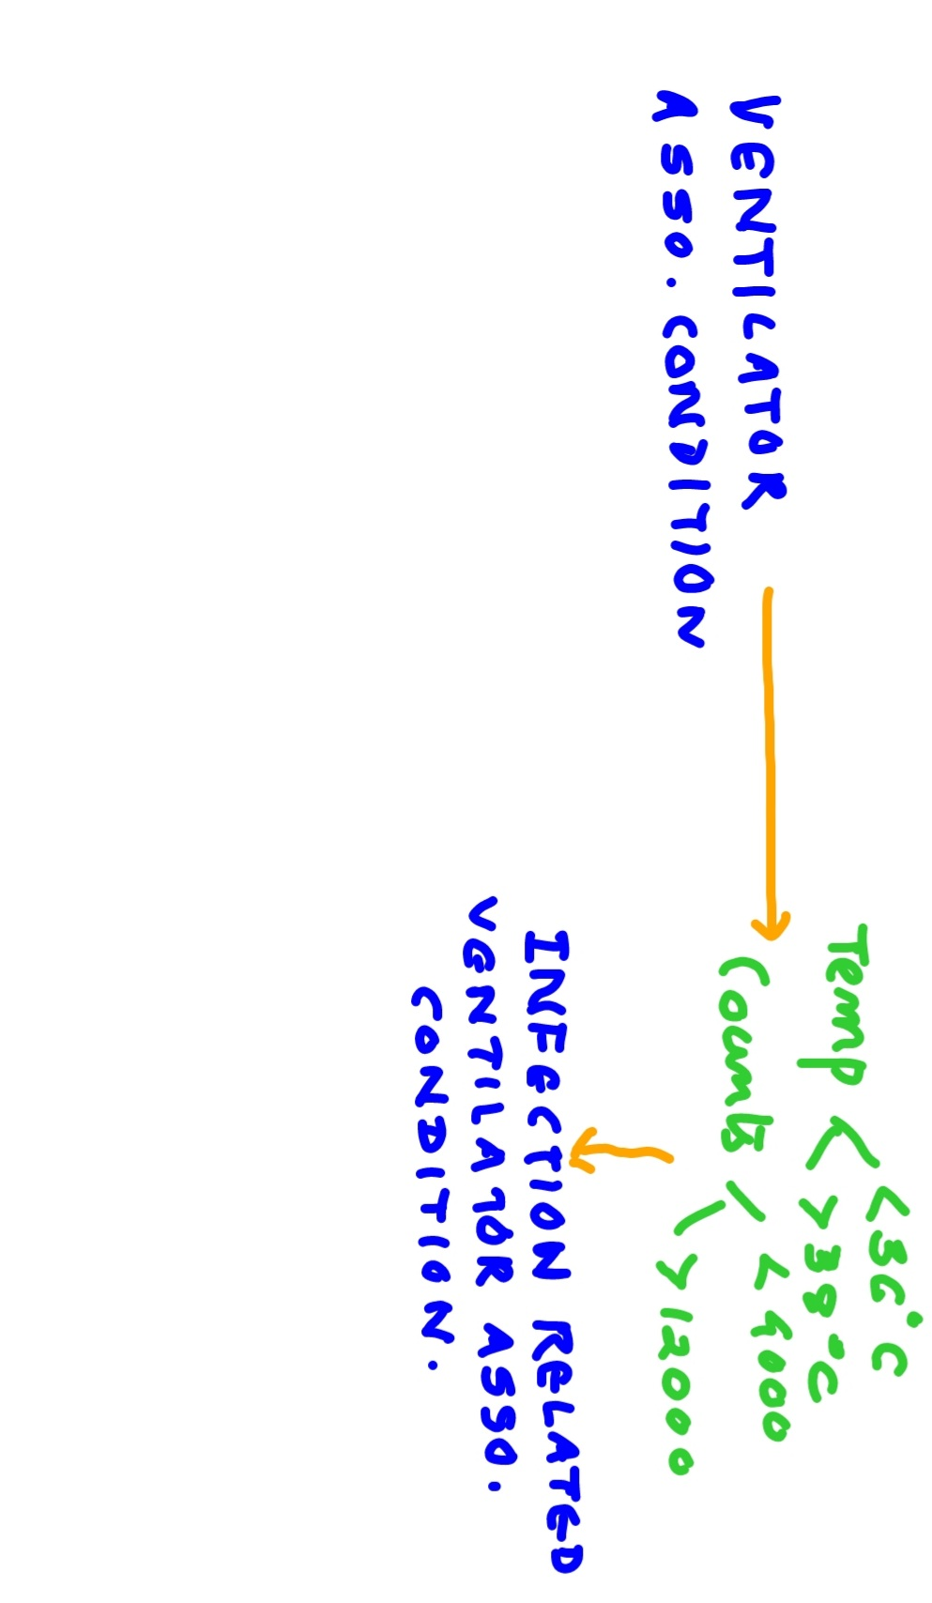

Slide 20
Possible and probable VAP
Possible VAP is defined as Gram stain evidence of purulent pulmonary secretions or a pathogenic pulmonary culture in a patient with IVAC .
Probable VAP is defined as Gram stain evidence of purulence plus quantitative or semiquantitative growth of a pathogenic organism beyond specified thresholds

Slide 21
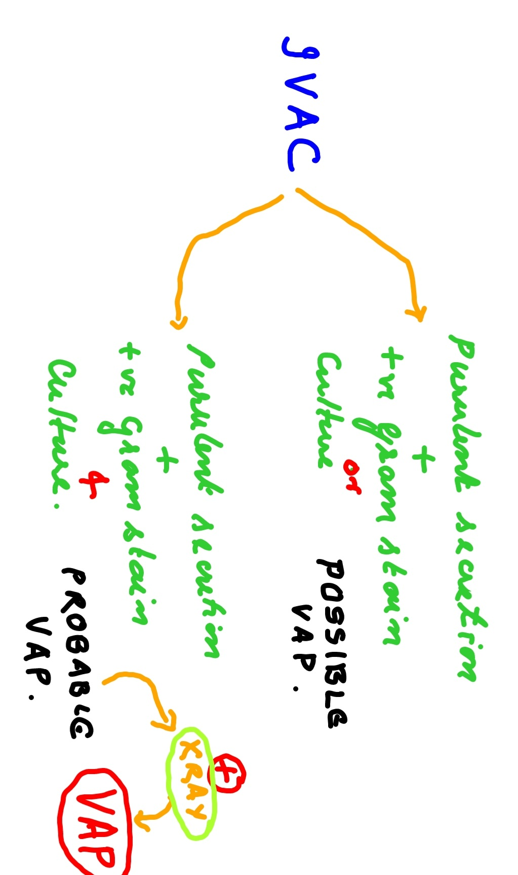

Slide 22
POINTS IN THE diagnostic criteria WHICH OUR PATIENT HAD..
VAP is a clinical diagnosis made in a patient who has been mechanically ventilated for ≥48 hours who develops a new or progressive lung infiltrate on imaging with clinical evidence that the infiltrate is of infectious origin (eg, fever, purulent sputum, leukocytosis, and decline in oxygenation), together with a positive pathogen identified on microbiologic respiratory sample

Slide 23
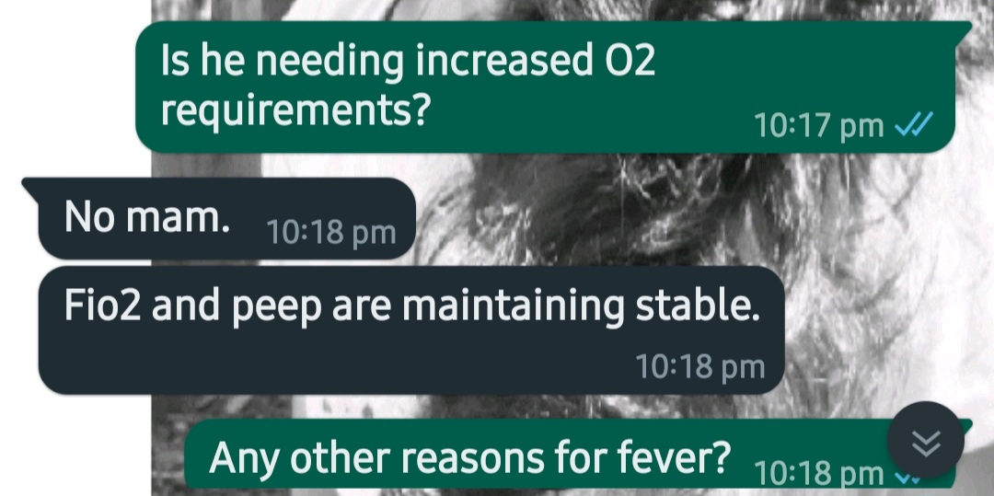

Slide 24
Fever in ICU
Normal body temperature is approximately 37°C (98.6°F) and ranges from 36.0 to 37.5°C (96.8 to 99.5°F)
A joint task force from the American College of Critical Care Medicine and the Infectious Diseases Society of America defined fever as a body temperature of 38.3°C (101°F) or higher

Slide 25
Infectious causes of fever in the intensive care unit
Common causes
Bacteremia
Intravascular catheter-related infection
Surgical site infection
Ventilator-associated pneumonia
Urinary tract infection
Other causes
Cellulitis
Cholangitis
Diverticulitis
Empyema
EndocarditisIntra-abdominal abscess
Meningitis
Myonecrosis
Necrotizing fasciitis
Pseudomembranous colitis
Septic arthritis
Sinusitis
Suppurative thrombophlebitis

Slide 26
Noninfectious causes of fever in the intensive care unit
Important causes
Acalculous cholecystitis
Adrenal insufficiency
Benign post-operative fever
Drug fever
Pancreatitis
Thyroid storm
Transfusion reaction
Other causes
Acute respiratory distress syndrome (late)
Burns
Drug overdose (eg, aspirin anticholinergic drugs)
Drug withdrawal
Gout
Heat stroke
Intracranial hemorrhage
Ischemic colitis
Malignancy
Malignant hyperthermia
Myocardial infarction
Neuroleptic malignant syndrome
Pheochromocytoma
Seizures
Serotonin syndrome
Thromboembolic disease
Vasculitis

Slide 27
In short…
16 infectious causes
&
24 non infectious causes
for fever in ICU other than VAP!!
& most are associated with leucocytosis!!

Slide 28
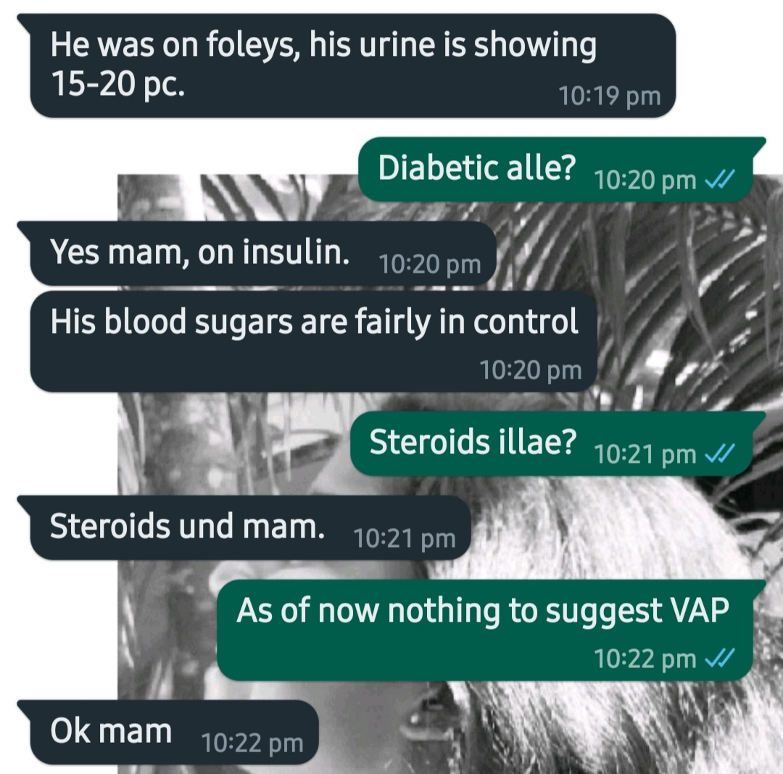

Slide 29
SO…
Is Nelson evolving into a VAP?
Or is it just a UTI?

Slide 30
At cross roads…
What next?
Wait for new symptoms/signs?
Change to an empirical antibiotic for VAP/UTI?
Send cultures & wait for results?

Slide 31
Waiting means a lot!!
Waiting for the condition to worsen
Losing valuable time
Probability of losing the patient!

Slide 32
And the worst part is..
We don’t have a clinical, microbiological, or pathologic diagnostic “gold standard” for the diagnosis of VAP !

Slide 33
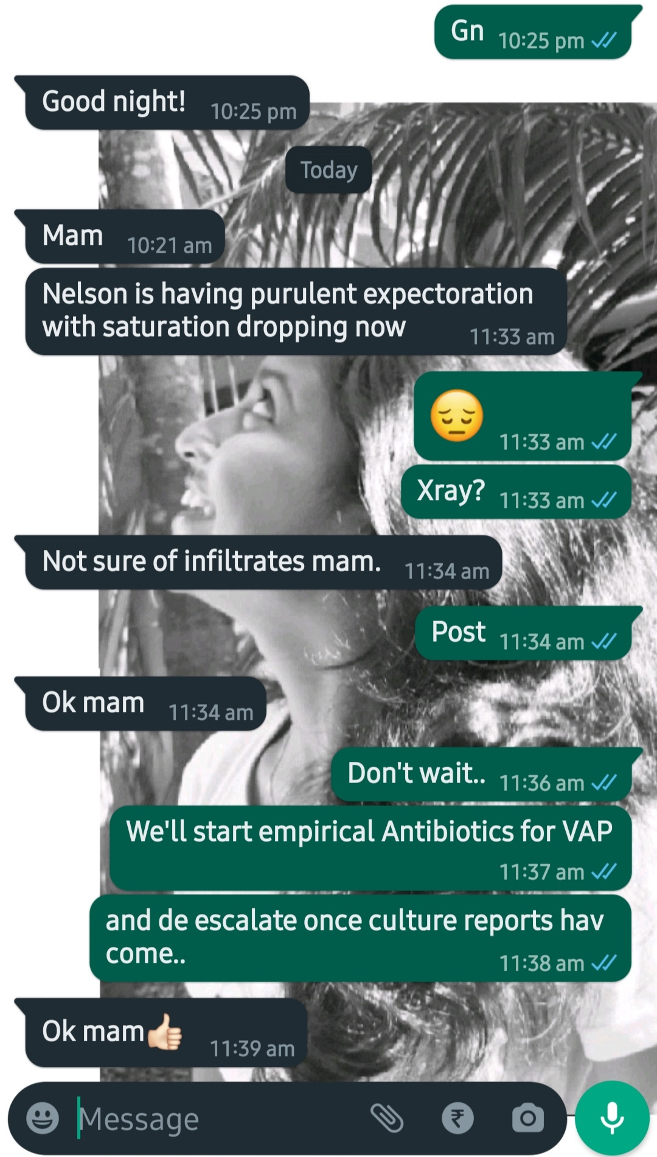
Going back to conversations…

Slide 34
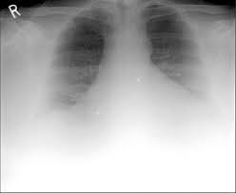
Xray of Nelson
Even I was not sure whether there were any infiltrates!!

Slide 35
Many commonly used VAP definitions, require radiographic findings of pneumonia.
&
May be that’s the most confusing!!

Slide 36
Evidence suggests that…
Chest radiograph findings do not accurately identify VAP !!
There is subjectivity and variability in chest radiograph technique, interpretation, and reporting!!
Confusion every where!

Slide 37
If …
….there is an increasing O2 requirement with lung infiltrates
Are you closer to VAP?

Slide 38
Closer but still you have other reasons!
Ventilator-associated pneumonia (VAP)
Sepsis
ARDS
Pulmonary embolism
Barotrauma
Pulmonary edema

Slide 39
So what next?
VAP is a clinical diagnosis made in a patient who has been mechanically ventilated for ≥48 hours who develops a new or progressive lung infiltrate on imaging with clinical evidence that the infiltrate is of infectious origin (eg, fever, purulent sputum, leukocytosis, and decline in oxygenation), together with a positive pathogen identified on microbiologic respiratory sample

Slide 40
More chats!

Slide 41
It’s ok to wait now…
VAP cannot be confirmed or excluded until the culture results are complete, which generally takes two to three days; thus the diagnosis is retrospective during which time empiric therapy is ongoing.

Slide 42
Finally the much awaited culture reports come!!
We shall discuss two scenarios!

Slide 43
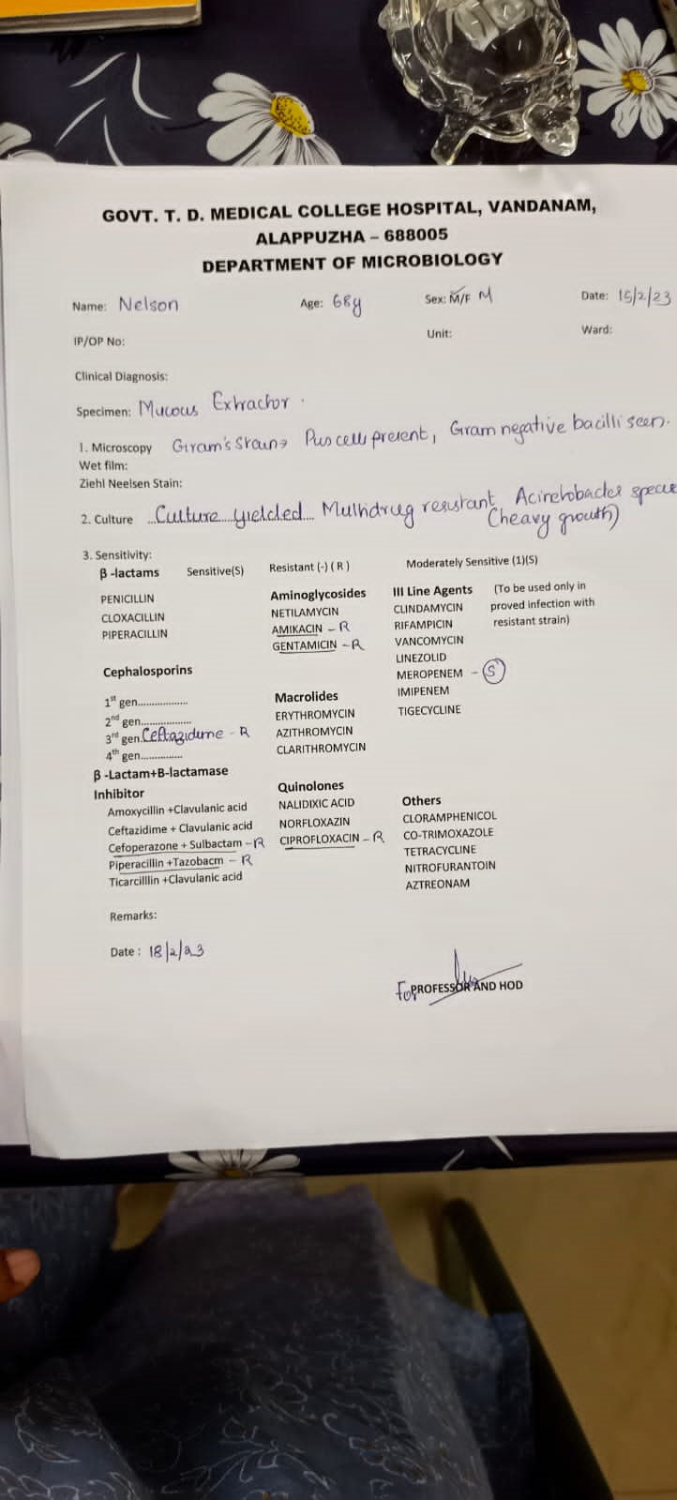

Slide 44
We know that…
The ETT is colonized with bacterial laden secretions as early as 12 hrs
In pre existing lung disease or prior antibiotic use there can be colonization with Pseudomonas,Acinectobacter or MRSA !

Slide 45
Presence of large quantities of bacteria in the airways doesn’t mean that lung should be infected!

Slide 46
SO WHAT IS IT??
THAT’S A MILLION DOLLAR QUESTION!!
Colonizer
Or
Infection?

Slide 47

Situations of uncertainty – Hero or villain?

Slide 48
It’s known that…
Quantitative cultures are better than qualitative cultures
Quantitative BAL cultures are better than quantitative ETT aspirates
This brings out a larger alveolar sample with minimal airway contamination.

Slide 49
The problem is..
It is more invasive
Needs technical expertise
Risk of complications like hypoxemia & barotrauma in an already unstable patient !

Slide 50
The worst part is
All cultures can be affected by antibiotics !

Slide 51
Whatever… how do you know it’s colonizer or infection?
VAP is supported if an established threshold of bacterial growth is exceeded.
ETT aspirate >100000 cfu/ml
BAL >10000 cfu/ml.
Please note that: Quantitative cultures are more labor intensive & more costly.
Most laboratories routinely do not perform this

Slide 52
Stay calm !
Decisions based on noninvasive sampling with semiquantitative cultures did not affect the clinical outcomes when compared to quantitative invasive sampling!!

Slide 53
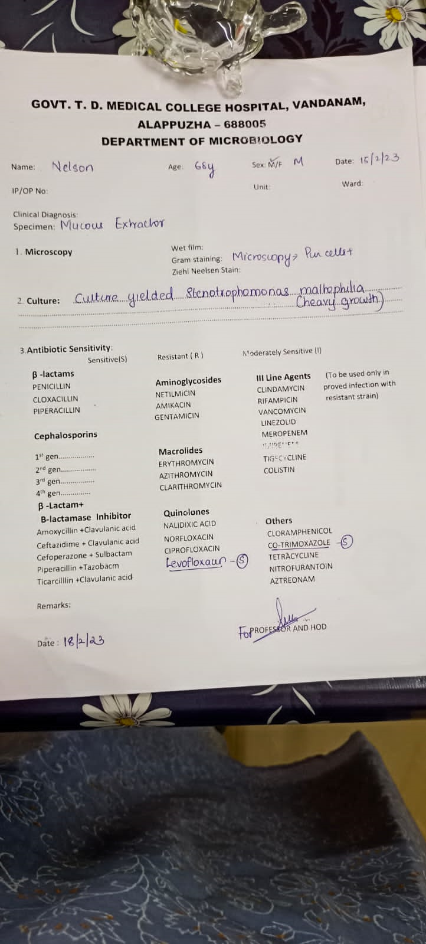
The next scenario!

Slide 54


What now??!!

Slide 55


Most such situations ends with a…

Slide 56
That’s the anticlimax!!
The lessons learned are…
Confusions are real when dealing with VAP
We need an evidence based common sense in dealing with most of the clinical situations.
Antimicrobial resistance is also real & is a great global crisis .
THE FUTURE OF ANTIBIOTICS DEPENDS ON ALL OF US!!

