Slide 1
Involuntary Movements
DR HARISH KUMAR A
JR1

Slide 2
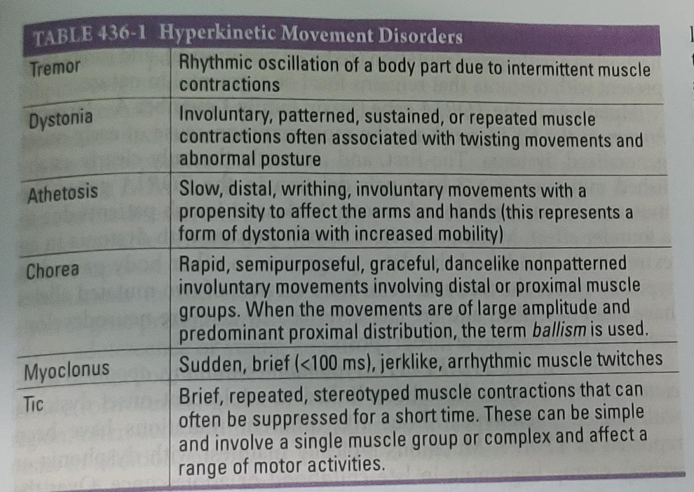

Slide 3
tREMOR
Tremor is defined as involuntary rhythmic oscillatory movement of a body part with alternating contractions of agonist and antagonist muscles
Types :
Rest tremor: prominent at rest
Postural tremor: on assuming a posture
Kinetic tremor: on actively reaching for a target
Action tremor : on carrying out a movement

Slide 4
PHYSIOLOGICAL TREMOR
It manifest as mild, high frequency (10-12 Hz), postural , or action tremor typically affecting the upper extremities
10% of population can have enhanced physiological tremor in association with anxiety, fatigue, hyperthyroidism , drugs( valproate , lithium ) or toxins ( caffeine, smoking , alcohol )
Treatment involves control of underlying disorder and can be improved with beta blockers

Slide 5
ESSENTIAL TREMOR
Most common movement disorder
High frequency tremor (6-10 Hz ) affecting upper extremities
Manifest as action or postural
Typically bilaterally symmetrical but can also begin on one side and remain asymmetric

Slide 6
Tremor involves Head in 30% cases, voice in 20%, tongue in 20% ,face/jaw in 10% , and in lower limb 10%.
The tremor is characteristically improved by alcohol and worsened by stress

Slide 7
Treatment
Many cases are mild ; no functional impairment and hence needs only reassurance
In severe cases, beta blocker and primidone are standard drug therapies and are useful in about 50% of cases
Botulinum toxin may be useful for limb and voice tremor
Surgical therapies targeting Ventro-intermediate nucleus of thalamus effective in drug resistant cases

Slide 8
Tremors associated with Parkinson Disease are resting tremors
In cerebellar disorder characterized by kinetic tremor associated with hypotonia and past pointing

Slide 9
DYSTONIA
Dystonia is a movement disorder characterised by sustained or intermittent muscle contractions of agonist/antagonist muscles causing abnormal, often repetitive movements and postures

Slide 10
Characteristics
It is initiated or worsened by voluntary action
Associated with overflow muscle activation( refers to extension to involve muscle groups and body regions not required for the intended action)
It can be aggravated by stress and fatigue and attenuated by relaxation and sensory tricks( like touching the affected body part )
Dystonia can be associated with tremor “dystonic tremor” which is more pronounced when the body part is moved in the direction of dystonia

Slide 11
Classification
Based on clinical and etiological basis
Clinical :
1) Age of Onset - infancy , childhood , adolescence , early and late adulthood
2) Body Distribution – Focal , segmental , multifocal , and generalised
3) Temporal – static or progressive, action specific (diurnal and paroxysmal )

Slide 12
Etiological :
1) Genetic : includes childhood onset and generalised forms of dystonia
2) following Trauma or Stroke

Slide 13
Isolated Dystonias
Focal, Multifocal, and segmental dystonia –
Examples include Cervical dystonia ,Blepharospasm , Oromandibular dystonia , Spasmodic dysphonia , limb dystonia
Generalised dystonia : hereditary in nature and onset in childhood or adolescence
There are 7 well established genes which when mutated would lead to generalised dystonia : TOR1A,THAP1,ANO3,GNAL,KMT2B,PRKRA, and HPCA

Slide 14
COMBINED DYSTONIA
Refers to dystonia occurring with a different movement disorder
Examples include Segawa syndrome , X linked dystonia-parkinsonism, Myoclonic dystonia
Segawa syndrome- Dopa responsive dystonia, GCH 1 gene mutation
X-linked dystonia parkinsonism – Filipino origin patients, starts as dystonia , generalises and then replaced by l-dopa unresponsive parkinsonism
Myotonic dystonia- action induced , alcohol responsive, related to mutation in SGCE gene

Slide 15
COMPLEX DYSTONIA
In this dystonia is a part of syndrome ; as if dystonia is the less prominent feature as the disease itself has varied prominent clinical manifestations
Hereditary- Wilsons disease , Huntington’s disease , Lesh Nyhan Syndrome , corticobasal ganglionic disorders
Consequence of Drugs or Toxins – usage of neuroleptic drugs , chronic levodopa treatment in PD, manganese or CO toxins
Psychogenic origin – present with fixed immobile dystonic postures

Slide 16
TrEATMENT
In young patients , rule out Wilson’s disease
Childhood dystonia- start levo-dopa to rule out DRD
High-dose anticholinergics ( trihexyphenidyl 20-120mg/d) beneficial in children
Oral baclofen ( 20-120mg) – benefit modest however side effects are problematic(sedation,weakness)
Clonazepam and diazepam are also sometimes effective

Slide 17
For focal and segmental dystonia – Botulinum toxin is preferred especially for blepharospasm, torticollis, and spasmodic dysphonia
Surgical Therapy like DBS of pallidum can provide dramatic benefits for some patients with various forms of hereditary and non hereditary generalised form of dystonia

Slide 18
Athetosis
Slow , distal, writhing , involuntary movements with a propensity to affect the arms and hands , toes , feet , neck and tongue
This represents a form of dystonia with increased mobility
This is due to degeneration of GP of Basal ganglia
Most commonly caused by complications at birth(intranatal asphyxia and neonatal jaundice) or by huntington’s disease
Rarely it is due to trauma or stroke

Slide 19
CHoreas
Huntington’s Disease
It is characterised by rapid, non patterned , semi purposeful, involuntary choreiform movements
Autosomal Dominant disease with age of onset 25-45 years
In early stages, chorea tends to be focal or segmental , but progresses to multiple body regions
With advancing disease, there is reduction in chorea and emergence of dystonia, rigidity, bradykinesia and myoclonus
They develop behavioural and cognitive disturbances and progress to dementia

Slide 20
MRI
Disease predominantly affects striatum but progress to involve cerebral cortex and other brain regions
Progressive atrophy of the head of caudate nucleus which forms the lateral margin of lateral ventricle is seen on MRI, but putamen can be equally or more severely affected
More diffuse cortical atrophy can be seen in middle and later stages of disease

Slide 21
There is no disease modifying therapy for this disorder and symptomatic treatment is limited
Deuterated Tetrabenazine approved treatment for chorea in HD
Depression and anxiety can be major problems and patient should be treated with appropriate anti depressants and anti anxiety
Psychosis should be treated with atypical anti psychotics like clozapine(50-600mg/d),quetiapine (50-600mg/d) and risperidone ( 2-8mg/d)

Slide 22
Other choreas
Chorea can be seen in number of additional disorders related to genetic mutations or other disease states
Childhood onset chorea- NKX2-1 gene and ADVCY5 gene
Chorea-acanthocytosis – AR disorder – chorea with acanthocytes in blood
Sydenham’s chorea- develops in association with prior exposure to group A streptococcal infection and is autoimmune in nature
Chorea gravidarum – in association with pregnancy or treatment with sex hormones

Slide 23
Choreas have been associated with :
SLE
Hyperthyroidism
Sjogren’s syndrome
Polycythemia vera rubra
Drugs- cocaine , CNS stimulants , estrogen , and lithium ,chronic levo dopa treatment in PD

Slide 24
BALLISM/HEMIBALLISMUS
Ballism is a violent form of choreiform movement composed of wild, flinging, large – amplitube movements most frequently affecting proximal limb muscles on one side of the body ( hemiballism ).
Most common cause is a partial lesion (infarct or hemorrhage) in subthalamic nucleus(STN), but in 30-40% of cases the lesion is found in the putamen, thalamus, or parietal cortex
Dopamine blocking agents can be used; hemiballismus is usually self limiting and tends to resolve spontaneously after weeks or months
In extrme cases , pallidotomy or DBS of GPi can be effective

Slide 25
TICS
A tic is a brief, rapid, recurrent, stereotyped, and seemingly purposeless motor contraction.
Motor tics- simple ; with movement affecting only single muscle group ( blinking, twitching of the nose , jerking of the neck ) , or complex-co-ordinated movement of multiple muscle group( jumping, sniffing, head banging and echopraxia )
Phonic tics – simple(grunting) , complex( echolalia, palilalia , coprolalia )
Sensory tics – unpleasant focal sensations in the face, head or neck.

Slide 26
TOURETTE’S SYNDROME
It is a neurobehavioral disorder characterised by motor tics and phonic tics
They can voluntarily supress the tics for shorter periods of time ,but then express an irresistible urge to express them
Tics vary in intensity and may be absent for days or weeks only to recur in different pattern
They present with 2-15 years and tend to lessen with age and even disappear in adulthood

Slide 27
treatment
Patients with mild disease often require education and counselling ; in high proportion of patients, tics wane off in adulthood thus arguing for conservative management
Drugs are indicated when tics are disabling; clonidine , guanfacine ; both alpha blockers have been tried
Atypical neuroleptics like risperidone, olazepine and ziprasidone is tried
If they are not working, classical neuroleptics like haloperidol, fluphenazine, pimozide or tiapride

Slide 28
MYOCLONUS
Myoclonus is a brief , rapid , shock-like , jerky movement consisting of single or repetitive muscle discharges.
It can be focal, multifocal, segmental , generalised or in association with voluntary movement(action myoclonus) or in response to external stimulus ( reflex myoclonus )
Negative myoclonus-brief loss of muscle activity ( asterixis in hepatic failure)

Slide 29
Unlike tics, myoclonic jerks are not repetitive , can severely interfere with normal voluntary movement, and are not suppressible
They are found in association with hypoxemia(especially following cardiac arrest), encephalopathy and neurodegeneration.
Reversible myoclonus seen in metabolic disturbances ( renal failure, electrolyte imbalance, hypocalcemia ) , toxins and many medications

Slide 30
treatment
Managing underlying condition or removing the offending agent
Pharmacological therapy involves combining one or more of GABAergic drugs like valproic acid, piracetam, clonazepam, levetiracetam, or primidone
DBS highly effective in myoclonic dystonia

Slide 31
Thank you

