Slide 1
ISCHEMIC MYELOPATHY
DR. MONET PHILIPOSE

Slide 2
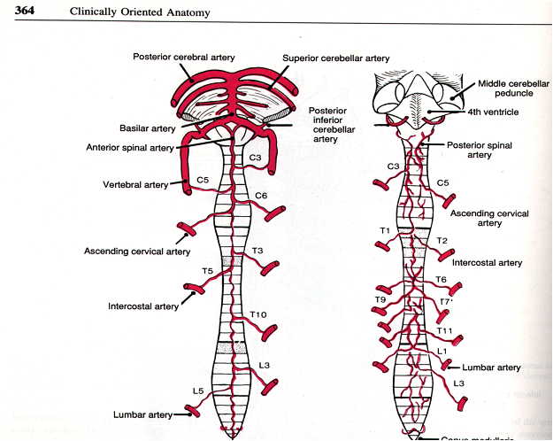
BLOOD SUPPLY OF SPINAL CORD
Anterior and posterior spinal arteries.
Branches of vertebral artery
These vessels extend longitudinally along the length of the spinal cord.

Slide 3
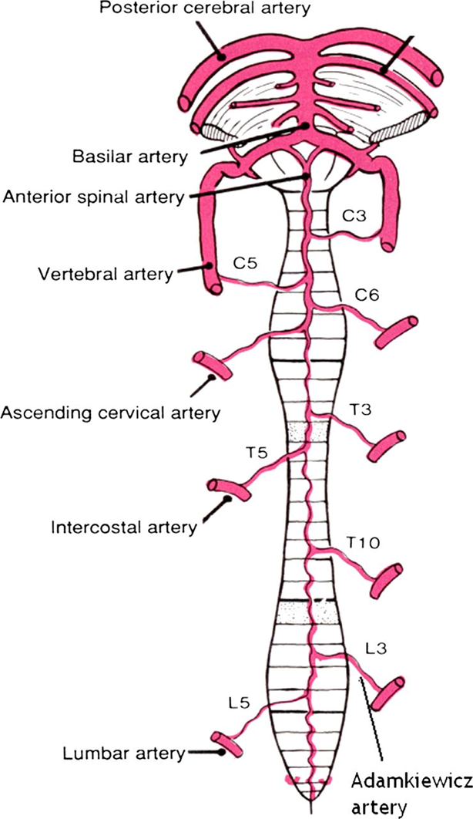
Anterior spinal artery
It is an anastomotic channel in the midline anteriorly.
ASA is a continuation of paired vessels, one each from near the termination of each of the two vertebral arteries .
Course ventromedially around the medulla to unite at the level of the foramen magnum to form a single ASA and continues up to conus medullaris.

Slide 4
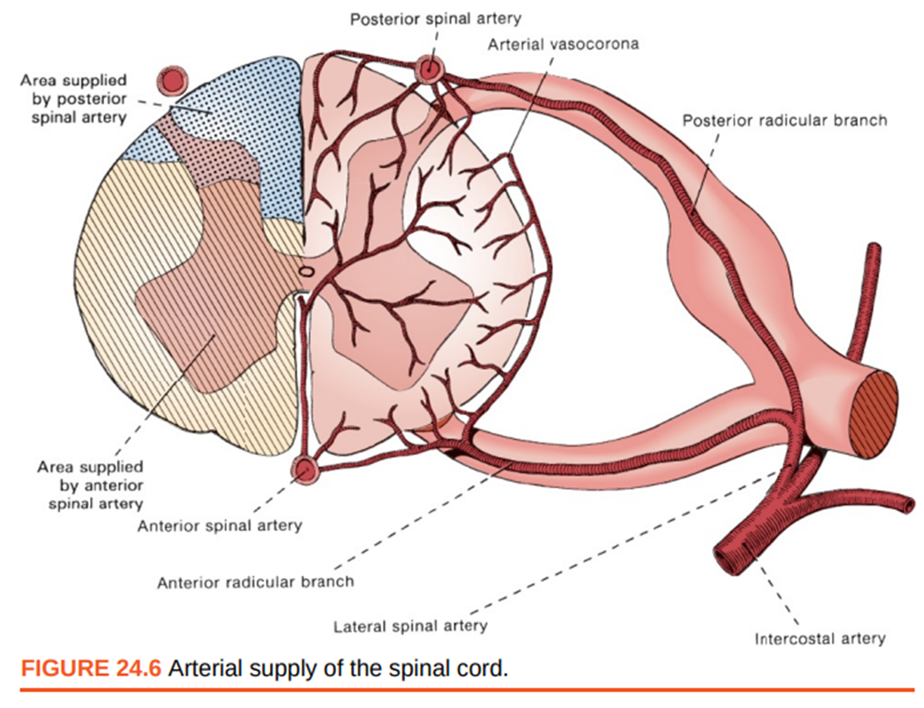
Along its course, the ASA is augmented by radicular arteries.
These small arteries enter the spinal canal through the intervertebral foramen.

Slide 5
From the ASA, sulcal arteries run into the center of the cord and then branch to the right or the left to supply the deep structures of the spinal cord
The ASA also contributes to a peripheral arterial plexus, which gives off radial branches to supply the periphery of the cord.
The ASA supplies blood to the anterior horns of the gray matter, spinothalamic tracts, and corticospinal tracts.
,.

Slide 6
PSA
Paired PSAs originate- vertebral arteries
Occasionally arise from the posterior inferior cerebellar arteries.
Distinct single vessels only at their origin, the PSAs are plexiform channels.

Slide 7
Travel the length of the cord in the posterior lateral sulci bilaterally.
The PSAs vary greatly in diameter throughout their course and may even be discontinuous.
The PSAs are supported by a greater number of radicular arteries than the ASA, commonly between 10 and 20
The PSAs supply the dorsal columns and the posterior horns.

Slide 8
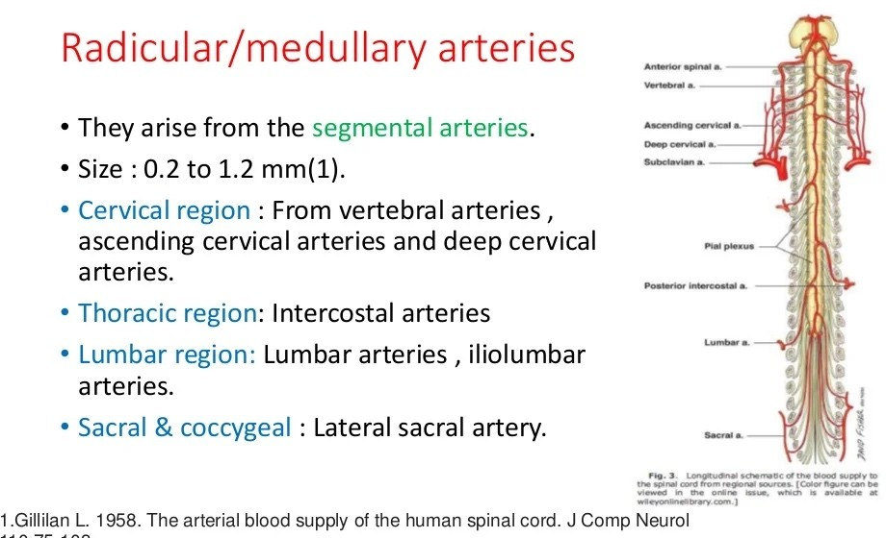
o
.

Slide 9
The typical segmental artery divides into anterior and posterior rami,the latter bifurcates, sending off a spinal branch that traverses the intervertebral foramen
The lateral spinal artery divides into anterior and posterior radicular arteries.
These vessels are referred to as radicular/ radiculomedullary,or medullary arteries .

Slide 10
The medullary arteries course anteriorly or posteriorly (but typically not both) and contribute blood to the ASAs or PSAs, which distribute blood to the spinal cord.
They are asymmetric and can reach the cord from either the right or left side, but usually not both sides at the same segmental level.
The posterior medullary arteries,which are smaller and more numerous than their anterior counterparts.
Posterior medullarv arteries supply the ipsilateral PSA,becomes narrower in the lumbosacral area.

Slide 11
The thoracic spinal cord is particularly dependent on radicular contributions.
Midthoracic cord is most vulnerable to infarction due to watershed zones.
Most prominent thoracic radicular artery is the artery of Adamkiewicz, - the artery of the lumbar enlargement.
It contributes to the ASA between the T9 to T12 level in 75 percent of individuals, but may be found above and below this level.

Slide 12
Vasa coronae and penetrating vessels.
The ASAs and PSAs give rise to surface vessels that form a vascular ring, or vasa coronae, around the spinal cord, and to penetrating vessels that supply the interior of the spinal cord .
Branches penetrating and supplying the spinal cord arise from the vasa coronae as well as the ASA and PSAs.

Slide 13
Central (sulcal) arteries.
The largest of the penetrating vessels are the central arteries. They are branches of the ASA that penetrate the cord through the anterior median fissure
The central artery supplies the white matter bordering the central sulcus, the gray matter of the anterior horn, and the deep gray matter of the posterior horn.

Slide 14
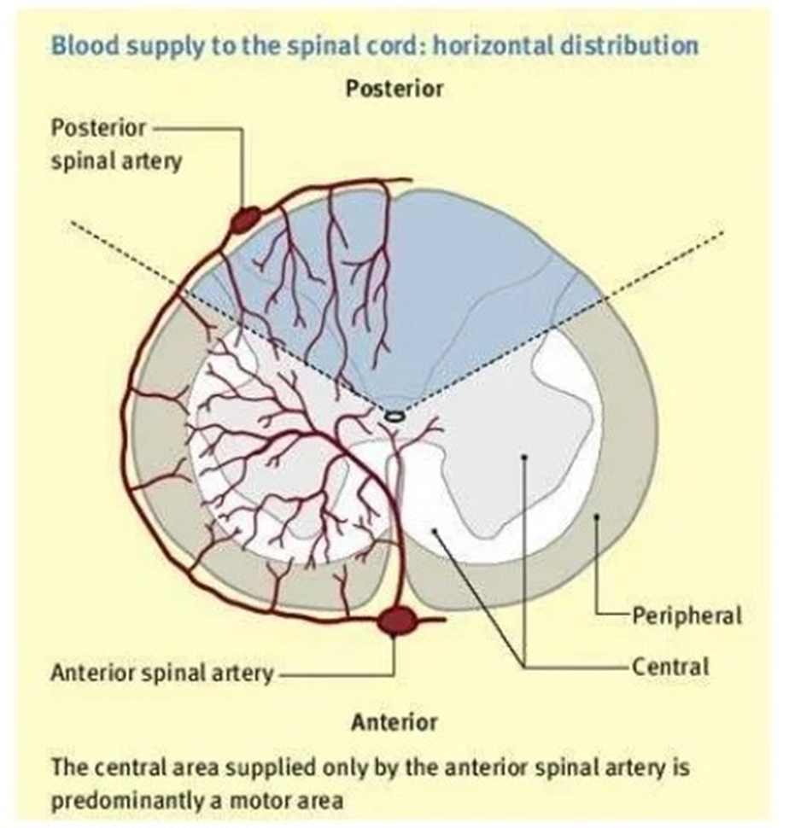

Slide 15
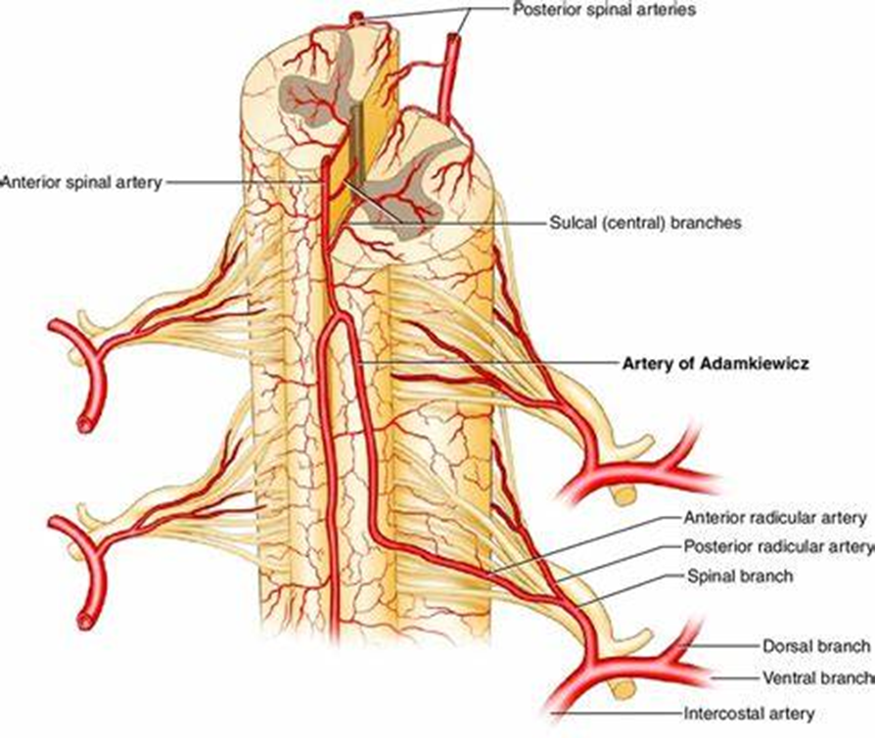

Slide 16
Venous system
Two major spinal veins, one anterior and one posterior, drain into a series of radicular veins, then into intravertebral and paravertebral plexuses, and finally into the azygous and pelvic venous systems.
Because spinal veins contain no valves, Valsalva and increased intra-abdominal pressure can lead to increased venous pressure and decreased spinal cord perfusion

Slide 17
SPINAL CORD ISCHEMIA
The mechanisms underlying these can be broadly categorized:
Diseases or procedures involving the thoracoabdominal aorta
Intrinsic arterial occlusion resulting from arteriosclerosis, vasculitis, infection, embolic occlusion, thrombosis
Hypoperfusion
Venous infarction

Slide 18
Aortic surgery —
Surgery to repair thoracic and thoracoabdominal aortic aneurysms is the most common cause of spinal cord infarction.
Rates of spinal cord ischemia following thoracic aortic surgery have been reported to be as high as 29 percent.
Both open surgery and endovascular repair are associated with spinal cord ischemia.

Slide 19
Aortic dissection —
spinal cord ischemia as the presenting symptom of aortic dissection is more unusual
Typically, spinal cord infarction in this setting involves the mid and lower thoracic cord levels.
Severe "tearing" pain and abnormal distal pulses suggest this diagnosis

Slide 20
Systemic hypotension — spinal cord is vulnerable to ischemic injury during episodes of systemic hypotension (eg, cardiopulmonary arrest, systemic bleeding)
Vascular malformation — most common presentation of a spinal vascular malformation is that of a progressive, step-wise myelopathy.
Vertebral artery atheroma and dissection - associated with rostral cervical cord infarction

Slide 21
Fibrocartilaginous embolism —
a rare phenomenon that can cause spinal cord infarction.
FCE originates from herniated intervertebral discs.
Most cases involve the cervical cord; some involve the lower medulla or upper thoracic cord.
Neck pain typically precedes neurologic symptoms by 15 minutes to 48 hours

Slide 22
Both inherited and acquired hypercoagulable conditions as well as sickle cell disease, which appear to underlie some cases of spinal cord infarction
Cervical spondylosis - a cause of spinal cord infarction, perhaps by causing dissection or compression of a radicular artery
Cocaine-related arteriopathy
Emboli from a variety of cardiogenic sources (artificial valves, vegetations)

Slide 23
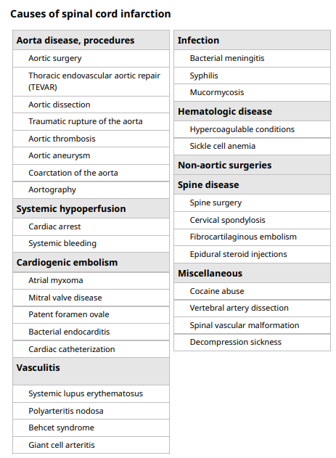

Slide 24
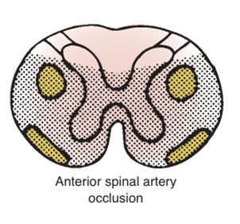
ANTERIOR SPINAL ARTERY SYNDROME
Typical ASA infarct pattern:
With involvement of anterior two-thirds of cord involving gray and white matter, causing bilateral weakness, dissociative sensory loss with or without autonomic symptoms.
The acute stages are characterized by flaccidity and loss of deep tendon reflexes;
spasticity and hyperreflexia develop over days and weeks

Slide 25
Incomplete pattern:
a) Involvement localized at the level of the anterior horns.
Clinical manifestation may be in form of:
i) Acute paraplegia (pseudo poliomyelitic form) without sensory abnormalities and without sphincter dysfunction
ii) Painful bilateral brachial diplegia in the case of a cervical lesion (the MIB syndrome).
iii) Progressive distal amyotrophy due to chronic lesions of the anterior horns; this form may be misdiagnosed as lateral amyotrophic sclerosis.

Slide 26
b) Sulco commissural syndrome presents as a partial Brown-Sequard syndrome
The syndrome consists of hemiparesis with a contralateral spinothalamic sensory deficit.
c) Central spinal infarct
occurs after cardiac arrest or prolonged hypotension.
Clinical presentation includes bilateral spinothalamic sensory deficit with sparing of the posterior columns.
Motor deficit and sphincter dysfunction are usually absent.

Slide 27
3. Another rare presentation - transverse medullary infarction (full transverse lesions)
presenting with sudden inability to walk due to paraplegia/paraparesis or tetraplegia/tetraparesis (in higher cord lesions).
There may be complete sensory loss involving all modalities and pain reported as circumferential tightness.
Autonomic dysfunction is noted.
Usually it is of embolic origin.

Slide 28
POSTERIOR SPINAL ARTERY SYNDROME
Clinical pattern of PSA infarction:
Because of presence of two posterior spinal arteries, this syndrome is usually unilateral and less severe.
Syndrome leads to ipsilateral loss of light touch, vibration, and proprioception and total anesthesia at the level of lesion .
However, there can be segmental deep tendon areflexia due to posterior horn involvement and paresis below the level at which the posterior portion of the cord is affected.

Slide 29
VENOUS INFARCTION OF SPINAL CORD
It is described, usually in association with spinal vascular malformations.
These infarcts may be either hemorrhagic or non hemorrhagic.
In non hemorrhagic venous infarcts, venous hypertension decreases the arterial-venous pressure gradient leading to decreased perfusion .
Nonhemorrhagic venous infarction - presents with a gradual onset of progressive neurologic decline
whereas hemorrhage is associated with the sudden onset of pain and flaccid paraparesis

Slide 30
Dural arteriovenous fistula - most common type .
These exist on the dural surface and drain intradurally by retrograde flow through a single medullary vein to the anterior or posterior median vein, resulting in engorgement of the coronal venous plexus.
Usually present after the fifth decade of life
More common in men.
Most common clinical presentation - progressive, often stepwise myeloradiculopathy, probably related to venous hypertension.
Some patients present with neurogenic claudication .

Slide 31
Intramedullary spinal arteriovenous malformations (AVMs) are supplied by medullary arteries and drain through medullary veins
Mean age at clinical presentation - mid-20s,
but ~ 20 percent of the lesions are diagnosed in children under 16 years of age .
A myelopathy is produced by the mass effect of the lesion or by ischemia or hemorrhage into the cord.
Some patients may present with subarachnoid hemorrhage

Slide 32
DIAGNOSIS
The diagnosis of spinal cord infarction is made in the setting of a compatible clinical syndrome: rapidly developing myelopathic deficits in the absence of another identifiable etiology by history, examination
Spinal MRI — MRI is required in the diagnosis of spinal cord infarction.
MRI can also provide confirmatory evidence to the underlying etiology of ischemia
MRI changes associated with spinal cord ischemia include hyperintensities on T2-weighted and short-tau inversion recovery images(STIR).

Slide 33
A finding of restricted diffusion on diffusion-weighted images (DWI-MRI) appears to be significantly more sensitive than standard T2 images.
The finding of vertebral body infarction adjacent to a cord signal abnormality on MRI is a specific indicator of ischemia and a useful confirmatory sign if present.

Slide 34
MRI is sensitive for intramedullary AVM, showing a cluster of low-intensity signal foci.
Contrast-enhanced MRA also helps localize the nidus and identify arterial supply and venous drainage
MRI with contrast-enhanced magnetic resonance angiography (MRA) can identify a dural arteriovenous fistula .
The most common finding is a nonspecific hyperintense signal lesion on T2-weighted images, intradural flow voids on T2-weighted images.

Slide 35
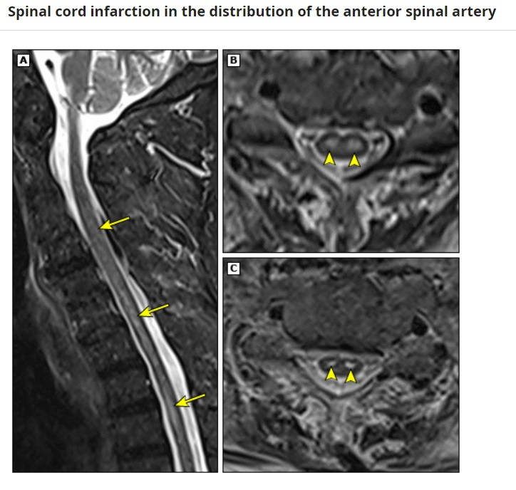
Sagittal STIR MRI image (A) shows hyperintensity in lower cervical and upper thoracic cord (arrows). Axial turbo spin-echo T2-weighted images (B, C) show hyperintensities in the ventral horns of the central gray matter ("owl's eyes sign") consistent with acute cervicothoracic cord infarction (arrowheads).

Slide 36
Aortic dissection can be identified by multiplane transesophageal echocardiography (TEE), chest computed tomography (CT)
Echocardiography can be performed to look for a source of embolism
CT angiography or MRA , should be performed to exclude a vertebral artery dissection in a patient with a rostral cervical cord infarction.

Slide 37
Blood tests to evaluate a possible hypercoagulable condition should be performed when the cause of spinal cord infarction is obscure, particularly in younger patients and those without vascular risk factors.
Rheumatologic tests (ESR, ANA, ANCA, and SSA/B antibodies) could be considered.
A lumbar puncture and cerebrospinal fluid (CSF) analysis should be performed in younger patients to look for signs of infection or inflammatory diseases.

Slide 38
TREATMENT
General care
Thrombolysis — Thrombolytic therapy for spinal cord ischemia remains investigational at this time.
The use of antiplatelet treatment in patients with underlying vascular risk factors or comorbid vascular disease is recommended to prevent other secondary atherothrombotic events.

Slide 39
Following aortic surgery or endovascular repair —
  A specific protocol has been developed that appears to be effective in reversing or limiting the neurologic deficits from spinal cord ischemia after aortic surgery and thoracic endovascular aortic repair .
  This employs a combination of blood pressure support and reduction of spinal cord canal pressure with lumbar drains

Slide 40
THANK YOU.

