Slide 1
INHERITED HEMOLYTIC ANEMIAS
DR AMRITA KURIAN
JUNIOR RESIDENT

Slide 2
INTRODUCTION
Hemolytic anemia – classification :
Inherited / Acquired
Acute / Chronic
Intravascular / Extravascular
Intracorpuscular / Extracorpuscular

Slide 3
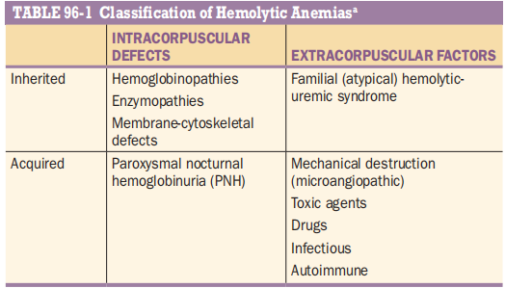

Slide 4
CLINICAL FEATURES
Jaundice
Pallor
Splenomegaly
Hepatomegaly
Skeletal changes

Slide 5
Lab features
ATTRIBUTABLE TO HEMOLYSIS
Hb: normal to severely reduced
Extravascular hemolysis:
  Raised Unconjugated Bilirubin, AST
  Raised urobilinogen in stool and urine

Slide 6
Intravascular hemolysis:
  Hemoglobinuria
  Free Hb in serum
  Raised LDH
  Low haptoglobin
  S.bilirubin may be normal

Slide 7
Attributable to Bone marrow response:
  Increased reticulocytes
  Increased MCV, MCH
  Peripheral smear – macrocytes polychromasia, nucleated RBC
  BM aspirate - erythroid hyperplasia

Slide 8
Essential pathophysiologic process in all hemolytic anemia: Increased Red cell turnover
Chronic intravascular hemolysis
  Persistent hemoglobinuria
  Signficant iron loss
Chronic extravascular hemolysis
  Iron overload
  Secondary hemochromatosis

Slide 9
INHERITED HEMOLYTIC ANEMIAS
Due to abnormalities of
  Hemoglobin (hemoglobinopathies)
  Membrane – Cytoskeleton complex
  Metabolic machinery to keep hemoglobin and membrane cytoskeleton complex in working order

Slide 10
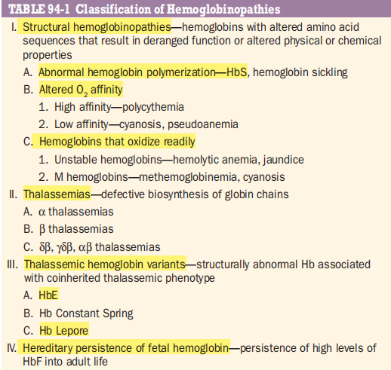
HEMOGLOBINOPATHIES

Slide 11
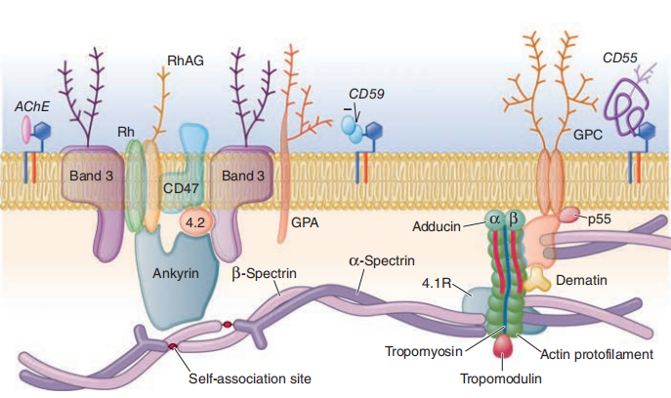
Ha due to abnormalities of membrane cytoskeleton complex

Slide 12
A lipid bilayer of phospholipids and cholesterol
Some proteins have their hydrophobic transmembrane domains embedded in the membrane with extracellular and intracellular extension
Others tethered to the membrane through a GPI anchor; having only an extracellular domain.
The most abundant red cell membrane proteins are glycophorins and Band 3, an anion transporter

Slide 13
Underneath the membrane, a network of proteins form the cytoskeleton
SPECTRIN (alpha spectrin and beta spectrin) –the main cytoskeletal protein
ANKYRIN ,Band 4.1 and Band 4.2 – link the membrane to the cytoskeleton

Slide 14
The membrane-cytoskeleton complex
  Is an envelope for the red cell cytoplasm
  maintains the normal red cells shape,
  provides highly specific cross-membrane transport of electrolytes and of metabolites such as glucose.
An abnormality of almost any of the components of the complex - structural or functional failure - alteration of normal biconcave disk shape of RBCs - hemolysis

Slide 15
HEREDITARY SPHEROCYTOSIS
Common, 1 in 5000
Identified by Minkowksy and Chauffard
RBCs abnormally susceptible to lysis in hypotonic media – OSMOTIC FRAGILITY
Heterogenous – arise from variety of mutations in one of several genes
Autosomal dominant (heterozygous) > Autosomal recessive (homozygous)

Slide 16
genetics
Gene | Protein produced | Comments
SPTA 1 | Alpha spectrin | 65 % HE (Hereditary Elliptocytosis)
SPTB | Beta spectrin | 30 % HE
ANK I | Ankyrin | Majority of HS (Hereditary Spherocytosis)
SLC4A1 | Band 3 | 25% HS
EPB41 | Band 4.1 | 5% HE

Slide 17
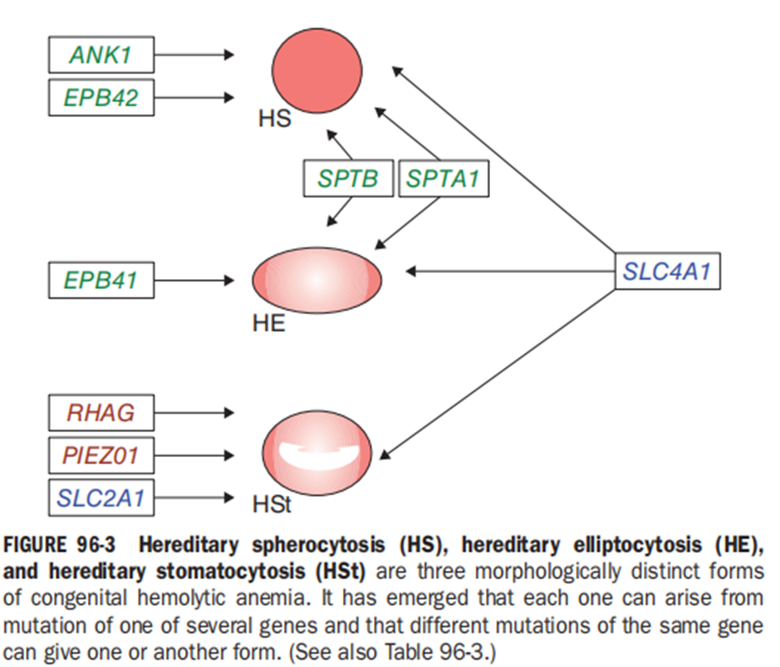

Slide 18
Clinical presentation
Severe cases : present with severe anemia in infancy
Mild cases : young adults or later
Jaundice
Splenomegaly
gallstones

Slide 19
In milder cases, hemolysis is often compensated.
But changes in clinical expression may be seen even in the same patient.
Intercurrent conditions (e.g., pregnancy, infection) may cause decompensation.
The anemia is usually normocytic, spherocytes (loss of central pallor )
Increased mean corpuscular hemoglobin concentration (MCHC >34)
HS is almost the only condition in which this abnormality occurs

Slide 20
Spleen : dual mechanism
Spleen itself is a major site of destruction
Transit through the splenic circulation makes the defective red cells more spherocytic
Accelerates their demise, even though that may take place elsewhere.

Slide 21
DIAGNOSIS
If family history +, diagnosis is easier
no family history? two reasons.
    de novo mutation
    recessive form of HS
Requires more extensive laboratory investigations.
  osmotic fragility test
  acid glycerol lysis test
  eosin-5′-maleimide (EMA)–binding test
  SDS-gel electrophoresis of membrane proteins and at times molecular studies

Slide 22
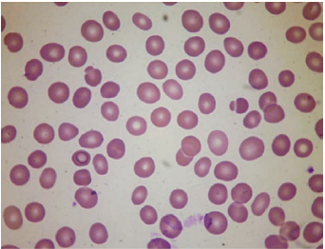

Slide 23
TREATMENT
No causal treatment
SPLENECTOMY– YES/ NO
Mild cases : avoid
Moderate cases : delay until puberty
Severe cases : splenectomy at the age of 4 – 6
Anti pneumococcal vaccination before splenectomy
Laparoscopic cholecystectomy when indicated

Slide 24
Hereditary elliptocytosis
Heterogenous
No direct correlation between morphology and clinical severity.
Spleen doesn’t have the specific role as it has in HS
Severe cases : splenectomy may be beneficial
SOUTHEAST ASIA OVALOCYTOSIS :
In frame deletion of 9 amino acids in the SLC4A1 gene encoding band 3
Asymptomatic in heterozygotes , lethal in homozygotes.

Slide 25
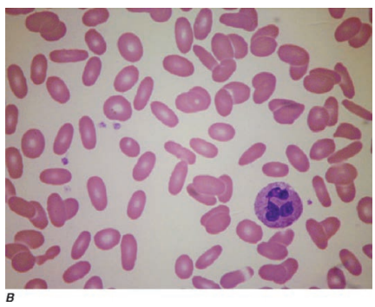

Slide 26
Disorders of cation transport
Autosomal dominant
Increased intracellular sodium, concomitant loss of potassium from cells
Incidental finding of pseudohyperkalemia
STOMATOCYTOSIS
When cation transport is associated with gain of water;
Red cells are overhydrated (low MCHC)
The normally round-shaped central pallor is replaced by a linear-shaped central pallor

Slide 27
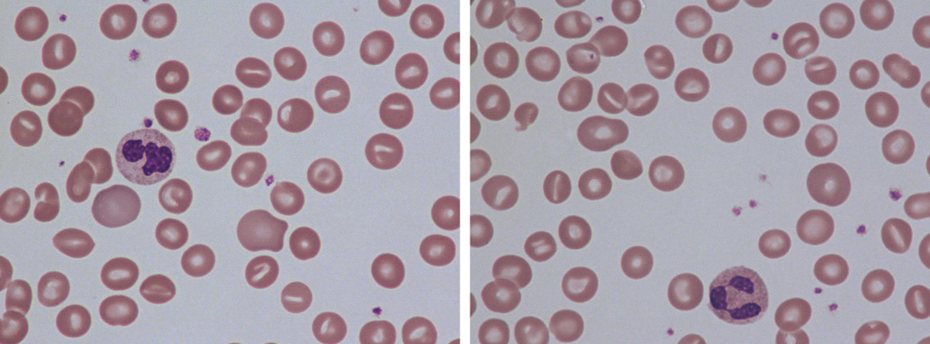

Slide 28
Mutations in
SLC4A1(encoding band 3),
the Rhesus gene RHAG,
the glucose transporter gene SLC2A1 (cryohydrocytosis)
In stomatocytosis splenectomy is strongly contraindicated
Followed by severe thromboembolic complications.

Slide 29
XEROCYTOSIS / DEHYDRATED HEREDITARY STOMATOCYTOSIS
Red cells are dehydrated (high MCHC), and they are consequently rigid
xerocytosis results from mutations in PIEZO1.

Slide 30
ENZYME ABNORMALITIES
When one of the enzymes is defective, the consequences depend on the precise role of that enzyme in the metabolic machinery of the red cell.
This machinery has two main functions:
(1) to provide energy in the form of ATP
(2) to prevent oxidative damage to hemoglobin and to other proteins by providing sufficient reductive potential; the key molecule for this is NADPH.

Slide 31
ABNORMALITIES OF THE GLYCOLYTIC PATHWAY
Red cells rely exclusively on the anaerobic portion of the glycolytic pathway for producing ATP
ATP is required by the red cell for cation transport against a concentration gradient across the membrane.
Defect of any of the enzymes of the glycolytic pathway : failed ATP production : hemolytic disease.
Pyruvate Kinase and Glucose 6 Phosphate Isomerase

Slide 32
PYRUVATE KINASE DEFICIENCY
Inherited
Rare 1:10,000
Clinical Picture
Homozygous (or biallelic) PK deficiency : HA that often presents in the newborn
  neonatal persistent jaundice;
  associated with reticulocytosis.

Slide 33
Anemia could be severe or mild (nearly compensated hemolytic disorder)
Since anemia is remarkably well tolerated – delay in diagnosis
Metabolic block at the last step in glycolysis
Increase in 2,3-bisphosphoglycerate (or DPG),
A major effector of the hemoglobin-oxygen dissociation curve;
Oxygen delivery to the tissues is enhanced, a remarkable compensatory feat.

Slide 34
TREATMENT
Supportive
Oral folic acid supplements in view of markedly increased red cell turnover.
Iron chelation
Blood transfusion when necessary
Severe disease, splenectomy may be beneficial (anemia improves, paradoxical increase in reticulocytes)

Slide 35
Single case report of curative treatment of PK deficiency by bone marrow transplantation (BMT) from an
HLA-identical PK-normal sibling.
Viable option for severe cases when a sibling donor is available.
Prenatal diagnosis has been carried out in a mother who had already had an affected child.
Ongoing trial : Rescue of inherited PK deficiency through lentiviral-mediated human PK gene transfer.

Slide 36
Other glycolytic enzyme abnormalities
Varying degrees of severity; from severe neonatal jaundice requiring exchange transfusion to incidental detection when a CBC is done for unrelated reasons.
Splenomegaly
CNS involvement (mental retardation in triose phosphate isomerase deficiency)
Neuromuscular system involvement
Investigations : TRIAD of normomacrocytic anemia, reticulocytosis, hyperbilirubinemia

Slide 37
Unlike membrane disorders, in glycolytic enzymopathies, specific morphologic abnormalities are absent
They should be considered as a differential in any Coombs negative HA.
In isolated cases of glycolytic enzyme abnormalities BMT has been carried out successfully
Unfortunately non-hematologic manifestations, if any, are not reversed.

Slide 38
Abnormalities of redox metabolism:
GLUCOSE 6 PHOSPHATASE DEHYDROGENASE (g6pd) deficiency
In red cells, G6PD - the only source of NADPH
  directly and via glutathione (GSH) defends these cells against oxidative stress.
G6PD deficiency-related HA
  HA due to interaction between an intracorpuscular cause and an extracorpuscular cause
  In the majority of cases hemolysis is triggered by an exogenous agent

Slide 39
GENETICS
X-linked
Males – hemizygous – normal or G6PD deficient
Females – normal or deficient (homozygous) or intermediate (heterozygous)
Heterozygous females – genetic mosaics
  Due to X-chromosome inactivation phenomenon
  Variable ratio of of G6PD-normal and G6PD-deficient cells
  Variable clinical expression

Slide 40
Single missense point mutation –
  decrease in vivo stability of G6PD
  Reduced catalytic function
400 million people have G6PD deficiency gene
G6PD deficiency confers relative resistance against Plasmodium falciparum
Heterozygotes are protected

Slide 41
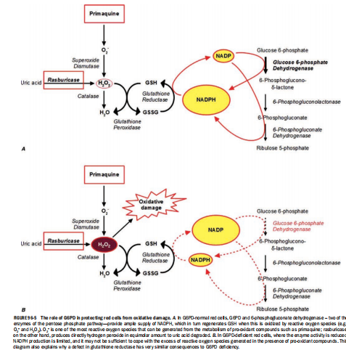

Slide 42
CLINICAL MANIFESTATIONS
Majority – asymptomatic for life
Increased risk of neonatal jaundice +
Increased risk of acute HA (with oxidative stress)

Slide 43
Neonatal jaundice (NNJ) in G6PD deficiency
Rarely presents at birth
Peak incidence – day 2-day 3
Non severe anemia
Severe when a/w prematurity, infection, naphthalene gauze (used in baby bedding)
Coexistent mutant Uridyl transferase gene
If Inadequately managed
  kernicterus, permanent neurological damage in neonates

Slide 44
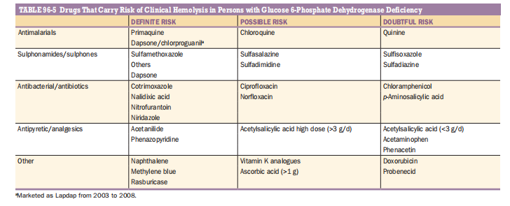
In adults – triggers:
  Fava beans, Drugs

Slide 45
Hemolytic attack
Malaise, weakness, abdominal or lumbar pain
Interval of several hrs to 3 days
Jaundice, high coloured urine
Anemia –
  Moderate to extremely severe
  normocytic normochromic
  Due to intravascular hemolyisis
    So, hemoglobinemia, hemoglobinuria, high LDH, low or absent haptoglobin

Slide 46
Peripheral smear –
  anisocytosis, polychromasia, spherocytes
  Most typical – bite cells, hemighost
    Hemighost – red cells having unevenly distributed hemoglobin
    Bite cells – red cells with parts of them bitten away

Slide 47
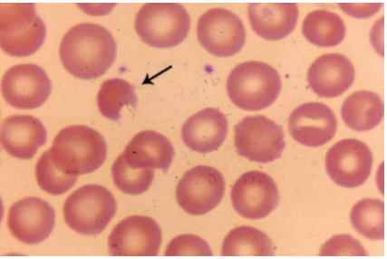
Bite cell

Slide 48
Supravital stain - Heinz bodies
  Heinz bodies – precipitate of denatured Hb
  Signature of oxidative damage to cells
Unconjugated hyperbilirubinemia
Most serious complication in adults – Acute renal failure

Slide 49
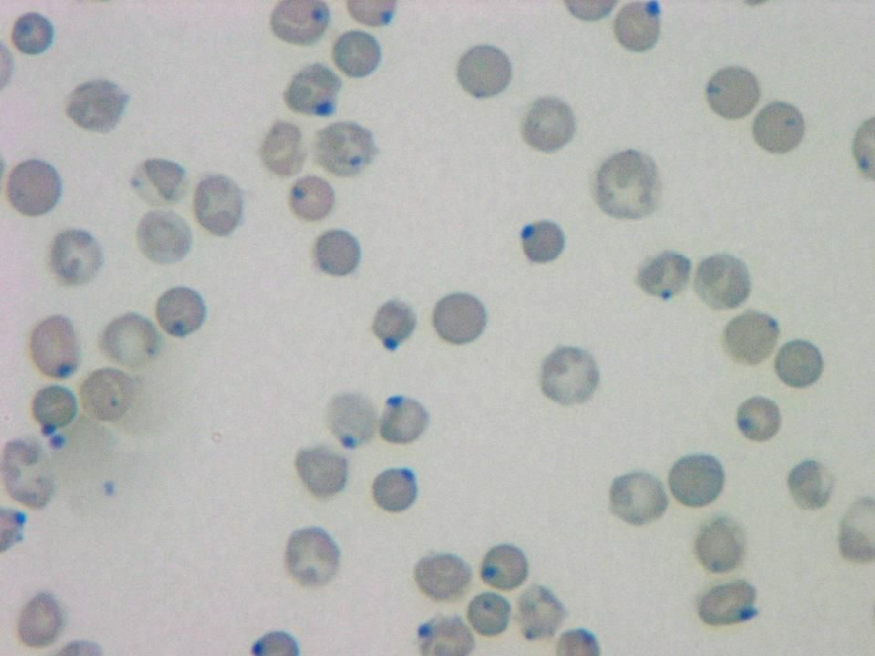

Slide 50
Chronic Non Spherocytic Hemolytic Anemia (CNSHA)
Severe clinical phenotype
Males> females
h/o neonatal jaundice
Presentation - anemia, jaundice, gall stones at later life

Slide 51
Splenomegaly +
Bilirubin, LDH high
P.smear – normomacrocytes with reticulocytosis
More susceptible to infections
  Due to oxidative burst of granulocytes

Slide 52
TREATMENT OF G6PD DEFICIENCY
Largely preventable – avoid exposure to triggers
Drug induced hemolysis – prevented by
  Testing for G6PD before prescription of high risk drugs
Mild AHA – no specific treatment needed
Severe anemia – Blood transfusion
Renal Failure – Hemodialysis; complete recovery if no previous kidney disease

Slide 53
CNSHA : TREATMENT
  Non severe anemia –
  Folic acid supplementation
  Hematologic surveillance
  During exacerbations – Blood transfusion

Slide 54
Other abnormalities of redox system
Inherited defects of GSH metabolism – chronic hemolytic anemia
Rare entity
Infantile poikilocytosis – deficient glutathione peroxidase (GSHPX)
  Transient nutritional deficiency of Selenium
  Severe but self limited disease

Slide 55
PYRIMIDINE 5’ NUCLEOTIDASE (P5N) DEFICIENCY
P5N – Nucleotide catabolism
  In the final stages of erythroid cell maturation
Distinct feature – BASOPHILIC STIPPLING
Rare condition ( 3rd most frequent in red cell enzyme defects)
May benefit from splenectomy

Slide 56
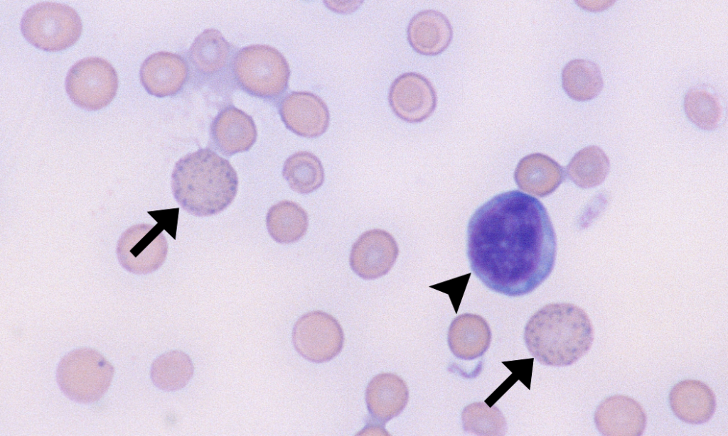
Basophilic stippling

Slide 57
Familial (atypical) hemolytic-uremic syndrome (ahus)
A group of rare disorders
Core features:
  Microangiopathic HA
  Fragmented erythrocytes in peripheral smear
  Thrombocytopenia (usually mild)
  Acute renal failure
HUS by infection – considered as typical HUS

Slide 58
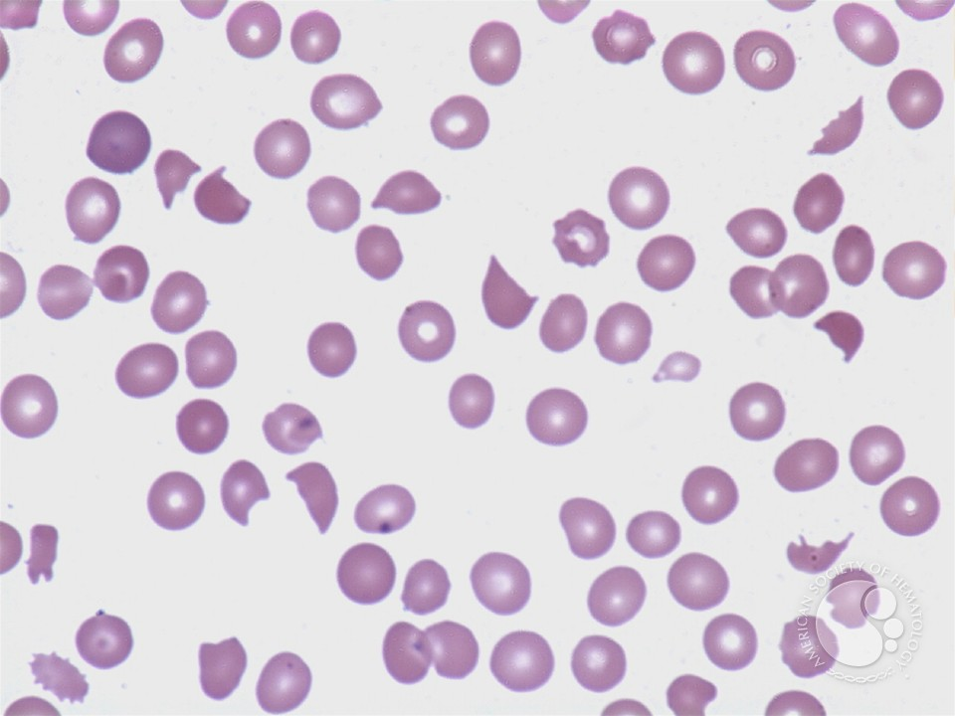
SCHISTOCYTES

Slide 59
Genetics in aHUS
  Complement factor H (CFH)
  CD 46 or membrane cofactor protein (MCP)
  Complement factor 1 (CF1)
  Complement factor B (CFB)
  Complement component C3
  thrombomodulin

Slide 60
Unique feature in aHUS
  Hemolysis due to inherited defect external to red cells
When the complement cascade is triggered – eg. infection – deficiency manifests
  Endothelial cell damage, especially in kidney
  Brisk hemolysis
Severe disease; 15% mortalilty , 50% progress to ESRD
Spontaneous remissions and relapses secondary to infection

Slide 61
Treatment
  Plasma exchange (traditionally) – supply the deficient complement regulator
  ECULIZUMAB – anti-C5 complement inhibitor
    May need treatment indefinitely to prevent ESRD

Slide 62
THANK YOU.

