Slide 1
Hepatic hydrothorax
Dr. Nithya Ramanujan

Slide 2
Definition
Presence of pleural effusion(usually>500ml) in a pt with cirrhosis without other causes (cardiac, pulmonary or pleural disease
5-15% of pts with cirrhosis
Even mild pleural effusion (500ml) cause severe symptoms (while 5-10L ascitic fluid produce mild symptoms)
Occurs when absorptive capacity of pleural space is exceeded

Slide 3
Pathogenesis
Passage of ascitic fluid
peritoneal cavity pleural cavity
diaphragmatic pores
Defects <1cm (or microscopic)
Tendinous portion of diaphragm
More in Rt hemidiaphragm (Lt hemidiaphragm is more thicker and muscular)
Negative intrathoracic pressure generated during inspiration
Increased intraabdominal pressure

Slide 4
Right sided : 73-85%
Left sided : 13-17%
Bilateral : 8-24%

Slide 5
Clinical features
Dyspnea
Non productive cough
Pleuritic chest pain
Fatigue(hypoxemia)
Signs of ascites(abd distension)
Signs of cirrhosis
Asymptomatic

Slide 6
Diagnosis
Differential diagnosis
Documentation of pleural effusion& exclusion of alternative diagnosis
Cardiopulmonary d/s
Chylothorax
Tb
Malignant effusion
Hemothorax

Slide 7
Investigations
Chest xray- PA /lateral view
Ct chest- mediastinal, pleural or pulmonary lesion
Echo –cardiac cause
USG abdomen+doppler – liver masses, patency of PV &HV, ascites
Intraperitoneal injection of radioisotopes
99mTc-sulphur colloid,99mTc-human s.albumin
Shortly after thoracocentesis
Thoracocentesis and fluid analysis

Slide 8
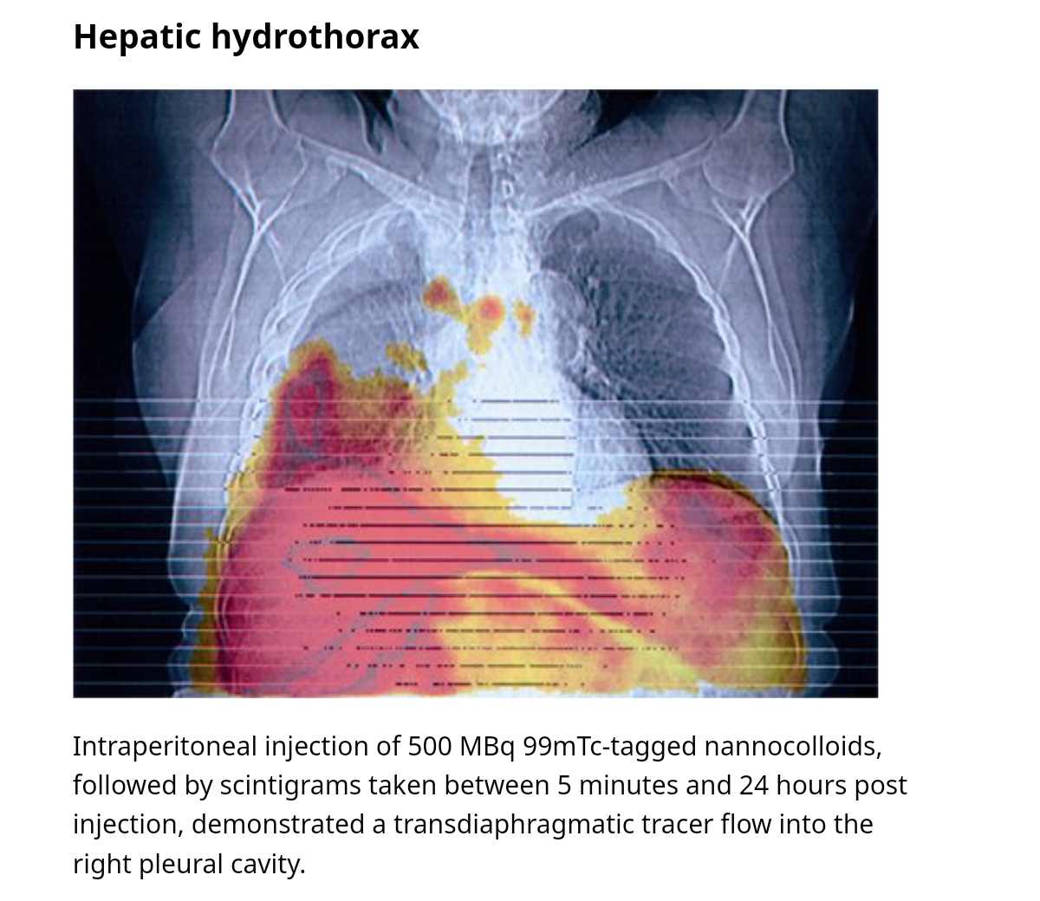

Slide 9
Fluid analysis
Cell count, DC (PMN<250 cells/mm3)
Hct
Gram stain, AFB
Culture(direct inoculation at bedside is preferred)
Protein, albumin,LDH
Bilirubin
pH
TGL(chylothorax)
TB PCR
Amylase
Cytology

Slide 10
Serum- albumin, LDH, bilirubin, Hct
Pleural effusion from portal HTN are transudative
Low protein(<2.5g/dL)
High serum-pleural fluid albumin gradient(>1.1g/Dl)

Slide 11
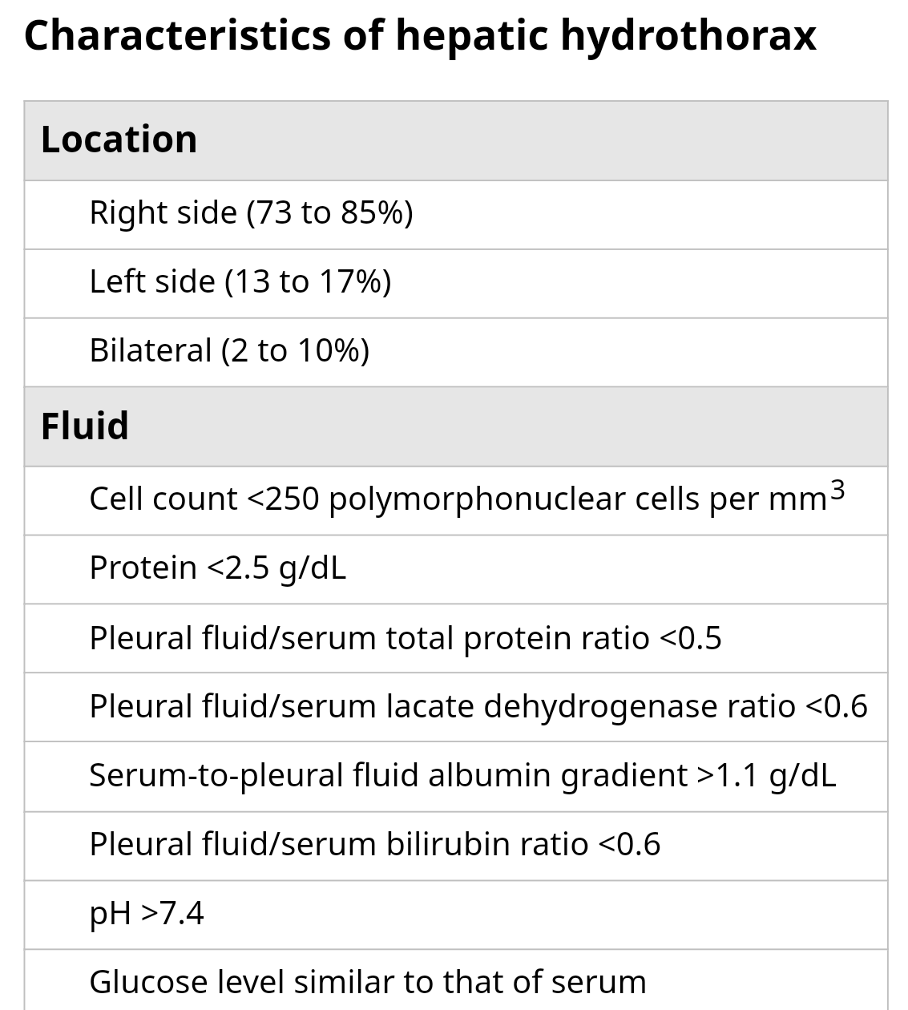

Slide 12
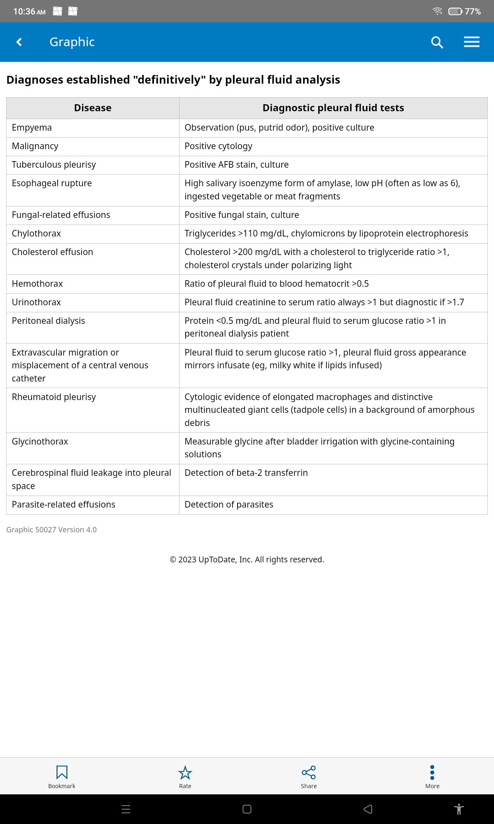

Slide 13
Complications
Refractory hydrothorax
SBEM
Death

Slide 14
Refractory hydrothorax
20-25%
Persistent hydrothorax despite sodium restricted diet & diuretic therapy or
develop diuretic related complications
Exclude non compliance with Na restiction & diuretic
History
24hr urinary sodium excretion <78 mEq

Slide 15
Spontaneous bacterial empyema(SBEM)
Criteria
Positive pl. fluid culture and PMN cell count>250 or
Negative pl. fluid culture and PMN cell count>500
No e/o pneumonia on CXR
Pathogenesis
Seeding of PE with bacteria directly from abd cavity
Bacteremia

Slide 16
13-16%
E.coli, steptococcus sp, enterococcus, klebsiella, pseudomonas
Treatment
IV antibiotics
3rd gen cephalosporin( Xone 2g iv od 7-10days)
Inj Levoflox
Changed acc to C&S
Slow recovery- repeat thoracocentesis

Slide 17
High mortality even with antimicrobial(20%)
Poor outcome predictors
High MELD-Na score
Initial ICU admission
Initial antibiotic treatment failure

Slide 18
Management
Alcohol abstinence
Dietary sodium restriction
Diuretics
Therapeutic thoracocentesis
Tx of refractory hydrothorax
Others
Splanchnic vasoconstriction
Treatment of infection(SBEM)

Slide 19
Refractory hydrothorax
Serial thoracocentesis
TIPS
Pleurodesis
Thoracoscopic Sx for diaphragmatic defects
Liver transplantation

Slide 20
Sodium restriction
Diuretics
<2g/day
Avoid NSAIDs- sodium retension, renal failure
Mild-moderate symptoms along with diuretics
Frusemide 4omg od and spironolactone 100mg od
Double the dose every 3-5days
Maximum – frusemide 160mg and spironolactone 400mg

Slide 21
Therapeutic thoracocentesis
Most effective for large effusion(>1.5L)
No more than 2L removed at a time(risk of pulmonary odema, hypotension)
Complications- pain, pneumothorax, hemothorax, vasovagal episode, hemoptysis, air embolism, laceration of liver or spleen, empyema, subcutaneous emphysema
In pts requiring thoracentesis every 2-3wks- alternative should be considered

Slide 22
?? Chest tube insertion
Not preferred
Only in pts with SBEM and frank pus, pts udergoing pleurodesis
Massive protein & electrolyte depletion, infection, renal failure, bleeding
Impossible to remove tube because of rapid reaccumulation
Complications – s/c emphysema, lung liver spleen & stomach laceration, hemothorax(intercostal aretry laceration), misplacement into abd cavity, high mortality

Slide 23
Transjugular intrahepatic portosystemic shunts
Response rate 70-80%
Reserved for
Child pugh score≤13
No C/I for TIPS
Younger than 70yrs
No hep encehalopathy

Slide 24
Contraindications
Absolute
Relative
Congestive heart failure
Severe TR
Severe pul HTN (MPP>45)
Polycystic liver d/s
Active sys. infection
Biliary obstruction
Hepatic tumors
Obstruction of all HV
Hep encephalopathy
PV thrombosis
Thrombocytopenia (<20,000/µL)
Moderate pul HTN

Slide 25
Complications
Technical- cardiac arrythmia, traversal of liver capsule
Portosystemic encephalopathy
TIPS stenosis
Risk factor for mortality after TIPS
Child pugh score>10
Pre TIPS MELD score> 15-17
Elevated pre TIPS Cr
Lack of response in hydrothorax

Slide 26
Pleurodesis
Rarely done
In pts whom no other option available
Chemical pleurodesis or talc poudrage
Difficult form of nonmalignant pleural effusion to be treated with chemical pleurodesis
Adverse effects- fever, renal failure, pneumothorax, hepatic encephalopathy

Slide 27
Thoracoscopic repair
Pleural flap or surgical mesh reinforcement
High mortality in decompensated cirrhosis
Option in
Pts who are not TIPS candidates
Low MELD score

Slide 28
Liver transplanation
Pts with hepatic hydrothorax typically have ESLD
Definitive treatment

Slide 29
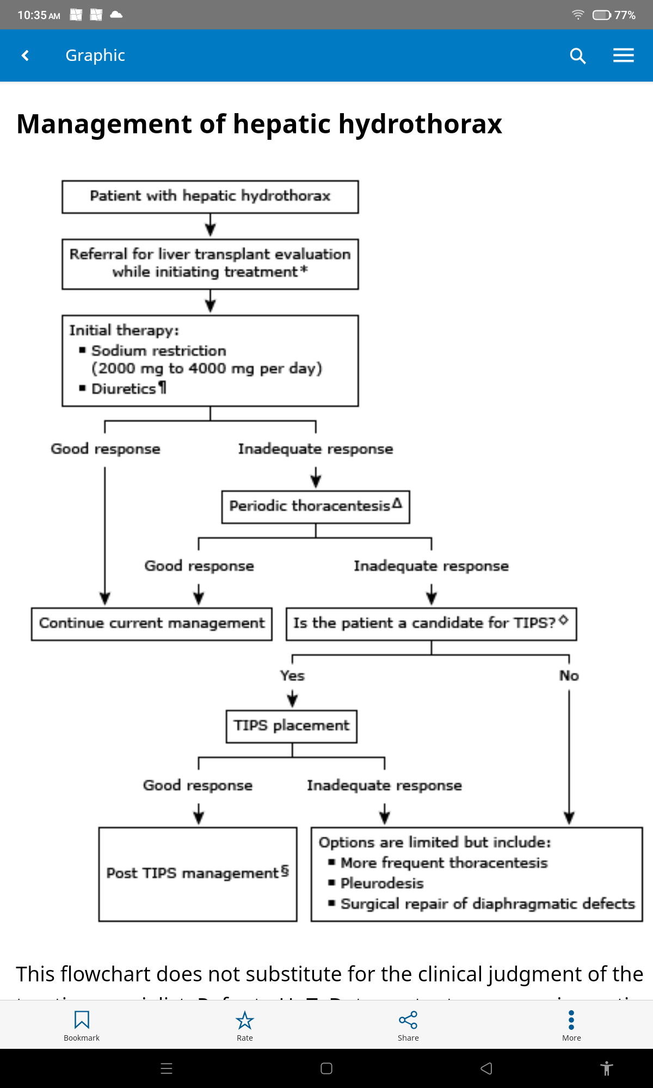

Slide 30
Thank you

