Slide 1
OTHER CARDIAC SOUNDS
Dr.BIBYMOL JOSEPH
JUNIOUR RESIDENT

Slide 2
EXTRA HEART SOUNDS DURING SYSTOLE
EXTRA HEART SOUNDS DURING DIASTOLE
HEART MURMURS

Slide 3
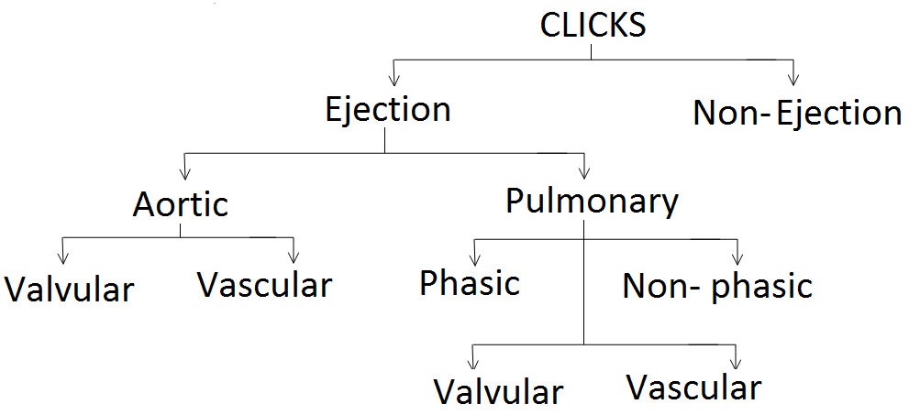

Slide 4
EXTRA HEART SOUNDS IN SYSTOLE
EJECTION SOUNDS
In certain cardiac conditions, brief, sharp,high-pitched sounds in early systole, occurring shortly after S1,
referred as aortic or pulmonic ejection sounds.
Ejection sounds occur at the onset of ventricular ejection and systolic flow into the great vessels.
They are heard best with the diaphragm chest piece and frequently are close enough to S1 to simulate splitting.

Slide 5
The ES is usually the result of “doming” of a congenitally stenotic, but mobile and compliant, aortic or pulmonic valve.
The intensity of the ES correlates
directly with the valve’s mobility and becomes faint or disappears with calcific fixation of the valve

Slide 6
Absent in extremely severe stenosis and in calcification.
Aortic stenosis- common in BAV, less common in acquired valvular AS
Pulmonic stenosis-
  Common in valvular PS
  Softens or disappears with inspiration
  Absent in very mild PS

Slide 7
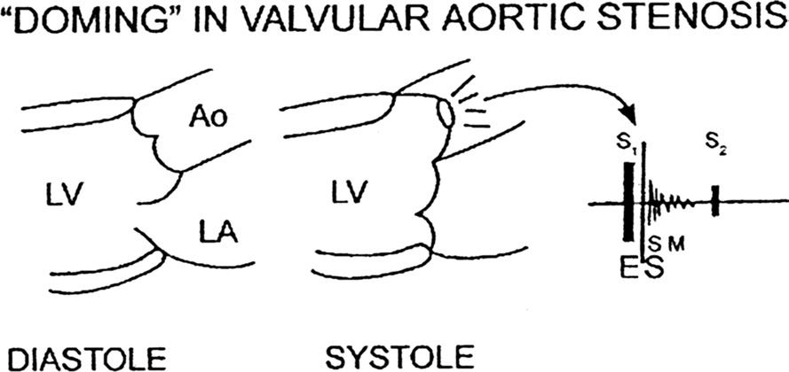

Slide 8
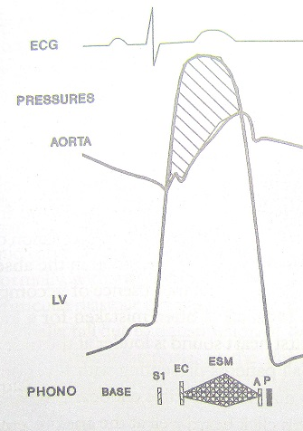
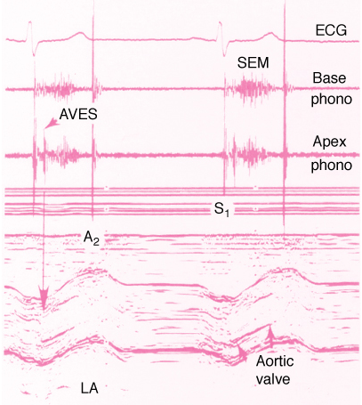

Slide 9
NON EJECTION CLICK
QUALITY : Sharp, high-frequency, clicking
Best over: cardiac apex with the diaphragm, but can be transmitted widely
Mechanism : Tensing of the atrioventricular valves during systole.
Asso : systolic murmur may or may not follow the click
Causes :
MVP
Left ventricular aneurysm
Aneurysm associated with ventricular septal defects

Slide 10
EXTRA HEART SOUNDS DURING DIASTOLE
THE OPENING SNAP
Quality : short, high-frequency, early diastolic sound
Timing : usually occurs 40 to 100 ms after the S2
Coincides with the full opening of the mitral valve
Best heard :
With the diaphragm of the stethoscope just medial to the cardiac apex
widely transmitted
Causes
AV valve stenosis
Excessive flow through the mitral valve in early diastole as in VSD,MR and thyrotoxicosis

Slide 11
Mechanism :
sudden checking of the early diastolic descent of the funnel-shaped stenotic valve when its elastic limits were met.
This sudden diastolic doming causes the anterior leaflet to bulge downward with a snap

Slide 12
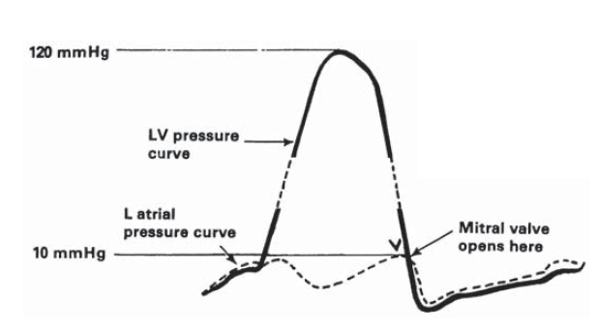

Slide 13
FACTORS DECREASING INTENSITY OF OS
Associated valvular disease:MR / AR / AS
Decreased cardiac output:Cardiac failure / PAH
Extensive valve calcification

Slide 14
FACTOR AFFECTING A2-OS INTERVAL
Severity of MS
Severe MS: short A2-OS interval
Associted valvular heart disease
AS/ AR – Prolonged
MR - narrow
Increased LVEDP
LV dysfunction– Long A2-OS
Heart rate
Bradicardia – Long A2-OS

Slide 15
TUMOR PLOP
QUALITY : low-pitched diastolic sound
Best heard : only in certain positions
MECHANISM :
arises from the diastolic prolapse of the masses across the AV valve.
Associated : diastolic murmur may be present
Causes :
Turmors (Myxoma) .

Slide 16
PACEMAKER SOUNDS
QUALITY : brief High-frequency sounds
Timing : synchronous (within 6-10 ms) with the pacemaker spike
MECHANISM :
caused by stimulation of intercostal nerves adjacent to endocardial electrodes
stimulus results in contraction of the intercostal muscles, pectoral muscles & diaphragm
CAUSES
myocardial perforation by the endocardial lead

Slide 17
PERICARDIAL KNOCK
QUALITY : High-pitched early diastolic sound
Timing : 0.08- 0.10 sec after S2 , with the steep y descent of jugular venous waveform
MECHANISM :
The sudden slowing of blood flow into the ventricle in early diastole that occurs when the ventricle meets the rigid pericardial sac
CAUSES
constrictive pericarditis

Slide 18
PERICARDIAL RUB
With roughening or inflammation of the pericardium, a “friction rub” may be produced.
The pericardial friction rub is a coarse, leathery, or scratchy series of sounds
best heard along the left sternal border, exerting firm pressure on the diaphraghm
The patient sitting upright, breath held in deep expiration
They occur in patients with acute pericarditis, after acute MI, cardiac surgery, chest injury, and in association with uremia, malignancy, or connective tissue diseases.
Pericardial friction rubs generally become louder with inspiration and may occur even with a large pericardial effusion.

Slide 19
HAMMANS CRUNCH
QUALITY : series of crunching sounds synchronous with the cardiac cycles
Mechanism : presence of air in the pericardium and mediastinum
Best heard : over the precordium during ventricular systole in left lateral position
Causes :
spontaneous mediastinal emphysema
tracheobronchial injury
Trauma
medical procedures (e.g., bronchoscopy)
proximal pulmonary bleb rupture.
Boerhaave syndrome

Slide 20
PROSTHETIC VALVE SOUNDS
Mechanical valves
ball-in-cage valve- opening & closing sound
Tilting disc & bileaflet- high pitched metallic closing sound
Bioprosthetic valves- closing sounds are similar to those of native valves
a low frequency early os may be present in mitral position

Slide 21
CARDIAC MURMURS

Slide 22
subtitles
DEFINITION
MECHANISM OF PRODUCTION
CHARACTERISTICS OF MURMUR
DYNAMIC AUSCULTATION
SYSTOLIC MURMURS
DIASTOLIC MURMURS
CONTINUOUS MUMRURS

Slide 23
DEFINITION
A cardiac murmur is defined as a relatively prolonged series of auditory vibrations of Varying intensity(loudness), frequency (pitch), quality, configuration, and duration

Slide 24
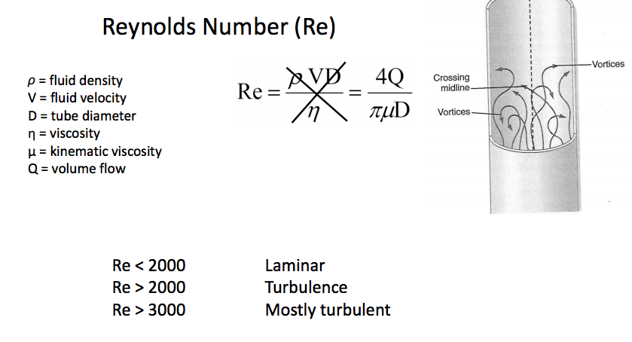
MECHANISM OF MURMUR PRODUCTION
TURBULENT BLOOD FLOW

Slide 25
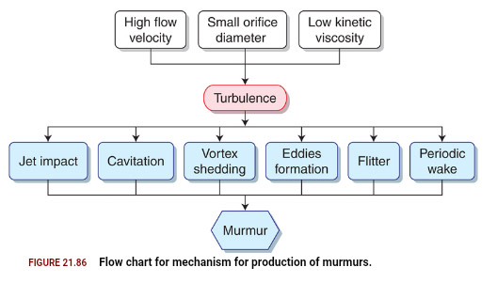

Slide 26
  increased turbulence from accelerated blood flow through normal or abnormal orifices.
  flow through a narrowed or irregular orifice into a dilated vessel or chamber,
  or
If blood flows in an abnormal direction; say (1)backward flow through an incompetent valve (2) ventricular septal defect, or (3) patent ductus arteriosus.

Slide 27
Thus, turbulence is thought to be the primary factor in the genesis of heart murmurs.
Determinants of turbulence :
  the velocity of blood flow; increase in velocity result in marked increase in turbulence.
  An obstruction to blood flow, like stenosis produces abnormal turbulence.
  Turbulence increases as the pressure gradient across the valve becomes larger.
  Turbulence increases when blood moves from a small to large chamber.
  Low blood viscosity (e.g., anemia) enhances turbulence.

Slide 28
CHARACTERISTICS OF MURMUR
TIMING
LOCATION
DURATION
INTENSITY
FREQUENCY
CONFIGURATION
TRANSMISSION
DYNAMIC AUSCULTATION

Slide 29
1. TIMING OF MURMUR
SYSTOLIC MURMUR
DIASTOLIC MURMUR
SUBCLASSIFICATION-EARLY , MID , LATE OR PAN(HOLO)
CONTINUOUS MURMUR

Slide 30
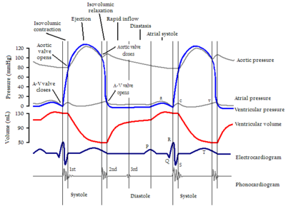

Slide 31
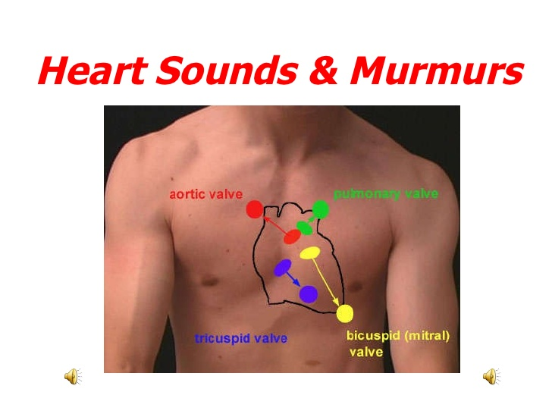
2. LOCATION OF MURMURS

Slide 32
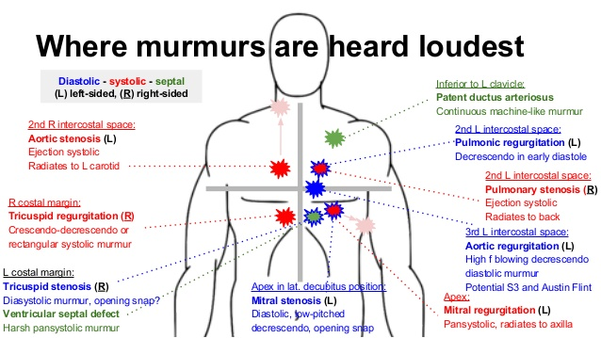

Slide 33
3. DURATION OR LENGTH
SHORT ,LONG OR HOLO
Depends on duration of events such as pressure gradient between the two sites or cardiac chambers
reflects the severity of lesion in stenotic lesions

Slide 34
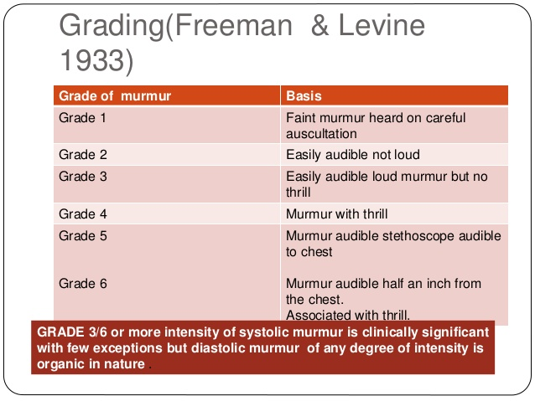
4. INTENSITY OR LOUDNESS

Slide 35
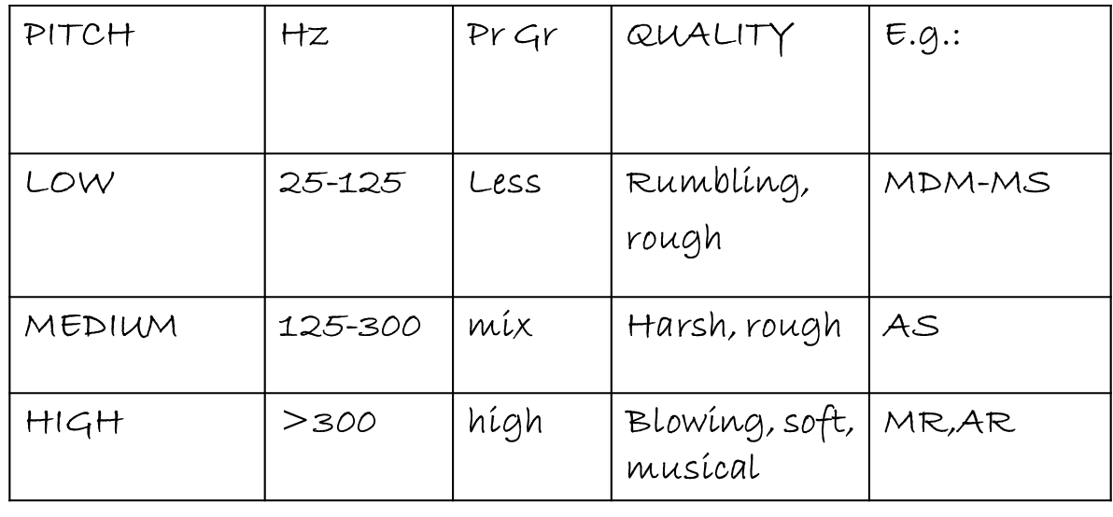
5. PITCH OF THE MURMUR
pressure gradient between 2 chambers – flow velocity

Slide 36
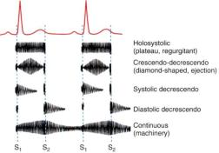
6.CONFIGURATION OR SHAPE OF MURMUR

Slide 37
7. TRANSMISSION OF MURMUR
Conduction with direct anatomical continuity | SM of AS to carotids PSM of MR to left axilla
Loud vs soft | Loud-transmit widely Soft-confined
High freq transmit proximally while low freq transmit distally | MR to apex AS to base and carotid
Low vs high freq murmurs | Low freq-better transmitted to surface –thrill High freq –poorly transmitted – no thrill

Slide 38
DYNAMIC AUSCULTATION

Slide 39
DEFINITION
technique of altering circulatory dynamics by a variety of physiological manoeuvres and determining the effects of these manoeuvres on heart sounds and murmurs

Slide 40
INTERVENTION
RESPIRATION
POSITION
PHYSICAL MANEUVERS
PHARMACOLOGICAL

Slide 41
RESPIRATION - INSPIRATION
↓ INTRATHORACIC PRESSURE
↑ VENOUS RETURN to right side of the heart AND Dilatation of pulmonary vascular system causing decrease in pulmonary impedance there by increasing pulmonary hang out interval(>80 ms)
↑ stroke volume of right side
accentuation of R side murmur

Slide 42
EXPIRATION
↓ lung volume → ↑ pulmonary venous flow
  left sided murmurs are loudest during expiration
  except
  MR which remain unchanged

Slide 43
Murmurs accentuated during
Inspiration
  TS
  TR (Carvallo’s sign)
  PR
  Mild or moderate PS
  Severe PS no further increase in gradient
Expiration
• MS
• AS
• AR
• VSD
• Pericardial rub (AP diameter)

Slide 44
In RV failure and PHT
high Rt heart filling pressures ,no increase in venous return with inspiration, hence no inspiratory augmentation of right sided murmurs and gallops
Absence of respiratory influence is of no particular diagnostic value.

Slide 45
postural
Auscultation is carried out immediately before and after the change in posture since effects may be quite transient persisting for only 10 – 15 heart beats

Slide 46
STANDING
Rapid standing or sitting up from lying position or rapid standing from squatting posture results in
decreased venous return due to venous pooling in legs and splanchnic vessels leads to-
decreased stroke volume
decreased mean arterial pressure
decrease in heart size
followed by reflex increase in heart rate & systemic resistance

Slide 47
STANDING
All murmurs decrease except-
ESM of HOCM becomes louder and longer
Click occurs earlier, murmur becomes longer in MVP while loudness shows variable response

Slide 48
SQUATTING
Sudden change from standing to squatting leads to-
Increases venous return & Stroke Volume
Increase of systemic vascular resistance due to kinking of iliac artery and reduction of pressure of gravity
Increase of systemic Arterial pressure with transient bradycardia
Notes:
Squatting from a standing position is associated with a simultaneous increase in venous return (preload) and systemic vascular resistance (afterload) and a rise in arterial pressure

Slide 49
SQUATTING
Increased venous return and CO - augments most murmurs (AS,PS,MR,AR,VSD) Right heart murmurs do so earlier
Increased left ventricular volume - decreases murmur of HOCM and delayed murmur and click of MVP
Ejection murmur of TOF↑ due to increase pulmonary blood flow and decrease in right to left shunt

Slide 50
OTHER POSTURAL CHANGES
Left Lateral Position
Causes closeness of heart to chest wall and transient rise of HR. So leads to –
Increased murmur of MS, MR and austin flint murmur of AR
Early appearance of click and systolic murmur of MVP due to increase HR.(increase HR & inotropism)

Slide 51
Sitting up and leaning forward
causes more closeness of base of heart to chest wall so AR and PR murmurs more readly audible
PRONE POSITION & KNEE CHEST POSITION
Bring heart close to chest wall making pericardial rub more prominent

Slide 52
ISOMETRIC EXERCISE
Handgrip with both hands simultaneously for 20-30sec
Use calibrated handgrip device or tennis ball or rolled up BP cuff.
Measure the maximum effort
Patient exerts 70 – 100% of this maximum for about 30 seconds
CAUTION:
Valsalva maneuver during handgrip should be avoided
Avoid in those with ventricular arrhythmias and myocardial ischemia
Contraindicated in recent myocardial infarction, uncontrolled hypertension, cerebrovascular disease, suspected aortic dissection

Slide 53
ISOMETRIC EXERCISE
Hemodynamic changes:
Significant increase in SVR
Arterial pressure
Heart rate
LV filling pressure
LV size

Slide 54
ISOMETRIC EXERCISE
Systolic Murmur of AS reduced due to reduced gradient across aortic valve
AR , MR , VSD – increased due to increase systemic vascular resistance
MDM of MS – increased due to Increased CO
Syst Murmur of HOCM reduced
MVP murmur + click delayed

Slide 55
SYSTOLIC MURMUR

Slide 56
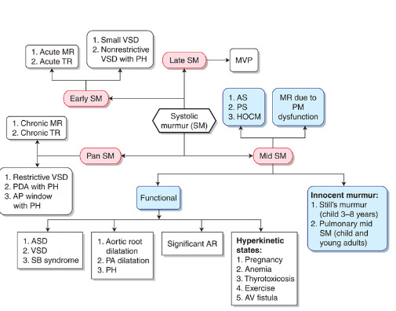

Slide 57
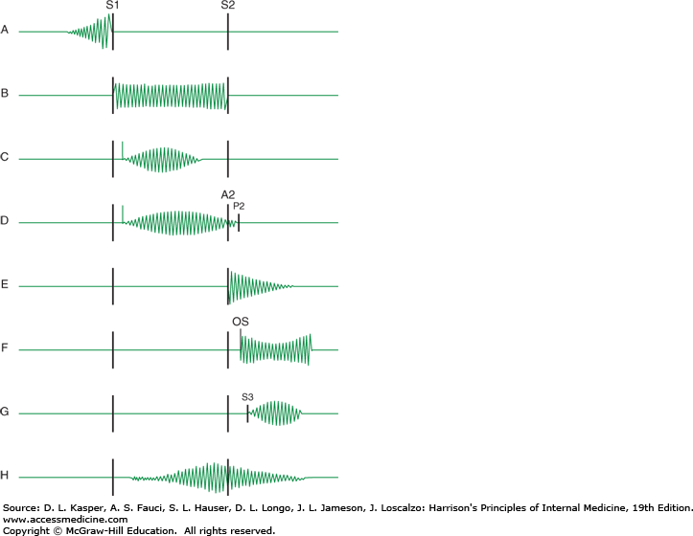

Slide 58
EARLY SYSTOLIC MURMURS
Early systolic murmurs begin with S₁ and extend for a variable period of time, ending well before S₂ (high pitch ,decrescendo)
1. Acute severe mitral regurgitation
  Regurgitation occurs into a normal-sized, relatively noncompliant left atrium and as LV-LA pressure gradient is abolished during late systole, termination of retrograde flow occurs well before S2.
  best heard at apical impulse
  Caused by:
  i. Papillary muscle rupture due to ischemia
  ii. Infective endocarditis -destruction of leaflet tissue, chordal rupture, or both

Slide 59
  iii. Rupture of the chordae tendineae in myxomatous mitral valve disease
  iv. Blunt chest wall trauma-papillary muscle contusion and rupture, chordal detachment, or leaflet avulsion.
2.Congenital, small ventricular septal defect-
ventricular size decrease and septum thickness increases which seals off defect

Slide 60
3. VSD with high PA pressure-
high pulmonary resistance will decrease the late shunting

Slide 61
MIDSYSTOLIC (EJECTION) MURMURS
Begin at a short interval following S₁, end before S₂
Flow across LV or RV outflow tract- when flow proceeds , murmur increase in crescendo and when it decrease murmur decrease in decrescendo.
Intensity of murmur depend on cardiac output

Slide 62
Causes are:
  1. Innocent: due to flow across normal ventricular outflow tract
  2. Functional: dilation of aortic root, pulmonary trunk or increase flow into aorta and pulmonary artery
  3. Pathologic
    are secondary to structural CV abnormalities-ventricular outflow obstruction
    e.g. Aortic stenosis, Hypertrophic cardiomyopathy, Pulmonic stenosis

Slide 63
Aortic stenosis
Harsh, medium pitch, loudest in aortic area; radiates along the carotid arteries and apex.
Intensity varies directly with CO
Severity varies with murmur may have an early peaking and short duration or late peaking and prolonged duration.
A/W parvus et tardus
Other conditions which may mimic the murmur of aortic stenosis w/o obstructing flow:
  1. Aortic sclerosis
  2. Bicuspid aortic valve
  3. Dilated aorta
  4. Increased flow across the valve during systole

Slide 64
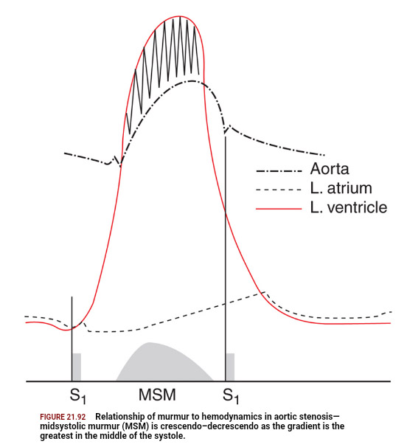
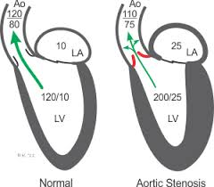
2
Notes:
IVC SI VENTRICULAR PRESSURE INCREASES – OPENING OF AORTA & PULM VALVE-EJECTION –MURMUR BEGINS—CRESENTO DECRESENTO-.. MURMUR ENDS BEFORE VENTRICULAR PRESSURE DROPS BELOW AORTIC PRESSURE AT WHICH AORTIC VALVEAND PULMONARY VALVE CLOSES GENERATING A2 & P2

Slide 65
GALLAVERDIN PHENOMENON/HOURGLASS PHENOMENON
Noisy medium pitch murmur at base due to turbulence of high velocity jet and
High frequency murmur reflected to mitral area (apex) due to periodic wake phenomenon caused by high frequency vibrations of the fibrocalcific aortic cusps – mimic MR (S2 clear)

Slide 66
 | AS | MR
Location | Aortic area | Apex
Radiation | Neck | Axilla
Shape | Diamond | Holosystolic
Pitch | Medium | High
Associated signs | Decreased A2 Slow rising and delayed pulse Ejection click S4 Narrow pulse pressure | Decreased S1 Laterally displaced diffuse PMI S3
Isometric Exercise | DECREASES | INCREASES
Amyl Nitrate | INCREASES | DECREASES

Slide 67
HYPERTROPHIC CARDIOMYOPATHY
Loudest b/t left sternal edge and apex; Grade 2-3/6
Does NOT radiate into neck.
Factors which increase intensity:
Increase LV contractility :exercise ,catecholamine ,digitalis
Decrease ventricular volume:valsalva,standing,amyl nitrates,tachycardia
Decrease aortic impedance and pressure:sustained handgrip,passive leg raising

Slide 68
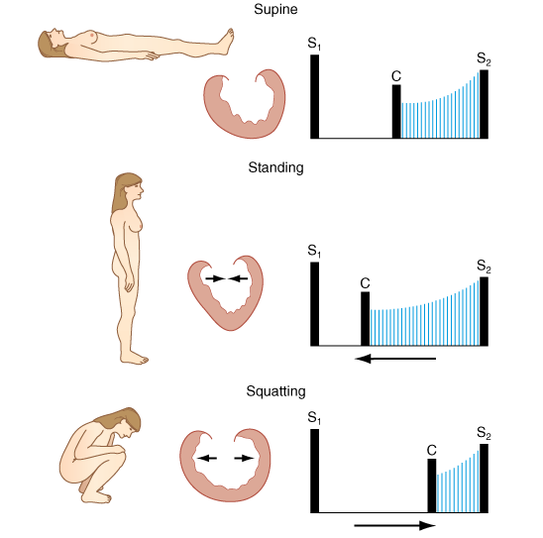

Slide 69
MANEUVERS | FIXED LVOT-AS | DYNAMIC LVOT-HOCM
RESPIRATION | NOT MUCH CHANGE | MAY INC WITH EXPIRATION
STANDING | DECREASES | INCREASES
SQUATTING | INCREASES | DECREASES
VALSALVA | DECREASES | INCREASES

Slide 70
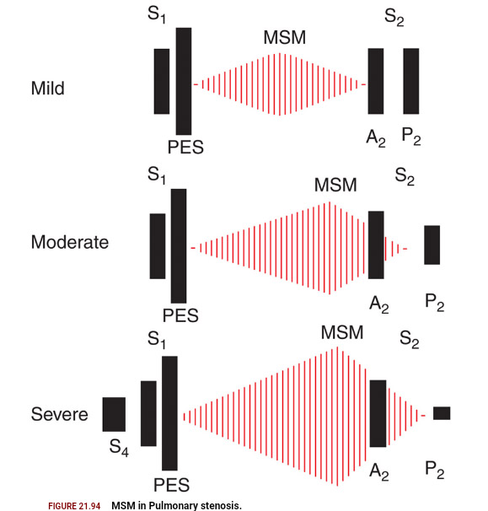
PULMONARY STENOSIS
As severity increases length increases and P2 becomes soft (abruptness of closure reduced ) ,S2 split widens.
May engulf A2 and P2 :may confuse with VSD

Slide 71
OTHER CAUSES OF MSM
Dilation of aorta and pulmonary trunk
Short soft midsystolic murmur
Left sided murmur in marfans syndrome , syphilis
Right sided murmurs in idiopathic dilation of pulmonary artery,pulmonary hypertension
MSM of hyperdynamic circulation
Normal aorta or pulmonary trunk but increased flow
Anaemia , pregnancy , fever , thyrotoxicosis

Slide 72
OTHER CAUSES OF MSM
OS-ASD
Rapid flow across pulmonary valve to dilated pulmonary trunk
Pure AR
Due to accelerated LV ejection

Slide 73
PHYSIOLOGICAL CAUSES
Flow or Functional Murmur. These are by far the most common heart
murmurs and are found in many normal persons.
In the presence of a normal resting cardiac output the murmur is known as an innocent or functional murmur
  Pulmonary mid systolic murmur
  Peripheral pulmonary systolic murmur
  Supraclavicular or brachiocephalic systolic murmur
  Aortic sclerosis
  Systolic mammary soufflé

Slide 74
If the murmur is related to a hyperkinetic state with increased cardiac output and stroke volume, the murmur is known as a physiologic murmur.
  Eg: in pregnancy, hyperthyroidism or anaemia .
  Grade 1-2 mid systolic murmur heard the left lower sternal border
  Stills murmur : Benign, grade 2, vibratory or mysical midsystolic murmur at the mid or lower left sternal border in normal children and adolescents, best heard in the supine position

Slide 75
MAMMARY SOUFFLE
Late pregnancy or pueperium
Sometimes continuous louder in systole , distinct gap from S1(time for ejection blood to reach mammary arteries)
Light pressure augments murmur becomes continuous firm pressure abolishes murmur

Slide 76
Pansystolic (Holosystolic) Murmurs
Are pathologic
Murmur begins immediately with S1 and continues up to S2
1. Mitral valve regurgitation
  Loudest at the left ventricular apex
  Radiation reflects the direction of the regurgitant jet
  i. To the base of the heart = anterosuperior jet (flail posterior leaflet)
  ii. To the axilla and back = posterior jet (flail anterior leaflet
  Also usually associated with a systolic thrill, a soft S3, and a short diastolic rumbling (best heard in left lateral decubitus
2. Tricuspid valve regurgitation
3. Ventricular septal defect

Slide 77
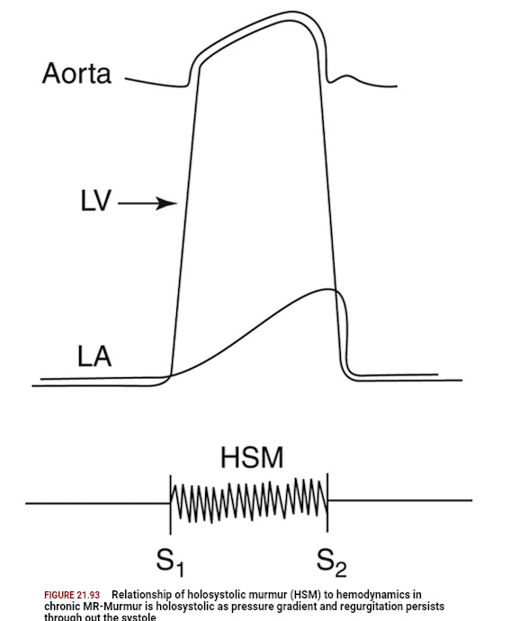
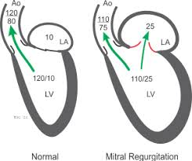
MITRAL REGURGITATION

Slide 78
TRICUSPID REGURGITATION
LLSB-RA
RIVERO CARVALLO SIGN – increased RV ,increase RV volume increased SV velocity of regurgitant flow
Sometimes TR heard only during inspiration
Carvallo sign disappears in RV failure

Slide 79
VENTRICULAR SEPTAL DEFECT
Depends on site ,size and gradient
  Very restrictive VSD –ESM decrescendo pattern
  Mod and NR VSD –PSM
  Septal aneurysm – click with LSM OR PSM with late systolic accentuation
  Large shunt – MDM
  PSM absent in Eissenmenger syndrome –only pulmonary ESM

Slide 80
LATE SYSTOLIC MURMUR- MVP
Longer and softer
prompt standing after squatting
valsalva II
Short and louder
squatting
sustained hand grip
amyl nitrate
Other LSM- papillary muscle dysfunction

Slide 81
DIASTOLIC MURMUR

Slide 82
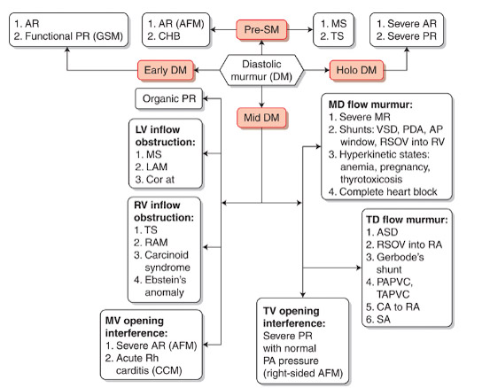

Slide 83
EARLY DIASTOLIC MURMUR
AORTIC REGURGITATION:
Soft high frequency EDM with pt sitting & leaning forward , breath held in full expiration
3 LICS [2 or 3 RICS in root dilatation
Musical quality in eversion
Austin flint murmur
Cole Cecil murmur-AR murmur in left axilla due to high position of apex

Slide 84
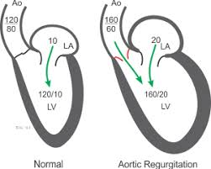

Slide 85
MID DIASTOLIC MURMUR
Begins at clear interval after A2
1.Rapid filling phase:
AV valve obstruction- stenosis AV valves, tumors, functional obstruction
abnormal pattern of AV flow : increased flow volume , increased flow velocity
2. Incompetent pulmonary valve [PR in normal PA pressure]
3. Atherosclerotic extramural coronary arteries

Slide 86
MID DIASTOLIC MURMUR
RV
- TS
LV
- MS
Austin Flint murmur
- Carey-Comb's
OTHERS
-Atrial Myxoma
ASD
- VSD
- PDA
- MR

Slide 87
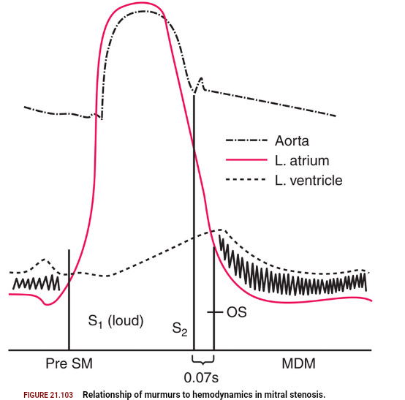
MITRAL STENOSIS
Low pitch rough rumbling [sound of distant thunder] MDM
Localized to apex, better heard in left lateral position with bell
Length - severity
Long murmurs up to S1 even in long cycles of AF- severe MS
Late diastolic or Pre systolic accentuation usually seen in pliable valves and in NSR [ sometimes in AF]
Notes:
OS- leaflet excursion comes to its anatomical limits because of its commissural tethering, part of the column of blood will be decelerated suddenly, along with the doming anterior leaflet.

Slide 88
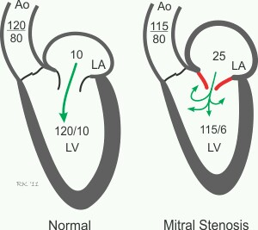
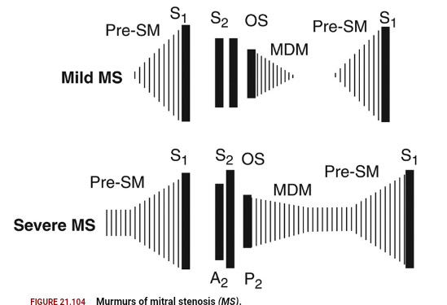

Slide 89
TRICUSPID STENOSIS
Similar to MS
Murmur usually seen associated with AF
Diff. from MS
  Increases during inspiration [Augmentation of RV volume]
  LLSB

Slide 90
AUSTIN FLINT MURMUR
Severe AR regurgitant jet directed toward the AML prevent the latter from opening well during diastole generating turbulent flow
Low pitch MDM or late diastolic, best heard at the apex.
To differentiate from MS
  No OS
  Amyl nitrate inhalation

Slide 91
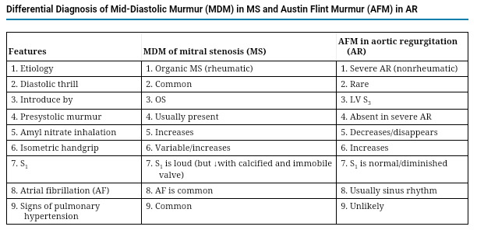

Slide 92
Late Diastolic/ Pre-systolic Murmurs
MS
Higher frequency than MDM
Sometimes only PSA heard- mild MS
Generally absent in calcified valves and most of AF [ may be present during short cycle lengths in AF]
Cause-
  Increased flow during atrial contraction in late systole

Slide 93
Other Mid Diastolic Murmur
Carey Coomb’s murmurs
  Acute rheumatic fever- mitral valve structures acutely inflamed with some thickening and edema
  CAUSES- turbulence of flow during the rapid filling phase.
    + moderate MR [increased mitral inflow in diastole]
  Low pitched short MDM.
  good evidence of active carditis

Slide 94
CONTINUOUS MURMUR

Slide 95
CONTINUOUS MURMUR
Begin in systolic and continue without interruption through the timing of S2 into all or part of diastole without change in character
D/D: to and fro murmurs of VSD + AR ,AS + AR ,MS + MR

Slide 96
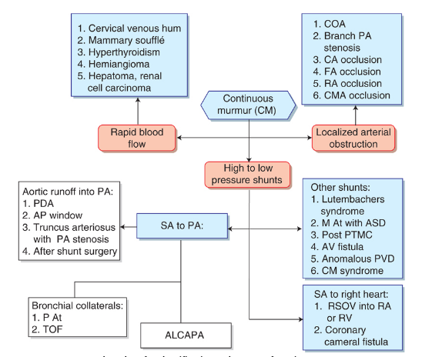

Slide 97
1.Connection b/w high pressure/vessel & low pressure chamber/vessels
1.From the aorta
  a.persistent ductus arteriosus
  b.Aorto-pulmonary window
  c.RSOV
2.From the coronary artery
a.coronary arteriovenous fistulae draining into RA,RV,PA
b.ALCAPA
3.Other AV communications
a.Bronchopulmonary collaterals
b.chest wall arteries-pulmonary vessels
3.Peripheral A-V Fistula
4.Others

Slide 98
PDA
Gibsons murmur
At 1 or 2 LICS
NR- high frequency soft murmur peaks around S2

Slide 99
PDA with no continuous murmur
Neonates- due to high PVR
Very small ductus
Very large ductus &large VSD –due to equalization of pulmonary and systemic pressure
PAH –first diastolic component goes, then systolic
AS,CoA-due to low aortic pressure

Slide 100
ALCAPA
  Murmur louder in diastole [LV contraction D/C flow]
  Do not peak at S2
  Usually LUSB or RUSB

Slide 101
Due to rapid blood flow
AV fistula
  Murmur heard in the venous side
Due to rapid blood flow
  cervical venous hum,mammary souffle, hyperthyroidism,hemangioma,hyperemia of neoplasm(HCC,RCC,Pagets disease)
Stenosed arteries with inadequate distal collaterals
  Aortic arch vessels occlusion ,atherosclerotic carotids ,coarctation of aorta,main pulmonary artery stenosis and peripheral pulmonary artery stenosis

Slide 102
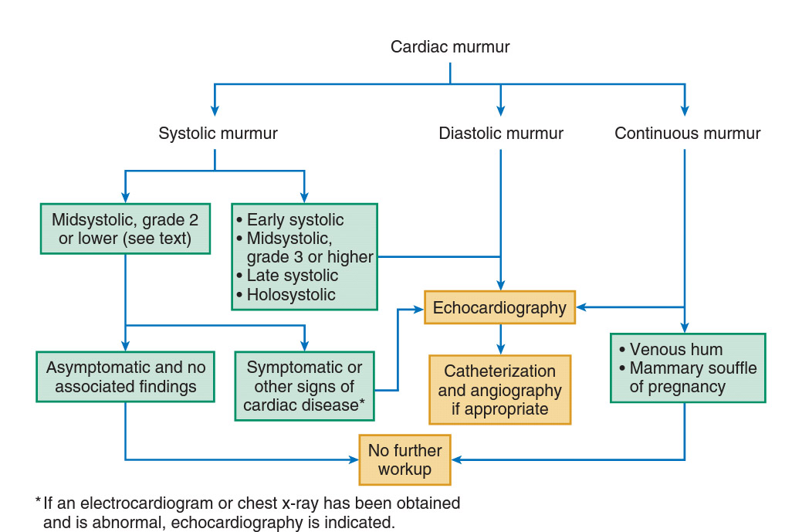
All MURMURS TO BE EVALUATED ?

Slide 103
THANK YOU

