Slide 1
MYELOPROLIFERATIVE NEOPLASMS
DR. NITHYA RAMANUJAN
JR2
GENERAL MEDICINE

Slide 2
WHO classification of the chronic myeloproliferative neoplasms (MPNs)
Eight disorders
share an origin in a hematopoietic cell
overproduction of one or more of the formed elements of the blood without significant dysplasia
predilection to: extramedullary hematopoiesis
myelofibrosis
transformation to acute leukemia(varying rates)

Slide 3
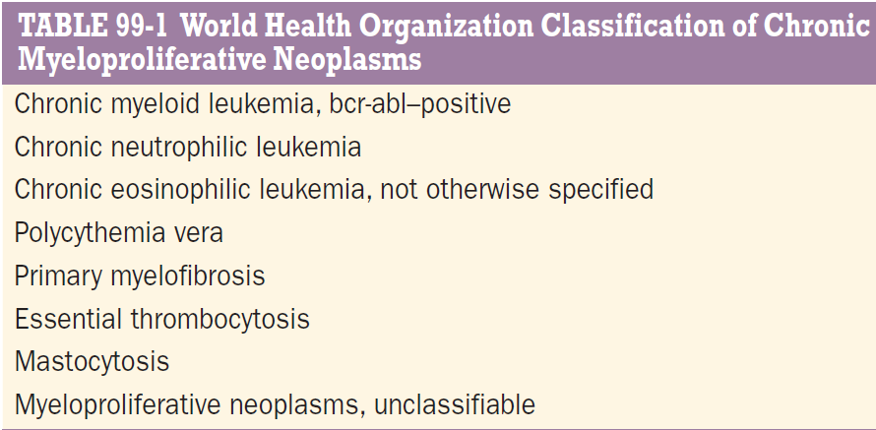

Slide 4
significant phenotypic heterogeneity
chronic myelogenous leukemia (CML)
chronic neutrophilic leukemia (CNL) myeloid phenotype
chronic eosinophilic leukemia (CEL)
polycythemia vera (PV)
primary myelofibrosis (PMF) erythroid or megakaryocytic essential thrombocytosis (ET) hyperplasia
Latter three disorders - capable of transforming into each other

Slide 5
phenotypic heterogeneity has a genetic basis
CML-t[9;22][q34;11]
CNL -t(15;19) translocation
CEL -deletion or balanced translocations
of PDGFRα gene
PV, PMF, ET -driver mutations that directly or indirectly activate JAK2 (tyrosine kinase -erythropoietin and thrombopoietin receptors and G-CSF receptor)
High rates of leukemic transformation
Natural history-years
Transformation to AL is uncommon in absence of chemo
Decades

Slide 6
PRIMARY MYELOFIBROSIS
Primarily affect men, 6th decade or later
Acute or malignant myelofibrosis occurs in any age
Chronic PMF(idiopathic myelofibrosis,agnogenic myeloid metaplasia, or myelofibrosis with myeloid metaplasia)
Least common chronic MPN

Slide 7
Clonal disorder of a multipotent hematopoietic progenitor cell of unknown etiology
Marrow fibrosis, extramedullary hematopoiesis, splenomegaly
Difficult to diagnosis in the absence of a specific clonal marker as
myelofibrosis f/o both PV and CML
splenomegaly variety of benign & malignant disorders

Slide 8
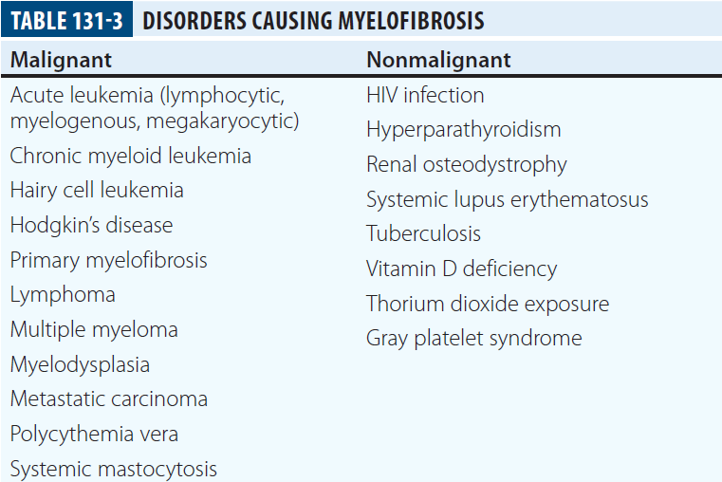

Slide 9
ETIOLOGY
Unknown
Nonrandom chromosome abnormalities such as 9p, 20q−, 13q−, trisomy 8 or 9, or partial trisomy 1q are common
No specific cytogenetic abnormality identified
JAK2 V617F ~ 50% of PMF patients
Mutations in thrombopoietin receptor Mpl ~ 5%
Most of the rest -mutations in the calreticulin gene (CALR)(alter the carboxy-terminal portion of the gene product)

Slide 10
Degree of myelofibrosis & extent of extramedullary hematopoiesis are not related
Fibrosis- associated with overproduction of TGF-β and tissue inhibitors of metalloproteinases
Osteosclerosis- associated with overproduction of osteoprotegerin (osteoclast inhibitor)
Marrow angiogenesis- increased production of VEGF
Fibroblasts in PMF are polyclonal

Slide 11
CLINICAL FEATURES
Asymptomatic
Usually detected- splenic enlargement and/or abnormal blood counts during a routine examination
Common presenting complaints- night sweats, fatigue, and weight loss
Blood smear- characteristic features of extramedullary hematopoiesis
teardrop-shaped red cells
nucleated red cells
Myelocyte
Promyelocytes
Myeloblasts may be present

Slide 12
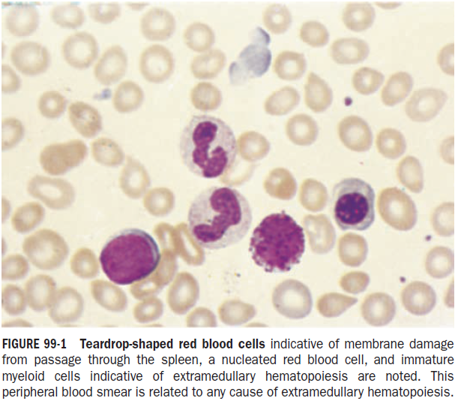

Slide 13
Anemia- mild initially
Leukocyte and platelet counts- normal or increased (can be depressed)
Mild hepatomegaly may accompany splenomegaly
Isolated lymphadenopathy suggest another diagnosis
serum LDH and ALP levels
LAP score -low, normal, or high
Marrow- inaspirable due to the myelofibrosis

Slide 14
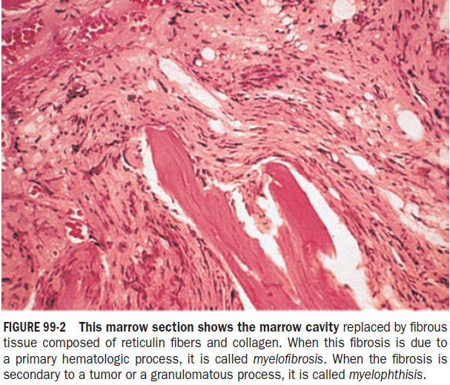

Slide 15
Bone x-rays:osteosclerosis
Exuberant ascites
extramedullary portal, pulmonary, or intracranial HTN
hematopoiesis intestinal or ureteral obstuction
pericardial tamponade
spinal cord compression
skin nodules
Splenic enlargement, sufficiently rapid →splenic infarction [fever, pleuritic chest pain]
Hyperuricemia and secondary gout

Slide 16
DIAGNOSIS
Clinical picture-characteristic of PMF
Clinical features can also be seen in PV or CML
Massive splenomegaly -masks erythrocytosis in PV
Intraabdominal thrombosis in PMF -unrecognized PV
In some PMF patients erythrocytosis is seen
Many other disorders have features that overlap with PMF; diagnosis of exclusion

Slide 17
Teardrop-shaped red cells, nucleated red cells, myelocytes, promyelocyte –EM hematopoiesis
Leukocytosis, thrombocytosis with large and bizarre platelets, circulating myelocytes-suggest MPN
Splenomegaly(may sufficiently massive)→ portal hypertension, variceal formation
Marrow- inaspirable due to increased marrow reticulin
Marrow biopsy- a hypercellular marrow with trilineage hyperplasia, esp. increased numbers of megakaryocytes in clusters and with large, dysplastic nuclei

Slide 18
No characteristic bone marrow morphologic abnormalities-distinguish PMF &other chronic MPNs
Autoimmune abnormalities - immune complexes, antinuclear antibodies, rheumatoid factor, or a positive Coombs’ test
Cytogenetic analysis of blood - to exclude CML,for prognostic purposes (complex karyotype abnormality- poor prognosis)
Circulating CD34+ cells is markedly increased in PMF (>15,000/μL)

Slide 19
50% of PMF patients- JAK2 V617F mutation (often homozygous) →usually older, higher hematocrits
Patients with MPL mutation→more anemic,lower TC
Somatic mutations in exon 9 of the calreticulin gene (CALR)- majority of patients with PMF and ET(lack above mutations)clinical course is more indolent

Slide 20
COMPLICATIONS
Marrow failure, transfusion-dependent anemia
Organomegaly (extramedullary hematopoiesis)
PMF- evolve from a chronic phase to an accelerated phase (constitutional symptoms, increasing marrow failure)
10% of patients spontaneously transform to an aggressive form of acute leukemia (therapy is usually ineffective)

Slide 21
Prognostic factors for disease acceleration- complex cytogenetic abnormalities, thrombocytopenia, transfusion-dependent anemia
Mutations in ASXL1, EZH2, SRSF2, and IDH1/2 genes- risk factors for early death or transformation to AL

Slide 22
Treatment
No specific therapy
Causes of anemia
inffective erythropoiesis uncompensated by splenic extramedullary hematopoiesis
hemodilution due to splenomegaly
splenic sequestration
blood loss secondary to thrombocytopenia or portal hypertension
folic acid deficiency
systemic inflammation
autoimmune hemolysis

Slide 23
EPO - worsen splenomegaly, ineffective if the serum EPO level >125 mU/L
Glucocorticoids- ameliorate anemia, constitutional symptoms (fever, chills, night sweats, anorexia, weight loss)
Glucocorticoids + low-dose thalidomide→effective
Thrombocytopenia (impaired marrow function, splenic sequestration, or autoimmune destruction) -respond to low-dose thalidomide and prednisone

Slide 24
Splenomegaly -abdominal pain, portal hypertension, easy satiety, and cachexia
Splenectomy – a/w postop complications
mesenteric venous thrombosis
Hemorrhage
rebound leukocytosis and thrombocytosis
hepatic extramedullary hematopoiesis
no amelioration of anemia or thrombocytopen
Also increases the risk of blastic transformation

Slide 25
Splenic irradiation(best)- temporarily palliative
significant risk of neutropenia
Infection
subsequent operative hemorrhage (if splenectomy attempted)
Allopurinol- control significant hyperuricemia
Local irradiation- bone pain

Slide 26
Pegylated IFN-α →ameliorate fibrosis in early PMF (in advanced d/s, exacerbate bone marrow failure)
Ruxolitinib (JAK2 inhibitor)- effective in reducing splenomegaly
alleviating constitutional symptoms
prolonging survival
Major side effect-anemia and thrombocytopenia (dose-dependent, with time, anemia stabilizes, thrombocytopenia may improve

Slide 27
Allogeneic bone marrow transplantation
only curative treatment for PMF
considered in younger patients, older patients with high risk disease

Slide 28
ESSENTIAL THROMBOCYTOSIS
Essential thrombocythemia, idiopathic thrombocytosis, primary thrombocytosis, and hemorrhagic thrombocythemia
Clonal hematopoietic stem cell disorder a/w mutations in JAK2 (V617F), MPL, and CALR
Overproduction of platelets without a definable cause
Incidence of 1–2/100,000
Female predominance (association with mutations)

Slide 29
Occur at any age in adults
Often without symptoms or disturbances of hemostasis
MPN driver mutations distinguish 90% of ET patients from the more common non clonal, reactive forms of thrombocytosis
Mutation-negative ET patients -have an hereditary form of thrombocytosis

Slide 30
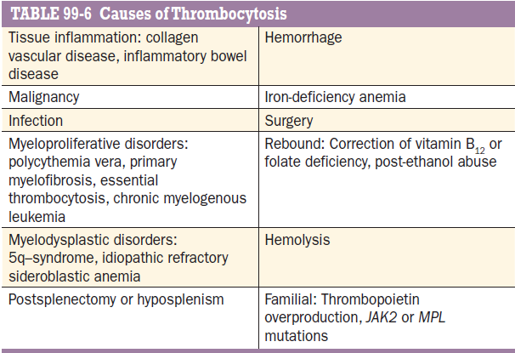

Slide 31
ETIOLOGY
Megakaryocytopoiesis &platelet production depend on thrombopoietin and its receptor MPL
Early megakaryocytic progenitors -require IL-3 & stem cell factor for optimal proliferation
Their subsequent terminal development -enhanced by the chemokine stromal cell-derived factor 1 (SDF-1)
Thrombopoietin - primarily in the liver, lesser extent in other organs (most importantly the bone marrow)

Slide 32
Inverse correlation- between platelet count and plasma thrombopoietin
Plasma thrombopoietin level -controlled by the size of the megakaryocyte progenitor cell pool
Thrombopoietin also enhances the reactivity of their end-stage product, the platelet

Slide 33
CLINICAL FEATURES
Incidentally by abn. platelet count on routine medical evaluation
Hemorrhagic tendancies (easy bruising)
Thrombotic tendencies (microvascular occlusive events- erythromelalgia, ocular migraine, TIA
Mild splenomegaly
Significant splenomegaly-s/o another MPN (PV, PMF, or CML)

Slide 34
Anemia is unusual
Mild neutrophilic leukocytosis
Blood smear number of platelets (may be very large)
May cause hyperkalemia- release of platelet K+ upon blood clotting (test tube artifact, not a/w ECG abnormalities)
Arterial oxygen measurements –inaccurate unless thrombocythemic blood is collected on ice

Slide 35
PT, APTT- normal
Prolonged BT and impaired platelet aggregation
platelet count-hinder marrow aspiration
Marrow biopsy- megakaryocyte hypertrophy & hyperplasia, increase in marrow cellularity
If marrow reticulin is increased→another diagnosis

Slide 36
Absence of stainable iron needs explanation
Iron deficiency alone can cause thrombocytosis
Absent marrow iron in presence of hypercellular marrow-feature of PV
Nonrandom cytogenetic abnormalities occur in ET, uncommon

Slide 37
DIAGNOSIS
Thrombocytosis -broad variety of clinical disorders (many have inflammatory cytokine production)
JAK2 V617F mutation – 55% ET
JAK2 V617F is absent- cytogenetic evaluation mandatory to find thrombocytosis
due to CML (Ph chromosome )
myelodysplastic disorder (the 5q− syndrome)

Slide 38
If Ph chromosome cytogenic study –ve → FISH analysis for bcr-abl is preferred assay
Bcr-abl translocation can be present in the absence of the Ph chromosome
bcr-abl reverse transcriptase PCR a/w false-positive results

Slide 39
In JAK2 mutation –ve pts→CALR (type 1 or type 2) : 36%
MPL mutations : 4%
Significant splenomegaly-suggest another MPN, hence red cell mass determination needed
ET can evolve into PV (usually in women with JAK2 V617F) or PMF (usually in men with type 1 CALR mutations)
Over years due to clonal evolution or succession

Slide 40
Sufficient overlap of the JAK2 V617F neutrophil allele burden b/w ET and PV
Only a red cell mass and plasma volume determination- distinguish PV from ET

Slide 41
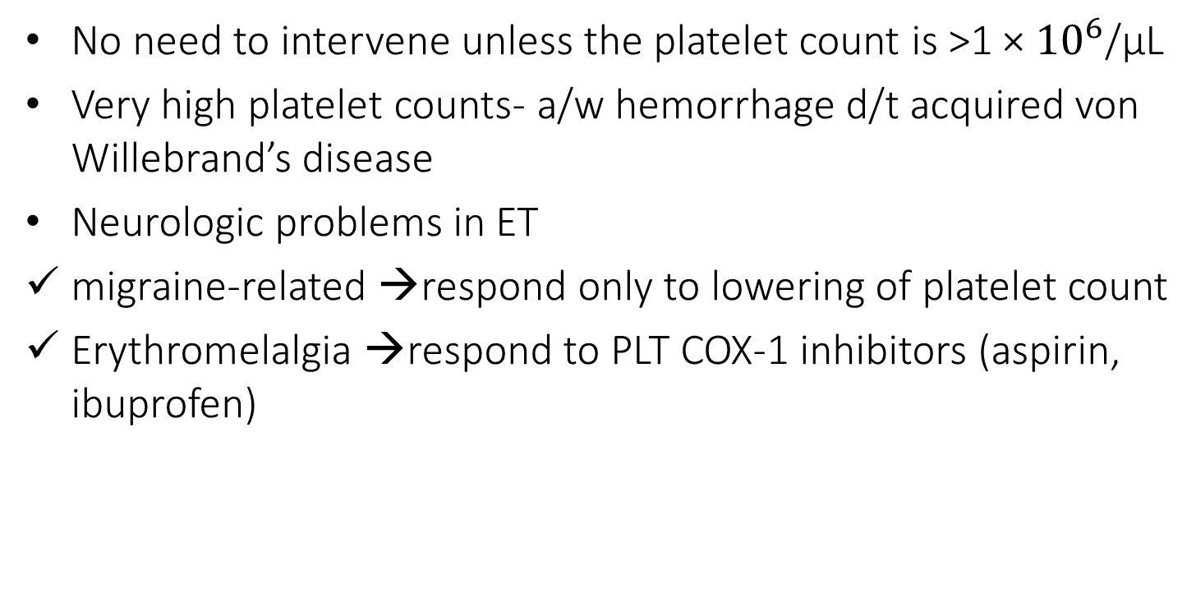
COMPLICATIONS
No need to intervene unless the platelet count is >1 × ${10}^{6}$/μL
Very high platelet counts- a/w hemorrhage d/t acquired von Willebrand’s disease
Neurologic problems in ET
migraine-related →respond only to lowering of platelet count
Erythromelalgia →respond to PLT COX-1 inhibitors (aspirin, ibuprofen)

Slide 42
TREATMENT
Elevated platelet count, asymptomatic patient, without cardiovascular risk factors or tobacco use→ no therapy
When platelet count rises above 1 × 10^6/Μl →substantial quantity of high molecular-weight von Willebrand multimers are removed from the circulation and destroyed by the enlarged platelet mass→ acquired von Willebrand’s disease
Identified by a reduction in ristocetin cofactor activity
Aspirin could promote hemorrhage
Bleeding -rarely spontaneous
Usually responds to ε-aminocaproic acid (given prophylactically before and after elective surgery)
Plateletpheresis - temporary and inefficient remedy

Slide 43
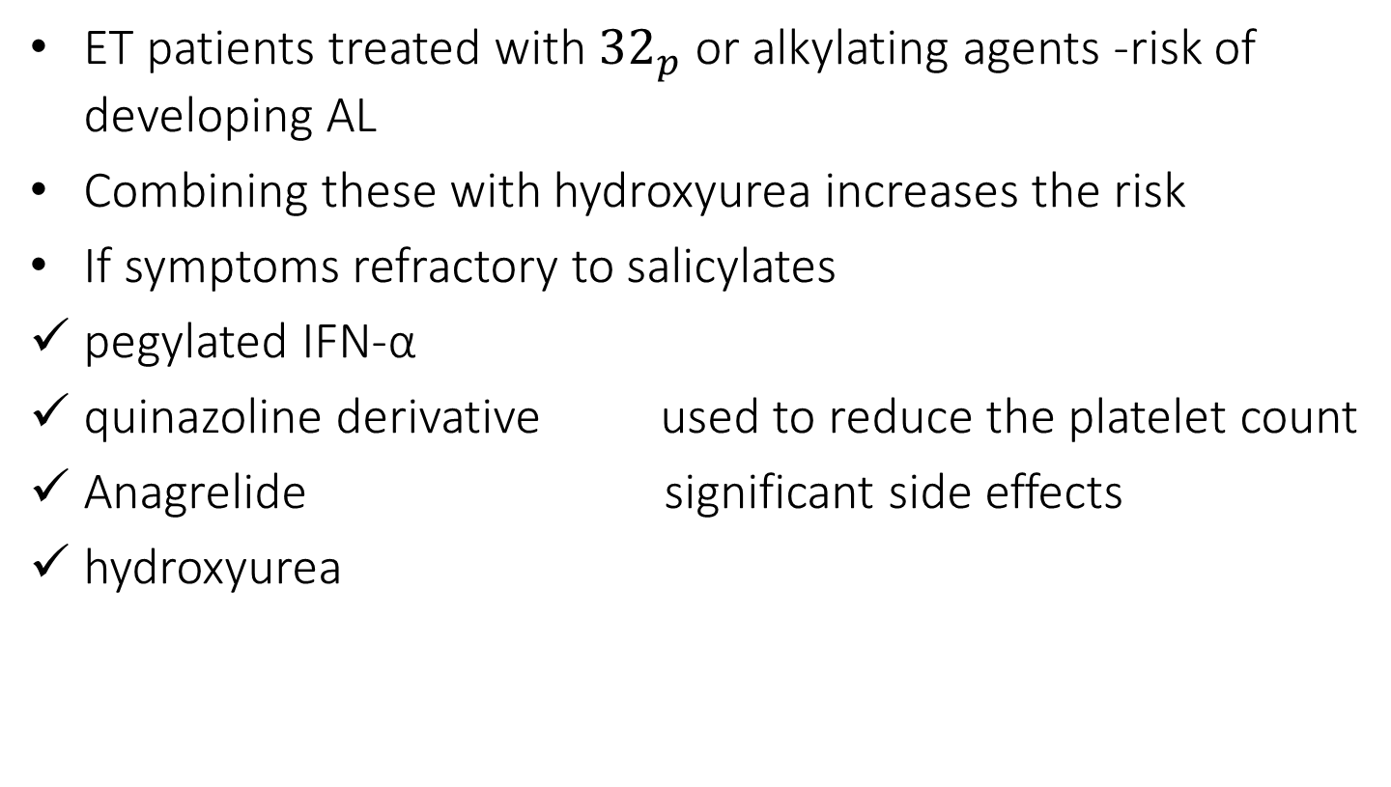
ET patients treated with ${32}_{p}$ or alkylating agents -risk of developing AL
Combining these with hydroxyurea increases the risk
If symptoms refractory to salicylates
pegylated IFN-α
quinazoline derivative used to reduce the platelet count
Anagrelide significant side effects
hydroxyurea

Slide 44
Hydroxyurea + aspirin : effective than anagrelide + aspirin, for prevention of TIA
as hydroxyurea is an NO donor
risk of GI bleeding higher with aspirin + anagrelide
Normalizing the platelet count →not prevent either arterial or venous thrombosis
Pegylated interferon→can produce a complete molecular remission in some ET patients

Slide 45
CHRONIC NEUTROPHILIC LEUKEMIA (CNL)
Clonal proliferation of mature neutrophils with few or no circulating immature granulocytes
In 2013, CNL was a/w activating mutations of gene- CSF3R encoding for the receptor for G-CSF (a/k/a CSF3)
Rare , with <200 reported cases
Median age at diagnosis ∼67 years
Equally prevalent in both genders
Median survival is ∼2 years

Slide 46
Patients may be asymptomatic
Constitutional symptoms, splenomegaly, anemia, thrombocytopenia
Causes of death- leukemic transformation, severe cytopenias, marked treatment-refractory leukocytosis
Pathogenesis
CSF3 -main growth factor for granulocyte proliferation and differentiation
Recombinant CSF3 is used for the treatment of severe neutropenia, including severe congenital neutropenia (SCN)
Some patients with SCN acquire CSF3R mutations

Slide 47
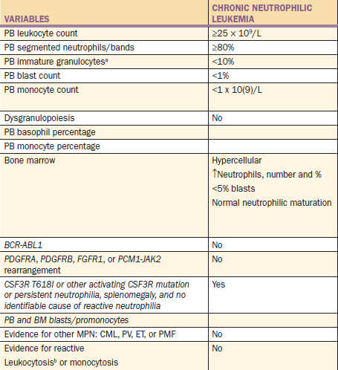
Diagnosis
Exclusion of the more common causes of neutrophilia (infections, inflammatory processes)

Slide 48
Treatment
palliative and suboptimal in efficacy
ASCT- reasonable to consider in presence of symptomatic disease, esp. in younger patients
Cytoreductive therapy with hydroxyurea – good
Response to hydroxyurea therapy is often transient
Interferon α- alternative drug
Ruxolitinib (a JAK1 and JAK2 inhibitor)
Response is often incomplete and temporary

Slide 49
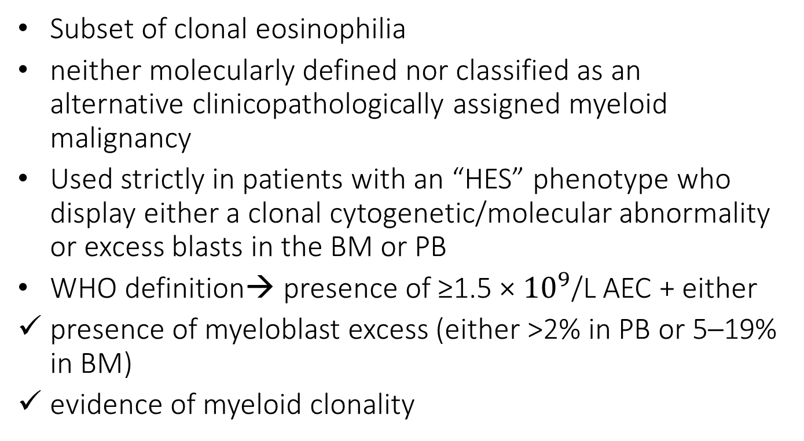
Chronic Eosinophilic Leukemia, Not Otherwise Specified
(CEL-NOS)
Subset of clonal eosinophilia
neither molecularly defined nor classified as an alternative clinicopathologically assigned myeloid malignancy
Used strictly in patients with an “HES” phenotype who display either a clonal cytogenetic/molecular abnormality or excess blasts in the BM or PB
WHO definition→ presence of ≥1.5 × ${10}^{9}$/L AEC + either
presence of myeloblast excess (either >2% in PB or 5–19% in BM)
evidence of myeloid clonality

Slide 50
Cytogenetic abnormalities in CEL, other than those a/w molecularly defined eosinophilic disorders
trisomy 8 (most frequent)
t(10;11)(p14;q21)
t(7;12)(q11;p11)
CEL-NOS -no response to imatinib
Treatment not different from similar MPNs
ASCT for transplant-eligible patients with poor risk factors

Slide 51
MASTOCYTOSIS
Mast cell disease (MCD) - tissue infiltration by morphologically as well as immunophenotypically abnormal mast cells
Two broad categories
Cutaneous mastocytosis
Systemic mastocytosis (SM)
MCD in adults- usually systemic ,clinical course can be indolent or aggressive, depending on absence or presence of impaired organ function

Slide 52
Symptoms and signs
urticaria pigmentosa
mast cell mediator release symptoms(headache, flushing, nausea, lightheadedness, syncope, anaphylaxis, pruritus, urticaria, diarrhea, angioedema,abdominal cramps)
organ damage (lytic bone lesions, osteoporosis,HSM, cytopenia)
Aggressive SM can be
a/w another myeloid malignancy (MPN, MDS, MDS/MPN overlap (e.g., CMML)
present as overt mast cell leukemia (MCL)
Life expectancy is near normal in indolent SM, significantly shortened in aggressive SM

Slide 53
Diagnosis
BM examination : clusters of morphologically abnormal, spindle-shaped mast cells (immunohistochemical stains specific to mast cells -tryptase, CD117)
Mast cell immunophenotyping reveals aberrant CD25 expression by neoplastic mast cells
Increased levels of serum tryptase, histamine,urine histamine metabolites and prostaglandins
Mutation screening- KIT mutations (usually KITD816V) seen inmajority of pts

Slide 54
2016 WHO classification
(1) cutaneous mastocytosis (CM),
(2) SM
(3) mast cell sarcoma (MCS)
Another classification
(a) indolent SM (ISM)
(b) smoldering SM (SSM)
(c) SM with an associated hematological neoplasm (SM-AHN)
(d) aggressive SM (ASM)
(e) MCL

Slide 55
Treatment
mast cell mediator release symptoms- H-1,H-2 histamine receptor blockers, cromolyn sodium
patients with propensity to vasodilatory shock- wear a medical alert bracelet, carry an Epi-Pen self-injector for self-administration of s/c epinephrine
Urticaria pigmentosa- variable response to topical and systemic corticosteroid therapy

Slide 56
Aggressive SM
Interferon α or cladribine : first-line therapy
Imatinib -ineffective in the treatment of PDGFR-unmutated SM
Midostaurin(multikinase inhibitor)- study shown effective in 45%
ISM or SSM
Study reported marginal value for masitinib (oral tyrosine kinase inhibitor that inhibits KIT and LYN)

Slide 57
MYELOPROLIFERATIVE NEOPLASM,
UNCLASSIFIABLE (MPN-U)
Includes MPN-like neoplasms that cannot be clearly classified as one of the other seven subcategories of MPN
May present with unusual thrombosis or unexplained organomegaly, normal blood counts, but carry MPN-characteristic mutations (JAK2 , CALR)or BM morphology consistent with MPN
Some cases of MPN-U represent earlier stages in PV or ET (but fail to meet the threshold hemoglobin levels or platelet counts that is required per WHO diagnostic criteria)
Specific treatment interventions not necessary in asymptomatic
Pts with arterial thrombotic complications may require cytoreductive and aspirin therapy
Pts with venous thrombosis may require systemic anticoagulation

Slide 58
THANK YOU

