Slide 1
APPROACH TO HEADACHE
Dr. nithya ramanujan

Slide 2
INTRODUCTION
Headache is pain in any part of the head, including the scalp, face, interior of the head
Headache is one of the most common reasons patients seek medical attention
Headache is due to activation of pain sensitive structures
-in or around the brain
-Skull
-face
-Sinuses
-teeth

Slide 3
ETIOLOGY
May occur as a primary disorder or be secondary to another disorder
Primary
◦ Migraine
◦ Cluster headache
◦ Trigeminal autonomic cephalalgias
◦ Other primary headache disorders

Slide 4
Secondary
◦ Extracranial- Ocular, Dental, PNS, Vascular
◦ Intracranial- Bleeds, Tumors, CSF leak, IIH,
Infections, Vascular
◦ Systemic- Hypertension, Fever, Giant cell
arteritis, Hypoxia, Hypercapnea
◦ Drugs and Toxins- Nitrates, Analgesic overuse,
Caffeine withdrawal, CO

Slide 5
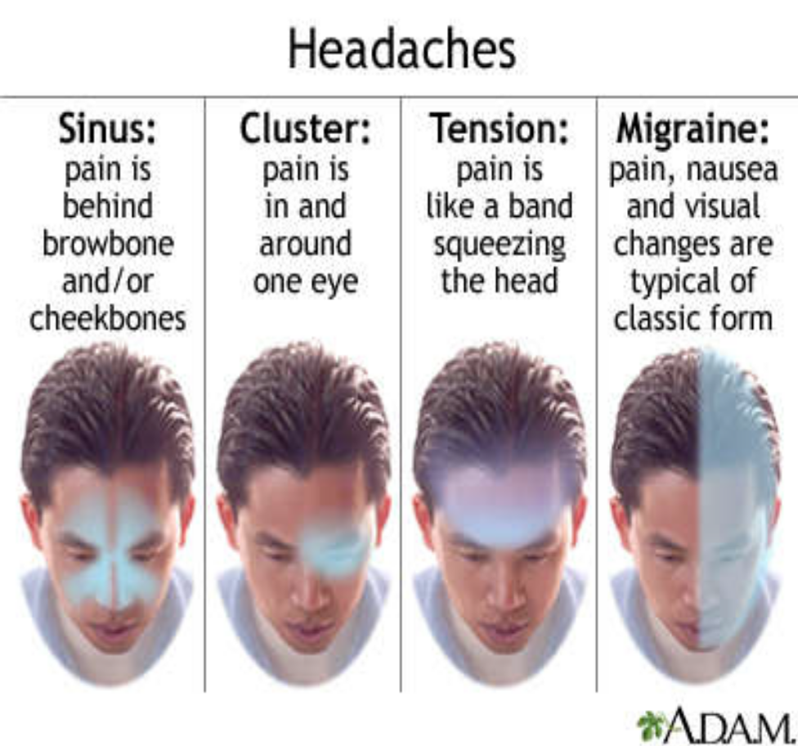
EVALUATION
History
Location
Duration
Severity
Onset (sudden/ gradual)
Quality (throbbing/ constant/ intermittent)
Exacerbating and remitting factors
Whether recurrent

Slide 6
◦ Vomiting: Migraine or increased intracranial pressure
◦ Fever: Infection (encephalitis, meningitis, sinusitis)
◦ Red eye and/or visual symptoms (halos, blurring)
◦ Visual field deficits, diplopia, or blurring vision:
Ocular migraine, mass lesion, or IIH
◦ Lacrimation and facial flushing: Cluster headache
◦ Rhinorrhea: Sinusitis

Slide 7
◦ Pulsatile tinnitus: IIH
◦ Preceding aura: Migraine
◦ Focal neurologic deficit: Encephalitis, meningitis,
bleeds, tumor, or other mass lesion
◦ Seizures: Encephalitis, tumor, or other mass lesion
◦ Syncope at headache onset: SAH
◦ Myalgias and/or vision changes (in people >55yr): Giant cell arteritis

Slide 8
Past medical history
◦ Exposure to drugs, substances (like caffeine)
◦ Recent lumbar puncture
◦ Immunosuppressive disorders or IV drug use
◦ Hypertension
◦ Cancer
◦ Dementia, trauma, coagulopathy, or use of
anticoagulants or ethanol
Family history- migraine, familial hemiplegic migraine

Slide 9
PHYSICAL EXAMINATION
General appearance (whether restless or calm in
a dark room)
Vital signs, including temperature
General examination with a focus on the head
and neck
Neurological examination
Scalp
Ipsilateral temporal artery
TM joints
Eyes and periorbital area including fundus

Slide 10
Nares
Oropharynx
Neck and cervical spine

Slide 11
RED FLAG SIGNS
Neurologic symptoms or signs
Immunosuppression or cancer
Meningismus
Onset of headache after age 50
Thunderclap headache
Worsening with positional change
Systemic symptoms (eg, fever, weight loss)
Progressively worsening headache
Red eye and halos around lights

Slide 12
Neurologic symptoms or signs (eg, altered mental status, confusion, neurogenic weakness, diplopia, papilledema, focal neurologic deficits)→ Encephalitis,subdural hematoma, subarachnoid
hemorrhage, intracerebral hemorrhage, tumor,other
intracranial mass, increased intracranial pressure
Immunosuppression or cancer--- CNS infection, metastases
Meningismus--- Meningitis, subarachnoid hemorrhage, subdural empyema
Onset of headache after age 50--- Increased risk of a serious cause (eg, tumor, giant cell arteritis)

Slide 13
Thunderclap headache (severe headache that peaks within a few seconds)--- Subarachnoid hemorrhage, pituitary apoplexy, cervical artery disection, RCVS(reversible cerebral vasoconstiction syndrome), cerebral sinus venous thrombosis
Combination of fever, weight loss, visual disturbances, jaw claudication, temporal artery tenderness, and proximal myalgias--- Giant cell arteritis
Systemic symptoms (eg, fever, weight loss)--- Sepsis, hyperthyroidism, cancer
Progressively worsening headache--- Secondary headache
Red eye and halos around lights--- Acute angle closure glaucoma

Slide 14
Chronic daily headache
Headache for 15 days or more per month.
Primary
◦ Chronic migraine
◦ Chronic tension type headache
◦ Chronic cluster headache
◦ Chronic paroxysmal hemicrania

Slide 15
Secondary
◦ Post traumatic
◦ Post infectious
◦ Iatrogenic
◦ Inflammatory
Giant cell arteritis
Sarcoidosis
Behcet’s syndrome
◦ Chronic CNS infection
◦ Medication overuse

Slide 16
New daily persistent headache
Headache on most/all days.
Can clearly recall the moment of onset.
Clinically distinct syndrome.
Primary
◦ Migranous type
◦ Featureless (tension-type)
Secondary
◦ Subarachnoid haemorrhage
◦ Low CSF volume
◦ Raised CSF pressure
◦ Post-traumatic
◦ Chronic meningitis

Slide 17
INVESTIGATIONS
All routines
CT / MRI Brain
Lumbar puncture and CSF analysis
Tonometry
ESR
CT PNS

Slide 18
TREATMENT
Directed at the cause
Medically Intractable
◦ Occipital nerve stimulations
◦ Single pulse transcranial magnetic stimulation

Slide 19
Migraine
20 year old female presented with headache 1 day duration,over right side of head, throbbing type, aggravated by movement, associated nausea and vomiting. Physical examination normal. She gives history of repeated attacks of similar episode in past. No obvious cause identified from history and examination. Diagnosis???

Slide 20
Simplified diagnostic criteria for migraine
Repeated attacks, 4-72hours,normal examination, no obvious cause
+
Atleast 2- unilateral pain, throbbing pain, aggravation by movement, moderate or severe intensity
+
Atleast 1- nausea/vomiting, photophobia& phonophobia

Slide 21
Pathogenesis
Due to the dysfunction of monoaminergic sensory control systems in brainstem and hypothalamus.
Cortical spreading depression
Triggers(sleep deprivation, hunger, stress, menses)
Activate cells in trigeminal nucleus
Vth nerve sensory endings- release of vasoactive peptides(CGRP)

Slide 22
Vasodilatation
Release of inflammatory occipital
mediators temporal
parietal
Meningeal irritation frontal
flashes of light
Pain vasoconstriction-scotoma

Slide 23
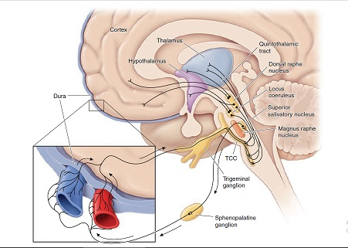
3rd order neuron
Meningeal vessels
2nd order neuron
1st order neuron

Slide 24
Treatment of acute migraine
Simple analgesics- acetaminophen, aspirin, caffeine
NSAIDS- naproxen, ibuprofen, tolfenamic acid, diclofenac
5-HT 1B/1D agonists (MOA- vasoconstiction)- ergotamine, naratriptan, rizatriptan, sumatriptan, frovatriptan, almotriptan, eletriptan, zoimitriptan(oral)
Nasal- dihydroergotamine, sumatriptan, zolmitriptan
Parenteral-dihydroergotamine, sumatriptan
Dopamine R- antagonists (adjuvant, improves gastric absorption of triptans and NSAIDS) - metoclopromide, prochlorperazine(oral)
Parenteral- chlorpromazine, metoclopromide, prochlorperazine
Other- midrin(acetaminophen+ dichloralphenazone+ isometheptene)
Parenteral- opioids
Neuromodulation- non invasive vagus nerve stimulation(nVNS), single pulse transcranial magnetic stimulation(sTMS)

Slide 25
Newer drugs for migaine
CGRP ANTAGONISTS
Telcagepant
Olcegepant
Monoclonal antibody targeting CGRP
Erenumab
Fremanezumab

Slide 26
Prophylaxis of migaine
Beta blockers-propranolol, metoprolol
Antidepressants- amitriptyline(s/e- wt gain), dosulepin, nortriptyline, venlafaxine
Anticonvulsant- topiramate, valproate
Serotonergic drugs- pizotifen
Other- flunarizine, candesartan
Neuromodulation- sTMS(single pulse transcranial magnetic stimulation)
Ona botulinum toxin type A- c/c migaine

Slide 27
Tension type headache
25 year old female, with h/o depressive episode in past present with headache 2weeks duration. Pain is mild to start with & fluctuating in nature(mild to severe). She describes it as tight band like discomfort around head. O/e forehead musles are tensed. No associated symptoms. Diagnosis??
Most common primary
Associated with depression, not tension
Muscle contraction(tensed)
Episodic- simple analgesics( aspirin, pcm, NSAIDS)
Chronic(15 days or more)- amitriptyline

Slide 28
Trigeminal autonomic cephalalgia
Cluster headache( Episodic & Chronic)
Paroxysmal hemicrania( Episodic & Chronic)
Short-lasting unilateral neuralgiform headache attacks
Short-lasting unilateral neuralgiform headache attacks with conjunctival injection and tearing (SUNCT)
-Episodic SUNCT
-Chronic SUNCT
Short-lasting unilateral neuralgiform headache attacks with cranial autonomic symptoms (SUNA)
-Episodic SUNA
-Chronic SUNA
Hemicrania continua
Probable trigeminal autonomic cephalalgia

Slide 29
Cluster head ache
30 year old male presented with headache at night casuality, deep excruciating and explosive pain behind his right eye (retroorbital) lasting about 30 mins. He woke up from sleep due pain and he was rubbing his head with hands and vigourosly shaking his head. There was associated conjunctival injection, lacrimation,aural fullness and right eye photophobia (unilaeral). He says everyday similar attacks occur sharp at 2am and 12pm (periodicity) for the past 8 weeks. Diagnosis???

Slide 30
Typical cluster haeadache- daily bouts of 1 or 2 attacks, shorter duration, unilateral pain. 8- 10 weeks year. Pain free interval 1year.(episodic)
Pain free interval <3 months- chronic
TREATMENT
Acute- o2 inhalation(TOC), sumatriptans(s/c), suma/zolmi nasal spray, nVNS
Short term prevention (episodic)- prednisolone, verapamil, greater occipital nerve injection
Long term prevention (episodic and prolonged chronic)
-verapamil, topiramate, nVNS, lithium, melatonin,
gabapentin

Slide 31
Paroxysmal hemicrania
Young medical student come to OPD with history of headache episodes lasting 3-4 mins associated with severe lacrimation and nasal congestion. He says >5 episodes of very severe pain which may be right or left sided (unilteral) occur everyday. He is having rapid relief on intake of indomethacin. Diagnosis??
Male=female
If remission(+) episodic
Non remitting form, chronic
Treatment – indomethacin, topiramate, pixoxicam, nVNS

Slide 32
Patient come to casuality with unilateral temporal pain, descibed as stabbing, lasting few seconds, associated with ipsilateral lacrimation and conjunctival injection (absent in SUNA). He give history of groups of stab like pain. He had more than 20 episodes till now. He also said that he took indomethacin asking his medical friend. But no relief obtained. Diagnosis???
SHORT LASTING UNITERAL NEURALGIFORM HEADACHE ATTACKS WITH CONJUNCTIVAL INJECTION & TEARING- SUNCT
SHORT LASTING UNITERAL NEURALGIFORM HEADACHE ATTACKS WITH CRANIAL AUTONOMIC SYMPTOMS- SUNA

Slide 33
3 patterns, single stabs or group of stabs or long attack
( many minutes) with multiple stab, no resolution of pain in between stabs.
Cutaneous or other triggers, lack of respnse to indomethacin- SUNCT
Treatment
Abortive therapy- iv lidocaine
Preventive therapy- lamotrigine, topiramate, gabapentin, carbamazepine

Slide 34
Other primary head ache
Primary cough headache- common in elderly
Primary exercise headache
Primary headache associated with sexual activity
Primary thunderclap headache
Cold-stimulus headache
Headache attributed to external application of a cold stimulus
Headache attributed to ingestion or inhalation of a cold stimulus
External-pressure headache
External-compression headache
External-traction headache
Primary stabbing headache
Nummular headache
Hypnic headache
New daily persistent headache (NDPH)

Slide 35
THANK YOU

