Slide 1
METABOLIC AKLALOSIS
DR AMRITA KURIAN

Slide 2
Elevated arterial pH
Increase in the serum bicarbonate
Increase in PaCO2 as a result of compensatory alveolar hypoventilation.
Often accompanied by hypochloremia and hypokalemia.

Slide 3
PATHOGENESIS
Results from net gain of bicarbonate or loss of nonvolatile acid (usually HCl by vomiting) from the extracellular fluid.
Generation stage : Loss of acid typically causes alkalosis
When vomiting/NG suction causes loss of HCl from stomach, bicarbonate secretion can’t be initiated in the small bowel bicarbonate is added to the ECF.
Maintenance stage: secondary factors prevent the kidneys from compensating by excreting HCO3
Maintenance of metabolic alkalosis, therefore, represents a failure of the kidneys to eliminate excess HCO3 from the extracellular compartment.

Slide 4
Alkalosis will be maintained if
(1) volume deficiency, chloride deficiency, and K+ deficiency exist in combination with a reduced GFR; or
(2) hypokalemia exists because of autonomous hyperaldosteronism.

Slide 5
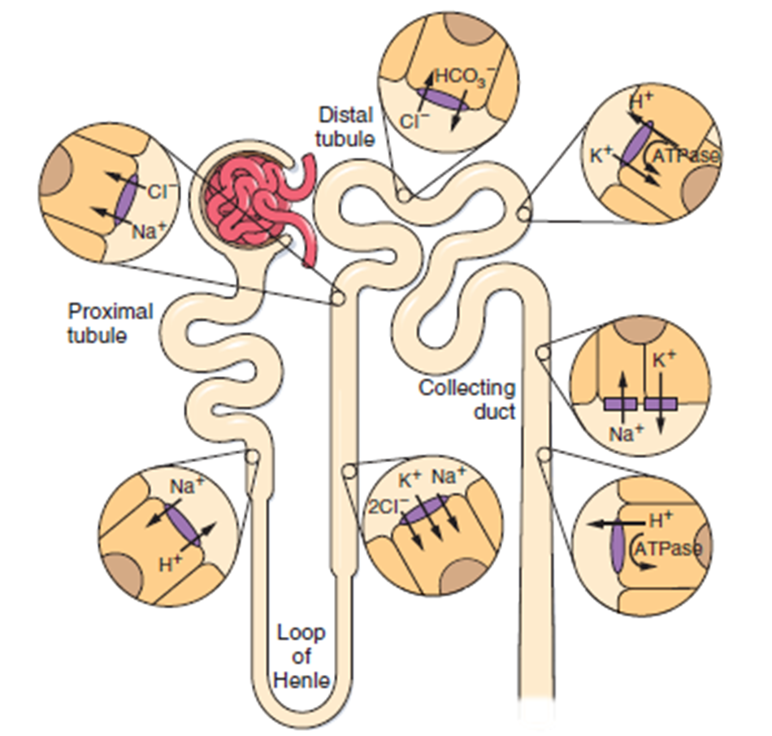
THE KEY EPITHELIAL TRANSPORTERS AND CHANNELS THAT PARTICIPATE IN HCO3− REABSORPTION AND SECRETION.

Slide 6
MECHANISMS
ECF VOLUME CONTRACTION: results in hypotension and secondary hyperaldosteronism.
PRIMARY HYPERALDOSTERONISM: ECF volume expansion + hypertension

Slide 7
3 GOLDEN RULES
Metabolic alkalosis predominantly due to volume contraction as in vomiting, RTA, diuretics : SALINE RESPONSIVE, URINARY CHLORIDE <20mEq
Metabolic Alkalosis with coexisting hypertension as in primary hyperaldosteronism, Cushing’s Syndrome and Renin secreting tumors: SALINE UNRESPONSIVE, URINARY CHLORIDE > 20mEq
Metabolic alkalosis persisting due to irreversible genetic defect of renal tubules as in Bartter’s , Gitelman’s or Liddle’s syndromes: SALINE UNRESPONSIVE

Slide 8
Thus, to establish the cause of metabolic alkalosis we need to assess the status of the extracellular fluid volume (ECFV), the serum [K+], and in some circumstances, an assessment of the renin-aldosterone system.
Eg (1) The presence of chronic hypertension and chronic hypokalemia in an alkalotic patient mineralocorticoid excess or that the hypertensive patient is receiving diuretics.
Eg (2) Low plasma renin activity and normal values for both the urine [Na+] and [Cl−], in a patient who is not taking diuretics, suggests primary mineralocorticoid excess.

Slide 9
Eg (3) The combination of hypokalemia and alkalosis in a normotensive, nonedematous patient can be due to Bartter’s or Gitelman’s syndrome, magnesium deficiency, vomiting, exogenous alkali, or diuretic ingestion.

Slide 10
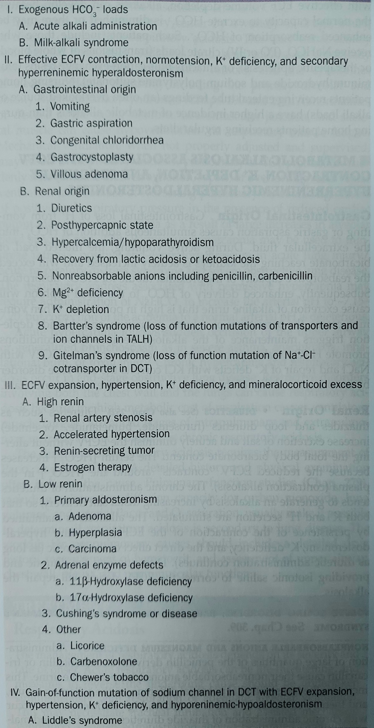
CAUSES

Slide 11
ALKALI ADMINISTRATION
Chronic administration of alkali to those with normal renal function rarely causes alkalosis.
In patients with coexistent hemodynamic disturbances associated with effective ECF volume depletion, alkalosis can develop because the normal capacity to excrete HCO3 is diminished or there may be enhanced reabsorption of HCO3.
These include those who receive NaHCO3 (PO or IV), citrate loads (transfusions of whole blood or therapeutic apheresis), or antacids plus cation-exchange resins (aluminum hydroxide and sodium polystyrene sulfonate).

Slide 12
METABOLIC ALKALOSIS ASSOCIATED WITH ECFV
CONTRACTION, K+ DEPLETION, AND SECONDARY
HYPERRENINEMIC HYPERALDOSTERONISM
GASTROINTESTINAL ORIGIN
Gastrointestinal loss of H+ from vomiting or gastric aspiration causes simultaneous addition of HCO3 into the extracellular fluid.
During active vomiting, the filtered load of bicarbonate reaching the kidneys is acutely increased and exceeds the reabsorptive capacity of the proximal tubule for HCO3 absorption.
Subsequently, enhanced delivery of HCO3 to the distal nephron excretion of alkaline urine.

Slide 13
When vomiting ceases, the persistence of volume, potassium, and chloride depletion triggers maintenance of the alkalosis because these conditions promote HCO3 reabsorption (Maintenance stage)
Correction of the contracted ECFV with NaCl and repair of K+ deficits with KCl corrects the acid-base disorder by restoring the ability of the kidney to excrete the excess bicarbonate.

Slide 14
RENAL ORIGIN
DIURETICS
Diuretics such as thiazides and loop diuretics increase excretion of salt and acutely diminish the ECFV without altering the total body bicarbonate content.
The serum [HCO3−] increases because the reduced ECFV “contracts” around the [HCO3−] in the plasma (contraction alkalosis).
The chronic administration of diuretics increase distal salt delivery, so that both K+ and H+ secretion are stimulated.

Slide 15
The alkalosis is maintained by persistence of the contraction of the ECFV, secondary hyperaldosteronism, K+ deficiency, and the direct effect of the diuretic (as long as diuretic administration continues).
Discontinuing the diuretic and providing isotonic saline to correct the ECFV deficit will repair the alkalosis.

Slide 16
SOLUTE LOSING DISORDERS :
BARTTER’S SYNDROME.
Autosomal Recessive
Mutations impeding Cl− associated Na+ reabsorption in the TAL (through Na+/K+/2Cl− cotransporter)
Results in ECF volume contraction and stimulation of RAAS : loss of H+ and K+
Ill early in life with metabolic alkalosis & volume depletion(as in abusing loop diuretic agents).
Hypercalciuria and mild hypomagnesemia

Slide 17
GITELMAN’S SYNDROME
Genetic mutations inactivate thiazide sensitive Na+/Cl− cotransporter in the early DCT
Hypokalemia and metabolic alkalosis
Clinically apparent later in life
Hypomagnesemia & hypocalciuria

Slide 18
NONREABSORBABLE ANIONS AND MAGNESIUM DEFICIENCY
Administration of large quantities of the penicillin derivatives (carbenicillin or ticarcillin) cause their nonreabsorbable anions to appear in the urine.
Increases the transepithelial potential difference in the collecting tubule - enhances H+ and K+ secretion.
Mg2+ deficiency may occur with chronic administration of thiazides, alcoholism,malnutrition and in Gitelman’s syndrome.
Potentiates the development of hypokalemic alkalosis by enhancing distal acidification through stimulation of renin and hence aldosterone secretion.

Slide 19
POTASSIUM DEPLETION:
Chronic K+ depletion may cause metabolic alkalosis by increasing urinary acid (H+) excretion.
The renal generation of NH4+ (ammoniagenesis) is upregulated directly by hypokalemia.
Chronic K+ deficiency also upregulates the renal H+/K+ ATPase to increase K+ absorption at the expense of enhanced H+ secretion.
Alkalosis associated with severe K+ depletion is resistant to salt administration, but repair of the K+ deficiency corrects the alkalosis.

Slide 20
AFTER TREATMENT OF LACTIC ACIDOSIS OR KETOACIDOSIS
When an underlying stimulus for the generation of lactic acid or ketoacid is corrected by treatment of the underlying disorder, such as correction of shock or severe volume depletion by volume restoration, or with insulin therapy, respectively, the lactate or ketones are metabolized to yield an equivalent amount of HCO3 −
Acidosis-induced contraction of the ECFV and K+ deficiency act in concert to sustain the alkalosis.

Slide 21
POSTHYPERCAPNIA
Prolonged CO2 retention with chronic respiratory acidosis enhances renal HCO3− absorption and the generation of new HCO3− (increased net acid excretion).
Metabolic alkalosis results from the effect of the persistently elevated [HCO3−] when the elevated PaCO2 is abruptly returned toward normal.

Slide 22
METABOLIC ALKALOSIS ASSOCIATED WITH
ECFV EXPANSION, HYPERTENSION, AND
HYPERALDOSTERONISM
Increased aldosterone levels may be the result of (1) autonomous primary adrenal overproduction or (2) secondary aldosterone release due to renal overproduction of renin.
Mineralocorticoid excess increases net acid excretion resulting in metabolic alkalosis, which is typically exacerbated by associated K+ deficiency.
Salt retention is due to upregulation of the epithelial Na+ channels in the collecting tubule to aldosterone
As a result of the associated ECFV expansion : hypertension

Slide 23
The kaliuresis persists because of mineralocorticoid excess and distal Na+ absorption causing
  enhanced K+ excretion
  continued K+ depletion with polydipsia,
  inability to concentrate the urine, and
  polyuria.

Slide 24
Liddle’s syndrome
Autosomal Dominant.
Inherited gain of function mutation of genes that regulate the collecting duct Na+ channel (ENaC).
Liddle’s is a rare monogenic form of hypertension due to volume expansion manifested as hypokalemic alkalosis with normal aldosterone levels.

Slide 25
TREATMENT
Primarily directed at correcting the underlying stimulus for HCO3− generation.
If primary aldosteronism or Cushing’s syndrome is present, correction of the underlying cause, when successful, will reverse the hypokalemia and alkalosis.
[H+] loss by the stomach or kidneys can be mitigated by the use of proton pump inhibitors or the discontinuation of diuretics.
The second aspect of treatment is to remove the factors that sustain the inappropriate increase in HCO3− reabsorption, such as ECFV contraction or K+ deficiency.

Slide 26
Isotonic saline is recommended to reverse the alkalosis when ECFV contraction is present.
If associated conditions preclude infusion of saline, renal HCO3− loss can be accelerated by administration of acetazolamide, a carbonic anhydrase inhibitor (125–250 mg IV), which is usually effective in patients with adequate renal function but can worsen K+ losses.

Slide 27
THANK YOU

