Slide 1
CLINICAL DIAGNOSIS OF FIBROCAVITARY DISEASE
DR IBRAHIM ALI SALEEM
JR3
GENERAL MEDICINE
GOVT. TDMCH

Slide 2
1.WHAT IS A FIBRO-CAVITARY LESION?
2.WHAT ARE THE CONDITIONS ASSOCIATED WITH
FIBROCAVITARY LESIONS?
3.HOW DO YOU CLINICALLY DIAGNOSE A FIBROCAVITARY LESION?

Slide 3
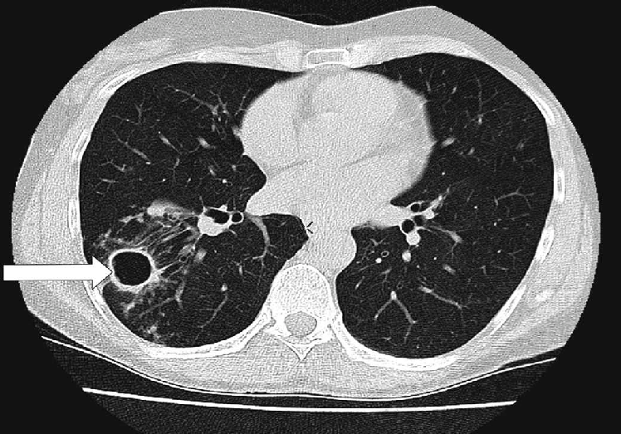
BEHOLD!

Slide 4
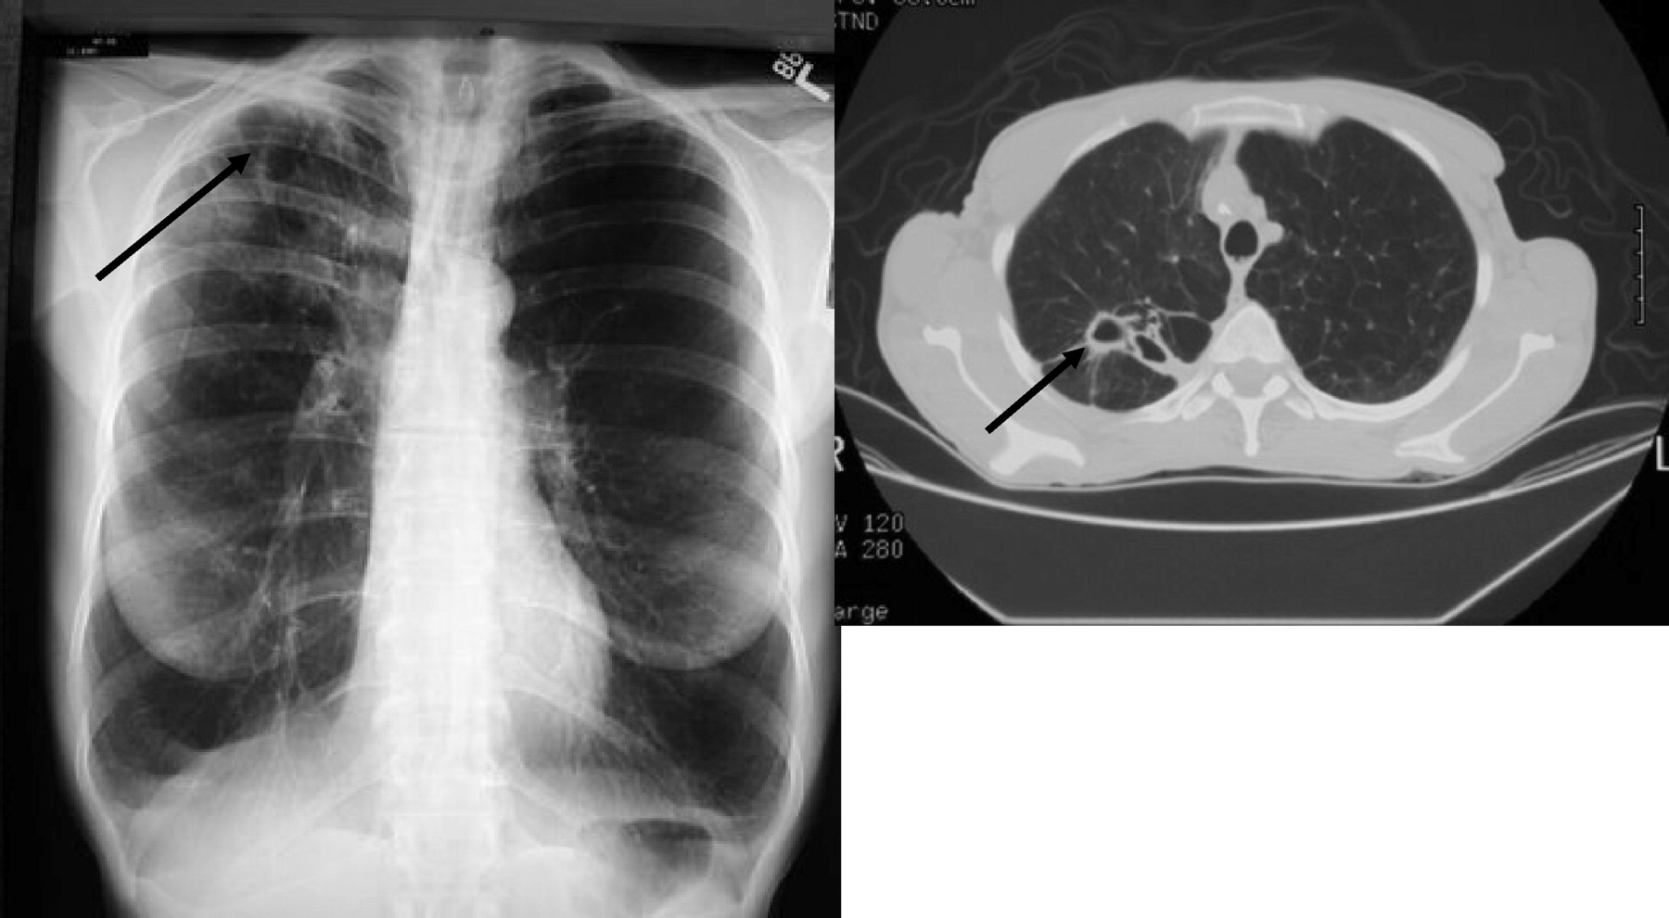

Slide 5
1. WHAT IS A FIBROCAVITARY LESION?
Areas of lung fibrosis
Plus
Areas of cavitations within them

Slide 6
LUNG FIBROSIS: simply put.
‘scarring in the lungs’
“Replacement of lung parenchyma by fibrobast cells producing scar tissue”
impacting how you breathe and get oxygen into the blood.

Slide 7
TYPES OF FIBROSIS
1. Replacement fibrosis
  TB
  Klebsiella
  Aspergillosis
  Parasitic infections
2. Interstitial fibrosis – progressive, bilateral
  ILD
3. Focal/Local - Silicosis

Slide 8
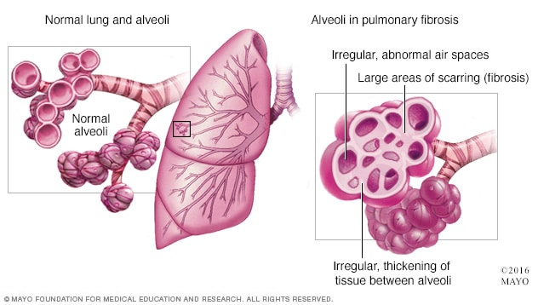

Slide 9
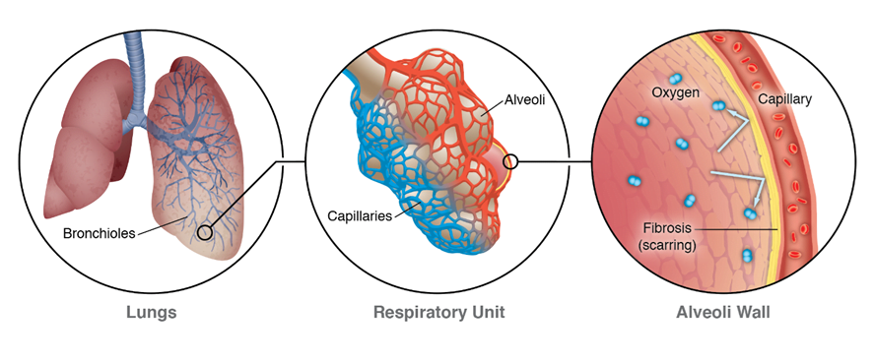

Slide 10
UL fibrosis – most common causes
  Old PTB
  Klebsiella
  Fungal infection

Slide 11
Complications of fibrosis
1. Recurrent infections
2. Cavity
3. Bullae
4. Hemoptysis
5.Traction bronchiectasis

Slide 12
LUNG CAVITY: pathologically
”a gas-filled area of the lung in the center of a nodule or area of consolidation or mass
produced by the expulsion of a necrotic part of the lesion via the bronchial tree”
Wall thickness > 1mm
Diameter > 2cm

Slide 13
LUNG CAVITY: radiographically
A lucency within a zone of pulmonary consolidation, nodule or mass
A lucent area within the lung that may or may not contain a fluid level and
And surrounded by a wall, usually of varied thickness

Slide 14
How a cavity is formed?
An inflammatory process adjacent to a patent bronchus – rupture into the bronchus
Expulsion of the necrotic debris by coughing
Bronchial epithelial cells start lining the cavity
- OPEN CAVITY formed
If the bronchocavitary junction gets obliterated – CLOSED CAVITY formed

Slide 15
Sometimes, a narrow neck connects the cavity with a patent bronchus
  Dormant bacilli can thrive within this cavity

Slide 16
Causes of cavity
Malignancy – Squamous cell cancer
Vasculitis
AI disorders
Infections – Fungus, TB, Pyogenic
Trauma
Congenital

Slide 17
COMPLICATIONS OF CAVITY
1.Fungal growth – Aspergilloma
2.Massive hemoptysis – structurally weak new blood vessels (brochial artery system) supply the cavity – form aneurysm = Rasmussen’s aneurysm
Due to severe cough/ infections - rupture and bleed - hemoptysis
3.Recurrent respiratory infections

Slide 18
Bullae –
  hyperlucency of any size
  wall thickness <1mm

Slide 19
A general rule of lung cavity:
Organisms that cause subacute or chronic pulmonary infections – more frequently associated with cavity
  Mycobacteria, fungi
Exceptions:
  Necrotising pneumonias a/w
  Klebsiella pneumoniae, Staph aureus
A cavity almost always rules out viral etiology

Slide 20
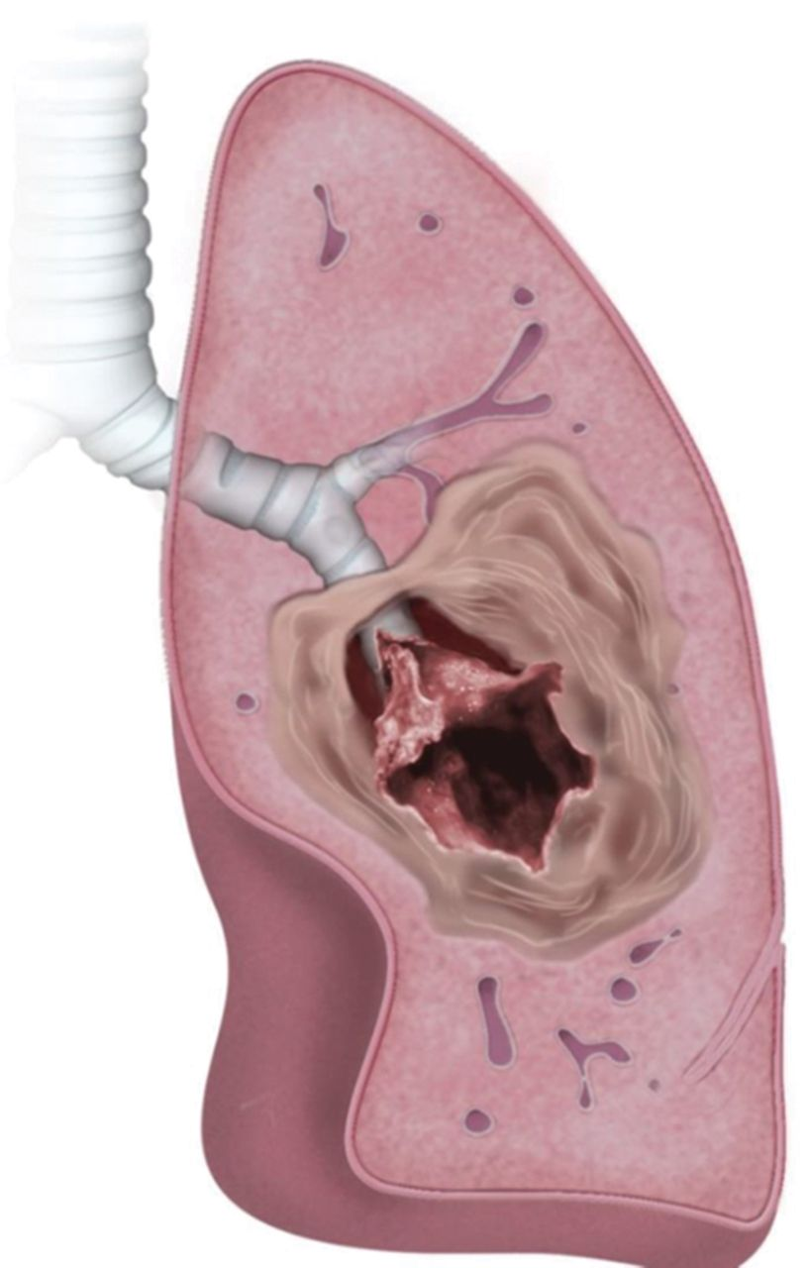
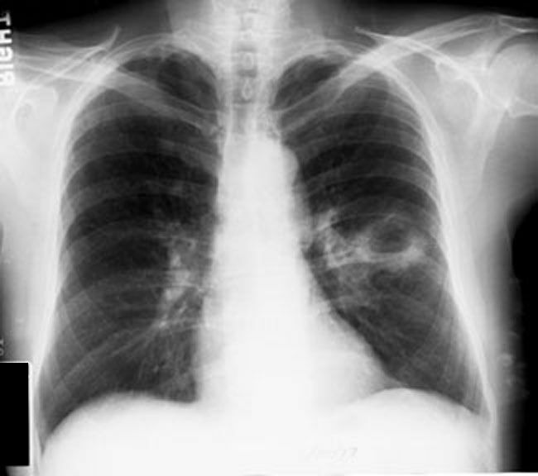

Slide 21
THE CONDITIONS ASSOCIATED WITH
FIBROCAVITARY LESIONS
1. TUBERCULOSIS
2. SARCOIDOSIS
3. BRONCHIECTASIS
4. POST-RADIATION FIBROSIS
5. EMPHYSEMA
6. FIBROSING ALVEOLITIS
7. POST-INFECTIVE SCARRING
8. ANKYLOSING SPONDYLITIS
9. MARFAN’S SYNDROME
10.MEDICATIONS

Slide 22
CLINICAL DIAGNOSIS OF A FIBROCAVITARY LESION
HISTORY
PHYSICAL EXAMINATION

Slide 23

HISTORY
Age :
20-40 : Sarcoidosis, CTD, Pulmonary LCH, Inherited ILD ( Familial IPF, Gaucher’s disease, Hermansky-Pudlak syndrome)
> 50years : IPF, Post TB Fibrosis
A child with Hermansky Pudlak syndrome:

Slide 24
Sex:
Females:
  Premenopausal women (exclusive) – Lymphangioleiomyomatosis, pulmonary involvement in Tuberous sclerosis
  ILD in Hermansky Pudlak Syndrome, CTD
Males:
  Pneumoconioses, RA - ILD

Slide 25
Occupation:
  Pneumoconiosis
  Exposure to silica, coal, asbestos, vapours, fumes, mold
Symptoms:
Usually part of a chronic disease
Hence chronic symptoms +

Slide 26
Symptoms
Chronic dry cough
Expectoration of large amounts of sputum (Bronchiectasis)
Gradual onset dyspnea
Fatigue
Fever

Slide 27
Myalgia
Loss of weight
Loss of appetite
Night sweats
f/o CTD: arthralgia, dry mouth, dry eyes, muscle weakness, numbness, Raynaud’s phenomenon, Chronic back ache

Slide 28
Current and recent medications:
Bleomycin, Amiodarone - fibrosis
Therapeutic Irradiation
Past history of TB, HIV, DM
H/o contact with TB patients
Malignancy, CTD, Other lung infections
  Staph aureus, Klebsiella ( Acute causes of cavitations)
  Covid 19 – Long Covid Syndrome

Slide 29
h/o recurrent lung infections
Subacute and chronic presentation – TB
Acute presentation – staph aureus, klebisella, lung abscess
Bedridden patient
  recurrent aspiration, lung abscess
Family h/o lung disease
  TB, ILD.

Slide 30
Chronic Smoker
  Emphysema, ILD, pulmonary LCH
  Emphysema – associated with Mycobacterium avium complex
Heavy alcoholic – Klebsiella

Slide 31
PHYSICAL EXAMINATION
GENERAL EXAMINATION
Poor nourishment, low BMI
  TB, Malignancy
Marfanoid habitus

Slide 32
External markers of TB:
  Anemia, Clubbing, Matted lymph nodes
  Erythema nodosum
  Phlyctenular conjunctivitis
  Discharging sinuses
  Scrofuloderma
  Lupus Vulgaris
  Generalised Tinea versicolor
  Uveitis

Slide 33
External markers of malignancy:
Cachexia
Anemia, Clubbing, Hard lymph nodes
Acanthosis nigricans
Horner’s Syndrome
SVC obstruction features

Slide 34
Pallor – TB, malignancy
Hyperemia/congested conjunctiva
  Emphysema, SVC obstruction
Icterus
  Hepatitis ( ATT-induced)
  Liver metastasis

Slide 35
Edema
  Cor Pulmonale – Emphysema, Bronchiectasis
Cyanosis
  COPD, Cor Pulmonale
Clubbing (especially Early clubbing - fibrosis)
  Bronchogenic carcinoma
  Bronchiectasis, lung abscess
  Post- TB, Sarcoidosis

Slide 36
Lymphadenopathy
  Generalised – Lymphoma, Disseminated TB, HIV, Histoplasmosis, coccidiodomycosis, paracoccidioidomycosis, sarcoidosis, amyloidosis, histiocytosis
Oral cavity examination
  Halitosis – lung abscess, bronchiectasis
  Tobacco staining of teeth
  Erythroplakia, leukoplakia

Slide 37
RESPIRATORY SYSTEM EXAMINATION
URT:
  Sinusitis
    Wegener’s granulomatosis
    Kartagener’s syndrome – BXIS

Slide 38
CHEST:
  Pectus carinatum / excavatum – Marfan’s syndrome
  Barrel shaped chest – COPD
  shoulder droop – volume loss in fibrosis/ collapse
    Prominent medial border of scapula
    Spinoscapular distance - reduced
    Inferior angle of scapula at lower level

Slide 39
  Unilateral bulge – Malignancy/ pleural effusion/ compensatory hypertrophy/ pneumothorax
  Unilateral flattening – fibrosis, collapse
Local bulging
  supraclavicular fullness
    Pancoast tumor, lymphadenopathy
Local retraction
  Apical TB (infraclavicular fossa)
  Lung fibrosis

Slide 40
Tracheal shift – upper mediastinal shift
  To same side – upper lobe fibrosis/collapse
  To opposite side – malignancy, massive pleural effusion
  Trail sign
Apical impulse – lower mediastinal shift
  Not felt/seen :
    Emphysema
    Left pleural effusion, Left pneumothorax
No mediastinal shift – Bronchiectasis, ILD

Slide 41
Spine – Gibbus, exaggerated thoracic kyphosis in emphysema, scoliosis in severe fibrosis
Acquired scoliosis disappears on bending forwards
Respiratory movements
  Unilateral reduced movement – fibrosis/collapse/pleural effusion/empyema/pneumothorax
  Bilateral reduced movement – COPD, ILD, Ankylosing spondylitis
  Unilateral intercostal retraction
    Collapse
    Fibrosis

Slide 42
Engorged veins in anterior chest wall
  SVC obstruction
    Bronchogenic carcinoma, mediastinal LN/mass
Hemithorax measurement
  Increased hemithorax size, decreased movement
    Pleural effusion, pneumothorax
  Decreased hemithorax size, decreased movement
    Fibrosis, collapse

Slide 43
Vocal fremitus
  Increased – large cavity
  Decreased – fibrosis, collapse, emphysema
Rib crowding
  Unilateral - Fibrosis, collapse
  Bilateral – Fibrosis

Slide 44
Percussion
  Impaired note – apical fibrosis
  Dull note – mass lesion
  Cracked pot resonance – lung cavity with communicating bronchus
  Amphoric – low pitched hollow note –
    large cavity, pneumothorax

Slide 45
Wintrich’s sign
Percussion of an area during inspiration appears clearer and higher pitched when mouth is open than when it is closed
  lung cavity communicating with a bronchus
Gerhardts’s sign
Percussion note over an area appears lower pitched with patient recumbent than when he is sitting/standing
  Lung cavity with both fluid and air
Friedreich’s sign
  Percussion note over an area becomes higher pitched during forced inspiration than expiration
  - Lung cavity

Slide 46
AUSCULTATION
Bronchial breathing –
Cavernous
Low pitched sound with a peculiar hollow quality
  Lung cavity
Amphoric
Low pitched bronchial breathing with high pitched overtones
  Lung cavity communicating with a bronchus

Slide 47
Vocal resonance – increased in large cavity
Whispering pectoriloquy – Cavity with communication to bronchus
Post-tussive suction
  Sign of superficial collapsible cavity
  To confirm the presence of cavity communicating with a bronchus
  Auscultate over the area of bronchial breathing, ask pt to cough – if cavity + hissing sound heard due to filling of cavity during the next inspiration due to filling of cavity with air
Crackles may be heard in fibrosis

Slide 48
COLLAPSE
FIBROSIS
No breath sounds
No adventitious lung sounds
Breath sounds +
Crepitations +

Slide 49
Thank you

