Slide 1
ACQUIRED HEMOLYTIC ANAEMIA
dr. bibymol joseph
jr2

Slide 2
INTRODUCTION
Increased destruction of RBCs
Primary etiology : INHERITED Vs ACQUIRED
Site of hemolysis : INTRAVASCULAR Vs EXTRAVASCULAR
With respect to mechanisms : INTRACORPUSCULAR Vs EXTRACORPUSCULAR

Slide 3
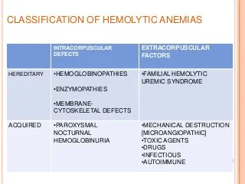
CLASSIFICATION OF HEMOLYTIC ANAEMIA

Slide 4
ACQUIRED HEMOLYTIC ANAEMIA
Mechanical destruction of red cells
Infections
Immune hemolytic anaemia
Hemolytic anaemia from toxic agents and drugs
Paroxysmal nocturnal haemoglobinuria

Slide 5
MECHANICAL DESTRUCTION OF RBCS
Red cells are characterized by the remarkable deformability
MARCH HEMOGLOBINURIA
Prolonged marching/marathon running
Forceful repeated impact of feet
MICROANGIOPATHIC HEMOLYTIC ANAEMIA (MAHA)
c/c and iatrogenic condition
Patients with prosthetic heart valves, esply when paraprosthetic regurgitation is present
If more than mild anaemia develops, re-intervention is required

Slide 6
INFECTION
Most frequent infectious cause of HA , in endemic areas is Malaria
In other parts of world, shiga toxin producing E.coli O157:H7
Main etiologic agent of HUS
More common in children > adults
Clostridium perfringens sepsis
Life threatening intravascular hemolysis due to a toxin with lecithinase activity
Following open wounds,septic abortion or contaminated blood unit
Rarely ,HA is seen with sepsis or endocarditis from a variety of organisms
Bacterial and viral infections can cause HA

Slide 7
IMMUNE HEMOLYTIC ANAEMIA
Two distinct mechanisms
INNOCENT BYSTANDER MECHANISM
When an antibody directed against a certain molecule (eg: drug) reacts with that molecule red cells may caught in that reaction
Toxic agents/drugs
II. AIHA
A true antibody is directed against a red cell antigen
`

Slide 8
AIHA
Onset is often abrupt and can be dramatic
Hb level may drop within days to low as 4g/dL
Jaundice
Splenomegaly
When this triad is present, suspicion of AIHA hould be high
Haemoglobinuria is a telltale sign of intravascular hemolysis
Warm antibody AIHA
Cold agglutinin disease/cold agglutinin syndrome
PCH
Mixed type

Slide 9
COOMBS TEST/DAT
1945
R.R.A.Coombs
Broad spectrum reagent - determine both Igs and complement fragments
Polyvalent DAT and monovalent DAT
Test is positive ; diagnostic of AIHA
Sensitivity varies
400 molecules on redcell surface for a positive test
Coombs negative AIHA may have severe AIHA antibody is so powerful for opsonization
INDIRECT COOMBS TEST/IAT : Detect anti-RBC antibodies in patients serum
Identifying alloantibodies prior to transfusion

Slide 10
WARM ANTIBODY AIHA
More common type
Reacts best at 37
Can be idiopathic or in association with systemic AI disorder SLE and CLL
Also occurred as a side effect of immune check point inhibitors such as nivolumab in patients with various types of cancers
Extravascular hemolysis > intravascular hemolysis
Haemaotological picture is usually reticulocytosis in response to anaemia
Some cases reticulocytes may no increase
AIHA is a/w Evans syndrome - it’s a severe disease

Slide 11
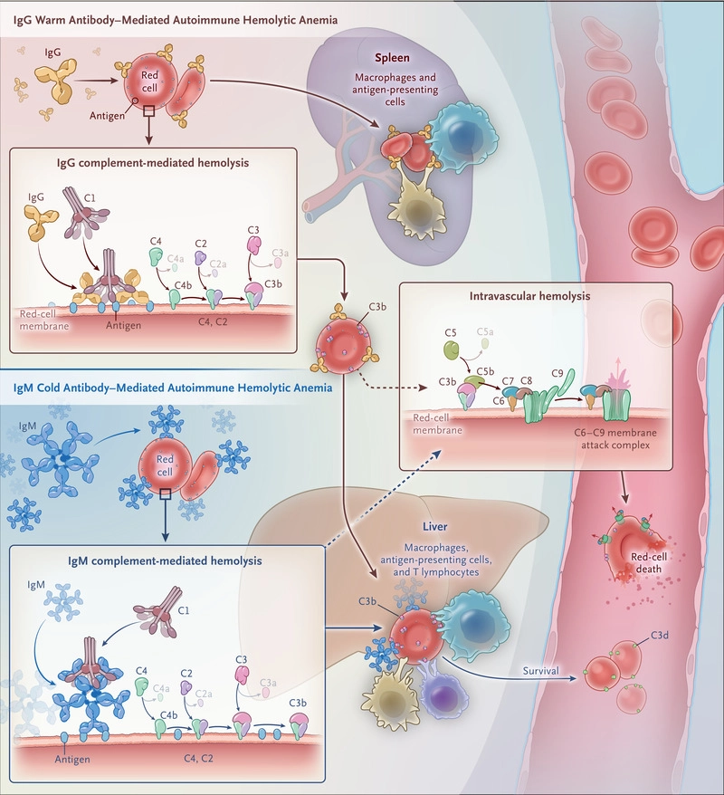

Slide 12
TREATMENT
Severe acute AIHA can be a medical emergency. The immediate treatment almost invariably includes transfusion of red cells.
This may pose a special problem because, if the antibody involved is nonspecific, all of the blood units cross-matched will be incompatible.
In these cases, it is often correct, paradoxically, to transfuse incompatible blood,
A situation like this requires close monitoring and understanding between the clinical unit treating the patient and the blood transfusion/serology lab.
Whenever the anemia is not immediately life-threatening, blood transfusion should be withheld (because compatibility problems may increase with each unit of blood transfused),

Slide 13
Medical treatment
T.prednisolone 60-100 mg for 2-3 weeks f/b tapering over 3-6 months according to response
Withdrawn if no response
Rituximab anti- CD20 Ab together with prednisolone as first line
Refractory cases – splenectomy
Risk of sepsis/thrombosis
Second/third line agents
Azathioprine, Cyclophosphamide, Cyclosporine
NOTE:
In very rare severe refractory cases myelo-immuno-ablative chemotherapy f/b rescue with allogenic stem cell transplantation

Slide 14
PCH
Rare form of AIHA
Mostly in children
Self limiting, triggered by a viral infection
DONATH LANDSTEINER ANTIBODY
Has anti-P specificity
Binds to red cells at a low temp (4),complement activation at 37
Intravascular hemolysis

Slide 15
CAD
Affects elderly
c/c condition
Antibody reacts to red-cells at a lower temp
Hemolysis is more prominent when body is exposed to cold
Ig M antibody with anti-I specificity
Antibody is produced by expanded b lymphocyte clone
Waldenstrome gammaglobulinemia, lymphoma
Avoidance of exposure to cold
Rituximab
Remissions rituximab-fludarabine combination
No role for prednisolone-splenectomy

Slide 16
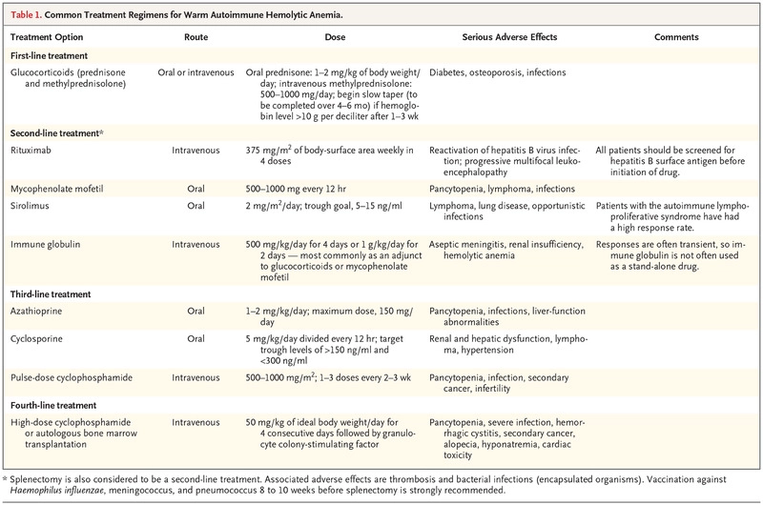

Slide 17
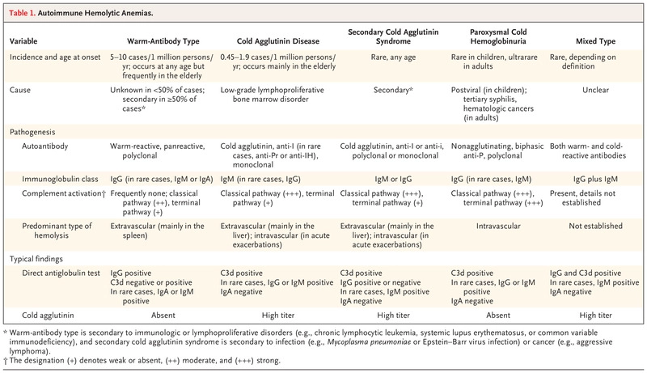

Slide 18
HA FROM TOXIC AGENTS AND DRUGS
A number of chemicals with oxidative potential can cause hemolysis
Hyperbaric oxygen
Nitrates, chlorates
Methylene blue, dapsone
Cisplatin and aromatic compounds
Chemicals with non-oxidative ,largely unknown mechanisms
Arsine, stibine, copper and lead
In these cases, hemolysis appears to be mediated by a direct chemical action on red cells.

Slide 19
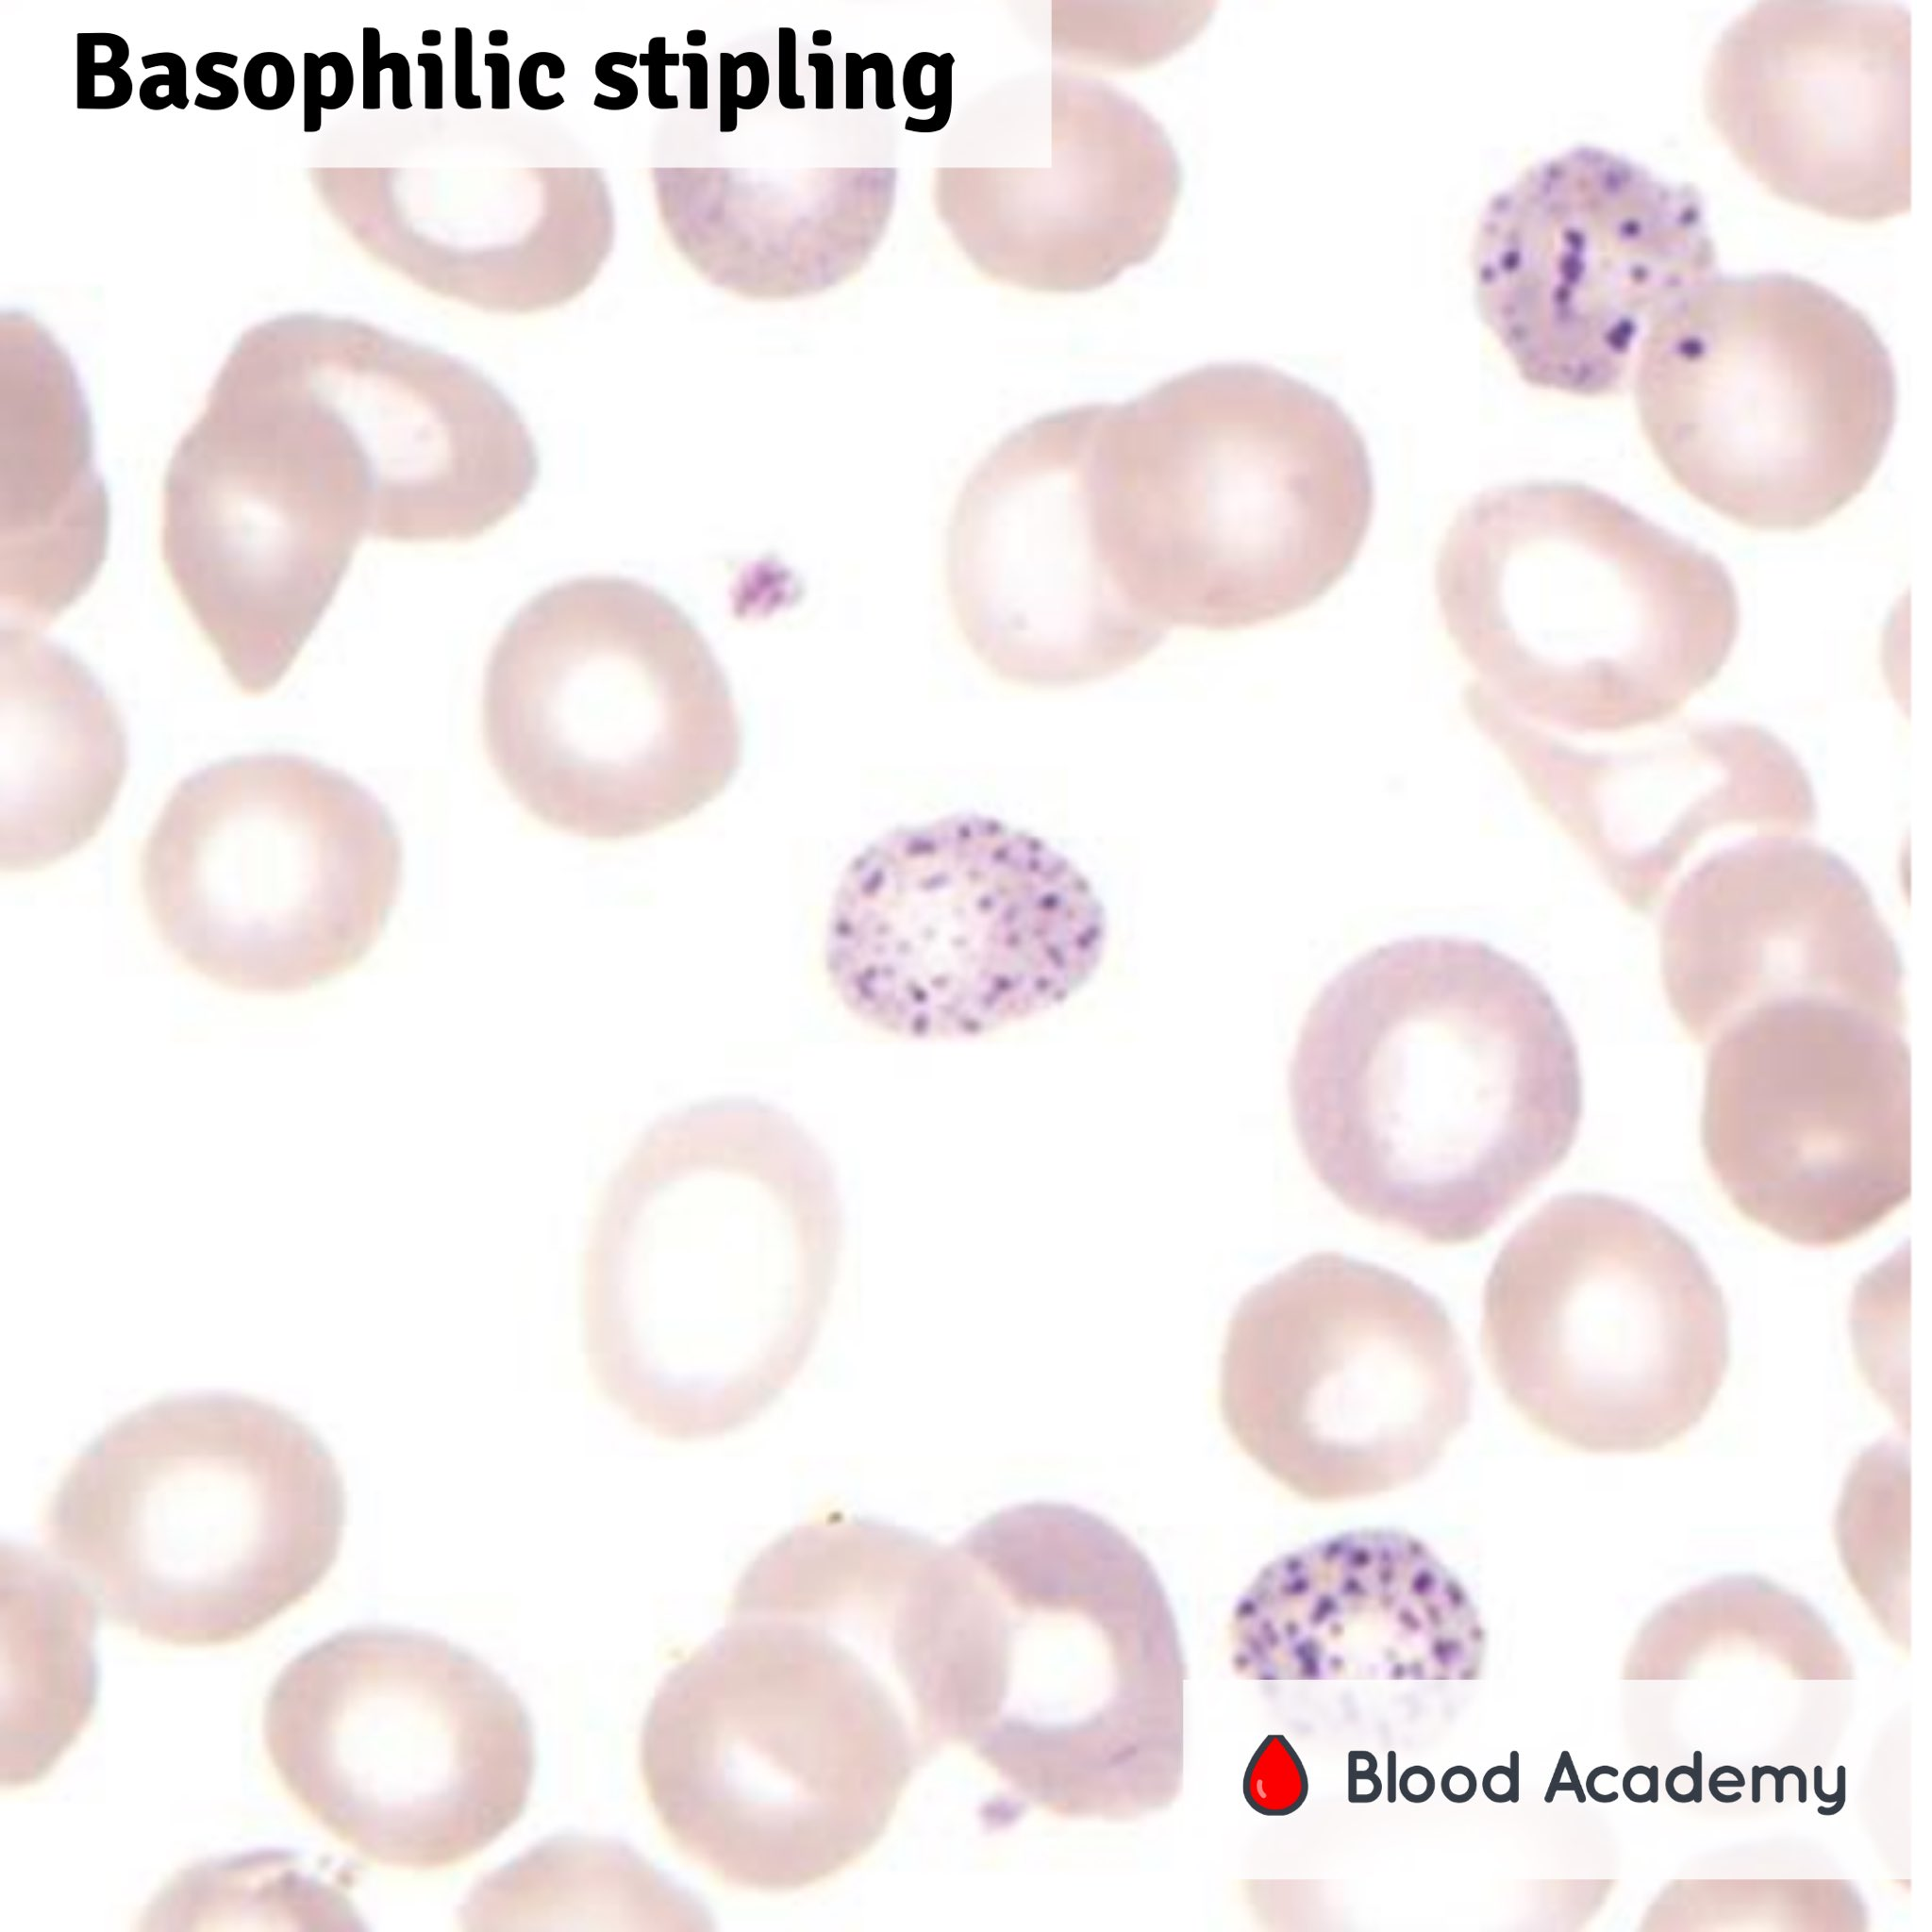
BASOPHILIC STIPPLING

Slide 20
Drugs can cause hemolysis through at least two other mechanisms.
A drug can behave as a hapten and induce antibody production;
Ex. Penicillin
Upon a subsequent exposure, red cells are caught, as innocent bystanders, in the reaction between penicillin and antipenicillin antibodies.
Hemolysis will subside as soon as penicillin administration is stopped.

Slide 21
II. A drug can trigger, the production of an antibody against a red cell antigen.
Perhaps through molecular mimicry
The best known example is methyldopa, an antihypertensive agent no longer in use,
The production of the Rhesus antibody anti-e
True Ab which results in true AIHA
Severe intravascular hemolysis can be caused by the venom of certain snakes (cobras and vipers)
HA can also follow spider bites.

Slide 22
PNH
PNH is an acquired chronic HA
Characterized by persistent intravascular hemolysis subject to recurrent exacerbations.
Triad of PNH
Hemolysis,
Pancytopenia
Distinct tendency to venous thrombosis
This triad makes PNH a unique clinical condition.
PNH has about the same frequency in men and women

Slide 23
It is a rare disease
Its prevalence is estimated to be approximately 5 per million.
There is no evidence of inherited susceptibility.
PNH has never been reported as a congenital disease,
But it can present in small children or as late as in the seventies, although most patients are young adults.

Slide 24
CLINICAL FEATURES
Patient may report as she/he may passed blood instead of urine
Classic presentation
Symptomatic anaemia or incidentally detected anaemia
The anemia is associated from the outset with neutropenia, thrombocytopenia, or both, thus signaling an element of bone marrow failure
Recurrent attacks of abdominal pain : thrombosis of abdominal vessels / NO depletion a/w intravascular hemolysis
When thrombosis affects the hepatic veins, it may produce acute hepatomegaly and ascites,
i.e., a full-fledged Budd-Chiari syndrome, which, in the absence of liver disease, ought to raise the suspicion of PNH.

Slide 25
Cont..
Natural history can extend over decades
Median survival rate : 10-20 yrs
MCC of death : venous thrombosis > infection secondary to severe neutropenia > haemorrhage secondary to thrombocytopenia
Rarely PNH - AML (1-2% cases )
Anaemia
most consistent blood finding
mild to moderate to very severe
normo-macrocytic

Slide 26
MCV is high,due to reticulocytosis ( marked upto 20 % )
microcytic if the patient is allowed to become iron deficient as a result of chronic urinary blood loss through hemoglobinuria.
Unconjugated bilirubin is mildly or moderately elevated;
LDH is typically markedly elevated (values in the thousands are common);
Haptoglobin is usually undetectable.
All of these findings make the diagnosis of hemolytic anemia compelling.

Slide 27
Hemoglobinuria may be overt in a random urine sample;
Obtain serial urine samples, because hemoglobinuria can vary dramatically from day to day and even from hour to hour.
The bone marrow is usually cellular, with marked to
massive erythroid hyperplasia.
At some stage of the disease, the marrow may become hypocellular or even frankly aplastic.
Consecutive urine samples from a patient with paroxysmal
nocturnal hemoglobinuria (PNH). The variation in the severity
of hemoglobinuria within hours is probably unique to PNH

Slide 28
PATHOPHYSIOLOGY
Intravascular hemolysis
Intrinsic abnormality of red cell, which make it sensitive to activated C ,whether C is activated through the alternative pathway or through the classical pathway
Alternate pathway : c/c hemolysis
Classical pathway : acute exacerbations in the course of a bacterial/viral infection
Somatic mutation in X linked gene called as PIGA gene
Required for an early step in GPI biosynthesis
GPI is unique glycolipid molecule,which anchors CD55 and CD 59 to the surface membrane of red cells
CD 59 and CD 55 are protective proteins on RBC membrane which hinders the insertion into the membrane of C( polymers of complement system

Slide 29
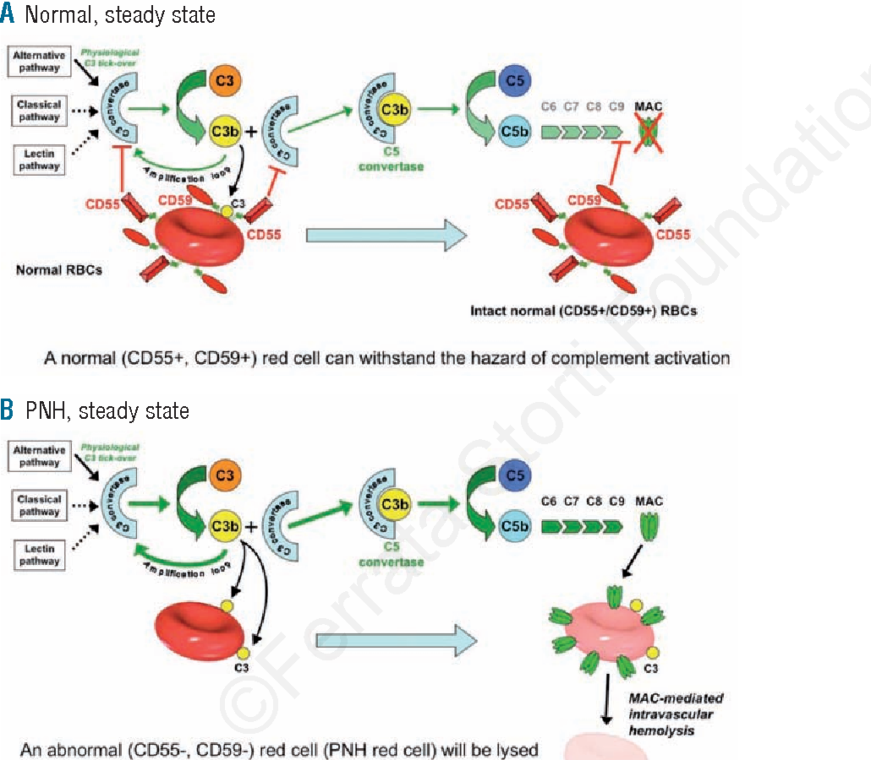

Slide 30
As a result, the patient’s marrow is a mosaic of mutant and nonmutant cells, and the peripheral blood always contains both PNH cells and normal (non-PNH) cells.
Thrombosis is one of the most immediately life-threatening complications of PNH and yet one of the least understood in its pathogenesis.
It could be that deficiency of CD59 on the PNH platelet causes inappropriate platelet activation; however, other mechanisms are possible.

Slide 31
PNH AND AA
A patient with PNH becomes less hemolytic and more pancytopenic and ultimately has the clinical picture of AA.
Because AA is probably an organ-specific autoimmune disease, in which T cells cause damage to hematopoietic stem cells
Target might be the GPI molecule itself

Slide 32
DIAGNOSIS
GOLD STANDRAD IS FLOW CYTOMETRY
Bimodal distribution of cells with discrete population that is CD55 and CD 59 negative
picture

Slide 33
TREATMENT
Until 10 yrs ago there are two treatment options for PNH
Allogenic BMT
Continued supportive treatment
humanized monoclonal antibody, eculizumab (advanced)

Slide 34
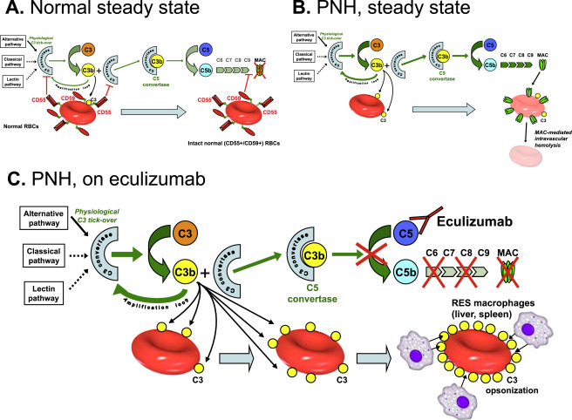

Slide 36


