Slide 1
INFECTIVE ENDOCARDITIS
DR IBRAHIM ALI SALEEM
JR3
GENERAL MEDICINE

Slide 2
1. DEFINITION
2. CLASSIFICATION
3. MICROBIOLOGY

Slide 3
INFECTIVE ENDOCARDITIS - DEFINITION
A CLINICAL SYNDROME CHARACTERISED BY COLONISATION OR INVASION OF THE HEART VALVES OR ENDOCARDIUM BY A MICROBE, LEADING TO THE FORMATION OF VEGETATIONS
Notes:
IF ARTERY IS COLONISED – INFECTIVE ENDARTERITIS
IF CARDIAC CHAMBER IS COLONISED – MURAL ENDOCARDITIS

Slide 4
CLASSICATION: 4 GROUPS
1. NATIVE VALVE IE
2. PROSTHETIC VALVE IE
3. INTRAVENOUS DRUG ABUSE IE
4.HEALTHCARE ASSOCIATED IE

Slide 5
ACUTE VS SUBACUTE IE
ACUTE IE | SUBACUTE IE
AFFECTS NORMAL VALVES | AFFECTS DAMAGED VALVES
VERY DESTRUCTIVE IE, FULMINANT | INDOLENT
METASTATIC COMPLICATIONS - STROKE, PE, PERIPHERAL A EMBOLISATION | A CAUSE OF PUO
OFTEN REQUIRE SURGERY | RISK OF STROKE +
FATAL IF UNTREATED
STAPH AUREUS BETA HEMOLYTIC STREPTOCOCCI PNEUMOCOCCI AEROBIC GRAM NEGATIVE BACTERIA | LESS VIRULENT ORGANISMS

Slide 6
MICROBIOLOGY OF IE

Slide 7
CULTURE POSITIVE IE:
EASY TO CULTURE
STREPS!
  STREPTOCOCCUS VIRIDANS
  BETA HEMOLYTIC STREPTOCOCCI
  STREPTOCOCCUS GALLEOLYTICUS/BOVIS
  STREPTOCOCCUS PNEUMONIA
ENTEROCOCCI
STAPH AUREUS
CONS
HACEK – GRAM NEGATIVE
AEROBIC GRAM NEGATIVE BACILLI

Slide 8
GRAM POSITIVE PREDOMINANCE!
WHY?
2 REASONS:
  SECRETE ADHESINS – HELPS ADHERE TO VALVES
  BIOFILM FORMATION – PROTECTS IT FROM IMMUNE ATTACKS AND ANTIBIOTICS

Slide 9
CULTURE NEGATIVE IE:
DIFFICULT TO CULTURE/NON-CULTURABLE
5-15% OF IE
MOST COMMON CAUSE – PREVIOUS ANTIBIOTIC THERAPY
  EG. STEP VIRIDANS – 3 DAYS OF ANTIBIOTICS – THEN CULTURE TAKEN – STERILE
FASTIDIOUS ORGANISMS
  COXIELLA BURNETII
  BARTONELLA HENSELAE
  TROPHERYMA WHIPPELI
  LEGIONELLA
  BRUCELLA

Slide 10
BLOOD CULTURE NEGATIVE ENDOCARDITIS (BCNE)
1.NON- BACTERIAL THROMBOTIC ENDOCARDITIS
  MARANTIC ENDOCARDITIS -MALIGNANCY, HIV,AUTOIMMUNE DISEASE
  SLE
  RA
  LIBMAN-SACKS ENDOCARDITIS
  BEHCET DISEASE
  UNDERLYING MALIGNANCY

Slide 11
BLOOD CULTURE NEGATIVE ENDOCARDITIS (BCNE)
2.BCNE WITH IDENTIFIED ETIOLOGY
  COMMON BACTERIA SUPPRESSED BY ANTIBIOTICS
  ZOONOTIC AGENTS
  FASTIDIOUS AGENTS
  FUNGI
3.BCNE WITHOUT IDENTIFIED ETIOLOGY

Slide 12
OVERALL MOST COMMON CAUSE – STAPH AUREUS
COMMUNITY ACQUIRED IE – STREP VIRIDANS > STAPH AUREUS
HEALTHCARE ASSOCIATED IE – STAPH AUREUS
IV DRUG USERS – STAPH AUREUS
PROSTHETIC VALVE IE –
  EARLY : <2 MONTHS – STAPH AUREUS
  LATE : 2-12 MONTHS – CONS > STAPH AUREUS
  > 12 MONTHS – SIMILAR TO CA-IE

Slide 13
STAPHYLOCOCCUS AUREUS:
MOST COMMON CAUSE OF
IE (OVERALL)
ACUTE IE
HEALTHCARE ASSOCIATED IE
IVDU ASSOCIATED IE
EARY PROSTHETIC VALVE ENDOCARDITIS
STENTOCARDITIS
CARDIOVASCULAR IMLANTABLE ELECTRONIC DEVICES
IF BLOOD CULTURE – STAPH AUREUS + : DO ECHO AND RULE OUT IE (25%)

Slide 14
STREPTOCOCCUS VIRIDANS
ALPHA HEMOLYTIC STREP
PART OF NORMAL FLORA
INDOLENT INFECTIONS USUALLY
COMMON CAUSE OF SABE IN RHD (LIKE RHEUMATIC MR)
SENSITIVE TO PENICILLIN

Slide 15
BETA HEMOLYTIC STREP
  ACUTE IE
  SUSCEPTIBLE TO PENICILLIN
STREP BOVIS/GALLEOLYTICUS
  FLORA OF GIT
  IF BLOOD CULTURE +, RULE OUT CA COLON – COLONOSCOPY
PNEUMOCOCCI
  ACUTE IE
  MENINGITIS, PNEUMONIA
  SENSITIVE TO PENICILLIN

Slide 16
CONS
NORMAL SKIN COMMENSALS
  HENCE – AT LEAST 3 BLOOD CULTURE POSITIVITIES - SIGNFICANT
MOST COMMON – STAPH EPIDERMIDIS
MOST VIRULENT – STAPH LUGDUNENSIS
DRUG RESISTANCE – COMMON (LIKE STAPH AUREUS)

Slide 17
ENTEROCOCCUS
E.FAECALIS – A/W GENITOURINARY TRACT ABNORMALITIES
  SENSITIVE TO PENICILLIN + GENTAMICIN
E.FAECIUM – RARE – HIGHLY DRUG RESISITANT

Slide 18
HACEK GROUP
HAEMOPHILUS SPP.
  AGGREGATIBACTER APROPHILUS
  H. PARAPROPHILUS
AGGREGATIBACTER ACTINOMYCETEMCOMITANS
CARDIOBACTERIUM HOMINIS
EIKENELLA CORODENS
KINGELLA SPP.

Slide 19
HACEK
NORMAL FLORA OF OROPHARYNX, URT
SLOW GROWING – ONLY LARGE VEGETATIONS PRODUCE SYMPTOMS
EMBOLISM COMMON
DOC - CEFTRIAXONE

Slide 20
AEROBIC GRAM NEGATIVE BACTERIA
RARE
ACUTE IE
E.COLI
KLEBSIELLA
PSEUDOMONAS

Slide 21
FUNGI
VERY RARE
MOST COMMON – CANDIDA
HIGH RATE OF RELAPSE – 25%
USUALLY TARGETS PROSTHETIC VALVES, INDWELLING CATHETERS
REQUIRES SURGICAL REPLACEMENT OF THE VALVE, IV ANTI-FUNGALS
LIFELONG ANTIFUNGAL THERAPY

Slide 22
PATHOGENESIS
ACUTE IE: DIRECT DAMAGE TO NORMAL VALVE

Slide 23
PATHOGENESIS
SUBACUTE IE:
  ENDOTHELIAL INJURY MUCOSAL INJURY
  FORMATION OF PLATELET-FIBRIN CLOT
  NON BACTERIAL THROMBOTIC ENDOCARDITIS BACTEREMIA
  BACTERIAL ADHERENCE TO NBTE
  BACTERIAL PROLIFERATION WITHIN NBTE
  VEGETATION

Slide 24
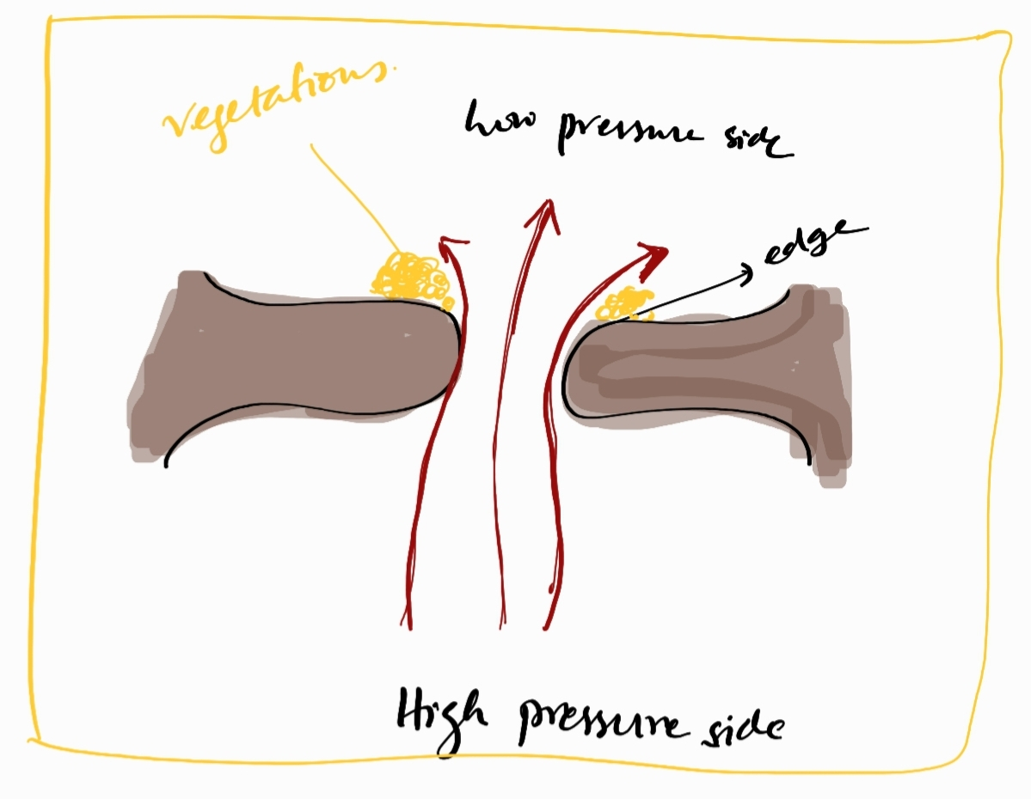
LOCATION OF VEGETATIONS
  LOW PRESSURE SIDE OF A HIGH PRESSURE JET

Slide 25
LOCATION OF VEGETATIONS
ATRIAL SIDE OF MV/TV
VENTRICULAR SURFACE OF AV/PV
IN VSD – ON RV SIDE OF THE DEFECT, TV, PV
IN AR – ANTERIOR LEAFLET OF MV
IN MR – MAY ALSO BE SEEN ON THE ATRIAL WALL WHERE JET STRIKES

Slide 26
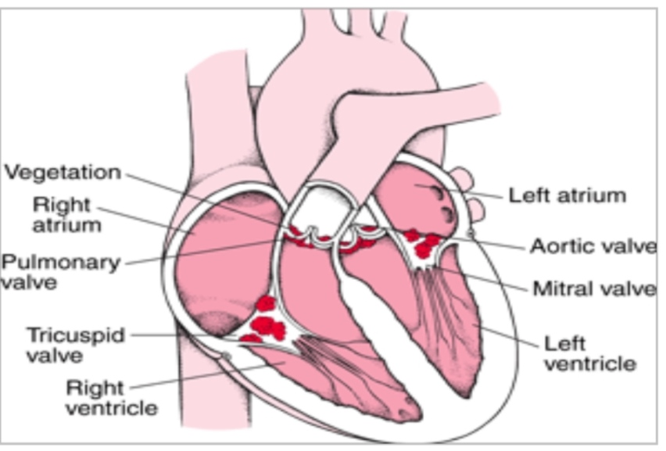
LOCATION
OF VEGETATION
* INSERT PICTURE OF LOCATION OF VEGETN FROM SLIDE

Slide 27
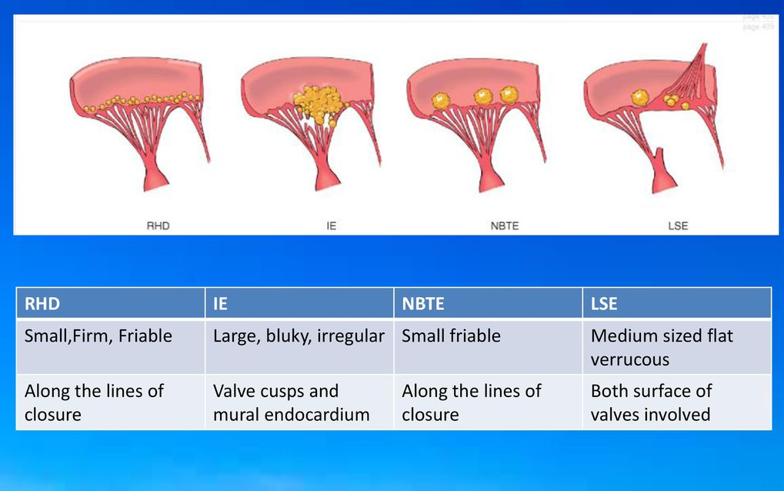
TYPES OF VEGETATIONS
VEGETATION IN RHD NBTE
IE LSE

Slide 28
PREDISPOSING CARDIAC LESIONS
MOST COMMON SITE – MV>AV
REGURGITATION > STENOSIS
MVP WITH MR
  MOST COMMON PREDISPOSING LESION
  2% POPULATION HAS MVP
AR – BAV
CHD – VSD

Slide 29
LEAST CHANCE OF IE IN
ASD
MS
  DUE TO VERY LOW GRADIENT
HCM – AT THE SITE OF WHERE AML HITS THE IVS DURING SAM
COA – 50% A/W BAV

Slide 30
PORTAL OF ENTRY
CUTANEOUS – 40%
  IVDU, IV CANNULATION
ORAL - 29%
  TOOTH INFECTION
  DENTAL EXTRACTION
GI - 23%
  STREP BOVIS

Slide 31
CLINICAL FEATURES
SYMPTOMS | PERCENTAGE | SIGNS | PERCENTAGE
FEVER | 80-85 | FEVER | 80-90
CHILLS | 42-75 | MURMUR | 80-85
ANOREXIA | 25-55 | CHANGING MURMUR | 10-40
WEIGHT LOSS MALAISE DYSPNEA | 25-40 | EMBOLIC EVENT (CNS>SPLEEN) CNS ABNORMALITIES | 20-40
COUGH SWEATS | 25 | SPLENOMEGALY | 10-40
HEADACHE | 15-40 | CLUBBING | 10-20
CHEST PAIN | 8-35 | OSLERS NODES | 3-10
MYALGIA/ARTHRALGIA | 15-30 | SPLINTER HEMORRHAGES | 5-15
NAUSEA/VOMITING | 15-20 | PETECHIAE | 10-40
STROKE, CONFUSION | 10-20 | JANEWAYS LESION | 6-10
ABDOMINAL PAIN | 5-15 | ROTH’S SPOTS | 4-10
BACKPAIN | 7-10
Notes:
FEVER IS THE MOST COMMON SIGN AND SYMPTOM
DYSPNEA – SECONDARY TO HEART FAILURE, ACUTE MR/ AR; CHEST PAIN – IN IVDU;
STROKE – SABE; MURMUR – REGURGITANT MURMUR

Slide 32
FEVER DURATION IN IE
(WITH ANTIBIOTICS)
TYPICALLY – 5-7 DAYS
IF COMPLICATIONS+ - >7 DAYS
< 4 DAYS – RULES OUT IE

Slide 33
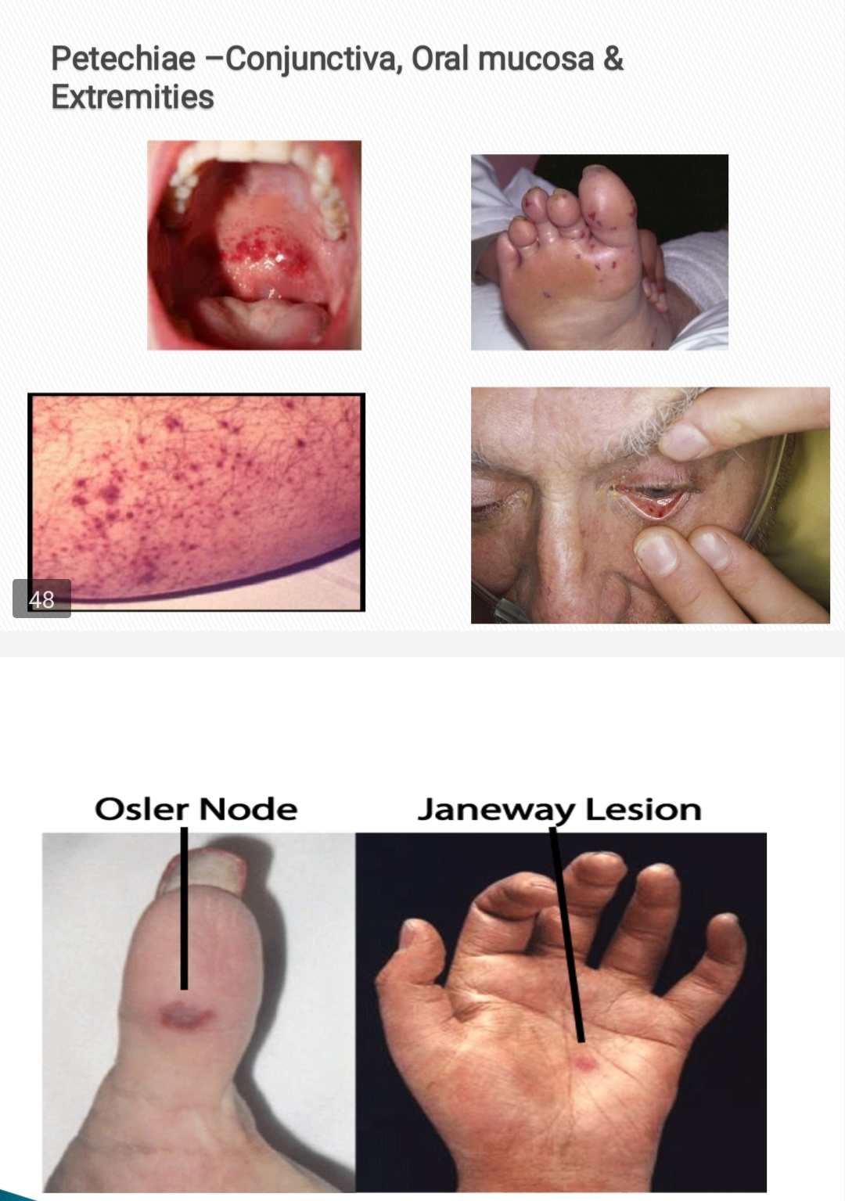
PERIPHERAL MANIFESTATIONS
PETECHIAE – MOST COMMON
ON PALPEBRAL CONJUNCTIVA
BUCCAL AND PALATAL MUCOSA
EXTREMITIES
*PICTURES

Slide 34
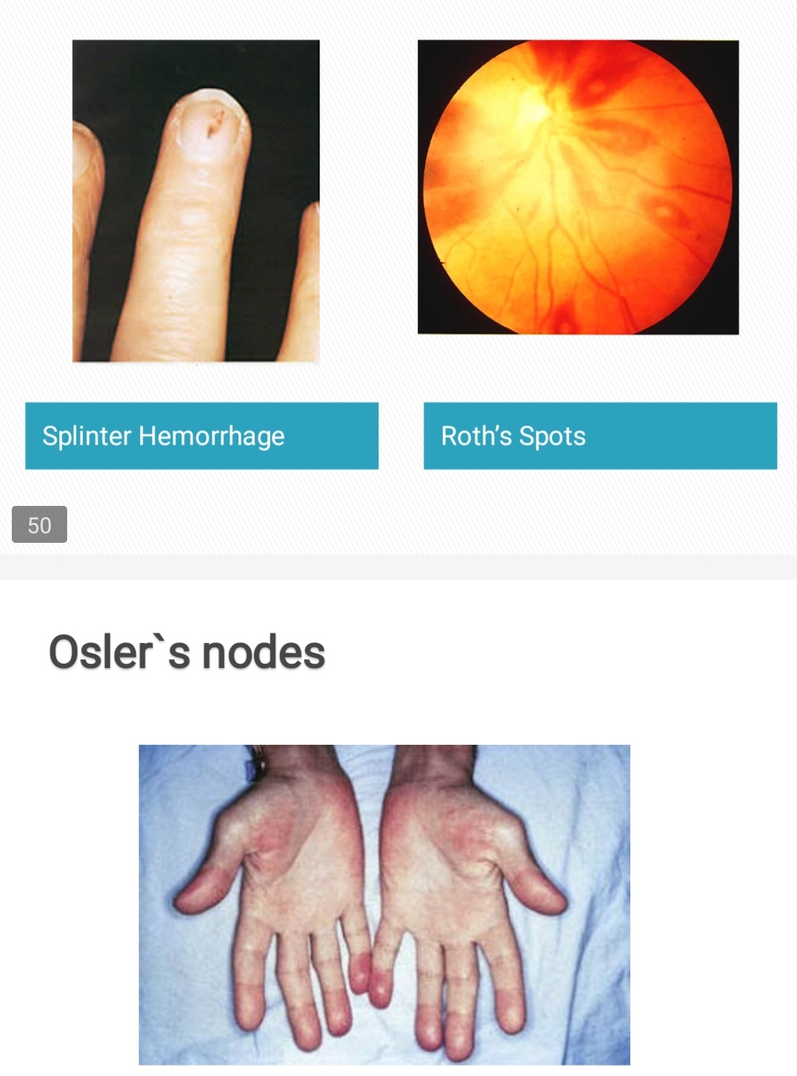
SPLINTER HEMORRHAGES
  SUBUNGUAL HEMORRHAGE
  DARK RED LINEAR/FLAME SHAPED
  PROXIMAL NAILBED
OSLER’S NODES
  SMALL, TENDER S/C NODULES IN THE PULP OF DIGITS OR MORE PROXIMAL
  PERSIST FOR HOURS TO DAYS

Slide 35
JANEWAY LESIONS
  NON TENDER
  ERYTHEMATOUS/HEMORRHAGIC MACULAR LESIONS
  PALMS/SOLES
  SEPTIC EMBOLIC EVENT
ROTH’S SPOTS
  OVAL RETINAL HEMORRHAGES WWITH PALE CENTERS

Slide 36
BRATCH WATCHER BODIES
  YELLOWISH WHITE MILIARY SPOTS IN MYOCARDIUM IN LONG STANDING IE

Slide 37
DIAGNOSIS OF INFECTIVE ENDOCARDITIS
MODIFIED DUKE’S CRITERIA
ESC 2015 DIAGNOSTIC CRITERIA

Slide 38
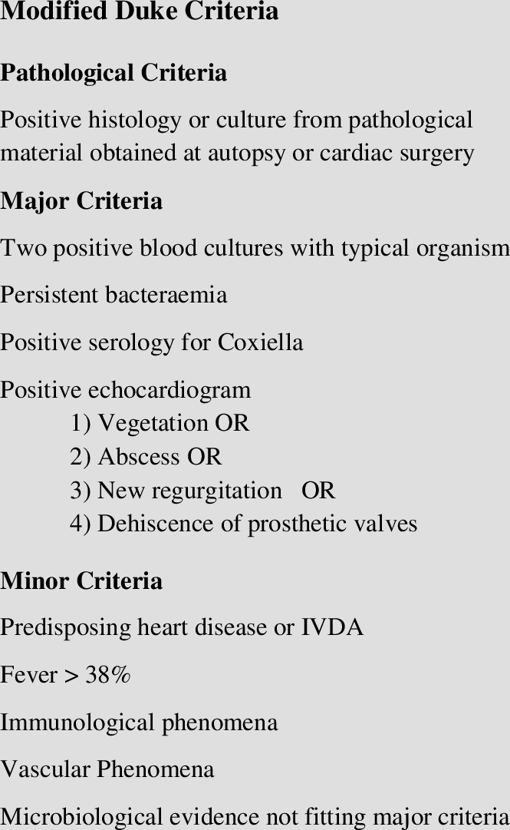
MODIFIED DUKE’S CRITERIA (2000)

Slide 39
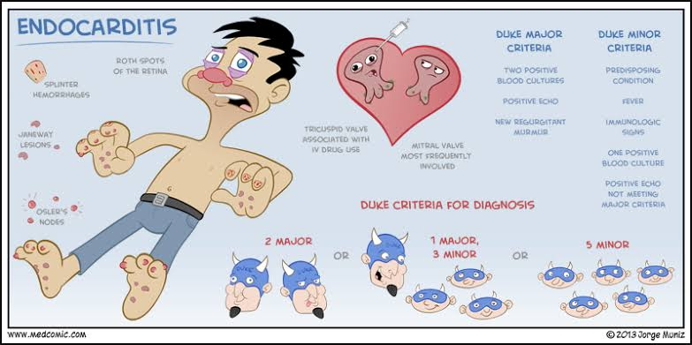

Slide 40
MAJOR CRITERIA
BLOOD CULTURE +
AND
EVIDENCE OF ENDOCARDIAL INVOLVEMENT
BOTH NEEDED FOR DIAGNOSIS

Slide 41
BLOOD CULTURE
TO DOCUMENT PERSISTENT BACTEREMIA
SETS OF BLOOD CULTURE TAKEN
  1 SET – 2 BOTTLES:
    1 AEROBIC
    1 ANAEROBIC

Slide 42
BLOOD CULTURE FOR SUBACUTE IE
  DRAW 3-5 BLOOD CULTURE SAMPLES OVER 24HR
  0h,6h,12DFFERENT h,18h,24h
  FROM SITES
BLOOD CULTURE FOR ACUTE IE
  AT LEAST 3 SETS DRAWN 30 MINS APART
ALWAYS START ANTIBIOTICS AFTER BLOOD CULTURE SAMPLE TAKEN
WHEN A MICROORGANISM IS IDENTIFIED
  REPEAT BLOOD CULTURE AFTER 48-72h TO CHECK IF TREATMENT IS EFFECTIVE

Slide 43
POSITIVE BLOOD CULTURE
TYPICAL MICROORGANSMS FOR IE FROM 2 SEPARATE BLOOD CULTURES OR
PERSISTENTLY POSITIVE BLOOD CULTURE
  DEFINED AS RECOVERY OF A MICROORGANISM CONSISTENT WITH IE FROM
  BLOOD CULTURES DRAWN >12 HOURS APART OR
  ALL 3 OR A MAJORITY OF >=4 SEPARATE BLOOD CULTURES, WITH 1ST AND LAST DRAWN AT LEAST 1HR APART OR
SINGLE POSITIVE BLOOD CULTURE FOR COXIELLA BURNETII OR PHASE I IgG ANTIBODY TITER OF >1:800

Slide 44
TYPICAL ORGANISMS
STAPH AUREUS
STREP VIRIDANS
STREP GALLEOYTICUS
HACEK
ENTEROCOCCI

Slide 45
DURATON OF THERAPY
DAYS COUNTED FROM THE DAY BLOOD CULTURE TURNS NEGATIVE
NOT FROM THE DAY OF STARTING TREATMENT
CONTINUED FOR 4-6 WEEKS

Slide 46
EVIDENCE OF ENDOCARDIAL INVOLVEMENT
ECHOCARDIOGRAPHY + FOR IE
  VEGETATION – OSCILLATING INTRACARDIAC MASS ON A VALVE OR NON SUPPORTING STRUCTURES, IN THE PATH OF REGURGITANT JETS, OR ON IMPLANTED MATERIAL, IN THE ABSENCE OF AN ALTERNATIVE ANATOMIC EXPLANATION, OR
  ABSCESS, OR
  NEW PARTIAL DEHISCENCE OF PROSTHETIC VALVE
  NEW VALVULAR REGURGITATION
    INDICATING A NEW SERIOUS DAMAGE TO THE VALVE – FISTULA/PERFORATION
    AN INCREASE IN/CHANGE IN PRE-EXISTING MURMUR NOT SUFFICIENT

Slide 47
ECHOCARDIOGRAPHY
TTE ALMOST = TEE
TTE - VISUALISES LA BETTER
  SENSITIVITY – 80-90%
  SPECFICITY – 70-90%
TEE – VISUALISES LV BETTER
  SENSITIVITY – 90-100%
  SPECIFICITY – 90%
  SUPERIOR FOR PVE, IE WITH COMPLICATIONS(ABSCESS/PERFORATION/PSEUDOANEURYSM)
TTE +TEE = COMPLEMENTARY

Slide 48
CLINICAL SUSPICION OF IE
TTE
PROSTHETIC VALVE/INTRACARDIAC DEVICE
NON-DIAGNOSIS TTE TEE
POSITIVE TTE
NEGATIVE TTE CLINICAL SUSPICION OF IE
HIGH
LOW STOP

Slide 49
MINOR CRITERIA
1. PREDISPOSITION
IVDU,PROSTHETIC VALVE, VALVULAR LESION WITH SIGNIFICANT REGURGITATION/TURBULENCE,VSD
2.FEVER
TEMP>38C
3.VASCULAR PHENOMENA
MAJOR ARTERIAL EMBOLI, SEPTIC PULMONARY EMBOLI, MYCOTIC ANEURYSM, ICH, CONJUNCTIVAL HEMORRHAGE, JANEWAY LESION
4.IMMUNOLOGIC PHENOMENA
GLOMERULONEPHRITIS, OSLER’S NODES, ROTH SPOTS, RHEUMATOI FACTOR

Slide 50
5.MICROBIOLOGICAL EVIDENCE
POSITIVE BLOOD CULTURE NOT MEETING MAJOR CRITERIA OR SEROLOGIC EVIDENCE OF ACTIVE INFECTION WITH ORGANISM CONSISTENT WITH IE

Slide 51
ESC 2015 CRITERIA FOR IE
ADDITION OF PET/SPECT/CARDIAC CT TO MODIFIED DUKE’S CRITERIA
TO PROVE ENDOCARDIAL INVOLVEMENT
IMAGING POSITIVE FOR IE:
ECHO +VE
  VEGETATION, ABSCESS, SEUDOANEURYSM, INTRACARDIAC FISTULA, VALVE PERFORATION/ANEURYSM, NEW PARTIAL DEHISCENCE OF PROSTHETIC VALVE
  ABNORMAL ACTIVITY AROUND THE SITE OF PV IMPLANT DETECTED BY FDG-PET CT (ONLY IF PV WAS IMPLANTED>3 MONTHS) OR RADIOLABELLED LEUKOCYTES IN SPECT/CT
  DEFINITE PARAVALVULAR LESIONS BY CARDIAC CT

Slide 52
ALL THESE CRITERIA ARE USEFUL, BUT THEY DO NOT REPLACE THE CLINICAL JUDGEMENT OF THE “ENDOCARDITIS TEAM”
THE ENDOCARDITIS TEAM
CARDIOLOGIST
SURGEON
INFECTIOUS DISEASE SPECIALIST
MICROBIOLOGIST
PRIMARY CARE PHYSICIAN
OTHER SPECIALITIES

Slide 53
COMPLICATED CASES
  MANAGED BY ENDOCARDITIS TEAM
NON COMPLICATED CASES
  MANAGED IN CONSULTATION WITH ENDOCARDITIS TEM

Slide 54
COMPLICATIONS OF IE

Slide 55
WHAT HAPPENS TO A VEGETATION?
WITH PROPER ANTIBIOTIC TREATMENT
  SMALL VEGETATION – DISAPPEARS
  LARGE VEGETATION – BECOMES SMALLER AND DENSER
    MAY NOT DISAPPEAR
    STOP EMBOLISING
    MAY REMAIN VISIBLE IN ECHO TAKEN EVEN A YEAR LATER

Slide 56
WITHOUT TREATMENT/PROPER ANTIBIOTICS
  VEGETATIONS BECOME LARGER
  CAUSE LOCAL DESTRUCTION
  RUPTURE OF CHORDAE TENDINAE,VALVE PERFORATION,FISTULA
  ACUTE MR/AR
  ABSCESS
  PERIVALVULAR EXTENSION – CHB
  >10mm SIZE – EMBOLISE
  SEPSIS
  METASTATIC COMPLICATIONS – MENINGITIS, PNEUMONIA, PYOTHORAX, MYCOTIC ANEURYSM

Slide 57
LOCAL COMPLICATIONS
HEART FAILURE (MC – LEFT SIDED HEART FAILURE)
  ACUTE AR/MR
  MORE COMMON IN NATIVE VALVE THAN PROSTHETIC VALVE
ABSCESS FORMATION
FISTULA FORMATION
MYCOTIC PSEUDOANEURYSMS
VALVE PERFORATION
Notes:
PROSTHETIC VALVE IS MORE RESISTANT TO DAMAGE

Slide 58
SYSTEMIC COMPLCATIONS
SEPSIS
SYSTEMIC EMBOLISM
MYCOTIC ANEURYSMS
  DUE TO EMBOLISM INTO VASA VASORUM OF ARTERY
  POOR NOURISHMENT OF ARTERY
  WEAKENED MUSCLE WALL – ANEURYSM – RUPTURE – SAH,ICH
RENAL DYSFUNCTION
NEUROLOGICAL MANIFESTATIONS

Slide 59
RENAL DYSFUNCTION IN IE
MULTIFACTORIAL
MOST COMMON CAUSE – DRUGS
  AMINOGLYCOSIDES
  VANCOMYCIN
SEPSIS
IMMUNE COMPLEX GLOMERULONEPHRITIS
HEART FAILURE – CARDIORENAL SYNDROME
RENAL EMBOLISM

Slide 60
NEUROLOGICAL COMPLICATIONS IN IE
STROKE
MYCOTIC ANEURYSM – SAH,ICH
MENINGITIS
BRAIN ABSCESS

Slide 61
PRINCIPLES OF TREATMENT
1.THERAPY AFTER BLOOD CULTURE AND SENSITIVITY
  IN SABE
    IF CULTURE +, TREAT
    IF CULTURE -, REPEAT CULTURE AND TREAT ACCORDINGLY
  IN ACUTE IE
    TAKE CULTURE SAMPLES
    TREAT WITHOUT WAITING FOR RESULTS

Slide 62
PRINCIPLES OF TREATMENT
2.PROLONGED THERAPY WITH BACTERICIDAL DRUGS
  VALVES ARE RELATIVELY AVASCULAR
  BACTERIA DOWNREGULATES ITS OWN METABOLISM
  HENCE, HIGH CONCENTRATIONS OF IV BACTERICIDAL DRUGS NEEDED FOR PROLONGED PERIODS
3.BLOOD CULTURE
  DURATION OF TREATMENT : 6 WEEKS FROM CULTURE NEGATIVITY
4.THE ENDOCARDITIS TEAM SHOULD DECIDE ON ANTIBIOTIC USAGE (DEPENDING ON THE INSTITUTION’S CULTURE AND SENSITIVITY REPORTS)

Slide 63
PROBLEMATIC IE
ANY FUNGAL IE
  NVE- REPLACE NV WITH PV
  PVE – REPLACE PV
STAPH AUREUS PVE – REPLACE VALVE
GRAM NEG BACILLI (EXCEPT HACEK) – REPLACE VALVE
MDR ORGANISMS – REPLACE VALVE
IE WITH MECHANICAL CX – SURGERY
CULTURE NEGATIVE IE – STOP ANTIBIOTICS,WAIT FOR FEBRILE PERIOD – SEND BLOOD CULTURE – TREAT

Slide 64
SURGERY FOR IE
LEFT > RIGHT HEART
INDICATIONS:
LEFT HEART
1.REFRACTORY HEART FAILURE -ACUTE AR/MR
2.UNCONTROLLED INFECTION
3.EMBOLISM PREVENTION -VEGETATION > 10mm size

Slide 65
RIGHT HEART:
1.HEART FAILURE
2.UNCONTROLLED INFECTION
3. EMBOLISM PREVENTION: VEGETATION>20mm

Slide 66
IVDU ASSOCIATED IE
RIGHT VALVE IE
RARELY - LEFT HEART - WORST PROGNOSIS
DUE TO CONTAMINANTS OF IV DRUG
MC - STAPH AUREUS
ENTEROCOCCI IN LEFT SIDED HEART DISEASE
PULMONARY MANIFESTATION -PNEUMONIA,EMPYEMA,PULMONARY INFARCT

Slide 67
CIED INFECTIONS
PACEMAKER EROSION
MC-STAPH AUREUS
MCC- CONTAMINATION AT DEVICE PLACEMENT
TREATMENT:REMOVE DEVICE, ANTIBIOTICS, REIMPLANT

Slide 68
STENTOCARDITIS
VERY RARE
STENT PLACED IN CORONARY ARTERY GETS INFECTED
FEVER, CHILLS, SEPSIS
TREATMENT: REMOVE STENT, VASCULAR REPAIR, GRAFTING
PET SCAN CAN LOCALISE INFECTION

Slide 69
PROPHYLAXIS AGAINST IE
FOR HIGHEST RISK PATIENT+ HIGHEST RISK PROCEDURE
MC - DENTAL PROCEDURE
HIGHEST RISK PATIENT:
PREVIOUS IE
PROSTHETIC VALVE/ REPAIR MATERIAL
POST TRANSPLANT CARDIAC VALVULOPATHY
UNCORRECTED CYANOTIC HEART DISEASE, INCLUDING PALLIATIVE SHUNTS
FULLY CORRECTED CHD IN THE FIRST 6 MONTHS
PARTIALLY CORRECTED CHD

Slide 70
WHO NEEDS PROPHYLAXIS?
ASD - LOW RISK FOR IE - NO PROPHYLAXIS
IF CLOSED WITH A DEVICE- 6M PROPHYLAXIS
BT SHUNT -YES
PDA DEVICE CLOSURE -YES
TRICUSPID ANNULOPLASTY RING - YES
MVP/MR - NO
AS/HOCM - NO
COA - NO

Slide 71
HIGHEST RISK PROCEDURES
DENTAL PROCEDURES
MANIPULATION OF GINGIVAL TISSUE/PERIAPICAL REGION OF TEETH
PERFORATION OF ORAL MUCOSA, LIKE TOOTH EXTRACTION
DRAINAGE OF DENTAL ABSCESS,
GENITOURINARY,GI PROCEDURES, BRONCHOSCOPY - IF UTI/ BIOPSY PLANNED - PROPHYLAXIS NEEDED.
IUD - NO HARM IN PLACEMENT, RESERVE FOR LAST THOUGH.

Slide 72
DRUGS FOR IE PROPHYLAXIS
AMOXICILLIN 2G IV 30-60 MIN BEFORE PROCEDURE
AMPICILLIN 2G IM/IV
CLINDAMYCIN 600MG
AZUTHROMYCIN 500MG
CLARITHROMYCIN 500MG

Slide 73
TAKE HOME MESSAGES
IE HAS PROTEAN MANIFESTATIONS
NEEDS A HIGH INDEX OF SUSPICION FOR DIAGNOSIS
STAPH AUREUS -MC CAUSE,EXCEPT:
LATE ONSET PVE -CONS, COMMUNITY ACQUIRED NVE
VEGETATIONS MORE COMMON SEEN AT LOW PRESSURE SIDE OF A HIGH PRESSURE JET
BLOOD CULTURE AND IMAGING TO DOCUMENT ENDOCARDIAL INVOLVEMENT - NEEDED FOR DIAGNOSIS
TTE AND TEE - COMPLEMENTARY, OFTEN DONE IN ALL IE CASES

Slide 74
TAKE HOME MESSAGES
ENDOCARDITIS TEAM - TO DIAGNOSE AND MANAGE
COMPLICATIONS ARE COMMON - MOST REQUIRE SURGERY
ANTIBIOTICS TO BE USED ACCORDING TO LOCAL SENSITIVITY AND DECISION OF THE ENDOCARDITIS TEAM
IVDA - RIGHT SIDED IE - PULMONARY SYMPTOMS
PROPHYLAXIS - RARELY REQUIRED - NEEDED FOR HIGHEST RISK PATIENTS UNDERGOING HIGH RISK PROCEDURES (DENTAL WORK)

Slide 75
THANK YOU

