Slide 1
HYPERCALCEMIA

Slide 2
INTRODUCTION
Calcium helps in normal cell function and signaling
Myocardial contraction,coagulation of blood,
hormone secretion
Calcium level is maintained by PTH and 1,25 dihydroxy vitamin D
Normal physiologic level range 8.9 to 10.1 mg/dl(2.2 to 2.5mM)
99 % of calcium is in bone 1% in ECF

Slide 3
PTH stimulates bone resorption , promote conversion of vitamin D to calcitriol
CALCITRIOL is the active form of vitamin D . Stimulates intestinal absorption of calcium
CALCITONIN inhibits osteoclast activity and renal reabsorption of calcium thus lowering the serum calcium

Slide 4
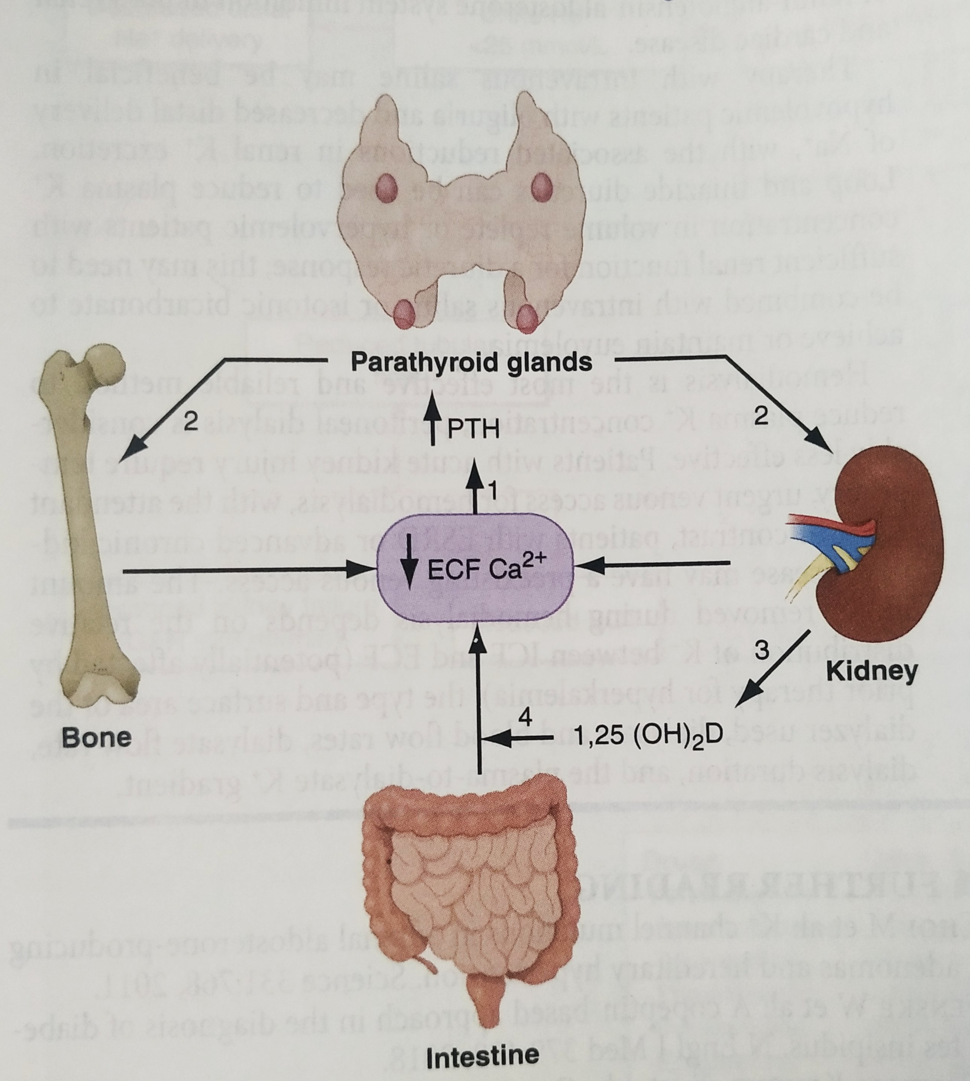
NORMAL FEEDBACK MECHANISM

Slide 5
DECREASE IN ECF CALCIUM TRIGGERS AN INCREASE IN PTH SECERETION VIA CasR ON PARATHYROID CELLS
PTH INCREASES TUBULAR REABSORPTION FROM KIDNEY , RESORPTION FROM BONE, AND ALSO HELPS IN ACTIVE VITAMIN D PRODUCTION
ACTIVE VITAMIN D IN TURN INCREASES CALCIUM REABSORPTION FROM GIT

Slide 6
HYPERCALCEMIA
A serum calcium > 10.3 mg/dl with a normal serum albumin or an ionized calcium >5.2 mg/dl defines hypercalcemia

Slide 7
ETIOLOGY
EXCESSIVE PTH PRODUCTION
PRIMARY HYPERPARATHYROIDISM
MC cause for hypercalcemia in ambulatory patients
MC in elderly women in whom annual incidence is
approximately 2 in 1000
85% adenoma 15% hyperplasia 1% carcinoma

Slide 8
TERITARY HYPERPARATHYROIDISM(LONG TERM
STIMULATION OF PTH IN RENAL INSUFFICIENCY)
ECTOPIC PTH
FHH
LITHIUM THERAPY

Slide 9
HYPERCALCEMIA OF MALIGNANCY
MC cause for hypercalcemia in hospitalized patients
Osteoclast stimulation by tumor cell products or PTHrP
or tumor calcitriol
1. SOLID ORGAN TUMORS
2.MYELOMA ,BREAST CANCER (LYTIC BONY METS)

Slide 10
EXCESSIVE VITAMIN D3 PRODUCTION
GRANULOMA(TB,SILICOSIS,SARCOIDOSIS)
LYMPHOMA
VITAMIN D INTOXICATION
INCREASE IN BONE RESORPTION
HYPERTHYROIDISM
IMMOBILIZATION

Slide 11
EXCESS CALCIUM INTAKE
MILK ALKALI SYNDROME
Due to ingestion of large quantity of calcium containing
antacids
Hypercalcemia,Renal failure,Alkalosis
TPN

Slide 12
ENDOCRINE CAUSES
Adrenal insufficiency,Pheochromocytoma,VIPoma
Hyperthyroidism,Acromegaly
DRUGS
Thiazides,Vitamin A, Antiestrogens,Teriparatide
Theophylline
Pseudohypercalcemia
Seen in hyperalbuminaemia conditions such as severe
dehydration and paraproteinemias

Slide 13
CLINICAL MANIFESTATIONS
Mild hypercalcemia(11 – 11.5) usually asymptomatic
or may be vague neuropsychiatric manifestations
Acid peptic disease, Fractures, Nephrolithiasis
Severe hypercalcemia (>12-13 mg/dL) may present lethargy, stuper or coma or GI symptoms like nausea,anorexia or constipation OR pancreatitis
Polyuria and polydipsia

Slide 14
Osteopenia and frequent fractures
Osteitis fibrosa cystica due to prolonged hyperparathyroidism
Brown tumors
Bone pain , Pathologic fractures
Bradycardia,AV block, Short QT interval

Slide 15
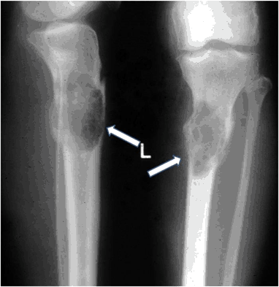
OSTEITIS FIBROSA CYSTICA

Slide 16
DIAGNOSTIC APPROACH
History and physical examination
1) Duration of symptoms
2) Clinical evidence of hypercalcemia
3) Signs and symptoms of malignancy
If hypercalcemia persist for more than 6 months without
obvious etiology primary hyperparathyroidism is almost
certainly the cause

Slide 17
Ensure that change in serum calcium is not due to abnormal albumin concentrations
We have to calculate corrected calcium levels if serum albumin falls below 4 g/dL
CRC = (4-Albumin)0.8 + Measured calcium level
After estimating hypercalcemia we should measure serum
PTH levels

Slide 18
Serum PTH MI 1 st step in evaluation
1 ) Normally elevated serum calcium suppress PTH.
So hyperca2+ with elevated PTH = PRIMARY HYPER PTH
2 ) When PTH is suppressed or normal then PTHrP can be
measured to r/o malignancy

Slide 19
1,25 (OH)2 D3 LEVEL
elevated in granuloma,acromegaly,primary hyper PTH
Vitamin D intoxication
Serum Phosphorus
Usually decreased in PHPT
Increased in Paget d/s and vit D intoxication

Slide 20
Urine Calcium
usually high in PHPT
In FHH low urine calcium clearance(<200mg)
FeCa (<1%)
ECG = QT prolongation and AV block

Slide 21
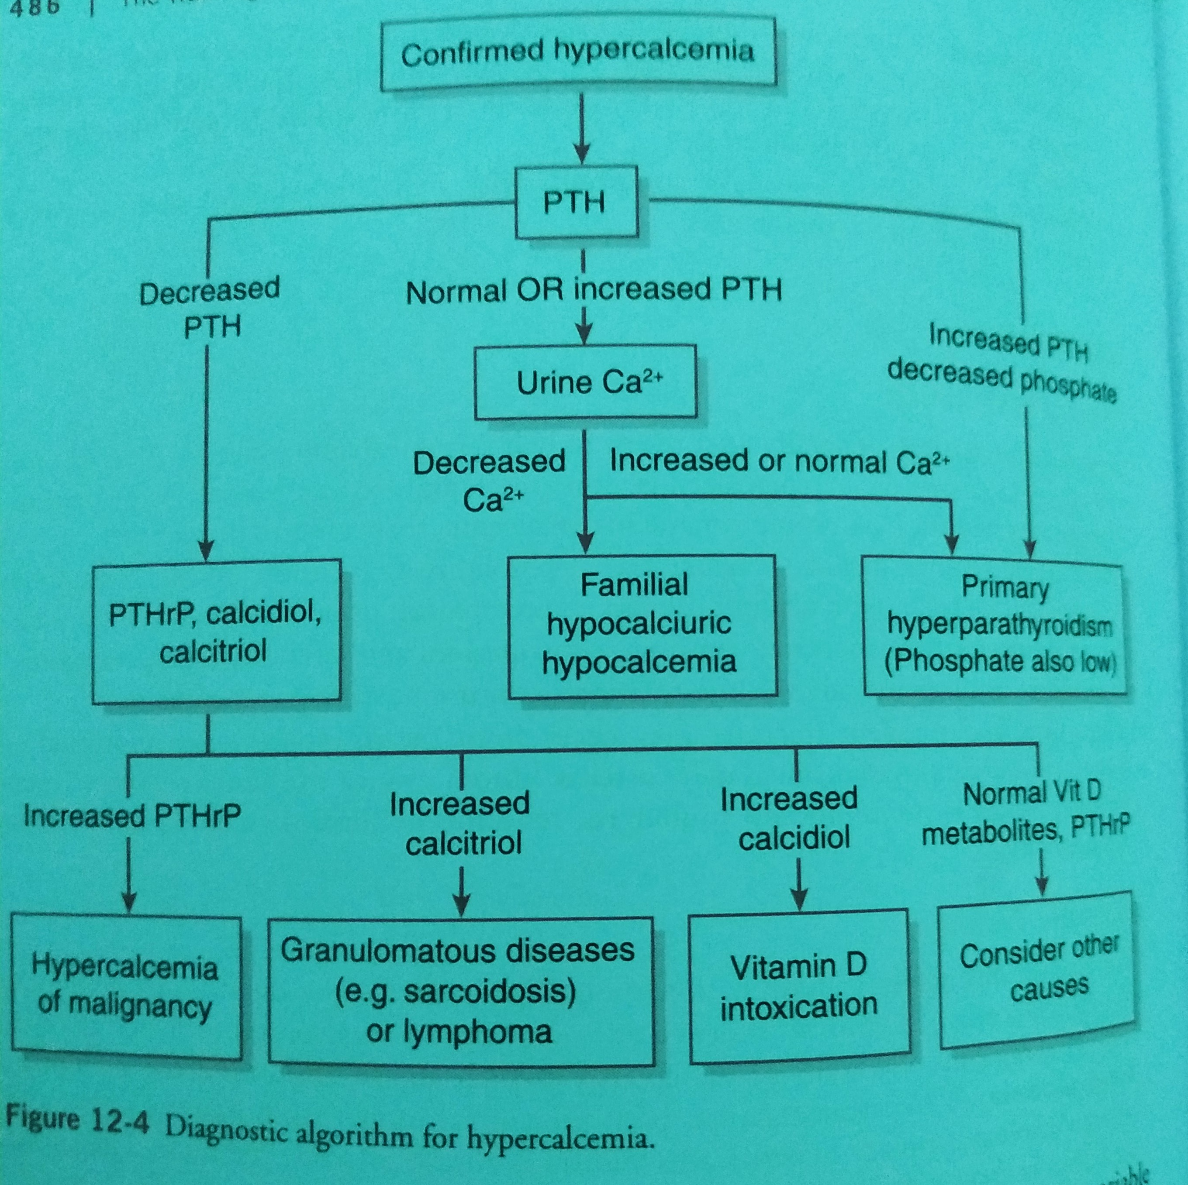

Slide 22
MANAGEMENT
Correction of hypovolemia
Because hypovolemia prevents calciuresis
4-6 liters of IV fluids may be required over 1st 24 hours
urine output 100-150ml/hr
Forced diuresis using LD should be considered once
hypovolemia is corrected.Also useful in HF,RF to prevent
volume overload

Slide 23
BISPHOSPHONATES
Decreases the liberation of calcium from bone
Pamidronate 60mg IV over 2-4h
Foe severe hypocalcemia cases 90 mg is used
Response within 2 days persist 2 weeks or longer
For recurrence dose can be repeated after 7 days
Zoledronate is most potent (4 mg over 15 min)

Slide 24
CALCITONIN
Calcitonin inhibit bone resorption and promote renal excretion of calcium
Salmon calcitonin 4- 8 U/Kg IM or SC every 6-12h
Lowers serum calcium by 1-2 mg/dl within hours
Safe in renal failure
Anagesis effect in bone mets

Slide 25
GLUCOCORTICOIDS
Used in hematological malignancies and granuloma
20 – 60mg/ day
Dose should be tapered and stop after correction

Slide 26
DENOSUMAB
RANK ligand inhibitor
Useful in refractory hypercalcemia
120 mg S/C wkly for 4 weeks

Slide 27
DIALYSIS
HD and Peritoneal dialysis using low calcium dialysate
are effective for very severe hypercalcemia(16mg/dl)

Slide 28
Chronic hypercalcemia
PRIMARY HYPERPARATHYROIDISM
Parathyroidectomy is done, IF
1)CRC >1 mg/dl above the upper limit of normal
2)Creatinine Clearance<60mL/min
3)Age<50
4)BMD Hip/L spine/Distal Radius>2.5 SD below peak bone mass

Slide 29
MEDICAL THERAPY
For asymptomatic patients
Liberal oral hydration,High salt diet,Daily physical activity
Avoid thiazides
Cinacalcet
Activate CasR

Slide 30
MALIGNANT HYPERCALCEMIA
Bisphosphonate and steroids
Calcium restriction (<400mg/day)
Denosumab if RF present

Slide 31
FAMILIAL HYPOCALCIURIC HYPERCALCEMIA
AUTOSOMAL DOMINANT SYNDROME
Family history of hypercalcemia
TYPE 1CaSR Inactivating mutations
TYPE 2 GNA11 mutation
TYPE 3 AP2S1 mutation
Low calcium creatinine clearance ratio<0.01
Sequential analysis

Slide 32
THANK YOU

