Slide 1
HODGKIN’S LYMPHOMA
DR Monet Philipose
JR2 Medicine

Slide 2
Malignancy of mature B lymphocytes;
Represents ~ 10% of all lymphomas diagnosed each year.
Formerly called Hodgkin's disease
Lymphoid neoplasms in which malignant Hodgkin/Reed-Sternberg (HRS) cells are admixed with a heterogeneous population of non-neoplastic inflammatory cells

Slide 3
WHO classification
Two major categories of HL
1. Classic HL (cHL) - 90 to 95 percent of cases of HL .
further subtyped according to pathologic features:
- Nodular sclerosis cHL (NSCHL)
- Mixed cellularity cHL (MCCHL)
- Lymphocyte rich cHL (LRCHL)
- Lymphocyte depleted cHL (LDCHL)
2. Nodular lymphocyte predominant HL (NLPHL)- accounts for the remainder

Slide 4
EPIDEMIOLOGY AND RISK FACTORS
Age —
* most common among young adults (20 to 34 years)
* the median age at diagnosis is 39 years.
* bimodal age distribution with some histologic subtypes.
● Nodular lymphocyte-predominant HL (NLPHL)
- peak incidence in 4th and 5th decades of life.
- more common in males than in females.

Slide 5
Classic Hodgkin lymphoma (cHL) – The age and sex distribution varies with the cHL subtype.
- NSCHL has a peak incidence between ages 15 and 35 years, whereas
- MCCHL has a bimodal distribution with the peak in young adults and a second peak in older adults.
- For NSCHL the incidence is comparable between males and females, but there is a male predominance for other subtypes of cHL.

Slide 6
Epstein-Barr virus —
  Detection of EBV in Hodgkin/Reed-Sternberg (HRS) cells varies with the histologic subtype, geography, and immunocompetence of the patient.
  EBV is most often associated with MCCHL and LDCHL subtypes, is more common in resource-limited settings, and is nearly always detected in HL of HIV-infected patients.
  Histologic subtype – approximately 10 to 25 percent of NSCHL, 40 percent of LRCHL, 70 percent of MCCHL, and close to 100 percent of LDCHL are EBV associated.

Slide 7
Immunosuppression —
      The incidence of HL is increased in patients infected with HIV and in other settings associated with immunodeficiency.
      HL in these populations is almost universally positive for EBV and many cases are LDCHL
      Although there is an increased incidence of HL in people infected with AIDS, HL is not considered an AIDS-defining malignancy

Slide 8
The risk for HL is also increased in patients
  After solid organ transplantation
  Hematopoietic cell transplantation
  Treatment with immunosuppressive drugs (eg, for autoimmune diseases)
Rarely, cHL can arise as a Richter's transformation of chronic lymphocytic leukemia, and this occurrence may be related to immunosuppressive therapy (eg, fludarabine) or EBV .

Slide 9
GENETIC FACTORS
  Variations at specific MHC/HLA loci are associated with an increased risk of developing HL.
  There is a consistent association with HLA-A1, and to a lesser extent, HLA-B5, HLA-B8, and HLA-B18

Slide 10
PATHOGENESIS
The pathogenesis of classic HL (cHL) involves malignant transformation of developing B lymphocytes, aberrant autocrine and paracrine signaling, and escape from immune destruction
Mutations and disordered expression affect key signaling pathways in HRS cells, including nuclear factor kappa B (NF-kB), JAK/STAT, activator protein 1 (AP-1), tumor necrosis factor (TNF), and Notch1.
These abnormalities, together with the robust inflammatory lymph node milieu and expression of cytokines and chemokines by HRS cells contribute to the pathophysiology of cHL

Slide 11
Abnormal immune checkpoint activation in cHL – Overexpression of PD-L1 and PD-L2 contributes to the creation of an immunoprotected niche that is implicated in the "exhaustion" of PD1+ cytotoxic T cells in cHL and permits HRS cell survival.
Nearly all cases of cHL have alterations of the PD-L1 and/or PD-L2 genetic loci.
EBV related -Latent membrane protein 1 (LMP1) encodes a transmembrane protein that is essential for EBV-mediated cellular transformation, and constitutive expression of LMP1 is sufficient to induce B cell lymphomas.

Slide 12
Clinical manifestations
cHL generally progresses slowly, but the tempo of disease is variable.
Typical presentations — Most patients with cHL present with asymptomatic lymphadenopathy or a mass on chest radiograph.
Constitutional symptoms ("B" symptoms; ie, fever, night sweats, or unintended weight loss) are present in approximately 40 % of cases.

Slide 13
1. Lymphadenopathy
  More than two-thirds of patients with cHL at presentation
  Involved lymph nodes are usually nontender and have a firm, rubbery consistency.
  Neck is the most common site of involvement, as 60-80% of patients have enlarged cervical and/or supraclavicular nodes.
  Enlarged axillary nodes are found in ~30 % and inguinal nodes in 10 % of patients.
  Mediastinal nodes are involved in 50-60% and retroperitoneal nodes in 30 % of patients. Infradiaphragmatic lymphadenopathy alone is uncommon, occurring in <10 % of patients.

Slide 14
Dissemination generally proceeds from a single lymph node region to adjacent lymph nodes via lymphatic channels before involving more distant or nonadjacent sites and organs.
It is likely that cHL can spread via the thoracic duct, possibly in either direction, without clinical enlargement of mediastinal nodes.
Noncontiguous spread and/or hematologic dissemination are uncommon, but are more often encountered in immunosuppressed patients (eg, HIV/AIDS).

Slide 15
2. Mediastinal mass —
  Discovery of a mediastinal mass on routine chest radiograph is another common presentation of cHL.
  Mass may be asymptomatic or associated with cough, shortness of breath, or retrosternal chest pain.
  Pericardial or pleural effusions are uncommon, except in patients with bulky mediastinal disease, and presentation with superior vena cava syndrome is rare.
  Among patients with early stage cHL, large mediastinal adenopathy is an adverse prognostic factor that influences treatment decisions.

Slide 16
3. B symptoms
  B symptoms are formally defined as follows
  ● Fever – Persistent temperature >38°C (>100.4°F)
  ● Sweats – The presence of drenching night sweats
  ● Weight loss – Unexplained loss of >10 percent of body weight over the past six months
  It generally accompany lymphadenopathy, but patients occasionally present with B symptoms alone.
  The presence of B symptoms varies with disease stage; B symptoms are present in <20 percent of patients with stage I/II cHL and up to half of patients with advanced disease.

Slide 17
Other symptoms - fatigue, pruritus, alcohol-associated pain , are not considered B symptoms.
Fever that accompanies cHL is often more in the evening and becomes more severe and continuous with time.
Pel-Ebstein fever - an uncommon but characteristic presentation in which fever cyclically increases and then decreases over a period of 1-2 weeks .

Slide 18
Less common presentations
      include extranodal disease
      noncontiguous spread to multiple nodal groups
      bone marrow or liver involvement
      isolated laboratory abnormalities.
      Atypical presentations can be seen in any patient, but are more common in individuals with HIV infection or other immunosuppressed patients

Slide 19
Neurologic findings –
  Direct involvement of the CNS by cHL is rare.
  Paraneoplastic syndromes - cerebellar degeneration, chorea, neuromyotonia, limbic encephalitis, subacute sensory neuropathy, subacute lower motor neuropathy, and the stiff person syndrome have been described in association with cHL.
Nephrotic syndrome –
  It can occur as a paraneoplastic syndrome in patients with early stage cHL.
  Usual pathologic pattern is minimal change disease, but focal segmental glomerulosclerosis, can also occur

Slide 20
● Laboratory abnormalities –
A variety of laboratory abnormalities can occur in patients with cHL. (eg, anemia, lymphopenia, leukocytosis,thrombocytosis, hypoalbuminemia)
Hypercalcemia – due to increased production of calcitriol (1,25-dihydroxyvitamin D3)
Anemia – Anemia can be due to diverse causes, including bone marrow replacement by cHL, hypersplenism, anemia of chronic inflammation, and rarely may be due to a Coombs-positive hemolytic anemia, with or without immune thrombocytopenia
Eosinophilia – common in HL and caused by production of chemokines (eg, interleukin-5, eotaxin)

Slide 21
Imaging — used to identify potential sites for biopsy and to evaluate organ involvement.
Biopsy
• Lymphadenopathy – For the patient who does not have accessible peripheral lymphadenopathy, ultrasonography, computed tomography (CT), or positron emission tomography (PET) may identify a suspicious site and/or guide a tissue biopsy.
•Mediastinal mass – For patients with a mediastinal mass, but without other accessible lymphadenopathy, chest CT and/or PET may identify a site for biopsy. Tissue biopsy may be obtained by CT-guided percutaneous approach, endobronchial biopsy or video-assisted thoracoscopy/biopsy (VATS).
• Extranodal sites & Organ involvement – PET/CT is used for staging cHL

Slide 22
Tissue biopsy — is required to diagnose cHL and to determine the histologic subtype.
Excisional or incisional biopsy of a peripheral lymph node is generally preferred
Fine needle aspiration (FNA) generally does not provide sufficient tissue for diagnosis.
Biopsy of suspicious cervical, supraclavicular, or axillary lymph nodes is generally favored

Slide 23
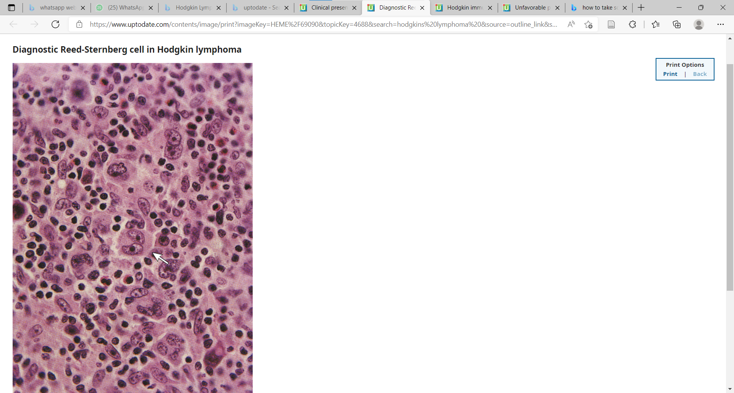

Slide 24
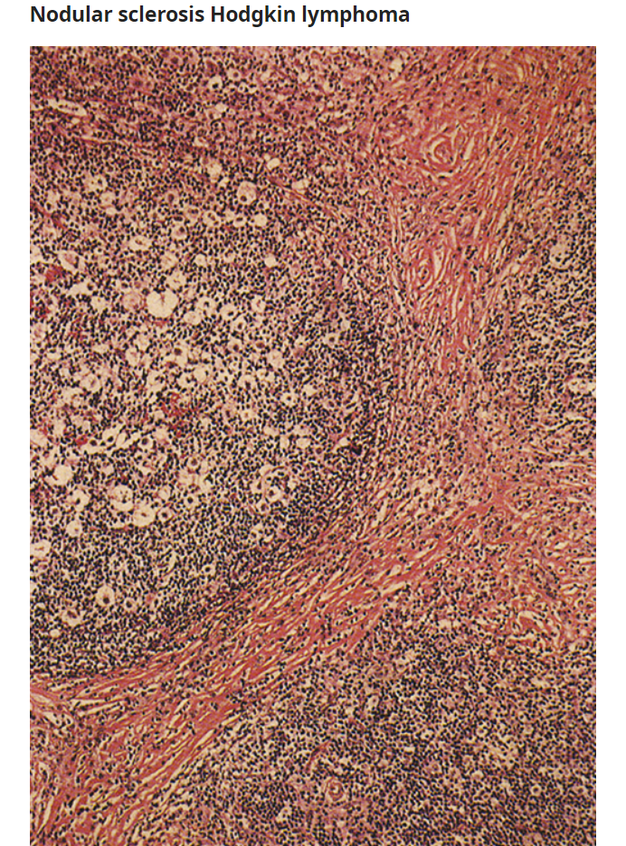
Broad bands of fibrosis separate several nodules in nodular sclerosis Hodgkin lymphoma.
majority of Hodgkin cells are lacunar cells

Slide 25
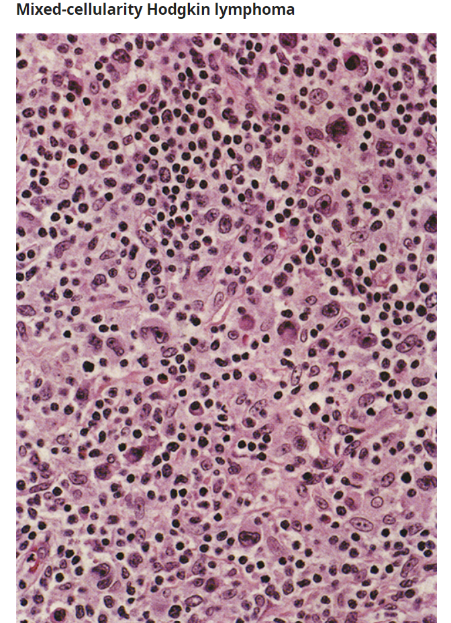
The characteristic background infiltrate of reactive cells (eosinophils, lymphocytes) and Reed-Sternberg cells are present in this field.

Slide 26
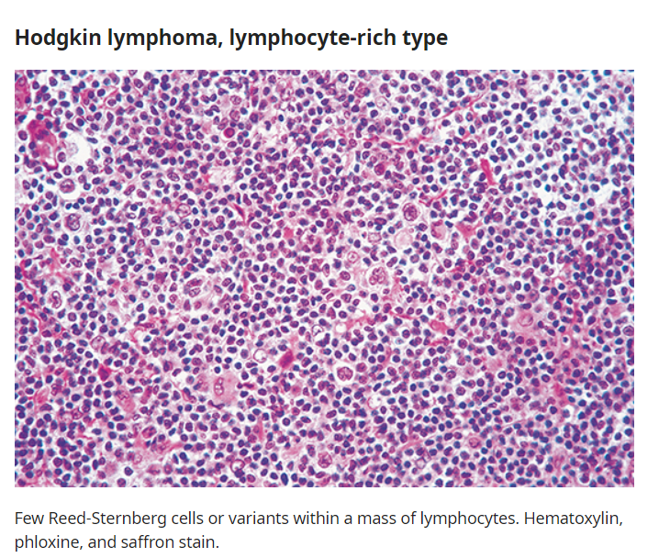

Slide 27
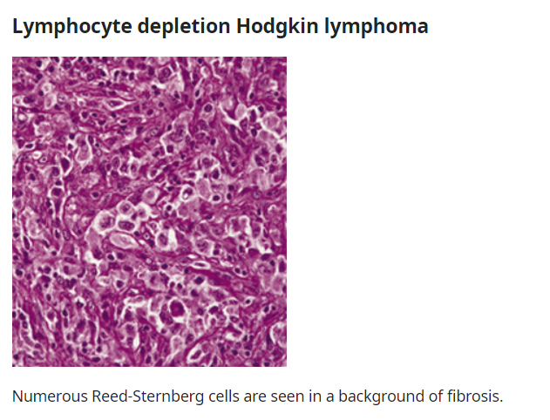

Slide 28
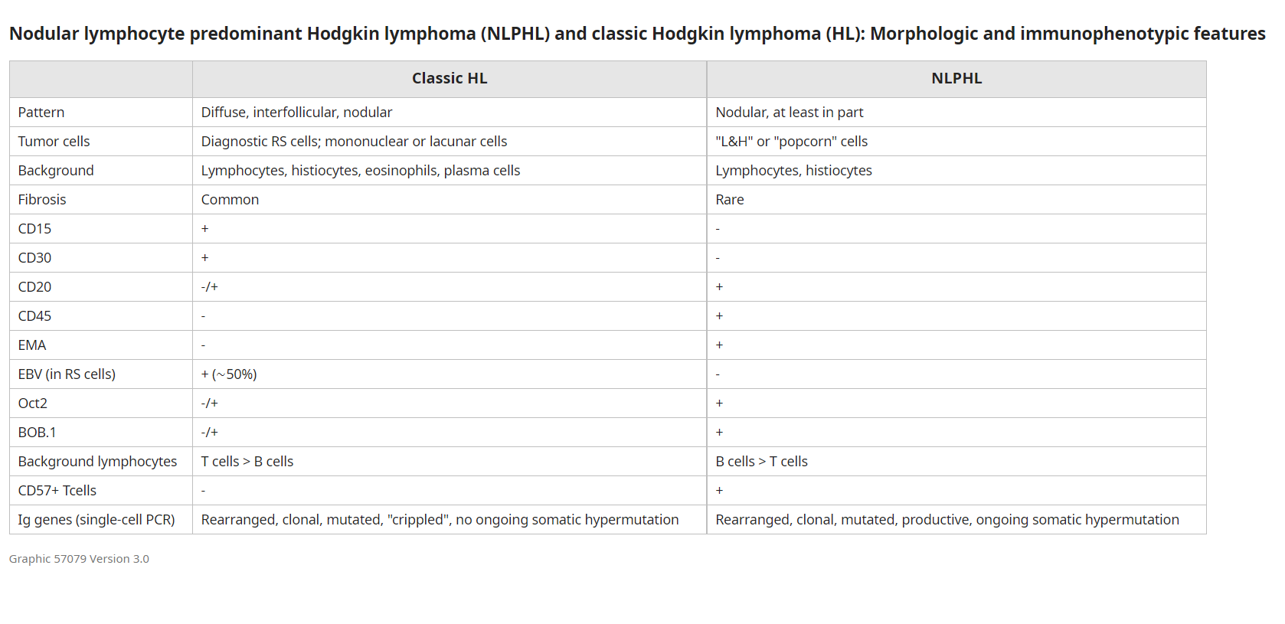

Slide 29
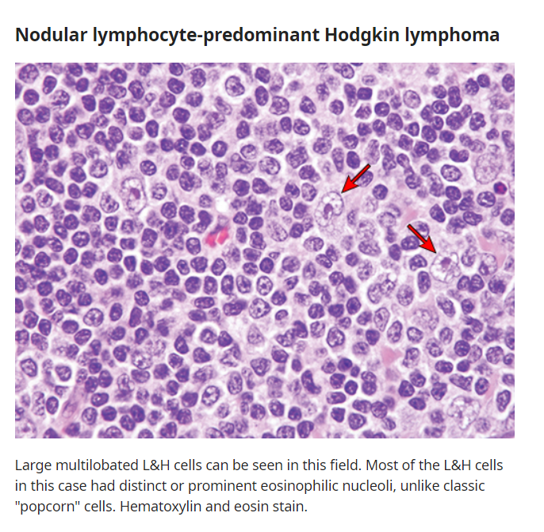

Slide 30
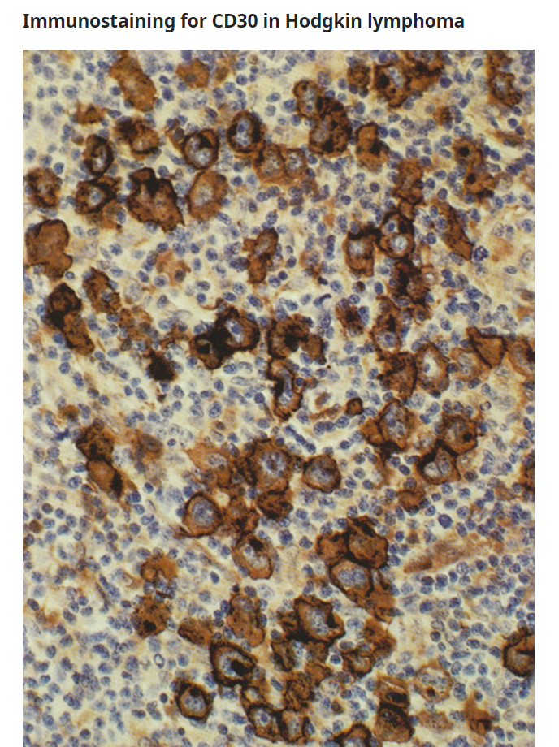
Immunostaining for CD30 demonstrates strong membrane and paranuclear staining, and weaker cytoplasmic staining, of the Hodgkin cells.

Slide 31
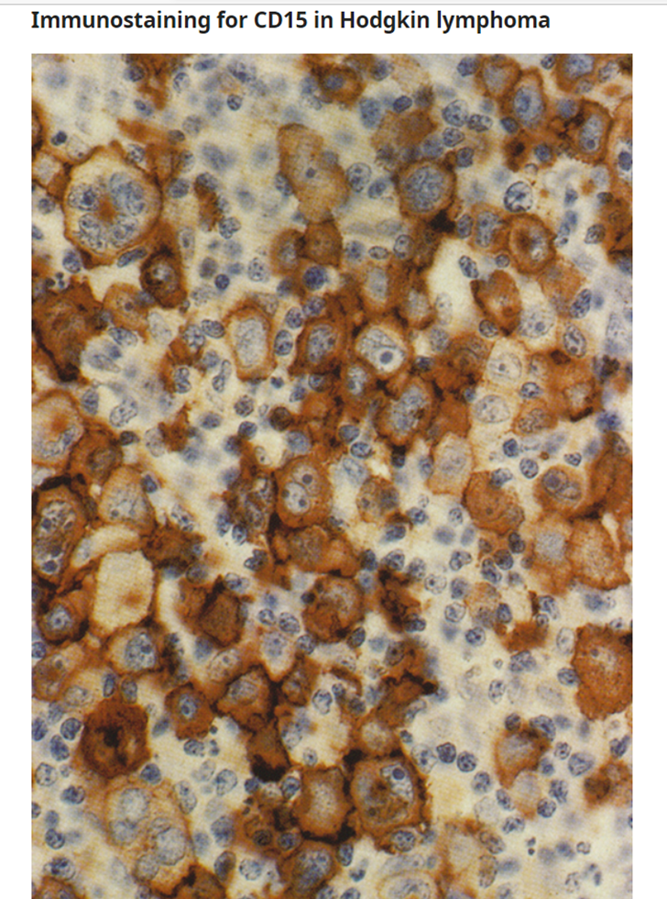
Immunostaining for CD15 demonstrates strong membrane and paranuclear staining of the Hodgkin cells.

Slide 32
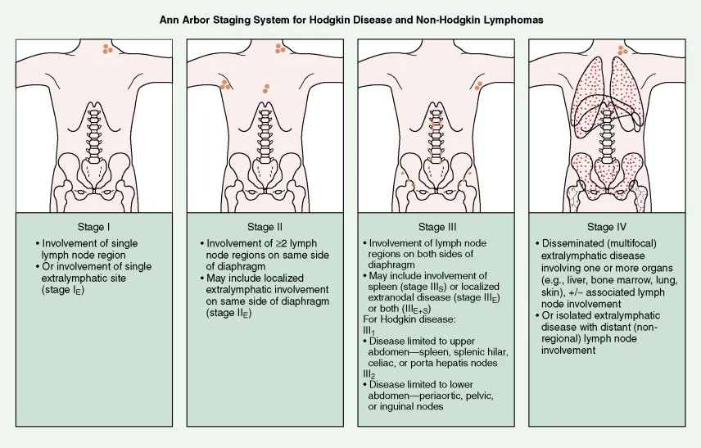
ANN ARBOR STAGING SYSTEM FOR HODGKIN’S LYMPHOMA

Slide 33
A – NO SYMPTOMS
B – Unexplained
E – Localised ,solitary involvement of extralymphatic tissue,excluding liver and bone marrow.
  ● Fever – Persistent temperature >38°C (>100.4°F)
  ● Sweats – The presence of drenching night sweats
  ● Weight loss – Unexplained loss of >10 percent of body weight over the past six months

Slide 34
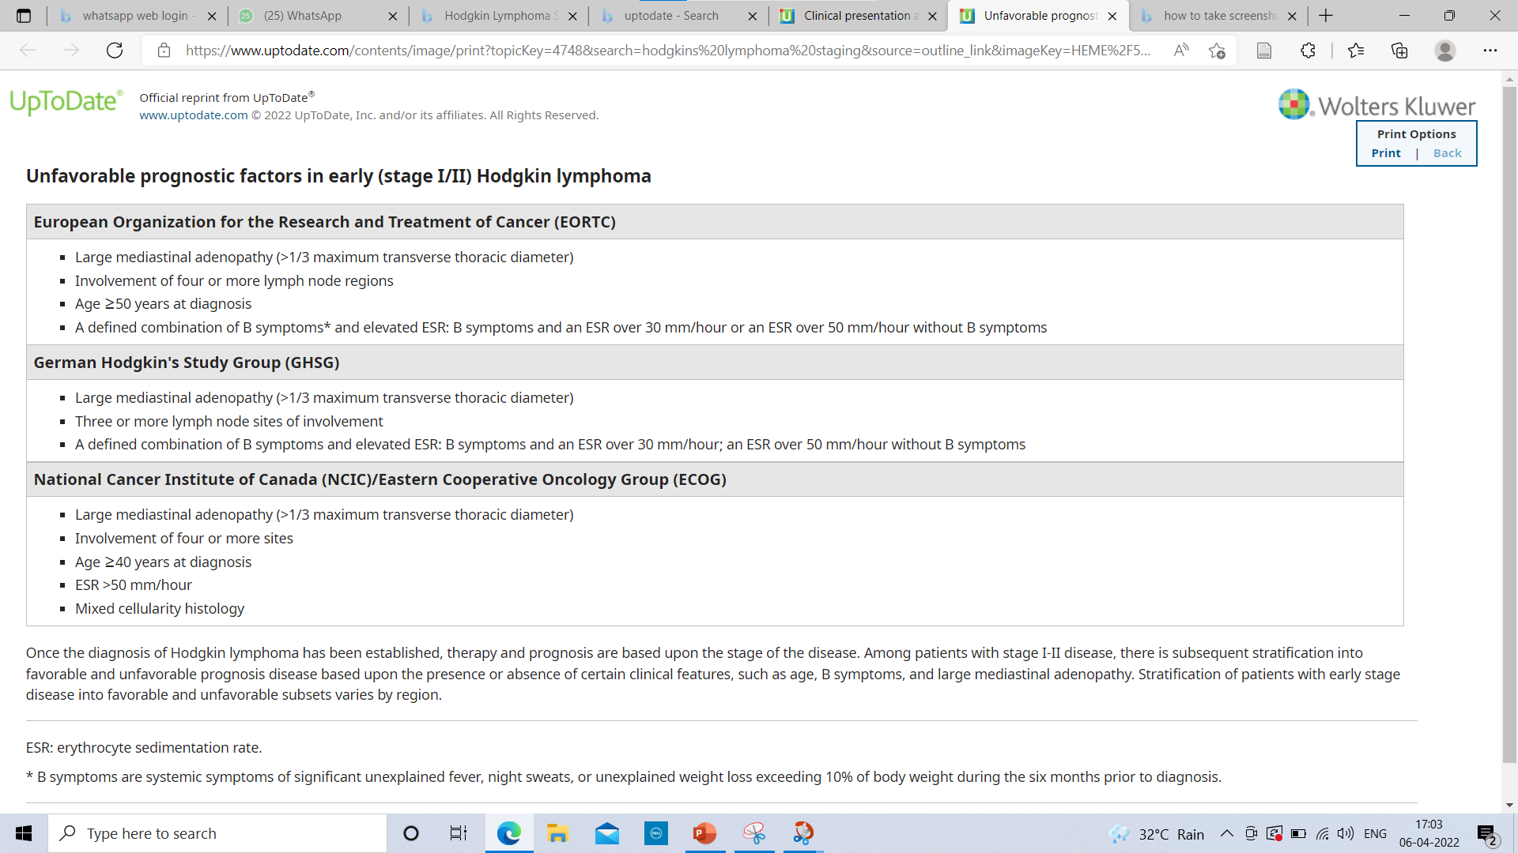

Slide 35
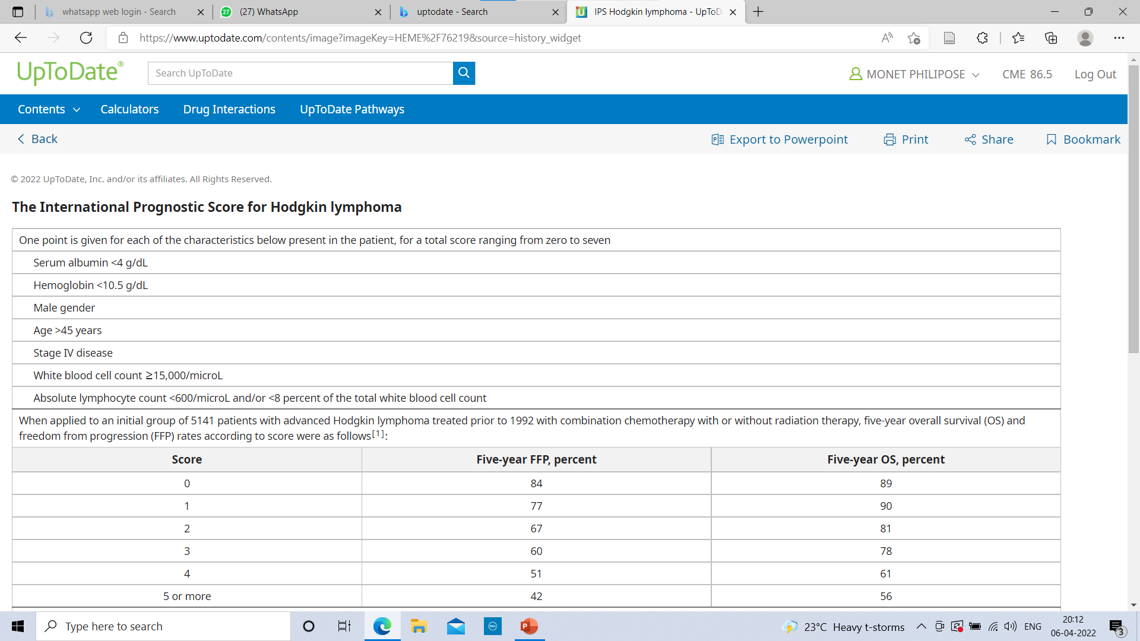

Slide 36
Early stage HL (stage I & II)- Favourable prognosis
ABVD (doxorubicin, bleomycin, vinblastine, dacarbazine ) for 3 (preferred) to 4 cycles, followed by involved-site radiation therapy to 30 Gy. This approach has the lowest relapse rate.
ABVD for 2 cycles, followed by involved-site radiation therapy with 20 Gy may be sufficient treatment for patients with favorable disease as defined by the GHSG. This regimen has lower toxicity.
ABVD for 4 to 6 cycles without radiation therapy is an option for patients at risk of long-term complications from radiation therapy.
Disease control with combined therapy is superior compared with chemotherapy alone, but this must be weighed against the risks of radiation therapy, including cardiac disease and secondary malignancies, particularly in young women who are at high risk for the development of breast cancer after chest irradiation.

Slide 37
Unfavorable prognosis stage I to II HL
Treated with chemotherapy followed by involved-site radiation therapy in a combined modality program.
ABVD remains the "gold standard" chemotherapy for these patients
For most patients, four cycles of ABVD plus radiation therapy appears to be adequate.
Combination chemotherapy alone may be an acceptable option for patients with nonbulky unfavorable early stage disease.

Slide 38
Advanced stage HL (stage III-IV) —
Combination chemotherapy is the main treatment for patients with advanced stage HL.
Radiation therapy may be used for selected patients as consolidation.
The three most widely used treatment regimens for advanced stage HL include
  1. ABVD * 6 Cycles

Slide 39
  2. Escalated BEACOPP
  - Bleomycin, etoposide, doxorubicin, cyclophosphamide, vincristine, procarbazine, and prednisone).
  - BEACOPP is associated with greater toxicity, including reversible bone marrow suppression, secondary malignancies, sterility, and rare cases of fatal sepsis.
  3. Stanford V
  - Doxorubicin, vinblastine, mechlorethamine, vincristine, bleomycin, etoposide, and prednisone
  - This regimen incorporates radiation therapy for all patients and may be preferred in some settings because of its short administration schedule (12 versus 24 to 32 weeks) and decreased pulmonary toxicity.
  -

Slide 40
RELAPSED DISEASE
Patients with first relapse of HL or refractory HL are generally treated with intensive combination chemotherapy ("salvage chemotherapy") or targeted chemotherapy and those who demonstrate a complete response upon restaging by positron emission tomography/computed tomographic (PET/CT) proceed to autologous HCT
Salvage chemotherapy includes Ifosfamide,carboplatin,etoposide (ICE ) regimen or
Gemcitabine,navelbine,doxil (GND) regimen

Slide 41
Autologous HCT — Autologous HCT should be considered the treatment of choice for most patients with r/r HL .
Benefits from HCT compared with chemotherapy alone are especially marked in the following categories of patients:
●Early relapse (<12 months after completion of initial therapy)
●Generalized systemic relapse, or the presence of other poor prognostic markers
●Second (or later) relapse
●Refractory HL (ie, induction failure after initial chemotherapy)

Slide 42
Targeted chemotherapy and immunotherapy —
The antibody-drug conjugate, brentuximab vedotin, preferentially delivers chemotherapy to CD30-expressing cells, including the Reed-Sternberg cells of HL.
Brentuximab vedotin — an antibody-drug conjugate that comprises an anti-CD30 antibody linked to the anti-tubulin agent, monomethyl auristatin E
* PD-1 blockade
Efficacy — Programmed death 1 (PD-1) ligands, PD-L1 and PD-L2, are overexpressed by Hodgkin Reed-Sternberg (HRS) cells in classic HL (cHL), leading to evasion of immune surveillance. nivolumab, pembrolizumab

Slide 43
THANK YOU !

