Slide 1
HEPARIN INDUCED THROMBOCYTOPENIA
DR AMRITA KURIAN
JUNIOR RESIDENT

Slide 2
sources
HEPARIN INDUCED THROMBOCYTOPENIA
Diala Nicolas, Samar Nicolas, Alexander Hodgens, Online publication :NCBI Stat Pearls, 2022, October 3
HEPARIN INDUCED THROMBOCYTOPENIA : A REVIEW OF NEW CONCEPTS IN PATHOGENESIS, DIAGNOSIS AND MANAGEMENT
Matteo Marchetti, Maxime G Zermatten , Lorenzo Alberio et al in Journal Of Clinical Medicine 2021, Feb;10(4)
HEPARIN INDUCED THROMBOCYTOPENIA
Gowthami M Arepally, in BLOOD by the American Society of Hematology, 2017

Slide 3
introduction
HEPARIN
Potentiates the action of antithrombin III and thereby inactivates Factors 2,9,10,11 and 12 as well as plasmin.
Unique pharmacologic properties
  rapid onset of action
  ability to inhibit multiple coagulant proteins
  ease of monitoring
  reversibility

Slide 4
At the therapeutic forefront for a number of indications where alternative therapies are currently
  lacking (cardiac surgery),
  unsuitable (mechanical valves), or
  untested (cancer associated thrombosis and antiphospholipid antibody syndrome).

Slide 5
Heparin induced thrombocytopenia (HIT) : heparin’s most clinically relevant non hemorrhagic complication.
A potentially devastating immune mediated adverse drug reaction caused by the emergence of antibodies that activate platelets in the presence of heparin.
Instead of bleeding, HIT is strongly associated with thromboembolic complications involving both the arterial and venous systems.

Slide 6
The immune reaction is common (8% to 50%), but only 0.5 to 1% on UFH will develop HIT
Incidence even lower with LMWH : 0.1 to 0.5%
Incidence greater with bovine than porcine heparin
Major surgery (cardiac > orthopaedic > vascular) higher risk than minor surgery or medical therapy
Rare in obstetric patients
Females > Males

Slide 7
50% of HIT cases develop HITT ( Heparin Induced Thrombocytopenia with Thrombosis)
MORTALITY : upto 30%
WHY DOESN’T ALL PATIENTS WITH HIT ANTIBODY DEVELOP HIT?
Not completely understood, but association between polymorphisms of Fc receptor and thromboembolic complications in HIT has been observed

Slide 8
TYPES OF HIT
TYPE 1 HIT : HEPARIN ASSOCIATED THROMBOCYTOPENIA
Non immune mediated reaction
More common, mild
As early as day 1 of therapy
Platelet counts spontaneously normalize even if heparin is continued

Slide 9
TYPE 2 HIT
Immune, antibody mediated reaction
Occurs 5 to 14 days of receiving heparin, within I day if recent exposure to heparin ie in the last 100 days.
Hypercoagulable state, life threatening complications

Slide 10
PATHOPHYSIOLOGY
1. ANTIGEN FORMATION : PLATELET FACTOR 4- HEPARIN COMPLEXES (PF4/H)
The HIT antigen is situated on the platelet factor 4 (PF4), a chemokine within platelet α-granules.
PF4 not immunogenic in its primary form.
Conformational changes occur in PF4 secondary to binding with negatively charged molecules - heparin and other glycosaminoglycans (GAGs); BECOMES IMMUNOGENIC
Affinity of PF4: heparin > heparan sulfate > dermatan sulfate > chondroitin sulfate

Slide 11
The size and the charge of the complexes play a central role in pathogenicity.
PF4 molecules (positively charged) assemble with heparin chains(negatively charged) - multimolecular ultralarge Heparin/PF4 complexes (ULCs)
Maximal amount of ULCs formed at equimolar PF4/heparin ratio
A net positive charge facilitates the interaction with immune cells
Therefore, highest immunogenicity when PF4 is in excess and at a molar PF4/heparin ratio of 20:1

Slide 12
Heparin chains with at least 12 saccharides are necessary to form ULCs
Compared to UFH (45 saccharides) , far fewer ULCs are formed with LMWH(15 saccharide units) , and none with fondaparinux ( 5 saccharides)

Slide 13
2. ANTI PF4/H ANTIBODY SYNTHESIS
ULCs activate complement, deposition of C3/C4 on the complexes.
Facilitates binding to CD21 on B cells, B cell activation and antigen transport to secondary lymphoid follicles
Culminates in an adaptive humoral immune response and anti-PF4/H antibodies production

Slide 14
3 PLATELET ACTIVATION
In presence of PF4, increasing heparin initially leads to an increasing antigen-complex size - ULCs
HIT antibodies then bind to these ULCs
The antigen–antibody binds on the platelet surface via Fc receptor
Induces platelet activation : platelet degranulation and aggregation

Slide 15
Degranulation releases
PF4 : increase in PF4 concentration - further antigen-complex formation
platelet-derived procoagulant microparticles : enhance thrombin generation.
In presence of excess PF4, further cells, including monocytes, endothelial cells, and neutrophils are recruited.

Slide 16
ROLE OF OTHER CELLS BEYOND PLATELETS
MONOCYTES :
Excess PF4 bind to GAGs in their glycocalyx
Activated monocytes (a) secrete IL 8
(b) increased expression of Tissue Factor
This procoagulant activity culminates in thrombin generation

Slide 17
ENDOTHELIAL CELLS :
HIT antibodies bind to PF4 on endothelial cells (pre requisite: platelet activation and degranulation)
Endothelial injury – release of von Willebrand factor (platelet adhesion)
and thrombomodulin (decreases the anticoagulant potential)
Endothelial activation: expression of tissue factor

Slide 18
NEUTROPHILS:
Activated via P-selectin on platelets and immune complexes formed by binding to chondroitin sulfate
Induces formation of Neutrophil Extracellular Traps that participate in hypercoagulability

Slide 19
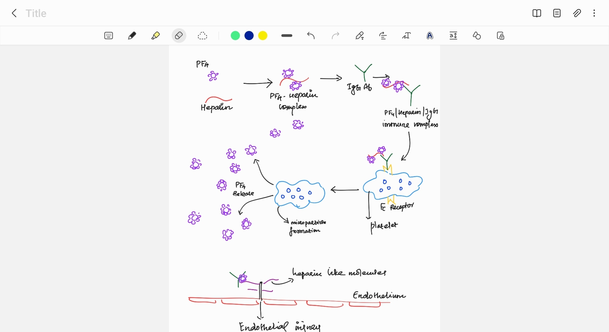

Slide 20
Reasons for thrombocytopenia
Macrophages consume the IgG coated platelets and the reticuloendothelial system removes them
As platelets become activated , they aggregate – thrombus formation and platelet counts drop

Slide 21
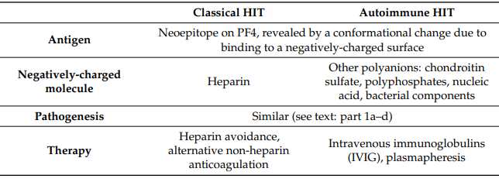
HIT WITHOUT HEPARIN
SPONTANEOUS OR
AUTOIMMUNE HIT

Slide 22
CLINICAL FEATURES
In heparin-naive individuals, PF4/heparin antibodies become detectable at a median of 4 days from start of heparin therapy.
Clinical manifestations of thrombocytopenia and/or thrombosis develop 5 to 14 days after initial heparin therapy
In patients with recent heparin exposure (within 100 days), thrombocytopenia occurs precipitously within 24 hours of drug re exposure because of circulating anti-PF4/heparin antibodies.

Slide 23
THROMBOCYTOPENIA
Occurs in 95%
Manifest either as an absolute drop in platelet count (less than 1,50,000/L) or a relative decline of ≥ 50% from baseline platelet counts.
Nadir ≥ 20,000
Patients with isolated thrombocytopenia (isolated HIT) remain at high risk for subsequent thrombosis (20% to 50%) from circulating antibodies

Slide 24
THROMBOSIS
Occur concurrently with thrombocytopenia
Venous thromboses predominate, particularly at sites of vascular injury from catheters.
Atypical presentations : bilateral adrenal hemorrhage, venous limb gangrene, and skin necrosis should prompt diagnostic consideration of HIT.

Slide 25
Not known why some seropositive patients remain asymptomatic while others progress to severe disease.
Clinical studies indicate that certain serologic features, such as
  IgG isotype
  high antibody levels
  marked thrombocytopenia (> 90% decline from baseline counts) are associated with thrombotic risk

Slide 26
COURSE
Platelets start to rise within 2 to 3 days of stopping heparin and returns to normal within 7 to 10 days.
Even with platelet recovery, patients are at risk for thrombosis for 4 to 6 weeks after diagnosis.
It takes another 2 to 3 months for the antibodies to disappear (3 months for immunoassays)
Patients who are re-exposed to the drug after many months or years don’t often manifest anamnestic responses and seroconversion risk appears similar to de novo heparin.

Slide 27
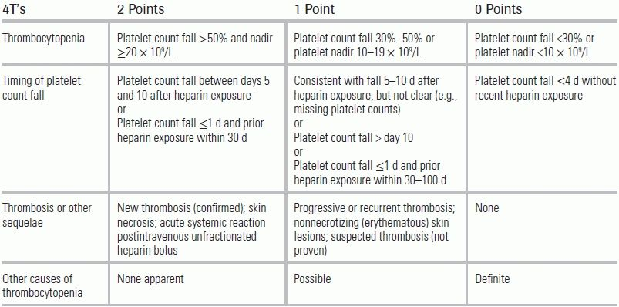
CLINICAL SCORING SYSTEMS : 4 T SCORE
To estimate the probability of hit.
Score of 0-3 : rules out HIT
Score of 4-5 : intermediate probability
Score of 6-8 : High probability of HIT (around 50%)

Slide 28
HEP (HIT Expert Probability Score) :
More recent, higher specificity among ICU patients
Not yet recommended.

Slide 29
LABORATORY WORK UP
In those with intermediate to high probability of HIT
ANTIGENIC ASSAYS
Highly sensitive (80 to 100%) and excellent negative predictive value
Low specificity
Easier to perform ; ELISA based
Aims to detect Anti PF4-heparin Antibody in patient’s serum or plasma
Typically IgG specific (95% of PF4/H antibodies are IgG)

Slide 30
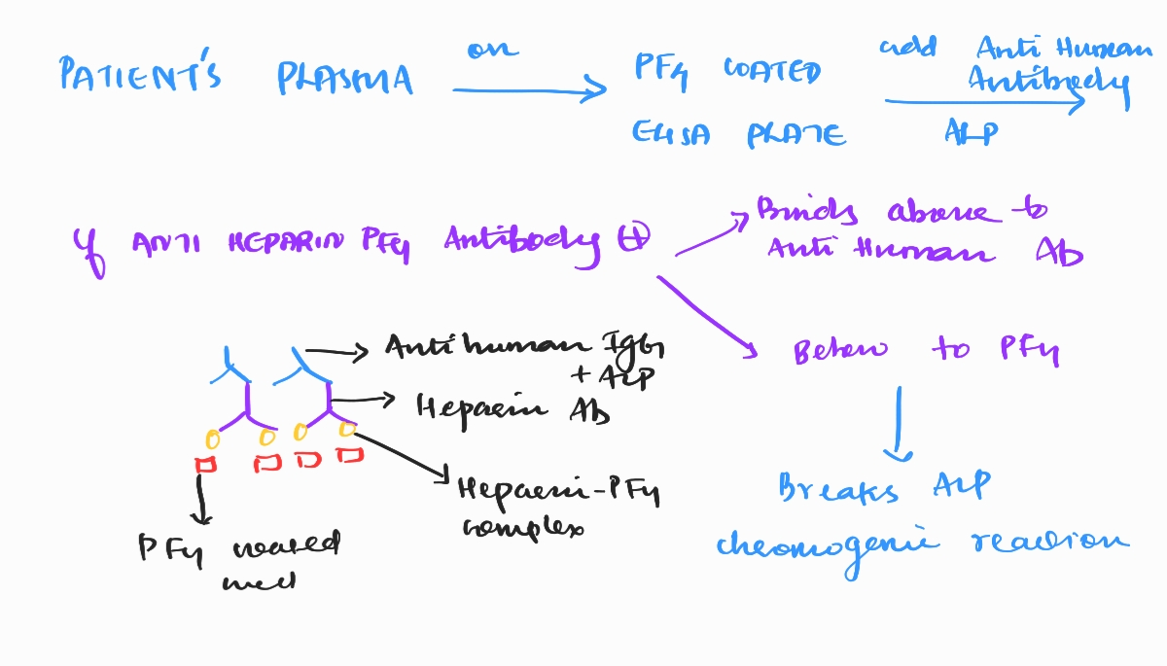

Slide 31
FUNCTIONAL ASSAYS (ACTIVATION ASSAYS)
Gold standard
But time consuming and not available in all hospitals
Their use is currently only recommended only among patients with intermediate and/or high clinical suspicion and a positive Immunoassay

Slide 32
Sample : patient’s serum having H/PF4 Ab + washed platelets
Tests the ability of H/PF4 Ab to activate platelets in the presence of exogenous heparin
We measure
  Serotonin release ( >20%) from activated platelets
  ATP release
  HIPA (heparin induced platelet activation)

Slide 33
DIFFERENTIAL DIAGNOSIS
TYPE I HIT
DISSEMINATED INTRAVASCULAR COAGULATION
BACTERIAL SEPSIS
THROMBOTIC THROMBOCYTOPENIC PURPURA
HEMOLYTIC UREMIC SYNDROME
IMMUNE THROMBOCYTOPENIA
DRUG INDUCED THROMBOCYTOPENIA
MYELOSUPPRESION
CHRONIC LIVER DISEASE
HYPERSPLENISM

Slide 34
MONITORING OF PLATELET COUNT
The American College of Chest Physicians, in collaboration with the College of American Pathologists
A baseline platelet count before initiating heparin treatment in all patients
In higher risk patients, eg: those receiving unfractionated heparin at therapeutic doses, the platelet count to be checked at least every other day from day 4 to 14 of treatment (or until heparin is stopped, whichever is sooner).
In lower risk surgical, medical and obstetric patients, monitoring should be at least on every second to fourth day between days 4 and 14 while on heparin

Slide 35
TREATMENT
CORNERSTONES
Immediate cessation of heparin
Send blood samples for laboratory confirmation
Lower limb venous doppler for DVT
Avoid platelet transfusions - exacerbate the hypercoagulable state.
However, if the patient develops bleeding or is undergoing major surgical intervention, therapeutic platelet transfusion can be considered.

Slide 36
ALTERNATIVE ANTICOAGULATION
  Direct parenteral thrombin inhibitors: argatroban or bivalirudin
  Indirect parenteral factor Xa inhibitors: danaparoid or fondaparinux
  Newer oral anticoagulants : rivaroxaban, apixaban or dabigatran (but the data on their use is very limited)
Overlap with Vit K antagonist to be initiated only after platelet counts are ≥ 1.5 lakhs for 2 consecutive days

Slide 37
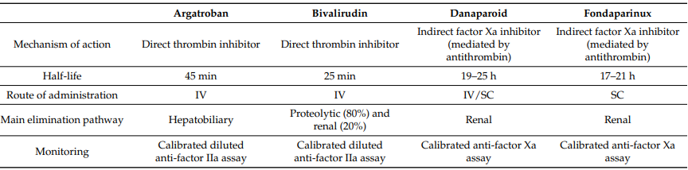

Slide 38
DOSAGES
FONDAPARINUX
< 50 kg : 5mg S/C OD
50- 100 kg : 7.5mg S/C OD
> 100 kg : 10mg S/C OD

Slide 39
Initial dose: 2mcg/kg/min, continuous IV infusion
Maintenance: Not to exceed 10mcg/kg/min
Measure APTT after 2 hours and adjust the dose till APTT is 1.5-3 times the initial baseline value (<100s)
While converting to warfarin, loading dose of warfarin not used due to their combined effect on the INR
Patients receiving ≤ 2mcg/kg/min : Argatroban can be stopped when INR >4 following combined therapy
Patients on ≥ 2mcg/kg/min : reduce the dose of argatroban to 2mcg/kg/min and measure INR 4 to 6 hours after dose reduction; if >4, stop the drug
ARGATROBAN

Slide 40
BIVALIRUDIN
Initial dose : 0.2 mg/kg/hour
Adjust the dose to achieve an APTT of 1.5- 2.5 times the baseline
Warfarin may be overlapped with bivalirudin for minimum of 5 days until INR is within the target range

Slide 41
Duration of therapeutic anticoagulation:
HIT alone : 1 month
HITT: 3 – 6 months

Slide 42
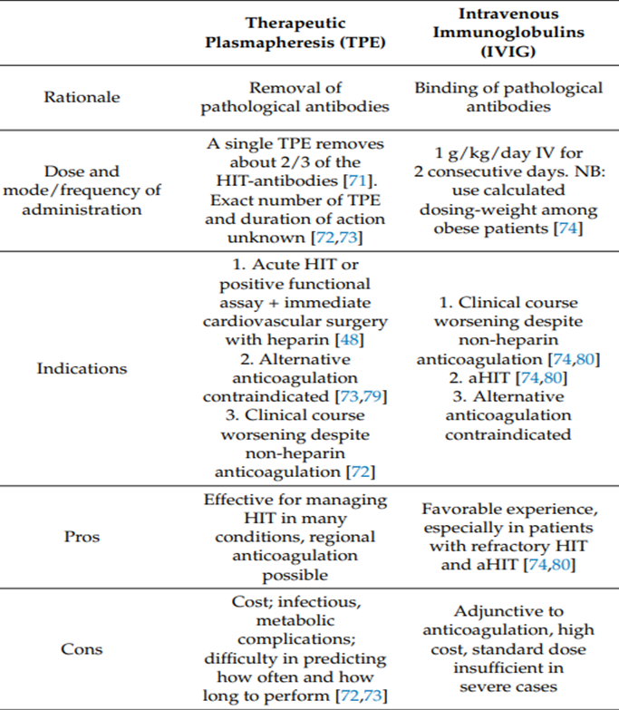
SECOND LINE TREATMENTS
Therapeutic plasmapheresis (limited experience)
Intravenous immunoglobulin

Slide 43
SPECIAL SCENARIOS
MANAGEMENT OF HIT DURING CARDIAC OR VASCULAR SURGERY
Delay the surgery if possible
Alternate anticoagulant
Avoid heparin in patients with a past history of HIT: risk of anamnestic response

Slide 44
If emergency surgery and heparin administration is absolutely necessary
In patients with HIT antibodies or high 4T score : IV Ig or plasma exchange prior to heparinisation
In patients without HIT antibodies: limit heparin exposure to the day of surgery only, thereafter a non heparin agent
Co administer epoprostenol with heparin intraoperatively : prevents platelet activation

Slide 45
HIT IN PATIENTS REQUIRING HEMODIALYSIS
No heparin method ( 200ml isotonic saline every hour for the entire session of HD)
Heparinised solution rinse : A heparinised solution is flushed through the dialysis circuit which is then rinsed out with isotonic saline prior to connecting the patient to the circuit

Slide 46
Thank you

