Slide 1
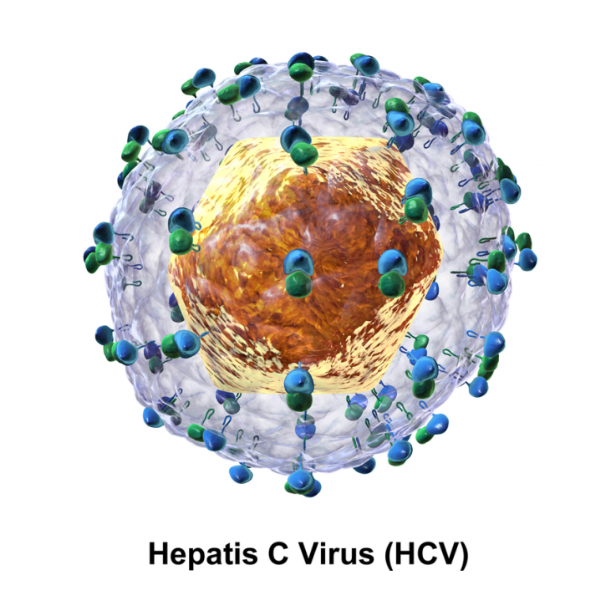
HEPATITIS C
Neethu Varghese
Junior Resident
General Medicine

Slide 2
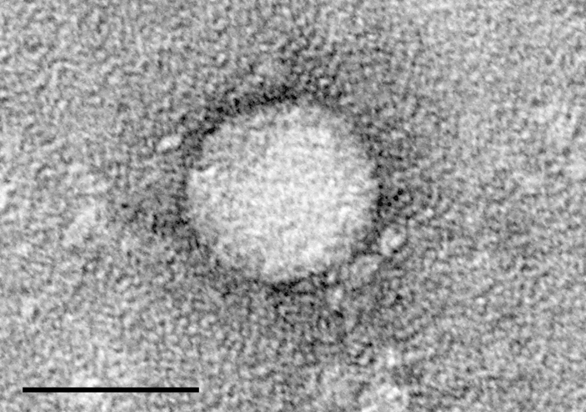
Before identification termed as NON A NON B Hepatitis
Linear
Single stranded
Positive sense
9600 nucleotide RNA virus
Family Flaviviridae
Genus Hepacivirus
Only species
INTRODUCTION

Slide 3
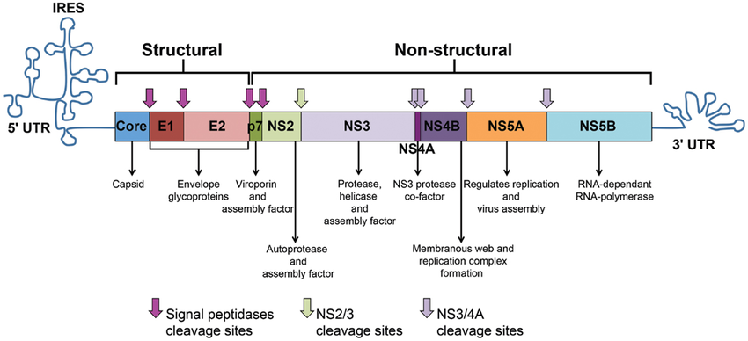
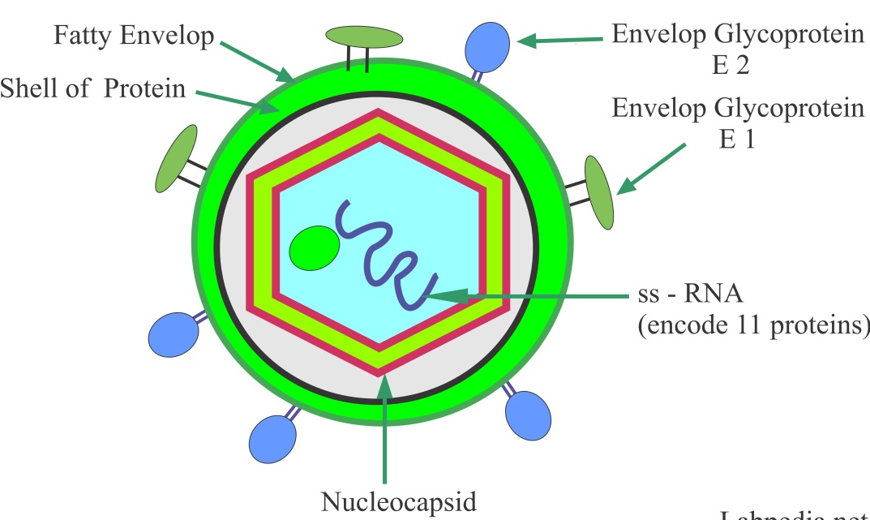

Slide 4
6 major genotypes and 1 minor genotype
Genotypes differ from one another in sequence homology by 30%
More than 50 subtypes
Subtypes differ by 20%
Some are closely related but differ by few percent but not amounting to different subtype or genotype termed as quasispecies

Slide 5
Globally, an estimated 58 million people have chronic hepatitis C virus infection.
WHO estimated in 2019, approximately 2,90,000 people died from hepatitis C, mostly from cirrhosis and HCC.
Burden of hepatitis C in India is not known.
Estimated that in India there is ~3 million to ~9 million persons with active HCV infection.
Hepatitis C accounts for 40% of chronic liver disease.
Genotype 1 is most common worldwide,70%.
BURDEN OF THE DISEASE

Slide 6
Usual routes of transmission of HCV infection are:
Blood transfusion
Unsafe injection practices
      Healthcare-related
      Injection drug use
Nosocomial
      Unsterile surgical procedures, hemodialysis, tissue transplant
Body piercing, tattooing
Sexual activity
Mother to child (Breast feeding doesn’t increase risk)
TRANSMISSION

Slide 7
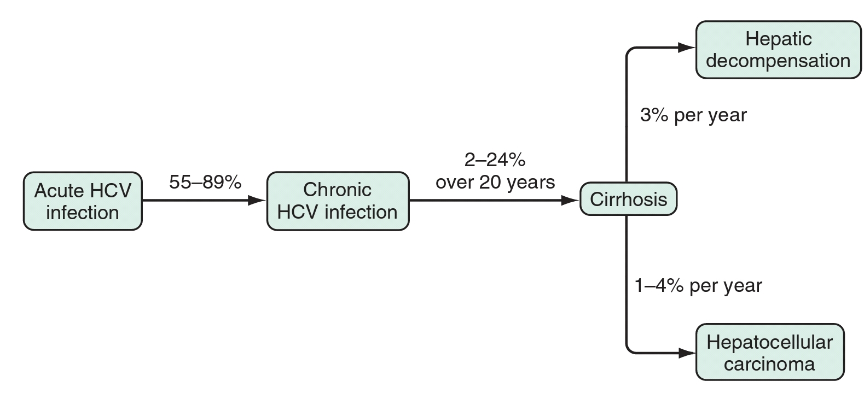
Natural history of HCV infection

Slide 8
Acute hepatitis c
Rarely seen in clinical practice
Incubation period – 15 to 160 days (mean 7 wks)
Variable manifestations
    Asymptomatic
    Mild non-specific symptoms
    Mild clinical jaundice in up to 15% of patients
May be identified in those on high risk and on regular monitoring for HCV infection
(e.g. persons on maintenance hemodialysis)

Slide 9
Diagnosis difficult
Diagnosis of acute hep C can be made
    Recent change in anti-HCV antibody/HCV RNA status
    (from -ve to +ve)
    Elevated ALT level

Slide 10
Persistent or chronic infection
      A person who continues to have detectable HCV RNA in blood beyond six months after acute infection
Resolved infection
      HCV disappears from the body within 6 months after infection. However, anti-HCV usually continues to be positive
Relapse is rare once RNA is spontaneously cleared
Re-infection can occur following repeat exposure
(e.g. in those who continue to be at high risk: iv drug users, dialysis)

Slide 11
CHRONIC HEPATITIS C
HCV RNA persists in blood beyond 6 months
Serum ALT levels are usually elevated (2x to 8x)
Persistent normal ALT levels seen in women
Fatigue is the most common symptom
Jaundice is rare
Less common symptoms include arthralgias, paresthesia, myalgias, nausea, anorexia

Slide 12
PATHOGENESIS
HCV that enters the liver cell, undergoes replication & simultaneously causing cell necrosis
Mechanims involved are
  Immune mediated
  Viral mediated
Chronic hepatitis develops in 50 to 90% of persons with acute HCV infection
In minority, acute infection resolves due to an early & multi specific Tcell response

Slide 13
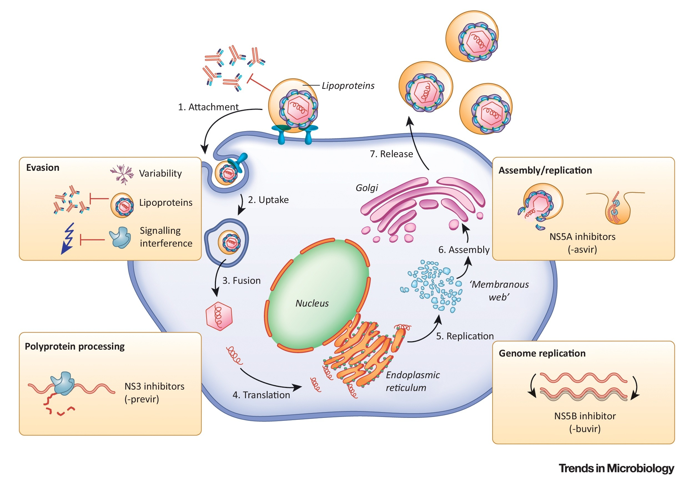

Slide 14
IMMUNE MEDIATED MECHANISMS
HCV infection elicits innate response f/b adaptive response
Components of innate immunity are
          NK cell activation and Cellular antiviral mechanisms (via JAK STAT, TLR3 activation) triggered by PAMPS (Pathogen associated molecular pattern)
          These lead to apoptosis of infected cells
          NK cells increases production of TNF beta, IFN alpha and cytokines, resulting in dendritic cell maturation, thus inducing adaptive immunity

Slide 15
HCV disrupts innate immune response by HCV E2 protein binding to CD81
    Leads to chronic infection
    Prevents vigorous adaptive immune response by reducing priming of CD8 and CD4 T cells
CD8 T cell response predominates, resulting in hepatocellular injury
Successful clearance of HCV during acute infection depends on the rise, vigor & persistence of Th1 immune response
Those who lacked may develop a chronic infection

Slide 16
Determinants of persistence of HCV include
    The evasion of immune responses through viral mechanisms
    Inadequate induction of innate immune response
    Insufficient induction or maintenance of adaptive response
    The production of viral quasispecies
    The induction of immunologic tolerance

Slide 17
VIRAL MECHANISMS
Less significant, largely immune mediated
Important pathway in immunocompromised HCV patients (HIV and transplant recipients)
Direct viral hepatotoxicity of infected cells – viral levels are more in the infected cells

Slide 18
PATHOLOGY
Histological lesion shows
        Relative paucity of inflammation
        Marked increase in sinusoidal lining cells
        Lymphoid aggregates
        Presence of fat (more with genotype 3)
        Bile duct lesions in which biliary epithelial cells piled up without interruption of basement membrane

Slide 19
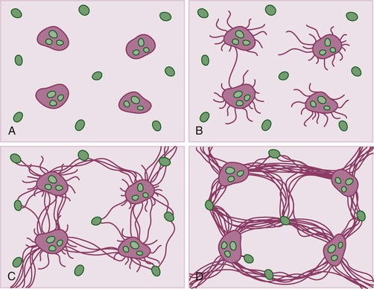
Prolonged liver injury leads to scarring (fibrosis)
Central vein
F1
F2
Portal tract
F3
F4
Scarring/fibrosis: particularly affect the central vein and portal tracts (blood vessels)
Fibrosis affects flow of blood through the portal tracts and hepatic lobules

Slide 20
EXTRA HEPATIC MANIFESTATIONS
PROVEN
Essential mixed cryoglobulinemia (EMC)
    Characterized by arthritis, cutaneous vasculitis (palpable purpura), and glomerulonephritis
    Serological presence of circulating cryoprecipitable immune complexes of more than one ig class, positive RA factor and low complement levels
    Treatment should be considered in patients with symptomatic cryoglobulinemia

Slide 21
Glomerular diseases
  Cryoglobulinemic nephropathy – manifested as hematuria, proteinuria, edema & renal insufficiency
  MPGN
  Membranous nephropathy
Autoimmune thyroiditis
B cell non hodgkin’s lymphoma – HCV is not a typical oncogenic virus
  HCV shows lymphotropism & facilitate the development and selection of abnormal B cell clones by chronic stimulation of immune system
Lichen planus
Monoclonal gammopathies
Porphyria cutanea tarda

Slide 22
POSSIBLE
Chronic polyarthritis
Diabetes mellitus
Idiopathic pulmonary fibrosis
Non cryoglobulinemic nephropathies
Sicca syndrome
Renal cell carcinoma
Vitiligo

Slide 23
DIAGNOSIS
Episodic pattern of aminotransferase elevation is common
INDIRECT ASSAYS
    Enzyme immunoassays detect antibodies against different HCV antigens
    3rd gen EIAs detect antibodies against HCV core, NS3, NS4, NS5 antigens as early as 7 weeks after infection
    Sensitivity and specificity rates of 99%
DIRECT ASSAYS
    HCV RNA is gold standard in diagnosing hepatitis C
    HCV core antigen assay

Slide 24
HCV Markers
Test | Clinical interpretation
Anti-HCV (Anti-hepatitis C virus antibody) | Indicates exposure to HCV Does not differentiate between active or resolved infections Remains positive even after successful treatment and clearance of HCV infection Cheap, easy A very good screening test for HCV infection
HCV RNA (quantitative or qualitative) (Nucleic acid test) | Qualitative tests: HCV RNA is detectable (positive) or not Quantitative test: Amount of HCV RNA per unit blood Positive test indicates presence of active virus replication Becomes negative after successful HCV treatment Costly, time consuming and require expertise Differentiates between active and resolved infection Used for monitoring treatment and its efficacy

Slide 25
HCV Markers
Test | Clinical interpretation
HCV genotype | HCV has several strains which vary from each other genetically Classified based on genomic sequences into genotypes 1 to 6 Virus genotypes vary in sensitivity to some drugs Costly, needs specialized equipment and personnel Can help in deciding appropriate treatment in some situations No use if treatment does not depend on genotype
HCVcAg (Hepatitis C core antigen) | A viral protein, produced only when virus is replicating Positive in unresolved chronic infection Become negative after successful HCV treatment Cheaper and easier than HCV RNA Reasonable and cheaper alternative of HCV RNA test However, may be negative in those with very low HCV RNA (lower sensitivity)

Slide 26
Interpretation of HCV serologic test results
Anti-HCV | HCV RNA | HCV Ag | Interpretation
− | − | − | Never infected
−/+ | ＋ | ＋ | Recent infection
＋ | ＋ | ＋ | Persistent (chronic) infection
＋ | − | − | Previously infected (Infection resolved or cured)
HCV antigen test gives the same information as HCV RNA.
It has the potential to replace the RNA test –
currently not widely accepted, but is likely to do so in future

Slide 27
Approaches for detecting HCV infection
  Mass screening
  (unselected testing of general population)
  Targeted screening
    Birth cohort testing
    Specific high-risk groups
    Blood donor screening (primarily done for blood safety)

Slide 28
Approach for testing for HCV infection
Testing approach | Recommendations
General population testing | In a setting with anti-HCV seroprevalence ≥2% or ≥5%, all adults should have access to HCV serological testing and linkage to care
Birth cohort testing | Used if ‘specific identified birth cohorts‘ (e.g. older persons) are at a higher risk of HCV infection
Focused testing in most affected populations | In all settings, testing for anti-HCV antibody should be offered to: Adults and adolescents from populations most affected by HCV infection High prevalence: migrants, high/intermediate prevalence, specific tribes History of exposure High-risk behaviours Adults and children with a clinical suspicion of chronic viral hepatitis
WHO. Guidelines on Hepatitis B and C Testing, 2017. Page P37.

Slide 29
Approach for testing for HCV infection
Testing approach | Recommendations
Ante-natal screening | Routine testing of pregnant women for HCV infection is currently not recommended
Blood donor screening | All donors should be screened for HCV infection
GUIDELINES ON HEPATITIS B AND C TESTING (WHO 2017) P37

Slide 30
High risk-groups for HCV infection
People who inject drugs
Men who have sex with men
Female sex workers
People who received blood transfusion before routine testing for hepatitis C
People who need frequent blood transfusion, such as, thalessemic and dialysis patients
People living with HIV
Inmates of prisons and other closed settings

Slide 31
Summary of serology
A positive anti-HCV test indicates exposure to HCV, which is either active or has resolved
Anti-HCV remains positive following successful treatment
Anti-HCV antibody test can be used as a screening test for HCV infection
Tests for HCV RNA or HCVcAg serve as confirmatory test, indicate active infection and need for treatment. These are also useful to monitor treatment and confirm cure

Slide 32
INDICATIONS FOR LIVER BIOPSY IN HEP C
Evaluation for concomitant liver diseases
Guidance for decisions regarding Rx
Staging fibrosis
Assessment of the need for surveillance for hepatocellular carcinoma

Slide 33
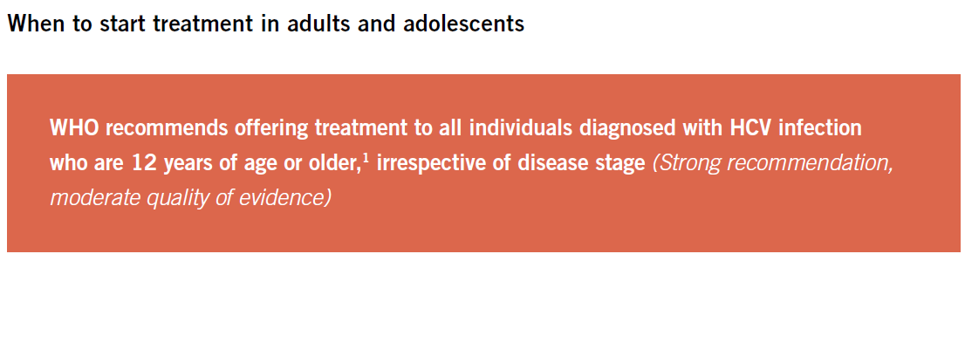
TREATMENT
1 with the exception of pregnant women

Slide 34
The duration of treatment will depend on the several situations such as,
      cirrhosis versus non-cirrhosis,
      presence of decompensation (ascites, variceal bleeding, hepatic encephalopathy, or infection(s)
      treatment naïve versus treatment experienced patients (to peg IFN, DAAs, etc ).

Slide 35
Why treat HCV infection?
Delay the progression of cirrhosis
Reduce the incidence of hepatocellular carcinoma
Improve quality of life
Improve long-term survival (reduce death)
Potentially, reduce transmission

Slide 36
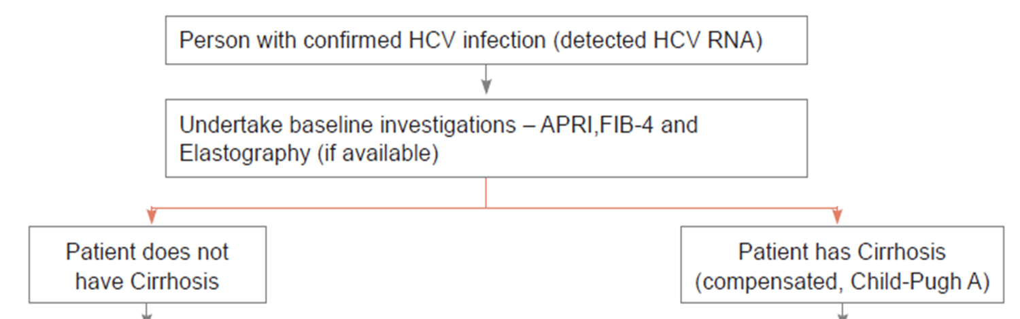
Assessment Before Initiating Treatment

Slide 37
Chronic HCV infection can lead to progressive liver fibrosis
Degree of fibrosis can be identified by liver biopsy and is classified as F0 to F4 (using the METAVIR staging system).
Cirrhosis (or F4 fibrosis) indicates extensive liver scarring secondary to prolonged inflammation of the liver, and is associated with a high risk of serious complications
METAVIR stage | Definition
F0 | No fibrosis
F1 | Portal fibrosis without septa
F2 | Portal fibrosis with septa
F3 | Numerous septa without cirrhosis
F4 | Cirrhosis

Slide 38
Diagnosis of cirrhosis
Indirect tests
  Hemogram, especially platelet count
  Biochemical tests: ALT, AST, albumin
  Composite measures
    FIB-4, APRI
Imaging
  Ultrasound
Specialized tests
  Endoscopy for varices
  Liver stiffness (elastography)

Slide 39
Cirrhosis versus no cirrhosis
 | Components | Requirements | Cost
APRI | AST, platelets | Simple serum and hematology test | +
FIB-4 | Age, AST, ALT, Platelets
FibroTest | GGT, haptoglobin, bilirubin, apoprotein A1, α2-macroglobulin | Specialized tests at designed laboratories | ++
Fibroscan ® | Transient elastography | Dedicated equipment | +++
AST Aspartate aminotransferase
ALT Alanine aminotransferase
GGT Gamma glutamyl transpeptidase
APRI Aspartate aminotransferase-to-platelet ratio index
FIB-4 Fibrosis-4 score

Slide 40
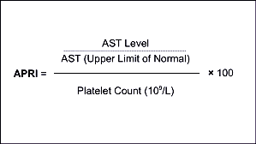
AST to Platelet Ratio Index (APRI)

Slide 41
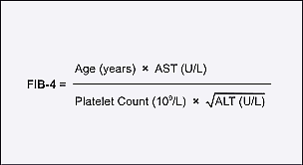
Fibrosis-4 score

Slide 42
Compensated versus decompensated cirrhosis
Compensated cirrhosis
Cirrhosis usually without liver-related symptoms or signs
Decompensated cirrhosis
Cirrhosis with development of symptomatic complications
  Ascites
  Hepatic encephalopathy
  Total bilirubin >2.5 x ULN + prolonged prothrombin time
  (>3 second prolongation or INR >1.5)
  Variceal bleed
Indicates presence of advanced liver disease

Slide 43
Severity of liver dysfunction
Methods | Parameters assessed
Child-Pugh-Turcotte (CTP) score/class | Clinical evaluation: Ascites Encephalopathy Serum bilirubin Serum albumin Prothrombin time (INR)
Model for End-stage Liver Disease (MELD) | Serum bilirubin Prothrombin time (INR) Serum creatinine

Slide 44
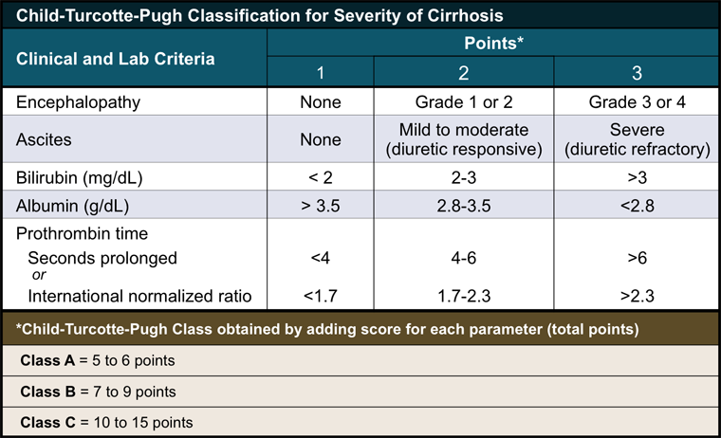
Child-Pugh-Turcotte Score

Slide 45
Pre-treatment Assessment-Summary
Clinical features Cirrhosis
Decompensation
Laboratory Hemogram
Liver function tests
Creatinine
Fibrosis/cirrhosis Non-invasive fibrosis assessment
Fibroscan: if available
UGI endoscopy, if needed
HCV RNA

Slide 46
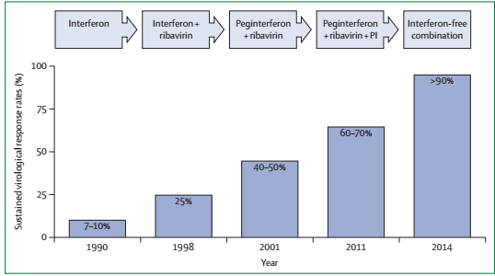
Evolution of HCV treatment over time

Slide 47
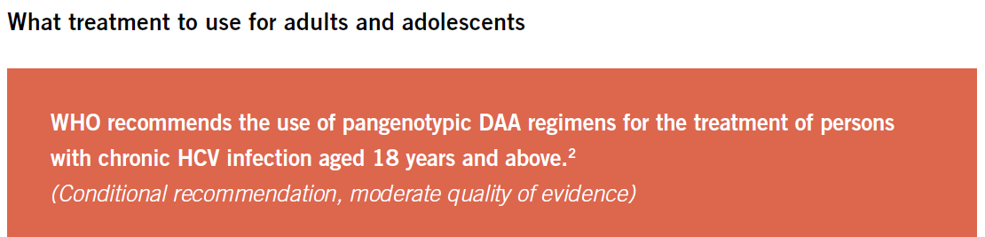

Slide 48
Direct-acting Anti-viral Drugs (DAAs)
DAAs = Drugs that specifically act against hepatitis C virus
Three groups depending on mechanism of action
NS3 protease inhibitors (….previr) simeprevir
NS5B inhibitors (….buvir) sofosbuvir
NS5A inhibitors (….asvir) daclatasvir

Slide 49
General rules for DAA-based treatment
However, with the 2018 Indian guidelines, genotyping is not recommended in treatment naiive patients
Genotype
  1, 4, 5 and 6- Similar treatment
  2 ‘Easy to treat’
  3 ‘Difficult to treat’
If cirrhosis present
  Longer duration of treatment
  Addition of ribavirin may provide additional benefit
    Higher response rate
    Shorter duration
  Higher risk of complications and need for monitoring during Rx
  Higher risk of relapse

Slide 50
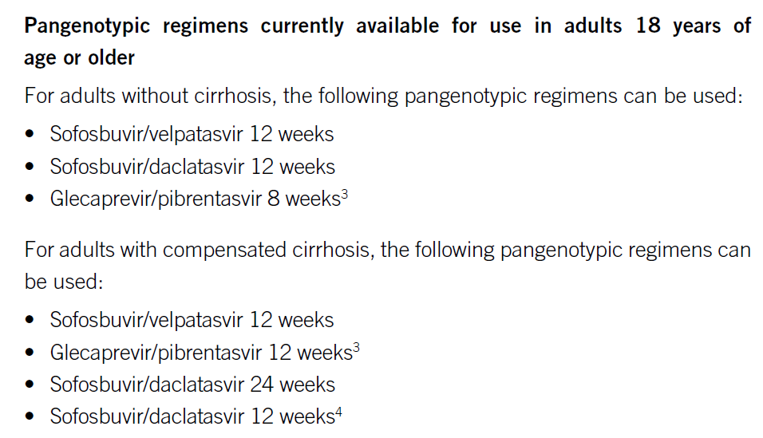
WHO REGIMENS

Slide 51
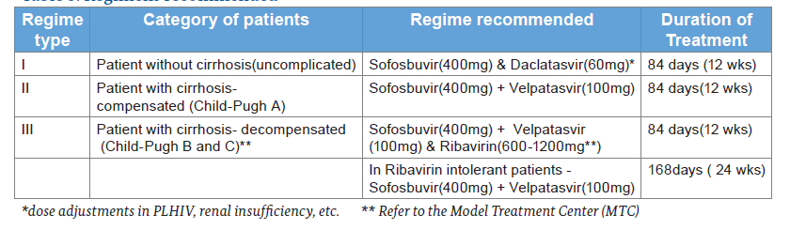
Summary of recommended regimens

Slide 52
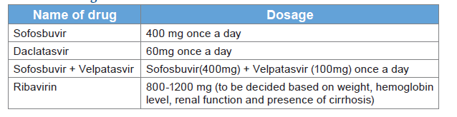
Dosage of DAA

Slide 53
Dose Adjustments for Ribavirin
Anaemia is a common, predictable side-effect of ribavirin therapy and dose adjustment is often required.
Haemoglobin levels
  <10g/dl- Reduce dose
  <8.5g/dl- Discontinue ribavirin
H/o cardiovascular disease- dose reduction needed if Hb falls >2g/dl over any 4 weeks
Patients with renal failure- Not used if eGFR <50ml/min

Slide 54
Outcome of interest
Sustained virological response at 12-weeks post-treatment
SVR12
Undetectable HCV RNA at 12 weeks after stopping drugs
  No cirrhosis ~95-98%
  Cirrhosis ~80-90%

Slide 55
Monitoring
While on treatment: All patients
  Adherence, toxicities
  Hemoglobin, TLC, platelets (only with IFN or RBV)
  Liver function tests (esp. if cirrhosis)
  Creatinine
12-weeks after completion of treatment: All patients
  Treatment response: HCV RNA (12 weeks after completion)
On follow-up after SVR: Only in those with cirrhosis
  Hepatocellular carcinoma
  Portal hypertension

Slide 56
Approach to treatment
Anti-HCV +ve
HCV RNA test
HCV RNA -ve
HCV RNA +ve
Age ≥ 18 years
No treatment or follow-up
Treat

Slide 57
Approach to treatment in adults
Anti-HCV +ve, HCV RNA +ve
Age >18 years
Look for cirrhosis (APRI)
No cirrhosis
Cirrhosis
Sofosbuvir + daclatasvir 12 weeks
Compensated
Decompensated
Sofosbuvir + Velpatasvir 12 weeks
Sofosbuvir + velpatasvir+ ribavirin 12 weeks

Slide 58
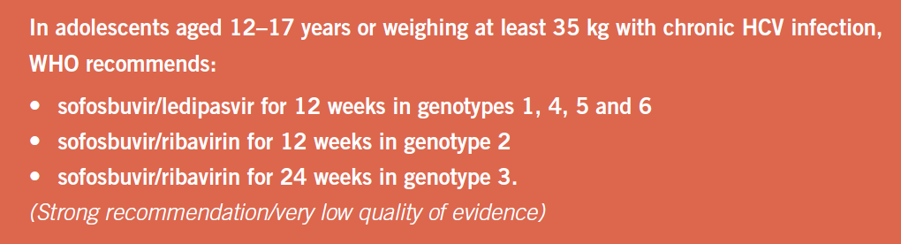

Slide 59
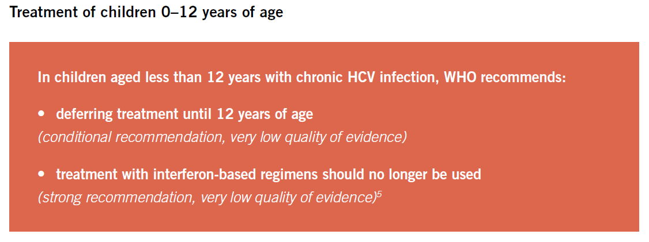

Slide 60
Summary of treatment
All persons aged >12 years with detectable HCV RNA need treatment
Before treatment, evaluate for cirrhosis and decompensation
Treatment regimen depends on person’s age and cirrhosis status
DAAs have excellent response rate and are free of adverse effects
Sustained virological response at 12 weeks post-treatment implies cure and no further testing is needed
Persons with decompensated cirrhosis need closer monitoring during treatment
Persons with cirrhosis need follow-up for hepatocellular carcinoma

Slide 61
Effect of treatment on natural history
Chronic HCV, no cirrhosis
      Halts progression of fibrosis
      Marked reduction in risk of progression to cirrhosis
      Marked reduction in risk of HCC
Chronic HCV with cirrhosis
      Reduced risk for HCC
      Reduced risk of decompensation
      ? Reversal of cirrhosis – in early stages

Slide 62
HCV in HIV co-infected person
Lower rates of spontaneous HCV clearance
Relatively rapid HIV disease progression
Impaired recovery of CD4 cells count following effective antiretroviral therapy
Accelerated progression to cirrhosis, decompensation and hepatocellular carcinoma (HCC)
Higher rates of HCC and at an younger age
Sofusbovir/Velpatasvir FDC DAA regimen have good efficacy in HCV/HIV coinfection

Slide 63
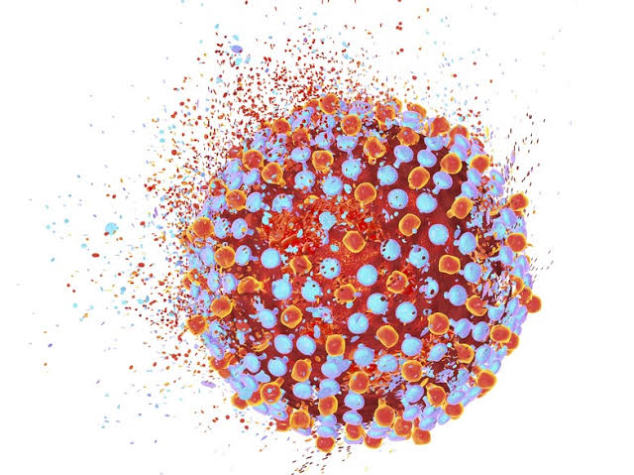
Thank you…..

