Slide 1
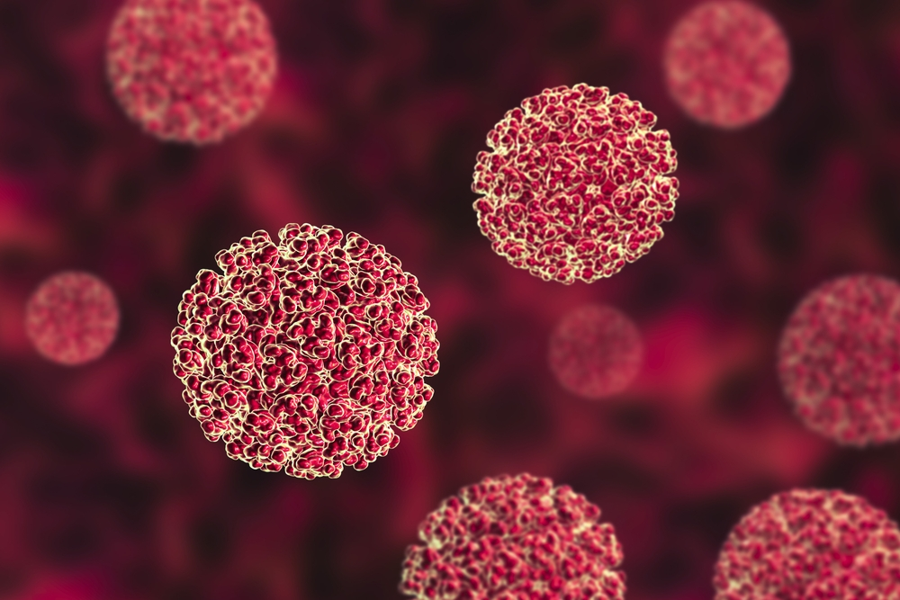
HEPATITIS B
PART 2
DR MEERA G KOOTTUM;

Slide 2

TODAY
DIAGNOSIS
TREATMENT
SPECIAL SITUATIONS
COMPLICATIONS
VACCINATION

Slide 3

DIAGNOSIS

Slide 4
Serological patterns of acute HBV infection
HBeAg
Anti-HBe
Total anti-HBc
Relative amount
HBsAg
IgM anti-HBc
Anti-HBs
Time since infection

Slide 5
Interpretation of serological markers
HBsAg | Total anti-HBc | IgM anti-HBc | Anti-HBs
- |  |  | -
- | + | - | +
- | + | - | -
- | - | - | +
- | + | + | +
+ | + | + | -
+ | + | - | -
Never exposed
Past natural infection, cleared, immunity achieved
Past natural infection, cleared,
anti-HBs has waned over time
Immunity due to vaccination
Recent infection, recovered, immunity achieved
Acute infection, ongoing
Chronic infection (ongoing)

Slide 6
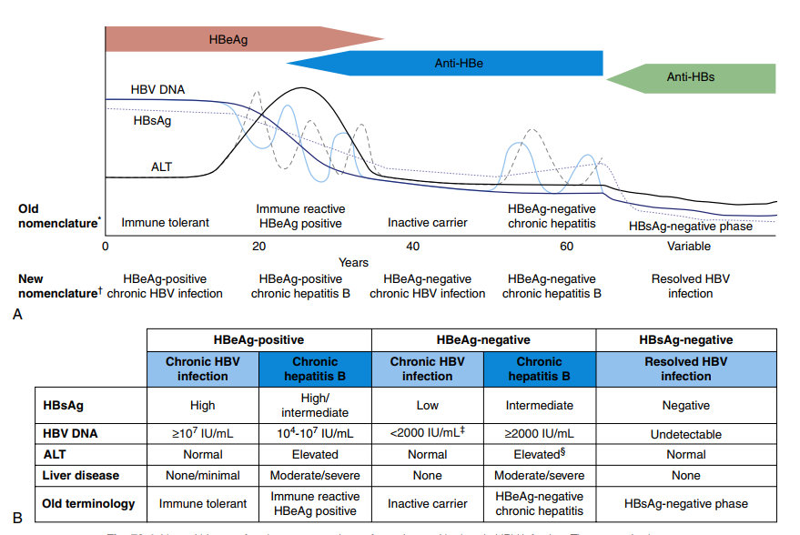
PHASES OF CHRONIC HEPATITIS B

Slide 7
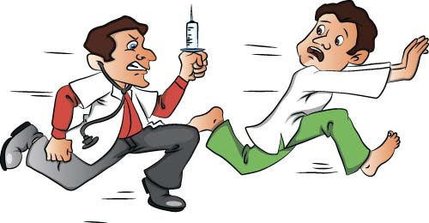
TREATMENT
ACUTE HEPATITIS B
CHRONIC HEPATITIS B
SPECIAL SITUATIONS

Slide 8

ACUTE HEPATITIS B

Slide 9
SUPPORTIVE CARE
ANITVIRALS USUALLY NOT REQUIRED EXCEPT IN SEVERE ACUTE
HEPATITIS B
NUCLEOSIDE ANALOGUE(ENTECAVIR,TENOFIFOVIR : most potent, least resistant)
CONTINUED TILL 3 MONTHS AFTER HBsAG SEROCONVERSION OR 6 MONTHS AFTER HBeAG SEROCONVERSION

Slide 10
WHEN TO START ANTIVIRALS IN ACUTE hep B?
Coagulopathy(INR>1.5)
Protracted course(Persistent symptoms , Bilirubin >10 >=4weeks after presentation)
Other-
Fulminant hep B
Immunocompromised
Hep C & D infection
Pre existing liver disease
Elderly

Slide 11

TREATMENT OF CHRONIC HEPATITIS B

Slide 12

What is normal ALT?(AASLD 2018 )
  Men: 29-33 U/L
  Women: 19-25U/L

Slide 13
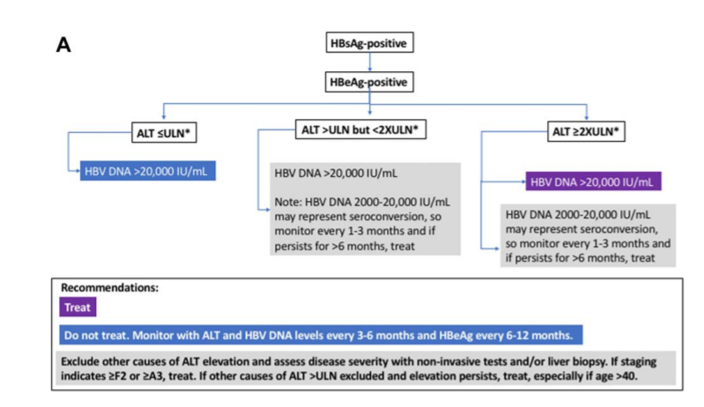
Notes:
F2 –STAGE OF SIGNIFICANT FIBROSIS
A3-METAVIR SCORING SYSTEM:a0 TO a3:PROGRESSION OF FIBROSIS:a3 IS SEVERE ACTIVITY

Slide 14
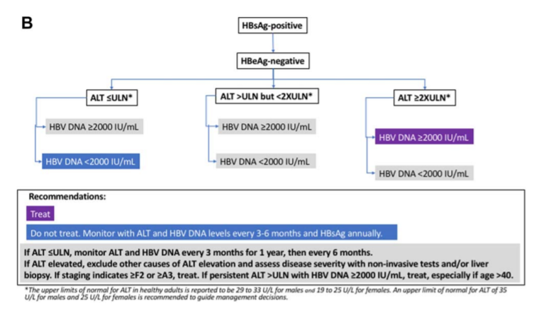

Slide 15
Chronic hepatitis B
Immune-tolerant
phase
Immune-active phase
Immune-control phase
Immune clearance
(cure)
Cirrhosis with any of the phases
Reactivation phase
Phases that need anti-viral drug treatment
Phases that DO NOT need anti-viral drug treatment

Slide 16

DRUGS

Slide 17
PREFERRED
PEG-IFN alpha 2a
Entecavir
Tenofovir Dipovoxil Fumarate(TDF)
Tenofovir Alafenamide(TAF)

Slide 18
NON PREFERRED
Lamivudine
Adefovir
Telbivudine

Slide 19
PEG INTERFERON ALPHA 2A
Dose : 180 mcg weekly(adult) for 48 weeks
Children:>1 yr : 6million IU/m2 thrice weekly
Pregnancy category C
Side effects:
Flu like symptoms
Fatigue
Mood disturbances
Cytopenia
Autoimmune disorders in adults
Anorexia and loss of weight in children

Slide 20
PEG INTERFERON ALPHA 2A
Monitoring on treatment:
CBC(monthly to every 3 months)
TSH(every 3 months)
Clinical monitoring for autoimmune, ischemic, neuropsychiatric and infectious complications
Contraindications:
DCLD, severe psychiatric disease, ALT>10times ULN, Neutropenia, thyroid disease, Malignancy, platelet count<90,000
Current/recent use of Telbivudine

Slide 21
ENTECAVIR
Dose:0.5mg daily
Children:>2yrs : Dosing is weight based till 30kgs
0.5mg above 30kgs
Pregnancy :Cat C
Side effect: Lactic acidosis(only in Decompensated cirrhosis)
Monitoring:
Lactic acid levels if there is clinical concern
Test for HIV before treatment initiation

Slide 22
In YMDD mutation,higher chance of Entecavir resistance too
Hence NOT PREFERRED in Lamivudine resistance
Dose for previously lamivudine treated patient:1mg/day

Slide 23
Entecavir Dose in Renal Impairment
Usual daily dose (0.5 mg)
CrCl ≥50 mL/min: No dosage adjustment required
CrCl 30-49 mL/min: Reduce to 0.5 mg q48hr
CrCl 10-29 mL/min: Reduce to 0.5 mg q72hr
CrCl<10 mL/min, hemodialysis, or CAPD: Reduce to 0.5 mg q7days

Slide 24
TDF
Dose:300mg daily
Children :.12yrs
Pregnancy category B
Side effects:
Nephropathy
Fanconi syndrome
Osteomalacia
Lactic Acidosis

Slide 25
MONITORING:
Cr Cl at baseline
If at risk of renal impairment, creatinine clearance, s.Phosphate,urine glucose and protein at least annually
Consider bone density study at baseline and during treatment if patients with history of fracture or at risk for osteopenia
Lactic acid levels if there is clinical conncern

Slide 26
TAF
Dose: 25mg daily
Not used in children
Pregnancy: insufficient data
Side effect:lactic acidosis
Monitoring:
Lactic acid levels If there is clinical concern
Assess s.creatinine, phosphorus, creatinine clearance, urine glucose and protein before initiation
Test HIV before treatment

Slide 27
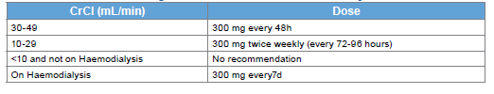
Dose Adjustment for Tenofovir

Slide 28
Entecavir preferred over tenofovir
Age > 60 years;
bone disease due to chronic steroid use or use of other medications that worsen bone density,
history of fragility fracture, osteoporosis;
altered renal function with eGFR < 60 mL/min/1.73 m2 or albuminuria > 30 mg/ 24 hr or moderate dipstick proteinuria or Low phosphate (<2.5 mg/dL) or
in patient on hemodialysis

Slide 29
LAMIVUDINE
Dose: 100mg daily
Children:3mg/kg daily to maximum 100mg
Pregnancy: Category C
Side effects:
Pancreatitis
Lactic acidosis
Monitoring:
Amylase if symptoms present
Lactic acid levels if there is clinical concern
Test HIV before initiation

Slide 30
ADEFOVIR
Dose : 10mg daily
Children: >12yrs
Pregnancy :Category C
Side effects:
Acute renal failure
Fanconi syndrome
Lactic acidosis
Monitoring: Similar to Tenofovir

Slide 31
TELBIVUDINE
Dose : 600mg daily
Not recommended in children
Pregnancy: Category B
Side effects:
Creatinine kinase elevation
Myopathy
Peripheral neuropathy
Lactic acidosis
Monitoring:
Creatinine kinase if symptoms present
clinical evaluation for peripheral neuropathy,
lactic acid levels if there is clinical concern

Slide 32
How to monitor?
: every 12 mo Disease progression / treatment response | : every 12 months Monitoring for treatment toxicities | : every 6 months Detection of liver cancer (cirrhosis / family history)
Adherence | Renal function | Ultrasound
ALT, HBV DNA, HBeAg | Risk factors for renal dysfunction | α-fetoprotein
Non-invasive tests

Slide 33
Selection of antiviral drugs for CHB
1st line agents: PEG IFN, Tenofovir, Entecavir
NAs which have a high barrier to drug resistance (Tenofovir or Entecavir) are recommended.
In woman of childbearing age Tenofovir may be preferred as the drug of choice in the eventuality of a pregnancy.
  Entecavir is not recommended in pregnancy.
Tenofovir is preferred in patients who have been exposed to lamivudine who have a potential for Entecavir resistance.
Entecavir is recommended in children aged 2–11 years.

Slide 34
IFN VERSUS NUCLEOTIDE ANALOGUES
IFN:
Finite duration of therapy
Achieves highest rates of HBEAG response after a year of therapy
Does not support viral mutations
But requires subcutaneous injections
Associated inconvenience
More intensive clinical and laboratory monitoring
Intolerability

Slide 35
Nucleotide Analogues
Require long term therapy
When used alone, Lamivudine and Telbivudine foster the emergence of viral mutations
Adefovir sometimes less so
Tenofovir rarely at all
Well tolerated
Don’t require intensive monitoring
Suppress HBV DNA more profoundly
Effective even in patients who fail to respond to IFN

Slide 36
Duration of treatment
Cirrhosis or APRI >2.0 Lifelong treatment
Discontinuation may be considered exceptionally in those without cirrhosis (or APRI < 2.0 in adults) and all of the following:
  Can be followed carefully for long-term for reactivation
  If HBeAg loss and seroconversion to anti-HBe, and maintained for one year
  Persistently normal ALT
  Persistently undetectable HBV DNA

Slide 37
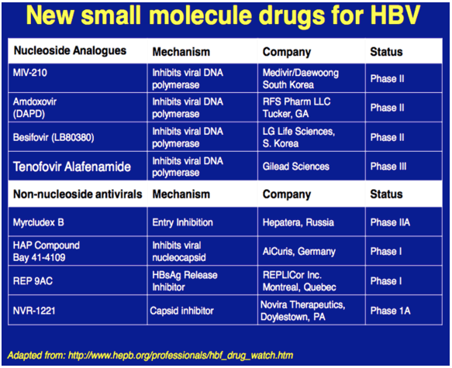
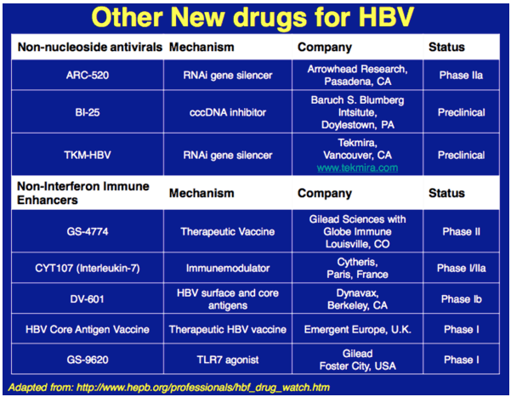
NEWER DRUGS

Slide 38
SPECIAL SITUATIONS

Slide 39
HBV/HIV co-infection
ART shall be started in all co-infected person, regardless of CD4 count (irrespective of HBV infection)
Choice of ART should be based on drugs that are active against both HIV and HBV
  Tenofovir (TDF)
  Lamivudine (3TC)
  Emtricitabine (FTC)

Slide 40
HBV/HIV co-infection: Outcomes
HIV co-infection results in
More rapid progression to cirrhosis
Higher risk for HCC
Higher liver-related mortality
Decreased treatment response

Slide 41
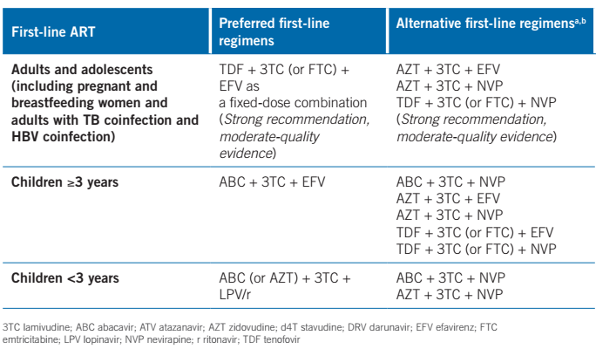
HBV/HIV co-infection

Slide 42
HBV-HCV coinfection
Indications for treatment of HBV infection in such patients are similar to those for HBV mono-infection
Treatment of HCV infection may lead to increased replication of HBV
If treatment is indicated for HBV infection, this should be started and HBV suppression should be achieved before the treatment for HCV is instituted

Slide 43
Children and adolescents
Children with HBV infection
  Usually asymptomatic
  Mostly in immune-tolerant phase
Treatment is not considered in this phase due to
  Low curative response rates
  Concerns about long-term safety
  Risk of drug resistance (immunotolerant -- very high viral load)
Entecavir is approved for children above 2 years
Tenofovir is approved for children above 12 years

Slide 44
Pregnant women
The AASLD suggests antiviral therapy to reduce the risk of perinatal transmission of HBV in HBsAG positive pregnant women with HBV DNA level>200,000
Hepatitis B in a pregnant woman is not a reason for considering termination of pregnancy. Similarly, the need for caesarean delivery should be decided based on obstetric indications, and not on the presence of HBV infection.

Slide 45
LAMIVUDINE,TDF and TELBIVUDINE have been studied
TDF is preferred
TAF hasn’t been studied much-Insufficient data for recommending
Antiviral was started in 28-32 weeks in most studies
Discontinued at birth to 3 months postpartum in most studies
Monitoring:For ALT flare every 3 months for 6months

Slide 46
Pregnant women with immune active hepatitis, treatment recommendation is same as that for non pregnant women
Breast feeding isn’t contraindicated
Insufficient long term safety data in infants born to mothers who took antivirals during pregnancy or breast feeding
The AASLD recommends AGAINST the use of antiviral therapy to reduce the risk of perinatal transmission of HBV in HBSAG positive pregnant women with HBV DNA level </=200,000IU/ml

Slide 47
All infants should receive a birth dose of hepatitis B vaccine followed by three doses
Administration of hepatitis B vaccine to pregnant women with HBV provides no benefit either to the mother or the baby.

Slide 48
Care of the baby
Immunoprophylaxis of hepatitis B virus infection
Hep B vaccine with in 24hr
HBIG-0.5 ml or 100 international units, intramuscular
Breast feeding
Timing of testing –after 1 yr
Notes:
Immunoprophylaxis of hepatitis B virus infection
The newborn baby should be administered a timely first dose (the ‘birth dose’) of hepatitis B vaccine (monovalent) as soon as possible after birth, ideally within 24 hours. Even within this time duration, the earlier it can be administered, the better. If, for some reason, the birth dose is not administered within 24 hours, it should still be administered as soon as it is possible and not omitted. This dose is administered intramuscularly in the anterolateral thigh. This birth dose must be followed by timely administration of 3-doses of hepatitis B-containing vaccine [e.g. monovalent hepatitis B vaccine, tetravalent combination vaccine with DPT (DPT-Hep B) or a pentavalent vaccine (DPT+Hep B+Hib)]. The hepatitis B vaccine birth dose followed by these three doses is the most effective method for prevention of mother-to-child transmission of hepatitis B.
Hepatitis B immunoglobulin (HBIG) may provide some additional protection in situations where risk of transmission is particularly high – i.e. babies born to mothers with hepatitis B who also have detectable detectable HBeAg and/or high viral load. However, additional benefit provided by it, over properly-administered hepatitis B vaccine (as described above) is small. Also, HBIG is costly and has limited availability. If a decision is taken to administer HBIG (0.5 ml or 100 international units, intramuscular), this should be done as soon after birth as possible (and within 12-24 hours) and in a limb other than the one in which hepatitis B vaccine has been administered.
Data on benefit and risks of administering anti-hepatitis B drugs to the pregnant women for prevention of mother-to-child transmission are unclear.
Breast feeding
A mother who has hepatitis B may breast feed her baby, unless there is an exuding injury or disease of the nipple or surrounding skin. The advantages of breast feeding far outweigh the risk, if any, of transmission of hepatitis B to a baby who has received hepatitis B vaccine.
Timing of testing
If it is felt that the baby needs to be tested for hepatitis B, this should be done only after 1 year of age. Any positivity before this age is difficult to interpret and may resolve spontaneously over time.

Slide 49
COMPLICATIONS
FULMINANT HEPATITIS(massive hepatic necrosis): Most feared, rare
CHRONICITY(1% in immunocompetent adults)
CIRRHOSIS
HEPATOCELLULAR CARCINOMA

Slide 50
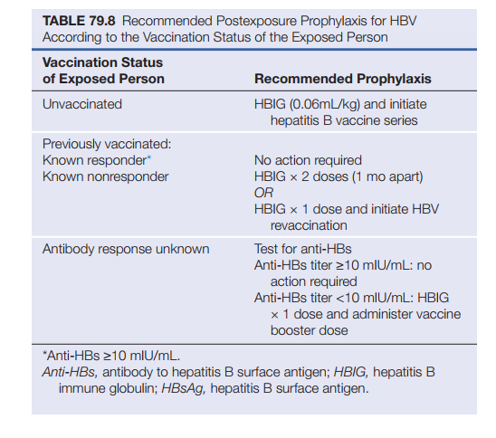

Slide 51
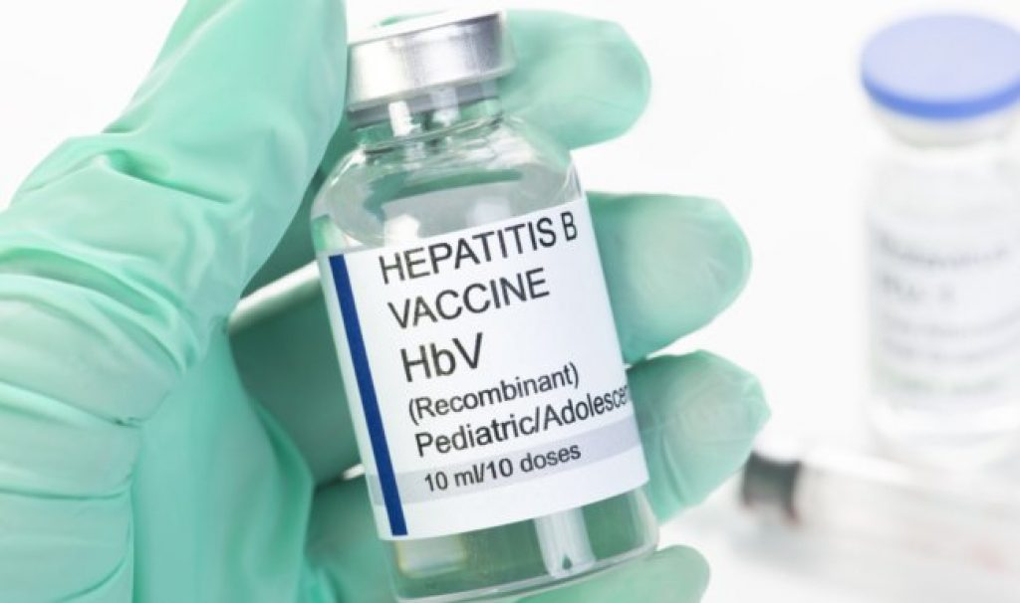

Slide 52
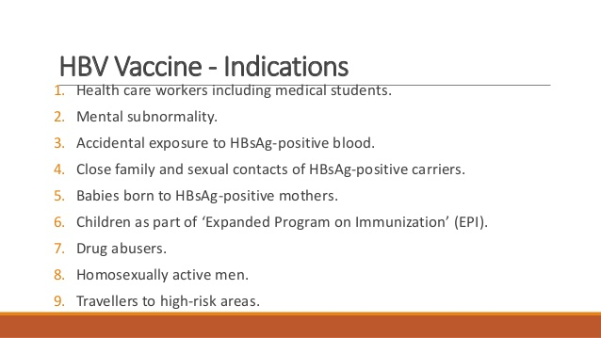

Slide 53

HEPATITIS B VACCINE
Contains HbsAg
Initially from serum of healthy hbsag carriers
Recombinant vaccine
  Gene for HBsAg is inserted into yeast or mammalian cells
  The cells are cultured to produce an excess of protein
  The protein is purified and adsorbed on the surface of an adjuvant (alum)
  Used as intramuscular injection
Notes:
RECOMBI VAX HB
ENGERIX B

Slide 54
Stability and storage
Hepatitis B vaccines
Storage at 2-8°C
Relatively heat stable – remains effective even after several days at room temperature
However, very sensitive to freezing

Slide 55
Hepatitis B vaccine: Dosage
Most of the manufacturers supply vaccine as dosages of 0.5 ml each. Most contain 20 μg/dose, but some have 10 μg/dose
Recommended doses
  Newborns, infant, children, adolescents (≤18 y) 0.5 ml
  Adults 1.0 ml
  Hemodialysis/Immunocompromised state 2.0 ml

Slide 56
Hepatitis B vaccine: Schedule
Usually three doses are needed
Recommendation for adults: 0, 1, 6 mo
For rapid induction of immunity: 0, 1, 2 mo + 12 mo
With birth dose : Birth dose, 6,10,14 weeks

Slide 57
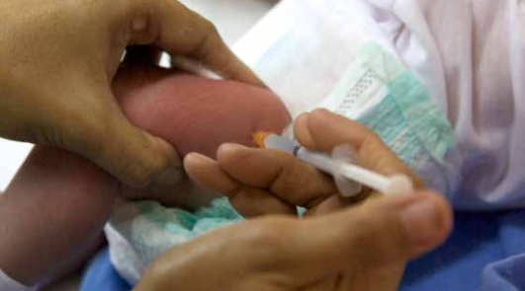
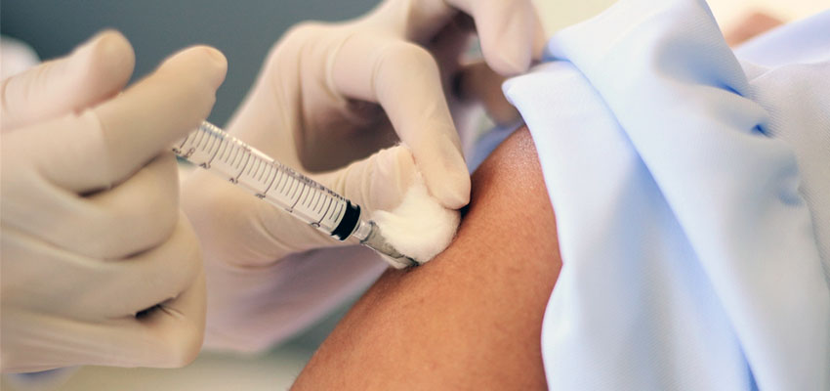
Hepatitis B vaccine
Site of administration
Infants Antero-lateral aspect of thigh
Others Deltoid
Not to be given in gluteal muscles (buttock)
Lower efficacy
Risk of sciatic nerve injury

Slide 58
Protection of infants by hepatitis B vaccination
Number of doses | Protection (%)
1 | 16 - 40
2 | 80 - 95
3 | 98 - 100

Slide 59
Vaccine non-responders
5-10% people may not respond to 3-dose schedule
Most of the non-responders do respond to an additional
3-dose vaccination series
Alternative options for non-responders
Double dose
Four dose schedule
Intradermal administration
Newer vaccines

Slide 60

ADR
Local reactions
Pain
Erythema
Swelling
Generalized reactions :Fever and Headache
Anaphylaxis :Rare

Slide 61
PREVENTION
Pre exposure vaccination
Post exposure prophylaxis
Mother to child transmission
Sexual exposure
Drug users
Universal precaution

Slide 62

LATEST NEWS!
The international Liver Congress of the European Association for the study of Liver(EASL) took place virtually from June 23-26th 2021
Findings from multiple trials from around the globe were presented

Slide 63
MANAGEMENT OF CHRONIC HEP B:Anything new??
Data from the RETRACT B trial were presented(2001-2020)
It studied rates of HbsAg loss, virological response and clinical relapse and retreatment following discontinuation of Entecavir or TDF therapy
All included patients were HbeAg negative with undetectable serum HBV DNA levels at treatment discontinuation

Slide 64
Virological Response : HBV DNA levels >/=2000IU/ml
Clinical relapse: HBV DNA >/=2000IU/ml and ALT>/=2ULN
Type of treatment(ETV/TDF) did not significantly impact HbsAg loss rates after statistical adjustment
However, virological and clinical relapse were observed earlier and more frequently with TDF than ETV
Virological relapse rates became comparable after 1st year off therapy
Retreatment rates didn’t differ between the two groups

Slide 65
HEPATITIS B IN PREGNANCY
The major route of transmission of chronic Hep B in the immunization era is Mother to Infant Transmission(MTIT) during perinatal period
HBV transmission is more likely from mothers with HbsAg/HbeAg positivity and high maternal viral load
Short term antiviral therapy for pregnant women has been recommended to prevent MTIT
Antiviral therapy using TDF/telbivudine since the 3rd trimester of pregnancy has been shown to decrease transmission

Slide 66
DATA FOR USE OF TAF DURING PREGNANCY
The effects of TAF treatment for highly viremic HBV infected pregnant women are comparable with TDF in terms of maternal HBV DNA reduction and preventing MTIT
TAF therapy initiated during the 2nd trimester for HBV infected pregnant women with HbeAg positive and high HBV DNA level was effective in preventing MTIT
There were no safety concerns for mothers and infants followed up for 28weeks following delivery

Slide 67
NEW DRUGS IN THE PIPELINE
AB-729 : RNA INTERFERENCE therapeutic that blocks all HBV RNA transcripts
Robust mean declines in Hbsag were sustained with repeat dosing of AB-729 with most subjects reaching Hbsag <100IU/ML
GSK-836 :MODIFIED ANTISENSE OLIGONUCLEOTIDE
Triggers multiple immunological responses in responders experiencing decline in Hbsag levels and ALT elevations

Slide 68

INTRODUCTION
HBV STRUCTURE & SEROLOGY
LIFE CYCLE
PATHOGENESIS
MODES OF TRANSMISSION
CLINICAL FEATURES
DIAGNOSIS
TREATMENT
SPECIAL CONDITIONS
PREVENTION
LATEST UPDATES

