Slide 1
Hepatocellular Carcinoma
DR SHIFA.C
JR3

Slide 2
Hepatocellular Carcinoma
Most common primary malignant tumor of liver.
5th most common cancer
Male: Female - 3.7:1
Histopathological evaluation is not as definitive as in other tumors –imaging studies are better.

Slide 3
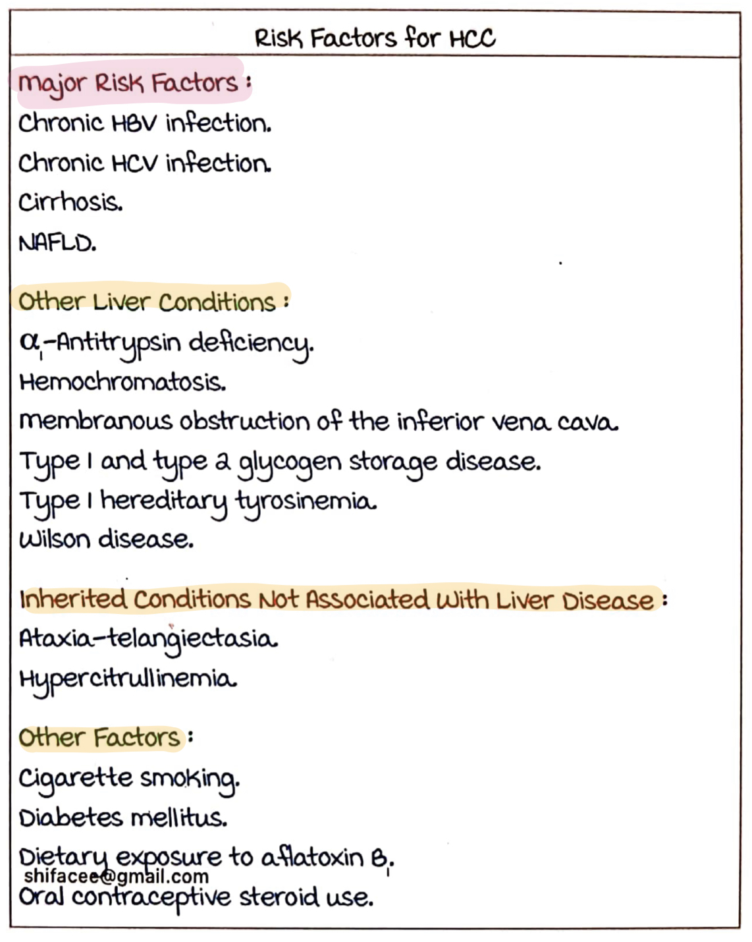
Risk factors for HCC

Slide 4
HBV – the most common causative risk factor
Increased risk :
Earlier infection
Higher DNA load (>2000 IU/L)
Higher level of quant. HbsAg (>10,000 U/L)
Genotype C
2 mechanisms:
Indirect – due to cirrhosis
Direct – by viral integration –pro carcinogenic

Slide 5
HCV- does not integrate with genome – easier to treat.
HCV Inflammation Cirrhosis HCC
NAFLD – can cause HCC without cirrhosis.
Chronic cigarette smoking – 50 times more risk.
Aflatoxin – from Aspergillus flavus & A.parasiticus – inactivates TP53

Slide 6
40% in untreated haemochromatosis.
Typ1 and Type 2 GSD – can directly cause HCC without cirrhosis.
Type 1Tyrosinemia – Cirrhosis -HCC

Slide 7
Clinical features
Incidentally detected abdominal mass
Mild-moderate upper abdominal pain – most common symptom
Weight loss, early satiety
Fatigue
Non-specific GI symptoms
Jaundice
Signs of HCC
Hepatomegaly
Ascites
Fever
Splenomegaly
Wasting
Jaundice
Hepatic bruit

Slide 8
Paraneoplastic manifestations
Hypoglycemia
Type A- more common
In late stages- liver is completely depleted of glycogen stores.
Type B – rare (<5%)
In early stages; severe hypoglycemia
Due to high insulin like activity –as the malignant hepatocytes cannot metabolize pro-insulin growth factor II

Slide 9
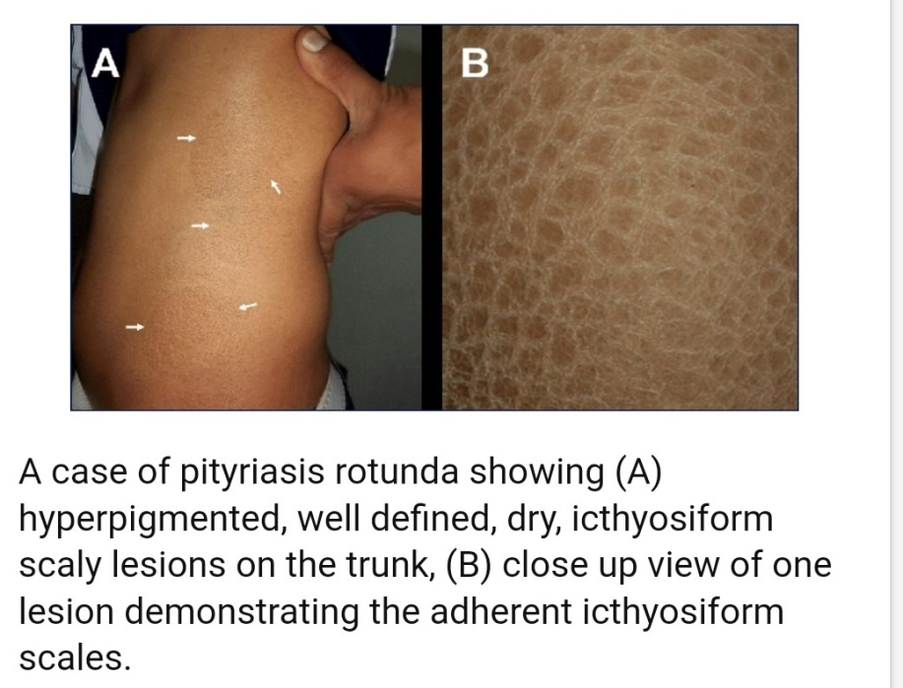
2. Polycythemia – in 40%
Due to production of erythropoietin/EPO like substances.
3. Hypercalcemia – due to production of PTHrP or in bony mets
4. Pityriasis rotunda – hyperpigmented scaly lesions over the trunk and thighs, dermatomyositis, pemphigus foliaceous, Leser- Trelat sign.
5.Carcinoid syndrome
6. Hypertension
7. Hypertophic osteoarthropathy

Slide 10
8. Neuropathy
9. Osteoporosis
10. Polymyositis
11. Porphyria
12. Gynaecomastia, feminisation
13. Thyrotoxicosis
14. Thrombophlebitis migrans
15. Watery diarrhoea syndrome

Slide 11
Other clinical features
Intra-peritoneal bleeding due to tumor rupture –
sudden onset severe abdominal pain with distension, hypotension, acute drop in Hb.
Previously stable cirrhotic patients – develop decompensation due to extension into hepatic/portal veins.
Obstructive jaundice – invasion of biliary tree or compression, rarely –hemobilia.
Central tumor necrosis-fever
Pyogenic liver abscess –v.rare

Slide 12
Extra-hepatic Mets
Lung
Intra-abdominal nodes
Bone
Adrenals
Brain mets – rare
Perihepatic lymphadenopathy need not represent mets.

Slide 13
Diagnosis of HCC
BASED ON :
Serum markers
Imaging
HPE
Imaging is the most important modality in diagnosis.
Serum markers and HPE are ancillary.

Slide 14
Tumor markers
Not diagnostic of HCC alone.
Ancillary.
Alpha feto protein (AFP)
AFP L3 – if >10% of total AFP.
PIVKA 1L
Markers useful for monitoring:
AFP.
AFP L3
Des gamma carboxy prothrombin
Glypican 3
Golgi protein 73
IGF1
TGF Beta

Slide 15
Alpha Fetoprotein
Useful as a diagnostic, prognostic and surveillance marker
<10.9 ng/mL – no HCC
Diagnostic values : > 1000 ng/mL or >400 ng/mL + liver mass.
>1000 : poor prognosis
>500 : poor prognosis after liver transplantation

Slide 16
False positive AFP:
Endodermal tumors
Non-seminomatous germ cell tumors
Pregnancy
Acute liver failure

Slide 17
Imaging in HCC
Can be diagnosed with CECT, MRI or ultrasound.
MRI with dynamic contrast imaging of liver – best.
USG – most effective for screening - hypoechoic lesion with capsule – suggestive of HCC
USG imaging – varies with hemorrhage, necrosis or features of hypervascularity.
Lesion adjacent to right hemi-diaphragm can be missed in USG

Slide 18
The imaging must be performed in 4 phases for both MRI and CT:
Non-contrast phase
Arterial phase
Venous phase
Delayed phase

Slide 19
Classical feature – arterial phase hyperenhancement with portal phase washout.
The neovascularization due to tumor- from the arteries. The tumor is primarily supplied by the arteries unlike the normal liver tissue (dual supply- 70% by portal vein, 30% by hepatic artery)
A mass >1 cm with this finding – diagnostic of HCC

Slide 20
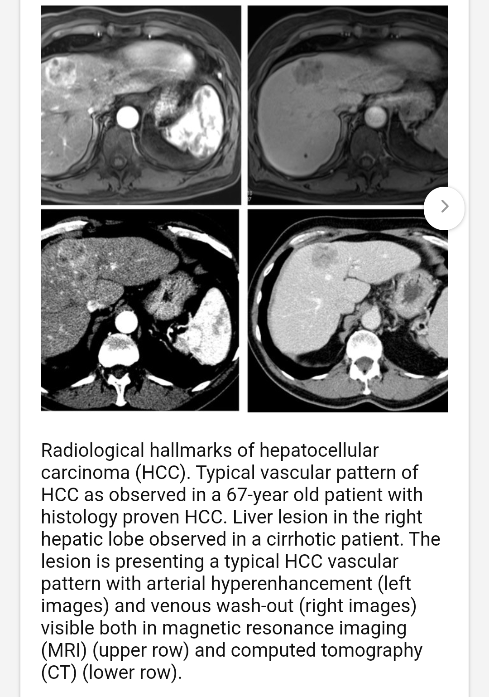

Slide 21
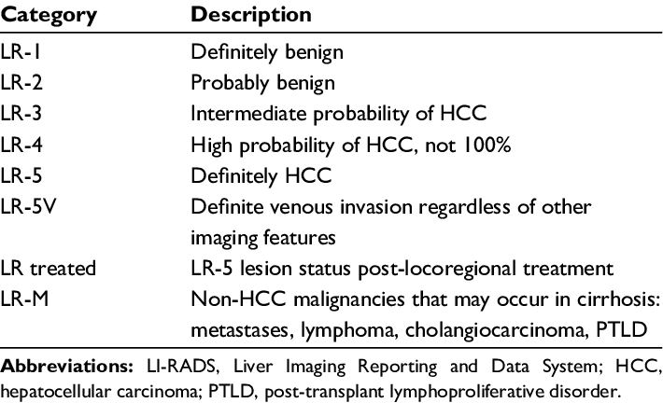
LIRADS

Slide 22
CT SCAN
Dynamic CT imaging with contrast
Hyper-enhancement in arterial phase with loss of enhancement and capsular enhancement in venous phase and delayed phase.
Effective with tumors > 2cm.
<2cm – only 30% diagnostic certainity.
Biopsy – only if the imaging features are not characteristic and if size > 1cm.

Slide 23
Dynamic contrast-enhanced MRI
Magnet strength > 1.5 Tesla
Gadolinium contrast – Gadoxetic acid is specifically used for HCC.
Hyper-intense lesions in T2 and DWI.
Early arterial enhancement with early washout.
Rim-enhancement on delayed post-contrast images causing a capsule appearance – relatively specific for HCC.

Slide 24
HPE
Gross pathology : could be
Nodular – most common type. Nodules separated by fibrous septa. Commonly seen in cirrhotic liver.
Massive– large mass with satellite lesions. In young, non-cirrhotic patients. Tumor rupture can occur.
Infiltrating – looks like indistinct minute regenerating nodules.

Slide 25
Microscopically :
Well – differentiated
Moderately differentiated
Undifferentiated
Progenitor cell HCC – arise from oval cells of canal of Herring. Aggressive. In chronic hepatitis.
Fibrolamellar HCC – young females. Non-cirrhotic liver. AFP normal. Good prognosis.

Slide 26
Treatment
Involves managing : 1) Cirrhosis 2) Cancer
Barcelona Clinic Liver Cancer Staging (BCLC) – standard for treatment.
Available treatment modalities :
Surgery
Ablation
Chemoembolization / Radioembolization
Chemotherapy

Slide 27
Surgical resection
Favourable location-eg. a single lobe, preferably in the left.
Non-cirrhotic liver.
Child Pugh Stage A without portal hypertension.
MELD <9
Atleast 40% functional liver
Chemotherapeutic agents can be used to make the size operable

Slide 28
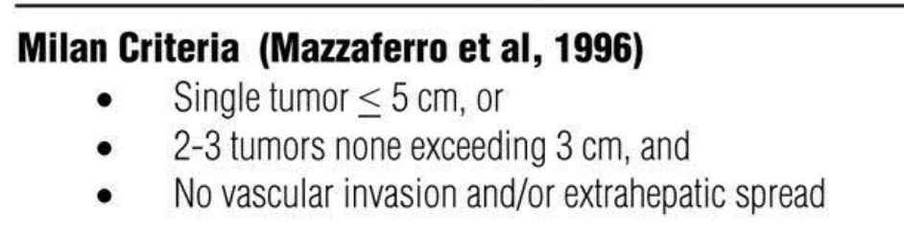
Liver Transplantation
In non-resectable tumors without any spread.
MILAN criteria is used
If there is waiting period >6 months, bridge methods like chemoembolization/ radioembolization can be used.

Slide 29
Ablation
For small tumors <3-5 cm & if not viable for surgery.
Tumor < 2 cm – percutaneous ethanol injection
3-5cm –Radiofrequency ablation(RFA)
Microwave ablation – if RFA is not possible (lesions near diaphragm or intestines)
As bridging therapy while awaiting transplantation.

Slide 30
Chemoembolization (TACE)
In advanced liver disease with good performance status.
When ablation methods are not possible.
Doxorubicin eluting bead TACE (DEB TACE)
Transarterial radioembolisation – using Y-90.

Slide 31
Chemotherapy
In HCC complicated by portal vein tumor thrombosis (PVTT)
SORAFENIB
oral multikinase inhibitor– inhibit RAF kinase, VEGFR, PDGFR
400 mg BD
Only modest survival benefit.
LENVATINIB
REGORAFENIB

Slide 32
Immunotherapy
Monoclonal antibodies
Immune check-point inhibitors
Atezolizumab + Bevacizumab (VEGFi)
Durvalumab + Tremelimumab

Slide 33
Treatment options -Summary
Modality | comments
Surgical resection | Curative . Limited to non-cirrhotic patients and cirrhotic patients with portal hypertension. High recurrence. Technical difficulty
Liver Transplantation | Milan criteria

Slide 34
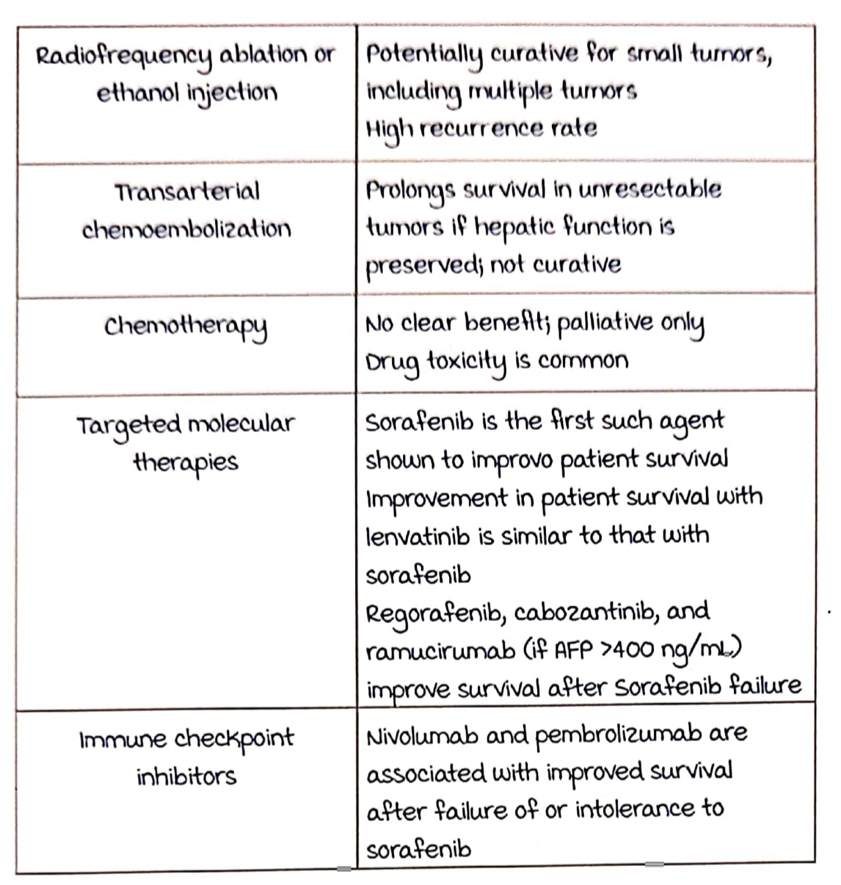

Slide 35
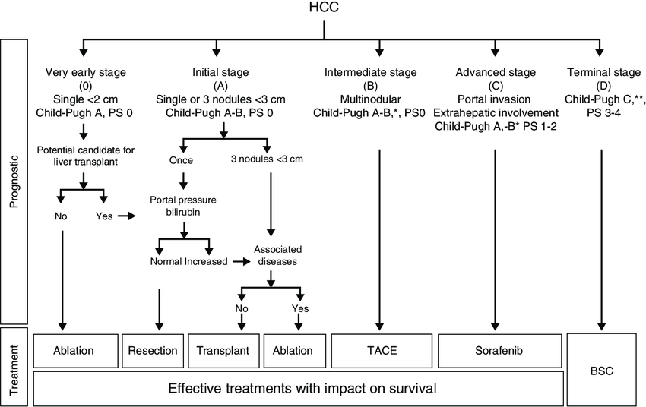

Slide 36
Take Home Message
Surveillance is important in high-risk patients.
Thank You!

