Slide 1
HYPERKALEMIA
Dr Shifa C
05/10/2021

Slide 2
HYPERKALEMIA
Plasma K+ of 5.5mM
Severe ,when K+ > 6.0mM
Rate of change is more important
Infants have a higher baseline value than children and adults.

Slide 3
Normal Potassium Homeostasis
Dietary potassium – absorbed in intestines – excreted in urine.
Urinary excretion- mainly by potassium secretion in the connecting segment and cortical connecting tubule.
Ingestion of a K+ load – excess potassium uptake by muscles cells and liver – faciliated by insulin and the beta-2-adrenergic receptors – increase Na- K ATPase pumps in the cell membrane.

Slide 4
Increase in plasma potassium – secretion of aldosterone – enhances Na reabsorption and K secretion.
K adaptation – efficiency of potassium excretion is enhanced if intake is increased.

Slide 5

Conclusions
Increasing potassium intake alone doesn’t commonly cause hyperkalemia, unless it is very acute.
The net release of potassium from cells ,if large enough can cause a transient rise of serum potassium.
Persistent hyperkalemia requires impaired urinary potassium excretion.
hypoaldosteronism/ aldosterone resistance
Acute or chronic kidney disease
Decreased Na and water delivery to the distal tubule

Slide 6
Causes of Hyperkalemia
1. Increased potassium release from cells

Slide 7

Pseudohyperkalemia
An artifactual increase in serum potassium d/t specimen collecting, handling or other causes.
Always rule out – when K+ seems elevated without explanation !
Excessive fist pumping during venipuncture/ tourniquet/ trauma
Cooling of the sample or prolonged storage
Thrombocytosis ,high leukocytosis (>120,000/mcL) as in CLL
Hereditary forms of pseudohyperkalemia – due to increase in potassium permeability of erythrocytes.

Slide 8
Insulin deficiency, Hyperglycemia and Hyperosmolality
Insulin promotes potassium entry into cells.
In uncontrolled hyperglycemia( diabestes mellitus), a combination of these – potassium moves out of cells –
i) Loss of cell water- passive potassium exit along the osmotic gradient.
ii) Solvent drag – K+ goes with the water.

Slide 9
2) Causes other than DM:
Somatostatin/ its analogues
Fasting – appropriate reduction in insulin- especially in those on dialysis.
In hypernatremia, ivig( contains sucrose) , hypertonic mannitol, radiocontrast media.

Slide 10
2) Increased tissue catabolism – trauma, tumor lysis syndrome, severe accidental hypothermia.
3) Beta blockers – interfere with Beta mediated K uptake
Usually less than 0.5 mEq/L
True hyperkalemia – rare, unless a large load, heavy exercise, or a defect in excretion.
4) Exercise

Slide 11
5) Hyperkalemia periodic paralysis – AD
6 ) Digitalis overdose d/t dose-dependent inhibition of Na-K ATPase, other related glycosides – yellow oleander, cane toad( bufadienolides), odollam- cerebrin.
7)Red cell transfusion d/t K release during storage – in infants/ massive transfusions.

Slide 12
8) Succinylcholine in burns, extensive trauma, prolonged immbolization, chronic infection or neuromuscular disease.
9) Arginine hydrochloride ( used in refractory metabolic alkalosis), and aminocaproic acid – d/t entry of cationic arginine
10) Drugs that activate ATP-dependent potassium channels in cell membranes – Calcineurin inhibitors ( cyclosporine, tacrolimus) ,diazoxide, minoxidil, and volatile anaesthetics like isoflurane.

Slide 13
2) Reduced Urinary K Excretion

Slide 14

The 4 major causes :
Reduced aldosterone secretion
Reduced response to aldosterone ( aldosterone resistance)
Reduced distal Na+ and water delivery – as in hypovolemia.
Acute and chronic kidney disease.

Slide 15
Reduced aldosterone secretion
Hyporeninemic hypoaldosteronism – very common in diabetics, elderly, renal impairment.
Drugs – ACEI, NSAIDs, Calcineurin inhibitors ( cyclosporine, tacrolimus) and heparin.
Hyperkalemia – minimal in patients with normal renal function, but can be significant in those with deranged RFT or other causes of Hyperkalemia.

Slide 16
Reduced Response to Aldosterone
Aldosterone/ mineralocorticoid resistance
With potassium sparing diuretics
- compete with aldosterone for receptor sites – spironolactone and eplerenone
- drugs that block ENaC ( at the principal cells of collecting tubule)- Amiloride and triamterene.
Acute and chronic kidney disease.
Pseduohypoaldosteronism type-1 – rare,AR form- affects ENaC, AD form- the mineralocorticoid receptor.

Slide 17
Reduced distal Na and Water delivery
To the connecting segment and cortical collecting tubule- the K secretory sites.
MCC- hypovolemia.
Decreased urinary Na concentration, therapeutic response to saline hydration.

Slide 18
Acute and Chronic Kidney disease
In oliguric AKI – rhabdomyolysis, tumor lysis syndrome.
CKD – more common in the oliguric, those on high K diet,increased tissue breakdown, reduced aldosterone secretion or responsiveness, fasting in dialysis patients

Slide 19
Clinical features
Cardiac Arrhythmia
Muscle weakness
Metabolic acidosis

Slide 20
Cardiac Effects
Arrhythmias – sinus bradycardia, sinus arrest, slow idioventricular rhythms, VT, VF , asystole.
K – mainly an intracellular cation
Determines the resting membrane potential (RMP)
RMP -90 mV - due to constant outward leak of K+ through inward rectifier channels

Slide 21
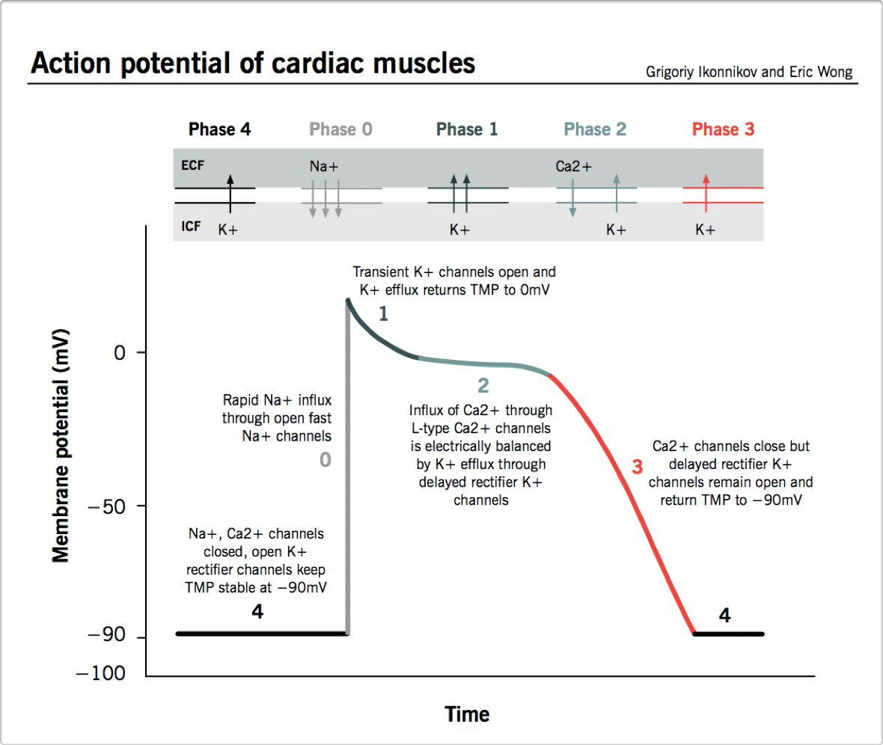

Slide 22
Mild increase in extracellular potassium – affect the repolarization phase of cardiac AP – T wave changes
Further increase – depresses intra-cardiac conduction – progressive prolongation of PR and QRS intervals
Severe – progressive widening of QRS complex – sine- wave – impending VF or asystole.

Slide 23
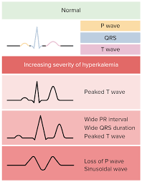

Slide 24
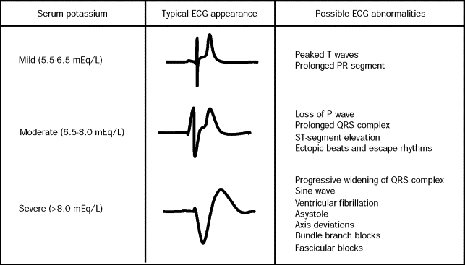

Slide 25
Muscle weakness
1. Secondary Hyperkalemic Paralysis
Vague muscle pain followed by paralysis- ascending, facial and respiratory muscles affected last.
Areflexia, flaccid motor paralysis, sphincer and sensations intact.
2. HYPP ( Familial Hyperkalemic Periodic Paralysis) – Weakness during hyperkalemia induced by increased intake or rest after exercise.
AD mutations in SCN4A gene – inactivation defect in skeletal Na channel.

Slide 26
3. Renal Effects
Reduced ability to excrete acid- hyperkalemic metabolic acidosis.
Competition between K and NH4 for reabsorption

Slide 27
Evaluation
1. Assess the need for emergency treatment, rule out pseudohyperkalemia.
History and physical examination – drugs, diet and supplements, risk factors for renal failure, output, BP, volume status.
Initial investigations- SE, BUN ,Créatinine , Serum osmolality, S.Ca, Mg, CBC, urinary pH, osmolality, créatinine, and electrolytes.
Urine Na < 20 mmol – Inadequate distal Na delivery - volume repletion with NS , or frusemide can correct the K

Slide 28
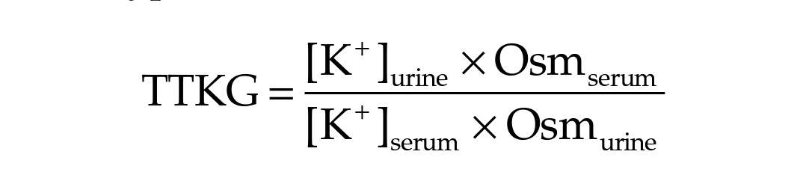
TTKG – is an index used to assess renal K secretion by cortical collecting duct – indirectly assess mineralocorticoid activity.
<6 – inappropriate renal response to hyperkalemia.
Expected values - <3 in hypokalemia;> 7-8 in hyperkalemia

Slide 29
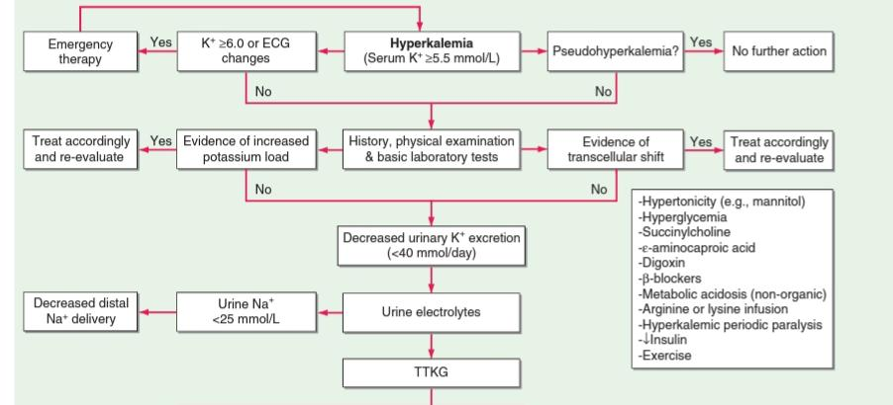

Slide 30
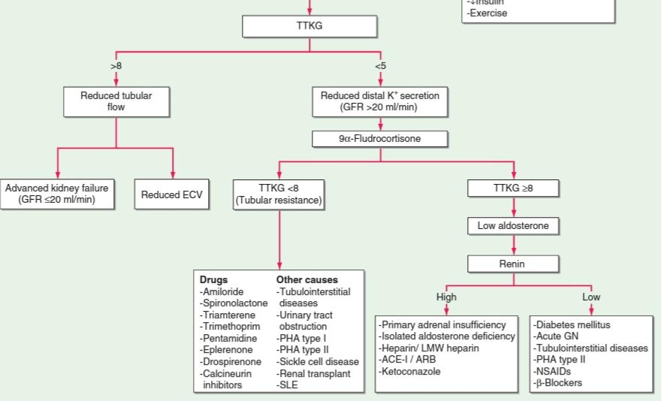

Slide 31
Management
ECG change/ K >6.5 mM ,- treat urgently.

Slide 32
Treatment – in 3 stages:
1.Immediate antagonism of cardiac effects - iv Ca!
Calcium raises the AP threshold and reduces excitability, without changing the RMP.
10 mL of 10% Ca gluconate infused iv over 2-3 minutes with cardiac monitoring.
Effect starts in 1-3 minutes and lasts 30-60 mins – can be repeated if ECG changes persist/ recur.
Hypercalcemia potentiates cardiac toxicity of digoxin- hence with caution – can be added to 100 mL 5D and infused over 20-30 mins.

Slide 33
2. Rapid reduction in plasma K concentration by redistribution into cells
10 units iv insulin in 50 mL 50% dextrose –effect begins in 10-20 mins, peaks at 30-60 mins, lasts for 4-6 hrs.
Hypoglycemia is common- hence follow with 50-75mL 10D with close monitoring of blood sugar.
In cases where RBS>200-250, insulin should be administered without glucose.

Slide 34
Beta 2 agonists – Albuterol ( salbutamol) effective!
~20% ESRD patients are resistant, hence not as a solo agent.
10-20 mg of nebulized Albuterol in 4 mL NS ,inhaled over 10 mins
Effect starts at 30 mins,peaks at 90 mins, lasts for 2-6 hrs.

Slide 35
IV bicarbonate – no role in acute treatment, but can slowly improve hyperkalemia with sustained administration over hours.
Not as bolus, as an infusion in an isotonic or hypotonic fluid (150 mEqu in 1L 5D)
In metabliic acidosis, a delayed drop in K after 4-6 hrs of isotonic bicarbonate infusion.

Slide 36
3.Removal of potassium
Cation exchange resins, diuretics, and/ or dialysis.
Sodium Polystyrene Sulfonate ( SPS) exchanges Na for K in the GI tract and increases the fecal excretion.
15-30 g powder of SPS in a pre-made suspension of 33% sorbitol.
Slow – full effect takes 24 hrs, repeat doses at 4-6 hrs.
Rare and fatal complication- intestinal necrosis –esp when as enema or in patients with hypomotility.

Slide 37
Novel intestinal K binders –
Patiromer –exchanges Ca for K – may cause hypomagnesemia.
ZS-9 – Na+ and H+ for K+ and NH4+ in the intestine.
Lacks the intestinal toxicity of SPS

Slide 38
Others
IV NS – in hypovolemia patients with oliguria and decreased distal delivery of Na
Loop and thiazide diuretics with IV saline or isotonic bicarbonate in normovolemic or hypervolemic patients with sufficient renal function.
Hemodialysis – most effective and reliable method , peritoneal dialysis- less effective.

Slide 39
Thank you !

