Slide 1
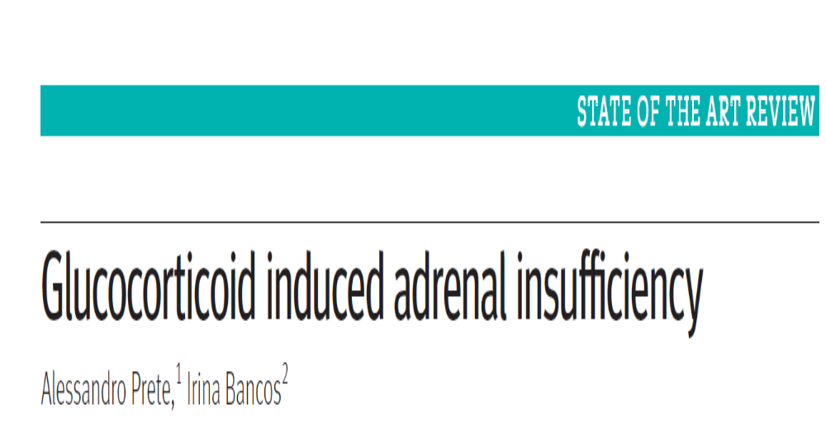
DR.SREERAJ.H
JUNIOR RESIDENT

Slide 2
INTRODUCTION…
Exogenous glucocorticoids - cause adrenal insufficiency (glucocorticoid induced adrenal insufficiency-GIAI)
True prevalence is difficult to ascertain because of the heterogeneity of studies
potential under-diagnosis and lack of awareness among clinicians
most dangerous adverse effects of glucocorticoid therapy and puts patients at risk of life threatening adrenal crises
aim of this review is to provide an up-to-date overview of the main aspects of GI-AI and discontinuation of glucocorticoids

Slide 3
EPIDEMIOLOGY OF GIAI
Systemic glucocorticoids are used by 1-3% of the general population
prevalence of GIAI 0.5-1.8%.
Oral glucocorticoids MC used by women and older people
highest risk in people with hematologic malignancies (60%)
renal transplant (56.2%)
inflammatory bowel disease (52.2%)
and rheumatologic disorders (39.4%)

Slide 4
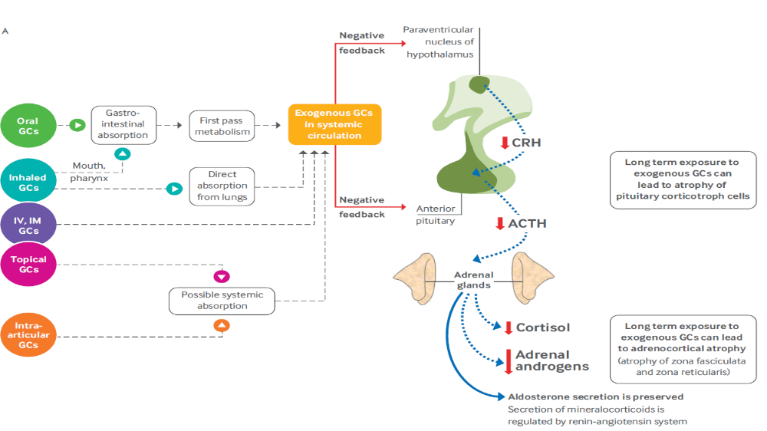

Slide 5
After short term treatment - ACTH secretion is the first to recover, followed by CRH and eventually cortisol and androgens.
After long term exposure-a swift and marked increase of ACTH is observed, and this precedes the recovery of cortisol secretion.
Abnormal cortisol secretion can last a very long time if adrenal atrophy has developed.
Adrenal androgens can also remain suppressed in the long term

Slide 6
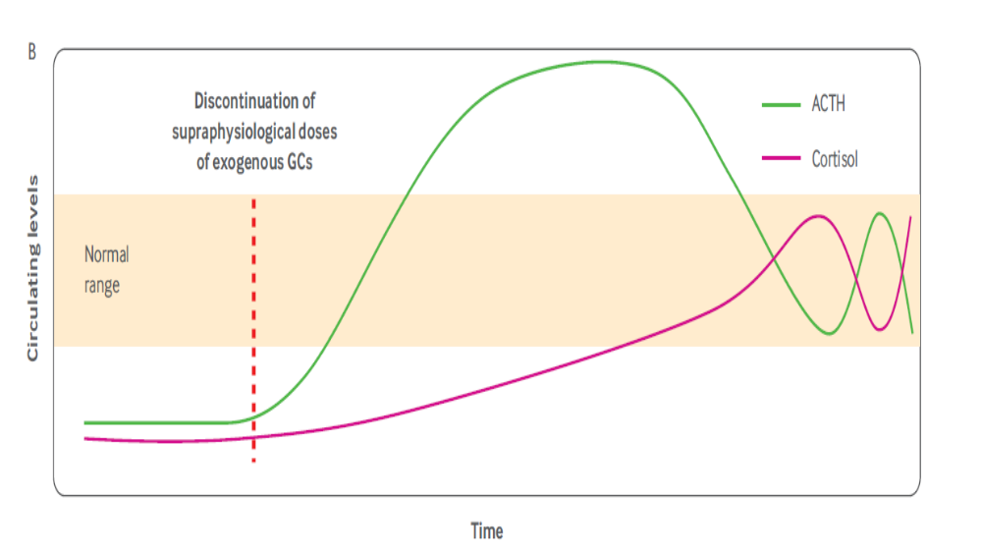

Slide 7
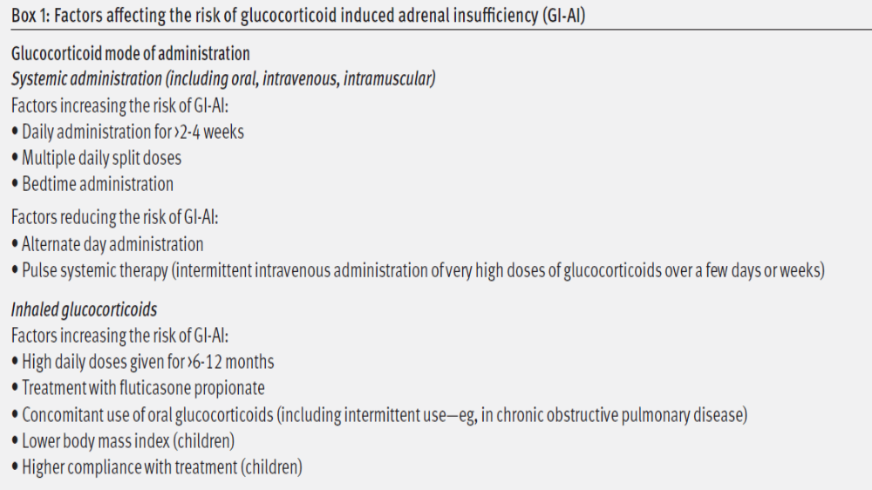

Slide 8
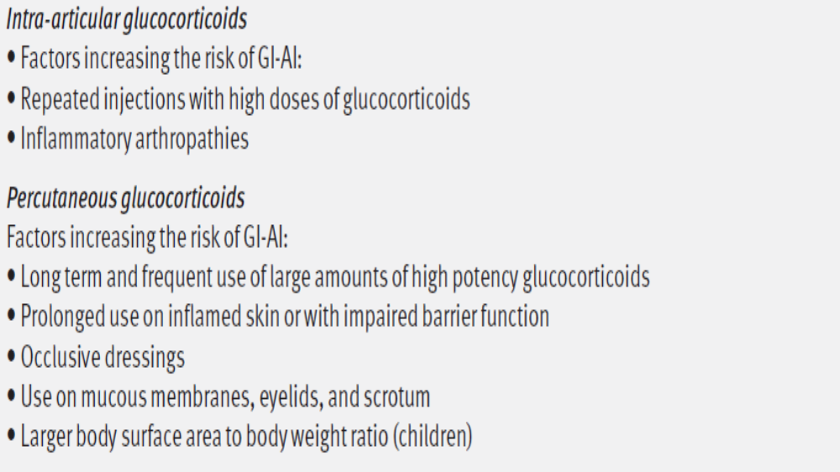

Slide 9
Half life and potency-long t1/2 and potent suppress HPA more.
Dose-Higher dose , more suppression
Drug interactions
CYP3A4 inhibitors
major pathway for the inactivation of most prescribed glucocorticoids
clarithromycin, indinavir, itraconazole, ketoconazole, lopinavir,mifepristone, posaconazole, ritonavir, saquinavir
amiodarone, aprepitant, cimetidine, conivaptan, crizotinib, ciclosporin, diltiazem, dronedarone, erythromycin,
grapefruit juice, imatinib, and verapamil

Slide 10
CYP3A4 inducers
carbamazepine, fosphenytoin, lumacaftor, phenobarbital,phenytoin, and rifampicin
bosentan,efavirenz, modafinil, nafcillin, rifabutin , rifapentine
Concomitant use of other drugs
• Megestrol acetate potentially increases the risk of adrenal suppression because of its glucocorticoid activity.
• High dose medroxyprogesterone acetate can inhibit release of adrenocorticotropic hormone and exerts weak glucocorticoid activity

Slide 11
CLINICAL RELEVANCE
patients with GI-AI can often present with non-specific signs and symptoms that can be attributed to other causes
infections and surgery in a patient with undiagnosed and untreated GI-AI can trigger a life threatening adrenal crisis because of the inability to mount an adequate stress response
many patients presenting with adrenal crisis were treated with inhaled glucocorticoids only (mostly high dose fluticasone propionate)
Most cases involved patients treated with fluticasone propionate ≥500 μg/day

Slide 12
emphasized the potential risks associated with their systemic absorption
also been described in patients exposed to oral glucocorticoids for less than two months, as well as in patients receiving topical, intra-articular, epidural, and rectal glucocorticoids.
Considering the widespread use of inhaled glucocorticoids, the low rates of GI-AI observed suggest that this problem is largely unrecognized or under-reported

Slide 13
CLINICAL PRESENTATION
High degree of clinical suspicion is paramount when a h/o of glucocorticoid exposure exists.
no symptoms, present with varying degrees of symptoms of cortisol deficiency, or present with life threatening adrenal crisis
Clinical diagnosis of GI-AI seems to be difficult
most patients report multiple symptoms at the time of diagnosis
has a less dramatic presentation than primary adrenal insufficiency
acute circulatory collapse and electrolyte abnormalities are infrequent because the secretion of mineralocorticoids is preserved

Slide 14
fatigue and abdominal pain are non-specific- onset may be insidious
mistakenly attributed to other causes or to the disease for which glucocorticoids were prescribed
untreated GI-AI may be more susceptible to infections and recover more slowly than those with normal adrenal function
could be another warning sign in patients with COPD and asthma treated with glucocorticoids
Patients- with signs and symptoms of cortisol excess due to glucocorticoid use (iatrogenic Cushing’s syndrome) have had marked systemic exposure and must be assumed to have a fully suppressed HPAA
Iatrogenic Cushing’s syndrome can occur with any formulation of glucocorticoids
take several months to resolve after the dose of glucocorticoid is decreased

Slide 15
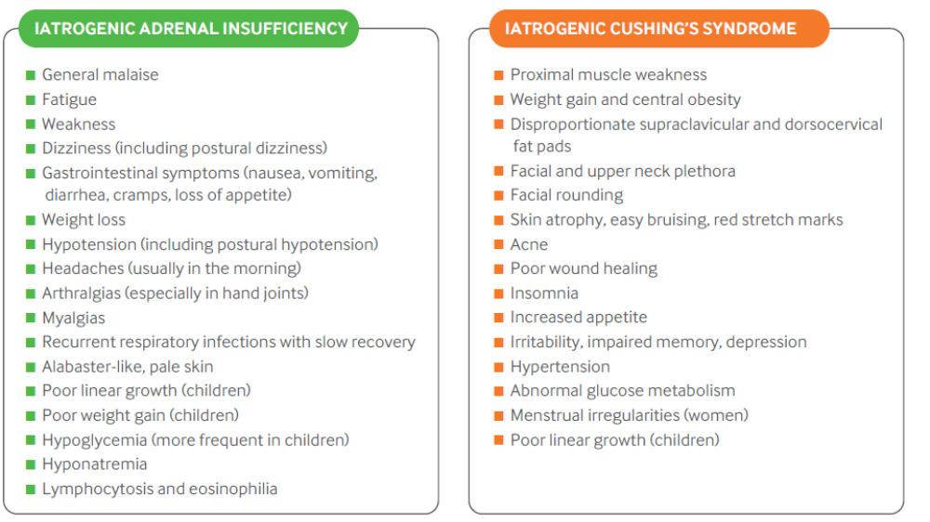

Slide 16
ADRENAL CRISIS
Life threatening emergency
Can develop in iatrogenic cushings and iatrogenic adrenal insufficiency
Present with at least 2 of the following
1.Hypotension or hypovolemic shock
2.Nausea or vomiting
3.Severe fatigue
4.Fever
5.Impaired consciousness
Can present with lab abnormalities like Hypotension,Hypoglycemia,Hyponatremia,Lymphocytosis,Eosinophilia

Slide 17
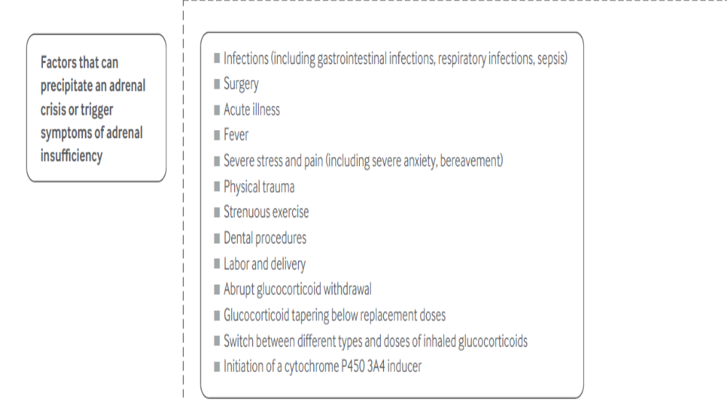

Slide 18
DRUG TYPE | DRUG | PED (5mg pred as reference)
Short Acting (t1/2<12hr) | Hydrocortisone Cortisone acetate Deflazacort | 20mg 25mg 6mg
Intermediate acting (t1/2 12-36 hrs) | Prednisone Prednisolone Methylprednisolone Triamcinolone | 5mg 5mg 4mg 4mg
Long acting(t1/2 36-54 hrs) | Dexamethasone Betamethasone | 0.5mg 0.5mg

Slide 19
APPROACH TO STEROID TAPER…
goal of glucocorticoid therapy -shortest treatment with the lowest effective dose
require consideration of several aspects of the care of patients
First one relates to the original reason for the exogenous glucocorticoid therapy
chronic condition (for eg , rheumatoid arthritis, asthma, inflammatory bowel disease), may relapse after discontinuation of glucocorticoids
ensure that the patient is able to discontinue glucocorticoids
underlying disorder is in remission or well controlled with an alternative, non-glucocorticoid therapy
Secondly, symptoms related to the glucocorticoid withdrawal should be anticipated
Thirdly, GI-AI should be expected and glucocorticoids should not be discontinued until recovery of the HPAA is documented

Slide 20
best choice of glucocorticoid to use during glucocorticoid taper has not been explored
differences in the pharmacokinetics and potency of various glucocorticoids likely influence both glucocorticoid withdrawal syndrome (GWS) and the rapidity of HPAA recovery.
Reported tapering regimens are based on very low quality evidence
Approaches to the glucocorticoid taper should include consideration
1.duration of supraphysiological glucocorticoid use
2. average dose used over this period
3.clinical manifestations of iatrogenic Cushing’s syndrome
4.overall functional status
5. risk of relapse and previous response with GWS.
Rapid taper protocols were found to be less effective

Slide 21
absence of well designed studies that evaluate approaches to glucocorticoid taper
an individualized approach is needed for each patient
As most patients are treated with either predniso(lo)ne or dexamethasone, suggest conversion to predniso(lo)ne therapy taken once a day in the morning as soon as possible

Slide 22
RECOMMENDATIONS…
SYSTEMIC STEROIDS
use the lowest effective dose of glucocorticoids for the shortest period of time
favor once daily dosing when using intermediate and long acting glucocorticoids (eg, prednisone, prednisolone,dexamethasone)
avoid bedtime administration of glucocorticoids
Do not taper down glucocorticoids if the treatment course is <2 weeks.
The risk of HPAA axis suppression in such cases is low
can be discontinued abruptly. If treatment is prolonged beyond 2 weeks, the risk of HPAA suppression increases

Slide 23
INHALED GLUCOCORTICOIDS
•use the lowest effective dose of glucocorticoids for the shortest period of time
• Use spacers and mouth rinsing to reduce systemic absorption through the GI tract
INTRA ARTICULAR GLUCOCORTICOIS
• reduce the number of injections and space out the administration of intra-articular glucocorticoids
high risk of sustained glucocorticoid induced adrenal insufficiency if they receive >3 injections over course of a year
• Whenever possible, avoid simultaneous injections of multiple joints
• Use the lowest effective dose of glucocorticoids
• Favor triamcinolone hexacetonide over triamcinolone acetonide because of its higher residence time in the joint (lower risk of systemic absorption)

Slide 24
Initial rapid glucocorticoid taper
• For patients on an average daily glucocorticoid dose of:
○○PED >40 mg daily—decrease daily glucocorticoid dose by 5-10 mg weekly increments until PED 20 mg daily
○○PED 20-40 mg daily—decrease daily glucocorticoid dose by 5 mg weekly increments until PED 20 mg daily
○○PED 10-20 mg daily—proceed to the slow glucocorticoid taper recommendations
• For patients taking twice a day predniso(lo)ne, or evening doses, switch predniso(lo)ne to once a day, in the morning
• For patients taking dexamethasone, switch to predniso(lo)ne equivalent dose

Slide 25
Subsequent slow glucocorticoid taper
• For patients transitioning after the initial rapid glucocorticoid taper or patients taking PED ≤20 mg daily:
○○PED 10-20 mg daily—decrease daily glucocorticoid dose by 1-2.5 mg weekly decrements until 10 mg daily. If severe GWS, consider bi-monthly decrements
○○PED 5-10 mg daily—decrease by 1 mg weekly decrements until 5 mg daily. If severe GWS, consider bi-monthly or even monthly decrements
○○PED 5 mg daily*—do not stop or decrease glucocorticoid until HPAA recovery has been documented. Consider switching to hydrocortisone 20 mg (15 on waking,5 mg at noon) if HPAA recovery is delayed

Slide 26
Assessment of hypothalamic-pituitary-adrenal axis
recovery of the HPAA should be assessed only in patients taking a prednisolone equivalent dose of 5 mg a day
recovery is likely to occur more rapidly if the patient is switched to hydrocortisone (short acting glucocorticoid) as opposed to predniso(lo)ne
HPAA recovery is unlikely in patients treated with long acting glucocorticoids
Approach is to asses HPAA for at least one to four weeks and reassess every three months until recovery occurs
patients with GI-AI lasting for more than one to two years, reassessment can be spanned out to every six to 12 months
done after 24 hours without any glucocorticoid therapy
MC- measurement of morning cortisol concentrations, synthetic ACTH stimulation tests

Slide 27
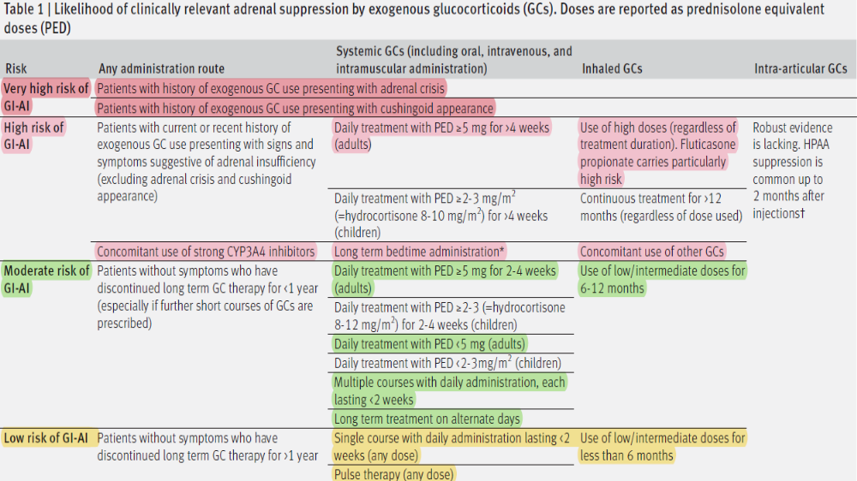

Slide 28
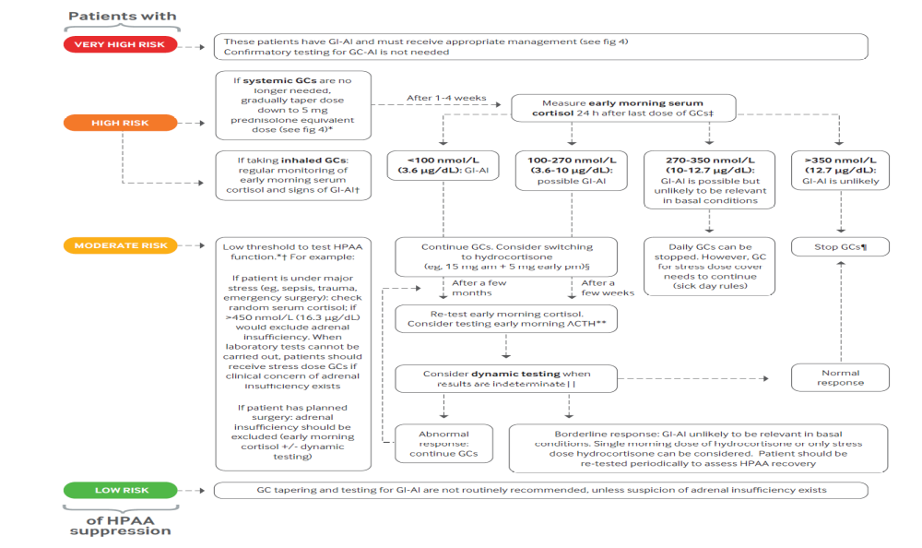

Slide 29
GWS
withdrawal reaction that may occur during the glucocorticoid taper owing to developed dependence on supraphysiological glucocorticoid concentrations
pathophysiology of GWS is multifactorial
mediated by:-
suppressed corticotropin releasing hormone,
central noradrenergic and dopaminergic system,
decrease in pro-opiomelanocortin related peptides
due to chronic suppression of HPAA
increase in cytokines (interleukin 6, tumor necrosis factor α) and prostaglandins
often feel unwell even when still taking doses that are supraphysiological but lower than their usual glucocorticoid doses

Slide 30
anorexia, nausea, emesis, lethargy, somnolence, arthralgia, myalgia, low grade fever, postural hypotension, and psychiatric symptoms (mainly depression, anxiety, and panic attacks)
may last months
patients report poor quality of life and wellbeing
under-recognized as a separate entity
Partly because of overlap of GWS symptoms with those of adrenal insufficiency and possibly the underlying disorder.
When do not recognized GWS as a separate entity, the recovery process can be difficult and prolonged, especially if
doses are increased unnecessarily.

Slide 31
Rx of GIAI
HPAA recovery in patients with GI-AI can take months to years
higher glucocorticoid doses for a longer duration, those with a lower body mass index, and those with features of iatrogenic Cushing’s syndrome are likely to take longer to recover
proportion of patients may develop chronic or permanent GI-AI
15% of patients may have persistent GI-AI when reassessed three years after discontinuation of supraphysiological glucocorticoid therapy, and 2-7% of patients may never recover adrenal function
median age at diagnosis of 54 years and a median duration of GI-AI -three years
One in five patients with GI-AI reported not being aware of the diagnosis
are less likely to receive adequate education on adrenal insufficiency than other patients

Slide 32
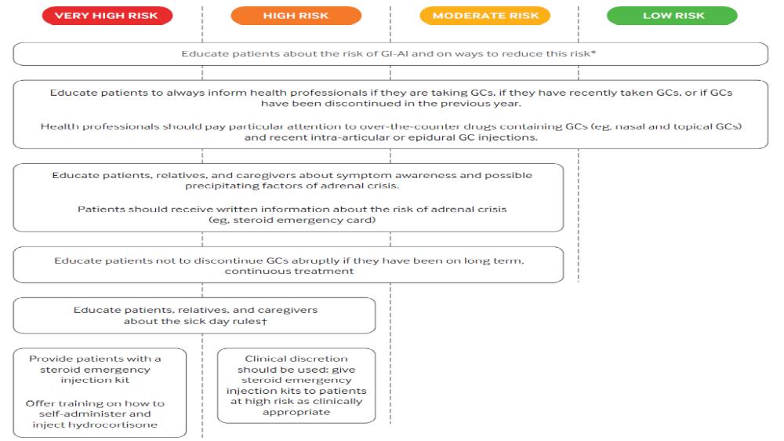

Slide 33
Sick day rules:
○○Sick day rule 1—double or triple daily oral glucocorticoid dose during illness that requires bed rest and/or antibiotics or is associated with high fever (>38°C)
Double or triple the dose on the day of any minor procedure/surgery that does not require fasting
○○Sick day rule 2†—self-inject glucocorticoid when unable to take oral glucocorticoid (eg, acute gastroenteritis), during severe illness, after major trauma,if patient is confused, drowsy, or unconscious.
Also, self-inject glucocorticoid in preparation for surgery and procedures requiring general anesthesia, during prolonged fasting (eg, preparation for colonoscopy),and at the onset of adrenal crisis.
Eg of recommended injectable doses in adults:
Hydrocortisone 50 mg every 6 hours
Dexamethasone 4 mg/24 hours
methylprednisolone 40 mg/12 hours.
If the patient is admitted to hospital, continuous hydrocortisone infusion should be favored

Slide 34
Chronic glucocorticoid therapy-hydrocortisone 15mg on waking and 5mg 6-8hrs later or
predniso(lo)ne 4-5 mg on morning once
Guidelines suggest twice or thrice daily hydrocortisone as a valid replacement scheme in patients with adrenal insufficiency to mimic the physiological cortisol rhythm
adrenal crisis in a hospital setting- hydrocortisone 100 mg bolus injection f/b IV of 100 mg hydrocortisone per 24 hours is the preferable.
clinical improvement is seen, hydrocortisone to be converted to oral administration at an increased dose (usually double the usual daily dose) and gradually tapered to the usual regimen

Slide 35
Emerging Rx
Novel modified release glucocorticoids
Replacement therapy to reproduce the circadian cortisol rhythm in patients with established adrenal insufficiency
these modified release formulations could reduce the risk of adrenal insufficiency
promote recovery of adrenal function in patients exposed to glucocorticoids
further research in this area is needed

Slide 36
Nutshell…
Patients exposed to exogenous glucocorticoids are at risk of developing GI-AI
needs to be promptly recognized, anticipated, and optimally managed.
treated with high doses of glucocorticoids for a longer duration may develop severe GWS when the treatment is tapered down
Individualized glucocorticoid taper
should receive optimal education on management of adrenal insufficiency
management of glucocorticoid therapy during an illness
Guidelines need to be developed to cover gaps in the management

Slide 37


