Slide 1
FIBROCAVITARY DISEASE
DR IBRAHIM ALI SALEEM
JR3
GENERAL MEDICINE
GOVT. TDMCH

Slide 2
1.WHAT IS A FIBRO-CAVITARY LESION?
2.WHAT ARE THE CONDITIONS ASSOCIATED WITH
FIBROCAVITARY LESIONS?
3.HOW DO YOU CLINICALLY DIAGNOSE A FIBROCAVITARY LESION?

Slide 3
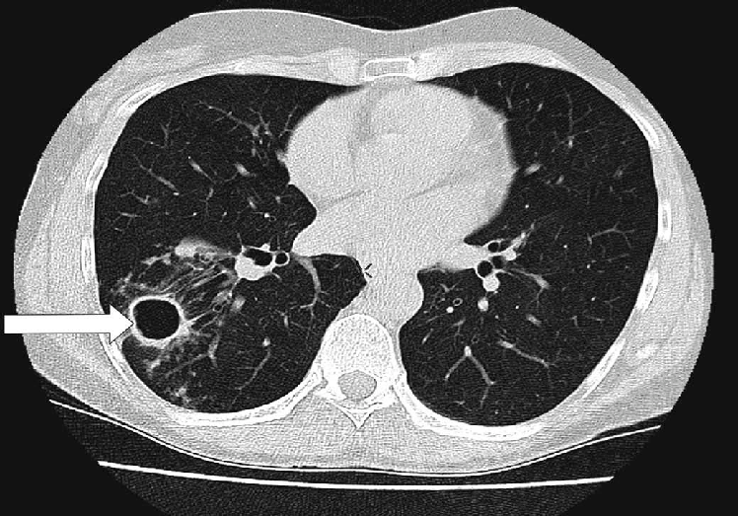
BEHOLD!

Slide 4
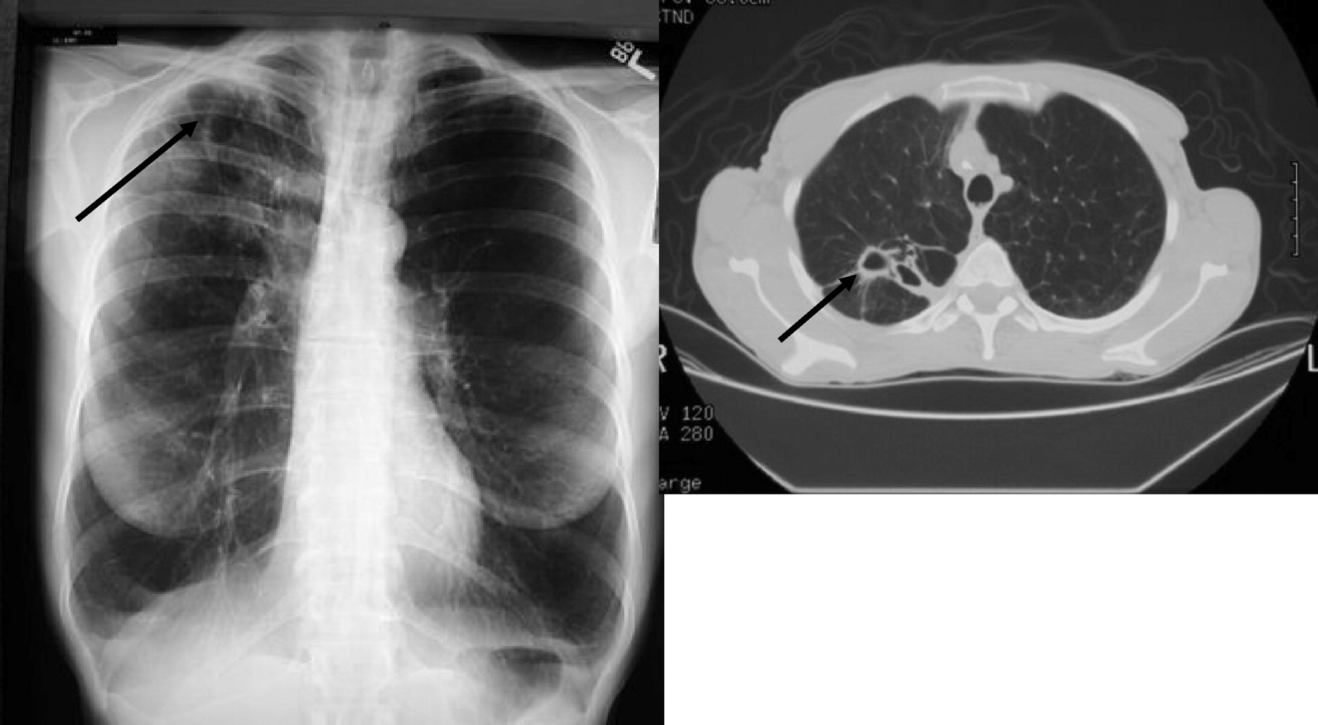

Slide 5
1. WHAT IS A FIBROCAVITARY LESION?
Areas of lung fibrosis
Plus
Areas of cavitations within them

Slide 6
DIVING A LITTLE DEEPER!
LUNG FIBROSIS: simply put.
‘scarring in the lungs’
impacting how you breathe and get oxygen into the blood.

Slide 7
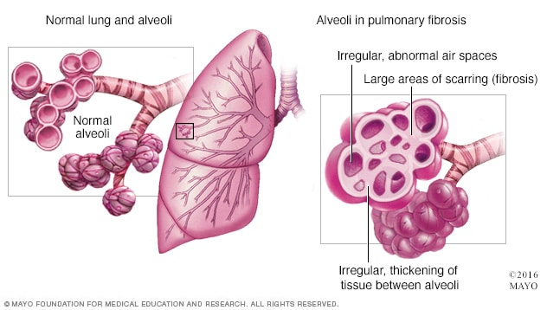

Slide 8
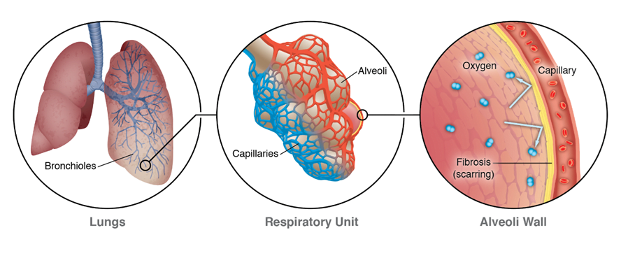

Slide 9
LUNG CAVITY: pathologically
”a gas-filled area of the lung in the center of a nodule or area of consolidation or mass
produced by the expulsion of a necrotic part of the lesion via the bronchial tree”

Slide 10
LUNG CAVITY: radiographically
A lucency within a zone of pulmonary consolidation, nodule or mass
A lucent area within the lung that may or may not contain a fluid level and
And surrounded by a wall, usually of varied thickness

Slide 11
A general rule of lung cavity:
Organisms that cause subacute or chronic pulmonary infections – more frequently associated with cavity
  Mycobacteria, fungi
Exceptions:
  Necrotising pneumonias a/w
  Klebsiella pneumoniae, Staph aureus
A cavity almost always rules out viral etiology

Slide 12
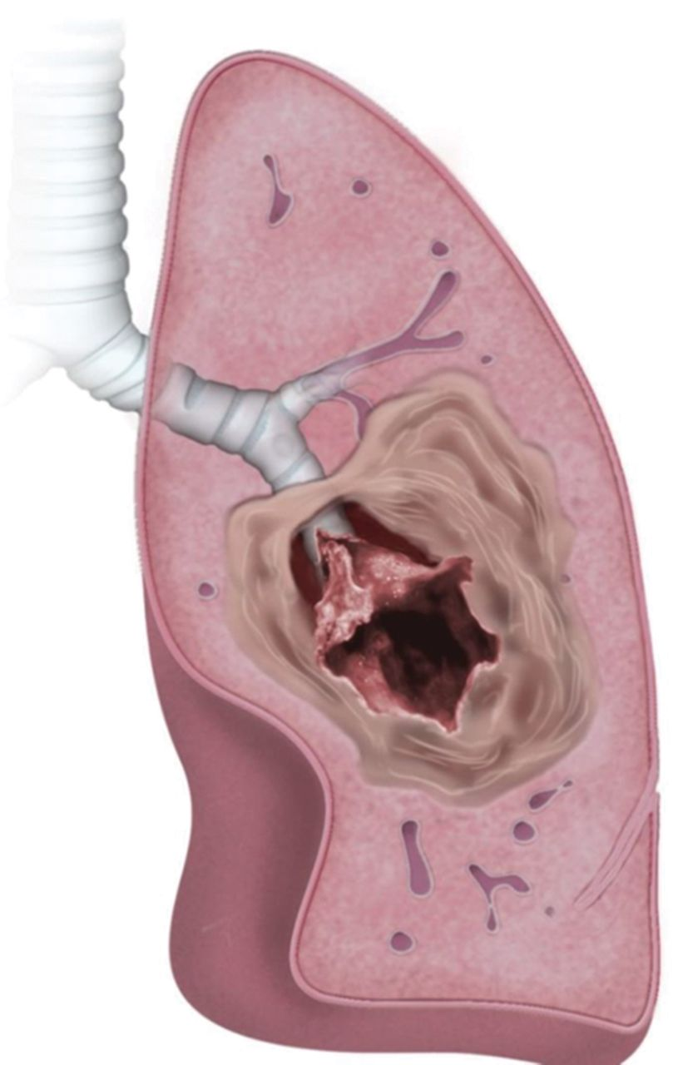
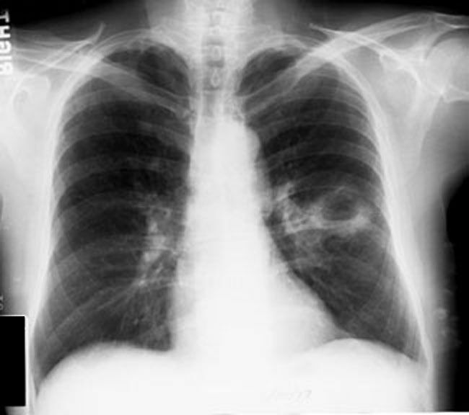

Slide 13
THE CONDITIONS ASSOCIATED WITH
FIBROCAVITARY LESIONS
1. TUBERCULOSIS
2. SARCOIDOSIS
3. BRONCHIECTASIS
4. POST-RADIATION FIBROSIS
5. EMPHYSEMA
6. FIBROSING ALVEOLITIS
7. POST-INFECTIVE SCARRING
8. ANKYLOSING SPONDYLITIS
MARFAN’S SYNDROME
MEDICATIONS

Slide 14
CLINICAL DIAGNOSIS OF A FIBROCAVITARY LESION
HISTORY
PHYSICAL EXAMINATION

Slide 15
HISTORY
Age :
20-40 : Sarcoidosis, CTD, Pulmonary LCH, Inherited ILD ( Familial IPF, Gaucher’s disease, Hermansky-Pudlak syndrome)
> 50years : IPF, Post TB Fibrosis

Slide 16
Sex:
Premenopausal women (exclusive) – Lymphangioleiomyomatosis, pulmonary involvement in Tuberous sclerosis
Females – ILD in Hermansky Pudlak Syndrome, CTD
Male – Pneumoconioses, RA - ILD

Slide 17
Occupation:
  Pneumoconiosis
  Exposure to silica, coal, asbestos, vapours, fumes, mold
Symptoms:
Usually part of a chronic disease
Hence chronic symptoms +

Slide 18
Usually chronic symptoms
Subacute and chronic presentation – TB
Acute presentation – staph aureus, klebisella, lung abscess
Chronic dry cough
Expectoration of large amounts of sputum (Bronchiectasis)
Gradual onset dyspnea
Fatigue
Fever

Slide 19
Myalgia
Loss of weight
Loss of appetite
Night sweats
f/o CTD: arthralgia, dry mouth, dry eyes, muscle weakness, numbness, Raynaud’s phenomenon, Chronic back ache

Slide 20
Current and recent medications:
Bleomycin, Amiodarone - fibrosis
Therapeutic Irradiation
Past history of TB, HIV, DM
H/o contact with TB patients
Malignancy, CTD, Other lung infections
  Staph aureus, Klebsiella ( Acute causes of cavitations)
  Covid 19 – Long Covid Syndrome

Slide 21
h/o recurrent lung infections
Bedridden patient
  recurrent aspiration, lung abscess
Family h/o lung disease
  TB, ILD.
Chronic Smoker
  Emphysema, ILD, pulmonary LCH
Heavy alcoholic – Klebsiella

Slide 23
PHYSICAL EXAMINATION
GENERAL EXAMINATION
Poor nourishment, low BMI
  TB, Malignancy
Marfanoid habitus

Slide 24
External markers of TB:
  Anemia, Clubbing, Matted lymph nodes
  Erythema nodosum
  Phlyctenular conjunctivitis
  Discharging sinuses
  Scrofuloderma
  Lupus Vulgaris
  Generalised Tinea versicolor
  Uveitis

Slide 25
External markers of malignancy:
Cachexia
Anemia, Clubbing, Hard lymph nodes
Acanthosis nigricans
Horner’s Syndrome
SVC obstruction features

Slide 26
Pallor – TB, malignancy
Hyperemia/congested conjunctiva
  Emphysema, SVC obstruction
Icterus
  Hepatitis ( ATT-induced)
  Liver metastasis

Slide 27
Edema
  Cor Pulmonale – Emphysema, Bronchiectasis
Cyanosis
  COPD, Cor Pulmonale
Clubbing
  Bronchogenic carcinoma
  Bronchiectasis, lung abscess
  Post- TB, Sarcoidosis

Slide 28
Lymphadenopathy
  Generalised – Lymphoma, Disseminated TB, HIV, Histoplasmosis, coccidiodomycosis, paracoccidioidomycosis, sarcoidosis, amyloidosis, histiocytosis
Oral cavity examination
  Halitosis – lung abscess, bronchiectasis
  Tobacco staining of teeth
  Erythroplakia, leukoplakia

Slide 29
RESPIRATORY SYSTEM EXAMINATION
URT:
  Sinusitis
    Wegener’s granulomatosis
    Kartagener’s syndrome – BXIS

Slide 30
CHEST:
  Pectus carinatum / excavatum – Marfan’s syndrome*
  Barrel shaped chest – COPD*
  shoulder droop – volume loss in fibrosis/ collapse*
    Prominent medial border of scapula
    Spinoscapular distance - ?
    Inferior angle of scapula at lower level
  Unilateral bulge – Malignancy/ pleural effusion/ compensatory hypertrophy/ pneumothorax

Slide 31
  Unilateral flattening – fibrosis, collapse
Local bulging
  supraclavicular fullness
    Pancoast tumor, lymphadenopathy
Local retraction
  Apical TB (infraclavicular fossa)
  Lung fibrosis

Slide 32
Tracheal shift – upper mediastinal shift
  To same side – upper lobe fibrosis/collapse
  To opposite side – malignancy, massive pleural effusion
  Trail sign
Apical impulse – lower mediastinal shift
  Not felt/seen :
    Emphysema
    Left pleural effusion, Left pneumothorax
No mediastinal shift – Bronchiectasis, ILD

Slide 33
Spine – Gibbus, exaggerated thoracic kyphosis in emphysema, scoliosis in severe fibrosis
Acquired scoliosis disappears on bending forwards
Respiratory movements
  Unilateral reduced movement – fibrosis/collapse/pleural effusion/empyema/pneumothorax
  Bilateral reduced movement – COPD, ILD, Ankylosing spondylitis
  Unilateral intercostal retraction
    Collapse
    Fibrosis

Slide 34
Engorged veins in anterior chest wall
  SVC obstruction
    Bronchogenic carcinoma, mediastinal LN/mass
Hemithorax measurement
  Increased hemithorax size, decreased movement
    Pleural effusion, pneumothorax
  Decreased hemithorax size, decreased movement
    Fibrosis, collapse

Slide 35
Vocal fremitus

