Slide 1
Extrahepatic Manifestations of Chronic
HCV Infection
DR KENFINE P JOHNSON

Slide 2
introduction
An estimated 71 million people worldwide have chronic hepatitis C virus (HCV) infection.
Known for morbidity mainly involving liver complications (cirrhosis and hepatocellular carcinoma), with an estimated 350,000 liver-related deaths per year.
Among all viruses, HCV is recognized as the virus most often associated with extrahepatic manifestations.

Slide 3
It includes
Mixed cryoglobulinemic vasculitis
B cell lymphoma
Cardiovascular events
T2DM
CKD
Miscellaneous

Slide 4
Mixed Cryoglobulinemic Vasculitis
Cryoglobulinemia is defined as the presence of cryoglobulins in serum, which are immunoglobulins that precipitate when the temperature is below 37°C and redissolve when rewarmed.
Type I cryoglobulinemia comprises a single monoclonal immunoglobulin (most commonly IgM).
Type II and type III are classified as mixed cryoglobulinemias that consist of polyclonal IgG with monoclonal or polyclonal IgM and rheumatoid factor activity.
From a clinicopathological point of view, mixed cryoglobulinemic vasculitis is a small vessel systemic vasculitis caused by the deposition of circulating cryoglobulins.

Slide 5
Pathophysiological Mechanisms
Chronic antigen stimulation reduces the B-lymphocyte threshold for activation and proliferation and induces B-cell lymphoma 2 (Bcl-2) activation and t(14;18) translocation, resulting in decreased apoptosis.
A B-cell clone (CD21−CD27+) expands and produces antibodies directed against the Fc portion of IgG (RF activity), forming immune complexes (the cryoglobulin) that precipitate in small vessels.
Increased activity of the type 1 helper T (Th1) and decreased regulatory T cells (which favors the persistence of autoreactive, cryoglobulin- producing B cells) are present.

Slide 6
Symptoms
Mild : fatigue, palpable purpura, and arthralgia.
Peripheral nervous system involvement is a common manifestation
The most frequently described form is a distal sensory or sensory–motor peripheral neuropathy, usually manifested as painful and asymmetric paresthesia that subsequently becomes symmetric.

Slide 7
The predominant renal manifestation is a membranoproliferative glomerulonephritis revealed by acute renal failure or a nephritic syndrome.
Rarely, the disease progresses to a more severe presentation, including life-threatening, widespread vasculitis with involvement of the central nervous system, heart, or gut.

Slide 8
Neurologic symptoms may fluctuate and take more time to disappear, regardless of viral elimination.
In patients with glomerulonephritis, creatinine levels may remain elevated, and a moderate proteinuria may persist.
Studies have shown that treatment with a direct-acting antiviral agent is associated with complete or partial remission of the manifestations.
However, long-term, complete clearance of cryoglobulin is reported in only 29 to 66% of cases
Long-term follow-up of such patients is crucial, particularly in order to monitor them for the appearance of B-NHL.

Slide 9
treatment
Treatment should be individualized according to the severity of the mixed cryoglobulinemic vasculitis.
Management include a combination of direct-acting antiviral agents with plasmapheresis (to clear the cryoglobulin), rituximab (to deplete cryoglobulin producing B cells), or both.
Patients with mild to- moderate manifestations (arthralgia, fatigue, and skin purpura) are treated with a direct-acting antiviral regimen alone.
In more severe cases rituximab should be administered, with plasmapheresis if necessary, and always in combination with direct acting antiviral therapy.
Low-dose glucocorticoids may be used to help control minor inflammatory symptoms, whereas other immunosuppressants should be given only in refractory cases.

Slide 10
B-Cell Lymphoma
The overall risk that B-NHL will develop in patients who have chronic HCV infection with cryoglobulinemia is about 35 times as high as the risk in the general population.
B-NHL can develop after a long period of HCV infection (>15 years)
Lymphoma is diagnosed a mean of 4.6 years earlier in HCV-infected patients than in the general population, and death occurs, on average, 12.6 years earlier

Slide 11
Pathophysiological Mechanisms
B-cell lymphoma may arise from the clonal proliferation (CD21−CD27+), as a result of both continuous HCV antigen stimulation and permanent genetic damage caused by viral proteins.
Oncogenic signals are further enhanced (e.g., Bcl-2, interleukin-6, and B-lymphocyte stimulator), whereas tumor-suppressive signals (e.g., microRNA-26b) are down-regulated.
Additional tumor suppressor genes undergo mutation, notably B-cell lymphoma 6 (Bcl-6), tumor protein p53, and β-catenin.
B-cell clones are unlikely to undergo programmed cell death, since decreased levels of caspase 3, 7, and 9 reduce their sensitivity to Fas-induced apoptosis.

Slide 12
HCV-associated lymphomas are predominantly marginal-zone lymphomas, with diffuse large B-cell lymphoma (DLBCL) and lymphoplasmacytic lymphoma observed less frequently.
Among patients with transformed DLBCL, those with HCV infection are younger, have more advanced disease, are more likely to have gastrointestinal and bone marrow involvement, and have a lower 2-year survival rate than HCV-negative patients.
Serum cryoglobulin levels higher than 0.6 g per liter, mixed cryoglobulinemic vasculitis, and hypogammaglobulinemia are independent variables associated with the development of B-NHL.

Slide 13
treatment
Direct-acting antiviral agents can be safely administered concomitantly with chemotherapy.
International guidelines have prioritized treatment with direct acting antiviral agents in HCV-infected patients with B-NHL, and recent data suggest that early treatment may be preferable for all patients, whether they have indolent or aggressive B-NHL.

Slide 14
Cardiovascular Events
There is considerable evidence that HCV infection is a nontraditional and modifiable risk factor for cardiovascular disease.
Observational studies have shown an increased prevalence of HCV infection among patients who have a major cardiovascular event or disease, including coronary artery disease, peripheral arterial disease, myocarditis, and heart failure.

Slide 15
Pathophysiological Mechanisms
Cardiovascular disease is thought to be due to several events taking place in the arterial wall:
Increased expression of adhesion molecules on the surface of the endothelium leads to local vascular damage.
Smooth cells in the media undergo proliferation and apoptosis inhibition, and local macrophages produce proinflammatory cytokines and free radicals.
These processes result in accelerated atherosclerosis, with procoagulant effects that may ultimately lead to major cardiovascular events.

Slide 16
The effect of HCV infection on the risk of cardiovascular events was greater among older patients with hypertension or diabetes.
The incidence of cardiovascular events was reported to be higher among patients with detectable HCV RNA than among those who were HCV antibody–positive with undetectable HCV RNA levels, suggesting that active HCV infection increases the risk of cardiovascular events.

Slide 17
Further evidence of the role of HCV infection in cardiovascular risk arose from studies showing the effect of viral eradication.
Initial Asiatic studies showing a reduced risk of cardiovascular events in interferon-alfa–treated patients versus untreated patients might have been biased by criteria for treatment eligibility.
In the era of direct-acting antiviral therapy, the risk of all or major adverse cardiovascular events was significantly reduced among patients who had a sustained virologic response, as compared with those who did not have a response, in a large cohort of French patients with cirrhosis who received therapy that was based on or free of interferon-alfa.

Slide 18
Other large retrospective and prospective studies using direct-acting antiviral agents confirmed an association between treatment and a decrease in the rates of overall cardiovascular events or cerebrovascular and cardiac events .
Two studies in which the event rates were stratified according to the degree of liver fibrosis showed that the association with direct-acting antiviral agents was maintained despite this potential confounder, reinforcing the role of the virus in cardiovascular events.

Slide 19
Type 2 Diabetes
There is an increased incidence of type 2 diabetes mellitus among patients with chronic HCV infection.
Underlying mechanisms include
direct viral effects
insulin resistance
release of proinflammatory cytokines
other immunemediated processes .

Slide 20
Patients with HCV associated cirrhosis have an increased risk of type 2 diabetes, as compared with patients who have cirrhosis in the absence of viral infection and those who have chronic liver disease.
Most studies of direct-acting antiviral therapy have shown a significant improvement in glycemic control both in patients without diabetes (on the basis of assessment for insulin resistance and insulin level) and in patients with diabetes

Slide 21
In a clinical trial involving HCV-infected patient with or without type 2 diabetes, there was a greater decrease in the mean glucose level at the end of the treatment period in the group that received direct-acting antiviral agents than in the placebo group and this decrease persisted for up to 52 weeks after treatment.
A reduced dose or discontinuation of oral hypoglycemic agents or insulin therapy has been reported in patients with diabetes, highlighting the importance of monitoring blood glucose levels for a reduction occurring either during or after treatment with direct-acting antiviral agents.

Slide 22
The association between HCV treatment and complications of diabetes has also been analyzed.
Analyzing data from the four U.S. health systems participating in the Chronic Hepatitis Cohort Study, showed that successful treatment of HCV infection (based on either interferon-alfa or direct-acting antiviral agents) in patients who had type 2 diabetes without prior complications is associated with a reduced incidence of acute coronary syndrome, end-stage renal disease, ischemic stroke, and retinopathy, regardless of the presence or absence of cirrhosis.

Slide 23
Chronic Kidney Disease
In addition to the conventional risk factors for chronic kidney disease (CKD), HCV infection has been implicated as a cause of kidney disease.
HCV-associated renal involvement related to a type I membranoproliferative glomerulonephritis is frequently reported.
Other forms of HCV-related renal disease are membranoproliferative glomerulonephritis without cryoglobulinemia, membranous nephropathy, and tubulointerstitial injury.
HCV infection may progress to CKD even in the absence of these entities, probably as a result of systemic inflammation and vascular damage.

Slide 24
Pathophysiological Mechanisms
chronic inflammation originating from atherosclerosis and insulin resistance
direct cytopathic effect, with endothelial and mesangial inflammation and podocyte and tubular injury.
Glomeruli may be the site of cryoprecipitable deposits, typically manifested as type I membranoproliferative glomerulonephritis.

Slide 25
Treatment
Most studies of direct-acting antiviral agents in patients with CKD have shown a stabilization of or increase in the GFR rather than a return to normal renal function.
The main limitations of interferon-alfa–based combinations (poor side-effect profiles) have been eliminated with the most recent direct-acting antiviral regimens, including the combination of sofosbuvir plus daclatasvir and three fixed-dose combination regimens (sofosbuvir–velpatasvir, sofosbuvir– velpatasvir–voxilaprevir, and glecaprevir–pibrentasvir).

Slide 26
Guidelines from the United States and Europe recommend no dose adjustment for any of the approved direct-acting antiviral agents in patients with mild-to-moderate renal impairment (eGFR ≥30 ml per minute per 1.73 m2).
In patients with severe renal dysfunction (eGFR <30 ml per minute per 1.73 m2), regimens without sofosbuvir are preferred.
No dose adjustment of glecaprevir and pibrentasvir is required in patients with any degree of renal impairment,including those on dialysis.

Slide 27
Miscellaneous Manifestations
HCV related sicca syndrome and Sjogren’s syndrome (both of which are characterized by the presence of xerostomia, xerophthalmia, anti-SSA or anti- SSB antibodies, and salivary gland histologic features)
Sicca symptoms have been reported in 20 to 30% of patients with HCV infection, whereas less than 5% of patients with a defined Sjogren’s syndrome are HCV-positive.
Arthralgia (with arthritis in rare cases) and myalgia have frequently been reported in patients with HCV infection, mostly in the context of mixed cryoglobulinemic vasculitis. There is no evidence of joint destruction. Rheumatoid factor activity is common, whereas anti–cyclic citrullinated peptide is absent.

Slide 28
Studies have documented a high prevalence of fatigue among patients with HCV infection, as well as depression and worsening of cognitive function.
The coexistence of functional somatic syndromes such as chronic fatigue and fibromyalgia in patients with HCV infection.

Slide 29
The prevalence of circulating autoantibodies is high among patients with HCV infection; the most common is rheumatoid factor (in 70% of patients), followed by antinuclear antibodies (20 to 40%), anticardiolipin antibodies (15%), antithyroid antibodies (12%), and anti–smooth muscle antibodies (7%).
These autoantibodies are not associated with manifestations of connective- tissue disease
Other, rare HCV-related extrahepatic manifestations include autoimmune cytopenia (hemolytic anemia and thrombocytopenia), skin manifestations (lichen planus and porphyria cutanea tarda), and hypothyroidism

Slide 30
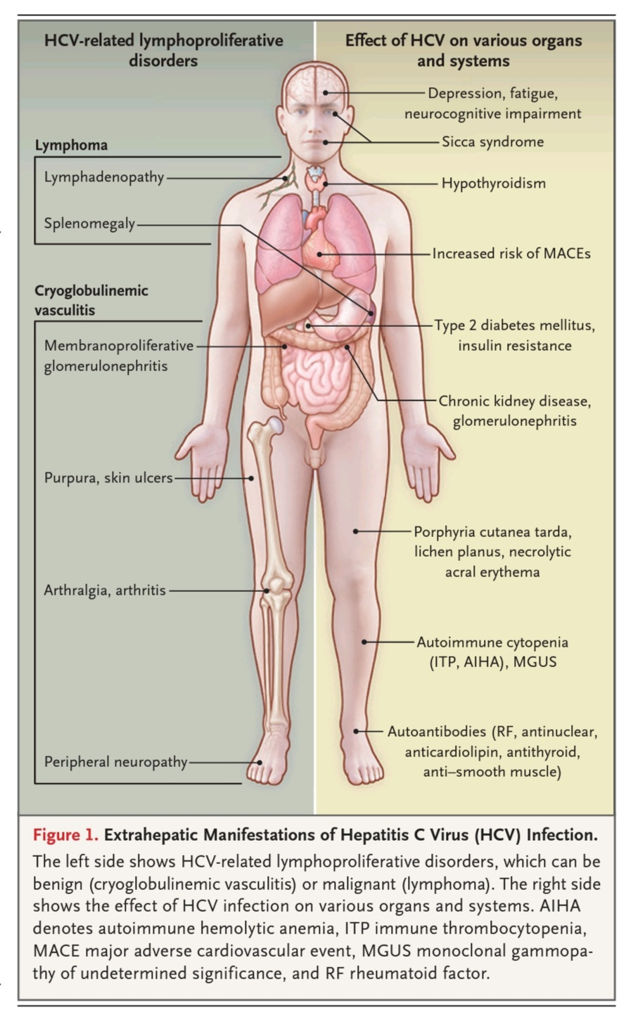

Slide 31
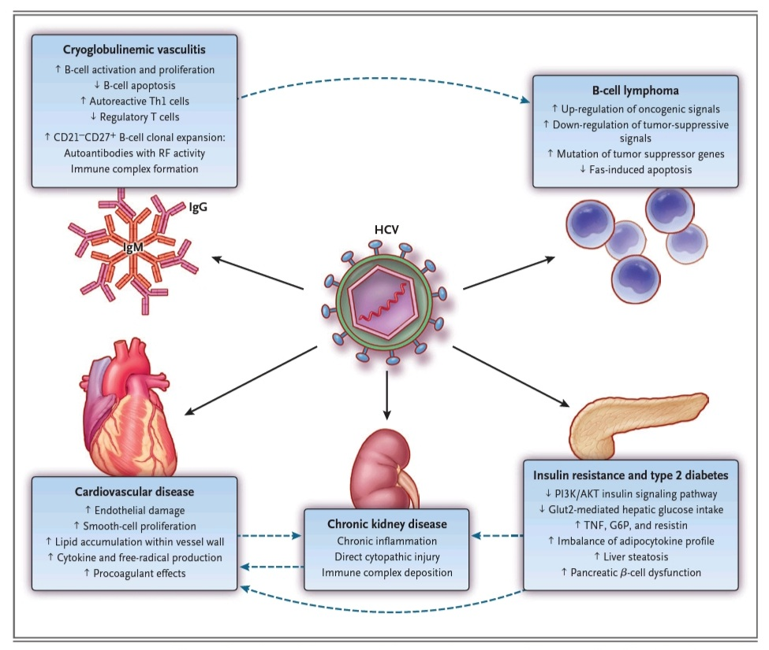

Slide 32
Conclusions
The introduction of interferon-alfa–free antiviral regimens that are safe and effective has transformed the prognosis for patients with HCV infection.
Studies have shown an association between direct-acting antiviral therapy and a reduction in both the incidence and severity of extrahepatic manifestations of HCV infection.
The majority of patients receiving direct-acting antiviral agents can be cured of HCV infection, with a benefit at the extrahepatic level, reinforces the recommendation that all patients with HCV infection should receive direct-acting antiviral therapy.

Slide 33


