Slide 1
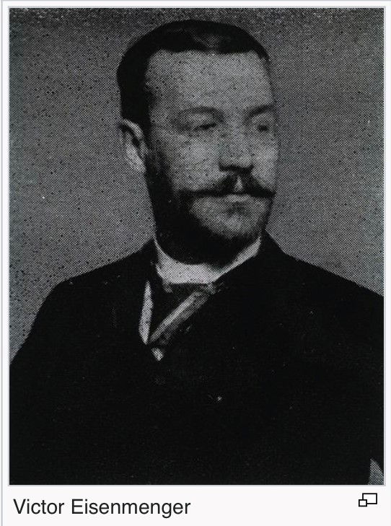
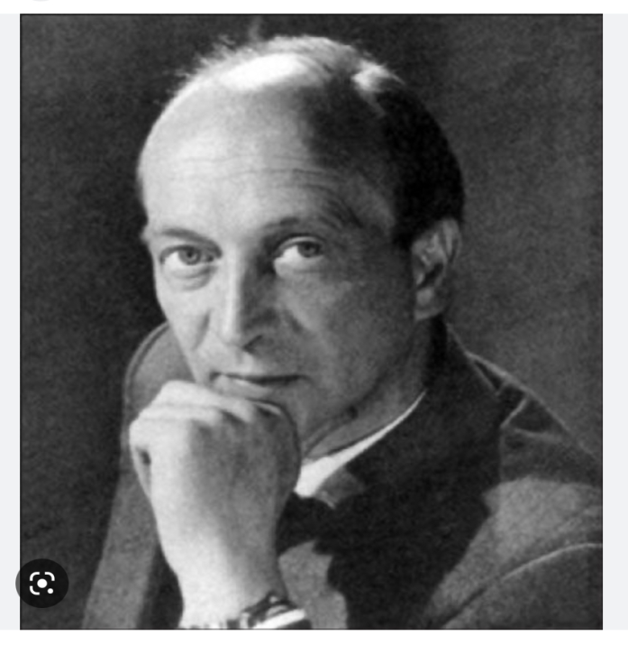
Eisenmenger Syndrome
Dr.Shifa.C, JR3

Slide 2
Victor Eisenmenger,1897 – described a case of:
A powerfully built man, with h/o cyanosis & some breathlessness since infancy- but active till 32 years.
Worsening of dyspnoea at 32 years, along with edema
Hospital admission with heart failure 8 months later, and died 11 months later of massive hemoptysis.

Slide 3
This was a case of VSD – Eisenmenger.
Pulmonary hypertension of any cause – long period of relative stability as RV compensates.
Once RV fails – rapid deterioration.
Eisenmenger has a balanced, but fragile physiology.

Slide 4

Paul Wood(1907-1962) – an eminent British Cardiologist.
Published an article on “Eisenmenger Syndrome” in the BMJ in 1958.

Slide 5
Eisenmenger Syndrome
Pulmonary artery hypertension at or near systemic level, with a reversed or bidirectional shunt – due to high PVR
Not a congenital heart disease
A preventable, multi-system disorder – a complication of CHD.

Slide 6
Definition
A chronic obstructive pulmonary vascular disease producing severe pulmonary hypertension resulting in aright to left shunt in a patient with a pre-existing left to right shunt.

Slide 7
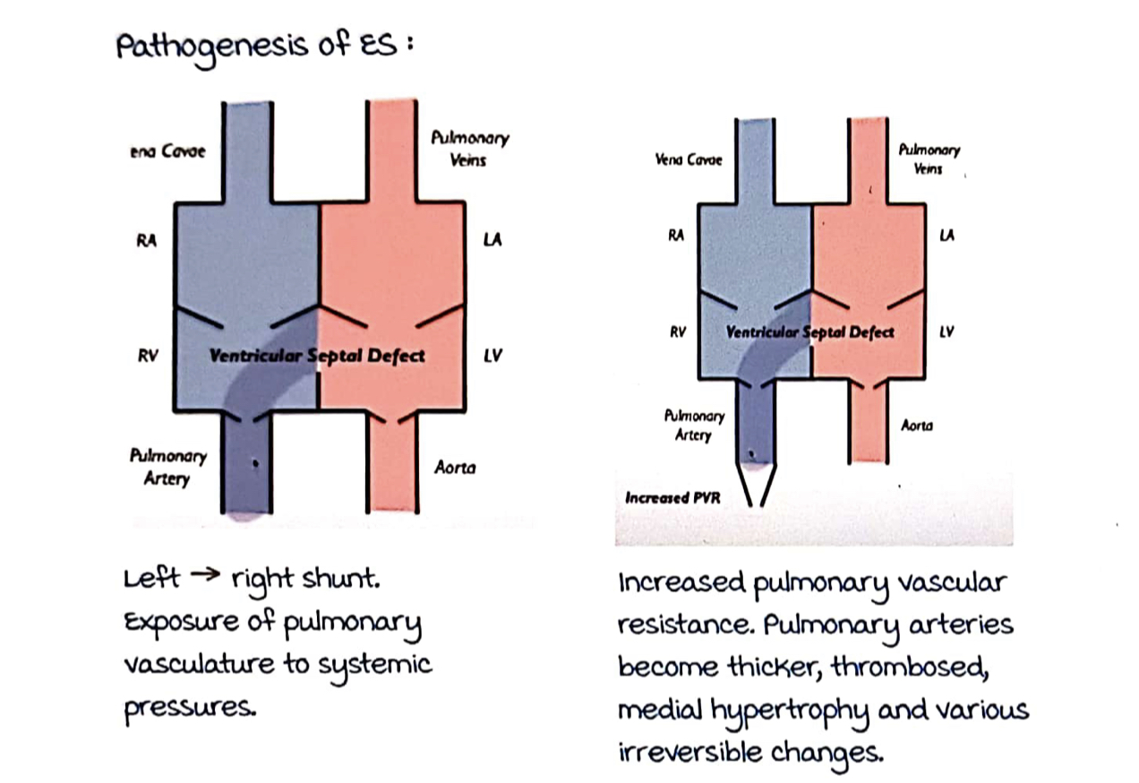
Pathophysiology

Slide 8
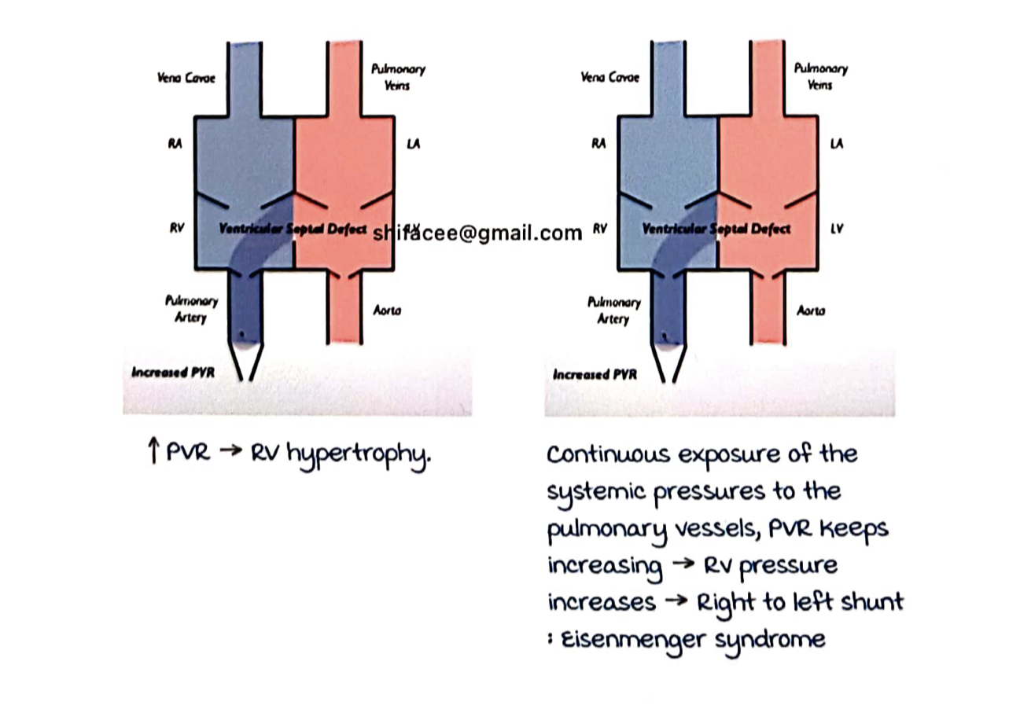

Slide 9
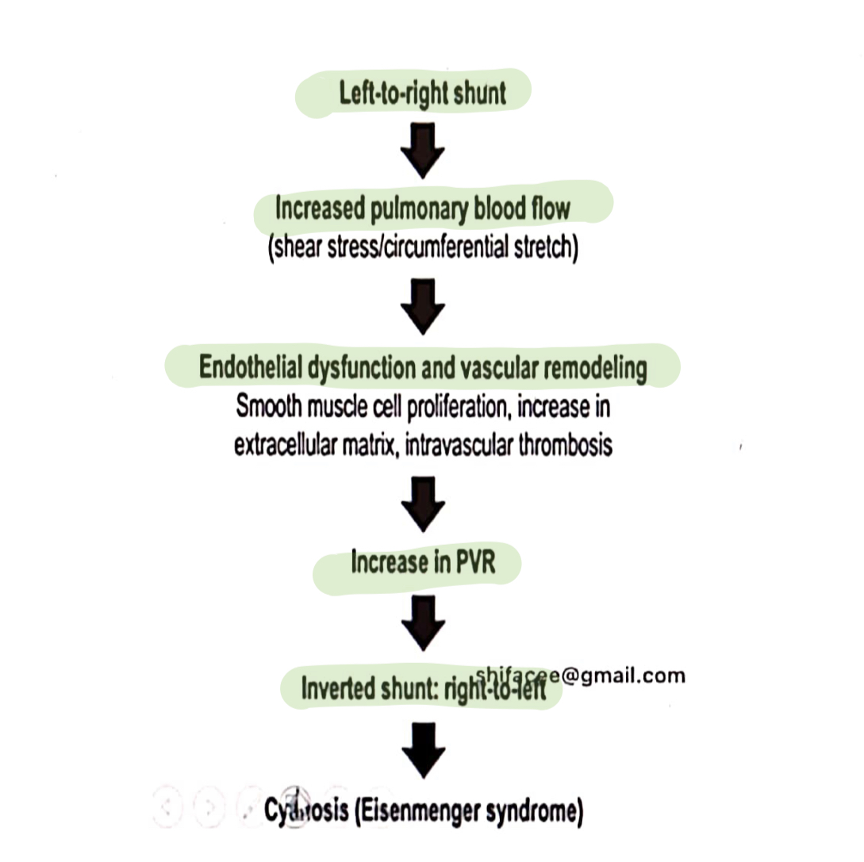

Slide 10
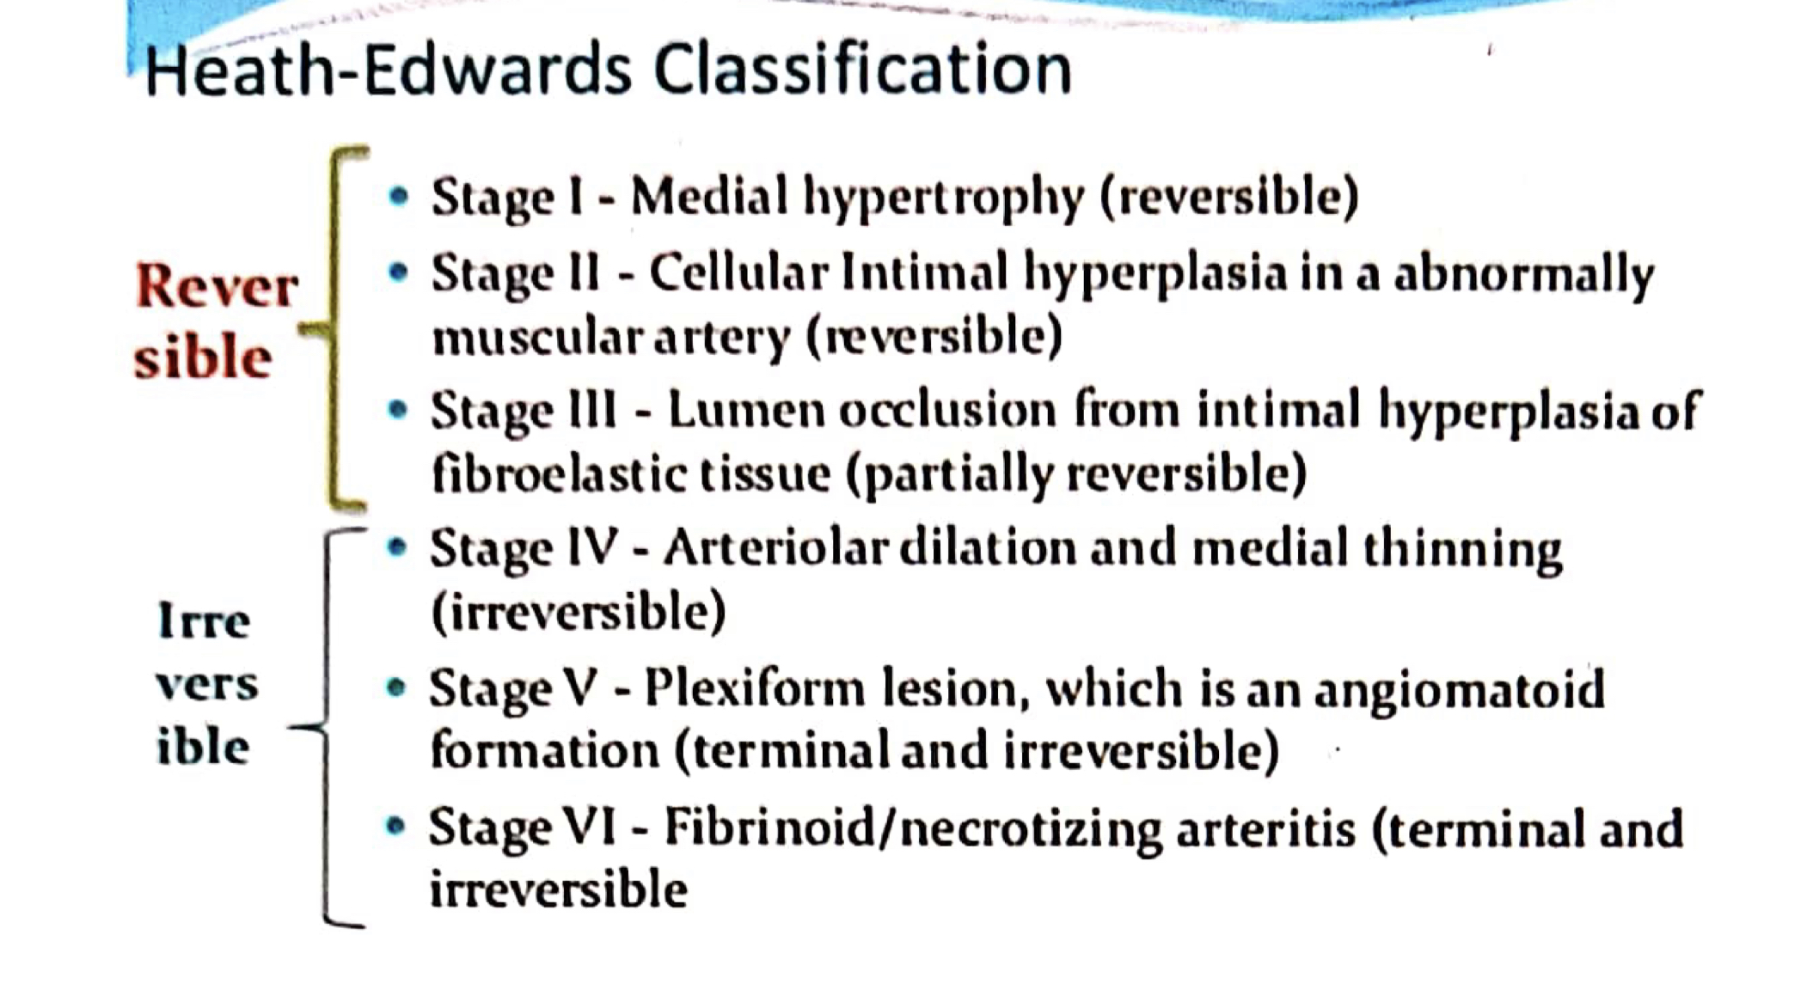

Slide 11
PROGESSION
A left to right shunt (VSD, PDA)
Increased pulmonary blood flow – LV volume overload – increased cardiac output – Hyperkinetic PAH
Constant left to right shunt – irreversible changes in pulmonary artery – increased PVR – RV pressure rises – reversal of shunt – Eisenmenger Syndrome

Slide 12
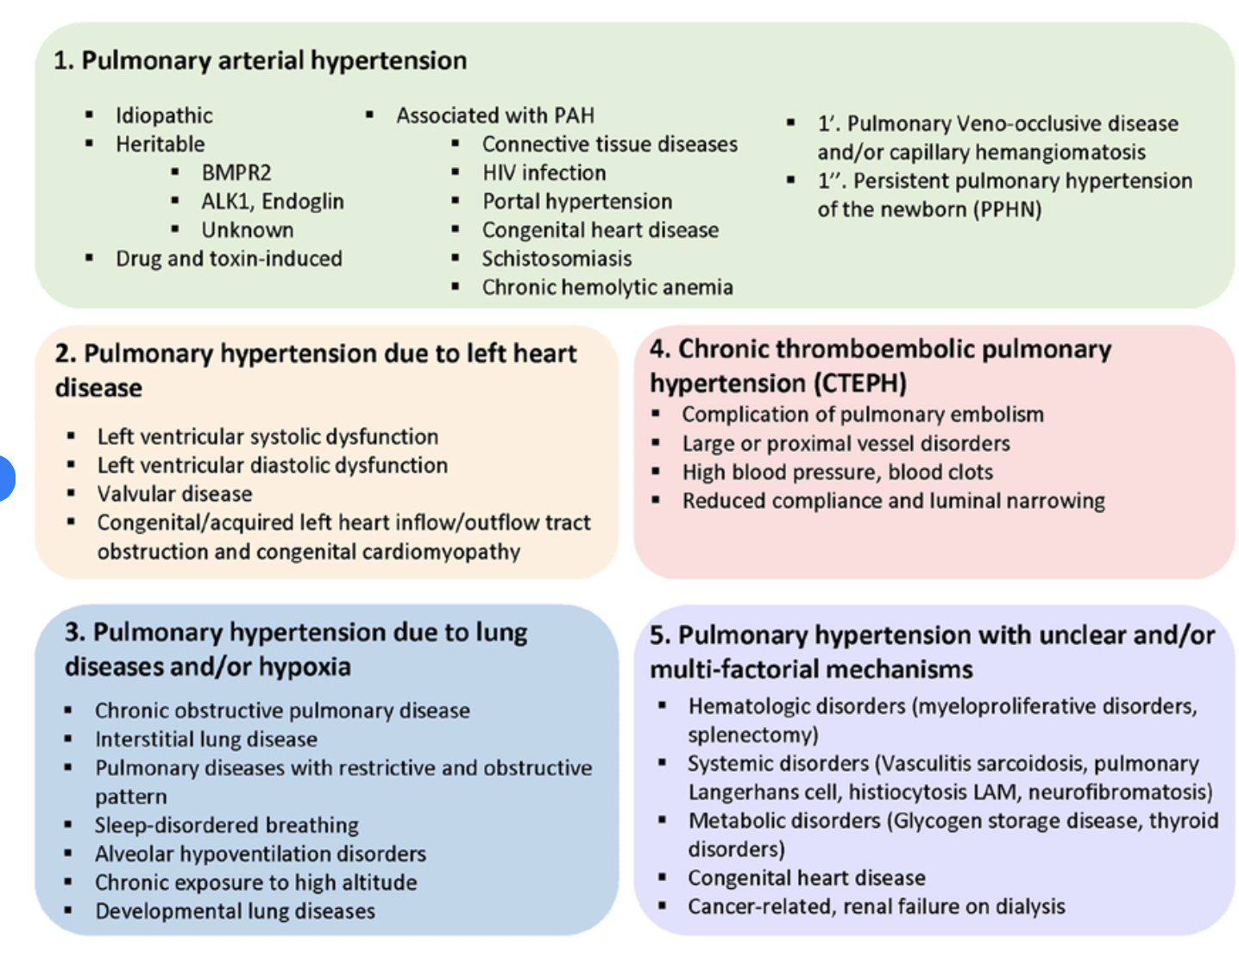
Belongs to Group 1 Pulmonary hypertension :PAH

Slide 13
CAUSES OF ES
SIMPLE
Pre- tricuspid : ASD, PAPVC, Gerbode defect (LV to RA).
Late Eisenmenger (20-30 years)
Post –tricuspid : VSD, PDA, Aorto-pulmonary window
Early Einsenmenger (2-3 years)

Slide 14
2.COMPLEX
Very early Eisenmenger (<1 year)
Ventricular – single ventricle
Truncus arteriosus
TGA/ TAPVC
3.POST –SURGICAL / PALLIATION
after ToF surgeries – artificial shunts between aorta and pulmonary artery

Slide 15
Eisenmenger’s complex- VSD-ES
All others –Eisenmenger Syndrome

Slide 16
Only large defects go for EISENMENGERISATION
Large PDA – 50%
Large VSD – 50%
Large ASD – 10%

Slide 17
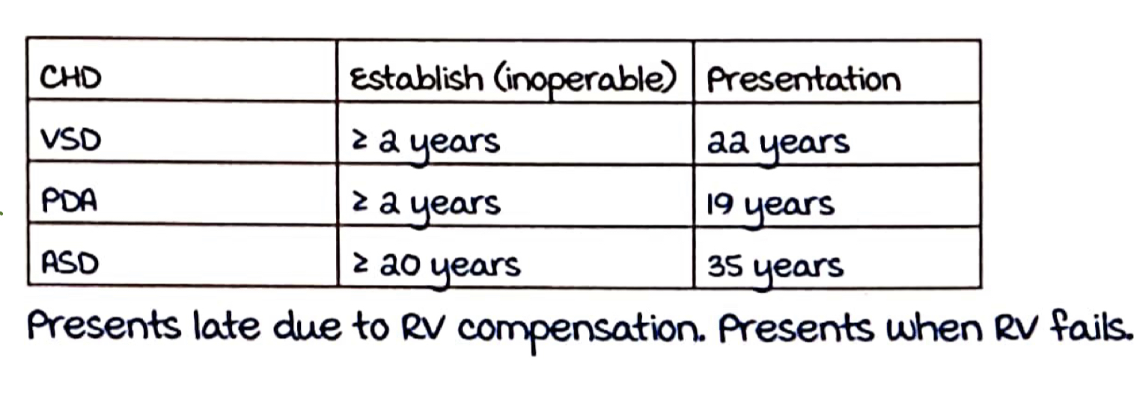
Tardive cyanosis

Slide 18
More the blood flow, faster the Eisenmengerisation
PDA - continuous murmur - during both systole & diastole – increased pressure in Pulmonary artery during both.
VSD – PSM – only during systole.

Slide 19
ASD –very rare – because of the lesser pressure difference
LA pressure: 4-12 mm Hg
RA pressure:0-4 mm Hg
A genetic component

Slide 20
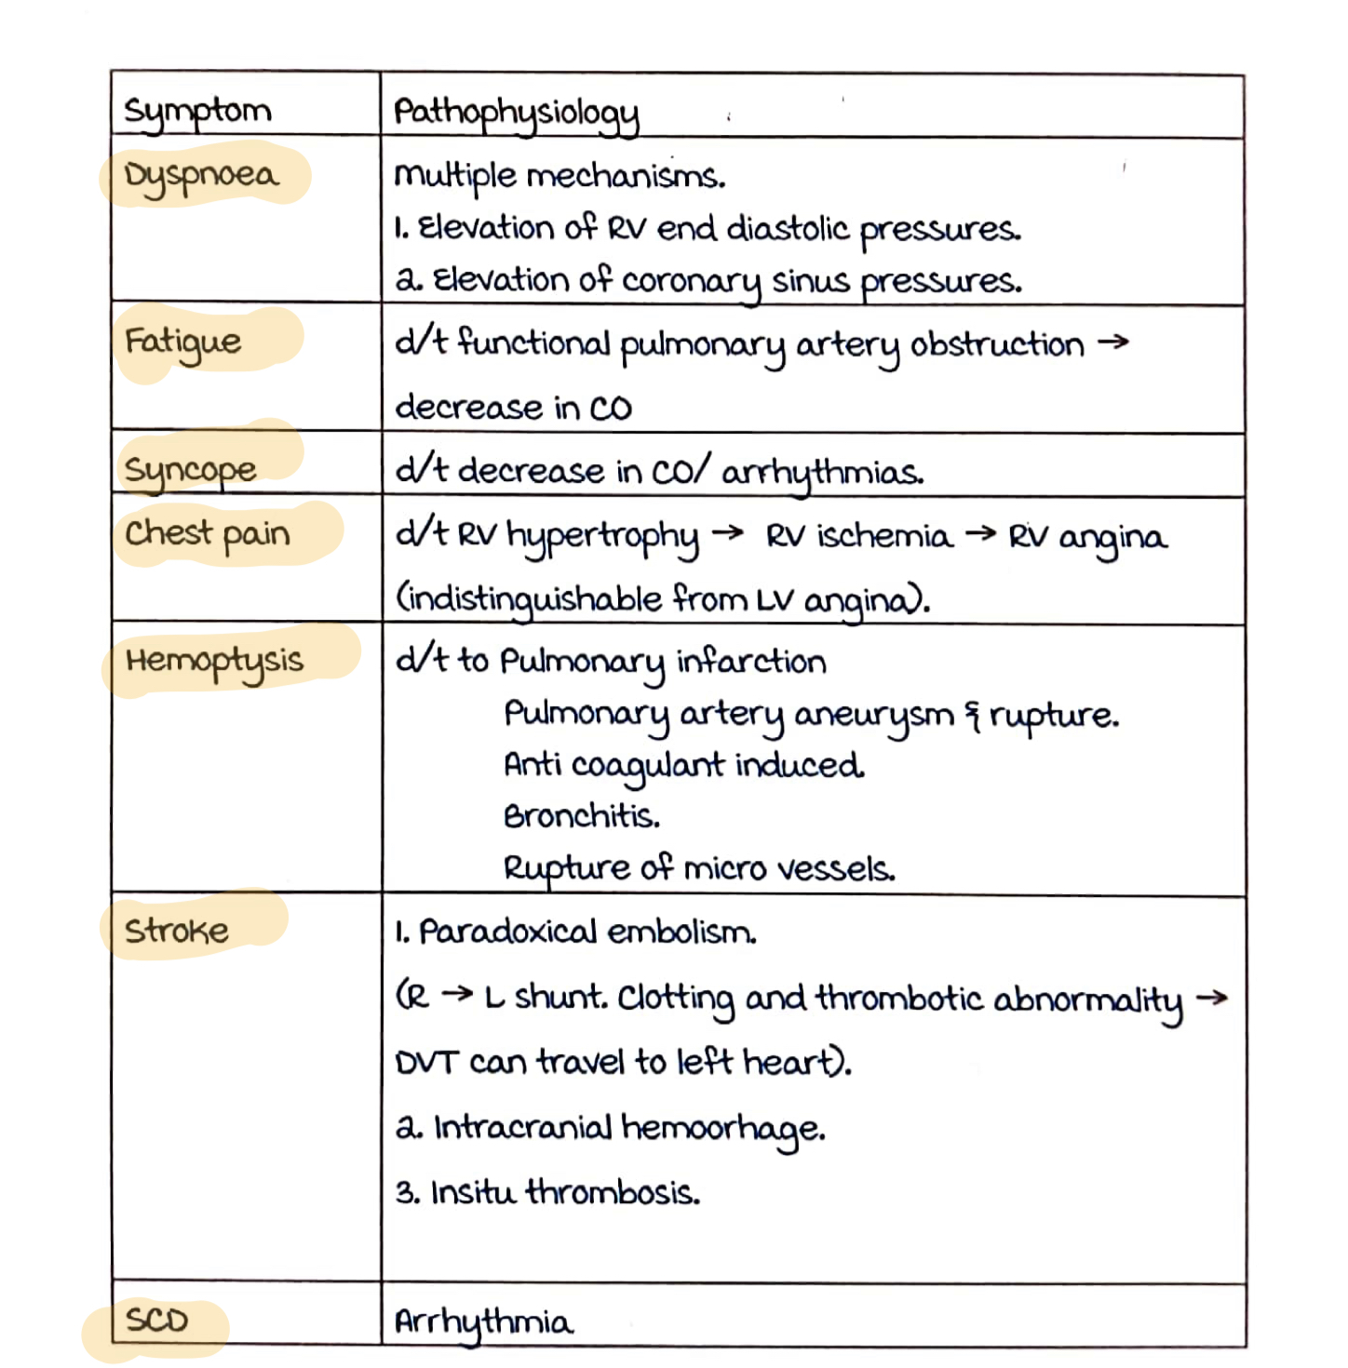
Symptoms

Slide 21
Clinical signs
Central cyanosis (differential cyanosis in PDA) – mild
Clubbing
Dominant A/V wave in JVP
Palpable, loud P2, LPH
Other features of right heart failure – RVS3, tender hepatomegaly, edema

Slide 22
Shunt murmurs disappear.
Murmurs due to PH –
PSM at TA ( due to TR)
Graham Steel’s murmur ( early diastolic murmur in PA)

Slide 23
Differentiating Types of ES
Features | ASD ES | VSD ES | PDA ES
ES in | 10% | 30-50% | 30-50%
Age | 35 years | 22 years | 19 years
Gender | Female | Equal | Female
Exercise intolerance | More (suprasystemic PA pressures)
Squatting |  | +
Cyanosis | Uniform | Uniform | Differential
Clubbing | Uniform | Uniform | Differential

Slide 24
Feature | ASD ES | VSD ES | PDA ES
JVP | ++ | + | +
Cardiac size | Cardiomegaly | Normal | Normal
Active precordium | ++ (rocking) | +- | +-
S2 | Wide split | single | Single/close
LPH | + | mild | -
EDM | 50% | 50% | 50%
TR murmur (PSM) | ++ | + | +

Slide 25
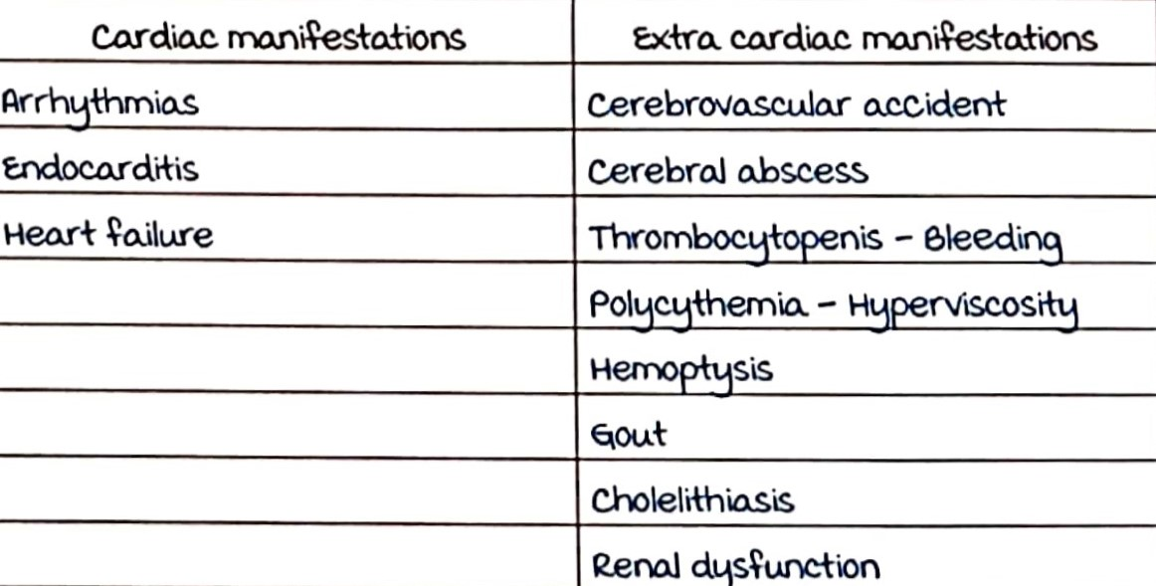

Slide 26
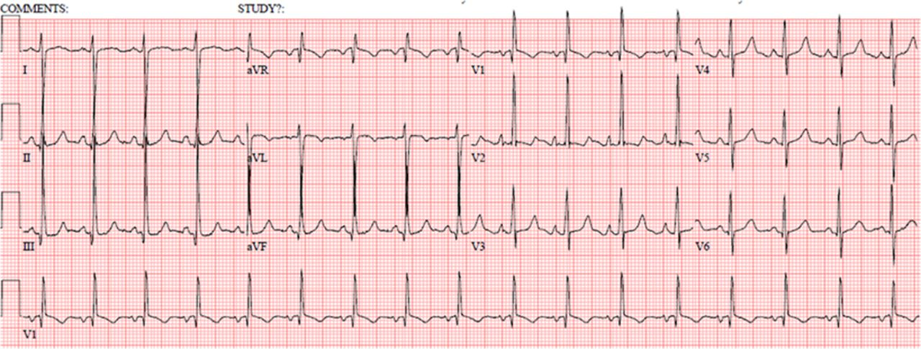
ECG

Slide 27
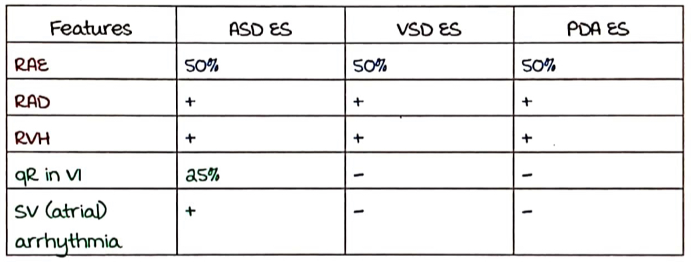
ECG Findings

Slide 28
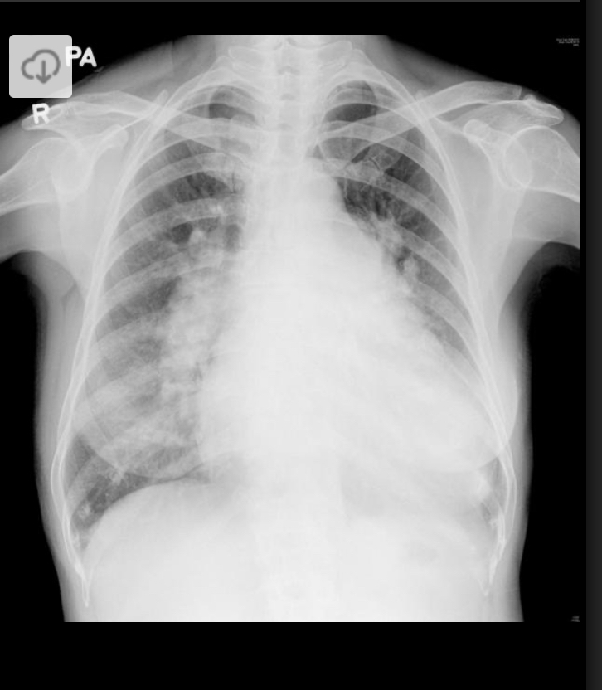
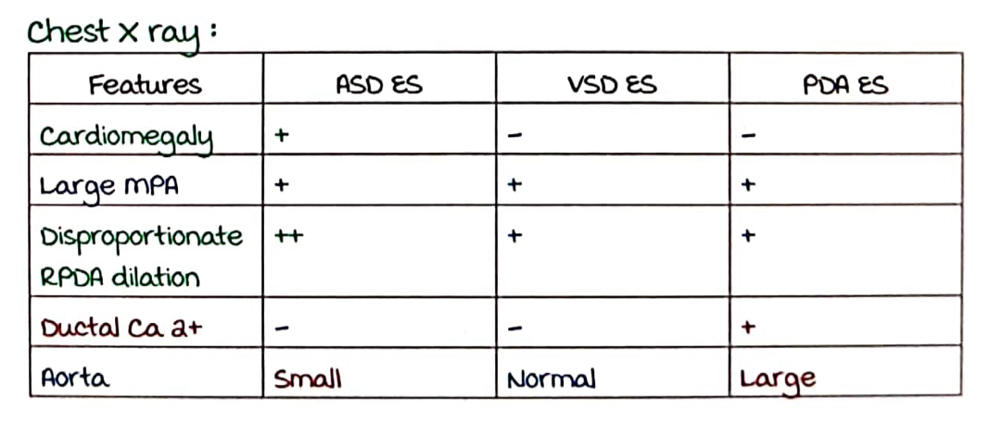
Chest Xray

Slide 29
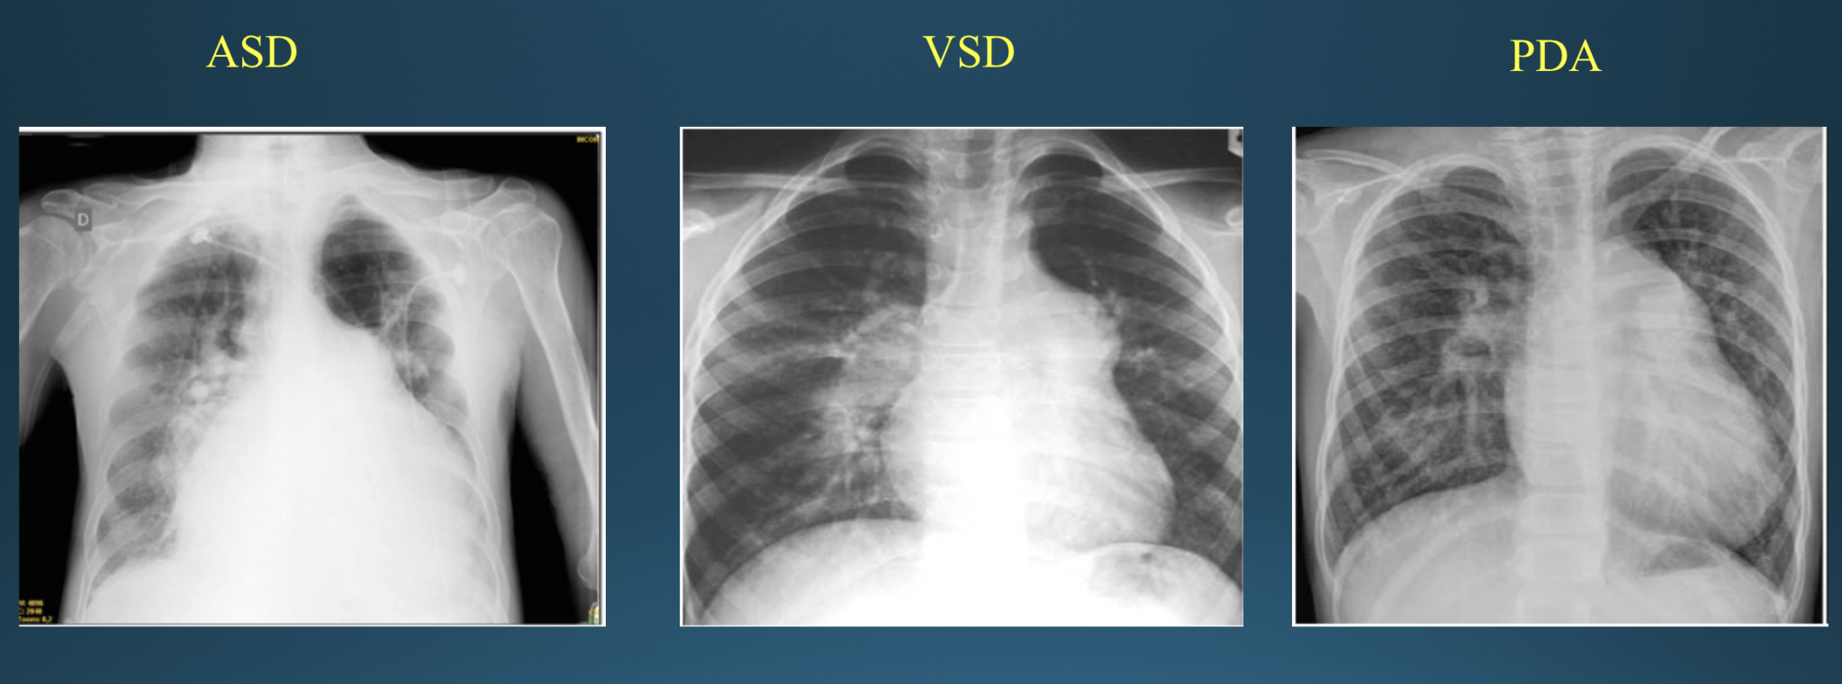

Slide 30
ECHO
To demonstrate the shunt
Contrast ECHO – in PDA
To assess RV function

Slide 31
Cardia cath
To assess operability when pressure is 4-8 wood units
< 4 Wood units –operable
>8 Wood units - inoperable

Slide 32
Prognosis
Closing the shunt?
Irreversible changes have already set in – progressive
We are closing the safety valve – RV, PA pressures are already high- functionally stenosed PA – now if we close- RV failure occurs early.
Cardiac output was being maintained via the shunt (at the expense of cyanosis) – decreases CO.

Slide 33
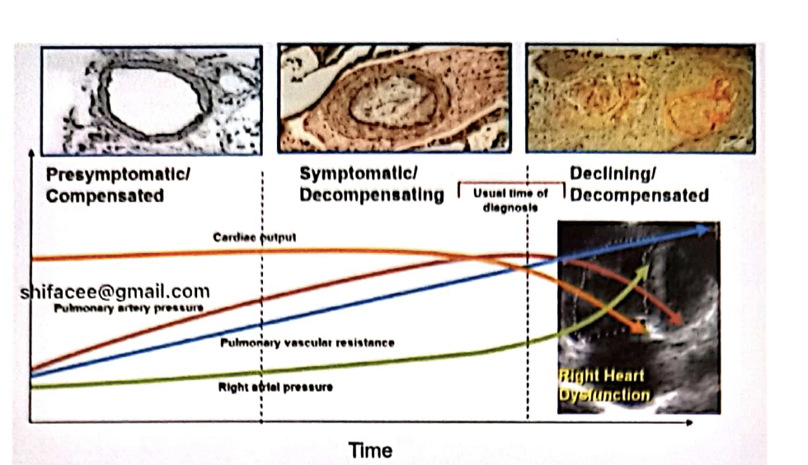
PROGRESSION OF ES

Slide 34
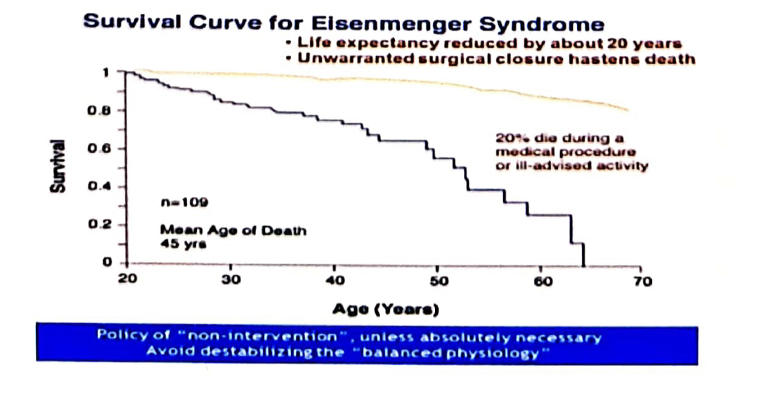

Slide 35
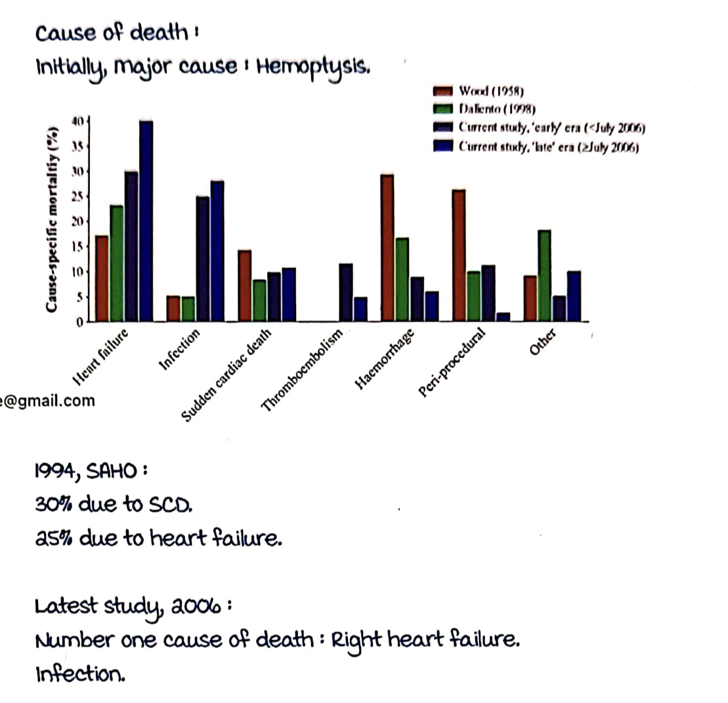
CAUSE OF DEATH IN ES

Slide 36
PREGNANCY IN EISENMENGER
Pregnancy is contraindicated
Maternal mortality – 36-45%
Fetal mortality – 16%
Maximum mortality is peri-partum – during labor & immediate post-partum
RV failure
Low cardiac output
Pulmonary thrombosis – paradoxical embolism

Slide 37
MANAGEMENT
Avoid destabilising factors at all costs – a delicately balanced physiology.
Pregnancy
General anaesthesia
Elective surgery (20% mortality)
Exercise
Excessive heat
Dehydration
Infections – vaccinate
High altitude
Anemia
Hypoxia

Slide 38
Medical management
Phlebotomy – for symptomatic hyperviscosity syndrome
O2support
Anti-coagulation
Digoxin
Diuretics
Anti-arrhythmics

Slide 39
Targetted PAH therapies:
1. Bosentan ( BREATHE5)
improves PA pressures and 6MWT
No mortality benefit
2. Sildenafil – no mortality benefit.

Slide 40
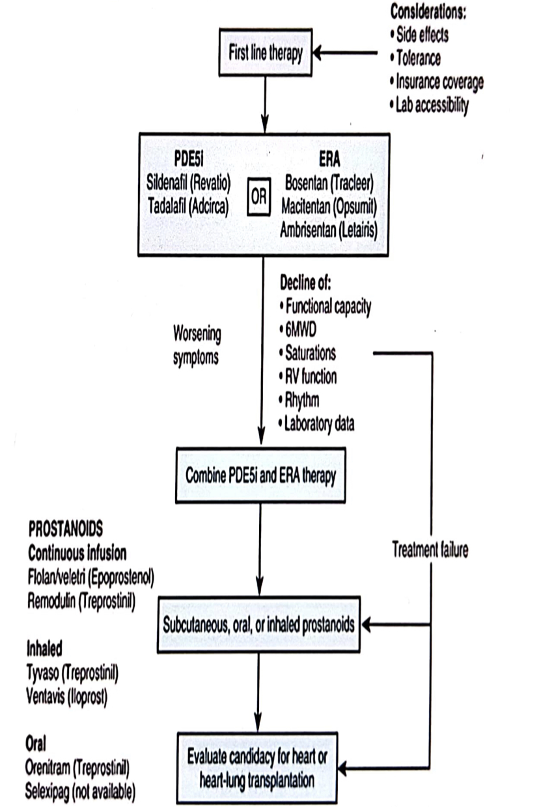
Treatment algorithm :

Slide 41
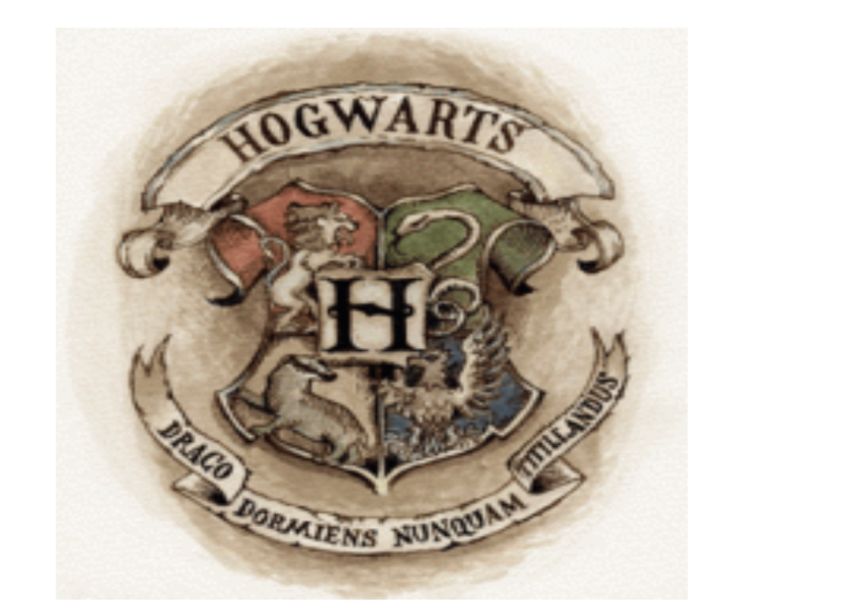
A preventable condition – no child should go for Eisenmenger.
Once set in – avoid anything that causes decompensation- pregnancy, procedures, strenous exercise.
Never Tickle A Sleeping Dragon

Slide 42
Thank You.

