Slide 1

Effect of Finerenone on Chronic Kidney Disease Outcomes in Type 2 Diabetes
George L. Bakris, M.D., Rajiv Agarwal, M.D., Stefan D. Anker, M.D., Ph.D., Bertram Pitt, M.D., Luis M. Ruilope, M.D., Peter Rossing, M.D., Peter Kolkhof, Ph.D., Christina Nowack, M.D., Patrick Schloemer, Ph.D., Amer Joseph, M.B., B.S., Gerasimos Filippatos, M.D., for the FIDELIO-DKD Investigators
By Dr.K.Meghanadha Reddy

Slide 2
INTRODUCTION
Type 2 diabetes is the leading cause of chronic kidney disease (CKD) worldwide.
International guidelines for the management of CKD in patients with type 2 diabetes recommend control of hypertension and hyperglycemia, as well as the use of a RAS blocker (ACE inhibitor or ARB) and, more recently, SGLT2 inhibitor.
Nonetheless, despite recommended treatment, a risk of CKD progression remains, and newer therapies are needed.

Slide 3
INTRODUCTION
Evidence supports a pathophysiological role for overactivation of the mineralocorticoid receptor in cardiorenal diseases, including CKD and diabetes, through inflammation and fibrosis that lead to progressive kidney and cardiovascular dysfunction
Although a meta-analysis showed a 31% reduction in urinary protein or albumin excretion after treatment with a steroidal mineralocorticoid receptor antagonist in patients with CKD, data on hard clinical outcomes are lacking.

Slide 4
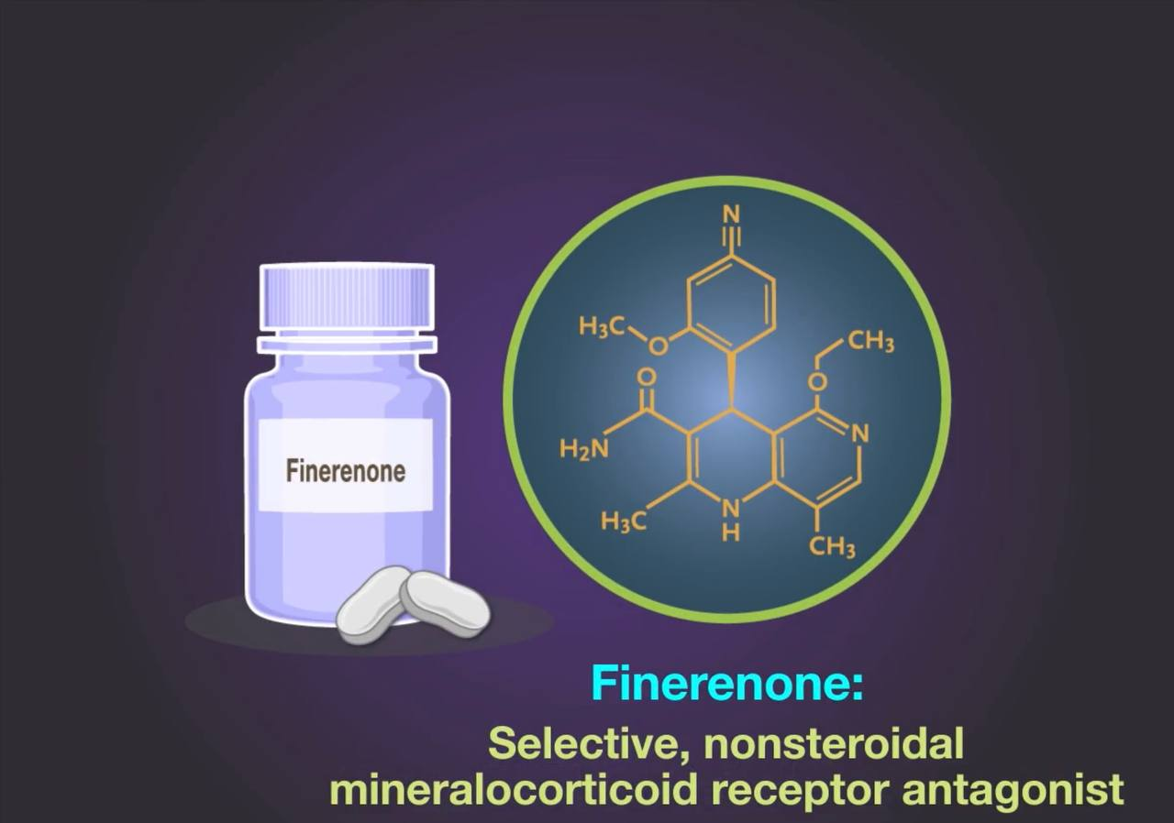
INTRODUCTION

Slide 5
INTRODUCTION
Finerenone, a nonsteroidal, selective mineralocorticoid receptor antagonist, had more potent anti-inflammatory and antifibrotic effects than steroidal mineralocorticoid receptor antagonists in preclinical models. Finerenone has been shown to reduce the urinary albumin-to-creatinine ratio in patients with CKD treated with an RAS blocker, while having smaller effects on serum potassium levels than spironolactone
CLINICAL TRIAL: The Finerenone in Reducing Kidney Failure and Disease Progression in Diabetic Kidney Disease (FIDELIO-DKD) trial

Slide 6
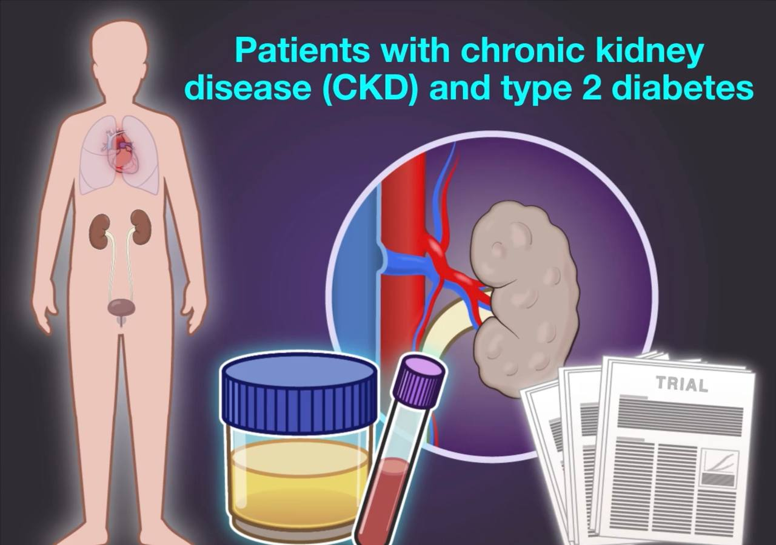
BACKGROUND
Finerenone reduced albuminuria in short term trials in patients with chronic kidney disease and type 2 diabetes but its long term effects on kidney and cardiovascular outcomes are unknown

Slide 7
Eligibility Criteria
Age ≥18 years with T2DM and CKD treated with an ACEI or ARB at the maximum dose
Urine ACR of 30-300 mg/g, eGFR of 25-60 ml/min/1.73 m² with Diabetic retinopathy
Urine ACR of 300-5000 mg/g. eGFR of 25-75 ml/min/1.73 m²
Patients with serum potassium level ≤4.8 mmol/L

Slide 8
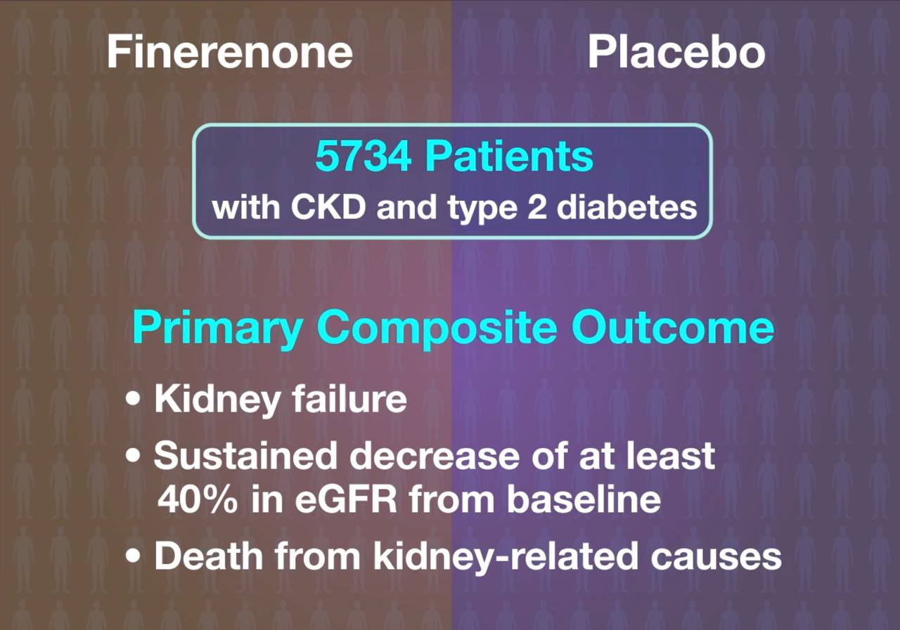

Slide 9
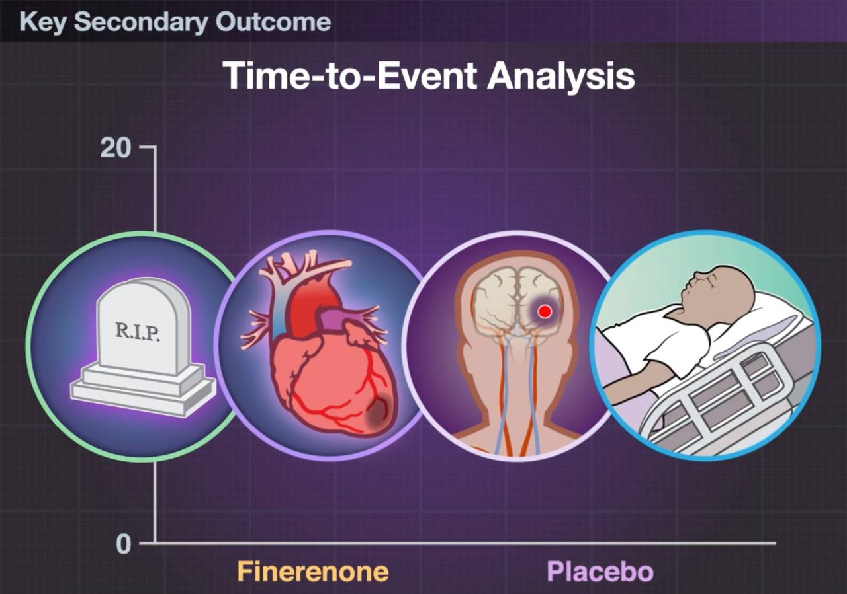
Death from cardiovascular causes
Non fatal myocardial infarction
Non fatal stroke
Hospitalization for heart failure

Slide 10
TRIAL PROCEDURES
Patients with an eGFR of 25 to less than 60 ml per minute per 1.73 m2 at the screening visit received an initial dose of 10 mg once daily
Patients with eGFR of >60 ml per minute per 1.73 m2 or more at the screening visit received an initial dose of 20 mg once daily
An increase in the dose from 10 to 20 mg once daily was encouraged after 1 month, provided the serum potassium level was 4.8 mmol per liter or less and the eGFR was stable
Decrease in the dose from 20 to 10 mg once daily was allowed any time after the initiation of finerenone or placebo
Finerenone or placebo was withheld if potassium concentrations exceeded 5.5 mmol per liter and restarted when potassium levels fell to 5.0 mmol per liter or less

Slide 11
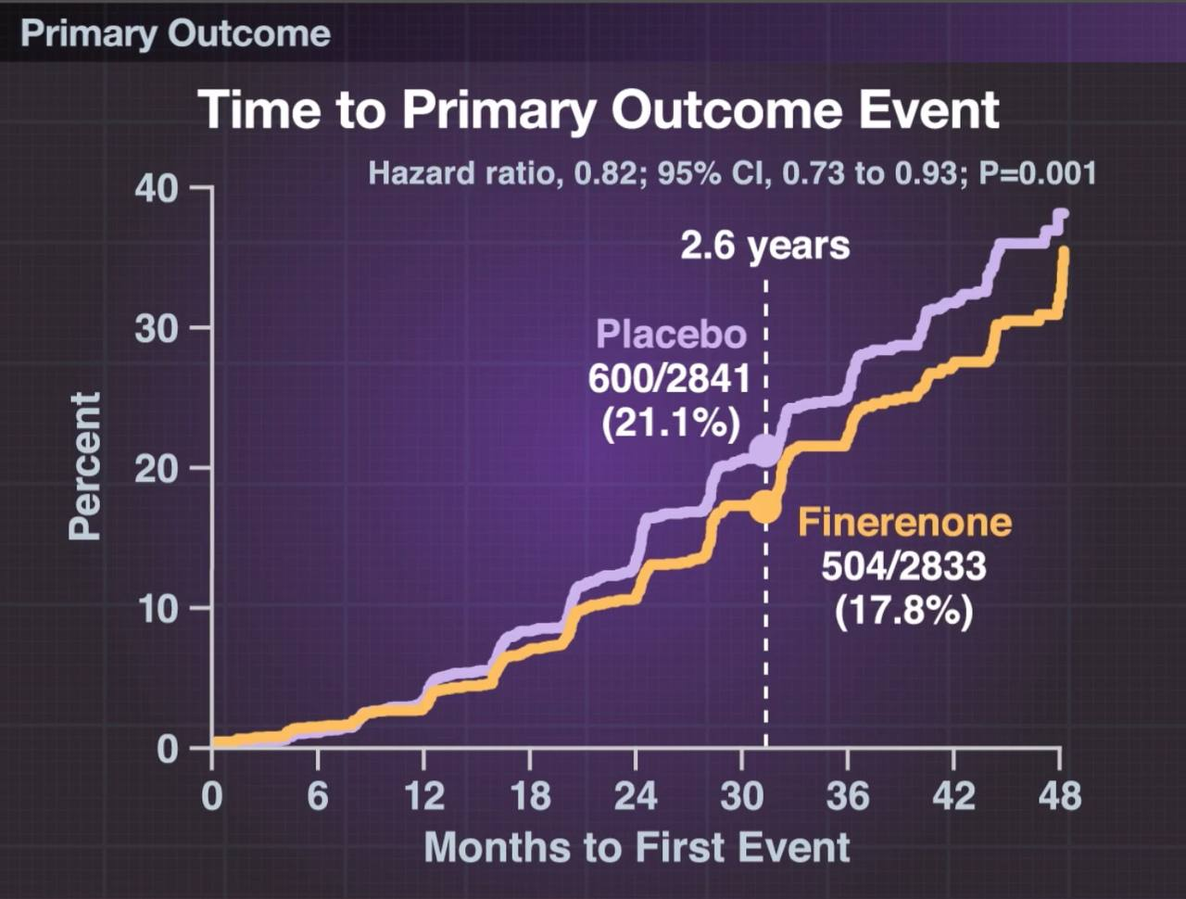

Slide 12
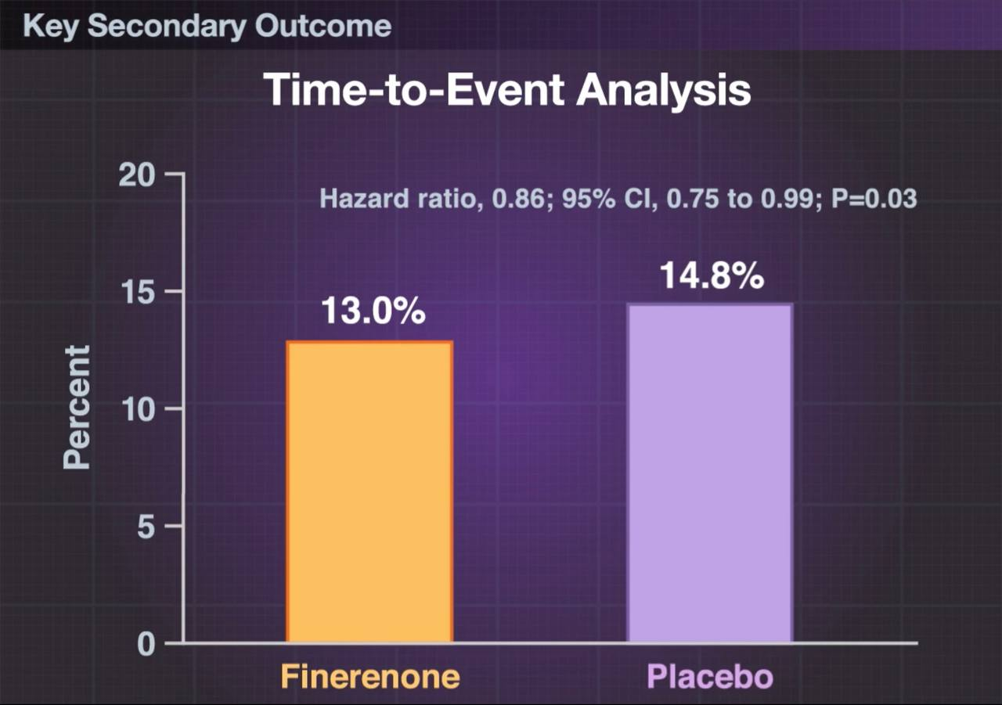

Slide 13
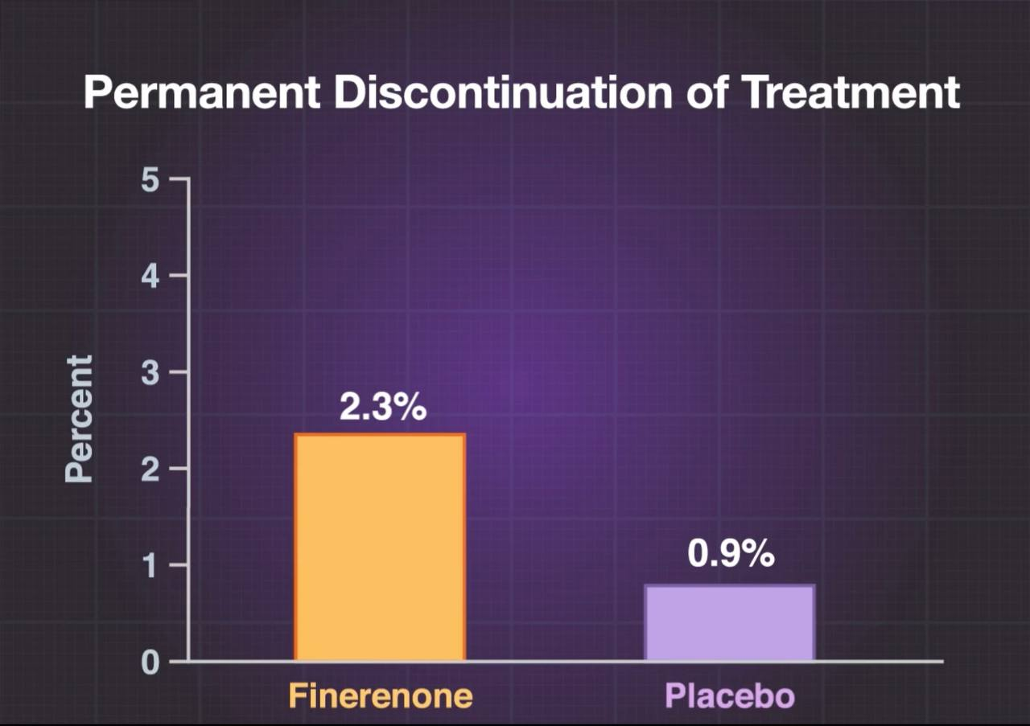

Slide 14
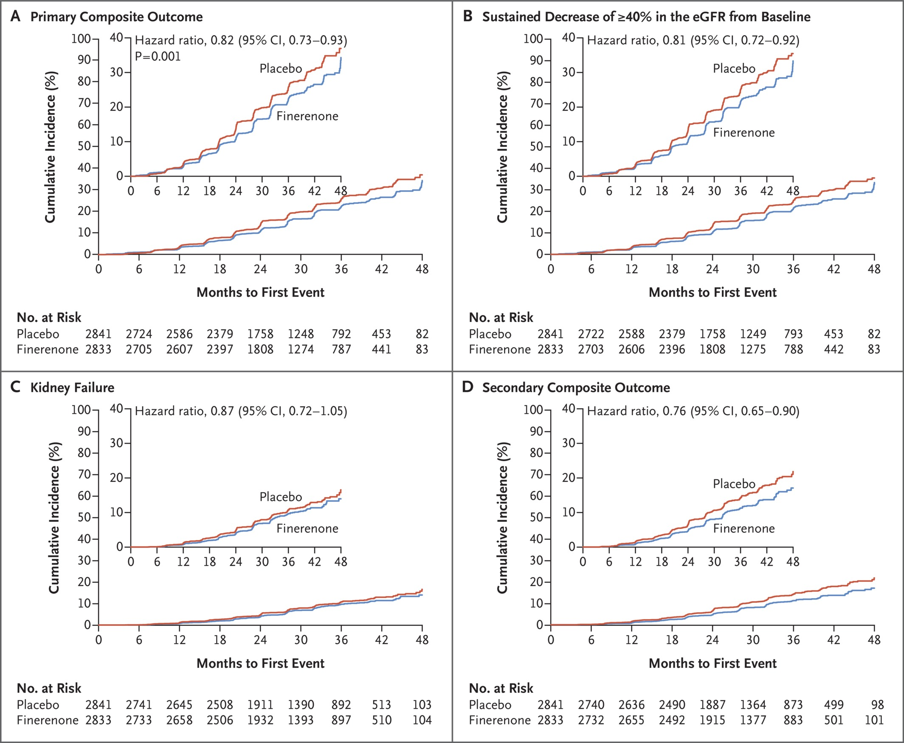
Kidney Outcomes.
Bakris GL et al. N Engl J Med 2020;383:2219-2229
Notes:
Figure 1 Kidney Outcomes. Outcomes were assessed in time-to-event analyses. Panel A shows the primary composite outcome of kidney failure, a sustained decrease of at least 40% in the estimated glomerular filtration rate (eGFR) from baseline, or death from renal causes in the finerenone and placebo groups. Panel B shows a sustained decrease of at least 40% in the eGFR from baseline maintained for at least 4 weeks (a component of the primary composite outcome). Panel C shows kidney failure (defined as end-stage kidney disease or a sustained eGFR of <15 ml per minute per 1.73 m² of body-surface area, confirmed by a second measurement ≥4 weeks after the initial measurement); end-stage kidney disease was defined as the initiation of long-term dialysis or kidney transplantation. Panel D shows the secondary composite kidney outcome of kidney failure, a sustained decrease of at least 57% in the eGFR from baseline (equivalent to a doubling of the serum creatinine level) maintained for at least 4 weeks, or death from renal causes. Insets show the same data on an enlarged y axis. CI denotes confidence interval.

Slide 15
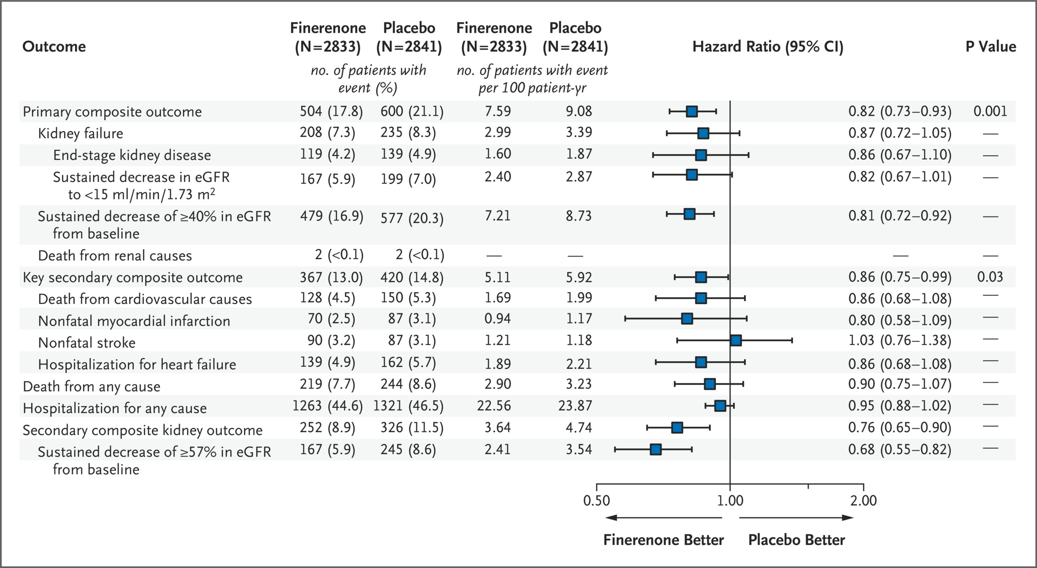
Efficacy Outcomes.
Bakris GL et al. N Engl J Med 2020;383:2219-2229
Notes:
Figure 2 Efficacy Outcomes. Shown are the hierarchical prespecified efficacy outcomes of the trial, including the components of the composite outcomes. Outcomes were assessed in time-to-event analyses. The key secondary outcome was a composite of death from cardiovascular causes, nonfatal myocardial infarction, nonfatal stroke, or hospitalization for heart failure.

Slide 16
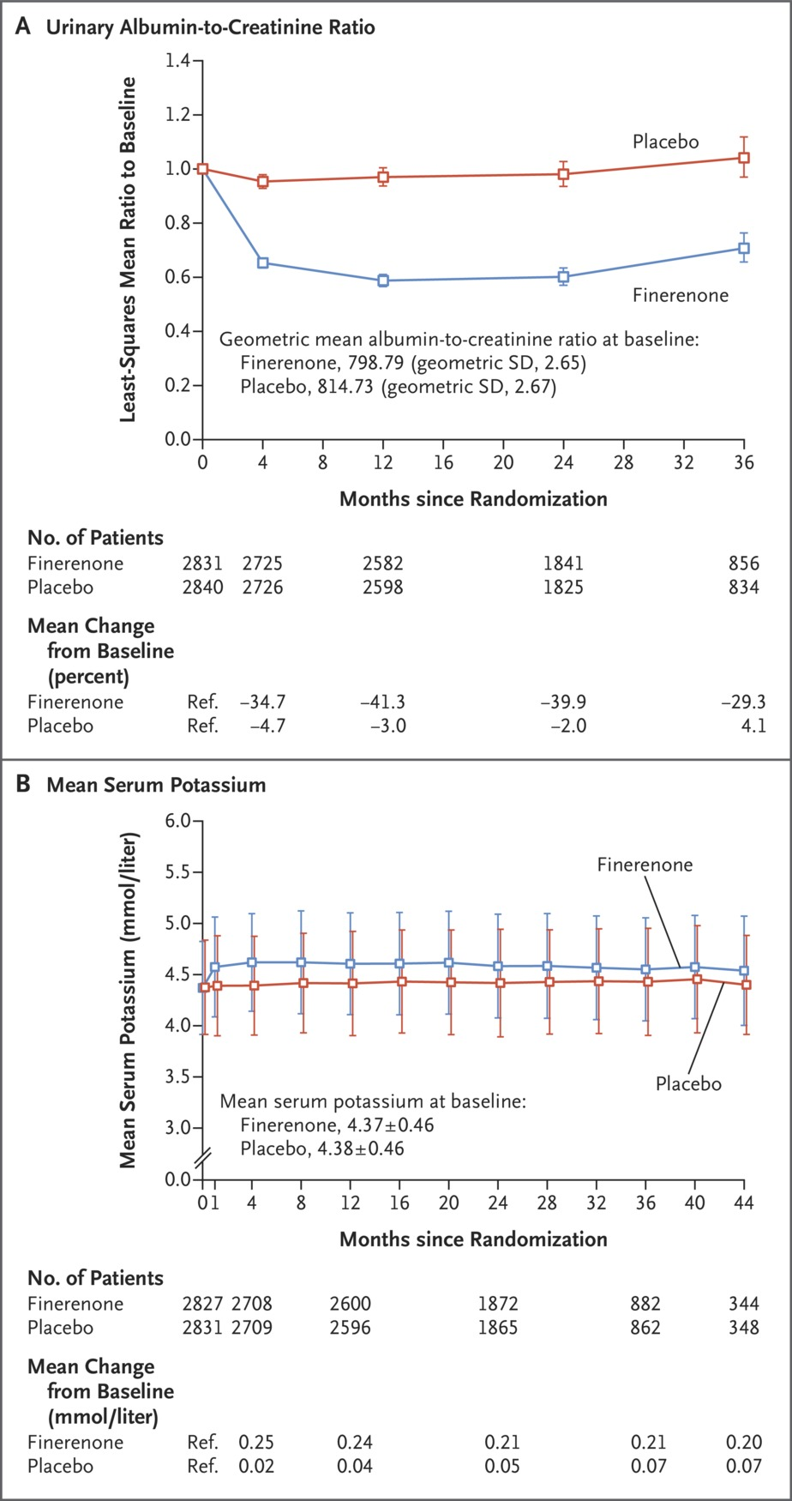
Effects on Albuminuria and Serum Potassium over Time.
Bakris GL et al. N Engl J Med 2020;383:2219-2229
Notes:
Figure 3 Effects on Albuminuria and Serum Potassium over Time. Panel A shows the effects of finerenone and placebo on the urinary albumin-to-creatinine ratio in the full analysis set. The urinary albumin-to-creatinine ratio was calculated with albumin measured in milligrams and creatinine measured in grams. Shown is the ratio of the urinary albumin-to-creatinine ratio at specific time points to the urinary albumin-to-creatinine ratio at baseline. Panel B shows the effects of finerenone and placebo on serum potassium levels in the safety analysis set. Plus–minus values are means ±SD. The 𝙸 bars indicate 95% confidence intervals.

Slide 17
RESULTS CONCERNED WITH HYPERKALEMIA
Overall hyperkalemia-related adverse events were twice as frequent with finerenone as with placebo (18.3% and 9.0%, respectively), and the frequency of hyperkalemia leading to discontinuation of the trial regimen was also higher with finerenone (2.3% and 0.9% in the respective groups)
No fatal hyperkalemia adverse events were reported
Finerenone has been shown to be having smaller effects on serum potassium levels than spironolactone

Slide 18
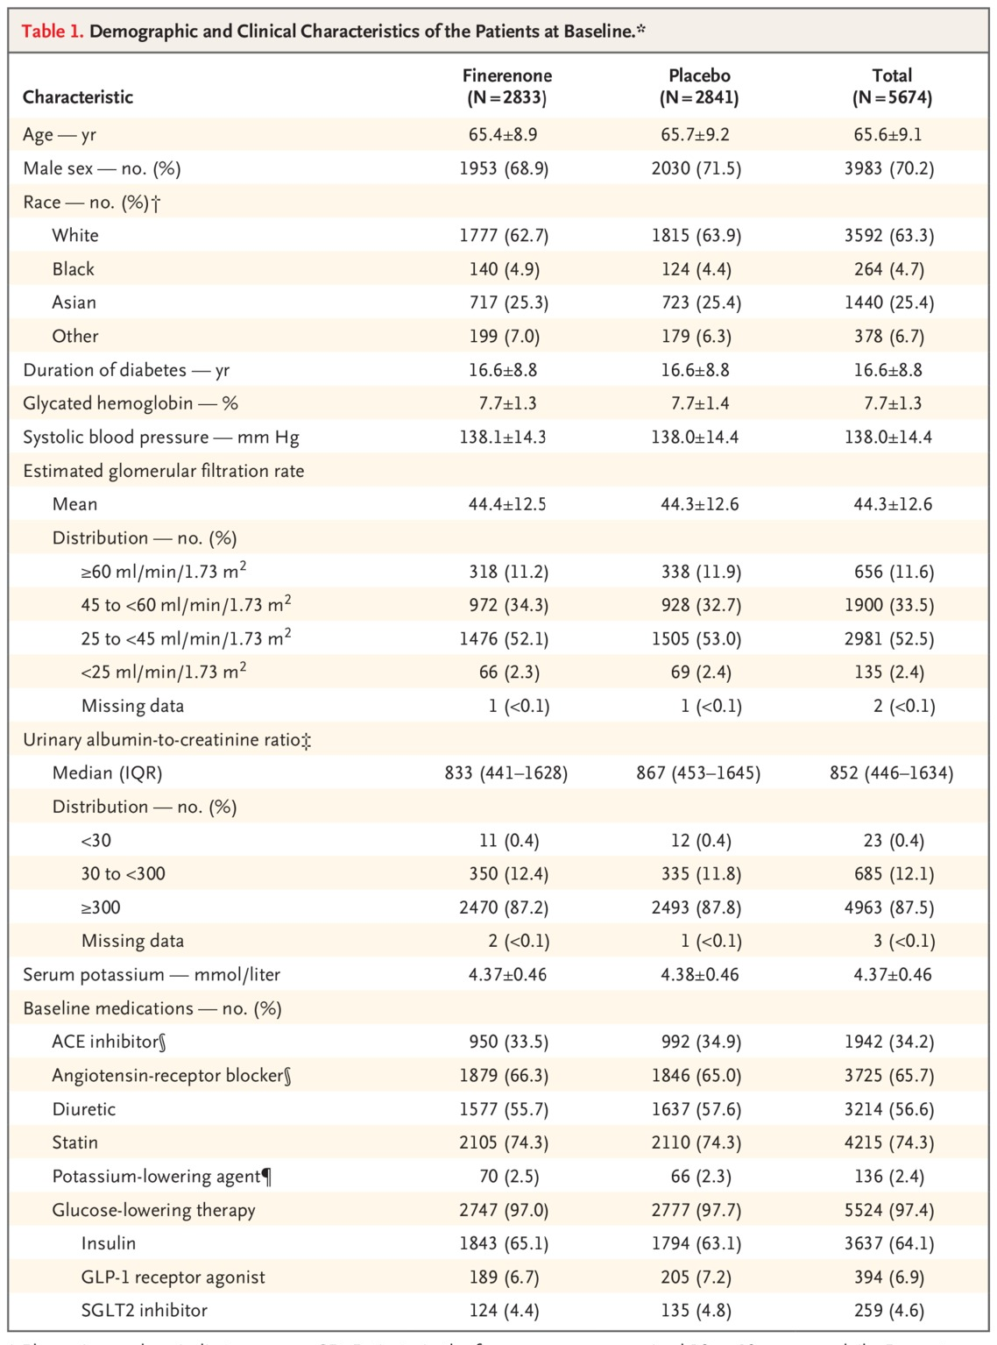
Demographic and Clinical Characteristics of the Patients at Baseline.
Notes:
Table 1 Demographic and Clinical Characteristics of the Patients at Baseline.

Slide 19
DISCUSSION
Previous kidney-outcome trials that involved patients with CKD and type 2 diabetes targeting dual RAS blockade have shown a lack of efficacy and increased risk (including increased incidences of acute kidney injury, hypotension, and hyperkalemia); such adverse events may be due to the inhibition of two proximal targets in the RAS cascade. In our trial, which combined a single RAS blocker with a drug, finerenone, targeting the mineralocorticoid receptor, patients in the finerenone and placebo groups had a similar risk of acute kidney injury–related adverse events
Although finerenone was associated with a higher overall risk of hyperkalemia than placebo, discontinuation of the trial regimen due to hyperkalemia was infrequent in patients who received finerenone (2.3%) and markedly lower than in trials of dual RAS blockade (4.8% with combination therapy with a direct renin inhibitor and an ACE inhibitor or ARB20 and 9.2% with dual ACE inhibitor and ARB therapy)

Slide 20
Conclusions
In patients with CKD and type 2 diabetes, treatment with finerenone resulted in lower risks of CKD progression and cardiovascular events than placebo.

Slide 21
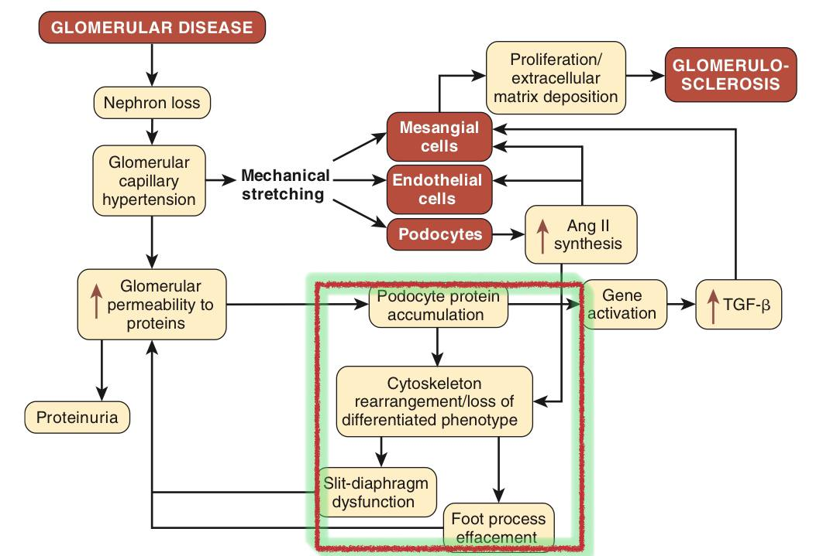

Slide 22
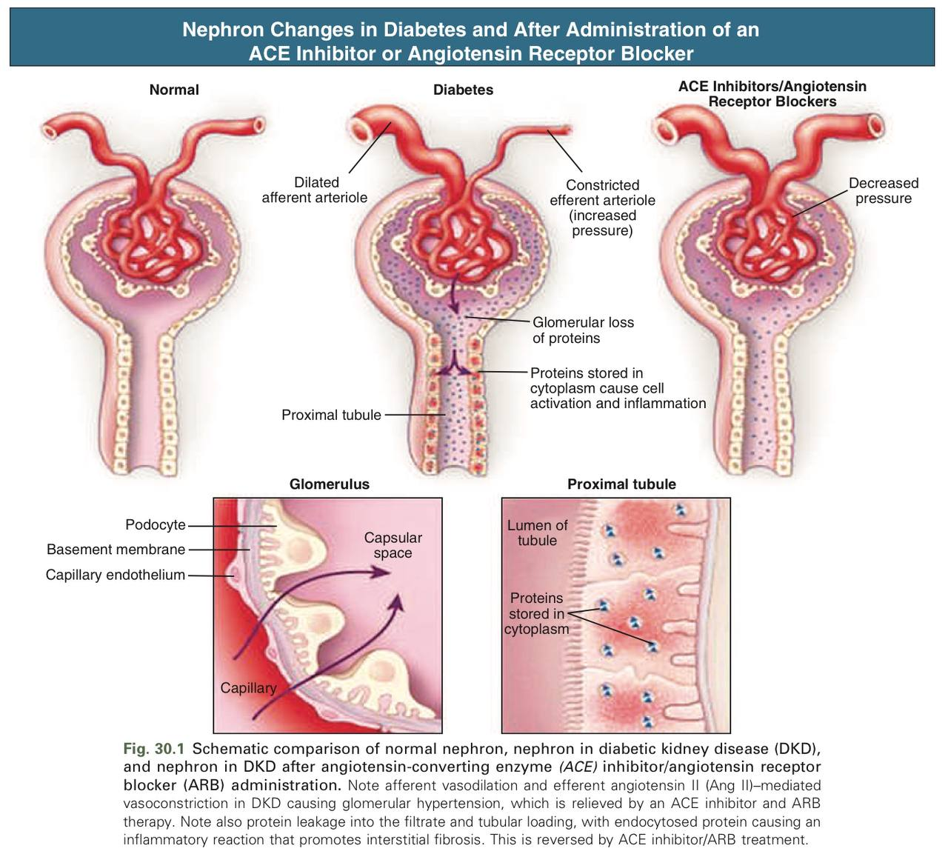

Slide 23
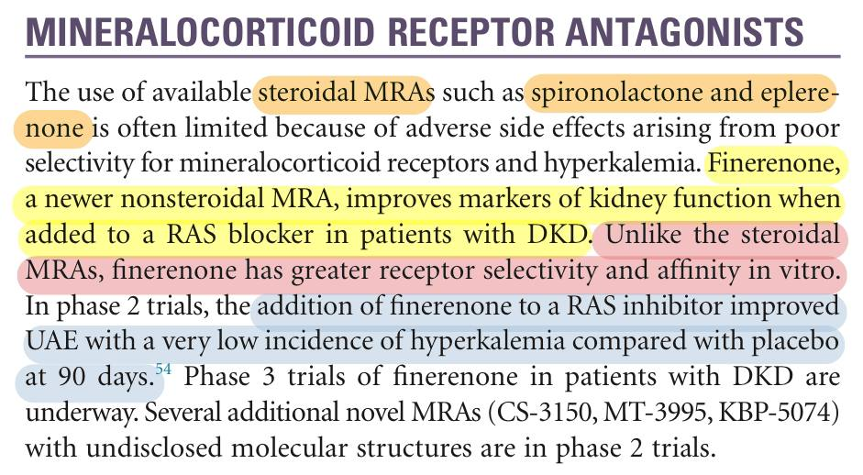

Slide 24
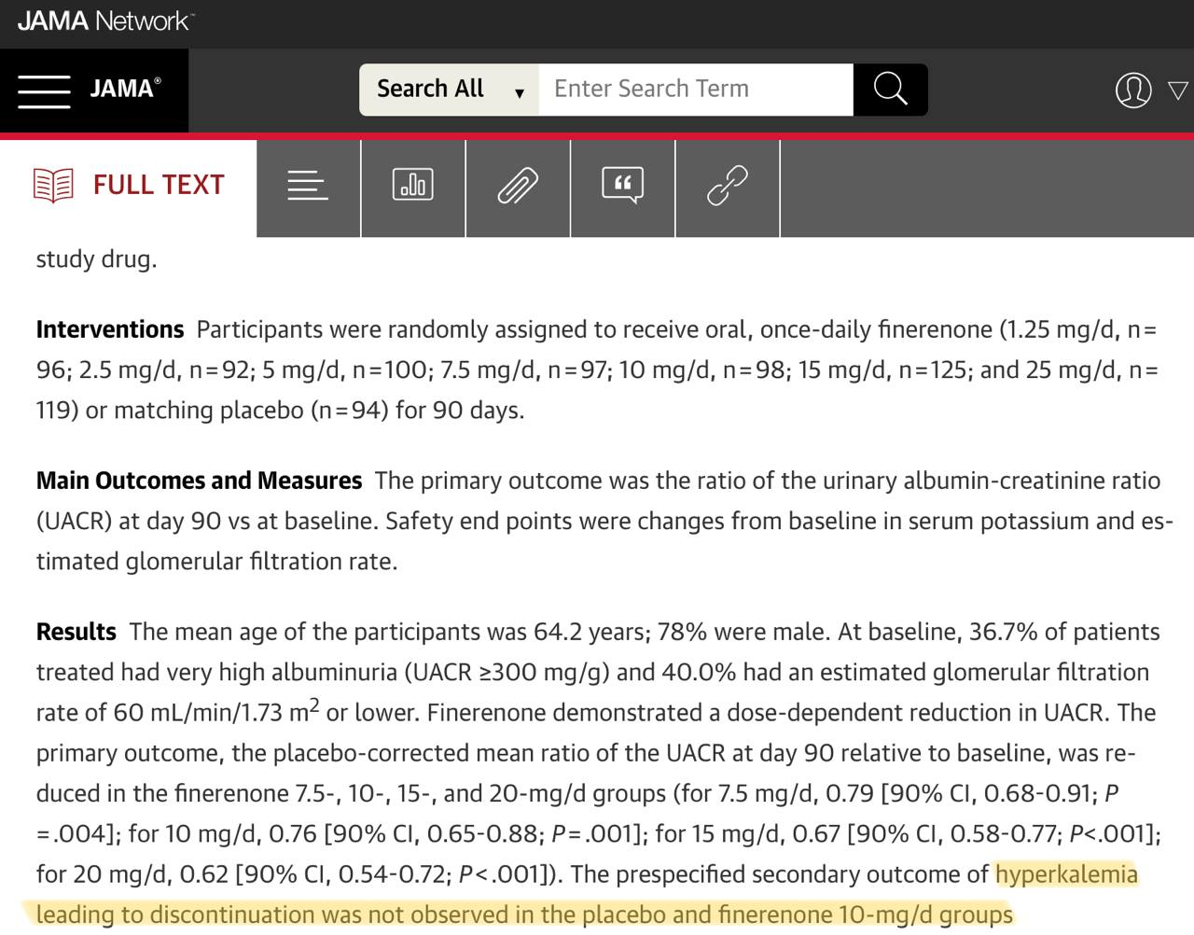

Slide 25
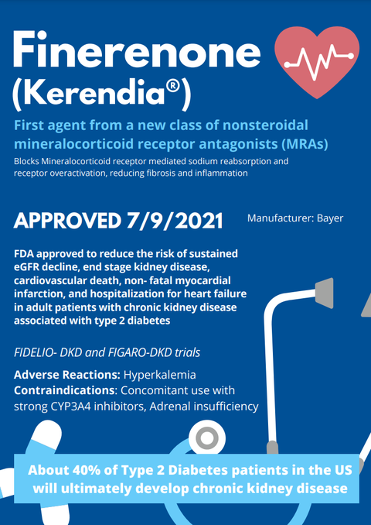
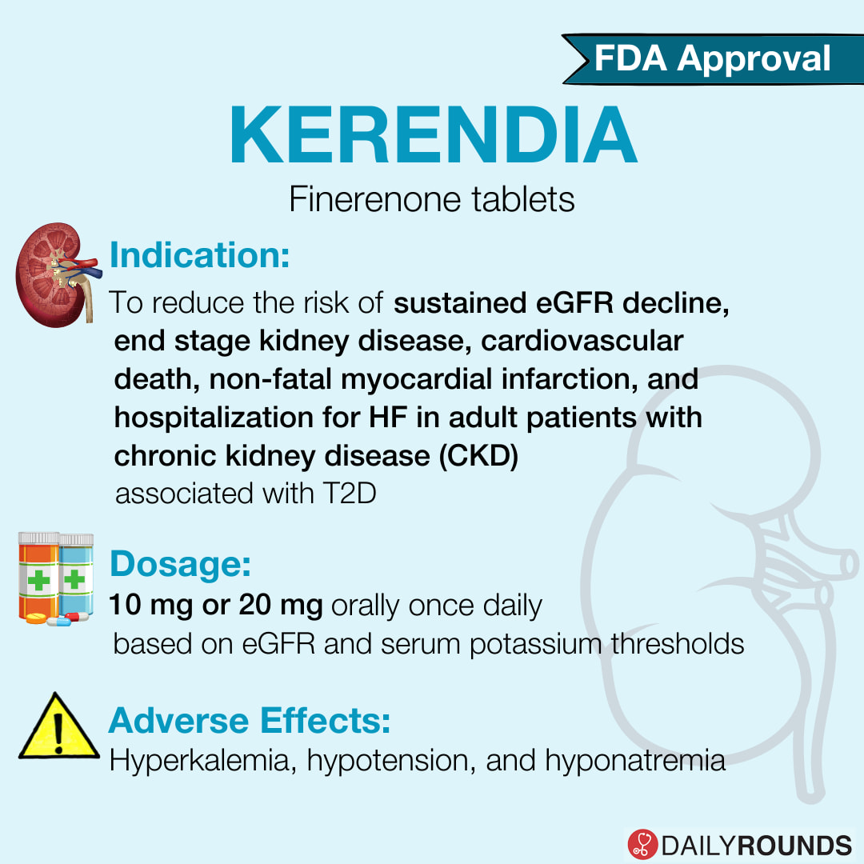

Slide 26
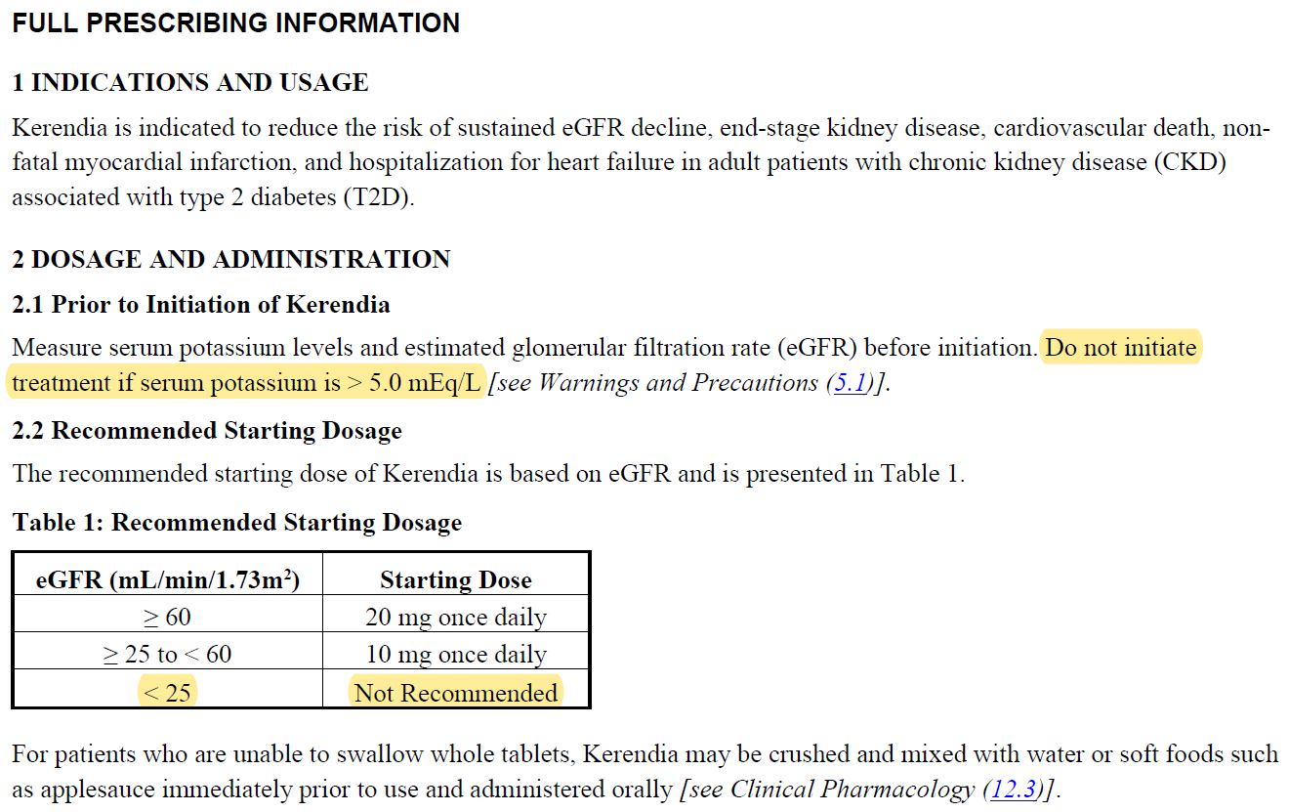
INFORMATION FROM FDA

Slide 27


