Slide 1
Compressive myelopathy - Extradural
Dr Shifa C
JR3

Slide 2
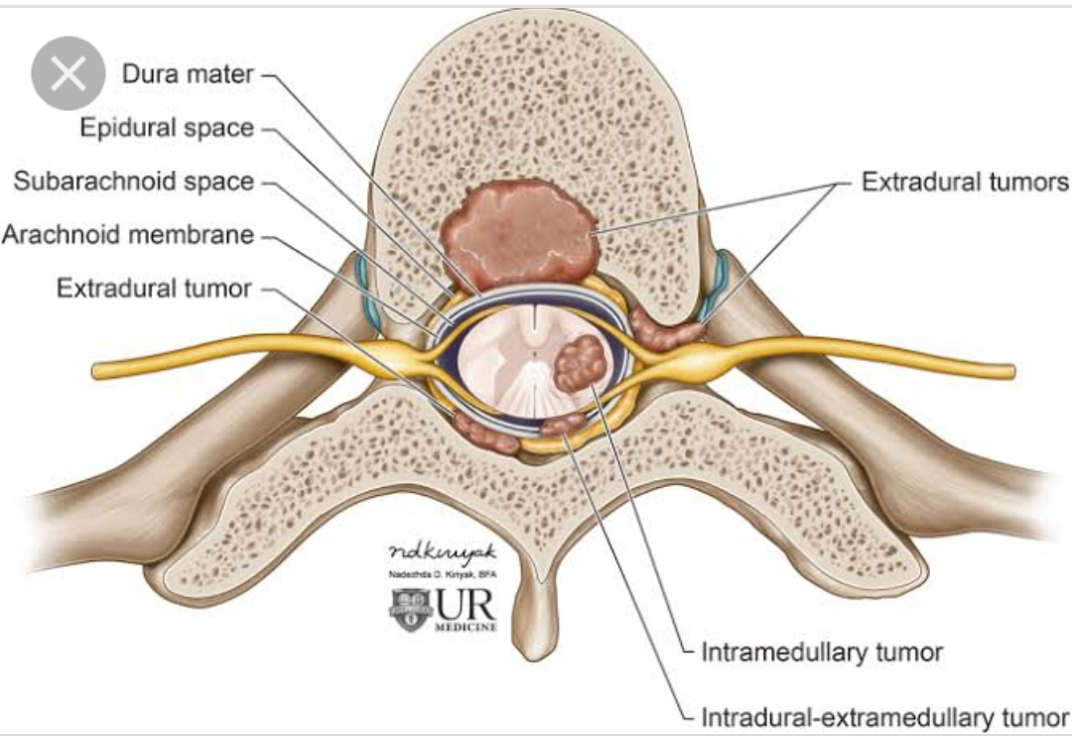
Anatomy

Slide 3
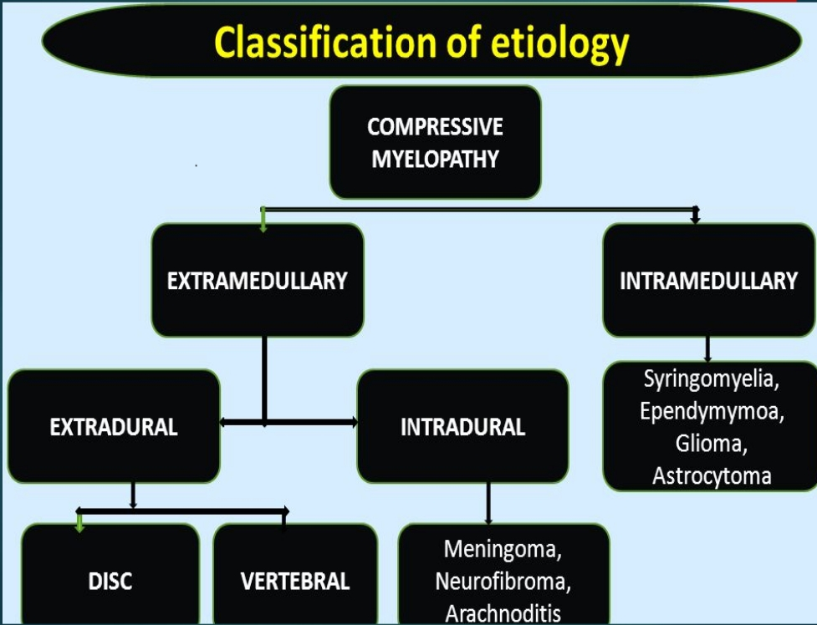

Slide 4
Compressive v/s non-compressive
 | COMPRESSIVE | NONCOMPRESSIVE
Bony deformity | + | -
Bony tenderness | + | -
Girdle like sensation | + | -
Upper level of sensory loss | + | -
Zone of hyperesthesia | + | -
Root pain | + | -
Onset and progress | Gradual | Acute
Symmetry | Asymmetrical | Majority symmetrical
Flexor spasm | Common | Absent
Pattern of deficit | Elsberg phenomenon | Bilaterally symmetrical
Bladder and bowel involvement | Early | Late
Example | TB spine | Acute transverse myelitis

Slide 5
EXTRAMEDULLARY |  | INTRAMEDULLARY
EXTRADURAL | INTRADURAL
Spondylosis | Tumours: Neurofibroma,Meningioma, Lipoma,Sarcoma | Syrinx
Disc prolapse | Metastasis | Tumors : Ependymoma, Astrocytoma, Hemangioblastoma, Hematomyelia
Trauma | Arachnoiditis
Tumour: Metastasis, Multiple myeloma | AV malformation
CVJ anomalies | Leukemic infiltration
Fluorosis | Arachnoid cyst
TB spine | Sarcoidosis
Epidural abscess
Epidural Hematoma

Slide 6
 | EXTRADURAL | INTRADURAL
Mode of onset | Symmetrical | Asymmetrical
Root pain | Less common | More common
Spinal tenderness | Common | Uncommon
Spinal deformity | Present | Absent

Slide 7
Etiology –Extramedullary extradural compressive myelopathy
Degenerative -spondylosis
Congenital –CVJ anomalies
Infections –epidural abscess, Pott spine
Vascular –epidural hematoma
Tumors – metastasis, multiple myeloma
Trauma

Slide 8
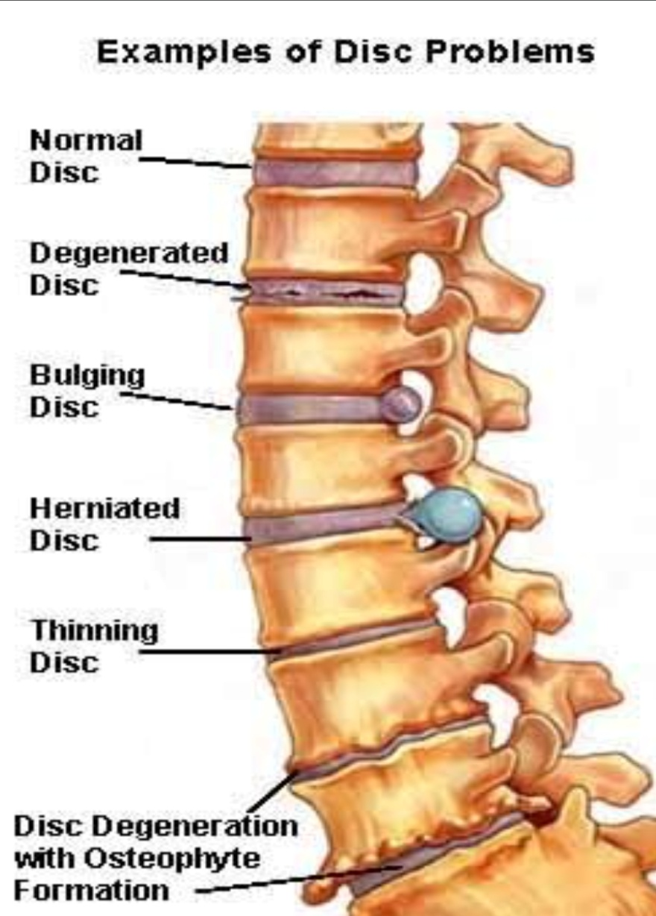
1.DEGENERATIVE
Spondylosis
Age related degenerative changes of the spine.
Starts with desiccation of the intervertebral discs.
Bulging/ herniation of disc material
Osteophyte formation along the vertebral endplates.
Ossification & hypertrophy of the PLL & ligamenta flava

Slide 9
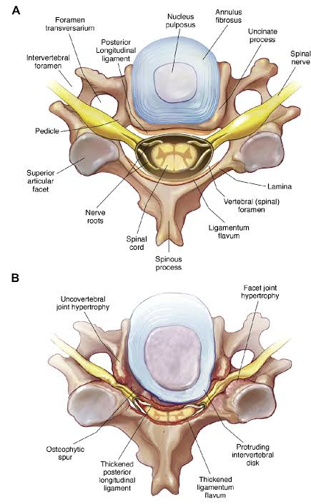

Slide 10
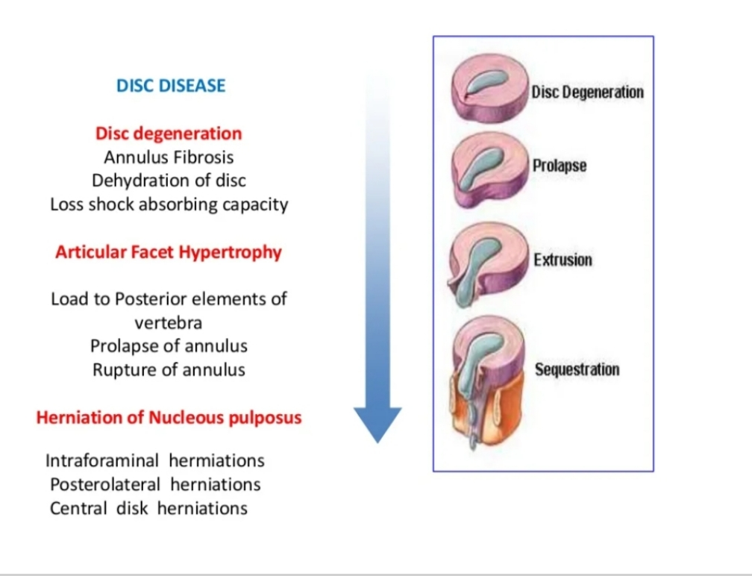
Results in spinal canal stenosis
-with or without degenerative facet joints
-with or without formation of osteophytes.
-with or without a herniated disc

Slide 11
Mechanism of myelopathy
Narrowing of central canal- stenosis.
-Mechanical compression of neural elements.
-spinal cord ischemia due to compression of the vasculature.
Neck movements – exacerbates compression
- canal diameter decreases by 2-3 mm in flexion
- extension can cause inward buckling of ligamentum flavum.

Slide 12
Clinical features
A myeloradiculopathy
At the level of compression – injury to AHC –LMN deficits.
Weakness in arms/legs/both
Sensory loss with a sensory level.
Urinary & rectal sphincter dysfunction.

Slide 13
Cervical spondylosis
Pain – neck, subscapular region, shoulder, often radiating to arms
Numbness /paraesthesia along the arms (can follow a dermatomal pattern)

Slide 14
Gait disturbance (spastic,scissoring)
Sensory deficits in lower limbs – reduced joint position & vibration (dorsal column function) , loss of pain sensation
UMN weakness in lower limbs ( exaggerated DTR, tone & Babinski)
LMN findings at the level of lesion in a myotomal distribution . In cervical spondylosis –C5C7
Bladder dysfunction – urgency, frequency, and/or retention.

Slide 15
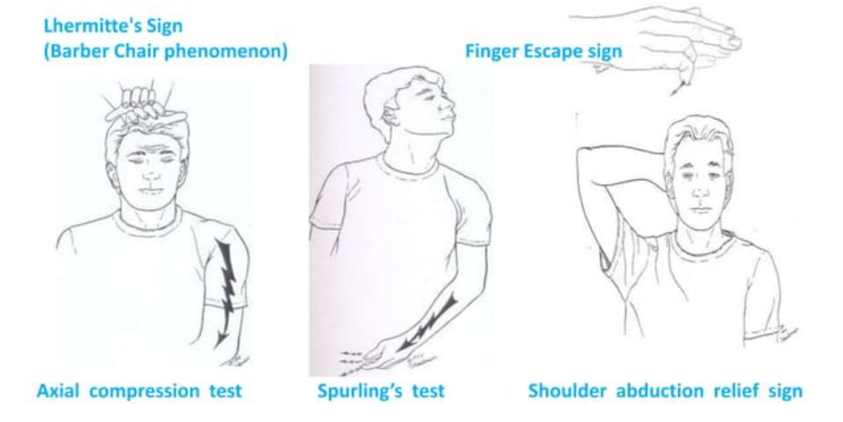

Slide 16
Lumbar spondlosis
L4-L5 common site
Sciatic pain
S1component – posterolateral calf & heel
L5 component – anterolateral aspect of leg & ankle.
Femoral pain –L2-L3 –to front of thigh

Slide 17
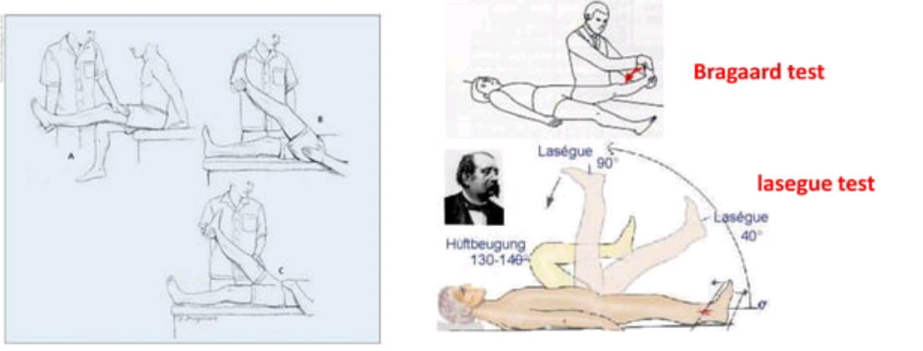

Slide 18
Investigations - MRI

Slide 19
MANAGEMENT
NON-SURGICAL MANAGEMENT
Cervical immobilisation (soft collar/brace)
Restriction of high-risk activities(slippery surfaces, heavy lifting, action sports)
Pain control – NSAIDS andother analgesics, anti-depressants.
SURGICAL DECOMPRESSION

Slide 20
2. Congenital / developmental
Cranio-vertebral junction anomalies- congenital malformations – skeletal
Malformations of occipital bone – basilar invagination, remnants around foramen magnum, clivus segmentations
Malformations of Atlas – Failure of atlas segmentation from occiput, atlantoaccial fusion
Malformations of axis –
atlantoaxial segmentation failure
Segmentation failure of C2 – C3
Dens dysplasia- os odontoideum, odontoid hypoplasia/aplasia

Slide 21
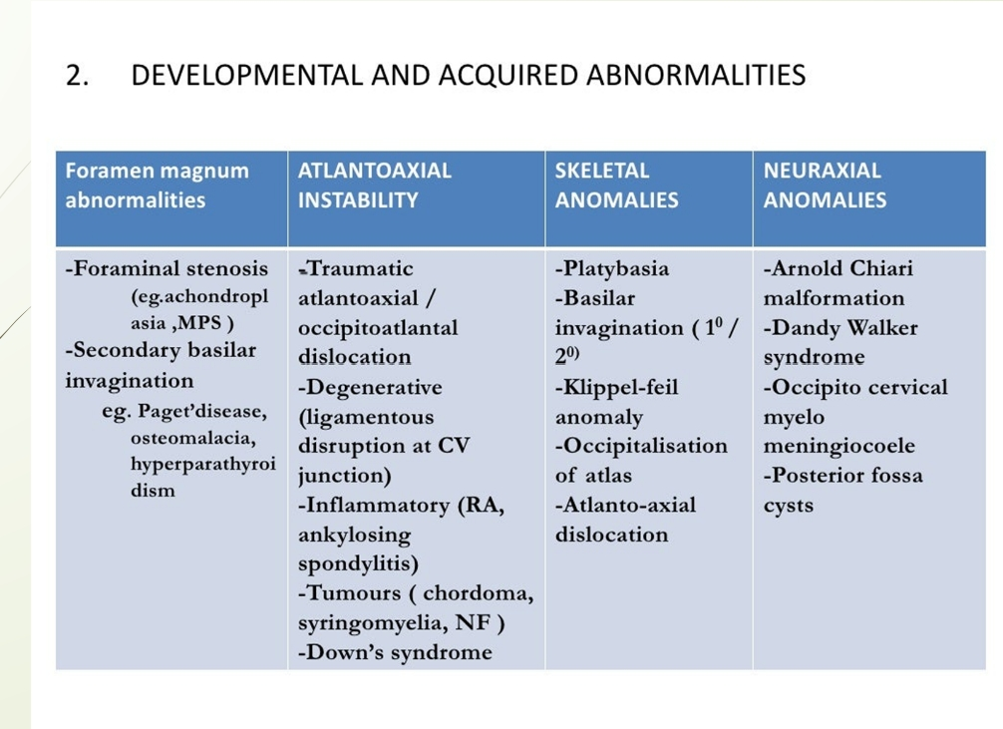

Slide 22
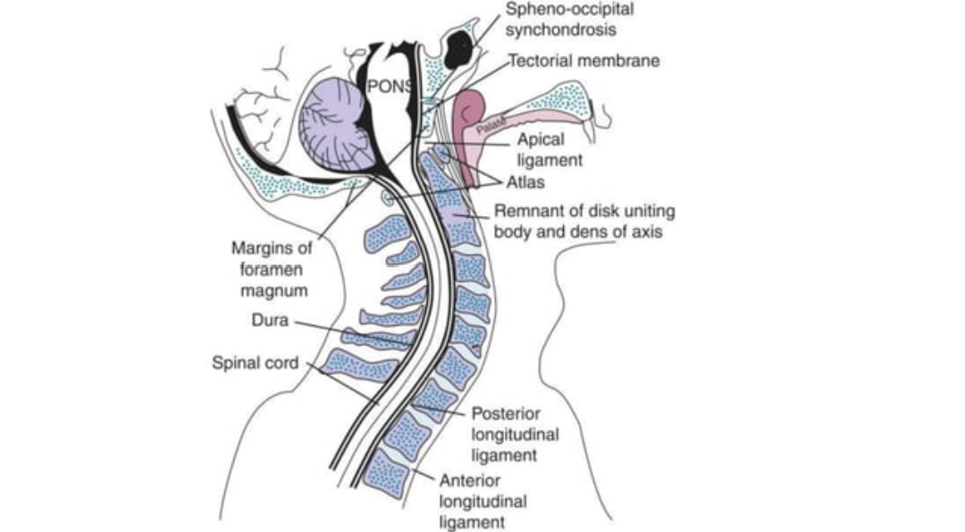
Cranio vertebral junction anomalies
The transition site between mobile cranium and the relatively rigid spinal column.
The site of medullo- spinal junction.
Parts of CV Junction:
The occiput
C1 ( Atlas)
C2 (Axis)
Their articulations
Connecting ligaments

Slide 23
Neural structures in relation to CVJ
The medulla
Cerebellum ( the tonsils, biventral lobules, lower part of the vermis)
4th ventricle
Rostral part of spinal cord
Lower cranial and upper cervical nerves

Slide 24
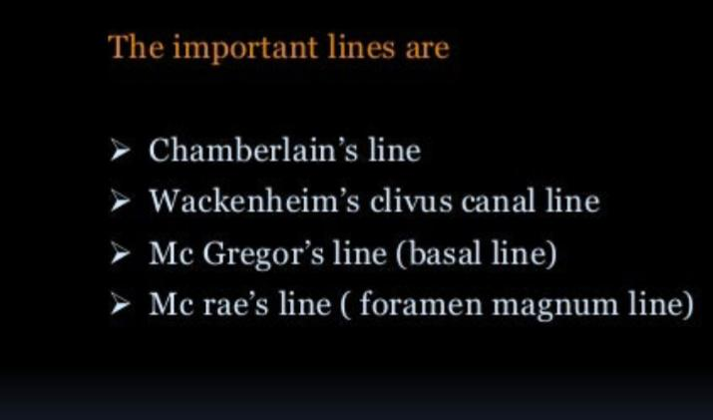
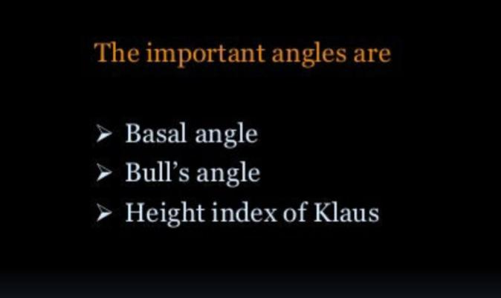
Craniometry

Slide 25
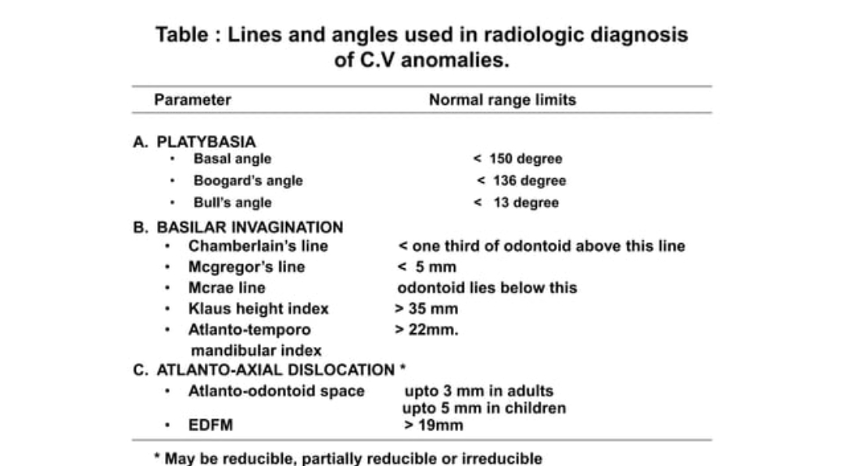

Slide 26
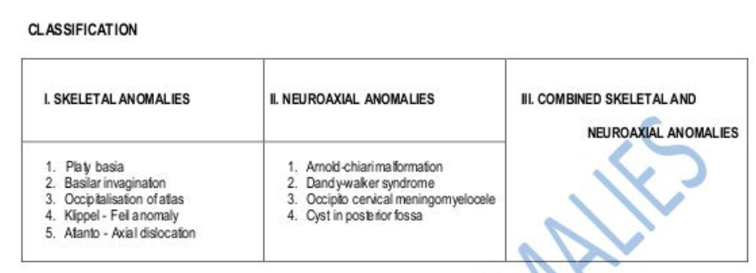

Slide 27
Clinical features
Short neck, low hairline, restricted neck movements
Transient attacks of vertebro-basular insufficiency ( A-A dislocation)
Myelopathic features – long tract involvement & wasting
Lower CN involvement –IX,X,XI,XII and rarely VII,VIII
Cerebellar symptoms & signs
Features of raised iCT ( in Basilar invagination, Arnorld Chiari)

Slide 28
Klippel Feil Syndrome
Congenital fusion of cervical vertebrae
Feil’s Triad
Low posterior hairline
Short neck
Limitation of head and neck movements

Slide 29
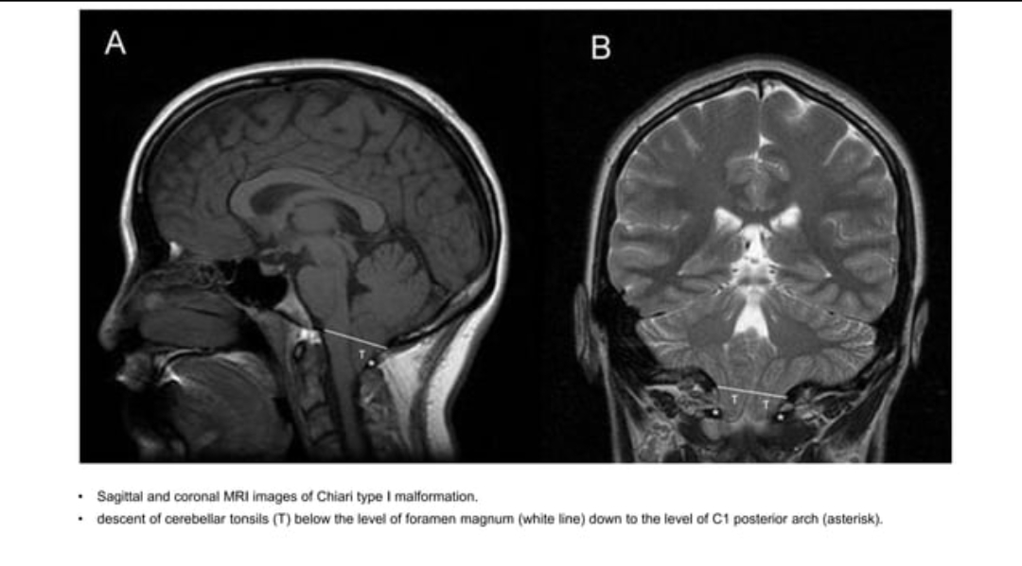
Chiari malformation
Chiari I: >5mm descent of the caudal tip of cerebellar tonsils past the foramen magnum.
Chiari II: brainstem, fourth ventricle, and >5 mm tonsillar herniation with spina bifida.

Slide 30
Chiari type I malformation is the most common and the least severe of the spectrum, often diagnosed in adulthood
Chiari III: herniation of the cerebellum with or without the brainstem through a posterior encephalocele.
Chiari IV: Cerebellar hypoplasia or aplasia with normal posterior fossa and no hindbrain herniation.

Slide 31
3.Infections
1.Epidural abscess
2.Pott spine

Slide 32
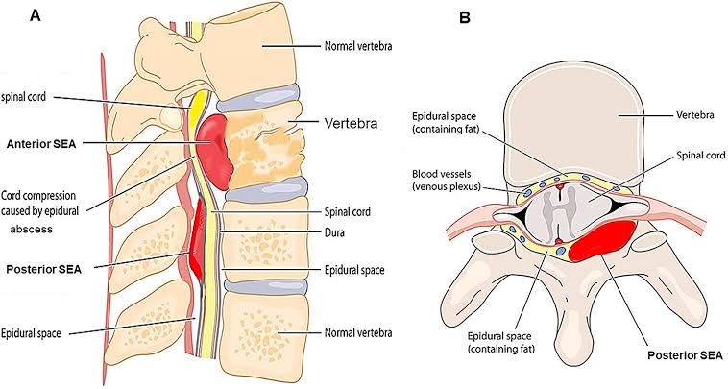
Epidural abscess
Fever, midline vertebral pain, progressive limb weakness
2/3 – haematogenous
1/3-from local infection

Slide 33
Management
Mycobacterium
S. Aureus – 63 %
Gram-negative bacilli – 16 %
Streptococci – 9 %
Coagulase-negative staphylococci – 3 % (h/o prior spinal instrumentation)
Anaerobes – 2%
Surgical decompression ,& drainage for most patients.
Vancomycin plus cetriaxone/cefotaxime
Ceftazidime, cefepime or Meropenem when Psuedomonas is suspected ( ICU, invasive device, bedridden, post Surgery, DM)

Slide 34
Management
Mycobacterium
S. Aureus – 63 %
Gram-negative bacilli – 16 %
Streptococci – 9 %
Coagulase-negative staphylococci – 3 % (h/o prior spinal instrumentation)
Anaerobes – 2%
Surgical decompression ,& drainage for most patients.
Vancomycin plus cetriaxone/cefotaxime
Ceftazidime, cefepime or Meropenem when Psuedomonas is suspected ( ICU, invasive device, bedridden, post Surgery, DM)

Slide 35
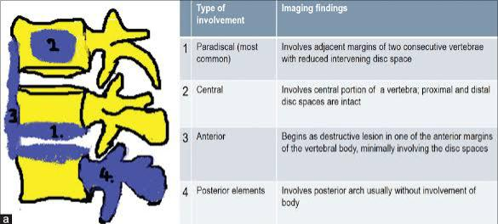
Pott Disease / tuberculous Spondylitis
Commonly lower thoracic & upper lumbar
Back pain- bone pain/ radicular
Fever, weight loss
50% neurological involvement
Paraplegia
Sensory symptoms
Root pain
Cauda equina

Slide 36
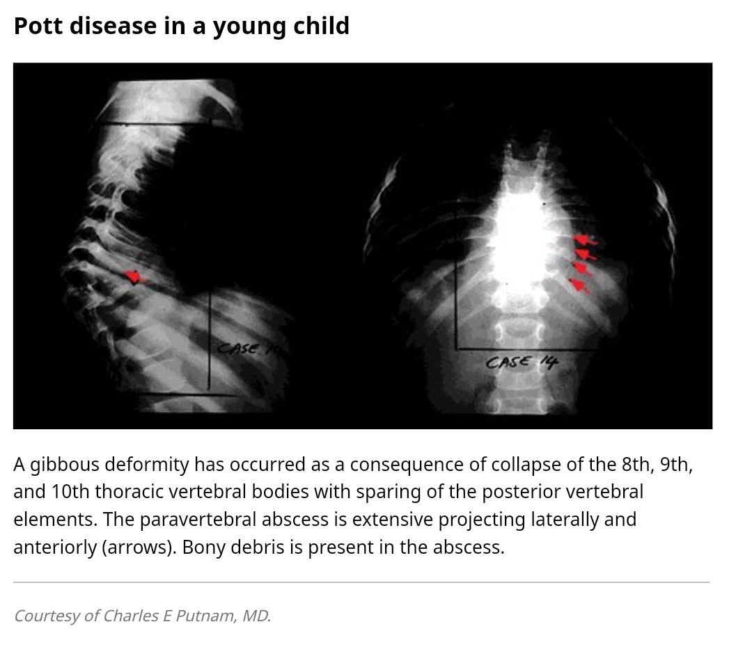

Slide 37
TB spine with paraplegia
Dorsal spine – more commonly involved
Motor > Sensory (Joint position & vibration last to be lost.)
Pathogenesis
Inflammatory edema
Extradural mass – tuberculous osteitis, cold abscess
Bony disorder – sequestra, internal gibbus
Meningeal changes – dura not involved – extradural granulation – cicatrisation- peridural fibrosis, paraplegia.
Spinal cord infarction – ASA endarteritis, periarteritis, thrombosis.
Myelomalacial, syringomyelic changes

Slide 39
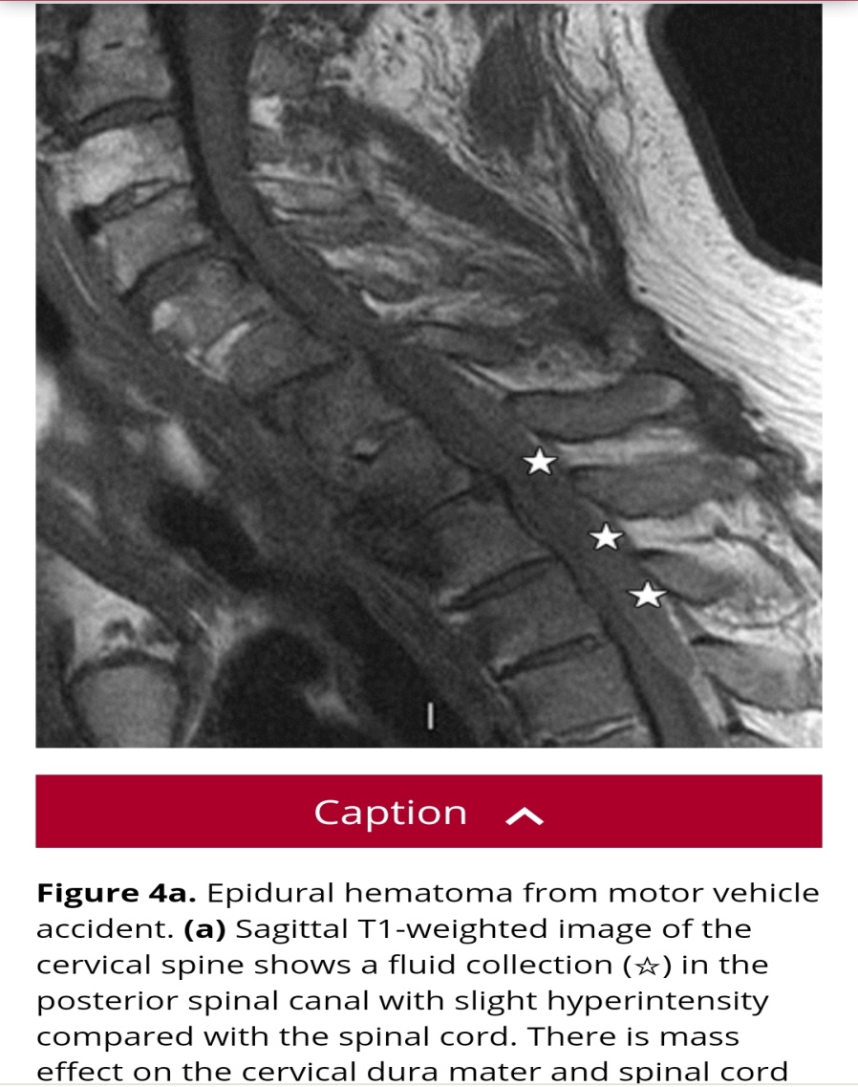
4.Vascular lesions
Epidural Hematoma
can occur throughout the spine but are most common in the cervicothoracic region, usually posterior to the thecal sac over 2-4 vertebral levels

Slide 40
Etiology
Spontaneous: most common ( a bleeding disorder or over-anticoagulation)
trauma, e.g. Vertebral fracture
iatrogenic, e.g. Lumbar puncture, epidural anesthesia
spinal arteriovenous malformations or other vascular anomalies
spinal tumors
pregnancy

Slide 41
5. Tumors – metastasis, multiple myeloma
6.Trauma

Slide 43
Symptoms
Pain -Occurs early. Localised over the spine or in a root distribution.
Aggravated by coughing, sneezing or straining.
Sensory: Occurs early. Paraesthesia, numbness spreading proximally to a level on trunk
Motor- Occurs late. Weakness, heaviness or stiffness of the limbs.
Sphincters -Urgency or hesitancy and retention of urine

Slide 44
Above C5 Life threatening
-UMN signs and sensory loss in all four limbs
-Diaphragmatic weaknes
C4-C5 level - Quadriplegia with preserved respiratory function
C5-T1 level: LMN signs and segmental sensory loss in the arms:UMN signs in the legs
Thoracic cord: Spastic paraplegia with sensory level on the trunk
- Sacral sensory loss and extensor plantar responses

Slide 45
Lumbar cord and cauda equina
L1-L2 Absent cremasteric reflex
L2-L4 Weak hip adduction ,knee extension and patellar reflex
L5-S1 Paralyses movements at ankle and foot ,hip extension and absent ankle jerk

Slide 46
 | CAUDA EQUINA SYNDROME | CONUS MEDULLARIS
Onset | Gradual and unilateral | Sudden and bilateral
Root pain | Severe | Less severe
Low back pain | More | Less
Sensory loss | May be Asymmetrical and unilateral | Saddle anaesthesia Bilateral and symmetrical
Motor involvement | Asymmetric areflexic limb weakness | No marked muscle changes
Fasciculation | Common | Rare
Reflexes | Knee and ankle lost | Usually preserved
Bowel and bladder | Urinary retention .Late and less marked | Early. Overflow urinary and fecal incontinence
Impotence | Less frequent | Frequent

Slide 47
Management
Glucocorticoids: reduce cord edema
Benign tumours :excised surgically
Extradural compression due to malignancy : Radiotherapy ,if started within 24hrs of onset of symptom weakness
TB: surgical treatment and antituberculous chemotherapy
Traumatic lesions: Laminectomy or vertebral body resection
Epidural abscess: Decompression laminectomy with debridement and long term antibiotic treatment
Vancomycin 15-20mg/kg q12h, ceftriaxone 2gm q24h and when indicated metronidazole 30mg/kg/day x 6-8wks

Slide 48
Rehabilitation
Bladder Dysfunction
Anticholinergics: Oxybutybnin 2.5-5mg qid
Alpha blockers: Terazosin 1-2mg tid/qid
Intermittent catheterization
Artificial bladder
Prophylaxis for venous thromboembolism
Management of decubitus ulcers
Physiotherapy

Slide 49
Thank you

