Slide 1
EXAMINATIONOF CEREBELLAR SIGNS
Dr Ibrahim Ali Saleem
JR, General Medicine

Slide 2
Clinical tests to detect dyssynergia, decompositionof movement, dysmetria.
"Cerebellar ataxia".
Notes:
Cerebellar ataxia is the combination of incoordination, awkwardness,errors in the speed, range and force of movement, along with dysdiadochokinesia, and intention tremor

Slide 3
Equilibratory coordination
Refers to the maintenance of balance and the coordination of the body.
In Cerebellar lesions,
Truncal ataxia
Reeling, wide based gait

Slide 4
Lesion in mid cerebellum- movements in all directions
Lateral cerebellum- staggering or falling towards side of lesion
Steadied by standing or walking on a wide base
Stance - ataxia from cerebellar disease - when pt stands on broad base (feet wide apart)

Slide 5
Nonequillibratory coordination
Tests of coordination
Handedness needs consideration

Slide 6

The finger to nose test

Slide 7
Finger chase test -
Note the smoothness and accuracy
Look for oscillation, jerkiness and tremor
Intention tremors

Slide 8
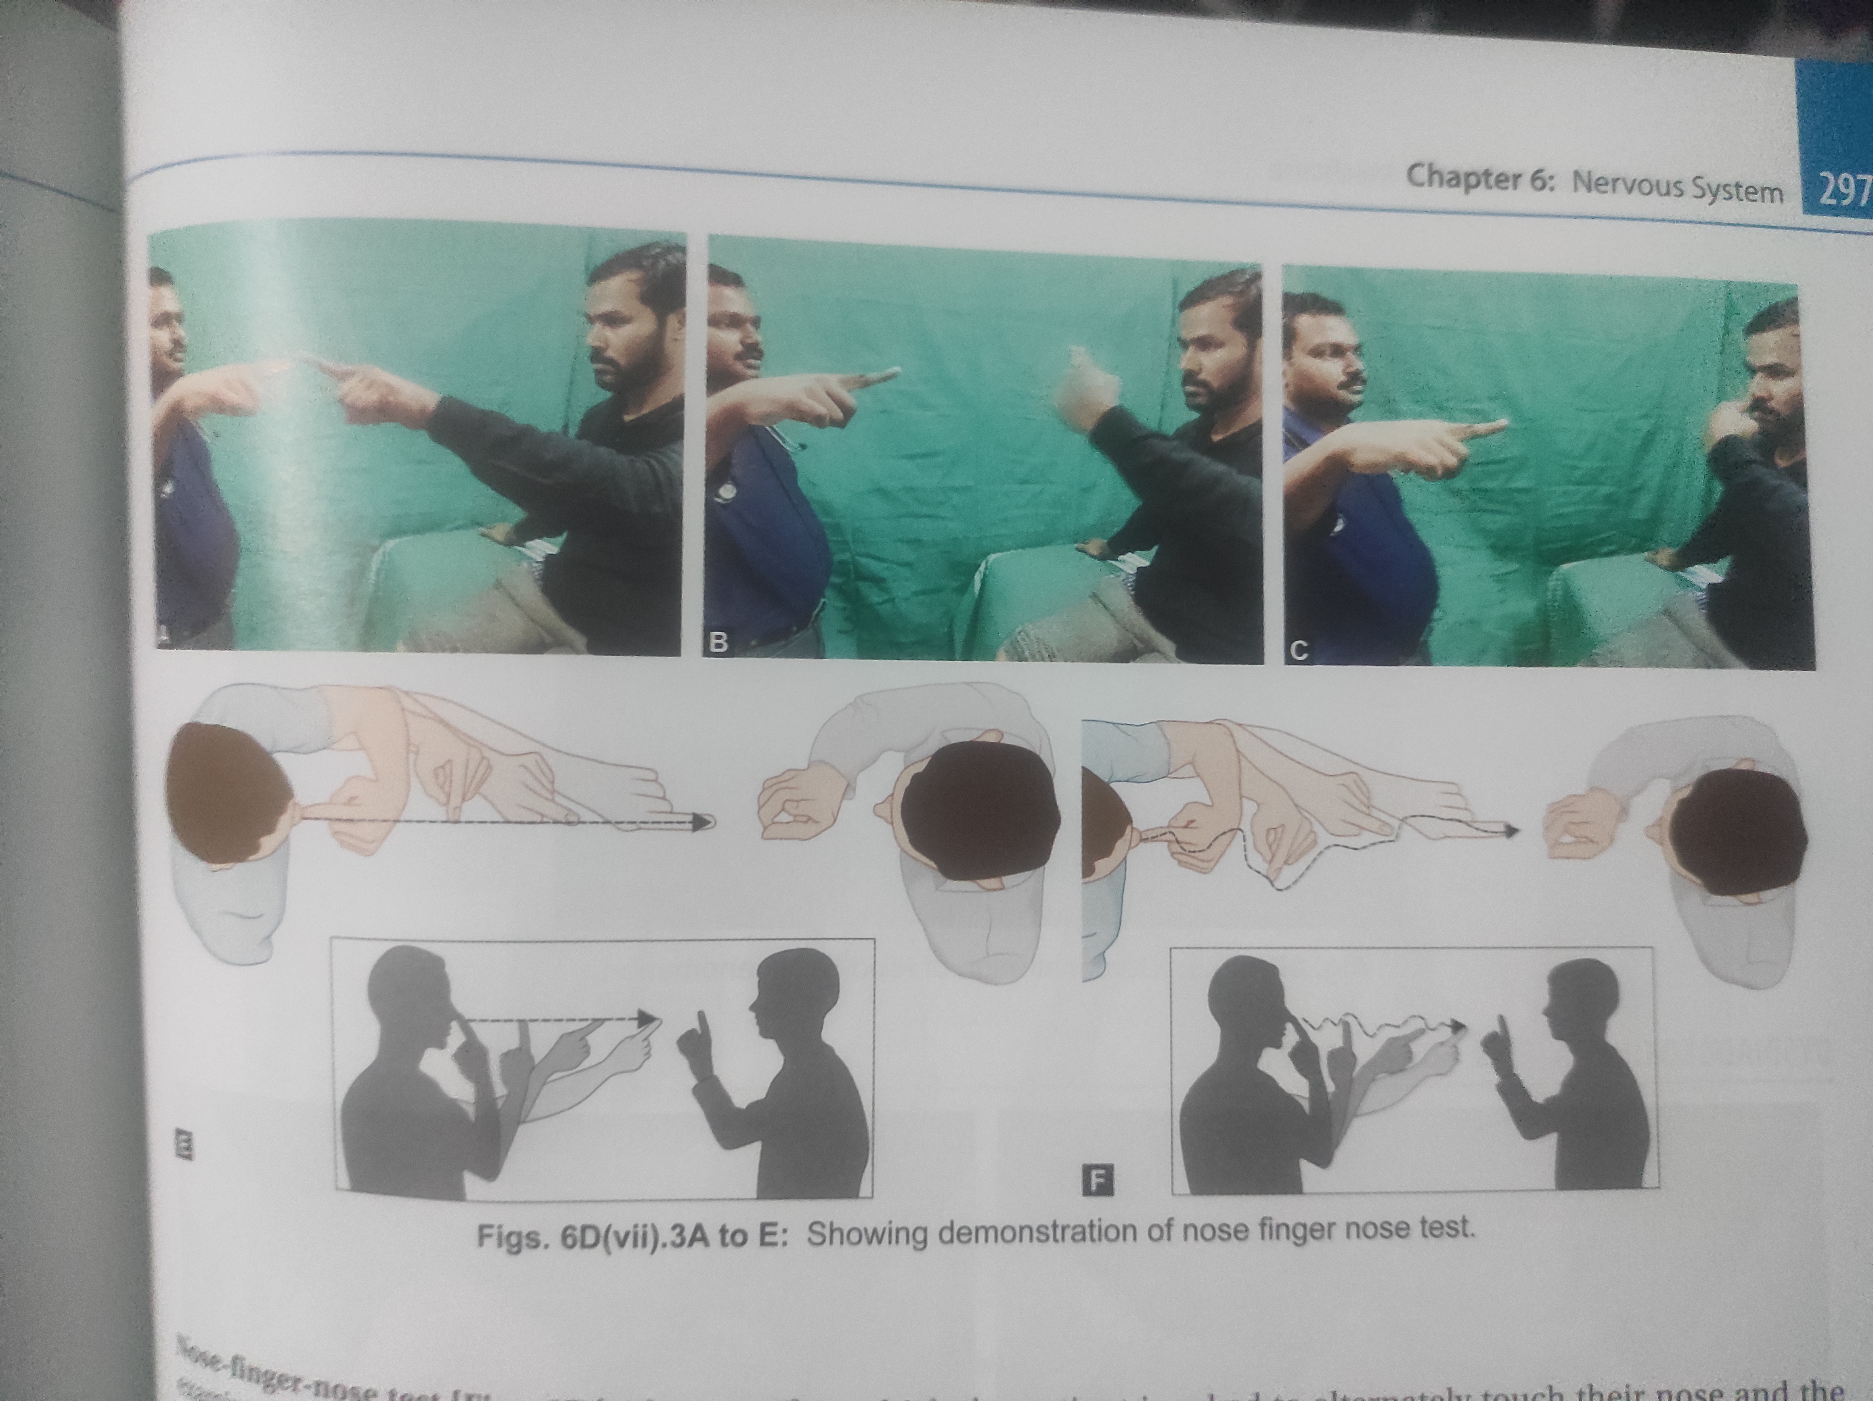

Slide 9
Slight resistance can cause mild ataxia to become evident.
Make the Pt draw a line, starting and then stopping at fixed points
Difficulty to start, undershoot/overshoot
Side to side oscillation

Slide 10
Macrographia
Finger to finger test
If u/l cerebellar lesion, finger on involved side may not reach midline, finger on the normal side may cross the Midline
Affected side finger - sag or rise.

Slide 11
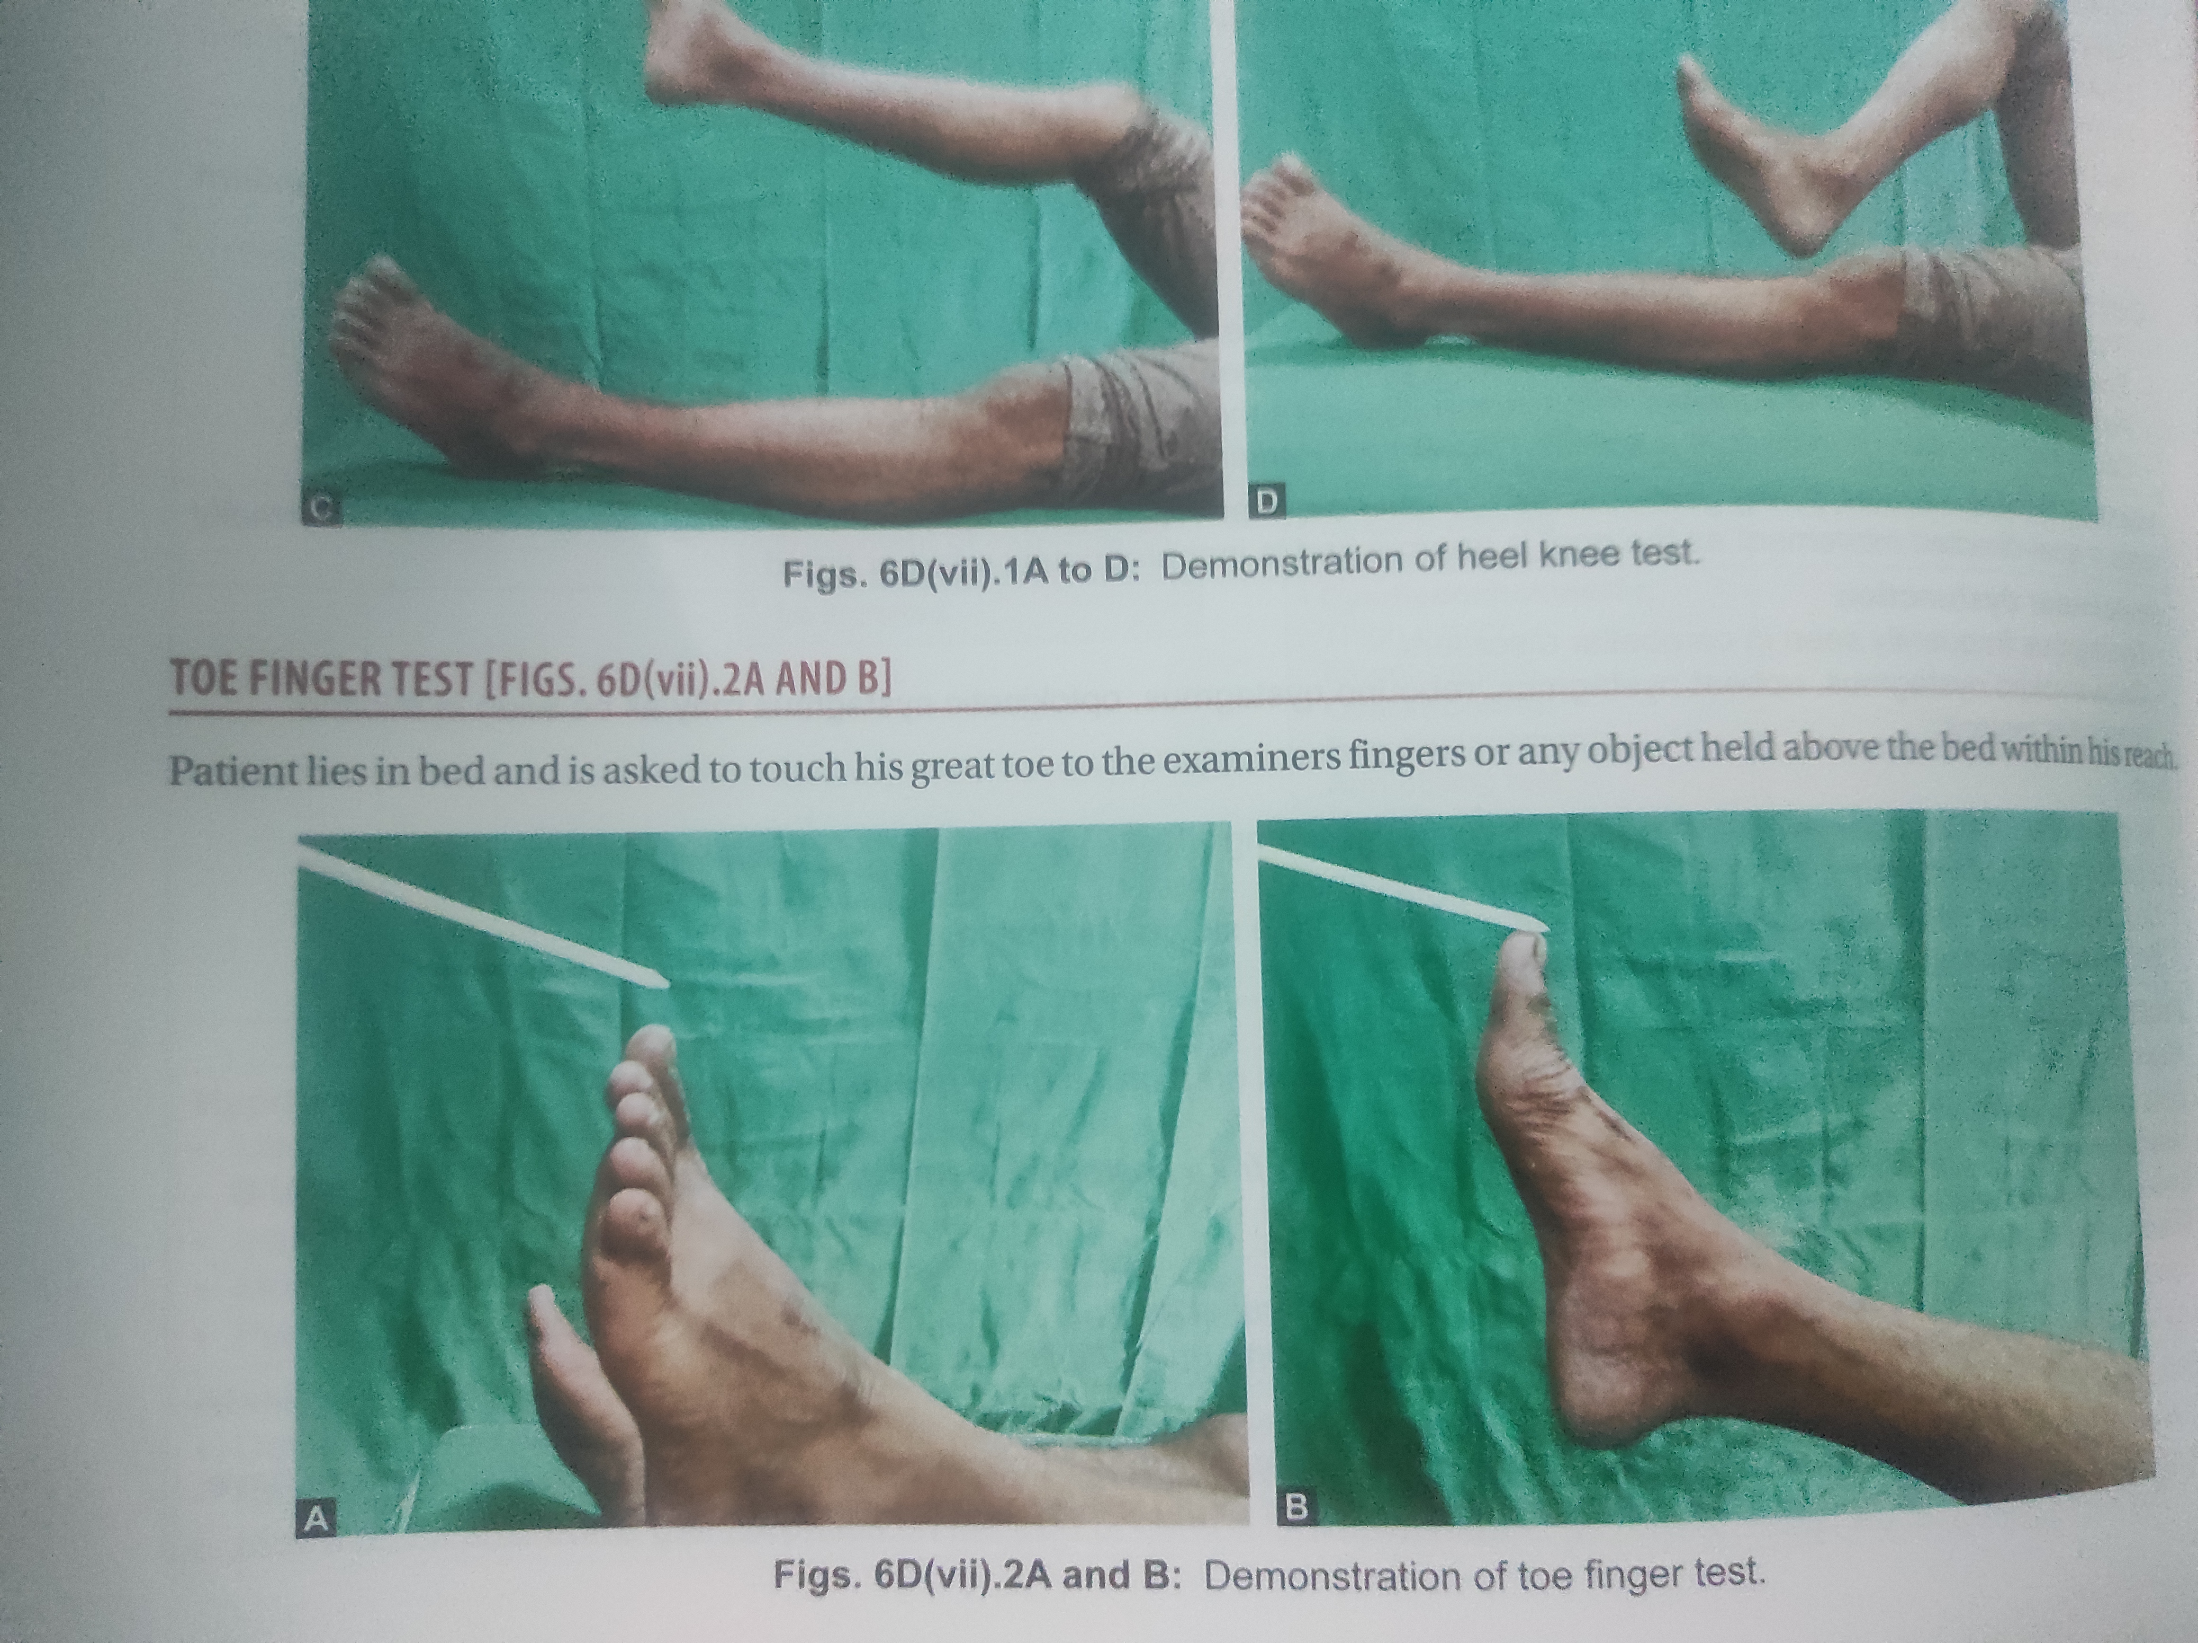

Slide 12
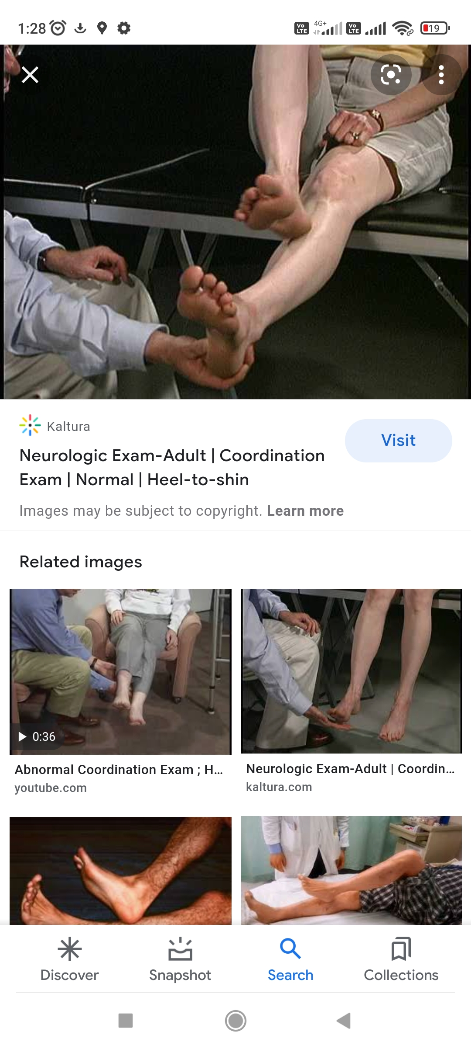
Heel to shin test - ( heel knee shin toe test)

Slide 13
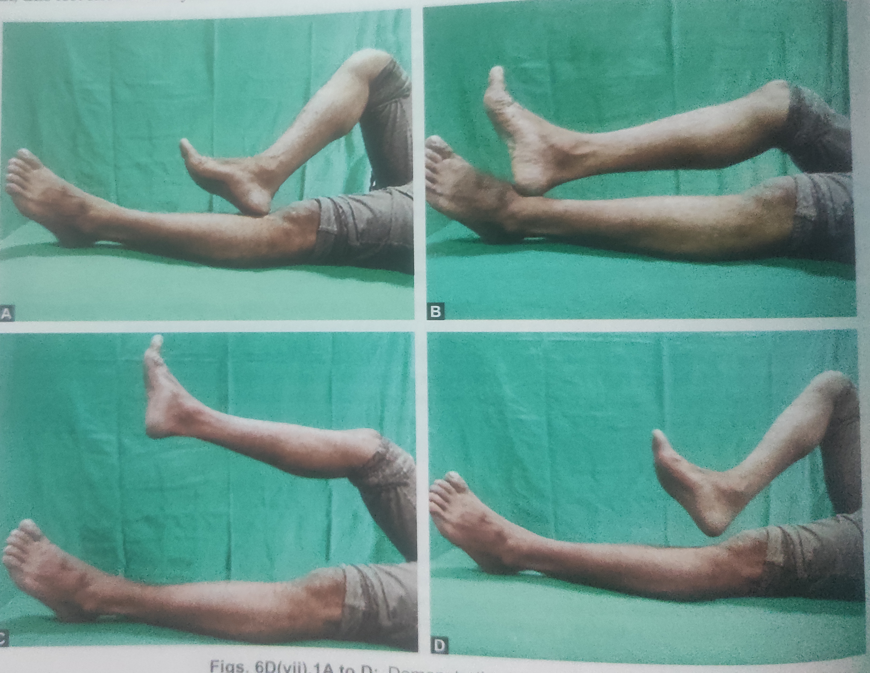
Toe-finger test

Slide 14
Rapid alternating movements
Dysdiadochokinesia
One act cannot be immediately followed by its diametric opposite

Slide 15
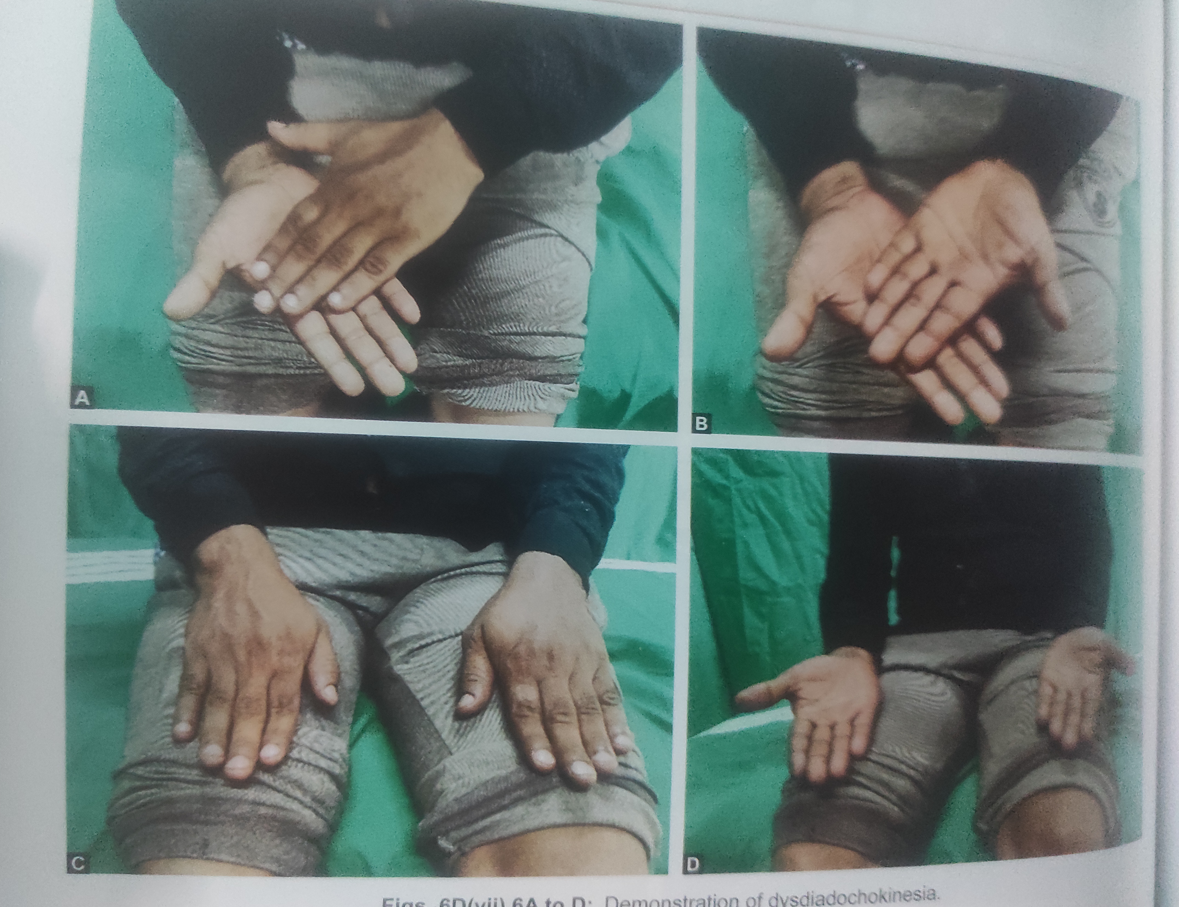

Slide 16
Impaired check and the rebound phenomenon
Checking movements involve contraction of the antagonists after a load is unexpectedly removed during strong contraction of the agonists.
Holmes (Stewart-Holmes) rebound test
Absence of rebound - cerebellar disease

Slide 17
Loss of rebound is more significant unilaterally than bilaterally
Arm stopping test

Slide 18
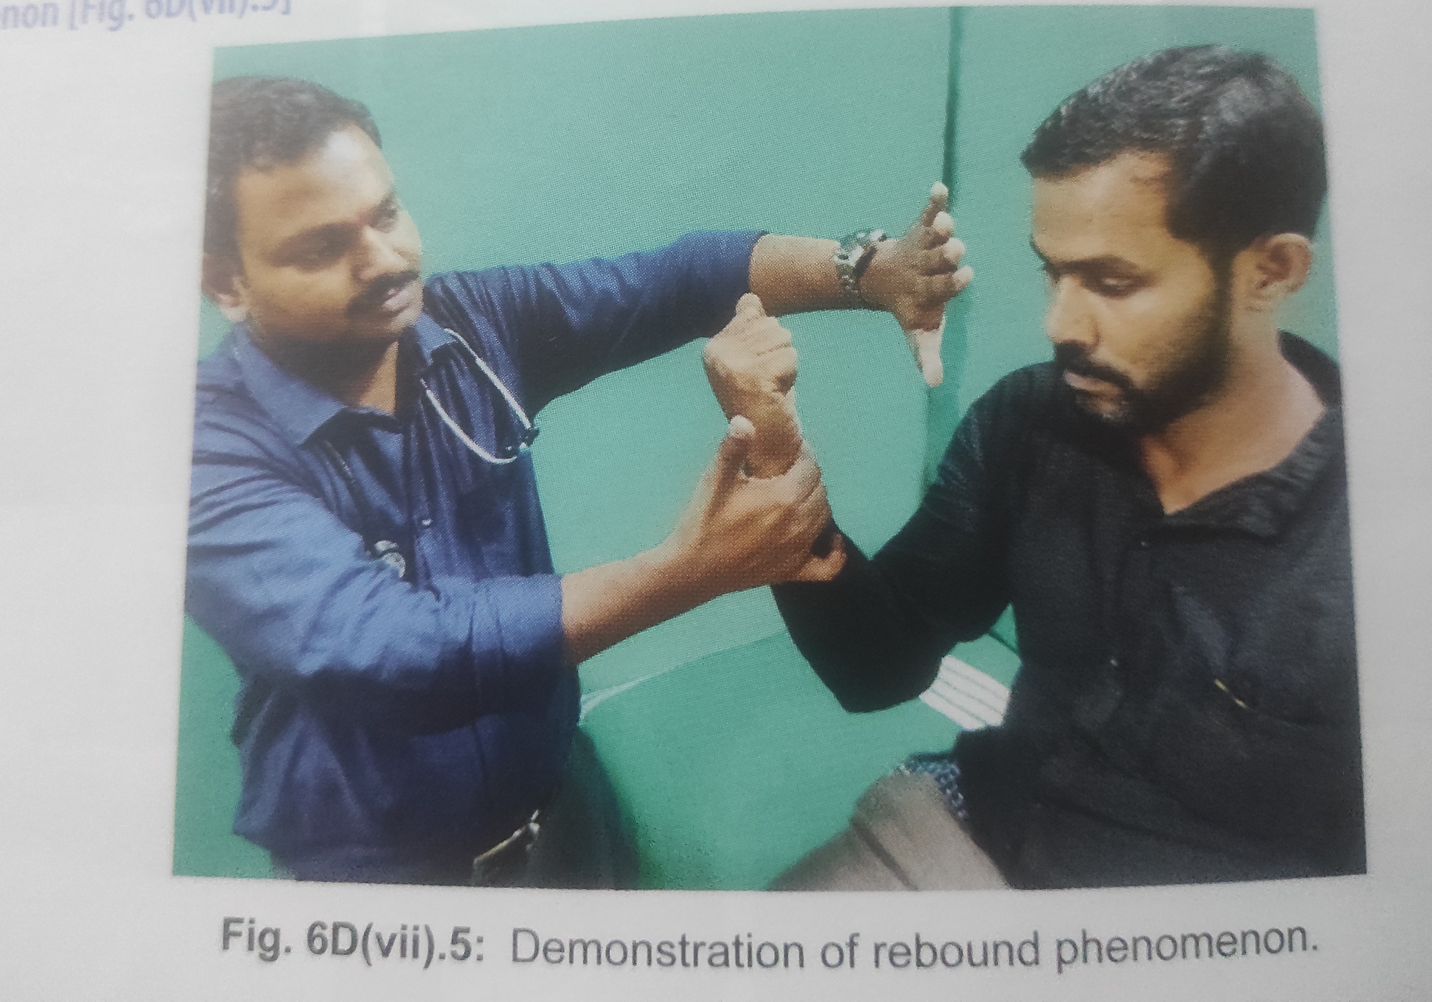

Slide 19
Deviation and past pointing
The patient may miss when
trying to reach out to touch a target (past pointing),
drift to one side when walking eyes closed,
have drift of the outstretched arm
In labyrinthine disease or with a cerebellar hemispheric lesion,
arm will deviate to the involved side on the return track, more so with the eyes closed. This deviation is called past pointing.

Slide 20
Eyes closed - finger nose finger test - deviation+
The pattern is different in vestibular as opposed to cerebellar past pointing.
In vestibular disease, past pointing occurs with both upper extremities toward the involved side;
in unilateral cerebellar disease, past pointing occurs toward the side of the lesion, or erratically to either side, but only in the ipsilateral arm

Slide 21
Cerebellar drift
drift of the outstretched upper extremities
Mainly outward
Testing is done with arms outstretched and eyes closed.
Disease involving one cerebellar hemisphere, the arm drifts toward the side of the lesion. accentuated by tapping the patient’s outstretched wrists.
Tapping on the wrists may also create an up-and-down oscillation because of impaired checking

Slide 22
Deviation and drift may also occur when the patient tries to walk with eyes closed.
As in vestibulopathy, the patient drifts to the side of the lesion.
Walking back and forth with eyes closed may reveal a “compass” or “star” gait due to deviation toward the involved side.
When walking around a chair, the patient shows a tendency to fall toward the affected side.

Slide 23
Other signs of cerebellar disorders
1. Cerebellar dysarthria - articulation and prosody
Scanning/slurring/staccato/explosive speech
More in hemisphere lesion
Enunciation of individual syllables +
2. Intention tremor - during goal directed movements - antagonist action inappropriate

Slide 24
3. Oculomotor dysfunction
Nystagmus - gaze evoked, upbeat, rebound
4. Hypotonia
Usually in acute hemisphere lesions
Pendular knee jerk (> 4times oscillation)
5.titubation
Rhythmic body/head tremor - rotatory,rocking or bobbing movement

