Slide 1
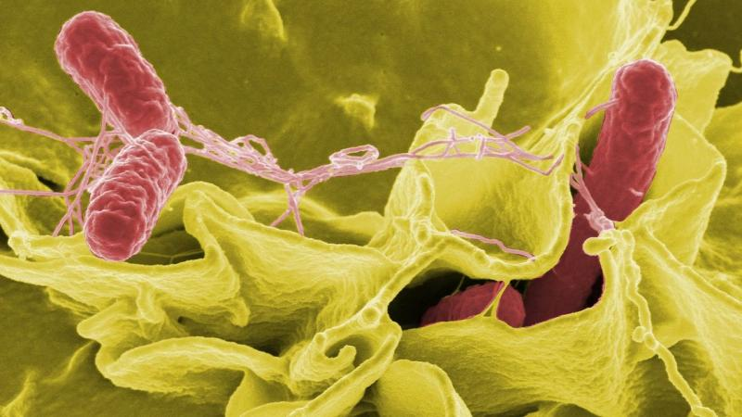
ENTERIC (TYPHOID)FEVER
Dr DIVYA R S

Slide 2
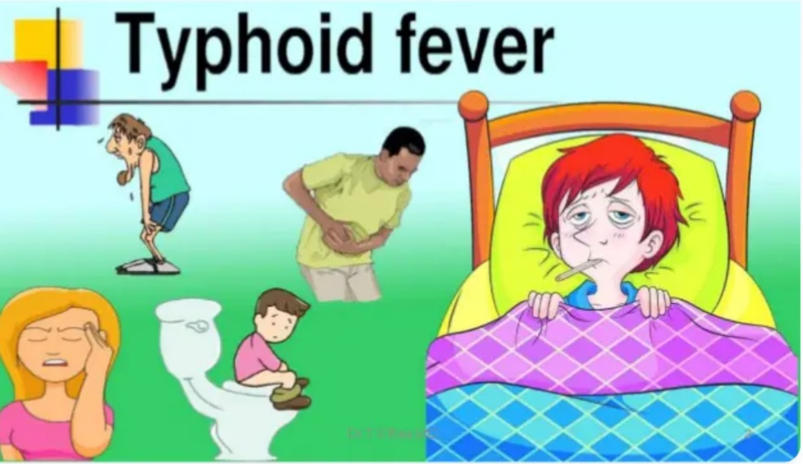
Typhoid fever is an important communicable disease affects many in the world

Slide 3
ETIOLOGY- SALMONELLA
Very complex group
Contains more than 2000 species
Typed on the basis of serotyping and species typing
Divided into
Enteric fever group
Food poisoning group
Septicemias

Slide 4
Salmonella can cause infections in humans and vertebrates
Carrier state is a concern

Slide 5
Key points…..
There are more than 2000 different antigenic types of salmonella
Those pathogenic to man are serotypes of Salmonella enterica
Serotyping is based on somatic O antigen, surface Vi antigen, and flagellar H antigen
Most serotypes of S. enterica cause food borne gastroenteritis and have animal reservoirs
S.enterica serotypes Typhi and Paratyphi cause typhoid fever

Slide 6
ENTERIC FEVER
Caused by Salmonella typhi and other groups called as paratyphi A, B, C
S. typhi- causes typhoid fever
S. paratyphi A, B, C causes paratyphoid fever
Food poison group
Spread from animals – humans
Causes gastroenteritis, septicemia and localized infections

Slide 7
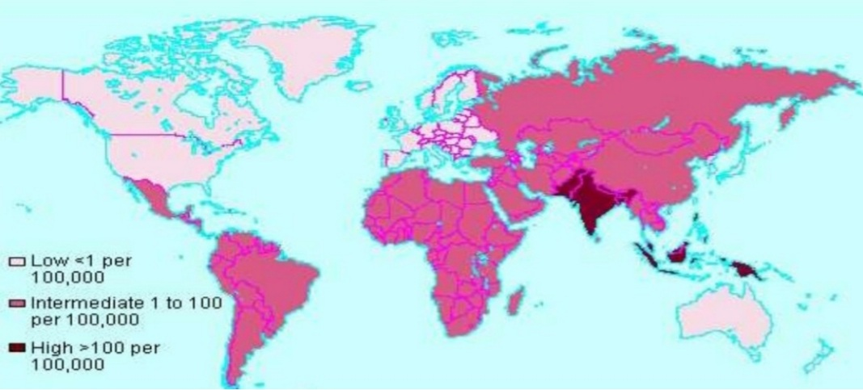
Typhoid fevers are prevalent in many regions of the world

Slide 8

Typhoid mary
A famous example is “TYPHOID MARY MALLON”, who was a food handler responsible for infecting at least 78 people, killing 5.
These highly infectious
carriers pose a great
risk to public health

Slide 9
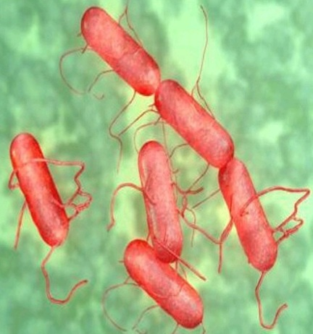
Morphology of salmonella
Genus salmonella belongs to Enterobacteriaceae
Gram negative, non spore
forming, facultatively anerobe
Measures 2-3um/0.4-0.6um
Motile with peritrichous
flagella
Distinguished from
other bacteria by biochemical
and antigen structure

Slide 10
Culture characters
Aerobic/ facultatively anaerobic
Grows on simple media- Nutrient agar
Temp- 15-41*c/37*c
Colonies appear as large 2-3mm, circular, low convex
On Mac Conkey medium appears colorless
Selective medium- Wilson Blair, Bismuth sulphide medium
Produce Jet black colonies
H2S produced by s. typhi

Slide 11
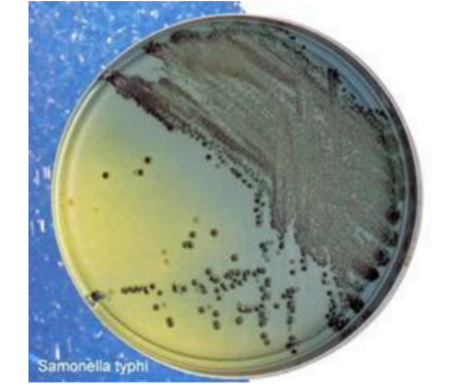
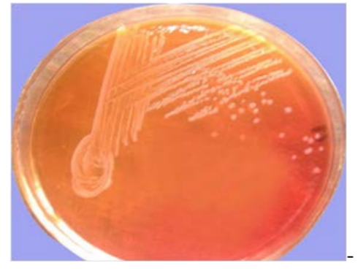
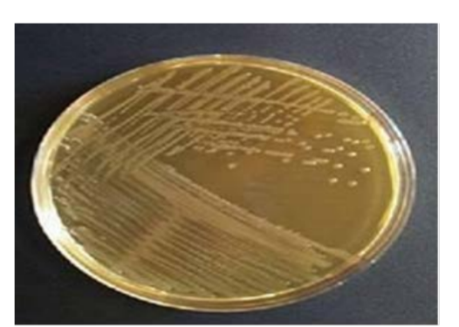

Slide 12
Enrichment meDium
Liquid medium
Selenite F medium
Tetrathionate broth
Used for isolation of salmonella from contaminated specimens
Particularly stool specimens

Slide 13
Identifying enteric organisms
Isolates which are non lactose fermenting
Motile, indole negative
Urease negative
Ferment glucose, mannitol, maltose
Do not ferment lactose and sucrose
Further identification by slide agglutination test

Slide 14
Resistance of salmonella
55*c – 1 hour
60*c – 15 minutes
Boiling, Chlorination, Pasteurization destroy the bacilli

Slide 15
Salmonella antigenic structure
H- flagellar antigen
O- somatic antigen
Vi- surface antigen in some species only
H antigens
Heat labile protein
When mixed with antiserum- produces agglutination and fluffy clumps
Strongly immunogenic
Induces antibodies rapidly

Slide 16
O antigen
Long chain polysaccharide
Heat stable
Forms integral part of the cell wall
Like endotoxin
When mixed with antiserum, produce chalky clumps
Takes more time to react, at high temp 50-55*c
Less immunogenic than H antigen

Slide 17
Vi antigen
Polysaccharide
Act as a virulence factor, protecting bacilli against phagocytosis and complement activity
Poorly immunogenic
Destroyed after boiling at 60*c for 1 hour

Slide 18
Pathogenesis
Bacteria enter through ingestion
Infectious dose ranges from 200 to 10^6 CFU
Ingested dose is an important determinant of incubation period and disease severity
Conditions altering stomach acidity, intestinal integrity or alteration of intestinal microbiome can increases the susceptibility to salmonella infection
Bacteria attach to microvilli, ileal mucosa, penetrate to lamina propria and submucosa

Slide 19
Phagocytosis by polymorphs and macrophages
Enters the mesenteric lymphnodes- peyers patches
Enters the thoracic duct to blood stream
Colonize the reticuloendothelial tissues
Liver, spleen, lymph nodes, bone marrow
Gall bladder, lungs, kidneys
Patients have only few or no signs and symptoms at this initial phase

Slide 20
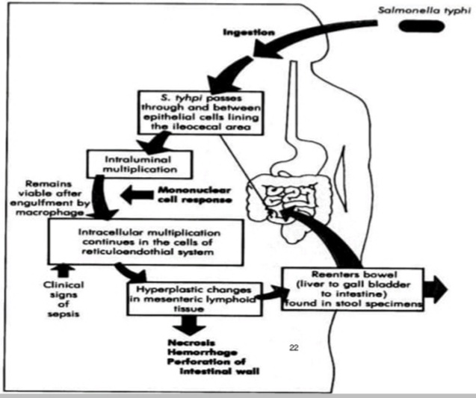
Once again spill into the blood stream causing critical illness due to the secretion of cytokines by macrophages and epithelial cells

Slide 21
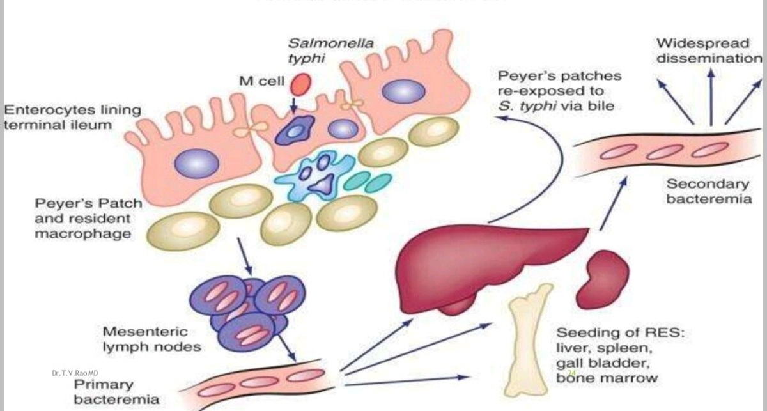

Slide 22
Multiply in the gall bladder
Bile rich source of bacteria
Spill into the intestine, infects peyers patches, lymph follicles
Inflammation- undergo necrosis and slough off
Typhoid ulcers
Causes perforation and hemorrhage

Slide 23
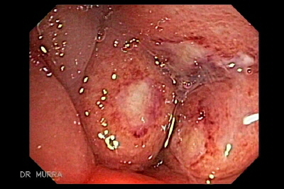
Duration of illness 3-4 weeks
Incubation period 7-14 days(3-56)

Slide 24
Immunity in Typhoid
Typhoid bacilli are intracellular pathogens
Cell mediated immunity is crucial

Slide 25
CLINICAL COURSE
Enteric fever is a misnomer
Hallmark features of the disease- fever and abdominal pain- are variable
Fever documented in >75%, but abdominal pain in 30-40% cases
High index of suspicion in patients present with fever and history of travel to endemic areas

Slide 26
FIRST WEEK
FEVER
Most prominent symptom – prolonged fever (38.8-40.5*c)
If untreated, can continue upto 4 weeks
Step ladder pattern
S. paratyphi produce milder disease than S. typhi with predominant GIT symptoms
OTHER SYMPTOMS
Headache, chills, cough, sweating, myalgia, malaise, arthralgia

Slide 27
Gastrointestinal – anorexia, abdominal pain, nausea, vomiting, diarrhoea more common than constipation
PHYSICAL FINDINGS
Early physical findings- rash(rose spots), hepatosplenomegaly, epistaxis and relative bradycardia
Coated tongue, abdominal tenderness

Slide 28
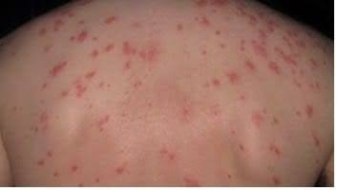
Rose spots
Faint salmon colored, blanching, maculopapular rash
Located primarily on trunk and chest
Evident in 30% cases at the
end of first week
Resolves without a trace
after 2-5 days
Are bacterial emboli to the dermis
Patient can have 2-3 crops of
lesions and salmonella can be
cultured from the punch biopsies

Slide 29
SECOND WEEK
Symptoms progress
Patient develops soft splenomegaly

Slide 30
THIRD WEEK
If untreated, more toxic, develops abdominal distension and pea soup diarrhoea
Apathy and confusion
Necrotic peyers patches---- bowel perforation and peritonitis

Slide 31
ATYPICAL MANIFESTATIONS
Isolated severe headache
Acute lobar pneumonia, isolated arthralgias, urinary symptoms, severe jaundice
Neurological manifestations- delirium, parkinsonian symptoms, GBS

Slide 32
COMPLICATIONS
Development of severe disease depends on
Host factors
Strain virulence and inoculum
Choice of antibiotic therapy
Gastro intestinal bleeding and intestinal perforation
Occurs in the 3rd and 4th week of illness
Due to hyperplasia, ulceration and necrosis of ileocecal peyers patches

Slide 33
Life threatening
Requires immediate fluid resuscitation
Surgical intervention
Broad spectrum antibiotics for polymicrobial peritonitis

Slide 34
Rare complications
DIC
Hematophagocytic syndrome
Pancreatitis
Hepatic and splenic abscess and granulomas
Endocarditis, pericarditis, myocarditis
Orchitis, hepatitis, glomerulonephritis
Pyelonephritis, HUS, severe pneumonia, arthritis
Osteomyelitis, endophthalmitis, parotitis

Slide 35
Carriers
Upto 10% of untreated patients
Excrete salmonella typhi in feces for upto 3 months
2-5 % develop chronic asymptomatic carriage shedding bacilli in either stool or urine for >1 year
Chronic carriage is more common among
Women,infants
Patients who have biliary abnormalities
Concurrent bladder infection with S. hematobium

Slide 36
Bacilli adapted to survive in the gall bladder environment by forming biofilm on gall stones and invading gallbladder epithelial cells
Chronic carriage- high risk for gall bladder cancer

Slide 37
How we diagnose typhoid fever
High index of suspicion
Other than a positive culture, no other test is diagnostic of enteric fever
In 15-25% cases- leucopenia and neutropenia
Leukocytosis- common in children during first 10 days, intestinal perforation or secondary infection
Other test- moderate elevated values in LFT and muscle enzymes levels

Slide 38
BLOOD CULTURE
1st week positive in 90%
2nd week positive in 75%
3rd week positive in 60%
> 3 weeks positive in 25%
Draw 5-10cc of blood by venipuncture
Add to 50-100ml of bile broth
Incubate at 37*c/subculture in MacConkey at regular intervals

Slide 39
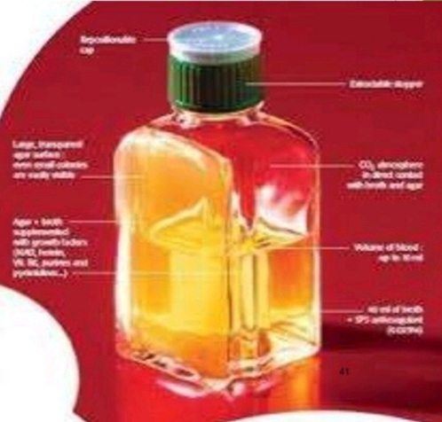
CASTANEDA’S METHOD
Double medium
Solid and liquid medium in same bottle
Contains bile broth and agar slant
For subculture bottle is merely tilted
Reduces the chance of contamination
Increases the chances of isolation

Slide 40
Presumptive diagnosis can be made within 24 hours of the reciept of specimen
Formal identification of serotypes take several days
Negative report must await the result of enrichment cultures- atleast 48 hours

Slide 41
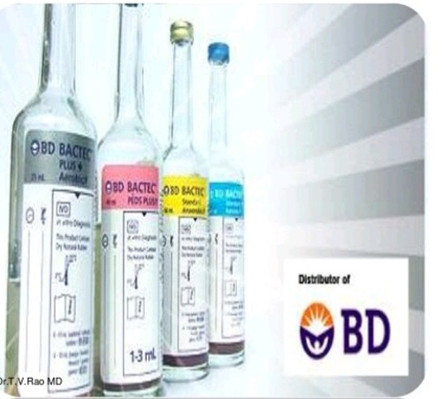
Bactec and Radiometric based
Recent use
Rapid and sensitive method for early diagnosis

Slide 42
Culturing other specimen
STOOL CULTURE
During first week- negative in 60-70%
Become positive during 3rd week if untreated
BONEMARROW CULTURE
>80% sensitivity
Yield not reduced by upto 5 days of antibiotic treatment
Culture of intestinal secretions
Non invasive duodenal string test

Slide 43
SEROLOGY
WIDAL TEST
Tube agglutination test
Detect O and H antibodies
Diagnosis of typhoid and paratyphoid
Testing for H agglutinin- Dreyer’s tube- floccules at the bottom
O agglutinin- Felix tube- chalky
Incubated at 37*c overnight

Slide 44
Serum antibodies raise abruptly during 2nd or 3rd week
Two serum specimen obtained at 7-10 days interval to read rising antibody titre
Interpretative criteria when single sample used may vary
False positive and false negative limits the utility of the test
Diagnostic
O - >1 in 80
H - >1 in 160
H agglutinins appear first

Slide 45
False positive
Unapparent infection
Immunization
Previously infected
Hence interpretated in the light of baseline titres in a healthy local population

Slide 46
False negative
Early treatment
Hidden organisms in bone and joints
Poorly immunogenic strains

Slide 47
Limitation of Widal test
Time consuming
Often when diagnosis is reached it is too late to start antibiotics

Slide 48
Diagnosis of carriers
Fecal carriers by isolation from stool sample
Bile aspiration
Sewer swab

Slide 49
TREATMENT
Early administration of antibiotics prevent the development of complications
Until 1990, Chloramphenicol was the drug of choice
Ampicillin and cotrimoxazole were also used
Due to development of drug resistance and marrow toxicity, these drugs are not commonly used nowadays

Slide 50
Uncomplicated enteric fever
Can be managed at home with oral antibiotics and antipyretics
Persistent vomiting, diarrhoea, abdominal distension
Admit the patient
Supportive therapy
Parenteral antibiotics
Duration of treatment- atleast 10 days or 5 days after fever resolution

Slide 51
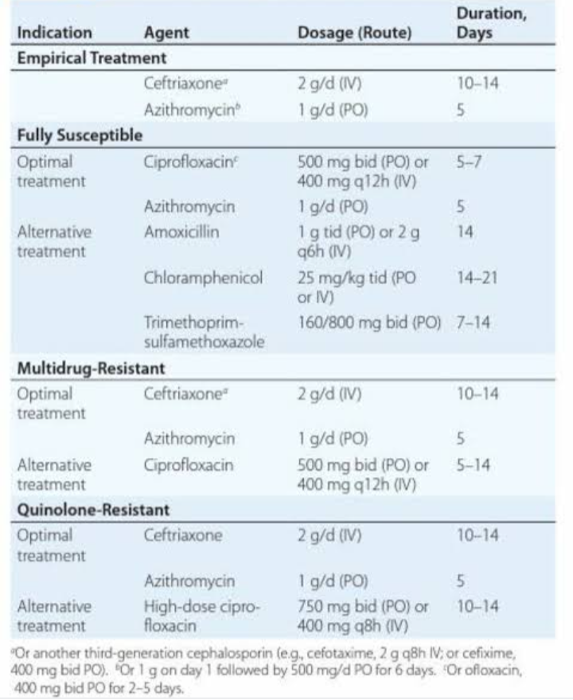

Slide 52
CHRONIC CARRIAGE
Oral ciprofloxacin or other fluroquinolones
Duration – 4 weeks
Eradication rate of 80%
In case of anatomical abnormality(biliary or kidney stones)- both antibiotic therapy and surgical correction

Slide 53
PREVENTION
Ty 21a vaccine
Live attenuated strain of S. typhi
Given orally in capsule form
Minimal age for vaccination 6 years
Given on days 1, 3, 5 and 7
With revaccination with a full 4 dose series every 5 years

Slide 54
Vi Polysaccharide vaccine
Given subcutaneously or intramuscularly as single dose
Consist of purified Vi polysaccharide from bacterial capsule
Children above 2 years
Immunity last for 2-3 years
Follow a booster every 2 years
Confers protection 7 days after injection

Slide 55
Typhoid vaccine is not required for international travel
Recommended to travellers to areas with moderate to high risk of exposure
Also laboratory workers and house hold contacts of carriers should be vaccinated
Protective efficacy of vaccine can be overcomed by high inocula
Hence it is a adjunct, not a substitute to the avoidance of high risk food and beverages

Slide 56
Not recommended for adults residing in endemic areas or management of persons who have been exposed in a common outbreak
Enteric fever is a notifiable disease

Slide 57
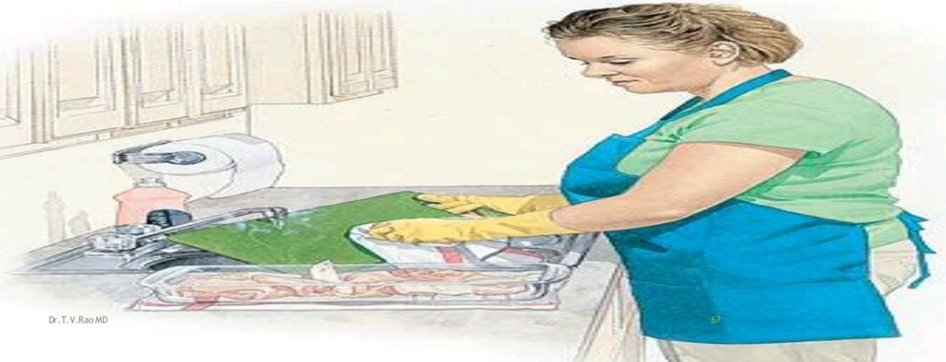
A single hand washing has many reasons to prevent Enteric fever

Slide 58


