Slide 1
ECG OF THE WEEK
Mohammed fazil k
JR2

Slide 2
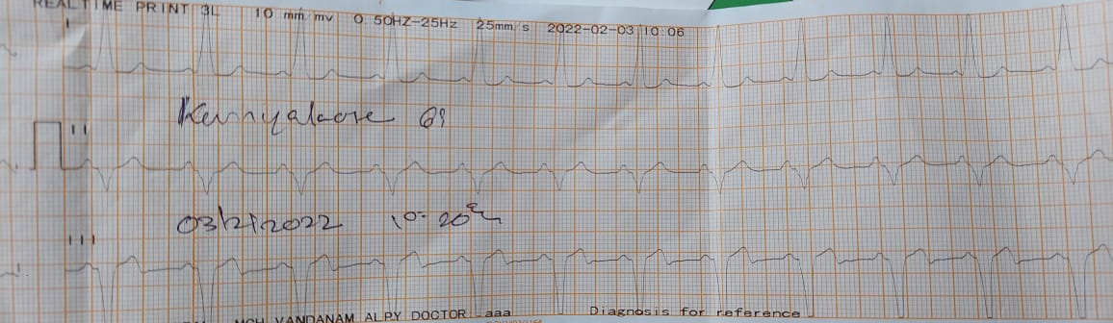

Slide 3
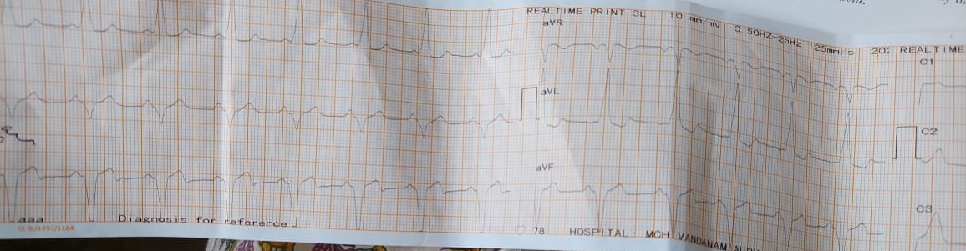
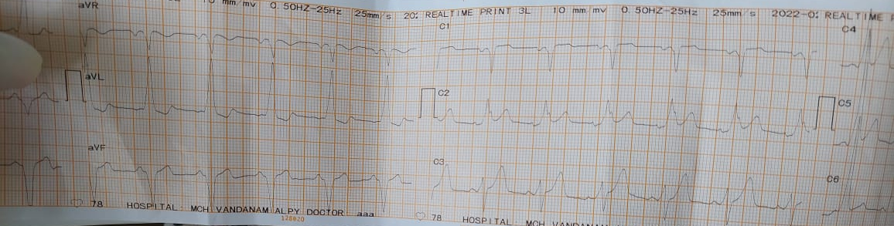
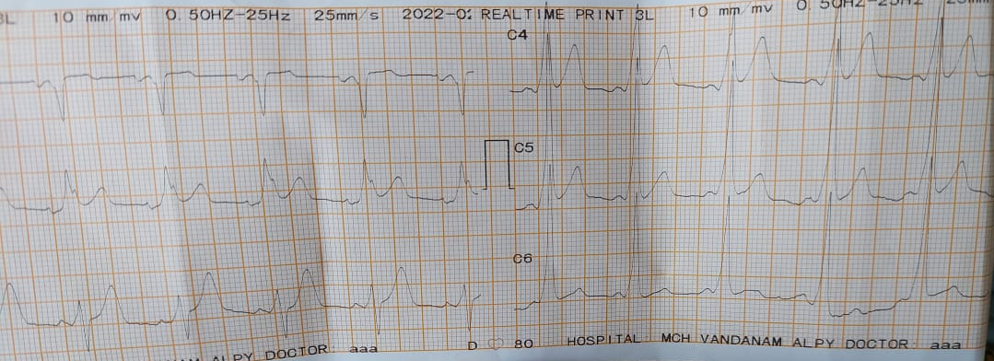

Slide 4
WPW SYNDROME
Stanley Kent in 1893 - impulses can travel from the atrium to the ventricle over a node-like structure other than the atrioventricular (AV) node .
Cohn and Fraser reported the first case of pre-excitation syndrome in 1913.
In 1930, Louis Wolff, Sir John Parkinson, and Paul Dudley White published a seminal article describing 11 young patients who suffered from attacks of tachycardia associated with an electrocardiographic pattern of bundle branch block with a short PR interval

Slide 5
INTRODUCTION
Congenital in origin
Familial form as AD
Association with familial HCM
BUNDLE OF KENT – muscular AV fibre
ATRIOVENTRICULAR RING(AV Valve annulus or septum)

Slide 6
PATHOPHYSIOLOGY
Persistance of accessory AV muscle fibres
PRE-EXCITATION OF VENTRICLE
Fitzpatrick described eight anatomical locations of pathways using fluoroscopic landmarks
5 – Rt sided along the tricuspid valve annulus
3 - Lt sided along the mitral valve annulus

Slide 7
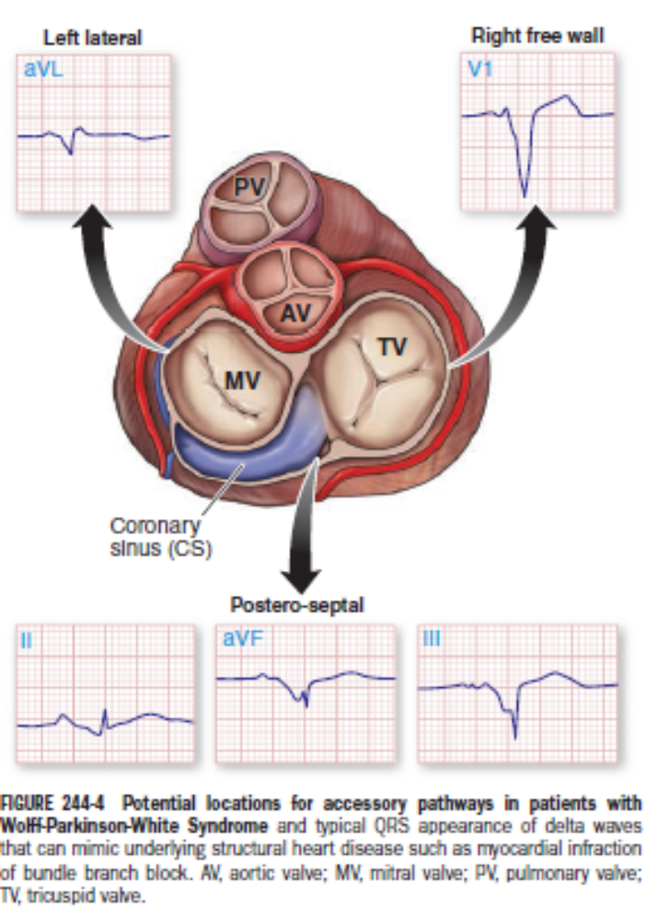

Slide 8
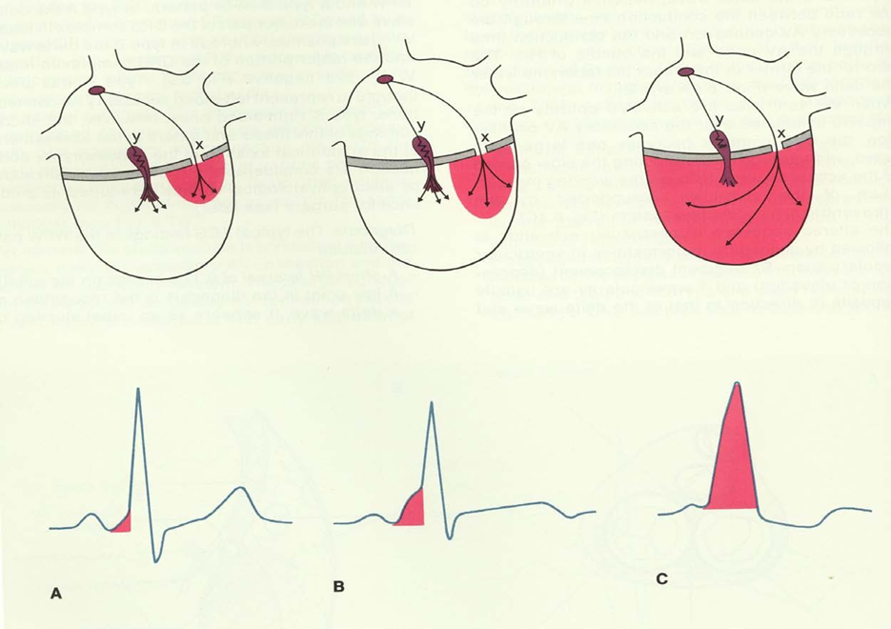
Conduction and ECG characteristics
1. shortened PR interval,
2. a widened QRS, and
3. a delta wave

Slide 9
COMPLICTIONS
1) RECIPROCATTING TACHYCARDIA
2) PRE-EXCITED TACHYCARDIA (ATRIAL FIBRILLATION)

Slide 10
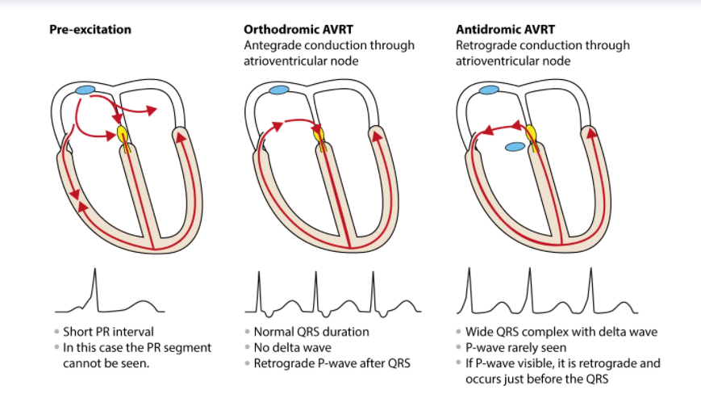
1) RECIPROCATING TACHYCARDIA

Slide 11
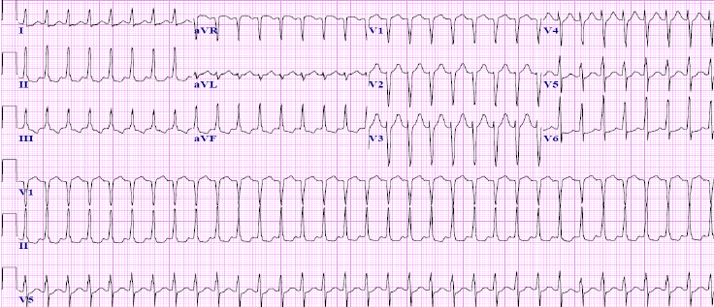
Orthodromic AVRT
Narrow QRS tachycardia
Regular ventricular rate – 150 to 250 bpm
Short RP tachycardia , but RP interval is usually longer than 70ms . It can be longer if AP is slow .
P wave is retrograde in leads II,III,avF .

Slide 12
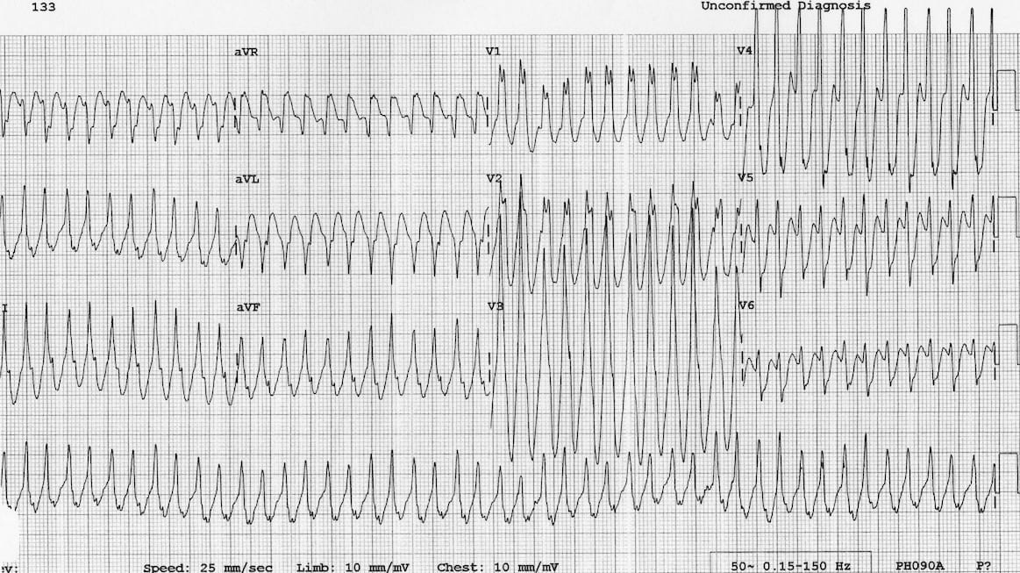
Antidromic AVRT
Wide QRS tachycardia (>120ms) , with Regular ventricular rate – 150 to 250 bpm
Delta waves visible in most cases.
P wave generally not visible , but if visible –just before QRS (long RP tachycardia)
Chance of spotting a delta wave may be maximal on the first QRS complex following the termination of antidromic AVRT .

Slide 13
2) PRE-EXCITED TACHYCARDIA
(ATRIAL FIBRILLATION)
This retrograde return may be so rapid that the atria are stimulated a second time before they have been completely recovered from their antegrade activation by the sinus impulse - Vulnerable to AF
Conducts to the ventricle – 3 ways
Ventricular fibrillation

Slide 14
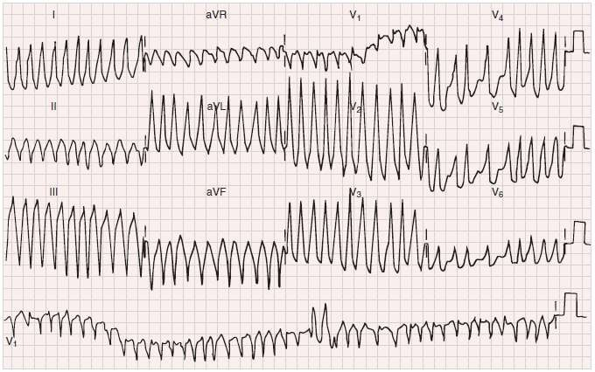

Slide 15
TREATMENT
Hemodynamic instability – Direct synchronized caedioversion
    Hemodynamically stable
ORTHODROMIC AVRT
PRE-EXCITED TACHY(AF –WPW)
AV nodal blocking agents
Elective cardioversion

Slide 16
THANK YOU

