Slide 1
APPROACH TO DEMENTIA
MOHAMMED FAZIL K

Slide 2
Dementia
Is defined as an acquired deterioration in cognitive abilities that impairs the successful performance of activities of daily living(social /occupational)
Progressive
Non-reversible
Reversible causes

Slide 3
COGNITION
Memory
Language
Visuospatial skills
Executive functions planning, judgement, reasoning.
Memory : cholinergic system
Behaviour ,mood : NA,DA, Serotonin
20 billion neurons

Slide 4
When specific group of neurons are reactivated
Short term memory
  Working memory : prefrontal cortex
Long term memory
  Explicit memory
Episodic memory formed and indexed in hippocampus
Semantic memory
Emotional memory : amygdala
Transferred to neocortex from hippocampus during sleep
  Implicit memory : basal ganglia, cerebellum.

Slide 5
FUNCTIONS OF THE LOBES OF BRAIN
FRONTAL LOBE: Personality,behavior,language,insight, abstract thinking, control of emotionns, ability to inhibit responses, motor control, micturition.
TEMPORAL LOBE : auditory perception, language, verbal memory
OCCIPITAL LOBE : visual

Slide 6
FUNCTIONS OF THE LOBES OF BRAIN
PARIETAL dominant: Calculation, sensory
Lesion causes : Acalculia, Alexia, Finger agnosia.
PARIETAL non dominant: construction skills, spatial orientation
Drawing a 2d diagram, drawing a clock face.

Slide 7
THE NEURAL NETWORKS
The left perisylvian for language
The pareitofrontal for spatial orientation
The occipitotemporal for face/object recognition
The limbic for memory
The prefrontal for executive functions

Slide 8
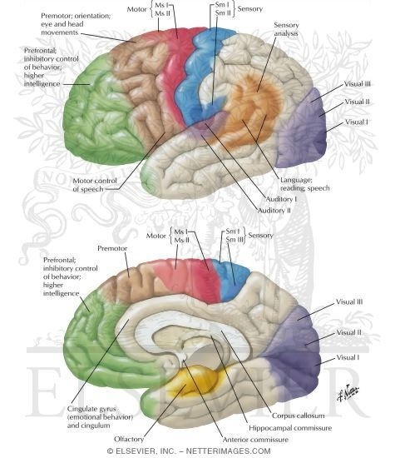

Slide 9
Degenerative/ Irreversible dementias
1. Alzheimer’s disease (AD)
2. Vascular dementia
3. Fronto-temporal dementia (FTD) more common <65
4. Lewy body dementia (DLB)
Prion diseases - Cruetzfeldt Jacob Disease (CJD)
Huntington’s disease (HD)
Aggregration of specific proteins : ab42/tau, alpha-synnuclein(DLB), fus (FTD), Prion protein

Slide 10
Reversible causes should be ruled out first
Hypothyroidism
Vitamin B12 deficiency, Thiamine deficiency
Normal pressure hydrocephalus
Chronic SDH
Drugs and alcohol
Neoplasms of CNS
Neuroinfections HIV
Autoimmune encephalitis
Paraneoplastic limbic encephelitis :
Depression,
Non convulsive seizure disorder
Poor vision and poor hearing
Notes:
Indian study by Srikanth et al, 2007
account for 18% of all dementias

Slide 11
History
Dementia is a clinical diagnosis
Onset, duration : acute, subacute, chronic
Tempo of progression : slow (AD), Fluctuating (DLB)
Age
stroke, irregular stepwise progression – vascular dementia
Seizures – stroke, neoplasm, AD
Gait disturbance, falls : NPH, PD/DLB, Vascular
High risk behaviour – HIV
H/o recurrent head trauma chronic traumatic encephalopathy

Slide 12
HISTORY
  Paraneoplastic limbic encephalitis : suba/c amnesia, psychoses
  Drugs : Anticholinergics, Psychotropicmedications,
  benzodiazapines
  Batteries, chemical factories : Heavy metal intoxication
  Depression : Patients them self are more likely to complain about memory loss than those with dementia
Vegetarian, irradiation of bowel, gastric surgery, autoimmunity, PPIs
Family history

Slide 13
HIGHER MENTAL FUNCTIONS
1. Consciousness : alert, drowsy, stupor, coma.
2. Orientation : (1) time,(2) place, (3)person.
3. Memory
immediate : registration
short term : recall, recent
long term : remote
4. Language
5. Delusions, hallucinations
6. Emotional state : anxious, depressed, excited, fearful
apathetic, emotional incontinence.

Slide 14
Cognitive testing
  The Mini-Mental State Exam (MMSE) is the most widely used cognitive test for dementia
  Maximum score is 30 points.
  Score of less than 24 points is suggestive of dementia

Slide 15
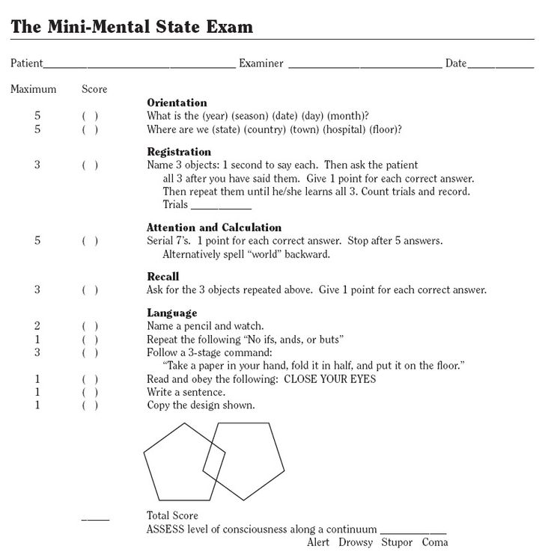
Score range
24-30-Normal
18-23-Mild
10-17-Moderate
<10-Severe

Slide 16
Physical examination
Spasticity
Focal neurological deficits
Resting tremors, cogwheel rigidity, bradykinesia,
Supranuclear gaze palsy
Motor neuron disease
Myoclonus
Released reflexes
Myelopathy
Peripheral neuropathy

Slide 17
Released reflexes in dementia
Released from the control of higher centres
Grasp reflex
The palmomental reflex
Sucking reflex
Glabellar tap reflex

Slide 18
LABORATORY EVALUATION
CBC, RFT, LFT, TFT,
Vitamin B12 level
MRI : regional pattern of atrophy
neoplasms, inflammation, infarction, NPH,
SDH
MR ANGIOGRAPHY
EEG
LUMBAR PUNCTURE
BRAIN BIOPSY

Slide 19
Alzheimers disease
50 % of dementias
Females
Family history
Low educational attainment
Insidious
Evolves over years
Benign forgetfulness of elderly
Mild cognitive impairment ( early AD)

Slide 20
ALZHEIMER’S DISEASE
Episodic Memory symptoms :Repeatedly asking questions, Forgetting conversations
Managing finances, Keeping job
Progresses to language & visuo-spatial deficits
Language. : Naming, comprehension, word finding.
Visuspatial deficits : dressing, eating, walking, apraxia, Driving, shopping, housekeeping
Lost on walks, wanders aimlessly
Social behaviour, superficial conversation : intact

Slide 21
ALZHEIMER’S DISEASE
MRI Entorhinalcortex of medial temporal lobe >hippocampus
Posteriorly predominant cortical atrophy
AB42 & tau aggregrate in the brain & form neurofibrillary tangles, neuritic plaques in brain
PET amyloid imaging positive
Biochemically decrease in acetyl choline
Rx
Cholinesterase inhibitors
      Donepezil , Rivastigmine , and Galantamine
    Memantine

Slide 22
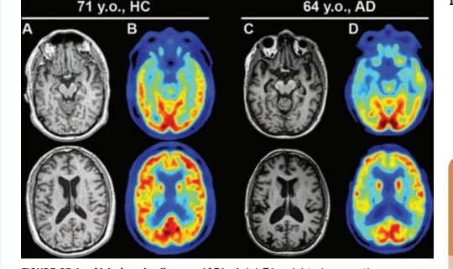

Slide 23
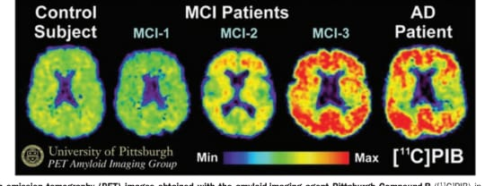

Slide 24
VASCULAR DEMENTIA
History of stroke, HTN, DM, AF, POVD
Sudden, stepwise deterioration
Spasticity
Focal neurological deficits
MRI : cortical, subcortical infarctions, diffuse white matter disease

Slide 25
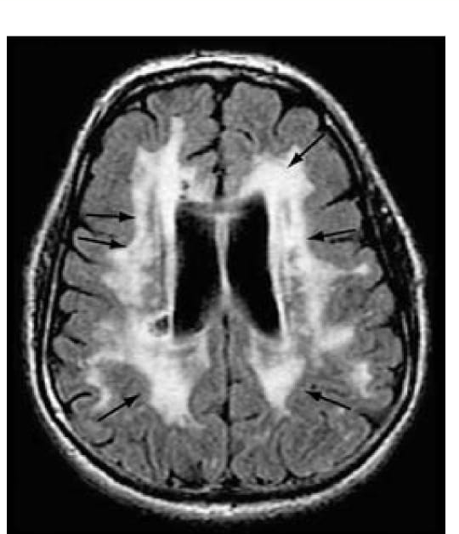

Slide 26
DEMENTIA WITH LEWY BODIES
Parkinsonism
Visual hallucinations, delusions
Capgrass syndrome
Proneness to delerium
Fluctuating alertness
MRI : Posterior parietal atrophy

Slide 27
FRONTOTEMPORAL DEMENTIA
Personality change
Disinhibition
Compulsive eating, weight gain
Apathy
Aphasia
Sparing of memory, visuo-spatial abilities
MRI : frontal, temporal atrophy
Anteriorly predominant cortical atrophy.

Slide 28
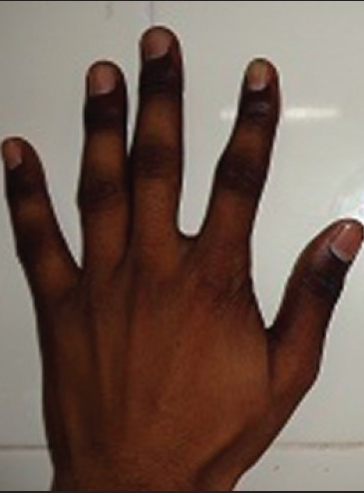
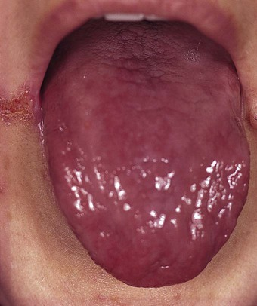
Vitamin B12 deficiency
Pallor
Beefy tongue
Knuckle hyperpigmentation
Pyramidal signs
Posterior column sensations
Rhombergs sign

Slide 29
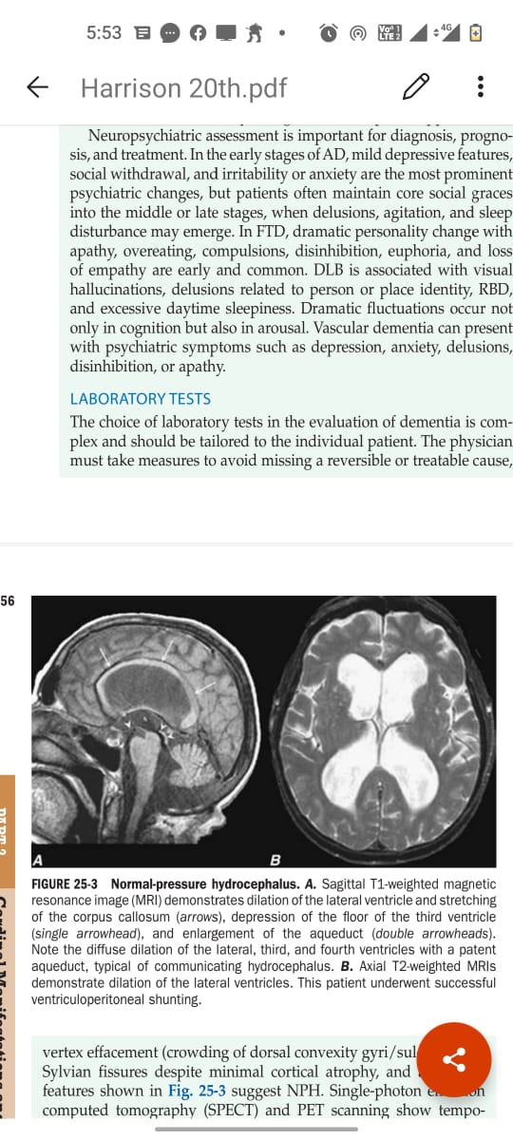
1. Early ataxia
Magnetic Gait
2. Dementia
3. Urinary incontinence
Therapeutic LP
VP shunt

Slide 30
WERNICKE ENCEPHELOPATHY
Deficiency of thiamine (vitamin B1) from chronic alcoholism, inadequate diet & protracted vomiting
consider in delerious alcoholics, hyperemesis gravidarum
Damage to the mamillary bodies, dorsomedial nuclei of the thalamus, periaqueductal grey matter
Acute presentation : nystagmus, ophthalmoplegia, ataxia and confusion
parenterally 200 mg 3 times daily for 48 hrs and then orally 100 mg 3 times daily.
Notes:
A rare but important effect of chronic alcohol misuse is the Wernicke– Korsakoff syndrome. This organic brain disorder results from damage to the mamillary bodies, dorsomedial nuclei of the thalamus and adjacent areas of periventricular grey matter; it is caused by a deficiency of thiamine (vitamin B1), most commonly from longstanding heavy drinking and an inadequate diet. It can also arise from malabsorption or even protracted vomiting. Without prompt treatment, the acute presentation of Wernicke’s encephalopathy (nystagmus, ophthalmoplegia, ataxia and confusion) can progress to the irreversible deficits of Korsakoff’s syndrome (severe short-term memory deficits and confabulation, and also reduced red blood cell transketolase). It must be considered in any confused patient; if in doubt, treat anyway. Prevention of the Wernicke–Korsakoff syndrome requires the immediate use of high doses of thiamine, which is initially given • 16 N E U R O L O G I C A L D I S E A S E 655 parenterally in the form of Pabrinex (two vials 3 times daily for 48 hrs) and then orally (100 mg 3 times daily). There is no treatment for Korsakoff’s syndrome once it has arisen.

Slide 31
Korsakoff’s syndrome
Severe short-term memory deficits
Unable to recall new information
Prior acquired knowledge is intact
Confabulation.
Mammillary body atrophy
No treatment

Slide 32
CRUETZFELDT JACOB DISEASE
Neurodegenerative prion disease
Rapidly progressing dementia : weeks to months
personality changes
Rigidity
90% have myoclonus
Death < One year from first symptom
EEG – Repetitive bursts of periodic complexes
MRI – Basal ganglia hyperintensity

Slide 33
Huntington’s disease
Autosomal dominant inherited disorder, usually presenting in adult life.
Gradually progressive chorea and behavioural disturbance are the earliest symptoms.
Cognitive impairment, which later becomes frank dementia.
Seizures may occur late in the disease.
Notes:
This is an autosomal dominant inherited disorder, usually presenting in adult life. It is due to expansion of a trinucleotide repeat on chromosome 4 and frequently demonstrates anticipation (younger age of onset in subsequent generations). Clinical features: Gradually progressive chorea and behavioural disturbance are the earliest symptoms. There is cognitive impairment, which later becomes frank dementia. Seizures may occur late in the disease. Investigations: The diagnosis is confirmed by genetic testing; presymptomatic testing for other family members is available but must be preceded by appropriate counselling. Brain imaging may show caudate atrophy but is not reliable. Management: Chorea may respond to risperidone or tetrabenazine. Depression is common and may be helped by antidepressant medication. Long-term psychological support and eventually institutional care are often needed

Slide 34
Subacute sclerosing panencephalitis
A rare, chronic, progressive and eventually fatal complication of measles.
Occurs in children and adolescents, usually many years after the primary virus infection.
The onset is insidious, with intellectual deterioration, apathy and clumsiness, followed by myoclonic jerks, rigidity and dementia.
The EEG is distinctive, with periodic bursts of triphasic waves.
Antiviral therapy is ineffective and death ensues within years
Notes:
This is a rare, chronic, progressive and eventually fatal complication of measles. It occurs in children and adolescents, usually many years after the primary virus infection. The onset is insidious, with intellectual deterioration, apathy and clumsiness, followed by myoclonic jerks, rigidity and dementia. The EEG is distinctive, with periodic bursts of triphasic waves. Antiviral therapy is ineffective and death ensues within years

Slide 35
Treatmnt of Dementia
Treat reversible causes
Provide support & comfort to the care givers & patient

Slide 36
Reversible causes
Hypothyroidism
B12, Thiamine deficiency
HIV : Antiretroviral therapy
Normal Pressure Hydrocephalus VP shunt
Treatment of CNS neoplasm
Removal of cognition impairing drugs

Slide 37
      THANK YOU

