Slide 1
TALKING ABOUT MADNESS!!
Dr Sooryalekshmi VS
JR1
M5 UNIT

Slide 2
Case summary
60 yr old male
C/c alcoholic
Known c/o T2DM / ALCOHOLIC LIVER DISEASE
Recent hospital admission 1 month back with hepatic encephalopathy

Slide 3
He needs assistance for his day-to-day activities , confined to home ,
Decreased interaction with family members * last 1 month
On the day of admission
He had 1 e/o seizure
H/o constipation +

Slide 4
Afebrile,jaundiced
Bp -140/90 mmhg
PR-96/’
GRBS 456 mg/dl
Drowsy
PEARL
Rigidity noted in both UL&LL
B/L plantar flexor
No neck stiffness

Slide 5
Except for few stigmata of CLD(clubbing,spider naevi) Patient did not have any other clinical findings of portal hypertension
Patient was remaining in the encephalopathy state even after correcting his high blood sugars
He was having a disproportionate encephalopathy which was recurrent (>2 episodes/yr) !!

Slide 6
INVESTIGATIONS
BRE –HB 14.2 mg/dl LFT Sbil- 4.4
TC -9800/mm T protein -6.6
Plt -3.6L S.alb-3.6
RFT-18/0.6
SE -143/3.9 OT/PT/ALP-42/54/109
S.Ca -8.5
s.Mg -2.1
PT (INR)???
Meld score??

Slide 7
USS ABD - ???
CT BRAIN – WNL
CSF TUDY –WNL
S. CERULOPLASMIN- 70 iu/l
S.AMMONIA – 180 micromol/l

Slide 8
WHY THAT WAS HAPPENING ?
Recurrent & persistent hepatic encephalopathy – frequently associated with large spontaneous portosystemic shunts(SPSS)

Slide 9
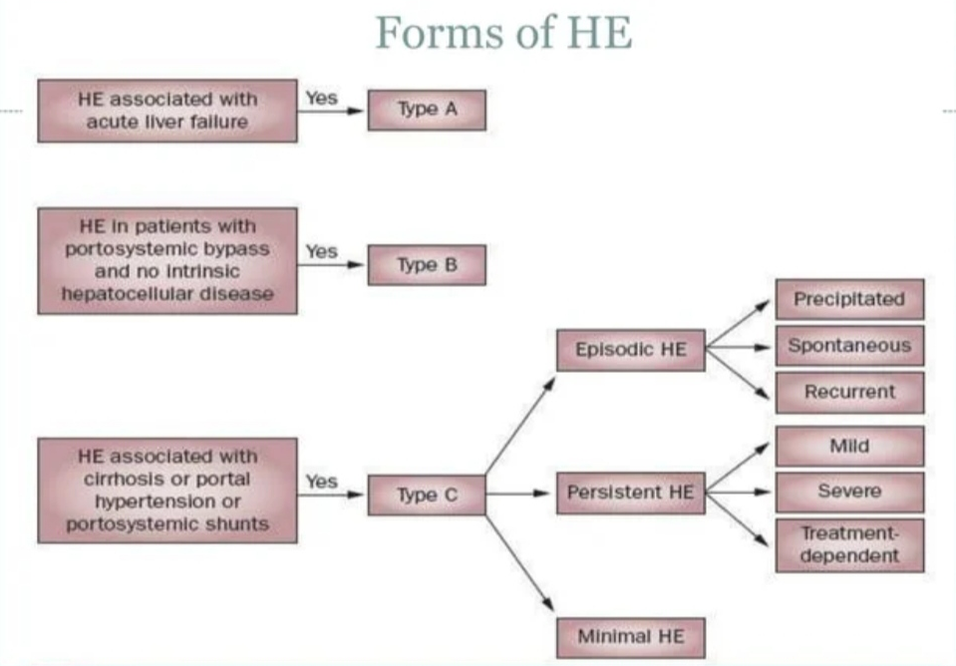
HEPATIC ENCEPHALOPATHY

Slide 10
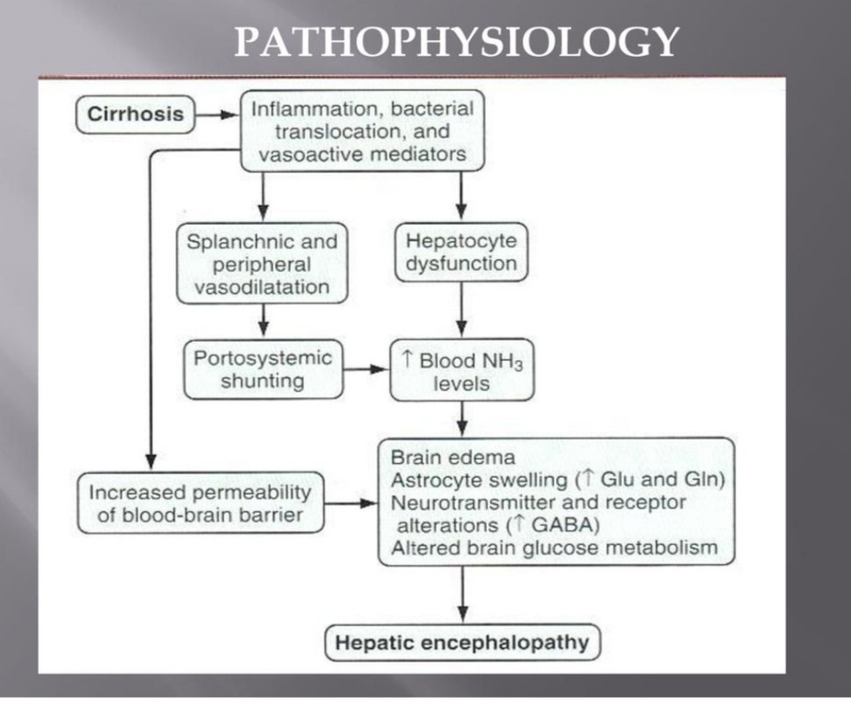
PATHOPHYSIOLOGY

Slide 11
Suspect SPSS if encephalopathy associated with
Low meld score 14
Less derangement of synthetic liver function
Less portal hypertension related complications
Recurrent hepatic encephalopathy
Disproportionate encephalopathy compared to liver dysfunction

Slide 12
For a diagnosis..
We requested for a portal venogram

Slide 13
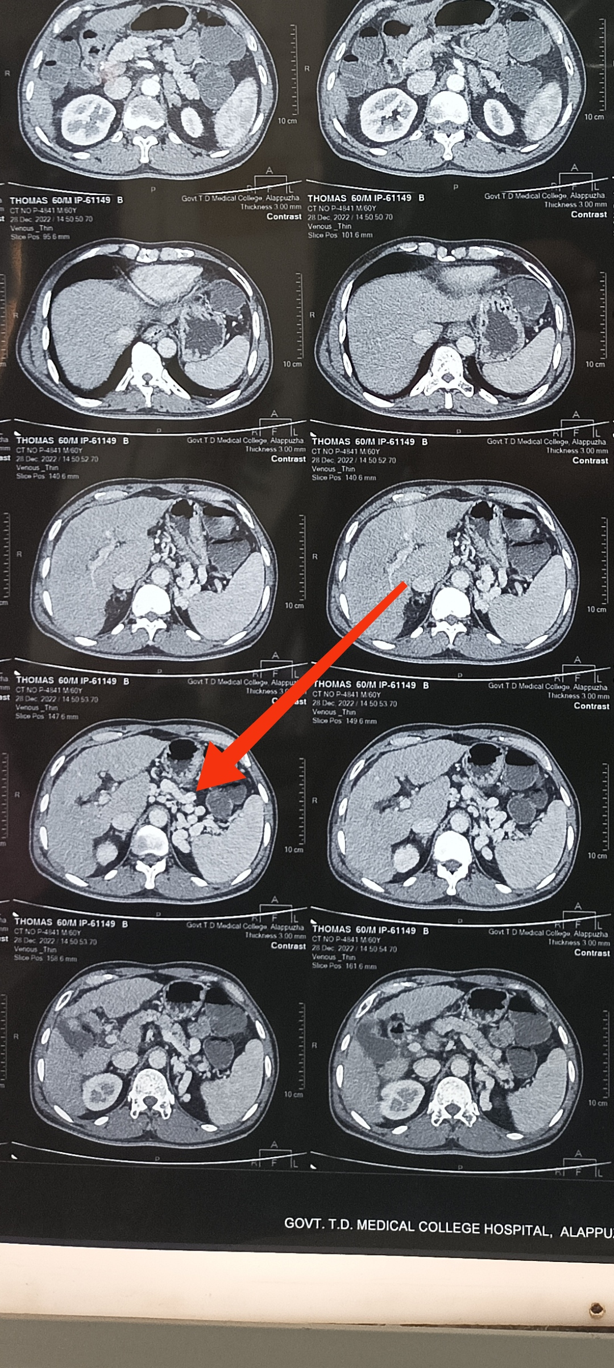
SPSS 2 types
Large > 8 mm
Small < 8mm
Our patient had : ???

Slide 14
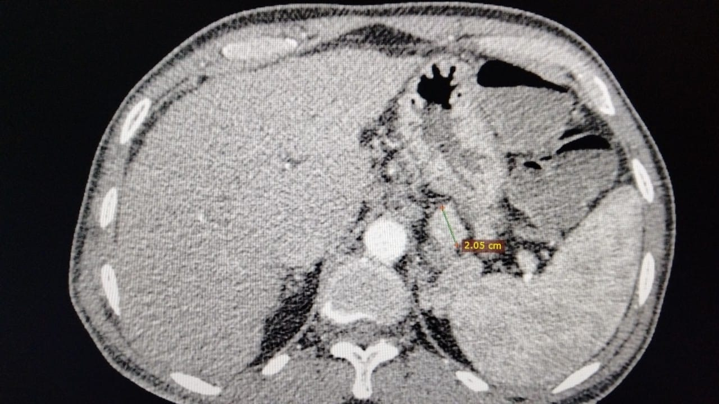

Slide 15
PORTOSYSTEMIC SHUNTS
Malformation of vessels – shunting of blood from portal vein to inferior venacava due to portal hypertension
Intrahepatic & extra hepatic
In liver cirrhosis - even in initial stages opening of embryologic extrahepatic portosystemic shunts
Release valves to reduce portal hypertension
By passes normal liver flow
Contribute to progression of liver disease

Slide 16
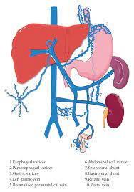
Common shunts are
LEFT SIDED SHUNTS
Gastrorenal - 80-85% patient with gastric varices
- Frequently associated with gastric variceal bleeding
Gastrocaval - gastric variceal bleeding
Splenorenal -14-21% of patients with cirrhosis
-Hepatic encephalopathy & portal vein thrombosis
CENTRAL
. Mesorenal – Uncommon
-Hepatic encephalopathy

Slide 17
RIGHT SIDED SHUNTS
Paraumbilical shunt – 6-30% of the patients with portal hyper tension
-Hepatic encephalopathy and portal vein thrombosis
Rectal varices - rare ; lower GI bleeding
Esophageal varices- 40-80% patient with cirrhosis
- hematemesis & malena

Slide 18
MANAGEMENT
EARLY STAGE - MELD score < 11 no significant portal hypertension related complications ( refractory / severe acites or recent variceal bleeding ) - embolisation
LATE STAGES - MELD score 12-14 , cosider each case individually
END STAGE - MELD Score >14 , PH related complications +
- severe hepatic dysfuction
- consider liver transplantation

Slide 19
THANK YOU

