Slide 1

DIABETES MELLITUS
CLASSIFICATION, PATHOGENESIS, DIAGNOSIS
Dr Hareesh M V
JR3 – General Medicine

Slide 2

Diabetes mellitus refers to a group of common metabolic disorders that share the phenotype of hyperglycemia.
Depending on the etiology factors contributing to hyperglycemia
reduced insulin secretion
decreased utilisation of glucose utilisation
increased glucose production.

Slide 3

GLOBAL CONSIDERATIONS
In 2017, the global estimate of diabetic individuals is 415 million.
Diabetic capital of the world is China followed(73 million) by INDIA
There is a shift of trend as far as type 2 DM is concerned, and it is starting to affect the younger population as well.

Slide 4
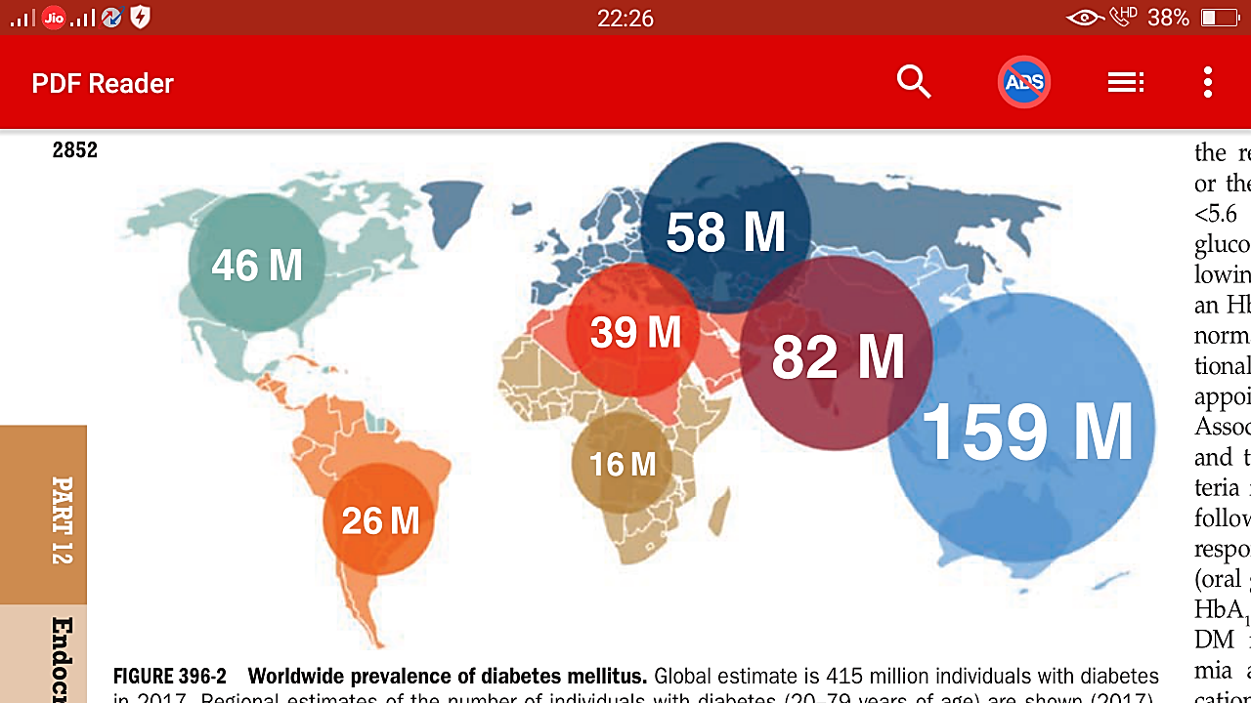

Slide 5
DIABETES IN 2015
China -109.6 million
India -73 million
United States -30.3 million
Brazil -14 million
Russian Federation -9 million
worldwide prevalence of DM has risen dramatically over the past two decades
(30 million cases in 1985 → 415 million in 2017)
prevalence of type 2 DM is rising much more rapidly
incidence of type 1 diabetes has been increasing at a rate of 3–5% per year worldwide

Slide 6
CLASSIFICATION OF
DIABETES MELLITUS

Slide 7
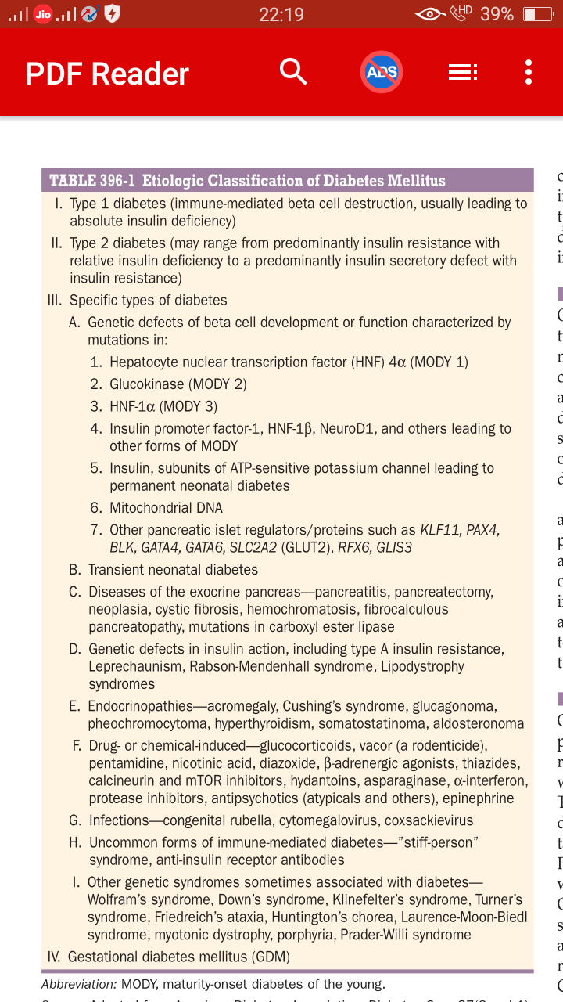

Slide 8
CLASSIFICATION OF DIABETES
There are 2 broad categories ; Type 1 and type 2
Type 1 results as a result of autoantibodies against insulin producing beta cells
Complete or near total insulin deficiency
Type 2 DM-variable degrees of insulin resistance, impaired insulin secretion and increased hepatic glucose production

Slide 9
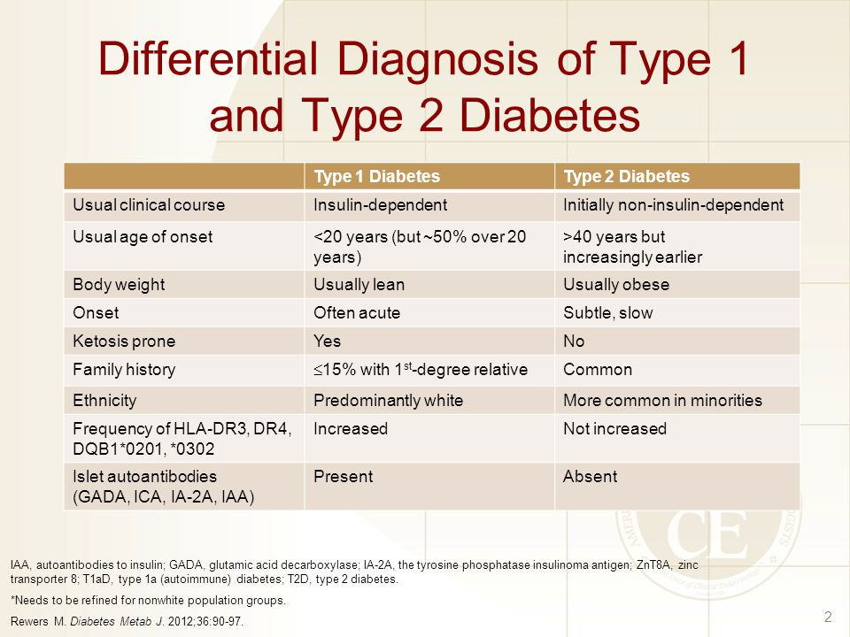

Slide 10
MONOGENIC DIABETES
Results from a single gene mutation involved in the production or release of insulin
MODY and neonatal diabetes are 2 major forms of monogenic diabetes
Neonatal diabetes is defined as occurrence of diabetes in the 1st 6 months of life and can be transient or permanent.

Slide 11
MODY(Maturity onset diabetes of the young)
14 types are recognised.
MODY 3 is the most common type(HNF 1^{α}) mutation.
The next most prevalent one is MODY 2(glucokinase gene mutation)
MODY 5

Slide 12
MODY 10, 11, 12, 13 Neonatal diabetes
MODY 6 and 7 : associated with obesity, insulin resistance and diabetes
MODY 14: mutation in the adaptor protein and leucine zipper gene

Slide 13
MODY
2-5% of patients diagnosed with diabetes before 30 yrs
It is believed that most of the patients remain underdiagnosed or misdiagnosed due to lack of awareness among clinicians
Mainly challenges are due to lack of diagnostic testing and financial constraints

Slide 14
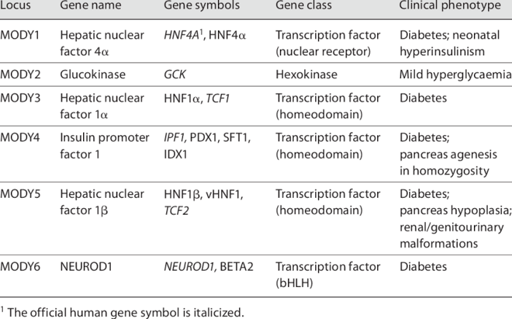

Slide 15
MODY-3
HNF 1 alpha mutation
Hyperglycemia and progressive beta cell failure
Reduced renal expression of Sodium glucose co transporter-2.
Complications similar to type1 or type 2; extremely sensitive to sulphonylureas

Slide 16
MODY-2(Glucokinase)
This enzyme converts glucose glucose-6-phosphate
Also important for glucose control in the hepatocytes and neurons
Clinically characterised by mild fasting hyperglycemia, present from birth
The glucose regulation is set at a higher point with normal first phase insulin secretion less post prandial glycemic excursion

Slide 17
BMI normal, first degree relative with MODY, persistent mild hyperglycemia
Sometimes even treatment might not be needed or some even do not respond to treatment
Less chance for microvascular and macrovascular complications.

Slide 18
MODY-5
HNF-1 β gene mutation
Extra pancreatic involvement- Renal cysts, renal tract malformation, renal dysplasia
Low birth weight, early onset diabetes, pancreatic atrophy and genital tract malformations
The patients will eventually require insulin

Slide 19
MODY???? How to suspect!!
<25yrs
Not yet treated with insulin
One of the parents is diabetic
In suspected cases get a genetic testing done

Slide 20
LATENT AUTOIMMUNE DIABETES OF THE ADULT
Various eponyms i.e. 1.5 diabetes, non insulin requiring autoimmune diabetes, slowly progressing Type 1
LADA is more likely to be misclassified as Type 2 because of the slow onset of hyperglycemia and relative lack of acute hyperglycemic crisis such as DKA.

Slide 21
Points we have to note
Phenotypically similar to type 2 DM
No signs of insulin resistance like acanthosis, skin tags or abdominal obesity.
Family or personal history of other autoimmune conditions like hashimotos/ celiac disease/ vitiligo/ pernicious anaemia

Slide 22
LADA SUSPECT!
Age 30-35 yrs
Presence of Autoantibodies(GAD-65)
Patient not requiring insulin for atleast 6 months after diagnosis
Autoimmune diseases(+)

Slide 23
PATHOPHYSIOLOGY OF LADA
Destruction of beta cells by auto antibodies
Beta cell function deteriorates faster than type 2 but slower than in Type 1
The progression might take several years before total beta cell failure ad that’s why they can survive without insulin for a few years

Slide 24
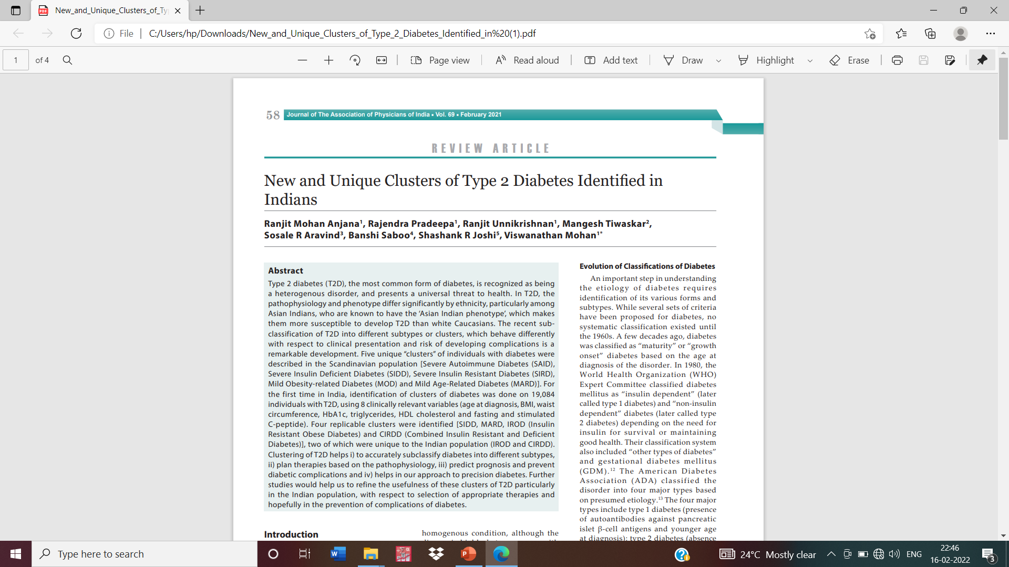
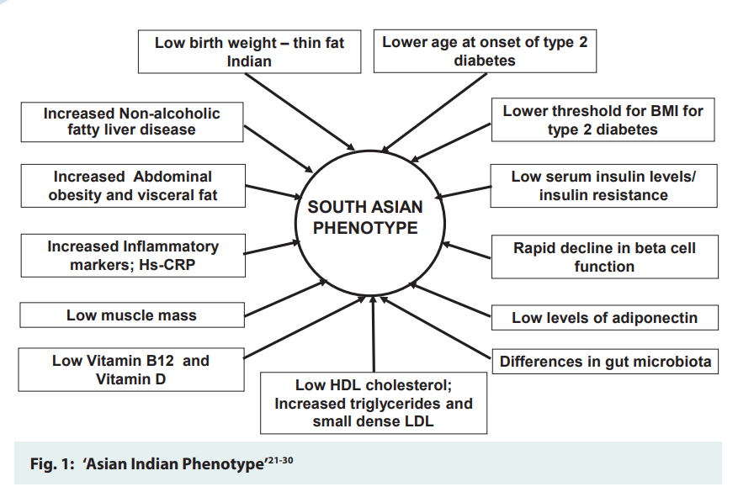

Slide 25
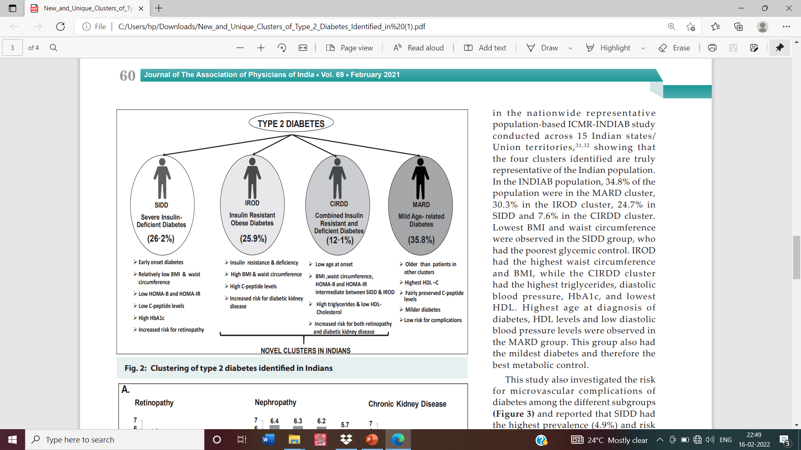

Slide 26
The recent subclassification of T2D into different subtypes or clusters, which behave differently with respect to clinical presentation and risk of developing complications is a remarkable development.
Five unique “clusters” of individuals with diabetes were described in the Scandinavian population
Severe Autoimmune Diabetes (SAID)
Severe Insulin Deficient Diabetes (SIDD)
Severe Insulin Resistant Diabetes (SIRD)
Mild Obesity-related Diabetes (MOD)
Mild Age-Related Diabetes (MARD)]

Slide 27
Diagnosis of Pre diabetes and IGT
Normal glucose tolerance: PRE- DIABETES
FBS<100mg/dl 100-125MG/DL
RBS after an OGTT <140mg/dl 140-199mg/dl
HBa1C<5.7% 5.7-6.4%
Pre diabetes is also synonymous with abnormal glucose homeostasis/intermediate hyperglycemia.

Slide 28
Pre diabetes- beyond the tip of the iceberg
The pathophysiology is beta cell dysfunction and insulin resistance.
In both glucose stimulated insulin secretion is impaired and there is fasting hyperinsulinemia due to a compensatory pancreatic beta cell reponse to fasting hyperglycemia.

Slide 29
IFG(Impaired fasting glucose) and IGT(impaired Glucose tolerance)
IFG is associated with more severe hepatic insulin resistance than IGT
IGT is associated with skeletal muscle resistance whereas as IFG is not.
It is predicted that 70% of the patients with pre diabetes can progress to type 2 diabetes. With annual incidence of 5-10%.

Slide 30

CRITERIA FOR THE DIAGNOSIS OF DIABETES
1)FBS>=126 mg/dl(7 mmol/l)
2)HBA1c>=6.5%
Symptoms of diabetes plus RBS>=200mg/dl (polyuria, polydipsia, weight loss)
2hour plasma glucose >200mg/dl following an OGTT

Slide 31
Screening for diabetes
Widespread use of Fasting Plasma glucose or HBA1c as the screening tool…why??
(1) A large no of individuals who meet the current criteria are asymptomatic and unaware that they have the disorder
(2)Studies show that type 2 DM may be present for upto a decade prior to the diagnosis

Slide 32
(3) Some individuals have one or more complications of diabetes along with the diagnosis.
(4) Treatment of diabetes might favourably alter the natural history of diabetes
(5)Diagnosis of pre diabetes should spur efforts for diabetes prevention

Slide 33
ADA recommendation is screening all individuals >45 years every 3 years and screening inviduals at an earlier age if they are over weight.
(BMI>25kg/m2)

Slide 34
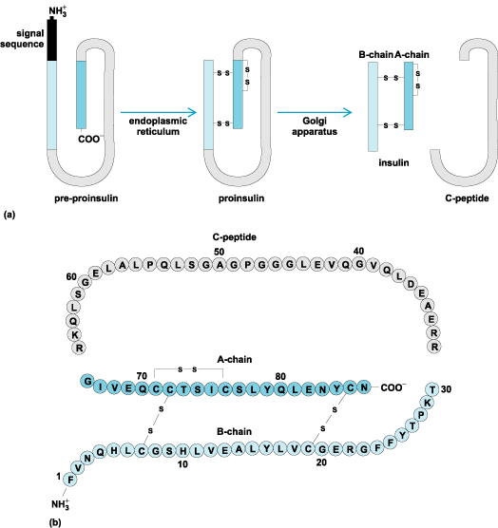
INSULIN BIOSYNTHESIS
Insulin is produced by the beta cells
86 amino acids

Slide 35
C peptide is cleared more slowly than insulin
So it is a useful marker of insulin secretion. Pancreatic beta cells co secrete islet amyloid polypeptide(IAPP) or amylin, along with insulin
The analogues are used for treating type 1 and type 2 DM

Slide 36
INSULIN SECRETION
Glucose is the key regulator of insulin secretion by the pancreatic cells
(amino acids, ketones, various nutrients, Gi peptides etc also influence the secretion)
Glucose levels >70mg/dl stimulate insulin synthesis by enhancing protein translation and processing.

Slide 37
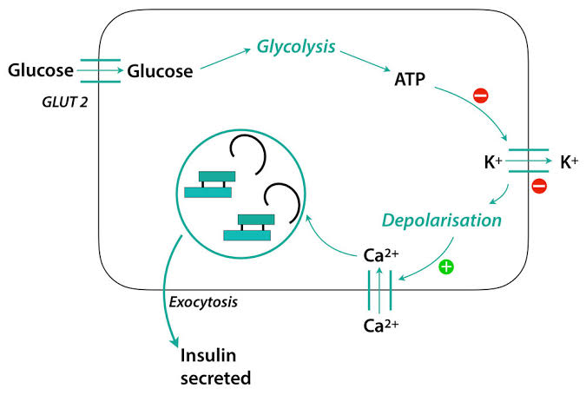
The K+ channel has 2 separate proteins, one is the binding site for OHA’s (sulfonylureas and meglitinide); and the other is inwardly rectifying potassium channel protein Kir 6.2

Slide 38
Glucagon like peptides and Glucose dependent insulinotropic peptide are incretin hormones that bind specific receptors on the beta cell
Stimulate insulin secretion through cyclic amp production
Incretins also suppress glucagon secretion
Secreted by the L cells of GIT following food ingestion.(also intraislet production is there.)

Slide 39
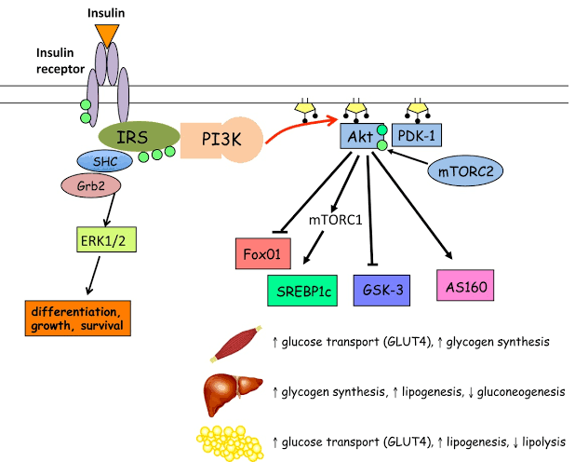

Slide 40
PATHOGENESIS OF TYPE 1 DIABETES
There is an interplay of genetic, environmental and immunologic factors ultimately lead to beta cell destruction.
In susceptible individuals the autoimmune process is thought to be triggered by an infectious or environmental stimulus.
In many individuals auto antibodies start appearing after this phase, followed by progressive loss of insulin secretion.

Slide 41
GENETIC CONSIDERATIONS
The major susceptibility gene for Type 1 DM is located on chromosome no.6
This region contains genes that encode the class II MHC molecules; they present antigen to helper T cells and are involved in initiating an immune response.
Most individuals with Type 1 DM have HLA DR3 and or/ DR4 haplotype
In addition to class II, 20 other genetic loci have been identified; ie promoter region of insulin gene, CTLA-4 gene, interleukin 2 receptor etc

Slide 42
Diabetes develops till there is a threshold level of insulin.
So till then there can be a phase of impaired glucose tolerance;
The events that trigger the transition from glucose intolerance to frank diabetes are often associated with increased insulin requirements like puberty and infections etc

Slide 43
Coxsackie, rubella, enterovirus
Bovine milk proteins
Vitamin D deficiency, environmental toxins
Nitrosourea compounds

Slide 44
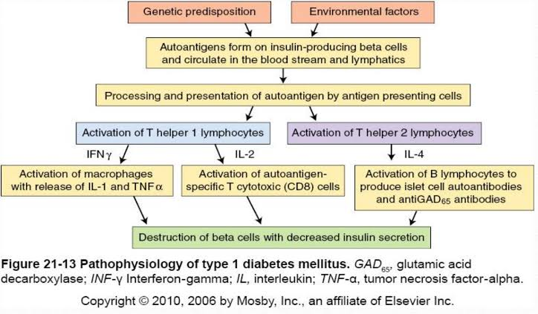

Slide 45
Alpha cells(glucagon producing) , delta cells(somatostatin producing) and pancreatic polypeptide producing cells(PP) are spared from the autoimmune destruction.
Alpha cell dysfunction is manifested by fasting hyperglucagonemia, post prandial hyperglucagonemia, and impaired glucose response to hypoglycaemia.
The modest infiltration of pancreatic islets by lymphocytes is referred to as insulitis.

Slide 46
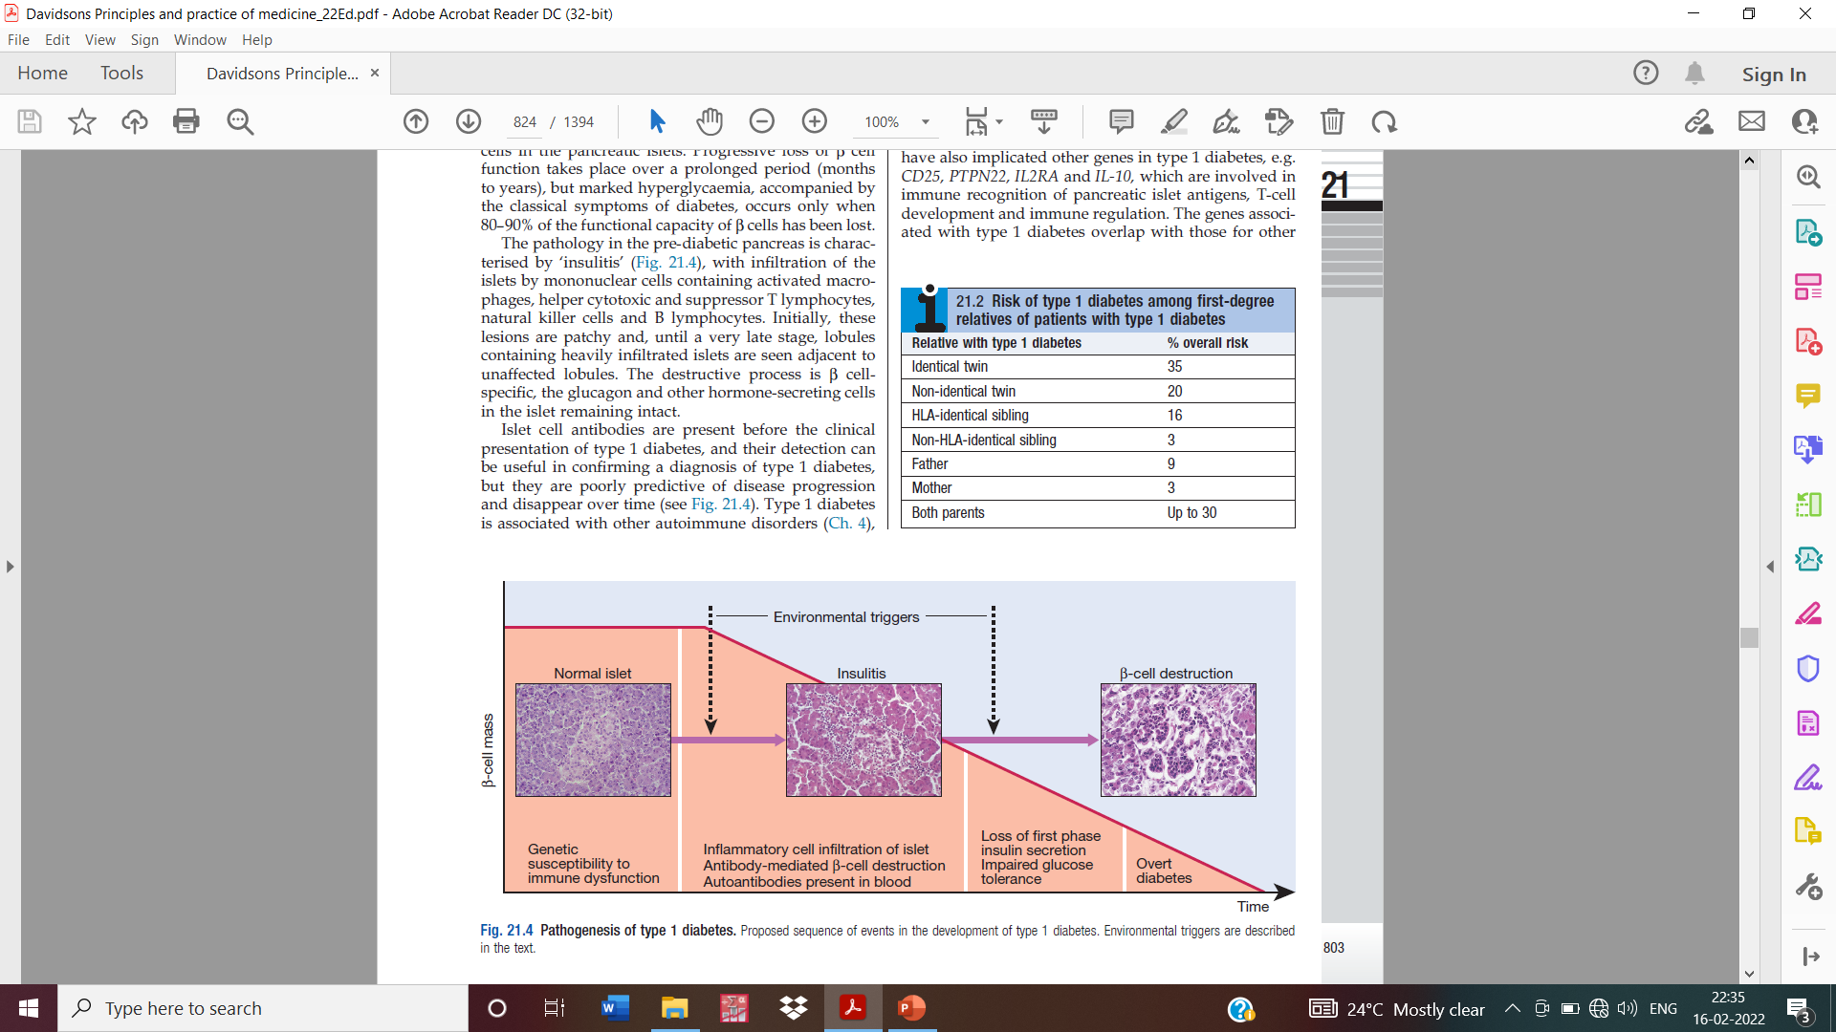

Slide 47
Islet cell autoantibodies are a composite set of several autoantibodies directed against pancreatic islet cell molecules.
Anti Gad 65 antibodies
Anti insulin antibodies
Anti IA-2/ICA 512 antibodies(tyrosine phosphatases)
Anti ZnT8 antibody
Islet antibodies are present in 85% patients with type 1 DM, 5-10% in type 2 DM and 5% in GDM

Slide 48
What is the risk of Type 1 diabetes???
3-4% if the parent has type 1 diabetes
5-15% if the sibling has Type 1 diabetes.
In relatives 3-4% show autoantibodies(1st degree relatives)
So in the background of impaired insulin secretion after IV glucose tolerance testing, they predict >50% chance of developing Type 1 in the next 5 yrs

Slide 49
TYPE 2 DIABETES MELLITUS
The central theme is Insulin resistance and abnormal insulin secretion.
Genetic considerations
Concordance between identical twins : 70-90%
If both parents are diabetic the chance for type 2 diabetes is around 40%.

Slide 50
The disease is polygenic and multifactorial(obesity, physical inactivity)
Mutation associated with Type 2 DM: transcription factor 7 like gene
Also related to polymorphisms associated with PPAR gamma, inward rectifying potassium channel, zinc transporter etc.

Slide 51
PATHOPHYSIOLOGY
Insulin resistance
Impaired insulin secretion
Excessive hepatic glucose production
Abnormal fat metabolism
Systemic low grade inflammation

Slide 52
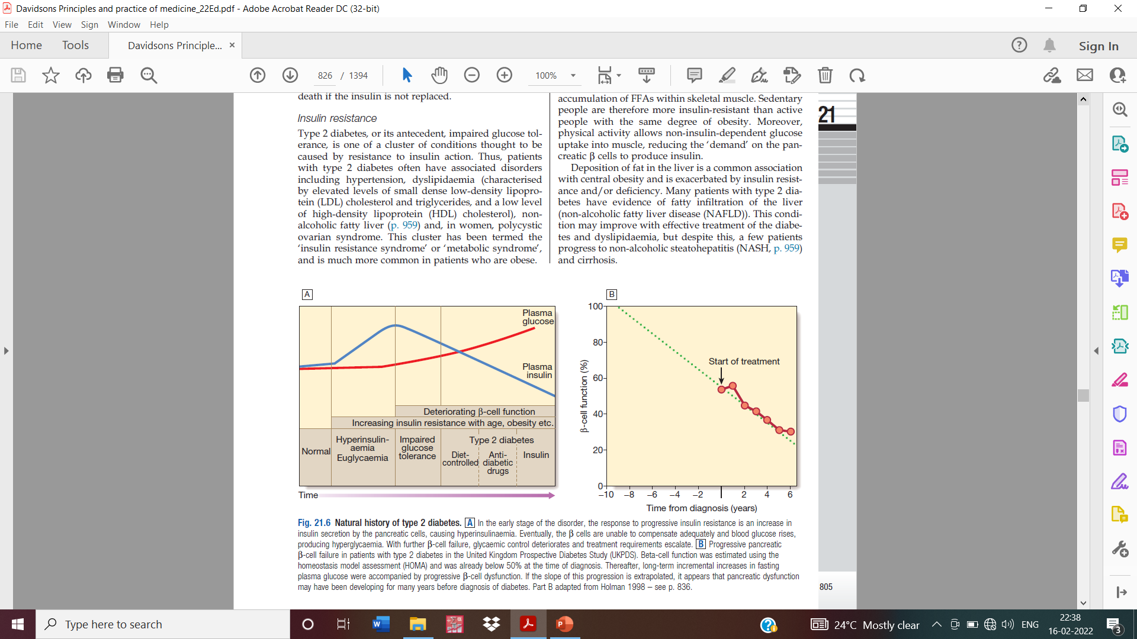

Slide 53
In the early stages, glucose tolerance remains near normal despite insulin resistance, because the pancreatic cells compensate by increasing the insulin output.
gradually β cells are unable to sustain the hyperinsulinemic state and their failure ensues.

Slide 54
METABOLIC ABNORMALITIES
Insulin resistance ie failure of insulin to act on the target tissues(muscle, liver and fat)
How???
In the initial phase there is hyperinsulinemia. So due to inadequate insulin suppression, glucagon levels also start rising.
This will further augment glucose output

Slide 55
Increased hepatic glucose output contributes to the increased FPG levels.
Decreased peripheral utilisation contributes to the post prandial hyperglycemia.
Secondary to hyperinsulinemia, insulin receptor levels and tyrosine kinase activity in the skeletal muscle are reduced
So “post receptor” defects in insulin related phosphorylation and dephosphorylation occurs.

Slide 57
Abnormal accumulation of lipid intermediates occurs within the myocytes; impairs mitochondrial oxidative phosphorylation
Reduces insulin stimulated mitochondrial ATP production.
Also generates reactive oxygen species.
Not all the pathways are resistant to the effects of insulin; The mitogen activated protein kinase pathway ensues and cell growth and differentiation happens.

Slide 58
Decrease in adiponectin also contributes to hepatic insulin resistance
FFA impair glucose utilization by skeletal muscle, promote glucose prod by liver
NEFFA, retinol binding protein 4 leptin, TNF alfa
Increased adipocyte mass

Slide 59
IMPAIRED INSULIN SECRETION
In type 2 DM, insulin secretion increases initially in response to insulin resistance-
initially the secretory defect is mild and is related to the glucose stimulated drive.
Abnormalities in “proinsulin” processing is reflected by increased secretion of proinsulin in type 2 DM

Slide 60
Amylin/IAPP secreted by the beta cells forms amyloid fibrillary deposits in long standing cases of diabetes.
FFA and systemic inflammation due to pro inflammatory cytokines worsen islet function.
GLP-1 action is also reduced and this can also contribute to insulin resistance.

Slide 61
INCREASED HEPATIC GLUCOSE AND LIPID PRODUCTION
Insulin resistance in the liver fasting hyperglycemia; failure of insulin to suppress gluconeogenesis.
Insulin resistance in the adipose tissue causes FFA flux, which needs to be cleared by the liver. This increases VLDL and triglycerides.
If the lipid is retained it causes steatosis in the liver and can lead on to NAFLD.

Slide 62
INSULIN RESISTANCE SYNDROMES
We have 2 types of insulin resistance syndromes.
Type A: affects young women and is characterised by hyperinsulinemia, obesity, and features of hyperandrogenism.
Type B: affects middle aged women and is characterised by severe hyperinsulinemia, hyperandrogenism and auto immune disorders.

Slide 63
Type A is due to some unidentified defect in the insulin signalling pathway
Type B insulin resistance syndrome have auto antibodies directed at the insulin receptor.
These antibodies may block insulin binding or may stimulate the insulin receptor leading to even hypoglycaemia.

Slide 64
Approach to a case of Diabetes!!!
Age of onset
Family history
Sleep history
Cardiovascular
Exercise
Smoking habits
Pancreatic disease
Ethanol use
Symptoms of hyperglycemia
Visual problems
Any recurrent infections like vaginitis, skin infections, slow healing of infections
History

Slide 65
Established case of diabetes; How to approach
What led to the diagnosis??
Emphasise on the treatment aspects, therapies tried,
prior HbA1c if tested, diabetic control, history of ketosis
PHYSICAL examination
Weight and BMI

Slide 66
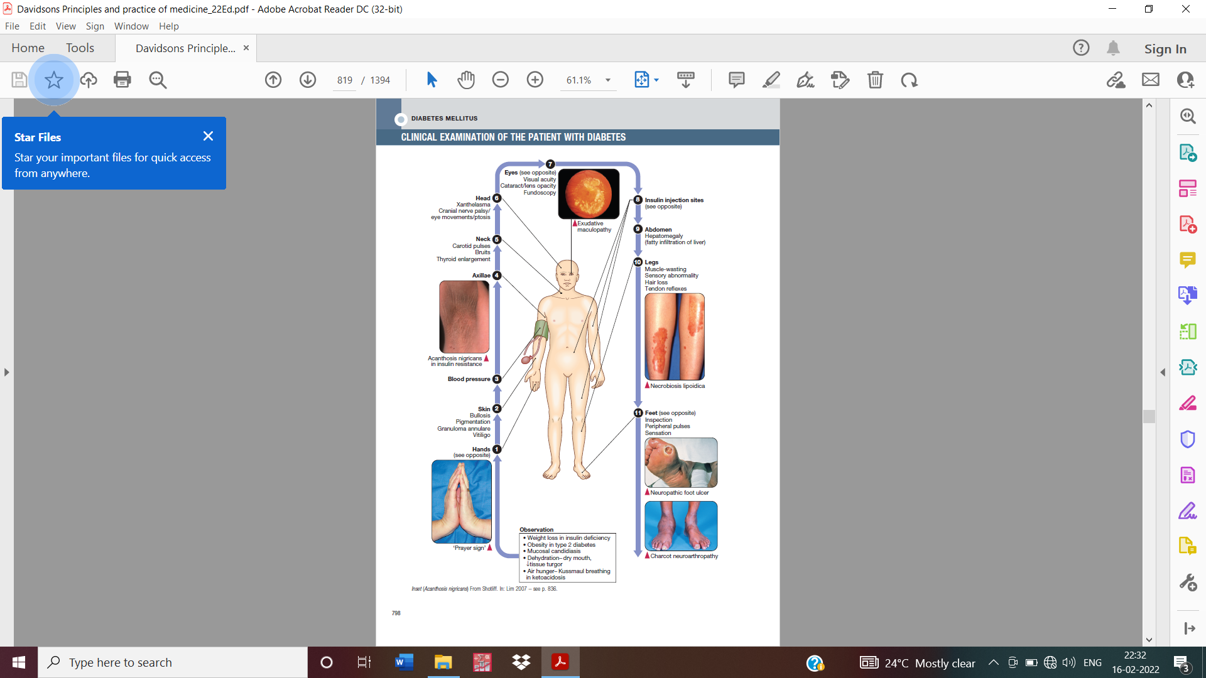

Slide 67
Blood pressure, ECG, Fundus examination, peripheral pulses
Foot examination-peripheral neuropathy, charcot joint
S.creatinine, Urine microalbumin SOS

Slide 68
CLASSIFICATION OF DIABETES IN AN INDIVIDUAL PATIENT
Type 1 DM:
Onset prior to 30 years
Lean body habitus
Requirement of insulin as the initial therapy
Propensity to develop ketoacidosis
Increased risk of other autoimmune disorders like adrenal insufficiency, pernicious anaemia, celiac disease, vitiligo, autoimmune thyroiditis.

Slide 69
Type 2 Diabetes Mellitus
1) Onset after 30 years
2)Usually obese(80%) individuals are obese
3)may not require insulin therapy early
4)May have associated conditions like insulin resistance, hypertension, cardiovascular disease, dyslipidemia, or PCOS

Slide 70
5-10% patients phenotype of Type 2 diabetes mellitus
Don’t have absolute insulin deficiency
Autoimmune markers positive
Age <50yrs, thinner
Have a personal or family history of autoimmune diseases than individuals with type 2 DM.
Latent autoimmune diabetes of the adult
Require insulin treatment earlier i.e within 5 years

Slide 71
Diabetes in childhood or early adulthood
Especially those diagnosed in the 1st 6 months of life
AD pattern of inheritance
No typical features of type 1 or Type 2 Dm
Stable mild fasting hyperglycemia.
Monogenic forms of diabetes
genetic testing may be done in such patients

Slide 72
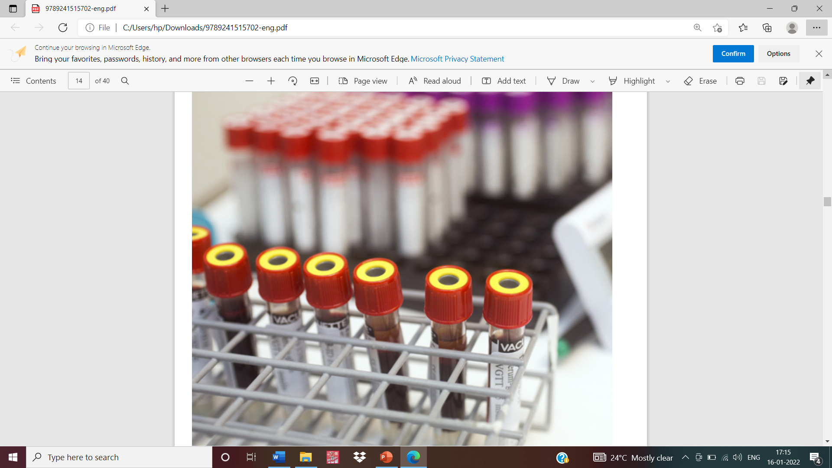
THANK YOU

