Slide 1
DEMYELINATING MYELOPATHY
Dr. Alby Maria Mathews

Slide 2
Inflammatory myelitis is applied to a heterogenous group of postinfectious, rheumatologic, granulomatous, paraneoplastic and demyelinating diseases.
Substantial overlap between clinical and imaging findings.
Identifying the relapsing forms has prognostic significance and may guide in treatment.

Slide 3
Diagnostic accuracy in myelopathy has been a challenge due to the multiple underlying pathophysiological mechanisms involved.
Temporal profile ( onset to symptom nadir) may help to differentiate the etiology.
Patients whose symptoms reach maximal within 4hrs are said to have ischemic etiology unless proven otherwise.
Inflammatory processes produce symptoms in a subacute manner hours to days.

Slide 4
Multiple sclerosis is the main form of inflammatory myelitis
Neuromyelitis optica spectrum disorder (NMOSD)
Acute disseminated encephalomyelitis (ADEM)
Anti-myelin oligodendrocyte glycoprotein (MOG)-antibodies associated disease
Glial fibrillary acidic protein (GFAP)-IgG associated disease.

Slide 5
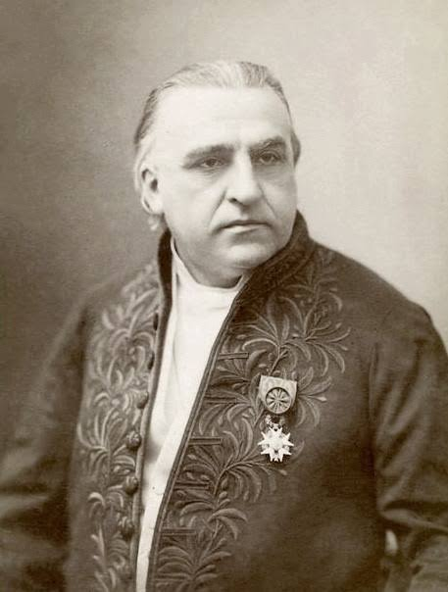
MULTIPLE SCLEROSIS
“Sclerose en plaques “

Slide 6
Autoimmune disease of the central nervous system
Chronic inflammation
Demyelination
Gliosis
neuronal loss

Slide 7
Variable clinical course
Benign →Rapidly evolving and incapacitating disease
Disseminated in time and place

Slide 8
CLINICAL MANIFESTATIONS
Onset- Abrupt / Insidious
Many times- Asymptomatic and insidious Radiological/ Autopsy finding

Slide 9
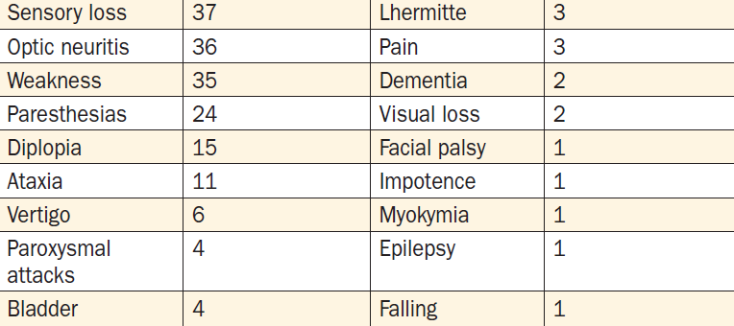
INITIAL SYMPTOMS OF MS & frequency%

Slide 10
Sensory symptoms – m/c symptoms
Paresthesia
Hypoesthesia
Unpleasant sensations
Pain is a common symptom →50% of patients. Pain can occur anywhere on the body and can change locations over time.
Spinal MS- sensory level + / Band like sensation +

Slide 11
Optic neuritis → Reduced visual acuity, decreased color perception
Can be mild or may progress to severe visual loss.
Generally monocular but may be bilateral.
Fundus-may be normal /papillitis
Optic atrophy commonly follows
Uveitis is uncommon

Slide 12
Weakness of the limbs
Exercise-induced weakness is a characteristic symptom of MS.
UMN type
Accompanied by other pyramidal signs such as spasticity, hyperreflexia, and Babinski signs.

Slide 13
Facial weakness
Lesion -pons
Resemble idiopathic Bell’s palsy
Not associated with ipsilateral loss of taste sensation or retro-auricular pain.

Slide 14
Spasticity - associated with spontaneous and movement-induced muscle spasms.
>30% patients - moderate to severe spasticity, especially in the legs.
Interfere with ambulation, work, or self-care.

Slide 15
Visual blurring
Optic Neuritis or diplopia
Diplopia may result from INO or from palsy of the sixth cranial nerve (rarely the third or fourth).
A bilateral INO is particularly suggestive of MS.
Other
a horizontal gaze palsy
“one and a half” syndrome (horizontal gaze palsy plus an INO)
acquired pendular nystagmus.

Slide 16
Ataxia- cerebellar tremors /cerebellar dysarthria (scanning speech).
Vertigo- from a brainstem lesion
Hearing loss -uncommon

Slide 17
Ancillary Symptoms
Paroxysmal symptoms
Brief duration (10 s to 2 min)
high frequency (5–40 episodes per day)
lack of any alteration of consciousness
self-limited course (generally lasting weeks to months).
include Lhermitte’s symptom/tonic seizures/paroxysmal dysarthria and ataxia/ paroxysmal sensory disturbances etc.

Slide 18
Lhermitte’s symptom -electric shock–like sensation (typically induced by flexion of the neck) that radiates down the back into the legs. It is generally self-limited but may persist for years. Lhermitte’s symptom can also occur with other disorders of the cervical spinal cord (e.g., cervical spondylosis).
Trigeminal neuralgia, hemifacial spasm, and glossopharyngeal neuralgia -when the demyelinating lesion involves the root entry (or exit) zone of the fifth, seventh, and ninth cranial nerve, respectively.
Most cases of trigeminal neuralgia are not MS related
atypical features such as onset before age 50 years, bilateral symptoms, objective sensory loss, or non paroxysmal pain -possibility of MS

Slide 19
Facial myokymia -It results from lesions of the corticobulbar tracts or brainstem course of the facial nerve.
Heat sensitivity -neurologic symptoms produced by an elevation of the body’s core temperature (due to transient conduction block).
Unilateral visual blurring may occur during a hot shower or with physical exercise (Uhthoff’s symptom).

Slide 20
Bladder dysfunction - >90% of MS patients
Detrusor hyperreflexia, due to impairment of suprasegmental inhibition, causes urinary frequency, urgency, nocturia, and uncontrolled bladder emptying.
Detrusor sphincter dyssynergia, due to loss of synchronization between detrusor and sphincter muscles, causes difficulty in initiating and/or stopping the urinary stream, producing hesitancy, urinary retention, overflow incontinence, and recurrent infection.

Slide 21
Sexual dysfunction
Constipation
Depression
Fatigue -90% of patients

Slide 22
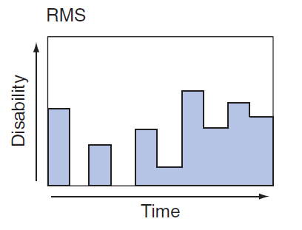
DISEASE COURSE
Three clinical types
1.Relapsing MS (RMS)
90% of MS cases
Discrete attacks of neurological dysfunction that generally evolve over days to weeks
There is often substantial or complete recovery
Between attacks, patients are neurologically stable.

Slide 23
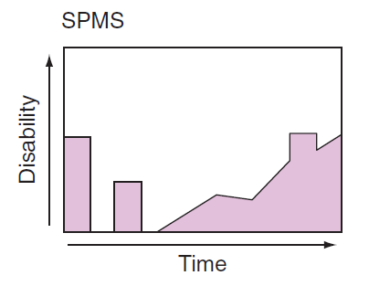
Secondary progressive MS (SPMS)
Always begins as RMS
Clinical course changes- deterioration in function unassociated with acute attacks.
RMS → risk of developing SPMS is 2% year, → majority of RMS ultimately evolves into SPMS.

Slide 24
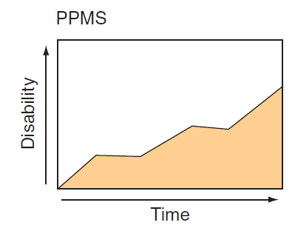
Primary progressive MS (PPMS)
10% of cases.
Do not experience attacks → steadily decline in function from disease onset.
Mean age -40 years
Disability develops faster

Slide 25
Epidemiology
women – 3 times common
Age- 20 and 40 years
Highest Prevalence- Orkney Islands, North of Scotland / temperate zones ( Low sunlight exposure)
Tropics (e.g., Asia, equatorial Africa, and the Middle East)- X 10-20 times less

Slide 26
Well-established risk factors for MS
Genetic predisposition
Vitamin D deficiency
Epstein-Barr virus (EBV) exposure after early childhood
Cigarette smoking

Slide 27
GENETICS
Whites > Africans
Susceptibility to MS is polygenic
Strongest susceptibility -HLA-DRB1 gene in class II MHC

Slide 28
PATHOGENESIS
Perivenular infiltration by inflammatory mononuclear cells(T cells and macrophages )
also the surrounding white matter
blood-brain barrier disrupted, but vessel wall is preserved.
myelin-specific autoantibodies
complement is activated.
Demyelination - pathological hallmark
Relative sparing of axons+
small numbers of B lymphocytes

Slide 29
surviving oligodendrocytes or those that differentiate from precursor cells partially remyelinate the surviving axons, producing so-called shadow plaques
As lesions evolve, there is prominent astrocytic proliferation (gliosis) and the term sclerosis refers to these gliotic plaques that have a rubbery or hardened texture at autopsy

Slide 30
Latest theory
Ectopic lymphoid follicles- aggregates of T, B, and plasma cells (resembling secondary lymphoid tissue)
Meninges, especially overlying deep cortical sulci/ in perivascular spaces and less commonly within brain parenchyma.
More prevalent in progressive MS
Located in proximity to cortical plaques
diffused factors from these ectopic follicles contribute to subpial cortical demyelination and neurodegeneration

Slide 31
Inflammation is always present when active demyelination or axonal injury occurs
presence of T-cell and B-cell infiltration is related to the extent of demyelination and axonal injury.
Nature of the inflammatory response - different between early and later stages of MS.
In relapsing MS, inflammation is associated with focal perivenular parenchymal infiltration of lymphocytes and monocytes associated with BBB disruption and active demyelination.

Slide 32
Progressive MS inflammation is more diffuse and is characterized by widespread microglial activation. Acute perivascular infiltrates are fewer in number, and lymphocytes and monocytes in chronic MS plaques aggregate at the lesion border suggesting ongoing inflammatory injury at the lesion edge.
A diffuse low-grade inflammation with microglial proliferation is observed across large areas of white matter, associated with reduced myelin staining and axonal injury (“dirty white matter”).
ongoing inflammation occurs behind a partially repaired BBB
failure of immunotherapies not capable of crossing the BBB to benefit patients with progressive MS.

Slide 33
Physiology
Conduction block occurs when the nerve impulse is unable to traverse the demyelinated segment.
Axon membrane becomes hyperpolarized due to the exposure of voltage-dependent potassium channels that are normally buried underneath the myelin sheath (temporary)
sodium channels (originally concentrated at the nodes) redistribute along the naked axon
This redistribution ultimately allows continuous propagation of nerve action potentials through the demyelinated segment.

Slide 34
Variable conduction block can occur with raised body temperature or metabolic alterations and may explain clinical fluctuations that vary from hour to hour or appear with fever or exercise.
Conduction slowing occurs when the demyelinated segments of the axonal membrane are reorganized to support continuous (slow) nerve impulse propagation.

Slide 35
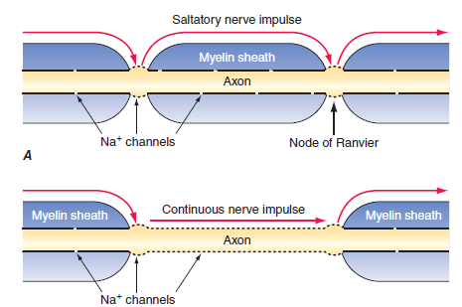

Slide 36
IMMUNOLOGY
A proinflammatory autoimmune response directed against a component of CNS myelin, and other neural elements, remains the cornerstone of current concepts of MS pathogenesis.

Slide 37
AUTOREACTIVE T LYMPHOCYTES
Myelin basic protein (MBP)- an intracellular protein involved in myelin compaction→ important T cell antigen
Activated MBP-reactive T cells have been identified in the blood, in cerebrospinal fluid (CSF), and within MS lesions.

Slide 38
HUMORAL AUTOIMMUNITY
B cell activation and antibody responses are also involved in the development of demyelinating lesions.
Myelin-specific autoantibodies, some directed against an extracellular myelin protein, myelin oligodendrocyte glycoprotein (MOG), have been detected bound to vesiculated myelin debris in MS plaques.
In the CSF, elevated levels of locally synthesized immunoglobulins and oligoclonal antibodies, derived from clonally restricted CNS B cells and plasma cells, are also characteristic of MS

Slide 39
NEURODEGENERATION
Axonal damage occurs in every newly formed MS lesion, and cumulative axonal and neuronal loss is considered to be the most important contributor to irreversible neurologic disability.
Demyelination can result in reduced trophic support for axons, redistribution of ion channels, and destabilization of action potential membrane potentials.
Axons can adapt initially to these injuries, but over time distal and retrograde degeneration (“dying–back” axonopathy) occurs.
Axonal and neuronal death may result from glutamate-mediated excitotoxicity, oxidative injury, iron accumulation, and/or mitochondrial failure either occurring as a consequence of free-radical damage or due to accumulation of deletions in mitochondrial DNA

Slide 40
DIAGNOSIS
There is no single diagnostic test for MS.
Documentation of two or more episodes of symptoms and two or more signs that reflect pathology in anatomically noncontiguous white matter tracts of the CNS
Symptoms must last for >24 h and occur as distinct episodes that are separated by a month or more.
In patients who have only one of the two required signs on neurologic examination, the second may be documented by abnormal tests such as MRI or evoked potentials (EPs).

Slide 41
The second clinical event (in time) may be supported solely by MRI findings, consisting of either the development of new focal white matter lesions on MRI or the simultaneous presence of both an enhancing lesion and a non enhancing lesion in an asymptomatic location.
In patients whose course is progressive from onset for ≥6 months without superimposed relapses, documentation of intrathecal IgG synthesis may be used to support a diagnosis of PPMS.

Slide 42
Revised McDonald Criteria
1)
2 or more attacks
objective clinical evidence of 2 or more lesions or
objective clinical evidence of 1 lesion with reasonable historical evidence of a prior attack

Slide 43
2)
2 or more attacks
Objective clinical evidence of 1 lesion
Dissemination in space, demonstrated by
≥1 T2 lesion on MRI in at least 2 out of 4 MS-typical regions of the CNS (periventricular, juxtacortical, infratentorial, or spinal cord)
OR
Await a further clinical attack implicating a different CNS site

Slide 44
3)
1 attack
objective clinical evidence of 2 or more lesions
Dissemination in time, demonstrated by
Simultaneous presence of asymptomatic gadolinium-enhancing and non enhancing lesions at any time
OR
A new T2 and/or gadolinium-enhancing lesion(s) on follow-up MRI, irrespective of its timing with reference to a baseline scan
OR
Await a second clinical attack

Slide 45
4)
1 attack
objective clinical evidence of 1 lesion (clinically isolated syndrome)
Dissemination in space and time, demonstrated by
For dissemination in space
• ≥1 T2 lesion in at least 2 out of 4 MS-typical regions of the CNS (periventricular, juxtacortical, infratentorial, or spinal cord)
OR
• Await a second clinical attack implicating a different CNS site

Slide 46
AND
For dissemination in time
• Simultaneous presence of asymptomatic gadolinium-enhancing and non enhancing lesions at any time
OR
• A new T2 and/or gadolinium-enhancing lesion(s) on follow-up MRI, irrespective of its timing with reference to a baseline scan
OR
• Await a second clinical attack

Slide 47
5)
Progressive Primary MS (PPMS)
1 year of disease progression (retrospectively or prospectively determined)
PLUS
2 out of the 3 following criteria
Evidence for dissemination in space in the brain based on ≥1 T2+ lesions in the MS-characteristic periventricular, juxtacortical, or infratentorial regions
Evidence for dissemination in space in the spinal cord based on ≥2 T2+ lesions in the cord
Positive CSF (oligoclonal bands and/or elevated IgG index)

Slide 48
MRI
Characteristic abnormalities are found in >95% of patients
>90% of the lesions visualized by MRI are asymptomatic.
Disrupted BBB is detected by leakage of intravenous gadolinium (Gd) into the parenchyma - marker of inflammation.
Lesions are frequently oriented perpendicular to the ventricular surface, corresponding to the pathologic pattern of perivenous demyelination (Dawson’s fingers).
Lesions are multifocal within the brain, brainstem, and spinal cord.

Slide 49
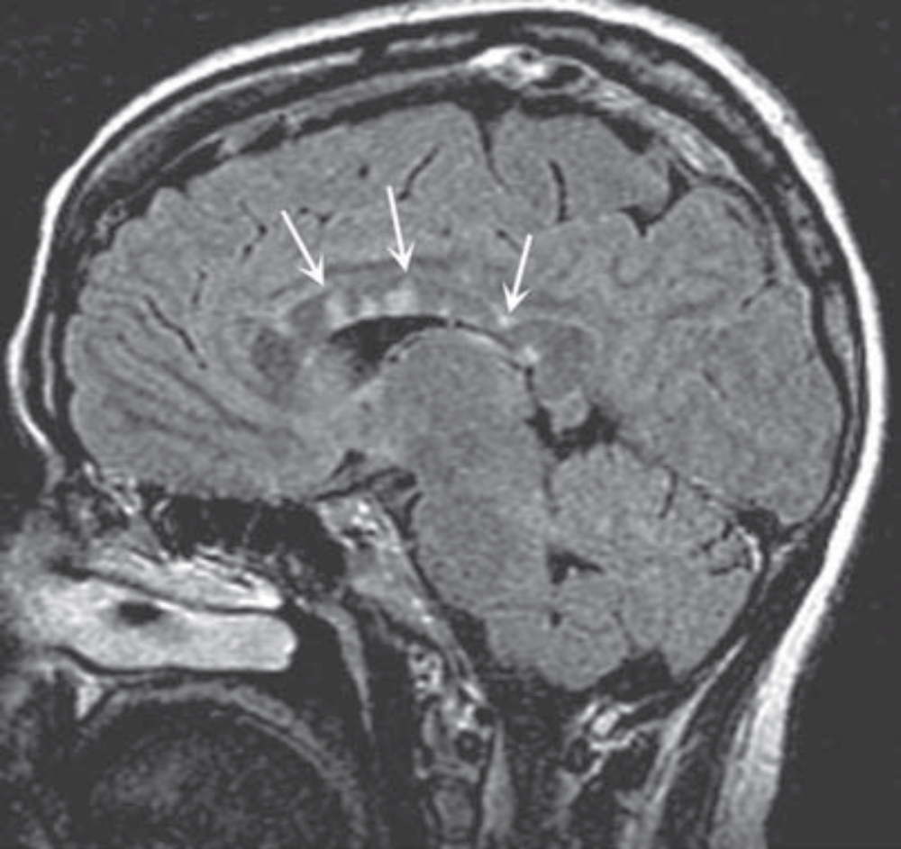
Dawson’s fingers

Slide 50
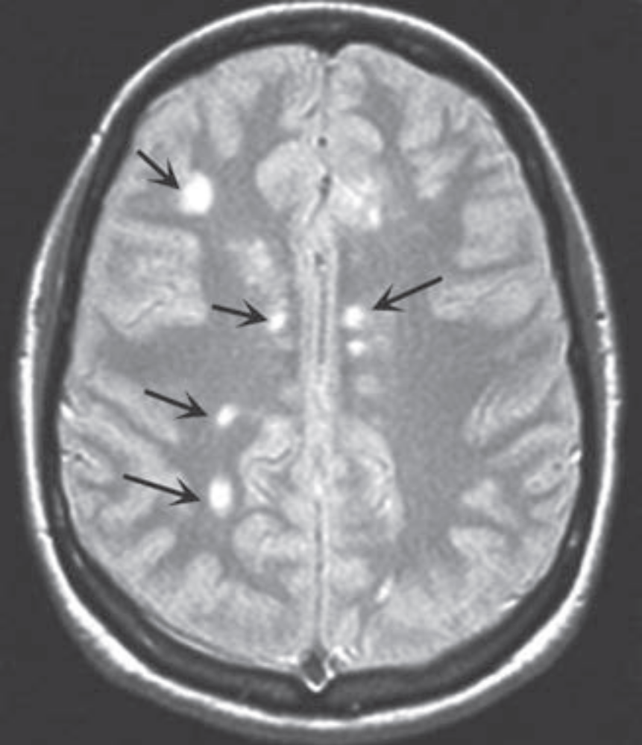
T2 lesions

Slide 51
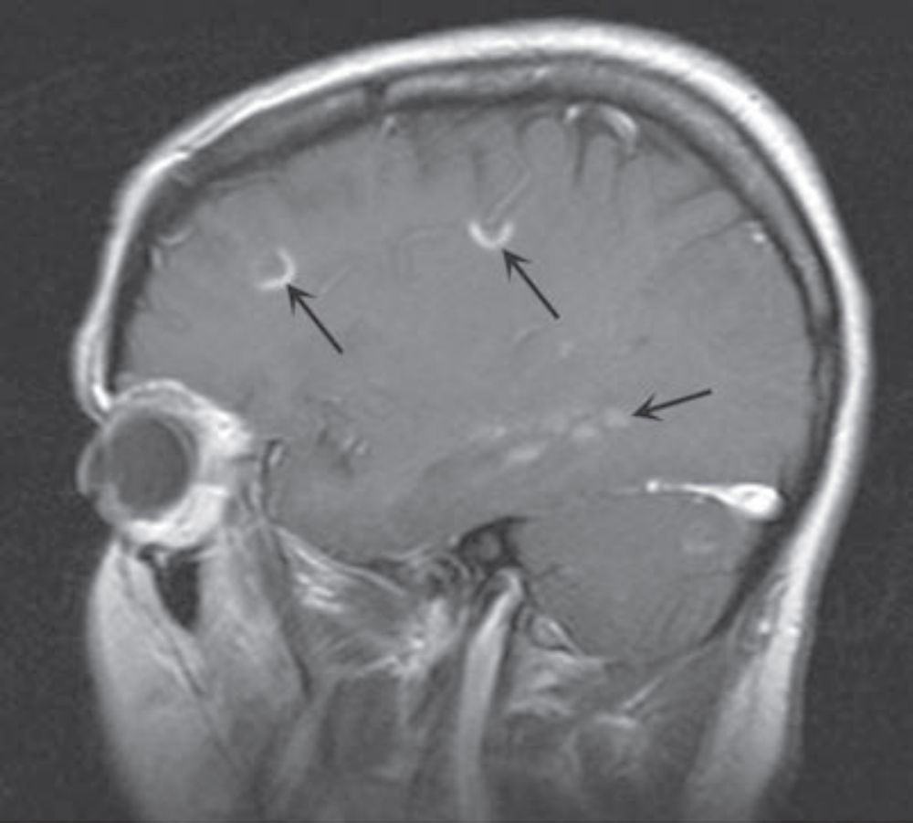
T1 lesions after Gd- disrupted BBB

Slide 52
Evoked Potentials
It assesses function in afferent (visual, auditory, and somatosensory) or efferent (motor) CNS pathways.
These tests provide the most information when the pathways studied are clinically uninvolved.
Abnormalities on one or more EP modalities occur in 80–90% of MS patients.

Slide 53
Cerebrospinal Fluid
Mononuclear cell pleocytosis
Increased level of intrathecally synthesized IgG.
The total protein is usually normal or mildly elevated.
CSF IgG index - Ratio of IgG to albumin in the CSF divided by the same ratio in the serum. ( to distinguish intrathecaly synthesized igG))
OCBs by agarose gel electrophoresis - intrathecal production of IgG.
A mild CSF pleocytosis (>5 cells/μL) is present in 25% of cases, usually in young patients with RMS.
A pleocytosis of >75 cells/μL, the presence of polymorphonuclear leukocytes, or a protein concentration >1 g/L →patient may not have MS.

Slide 54
DIFFERENTIAL DIAGNOSIS
Consider if…
symptoms are localized exclusively to the posterior fossa, cranio cervical junction, or spinal cord
Patient is <15 or >60 years of age
Clinical course is progressive from onset
Patient has never experienced visual, sensory, or bladder symptoms
Laboratory findings (e.g., MRI, CSF, or EPs) are atypical
Uncommon or rare symptoms in MS (e.g., aphasia, parkinsonism, chorea, isolated dementia, severe muscular atrophy, peripheral neuropathy, episodic loss of consciousness, fever, headache, seizures, or coma)

Slide 55
Disorders mistaken for MS
Neuromyelitis Optica
Sarcoidosis
Vascular disorders (antiphospholipid syndrome and vasculitis)
CNS lymphoma
Syphilis
Lyme disease.
ESR, serum B12 level, anti-nuclear antibodies, and treponemal antibody should be obtained in all patients with suspected MS.

Slide 56
Mimickers of Multiple Sclerosis
Acute disseminated encephalomyelitis (ADEM)
Antiphospholipid antibody syndrome
Behcet's disease
Cerebral autosomal dominant arteriopathy, subcortical infarcts, and leukoencephalopathy (CADASIL)
Congenital leukodystrophies (e.g., adrenoleukodystrophy, metachromatic leukodystrophy)
Human immunodeficiency virus (HIV) infection
Ischemic optic neuropathy (arteritic and nonarteritic)
Lyme disease
Mitochondrial encephalopathy with lactic acidosis and stroke (MELAS)
Neoplasms (e.g., lymphoma, glioma, meningioma)

Slide 57
Sarcoid
Sjogren's syndrome
Stroke and ischemic cerebrovascular disease
Syphilis
Systemic lupus erythematosus and related collagen vascular disorders
Tropical spastic paraparesis (HTLV-1/2 infection)
Vascular malformations (especially spinal dural AV fistulas)
Vasculitis (primary CNS or other)
Vitamin B12 deficiency

Slide 58
Effect of Pregnancy
Fewer attacks than expected (especially in the last trimester)
More attacks than expected in the first 3 months postpartum
Overall disease course is unaffected
Disease-modifying therapy is generally discontinued during pregnancy

Slide 59
TREATMENT
Treatment of acute attacks
Treatment with disease-modifying agents that reduce the biologic activity of MS
Symptomatic therapy.
Treatments that promote remyelination or neural repair do not currently exist

Slide 60
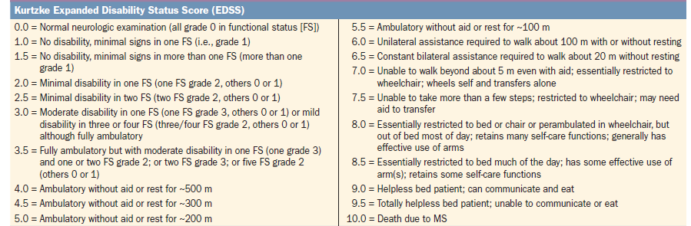
Kurtzke EDSS

Slide 61
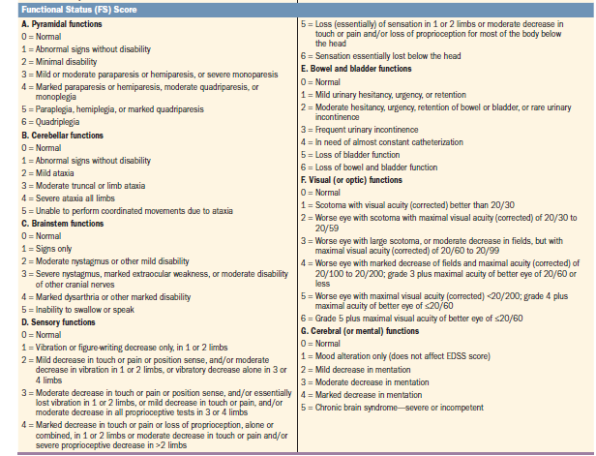

Slide 62
ACUTE ATTACKS / INITIAL DEMYELINATING EPISODES
New disease activity or a pseudo exacerbation (increase in ambient temperature, fever, or an infection)
Glucocorticoids for either first attacks or acute exacerbations.
Reduce the severity and shorten the duration of attacks.
Mild attacks are often not treated.
Physical and occupational therapy can help with mobility and manual dexterity.
IV Methylprednisolone, 500–1000 mg/d for 3–5 days → oral prednisone beginning at a dose of 60–80 mg/d and gradually tapered over 2 weeks.

Slide 63
Plasma exchange (five to seven exchanges: 40–60 mL/kg per exchange, every other day for 14 days) may benefit patients with fulminant attacks of demyelination that are unresponsive to glucocorticoids.

Slide 64
DISEASE-MODIFYING THERAPIES FOR RELAPSING FORMS OF MS
FREQUENTLY USED AGENTS FOR RMS

Slide 65
Interferon beta (Modestly Effective)
IFN-β reduces the attack rate and slows accumulation of disability and MRI-documented disease burden
IFN-β-1a (Avonex), 30 μg, IM once every week.
IFN-β-1a (Rebif), 44 μg, S/C three times per week.
IFN-β-1b (Betaseron or Extavia), 250 μg S/C every other day.
Pegylated IFN-β-1a (Plegridy), 125 μg S/C once every 14 days.

Slide 66
Common side effects-
flulike symptoms (e.g., fevers, chills, and myalgias
elevated liver function tests or lymphopenia
Rarely, more severe hepatotoxicity
Reactions at the injection site (e.g., pain, redness, induration, or, rarely, skin necrosis).

Slide 67
Glatiramer Acetate (Modestly Effective)
Polypeptide composed of four amino acids (l-glutamic acid, l-lysine, l-alanine, and l-tyrosine).
Mechanism of action
induction of antigen-specific suppressor T cells
Binding to MHC molecules, thereby displacing bound MBP
Altering the balance between proinflammatory and regulatory cytokines.

Slide 68
Glatiramer acetate reduces the attack rate
Considered as an equally effective alternative to IFN-β
20 mg every day or 40 mg thrice weekly S/C Injection
ADR
Local Reactions
Flushing, chest tightness, dyspnea, palpitations, and anxiety after injection
Lipoatrophy
FDA approved as a biosimilar medication (Glatopa) and is dosed at 20 mg every day.

Slide 69
Fingolimod (Moderately Effective)
Sphingosine-1- phosphate (S1P) inhibitor
Prevents the release of lymphocytes from secondary lymphoid organs such as the lymph nodes and spleen.
Daily oral dosing schedule makes it convenient for patients.
0.5 mg, is administered orally each day.

Slide 70
ADR
Elevated liver function tests or lymphopenia
First / second-degree heart block and bradycardia
Disseminated varicella-zoster and cryptococcal infections
QT prolongation

Slide 71
Dimethyl Fumarate (DMF) (Moderately Effective)
Krebs cycle metabolite
Modulate the expression of proinflammatory and anti-inflammatory cytokines.
Twice-daily oral dosing
Less Compliance than fingolimod
240 mg orally twice each day
ADR
abdominal discomfort, nausea, vomiting, flushing, and diarrhea
flushing mild decreases in neutrophil and lymphocyte counts and elevations in liver enzymes.
progressive multifocal leukoencephalopathy (PML)

Slide 72
Natalizumab (Highly Effective)
Humanized monoclonal antibody directed against the α4 subunit of α4β1 integrin-on the surface of lymphocytes.
Natalizumab - reduces the attack rate and significantly improves all measures of disease severity in MS (clinical and MRI).
Monthly IV infusions - 300 mg
<10% of patients experience hypersensitivity reactions
6% develop neutralizing antibodies to the molecule

Slide 73
ADR
Risk of PML- infection by the John Cunningham (JC) virus.
PML has occurred in 0.4% of patients treated with natalizumab.
JC antibody status be assessed at 6-month intervals in all patients receiving natalizumab treatment.
In antibody-positive patients, a change to another disease-modifying therapy should be strongly considered.
Natalizumab is generally recommended only for JC antibody–negative patients

Slide 74
Ocrelizumab (Highly Effective)
Humanized monoclonal antibody directed against the CD20 molecule present on the surface of mature B cells
600 mg is administered by IV every 24 weeks
ADR
Infusion-related reactions - with the first infusion , usually mild
Risk of increased malignancies including breast cancer

Slide 75
LESS COMMONLY USED AGENTS FOR RMS

Slide 76
Teriflunomid (modestly effective)
Inhibits mitochondrial enzyme dihydro-orotate dehydrogenase
de novo pyrimidine biosynthesis from carbamoyl phosphate and aspartate
active metabolite of the drug leflunomide
Limiting the proliferation of rapidly dividing T and B cells
daily oral dosing
7 or 14 mg, is administered orally each day
ADR
mild hair thinning and gastrointestinal symptoms (nausea and diarrhea)
toxic epidermal necrolysis or Stevens-Johnson syndrome
teratogenicity (pregnancy category X)
can remain in the bloodstream for 2 years due to hepatobiliary reabsorption.

Slide 77
Alemtuzumab (Highly Effective)
Humanized monoclonal antibody directed against the CD52 antigen - monocytes and lymphocytes.
Causes lymphocyte depletion (of both B and T cells)
ADR
autoimmune diseases including thyroiditis, Graves’ disease, thrombocytopenia, hemolytic anemia, pancytopenia, anti glomerular basement membrane disease, and membranous glomerulonephritis
Malignancies including thyroid cancer, melanoma, breast cancer, human papillomavirus (HPV)–related cancers, and lymphoproliferative disorders including lymphoma
Infections
Infusion reactions.

Slide 78
Mitoxantrone Hydrochloride (Highly Effective)
12 mg/m2 every 3 months upto 2-3 years
Antineoplastic action
intercalating into DNA and producing both strand breaks and inter strand cross-links
Interfering with RNA synthesis
Inhibiting topoisomerase II (involved in DNA repair).
ADR
Cardiotoxic (cumulative dose >140 mg/m2 is not recommended
Amenorrhea, which may be permanent
Risk of acute leukemia
Now rarely used for MS.

Slide 79
Daclizumab
Anti CD25, the α subunit of the interleukin 2 receptor
Withdrawn in 2018 because of reports of brain inflammation

Slide 80
Selecting Treatment
Mild - (EDSS ≤2.5 or less) or low disease activity
Either an injectable (IFN-β or glatiramer acetate) or an oral (DMF, fingolimod, or teriflunomide) agent is reasonable.
Natalizumab is more effective than these agents, and, therefore, this therapy can be considered even in minimally affected, JCV antibody–seronegative patients.
Ocrelizumab is more effective than IFN-β-1a can be considered regardless of JCV serology status

Slide 81
Moderate or Severe / Highly active disease (EDSS >2.5)
Either a highly effective oral agent (DMF or fingolimod) or ocrelizumab or, if the patient is JC virus antibody seronegative, infusion therapy with natalizumab is recommended.
Delay initiating treatment in patients with (1) normal neurologic examinations, (2) a single attack or a low attack frequency, and (3) a low burden of disease as assessed by brain MRI.
vitamin D deficiency should be corrected in all patients with MS, and generally this requires oral supplementation with vitamin D3, 4000–5000 IU daily.

Slide 82
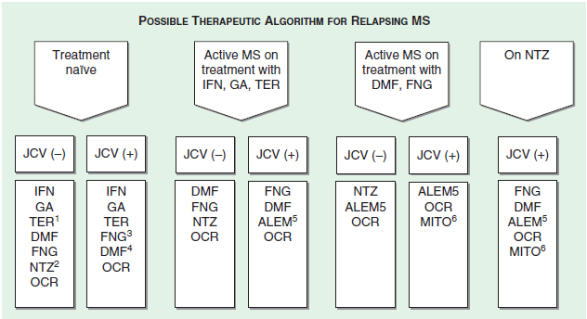

Slide 83
DISEASE-MODIFYING THERAPIES FOR PROGRESSIVE MS
SPMS
High-dose IFN-β probably has a beneficial effect
IFN-β is probably ineffective in patients with SPMS who do not have active disease.
Other agents have not yet been studied in this patient population.
PPMS
Ocrelizumab - reduce progression of clinical disability in PPMS by 24%, and also to improve other clinical and MRI markers of inflammatory and degenerative disease activity
First agent to convincingly modify the course of PPMS

Slide 84
OFF-LABEL TREATMENT OPTIONS FOR RMS AND SPMS
Azathioprine (2–3 mg/kg per day) has been used primarily in relapsing MS.
Marginally effective at lowering relapse rates
Methotrexate (7.5–20 mg/week) -slow the progression of upper extremity dysfunction in SPMS.
Cyclophosphamide (700 mg/m2, every other month) may be helpful for treatment-refractory patients who are (1) otherwise in good health, (2) ambulatory, and (3) <40 years of age.

Slide 85
Intravenous immunoglobulin (IVIg), administered in monthly pulses (up to 1 g/kg) for up to 2 years, appears to reduce annual exacerbation rates.
Methylprednisolone -as monthly high-dose intravenous pulses, reduce disability progression in one study
Hematopoietic stem cell transplantation appears to be highly effective in reducing the occurrence of relapses and may improve disability in relapsing MS.

Slide 86
SYMPTOMATIC THERAPY
Encourage a healthy lifestyle-a healthy diet, and regular exercise as tolerated (swimming is often well-tolerated because of the cooling effect of cold water).
Correct vitamin D deficiency with oral vitamin D.
Ataxia/tremor is often intractable. Clonazepam, 1.5–20 mg/d; primidone, 50–250 mg/d; propranolol, 40–200 mg/d; or ondansetron, 8–16 mg/d. Wrist weights occasionally reduce tremor in the arm or hand. Thalamotomy and deep-brain stimulation
Spasticity and spasms -physical therapy, regular exercise, and stretching.
Avoidance of triggers (e.g., infections, fecal impactions, bed sores).
Medications include baclofen (20–120 mg/d), diazepam (2–40 mg/d), tizanidine (8–32 mg/d), dantrolene (25–400 mg/d), and cyclobenzaprine hydrochloride (10–60 mg/d).

Slide 87
Weakness can sometimes be improved with the use of potassium channel blockers such as 4-aminopyridine (20 mg/d) and 3,4-di-aminopyridine (40–80 mg/d), particularly in the setting where lower extremity weakness interferes with the patient’s ability to ambulate.
Pain is treated with anticonvulsants (carbamazepine, 100–1000 mg/d; phenytoin, 300–600 mg/d; gabapentin, 300–3600 mg/d; or pregabalin, 50–300 mg/d), antidepressants (amitriptyline, 25–150 mg/d; nortriptyline, 25–150 mg/d; desipramine, 100–300 mg/d; or venlafaxine, 75–225 mg/d), or antiarrhythmics (mexiletine, 300–900 mg/d)

Slide 88
Bladder dysfunction –
Evening fluid restriction or frequent voluntary voiding . propantheline bromide (10–15 mg/d), oxybutynin (5–15 mg/d), hyoscyamine sulfate (0.5–0.75 mg/d), tolterodine tartrate (2–4 mg/d), or solifenacin (5–10 mg/d)
Urinary tract infections- treated promptly.
Prevention by urine acidification (with cranberry juice or vitamin C) inhibits some bacteria. Prophylactic administration of antibiotics is sometimes necessary
Intermittent catheterization may help to prevent recurrent infections and reduce overflow incontinence.
Constipation includes high-fiber diets and fluids. Natural or other laxatives may help.
Depression - selective serotonin reuptake inhibitors (fluoxetine, 20–80 mg/d, or sertraline, 50–200 mg/d), the tricyclic antidepressants (amitriptyline, 25–150 mg/d; nortriptyline, 25–150 mg/d; or desipramine, 100–300 mg/d), and the nontricyclic antidepressants (venlafaxine, 75–225 mg/d).

Slide 89
Fatigue -assistive devices, help in the home
Excessive daytime somnolence caused by MS may respond to amantadine (200 mg/d), methylphenidate (5–25 mg/d), modafinil (100–400 mg/d), or armodafinil (150–250 mg/d).
Cognitive problems may respond marginally to lisdexamfetamine (40 mg/d).
Heat sensitivity may respond to heat avoidance, air-conditioning, or cooling garments.

Slide 90
Acute Disseminated encephalomyelitis (ADEM)

Slide 91
ADEM has a monophasic course
Frequently associated with an antecedent infection (postinfectious encephalomyelitis)
5% cases follow vaccination (postvaccinal encephalomyelitis)
Commoner in children than in adults

Slide 92
Pathology
Hallmark of ADEM is the presence of widely scattered foci of perivenular inflammation and demyelination that can involve both white matter and grey matter structures.
Explosive form – acute haemorrhagic leucoencephalitis in which the lesions are vasculitic and haemorrhagic with a devastating clinical course.

Slide 93
ADEM is associated with measles, varicella , rubella, mumps, influenza, parainfluenza, EBV, HHV6, HIV, dengue, Zika , Mycoplasma pneumoniae, covid 19.
Some patients may have nonspecific upper respiratory infection or no antecedent infection.
Post vaccinal encephalomyelitis may follow may follow the administration of vaccine for small pox, rabies and Japanese encephalomyelitis.

Slide 94
Result from a cross reactive immune response to the infectious agent or vaccine that triggers an inflammatory demyelinating response.
Autoantibodies to MBP and MOG may be detected in the CSF.

Slide 95
Clinical manifestations
Neurologic syndrome begins late in the course of the viral illness.
Fever , headache, menigismus and lethargy
May progress to seizures, coma
Signs of disseminated neurologic disease- hemiparesis, quadriparesis, extensor plantar responses, lost or hyperactive tendon responses, sensory loss or brainstem involvement.
ADEM due to chicken pox- cerebellar involvement is conspicuous.

Slide 96
diagnosis
CSF protein is modestly elevated (50-150) mg/dL
Lymphocytic pleocytosis (more than 200 cells/uL) -80 % patients.
Transient CSF oligoclonal banding
MRI-
Extensive white matter hyperintensities on T2 and FLAIR in the brain and spinal cord.
Gd enhancement on T1 weighted sequences.

Slide 97
Diagnosis is most reliably established when there is history of recent vaccination or viral exanthematous illness.
Acute encephalitis with HSV/ HIV need to be excluded when there is predominant cerebral involvement.
Other dds: APLA, autoimmune limbic encephalitis, vasculitis, neurosarcoid, primary CNS lymphoma or metastatic cancer.

Slide 98
An explosive presentation of MS may mimic ADEM.
Simultaneous onset of disseminated symptoms, meningismus, drowsiness, coma and seizures are common in ADEM.
Optic nerve involvement- bilateral
Transverse myelopathy is complete.
MRI- extensive relatively symmetric white matter abnormalities, Gd enhancement of all abnormal areas.
OCBs are more common in MS

Slide 99
Initially classified as ADEM may have relapses
May be reclassified as MS, NMOSD
Recurrent ADEM has also been reported.

Slide 100
Treatment
Initial treatment is with high dose glucocorticoids
May be continued up to 8 weeks depending upon the response.
Patients who fail to respond within a few days may benefit from IVIG or plasma exchange.
Mortality rates 5-20%
Many survivors have permanent neurologic sequalae.

Slide 101
Glial fibrillary acidic protein (GFAP) autoimmunity

Slide 102
Pathology- autoimmunity against the astrocyte protein GFAP
25 % cases- paraneoplastic syndrome (esp ovarian teratoma)
Can coexist with anti NMDA receptor encephalitis or NMOSD
Presents with range of symptoms
Meningismus, encephalitis, myelitis and optic neuritis.

Slide 103
MRI- characteristic pattern of Gd enhancement in GFAP enriched CNS regions.
Venous structures in periventricular radial orientation, leptomeninges, periependymal spinal cord, serpiginious pattern in brain parenchyma.
Similarity in pattern with neurosarcoidosis.
CSF – lymphocytic pleocytosis
Antibodies against GFAP- CSF and serum

Slide 104
Treatment
Generally glucocorticoid responsive.
Relapses occur in 20 % cases and require immunosuppressive therapy.

Slide 105
Neuromyelitis optica

Slide 106
Also called as devic’s diaease
Aggressive inflammatory disease
Characterized by recurrent attacks of optic neuritis and myelitis
NMO spectrum disorder – includes partial forms
More frequent in women
Mean age of onset 40 yrs

Slide 107
Pathology
Autoimmune disease
Antibody against aquaporin-4- present in 90 % cases
AQP 4 localized on foot process of astrocytes ; paranodal regions near node of ranvier.
Antibody mediated complement fixation leading to axonal injury

Slide 108
Clinical features
Attacks of ON can be bilateral and produce severe visual loss.
Myelitis- severe and transverse; typically longitudinally extensive
Typically a recurring disease
Progressive symptoms do not typically occur.
Respiratory failure from cervical myelitis

Slide 109
Brain MRI:
areas of nonspecific signal change
Lesions associated with specific syndromes: hypothalamus (endocrinopathy); area postrema( vomiting or intractable hiccups); cerebral hemispheres (encephalopathy, seizures, focal symptoms)
Spinal cord MRI :
focal areas of swelling and tissue destruction extending over three or more spinal segments centred on the grey matter)

Slide 110
CSF findings- pleocytosis with neutrophils and eosinophils in acute cases.
Oligoclonal bands uncommon (<20 %)

Slide 111
Diagnostic Criteria for Neuromyelitis Optica Spectrum Disorder
CORE CLINICAL CHARECTERISTICS
1. Optic neuritis
2. Acute myelitis
3. Area postrema syndrome: episode of otherwise unexplained hiccups or nausea or vomiting
4. Acute brainstem syndrome
5. Symptomatic narcolepsy or acute diencephalic clinical syndrome with NMOSD-typical diencephalic MRI lesions
6. Symptomatic cerebral syndrome with NMOSD-typical brain lesions

Slide 112
Diagnostic Criteria for NMOSA with AQP4-IgG
1. At least 1 core clinical characteristic
2. Positive test for AQP4-IgG using best available detection method (cell-based assay strongly recommended)
3. Exclusion of alternative diagnoses

Slide 113
Diagnostic Criteria for NMOSD Without AQP4-IgG or NMOSD with Unknown AQP4-IgG Status
1. At least 2 core clinical characteristics occurring as a result of one or more clinical attacks and meeting all of the following requirements:
a. At least 1 core clinical characteristic must be optic neuritis, acute myelitis with LETM, or area postrema syndrome
b. Dissemination in space (2 or more different clinical characteristics)
c. Fulfillment of additional MRI requirements, as applicable
2. Negative test for AQP4-IgG using best available detection method or testing unavailable
3. Exclusion of alternative diagnoses

Slide 114
Additional MRI Requirements for NMOSD Without AQP4-IgG and NMOSD with Unknown AQP4-IgG Status
1. Acute optic neuritis: requires brain MRI showing (a) normal findings or only nonspecific white matter lesions, OR (b) optic nerve MRI with T2-hyperintense lesion of T1-weighted gadolinium-enhancing lesion extending over >1/2 optic nerve length or involving optic chiasm
2. Acute myelitis: requires associated intramedullary NMRI lesion extending ≥3 contiguous segments (LETM) OR ≥3 contiguous segments of focal spinal cord atrophy in patients with history compatible with acute myelitis
3. Area postrema syndrome requires associated dorsal medulla/area postrema lesions
4. Acute brainstem syndrome requires periependymal brainstem lesions

Slide 115
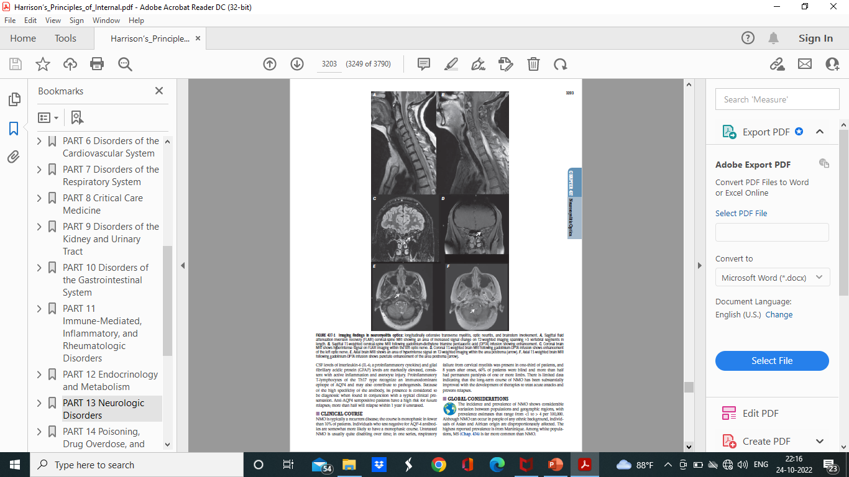
FLAIR / T1W with Gd

Slide 116
Optic nerve

Slide 117
Area postrema

Slide 118
Associated conditions
SLE, sjogrens syndrome, p-ANCA associated vasculitis, myasthenia gravis, Hashimoto thyroiditis, MCTD
May be associated with EBV, HIV or tuberculosis.
Rare cases may be paraneoplastic
MS patients rarely have comorbid autoimmune conditions.

Slide 119
Treatment of acute attacks
High dose glucocorticoids – methyl prednisolone 1g/day for 5- 10 days f/b prednisone taper
Not responding – plasma exchange

Slide 120
Prophylaxis against relapses
Mycophenolate mofetil 1000mg bd
Rituximab (anti CD20 Mab) 2 g IV Q6monthly
Methyl prednisolone 500 mg iv daily 5 days f/b prednisone taper plus azathioprine (2 mg per kg per day started on week 3 )
Mab for attack prevention: Eculizumab ( Ab to C5); Inebilizumab (Ab to CD 19 ); satralizumab (Ab to IL6 receptor)

Slide 121
Myelin oligodendrocyte glycoprotein antibody associated disease (MOGAD)

Slide 122
Anti MOG antibodies- detected on myelin oligodendrocyte glycoprotein epitopes.
May be associated with cases of ADEM in children and AQP4 seronegative NMO

Slide 123
Bilateral synchronous optic neuritis and myelitis
Papillitis seen on fundoscopy or orbital MRI
Spinal cord lesions can be longitudinally extensive or short and may involve conus medullaris

Slide 124
Treatment
Acute episodes- high dose glucocorticoids f/b prednisone taper
Plasmapheresis
Brain lesions may resolve entirely with treatment
Some cases- glucocorticoid dependence
Limited data for immunosuppressive therapies
Off label – daily prednisone, IVIg, rituximab and MMF

Slide 125
Thank you…

