Slide 1

CONFUSION AND DELIRIUM
Dr Devika Nandakumar

Slide 2
Confusion- mental and behavioral state of reduced comprehension, coherence and capacity to reason
Delirium- an acute confusional state

Slide 3
delirium
encephalopathy
ICU psychosis
Acute confusional state
Acute brain failure

Slide 4
DSM 5 definition
Disturbance of consciousness with reduced ability to focus, sustain, or shift attention.
The disturbance develops over a short period of time (usually hours to days) and tends to fluctuate during the course of a day.

Slide 5
An additional disturbance in cognition (e.g., memory deficit, disorganization, language, visuospatial ability, or perception
A change in cognition or development of a perceptual disturbance that is not better accounted for by a preexisting, established, or evolving dementia.

Slide 6
The disturbance is caused by
medical condition
substance intoxication
withdrawal (i.e., due to a drug of abuse or to a medication)
exposure to a toxin or
due to multiple etiologies.
Notes:
There is evidence from history, physical exam, or lab findings that

Slide 7
Clinical Characteristics of Delirium
Acute onset of mental status change with fluctuating course
Attentional deficits
Confusion or disorganized thinking
Altered level of consciousness
Perceptual disturbances
Disturbed sleep/wake cycle
Altered psychomotor activity
Disorientation and memory impairment
Other cognitive deficits
Behavioral and emotional abnormalities

Slide 8
Classification
Hyperactive
Delirium tremens
2. Hypoactive
Benzodiazepine intoxication
3. Mixed

Slide 9
Epidemiology
Hospitalized patients: 10 to >50%
Higher in elderly and patients undergoing hip surgery
Older patients in ICU: 75%
Terminal illness : 50-80%
Delirium in ICU- important manifestation of organ dysfunction
In hospital mortality rates among delirious- 25-33% (similar to sepsis)

Slide 10
Risk factors
PREDISPOSING FACTORS | PRECIPITATING FACTORS
Age >65 years | Sleep deprivation
Cognitive impairment | Physical restraints
Functional impairment | Bladder catheterization
Malnutrition | Polypharmacy
Medical or neurological illness | Arterial catheter
Baseline immobility | Gastric tube
Pressure ulcers | Multiple IV infusion
Sensory impairment- hearing, visual | Infection
Persistent pain | Hypoxia
Terminal illness | Ischemia
Male sex | Surgical and anestheticmrisk factors
 | Lack of visitors

Slide 11
Pathogenesis
Delirium is a neuropsychiatric disorder involving global encephalopathy dysfunction caused by multiple impaired neural pathways and physiologic compromises

Slide 12
Attentional deficit – neuropsychological hallmark of delirium
Diffuse localization
Brainstem, thalamus, prefrontal cortex, parietal lobes
m/c- right parietal and medial dorsal thalamic lesions

Slide 13
Neurotransmitters
Acetylcholine
Critical neurotransmitter
Anticholinergics-known cause of acute confusional states
Alzheimer's disease- particularly susceptible
Dopamine
Acute alterations in dopamine levels -characteristic symptoms of delirium.
Antipsychotic s-effective in treating delirium.
Gamma aminobutyric acid (GABA)
Benzodiazepines and propofol, which directly affect GABA receptors-delirium in the ICU setting
Serotonin

Slide 14
Neuroinflammatory Response Hypothesis
In critical illness, trauma, sepsis, and after surgical interventions
Inflammatory cytokines
Interleukins
Interferon
TNF-α
alters blood–brain barrier permeability
further affecting neurotransmission

Slide 15
Impaired Oxidative Metabolism
due to hypoglycemia, hyper- or hypothermia, and vitamin or amino acid deficiencies.
leads to reduced neurotransmitter synthesis
deregulation of sleep-wake cycle, behavior and mood, and psychomotor activity

Slide 16
Approach to the patient
Diagnosis is clinical
Often missed
Careful history and physical examination
Screening tools

Slide 17
Scales
Confusion assessment method(CAM)
Nursing Delirium Screening Scale(NuDESC)
Organic Brain Syndrome Scale
Delirium Rating Scale
CAM-ICU
Delirium Detection Score

Slide 18
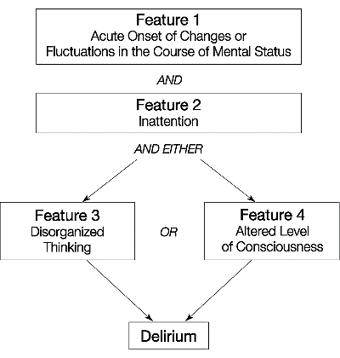
CONFUSION ASSESSMENT METHOD(CAM)

Slide 19
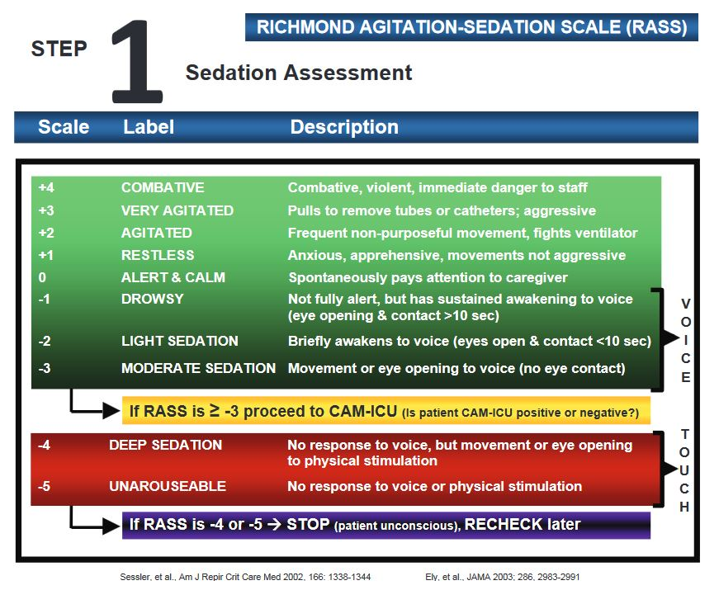

Slide 20
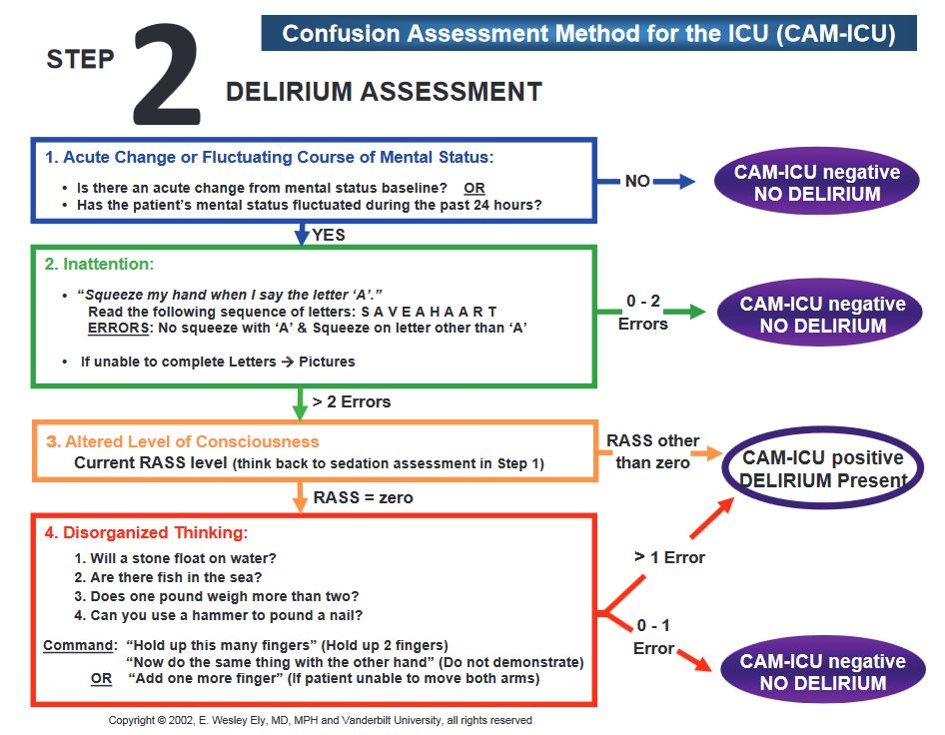

Slide 21
History
Baseline cognitive function
Time course of the illness
Current medications
Prescription drugs
Over the counter drugs
Herbal substances
Symptoms of organ failure or systemic infection
Illicit drug use, alcoholism, toxin

Slide 22
Physical examination
Signs of infection such as
Fever
Tachypnea
pulmonary consolidation
heart murmur
meningismus
Assess fluid status- dehydration and fluid overload with resultant hypoxemia
Jaundice in hepatic encephalopathy
Cyanosis in hypoxemia
Needle tracks in IV drug users

Slide 23
Neurological examination
Focal neurological deficits, raised ICP
postural tremor of high frequency (8–10 Hz)
asterixis
multifocal myoclonus
choreiform movements
dysarthria,
gait instability
agitation or psychomotor retardation, apathy, waxy flexibility, catatonia, or carphologia (“lint-picking” behavior).
Presence of hyperactivity of the autonomic nervous system may be life threatening -possible dehydration, electrolyte disturbances, or tachyarrhythmias.

Slide 24
Bedside tests of attention
serial recitation tasks
digit span test
4 or less- attentional deficit
continuous performance task
A vigilance test
alternate response task
three step sequence
Notes:
patient must indicate whenever the letter A is heard among
random letters presented one per second

Slide 25
Attention can be assessed while taking history from the patient
Tangential speech
Fragmentary flow of ideas
Inability to follow complex commands

Slide 26
Differential diagnosis
Dementia
Stroke with Wernickes aphasia
Schizophrenia
Depression
ADHD
Mania

Slide 27
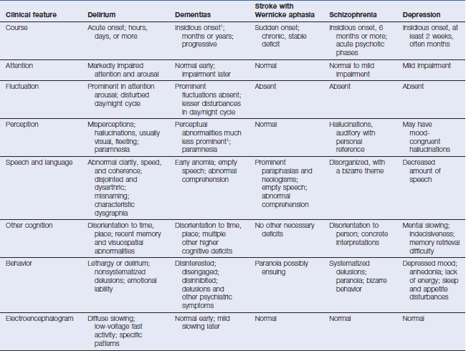

Slide 28
A general rule is that psychiatric behaviors such as psychosis or mania may be due to delirium, called delirious mania, especially if they occur in someone who is 40 years or older without a prior psychiatric history, they should be regarded as delirium until proven otherwise

Slide 29
Etiology

Slide 30
Toxins
Intoxication and overdose
Withdrawal:
alcohol, benzodiazepines, barbiturates, amphetamines, cocaine, coffee, phencyclidine, hallucinogens, inhalants, meperidine, and other narcotics
Drugs: anticholinergic, benzodiazepines, opiates, antihistamines, antiepileptics, muscle relaxants, dopamine agonists, monoamine oxidase inhibitors, levodopa, corticosteroids, fluoroquinolone and cephalosporin antibiotics, beta-blockers, digitalis, lithium, clozapine, tricyclics antidepressants, calcineurin inhibitors
Poisons: inhalants, carbon monoxide, ethylene glycol, pesticides

Slide 31
Metabolic conditions
Electrolyte disturbances: hyponatremia, hypernatremia, hypercalcemia, hypocalcemia, hypomagnesemia
Hypoglcemia and hyperglycemia
Hypothermia and hyperthermia
Pulmonary failure: hypoxemia and hypercarbia
Liver failure/hepatic encephalopathy
Renal failure/uremia
Cardiac failure
Vitamin deficiencies: B12, thiamine, folate, niacin
Dehydration and malnutrition
Anemia

Slide 32
Infections
Systemic infections: urinary tract infections, pneumonia, skin and soft tissue infections, sepsis
CNS infections: meningitis, encephalitis, brain abscess

Slide 33
Endocrinologic conditions
Hyperthyroidism, hypothyroidism
Hyperparathyroidism
Adrenal insufficiency

Slide 34
Cerebrovascular disorders
Global hypoperfusion states
Hypertensive encephalopathy
Focal ischemic strokes and hemorrhages: especially nondominant parietal and thalamic lesions

Slide 35
Autoimmune disorders
CNS vasculitis
Cerebral lupus
Neurologic paraneoplastic and autoimmune encephalitis

Slide 36
Seizure-related disorders
Nonconvulsive status epilepticus
Intermittent seizures with prolonged postictal states

Slide 37
Neoplastic disorders
Diffuse metastases to the brain
Gliomatosis cerebri
Carcinomatous meningitis
CNS lymphoma

Slide 38
Hospitalization
Terminal end-of-life delirium

Slide 39
LABORATORY AND DIAGNOSTIC EVALUATION

Slide 40
Initial evaluation
History with special attention to medications (including over-the-counter and herbals)
General physical examination and neurologic examination
Complete blood count
Electrolyte panel including calcium, magnesium, phosphorus
Liver function tests, including albumin
Renal function tests

Slide 41
First-tier further evaluation guided by initial evaluation
Systemic infection screen
Urinalysis and culture
Chest radiograph
Blood cultures
Electrocardiogram
Arterial blood gas
Serum and/or urine toxicology screen (perform earlier in young
persons)
Brain imaging with MRI with diffusion and gadolinium (preferred)
or CT
Suspected CNS infection: lumbar puncture after brain imaging
Suspected seizure-related etiology: electroencephalogram (EEG) (if
high suspicion, should be performed immediately)

Slide 42
Second-tier further evaluation
Vitamin levels: B12, folate, thiamine
Endocrine: thyroid-stimulating hormone (TSH) and free T4; cortisol
Serum ammonia
Sedimentation rate
Autoimmune : antinuclear antibodies (ANA), complement levels; p-ANCA, c-ANCA , consider paraneoplastic/autoimmune encephalitis serologies
Infectious : rapid plasmin reagin (RPR); fungal and viral serologies if high suspicion; HIV antibody
Lumbar puncture (if not already performed)
Brain MRI with and without gadolinium (if not already performed)

Slide 43
TREATMENT

Slide 44
Nonpharmacologic Management of Delirium
Target and address underlying causes first
Medication review and appropriate management
Nutritional and fluid replacement
Sleep enhancement through proper sleep hygiene, relaxation, and creation of quiet, soothing, warm environment
Adequate pain control, preferably nonopioid
Cognitive orientation by family or companion involvement, consistent medical staff, clocks, and calendars
Early and continued mobilization
Improved exposure to daylight to promote circadian rhythm
Sensory enhancement with glasses, hearing aids, or other adaptive equipment
Daily cognitive assessment with standardized tool

Slide 45
Pharmacologic Management of Delirium
There are no antipsychotic medications and benzodiazepines that are FDA approved for prevention or treatment of delirium

Slide 46
Typical Antipsychotics
Haloperidol 0.5–2.0 mg bid orally every 4 hours or intramuscularly every 30–60 minutes prn; maximum dose 20 mg in 24 hours
Most commonly used agent
Atypical Antipsychotics Quetiapine 25–200 mg orally bid
Risperidone 0.25–2 mg orally divided once daily to bid
Olanzapine) 2.5–10 mg orally once daily
Ziprasidone 20–80 mg orally bid
Aripiprazole 10–30 mg orally once daily
Benzodiazepines
Lorazepam 0.5–1.0 mg orally every 4 hours prn
Reserve for alcohol withdrawal
Can worsen delirium caused by other factors

Slide 47
PHARMACOLOGIC THERAPY
• Only when symptoms are severe, dangerous, or cause significant distress to the patient.
Similarly effective
Chosen on the basis of side effects
Haloperidol is the least sedating but has a high risk of extrapyramidal side effects
Quetiapine has the least side effects but is highly sedating.

Slide 48
Haloperidol can be used with caution to control agitation, with doses ranging from 0.25 to 2 mg IM/IV twice daily, repeating the dose every 20 to 30 min until patient has calmed and using lower doses for the elderly.
Risperidone 0.5 mg twice daily (off-label use, non-FDA approved) can also be used with caution with a slow increase to desired dose, not to exceed 1.0 to 2.0 mg.

Slide 49
Although benzodiazepines are frequently used in hospitalized patients for sedation and are the mainstay of therapy for alcohol withdrawal, they must be used with caution in the elderly because they can have a paradoxical effect on agitation.

Slide 50
Prevention
• Avoid polypharmacy as much as possible.
• Optimize chronic medical conditions.
• Provide frequent reorientation and a soothing environment for high-risk patients (e.g., lights on during the day, off at night; open curtains during the day so patient can see the weather).
• In patients over 70 without dementia, regular exercise has been associated with lower risk for developing delirium, and early return to physical activity can improve outcomes in ill patients.

Slide 51
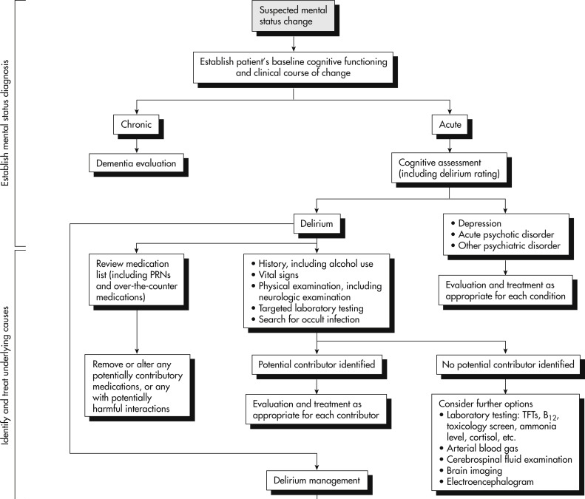

Slide 52
THANK YOU

