Slide 1
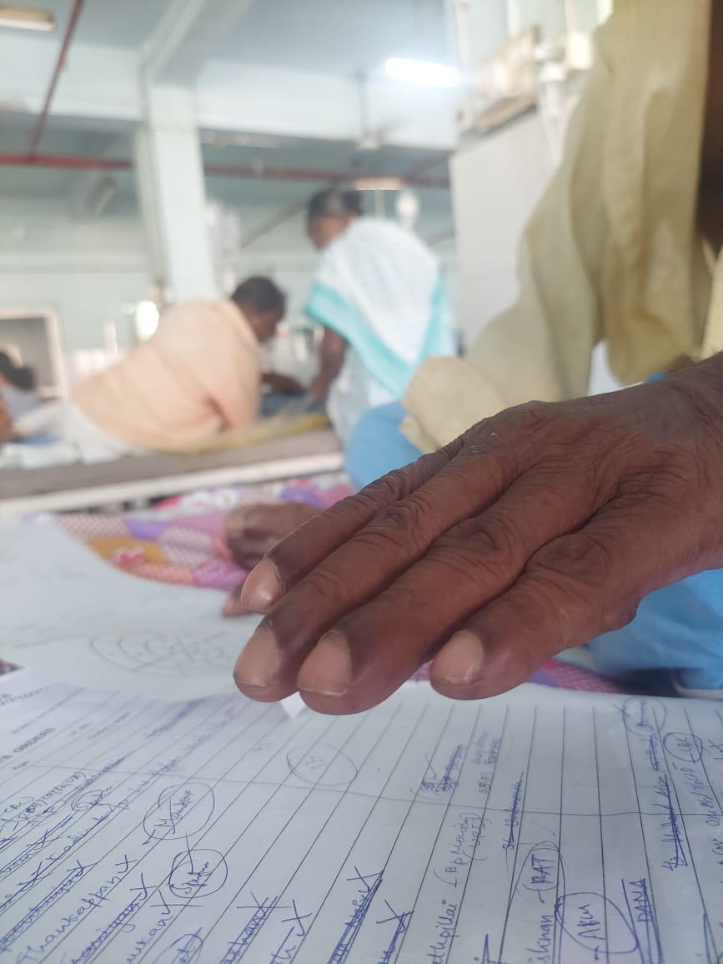
Clubbing-R68.3/Q68.1
Javed Anees

Slide 2
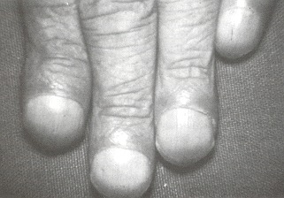
Physical sign characterized by bulbous enlargement of the ends of one or more fingers or toes
Proliferation and edema of connective tissue result in loss of the normal angle between the skin and nail plate and excessive sponginess of the nail base
usually acquired

Slide 3
Clubbing is usually painless and bilateral.
The patient may be unaware of the gradual enlargement of fingertips or toes until it is brought to his or her attention.
Patients with hereditary clubbing may report a family history of clubbing or a long duration of clubbing without any symptoms or signs to suggest an underlying illness.
In acute cases, the more rapid onset or mild associated discomfort may draw attention to the deformity.
It is important to detect early clubbing because clubbing can be the first clue to a serious underlying disorder that, if treated early, may be curable.

Slide 4
Signs of early clubbing
"floating nail" sign:
Normally, the root of the nail plate lies snugly against the bone of the distal phalanx; pressure on the root produces no movement. With clubbing, the root is separated from bone by connective tissue and edema; pressure upon the nail plate moves it toward the bone.
The base of the nail becomes resilient and springy, and the nail feels as if it is floating on a cushion.
As clubbing progresses, the nail becomes loosely attached, and the free edge of the nail plate may become visible or palpable as a horizontal ridge over the dorsal aspect of the finger.

Slide 5
"Profile" sign:
Normally, the angle between the nail plate and the skin overlying the proximal part of the distal phalanx is about 160 degrees or less.
With clubbing, proliferation of tissue under the nail plate causes this angle to increase to more than 160 degrees.
In fact, the angle may be entirely lost and the nail plate and skin lie in a straight line (180-degree angle).
As clubbing progresses, the angle exceeds 180 degrees. Eventually, the profile of the fingertip becomes bulbous.

Slide 6
Early clubbing must be distinguished from several other abnormalities of the fingertip.
These include:
(1) increased nail curvature, a normal finding in many adults (especially blacks);
(2) chronic paronychia, in which the soft tissue at the base of the nail is inflammed and swollen;
(3) felons or abscesses of the terminal pulp space, in which there is swelling over the palmar surface of the fingertip.
The fundamental angle between nail and terminal phalanx not altered in these conditions

Slide 7
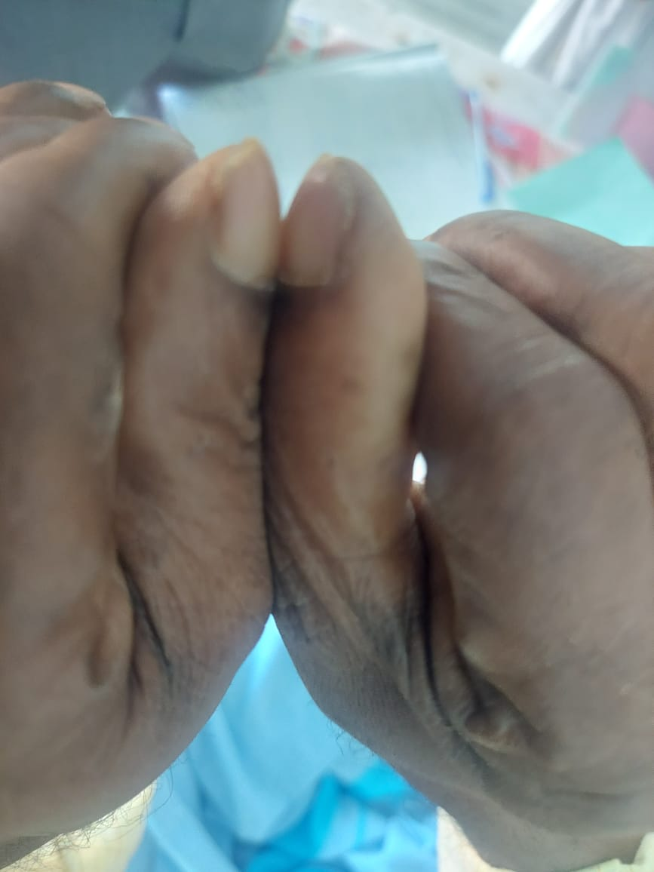

Slide 8
Schamroth- readily differentiates true clubbing from these pseudo-clubbing conditions.
The examiner asks the patient to hold the two thumbs back to back with the two fingertips and interphalangeal joints aligned. Because the base angle is unaltered in these conditions, an elongated, diamond-shaped area of empty space is apparent.
In true clubbing, this empty space is lost.
Schamroths window,Schamroths sign,Schamroths angle
Sensitivity-77-87%,Specificity-90% (Pallares-Sanmartin etal-2010)

Slide 9
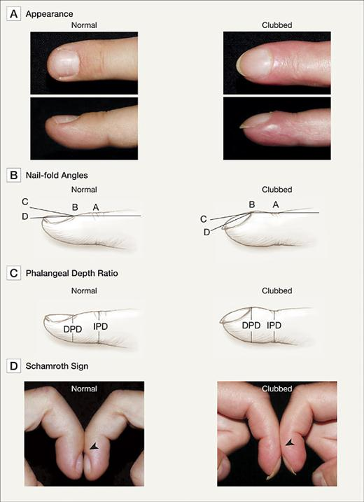

Slide 10
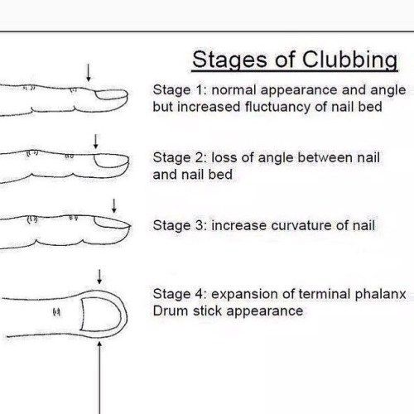

Slide 11
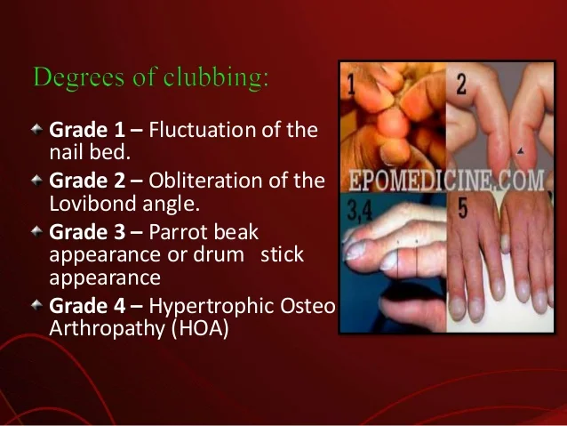

Slide 12
40% Clubbing associated with serious underlying disease.
In addition, because clubbing may precede any other evidence of the underlying disorder, it may serve as the only clue to an otherwise silent lesion.
Review of the literature indicates that between 75 and 80% of clubbing are associated with chronic pulmonary diseases; 10 to 15% are associated with cardiovascular diseases; 5 to 10% with chronic hepatic and gastrointestinal disorders; and 5 to 10% with miscellaneous disorders.

Slide 13
Unilateral clubbing - associated with hemiplegia and vascular lesions
Bilateral clubbing - associated with neoplastic, pulmonary, cardiac, gastrointestinal,infectious, endocrine, vascular and multisystemic disease
Clubbing involving a single digit:
Pseudoclubbing should be ruled out.

Slide 14
History taking in Clubbing
A person with clubbing often has symptoms of another condition.
So we need to take-
Family history
Medical history
Physical exam that looks at the lungs and chest

Slide 15
Questions asked?
eg:
Do you have trouble breathing
Do you have clubbing of fingers,toes or both
When did you first notice this?Do you thing its getting worse?
Does the skin ever have a blue colour?
What other symptoms do you have?

Slide 16
Tests may be done
Eg: CBC ESR,RFT,LFT,SE
ABG
CXR
CT Chest
ECG
ECHO
PFT

Slide 17
Hypertrophic Osteoarthropathy
Always be sought for if clubbing+
Severe, burning, deep pain over the distal extremities, especially of the legs, that is worsened at night and on dependency.
Early cases, the examiner may note warmth, reddening, or brawny edema of the skin over the distal long bones (particularly over the shins).
In acute or severe cases, there may be exquisite tenderness of the feet and legs and the hands and forearms, and tenderness and effusions of the adjacent joints (the ankles, knees, wrists, and fingers).
The examiner may elicit tenderness over bony prominences by simply pressing or by encircling the limb (e.g., the wrist) with his own fingers like a bracelet and gently squeezing it.
Later, autonomic changes such as flushing, sweating, or blanching (Raynaud's phenomenon) may be noted in the affected hands and feet.

Slide 18
Pachydermoperiostosis
Most often complain about their changing appearance or the excessive perspiration, especially of the hands and feet.
Active phase- they may have mild bone pain or arthralgia.
Later- clumsiness of fingers, ptosis from thickening of the skin over their eyelids, or facial palsy from thickening of the skull.
O/E Clubbing of the fingers and toes, accompanied by "spadelike" or "pawlike" enlargement of the hands and feet; joint effusions may be present.
Skin changes- excessive sweating, generalized thickening (called pachyderma) and redundancy, especially over the forehead and scalp, leading to characteristic "bulldog" furrowing (cutis verticis gyrata) and leonine facies, sometimes mistaken for leprosy.

Slide 19
Further Evaluation
In all three conditions (i.e., clubbing, hypertrophic osteoarthropathy, and pachydermoperiostosis), the physician should specifically examine for findings of associated illness.
including wheezes, rales, pleural effusion, supraclavicular adenopathy, cardiac murmurs, Roth spots, peripheral stigmata of endocarditis, splenomegaly, jaundice, vascular angiomata, palmar erythema, hepatomegaly, abdominal mass (suggesting regional enteritis), thyromegaly, and ophthalmopathy.

Slide 20
Xrays in clubbing:
Clubbing may be a manifestation of either hypertrophic osteoarthropathy or pachydermoperiostosis, the clinician may want to obtain x-rays of the distal extremities.
In early clubbing, x-rays will be normal except for increased soft tissue.
In the later stages, there may be fraying of the edges of the distal phalanx, followed by gradual resorption of the bone (acro-osteolysis).

Slide 21
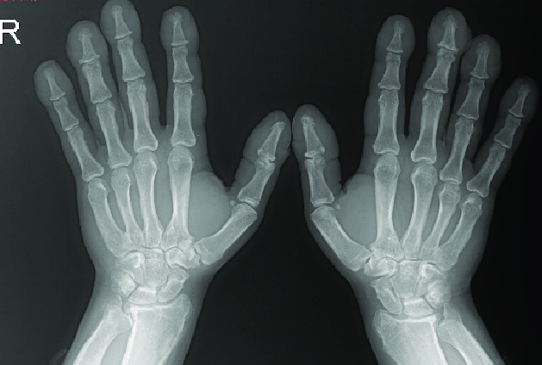
X-rays in hypertrophic osteoarthropathy: symmetrical, irregular periosteal proliferation, calcification and new bone formation (periostitis) over the distal arms and legs, or acro-osteolysis of the distal phalanges of fingers and toes.

Slide 22
The finding that 99m-technetium pyrophosphate bone scans are more sensitive than plain x-rays in detecting early periostitis can be helpful in difficult cases.
In advanced cases of osteoarthropathy, and in pachydermoperiostosis, x-rays may show extreme degrees of periostitis in almost any bone, although the skull, vertebrae, and articular surfaces are usually spared.

Slide 23
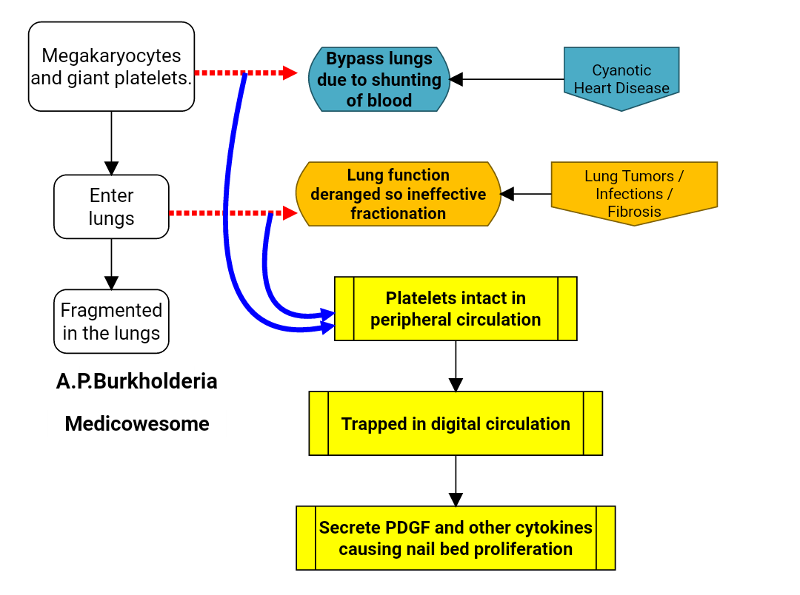
Theories
Arterial Hypoxaemia-Humoral
PDGF-VEGF
Vagal stimulation

Slide 24
Pulmonary disease is the most common cause
Primary or secondary malignancy of the bronchus or lung, as well as tumors of the pleura, mediastinum, thymus, and chest wall, are perhaps the most worrisome associations.
But a variety of chronic pulmonary infections, including lung abscess, chronic empyema, pneumoconiosis, chronic pneumonitis, cystic fibrosis, emphysema with chronic suppuration, actinomycosis, and bronchiectasis, can also produce the characteristic picture.
More rarely, it has been described in patients with chest deformities, aortic aneurysm with compression of lung, and neurogenic tumors of the diaphragm.

Slide 25
Conditions Associated with Clubbing
Pulmonary disease:
Bronchiectasis.
Lung abscess.
Bronchogenic carcinoma.
Empyema thoracis.
Fibrosing alveolitis.
Pleural mesothelioma.
Pulmonary arteriovenous fistula.
Cystic fibrosis.
Thymoma
Metastatic Ca
Pneumoconiosis
Chronic pneumonitis
Cystic Fibrosis
Neurogenic tumours of diaphragm

Slide 26
Pulmonary tuberculosis & clubbing
Uncommon in uncomplicated pulmonary tuberculosis
Occur in up to 25% of cases with supervening bronchiectasis or chronic cavitation.
causes:
Post tuberculous bronchiectasis
Diffuse B/L lung fibrosis
Empyema

Slide 27
Cardiovascular cause of clubbing
Infective endocarditis
Cyanotic CHD
Myxoma of atria
Aneurysm of major vessels such as aorta and subclavian artery
Cor Pulmonale
Secondary Polycythemia
Congestive cardiac failure
Pulmonary AV Fistula
Arterial Graft rejection

Slide 28
Gastrointestinal
Malabsorption
IBD - Crohn's, ulcerative colitis,Regional enteritis
Cirrhosis of liver particularly biliary cirrhosis
Chronic Infection
Ascariasis,Malaria,Intestinal TB
Chronic Amoebic Dysentery
Sprue

Slide 29
GastroIntestinal- Hepatic:
Cirrhosis (all types)
Amoebic abscess
Amyloidosis

Slide 30
Gastro Intestinal:
Neoplasm
Intestinal polyposis
Abdominal lymphoma
Nasopharyngeal carcinoma
Esophageal carcinoma
Gastric carcinoma
Colonic carcinoma

Slide 31
Miscellaneous
Endocrine conditions,Hyperthyroidism,Hyperparathyroidism
Pregnancy,Chronic infections,Chronic osteomyelitis with amyloidosis
Chronic pyelonephritis,
Congenital disorders: Muscular dystrophy,hemoglobinopathies
Idiopathic disorders: Chronic mountain sickness,Syringomyelia,
Neoplasms: Renal carcinoma, Chronic myelocytic leukemia
Toxin exposure:Arsenic, Mercury,Silica,Beryllium,Phosphorus,
Alcohol,Chronic laxative abuse

Slide 32
Asymmetrical Clubbing:
Unilateral: Anomalous aortic arch, Aortic or subclavian artery aneurysm, Pulmonary hypertension with patent ductus arteriosus
Brachial arteriovenous aneurysm or fistula, Recurrent shoulder dislocation, Superior sulcus (Pancoast) tumor
Unidigital: Hereditary, Trauma,Median nerve injury, Sarcoidosis,Gout,Idiopathic, digital mucoid cyst, osteoid osteoma and myxochondroma

Slide 33
What are the different types of clubbing?
Drum stick type of clubbing :
Congenital cyanotic heart diseases, e.g. Fallot's tetralogy.
Bronchiectasis.
Parrot-beak type of clubbing :
Commonly seen in bronchogenic carcinoma.

Slide 34
Painful clubbing
Bronchogenic carcinoma.
SBE.

Slide 35
Think of..
Clubbing limited to upper extremity:-
Chronic obstructive phlebitis of upper extremity as a result of chronic I.V drug addiction (eg. heroin).
Clubbing limited to lower extremity:-
infected abdominal aortic aneurysm : COA,sometimes in PDA with reversal of shunt.
Acute clubbing:-
Development of clubbing within 10 to 14 days of onset of illness- lung abscess

Slide 36
Pseudoclubbing?
Seen in conditions associated with subperiosteal bone resorption of terminal phalanges.
Here there is absence of soft tissue proliferation and increased curvature of nails and is seen in.
Scleroderma.
Acromegaly.
Hyperparathyroidism.
Leprosy.

Slide 37
Thank you

