Slide 1
Clinical heterogeneity of gbs

Slide 2
Clinical scenario
48 yr old , female
Prawns peeling in a fish market

Slide 3
Apparently normal before 4 days of admission
Then , she noticed difficulty in climbing stairs
On the same day, she experienced multiple e/o buckling of knees
Later , also found difficulty in getting up from squatting position
Also had difficulty in wearing chappels

Slide 4
On the next day , developed difficulty in pressing gas lighter
Difficulty in making food bolus
Difficulty to press flush button
Also noticed difficulty in lifting water filled bucket

Slide 5
No h/o swaying while walking
No h/o sensory symptoms
No h/o cranial nerve symptoms
No bowel and bladder disturbances
No h/o autonomic symptoms
No h/o trauma
No h/o febrile illness or acute diarrheal disease in the past 1 month

Slide 6
h/o hysterectomy for fibroid uterus, 8 yrs back
h/o covid -19, 1 and half yr back
3 monts after covid infection she developed b/l knee joint pain,for which was taking low dose steroids and HCQ till now…n she was told that it was covid related arthropathy
No arthralgia/ arthritis at present

Slide 7
examination
Concious and oriented
Moderatly built and nourished
No PICCLE
PR – 74/ min regular,normal volume and character, no RF delay,no vessel wall thickening,peripheral pulses palpable
BP- 120/80 mmhg left arm supine position
Postural bp 120/80 mmhg.. (no postural hypotension)
RR- 16/ min,regular, thoracoabdominal
Afebrile

Slide 8
Systemic examination
Higher mental function – normal
Cranial nerves- normal
Motor system
bulk of muscle – no wasting or hypertrophy of muscle
tone of muscle – almost normal bilaterally

Slide 9
power | right | left
Shoulder - flexion | 4 | 4
extension | 4 | 4
adduction | 4 | 4
abduction | 4 | 4
Elbow - flexion | 4- | 4-
extension | 4- | 4-
pronation | 4- | 4-
supination | 4- | 4-
Hand grip | weak | weak

Slide 10
 | Right | left
Abdominal muscles | normal | Normal
Extensors of spine | normal | normal
Hip - flexion | 4- | 4-
- extension | 4- | 4-
- adduction | 4- | 4-
- abduction | 4- | 4-
Knee - flexion | 4- | 4-
- extension | 4- | 4-
Ankle - dorsiflexion | 4- | 4-
- plantarflexion | 4- | 4-
Subtalar joint – eversion | 4- | 4-
- inversion | 4 | 4-
Great toe - flexion | Weak | Weak
- extension | weak | Weak

Slide 11
Reflexes
superficial reflexes – corneal n conjunctival reflex – present
- gag reflex – present
- abdominal reflex- absent
- plantar reflex – bilateral flexor

Slide 12
deep tendon reflex – trapezius reflex – b/l 1+
biceps reflex - b/l 2+
supinator reflex – b/l 2+
triceps reflex - b/l 2+
knee jerk - b/l 2+
ankle jerk - b/l 2+

Slide 13
Sensory system – normal
Cerebellar signs - nil
Romberg – negative
Gait – walking on wide base

Slide 14
No involoutary movts
Autonomic nervous system – normal
No signs of meningeal irritation
No peripheral nerve thickening
Skull and spine normal
Other system - WNL

Slide 15
Differential dignosis
GUILLAIN BARRE SYNDROME
HYPOKALEMIC PARALYSIS
MYELOPATHY – transverse myelitis
MYOPATHY – DRUG INDUCED ( steroid/hcq induced)

Slide 16
Investigations
CBC – wnl
ESR – 28 mm/hr
Rft n lft – wnl
S.na/k – 140/ 4
Ecg – normal
Chest xral – normal
S. cpk – 54 ug/L
ANA - negative
Anti ds- DNA – negative
RA factor / anti ccp - negative

Slide 17
NCS - Motor axonal neuropathy with proximal conduction block

Slide 18
CSF ANALYSIS – no cells
- protein – 56 mg/dL ( 20- 40 )
- albumin – 383 mg/L (<300)
MRI brain + spinal cord - NAD

Slide 19
Final diagnosis

Slide 20
Treatment given
IVIG

Slide 21
discussion
GBS can be mainly classified into :
1) AIDP
2) Axonal variants – AMAN and AMSAN
Although diagnosis of GBS requires
- progressive weakness and universal areflexia / hyporeflexia
Cases of GBS with preserved or increased DTRs have been increasingly recognized

Slide 22
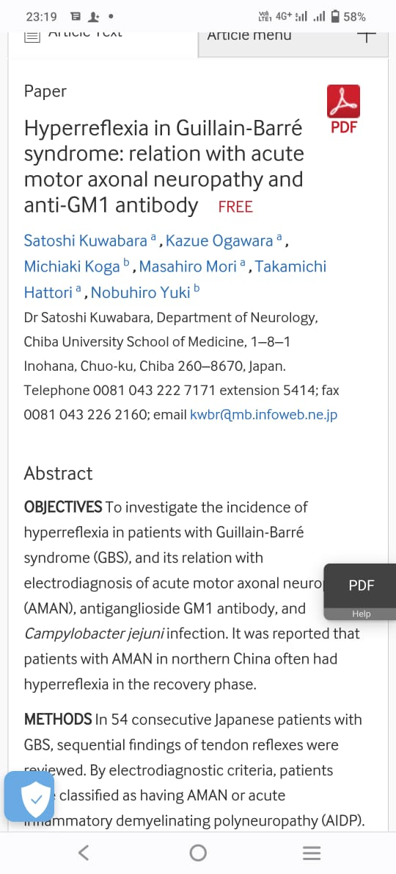
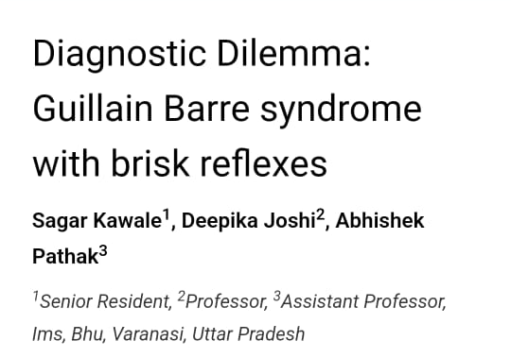
Article from site

Slide 23
discussion
Most common factors associated failure of considering Dx of GBS were :
- Intact or increased DTRs
- Atypical pattern of weakness
- pure sensory symptoms on presentation

Slide 24
Current data suggest 20% of AMAN and 5% of AIDP have preserved / exaggerated DTRs
Electrophysiological studies: increased excitability of AHC due upper motor neuron involvement
Mechanism : Dysfunction of spinal inhibitory interneurons

Slide 25
CONCLUSION
So, we cannot always rule out GBS in patient with typical h/o ascending type of
quadriparesis, with preserved or exaggerated reflex
Delay in Dx n Rx initiation has been asso. with residual weakness on discharge
Emergency physician’s awareness of atypical clinical presentations might
improve patients prognosis.

Slide 26
THANK YOU

