Slide 1
CLINICAL CLUB
The Game of metals
Angana S

Slide 2
18/8/2022
73 yr old female
Home maker
K/c/o CA OVARY on Neoadjuvant chemotherapy / SHTN on treatment
Completed one cycle of Inj . Carboplatin on 27/7/2022
now admitted for second cycle chemotherapy and supported care.

Slide 3
Patient was initially admitted in oncology department for undergoing chemotherapy .
On routine investigations patient was found to have hypocalcemia and mild hypokalemia.
After routine medicine consultation , patient was taken over to our side for detailed evaluation.

Slide 4
24/8/22
Vomiting -Multiple episodes since 4 days after chemotherapy second cycle, it was non projectile associated with nausea ,vomitus contain food particles following chemotherapy
asso. with generalised fatigability
Fever - intermittent low grade with no chills or rigor
Also had diffuse abdominal pain
Asso. with Loose stools - multiple episodes , no blood tinge ,no foul smell , contain food particles.

Slide 5
No h/o food intake from outside
No h/o abnormal posturing of hands and legs, tingling sensation , circumoral , paresthesia , seizures , loc, headache
No h/o cough , breathlessness , dysuria , malena , hematuria .

Slide 6
Past history
K/c/o CA OVARY with adjacent mets on NAC on 6th cycle of Inj. Carboplatin
No documented distant mets
No h/o any neck surgeries or neck trauma done in the past ,
No h/o pancreatitis, renal or liver failure , thyroid or parathyroid disorders.
No h/o similar episodes in the past during previous chemotherapy.
No h/o diuretic intake in the past
No other significant history in the past and in the family

Slide 7
General Examination
Pt drowsy , conscious , afebrile
Obeying commands
GCS E4 V5 M6
PR- 80 ; BP - 110 / 70 ; SPO2 - 99%
No cataract
Pallor + , No icterus, cyanosis, clubbing, generalised lymphadenopathy , edema
Senile graying of hair
Chvostek sign - negative : Trousseau sign - Negative
Breast and thyroid - normal

Slide 8
System Examination
G I system -
P/A - soft , diffuse abdominal tenderness +
mass palpable on right iliac fossa
Respiratory systems - WNL
Cardiovascular system - WNL
Nervous System - WNL

Slide 9
Routine investigations
 | 18/8/2022 | 19/8/22 | 22/8/22
Hb | 10.6 | 10 | 10.7
RBC | 3.7x10^6 | 3x 10^6 | 3.5x 10^6
TC | 9690 | 8700 | 10800
N /L | 77/13 | 70/20 | 75/16
Platelet | 4.5 lakh | 4 lakh | 3.4 lakh
ESR | 40
PCV | 31.4
MCV | 85
MCH | 28.8
MCHC | 33.8

Slide 10
 | 18/8/22 | 19/8/22 | 22/8/22
RBS | 88 | 92 | 100
Na/K | 137/3.0 | 129/2.2 | 133/2.1
Urea/Cr | 25/1.2 | 26/1.2 | 25/1.2
S.Bil | 0.7 | 0.6 | 0.7
TP/ Alb | 5.6/2.6 | 5.3/2.5 | 5.7/2.6
OT/PT | 41/20 | 40/22 | 38/25
ALP | 86 | 90 | 84

Slide 11
ECG - NSR , VR @ 68/min , P wave - 40ms, QT interval -500ms. No other significant ST- T changes .

Slide 12
Hypocalcemia workup
 | 19/8/22 | 27/8 | 29/8 | 2/9 | 3/9
S.Ca | 5.3 | 5.1 | 5.7 | 7.7 | 8.6
Corrected Ca | 6.2 | 6.3 | 6.7 | 8.9 | 9.8
PO4 | 3.4 |  |  | 3.0
Uric acid | 5.6 |  |  | 3.4
S.Mg | 1.9 | 2.0 |  | 2.0
S.VIT D3 | 9.03
S.Chloride | 98
iPTH | 17.67
TSH | 1.7

Slide 13
Urine Ca - 2.90 mmoles ( 2.50 to 7.50)
Urine potassium - 24.9
ABG | 30/8/22 | 3/9/22
pH | 7.66 | 7.54
PCO2 | 21.8 | 34.6
PO2 | 153 | 150
HCO3 | 24.9 | 30
sO2 | 100% | 98%

Slide 14
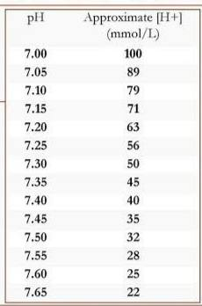
ABG Analysis
Step 1 : Validity of ABG confirmed.
Step 2 : pH - 7.66 —> Alkalosis
Step 3 : pCO2 - 21 (<40)—> Primary Respiratory
Step 4: for every 10mm hg decrease in PCO2 ,
Decrease in HCO3 = 2
In our case : PaCO2 = 40- 21= 19
Expected decrease in HCO3 = 3.8 ( 24 - 3.8 = 20.2)
Here HCO3 - 24.9 ,
hence there is an additional component of Metabolic Alkalosis

Slide 15
Acute Primary Respiratory Alkalosis
Metabolic Alkalosis with Hypokalemia

Slide 16
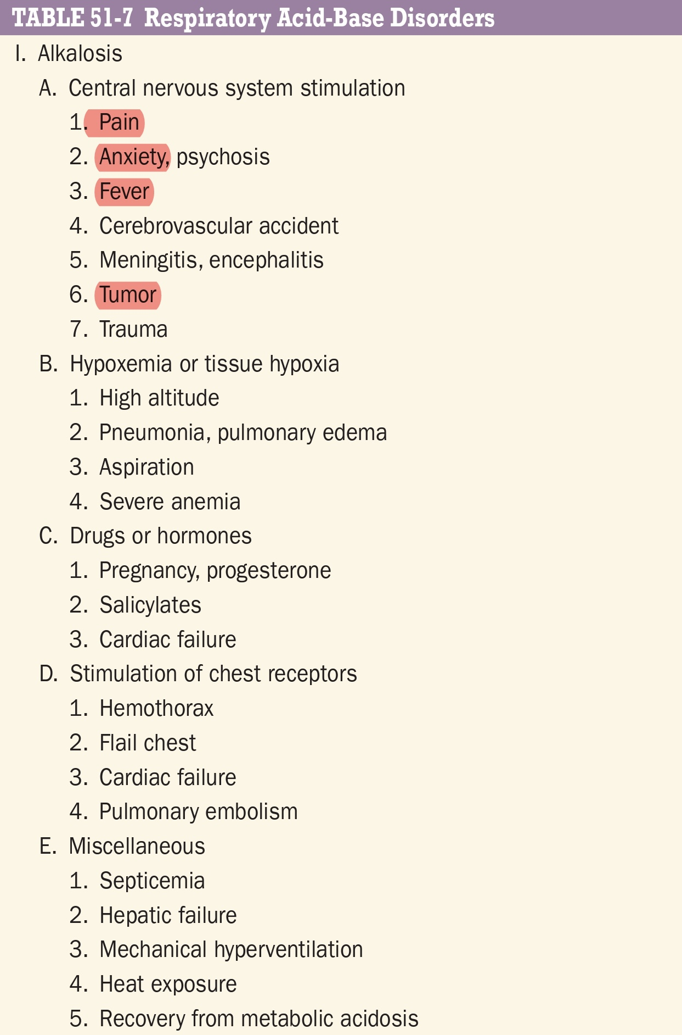
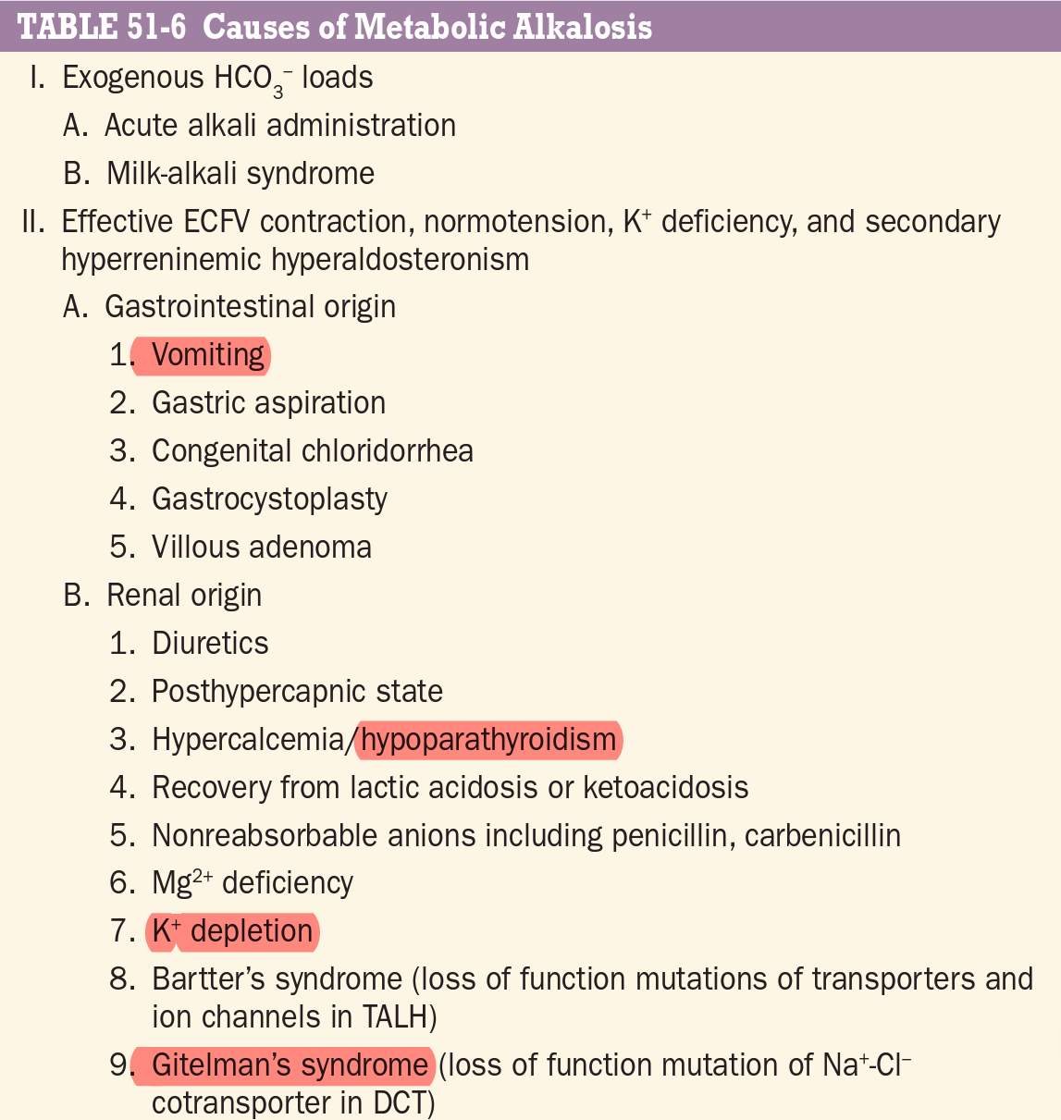

Slide 17
Discussion
Case of Carboplatin induced Hypocalcemia
Chemotherapy Induced hypoparathyroidism
Vitamin D3 deficiency

Slide 18
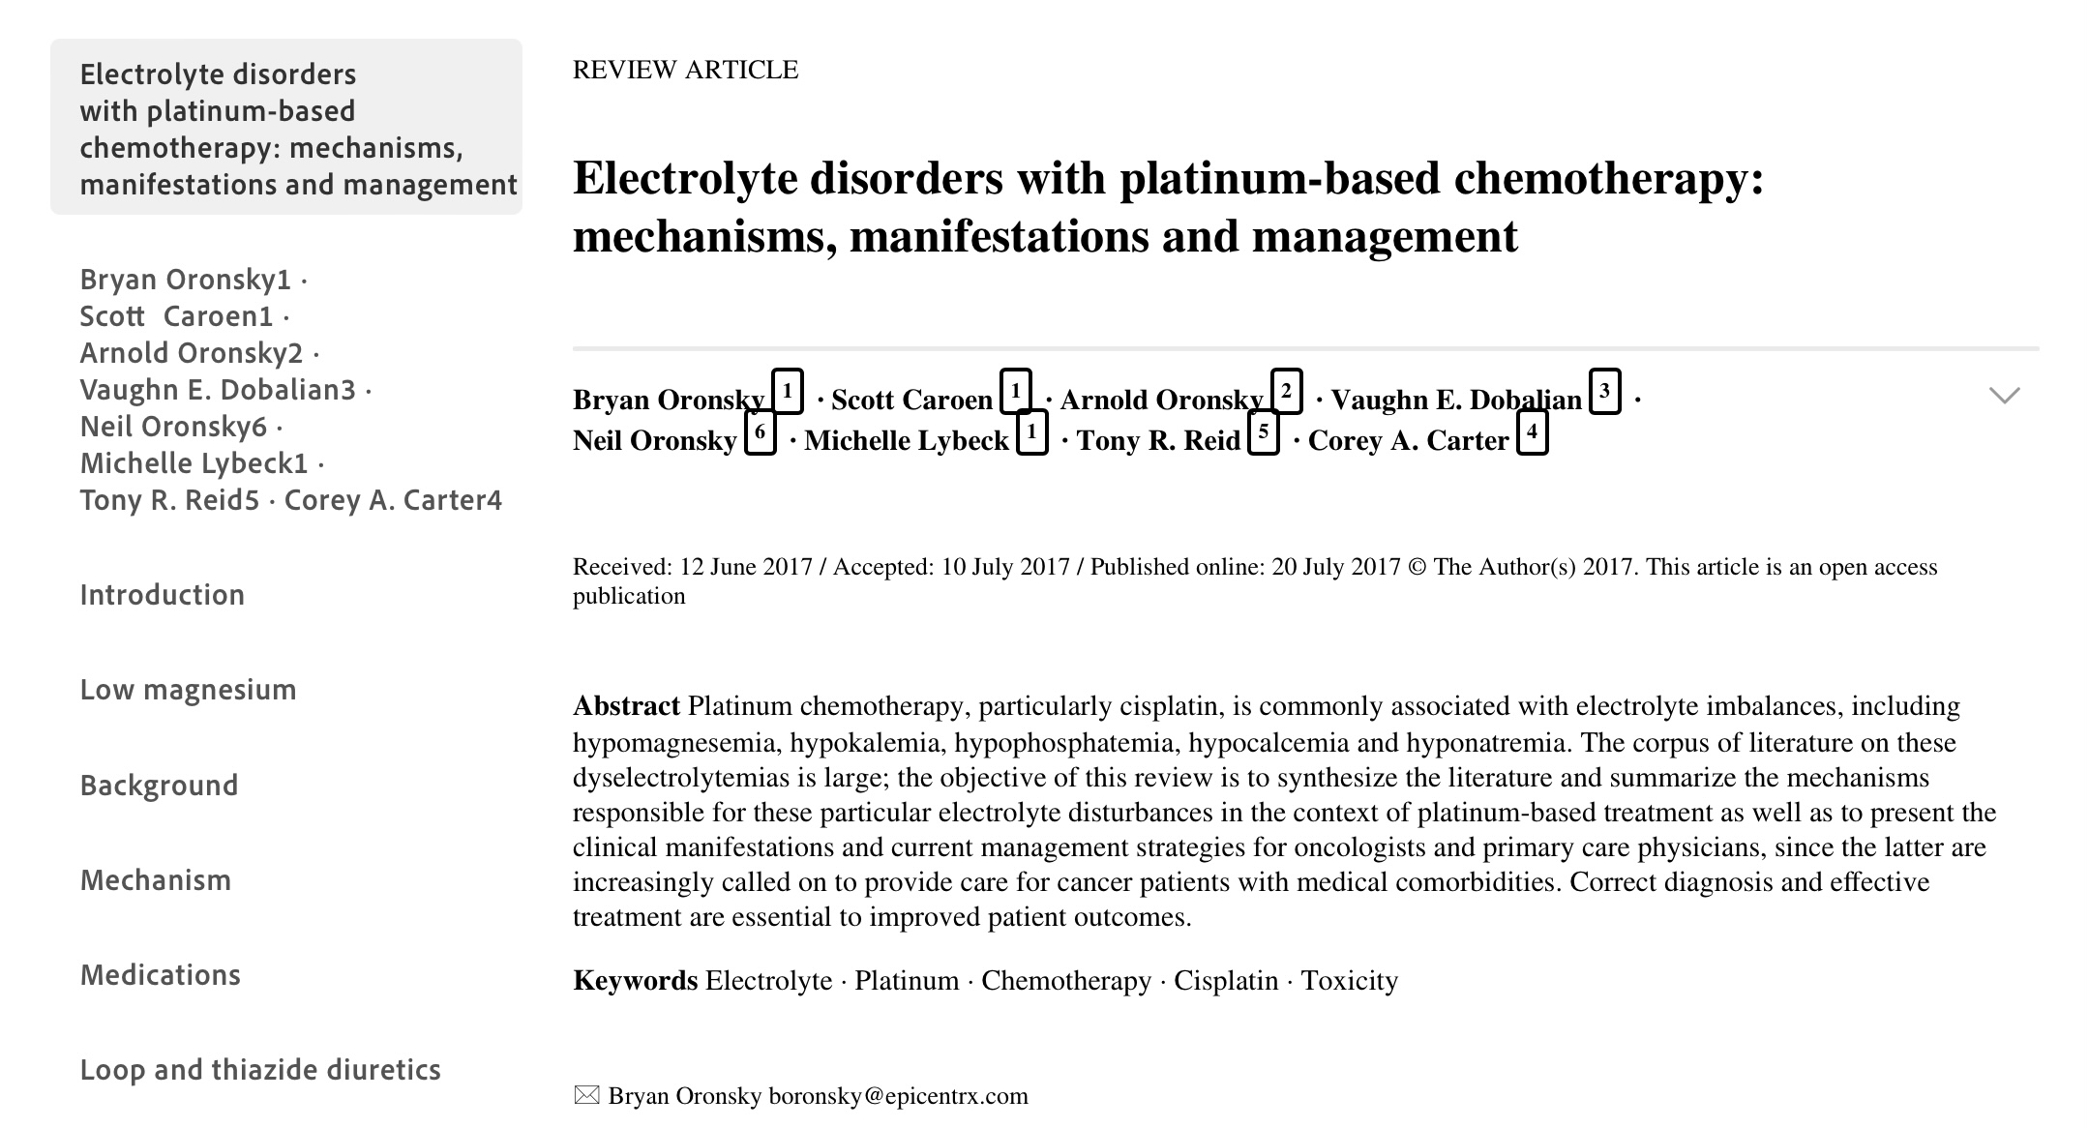

Slide 19
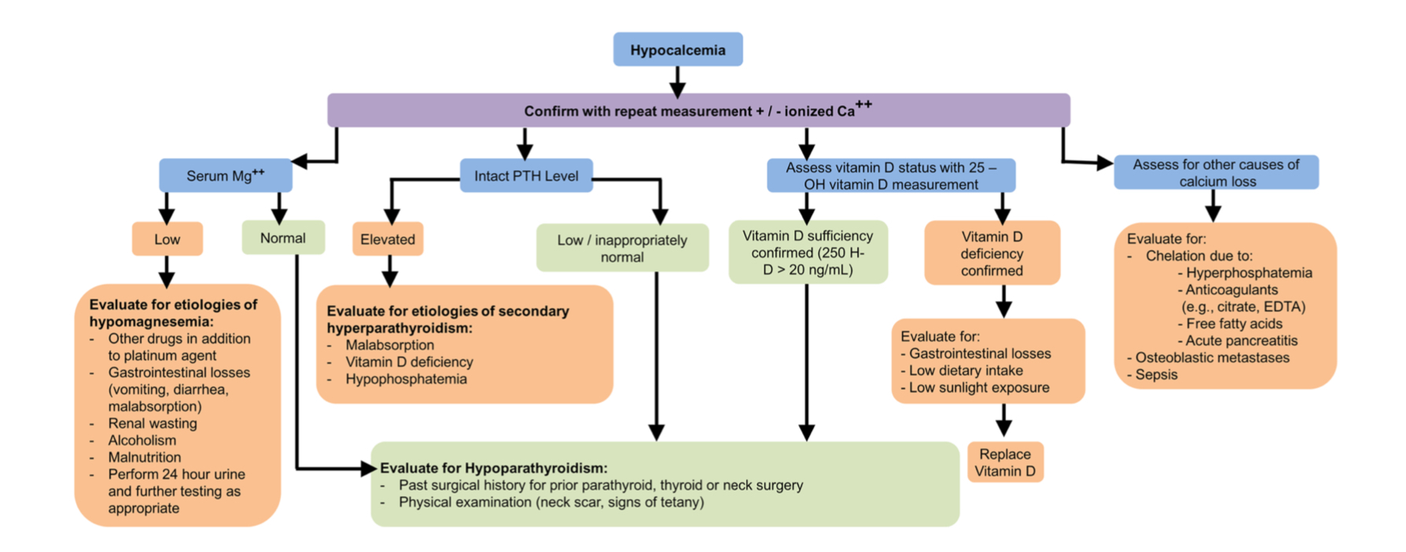
Approach to Hypocalcemia

Slide 20
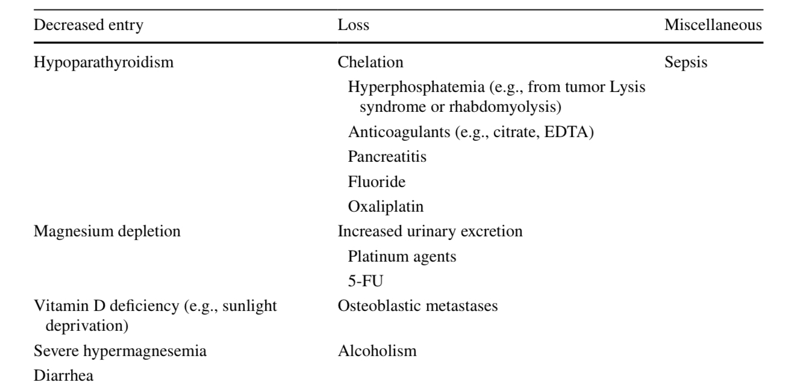
Causes of hypocalcemia

Slide 21
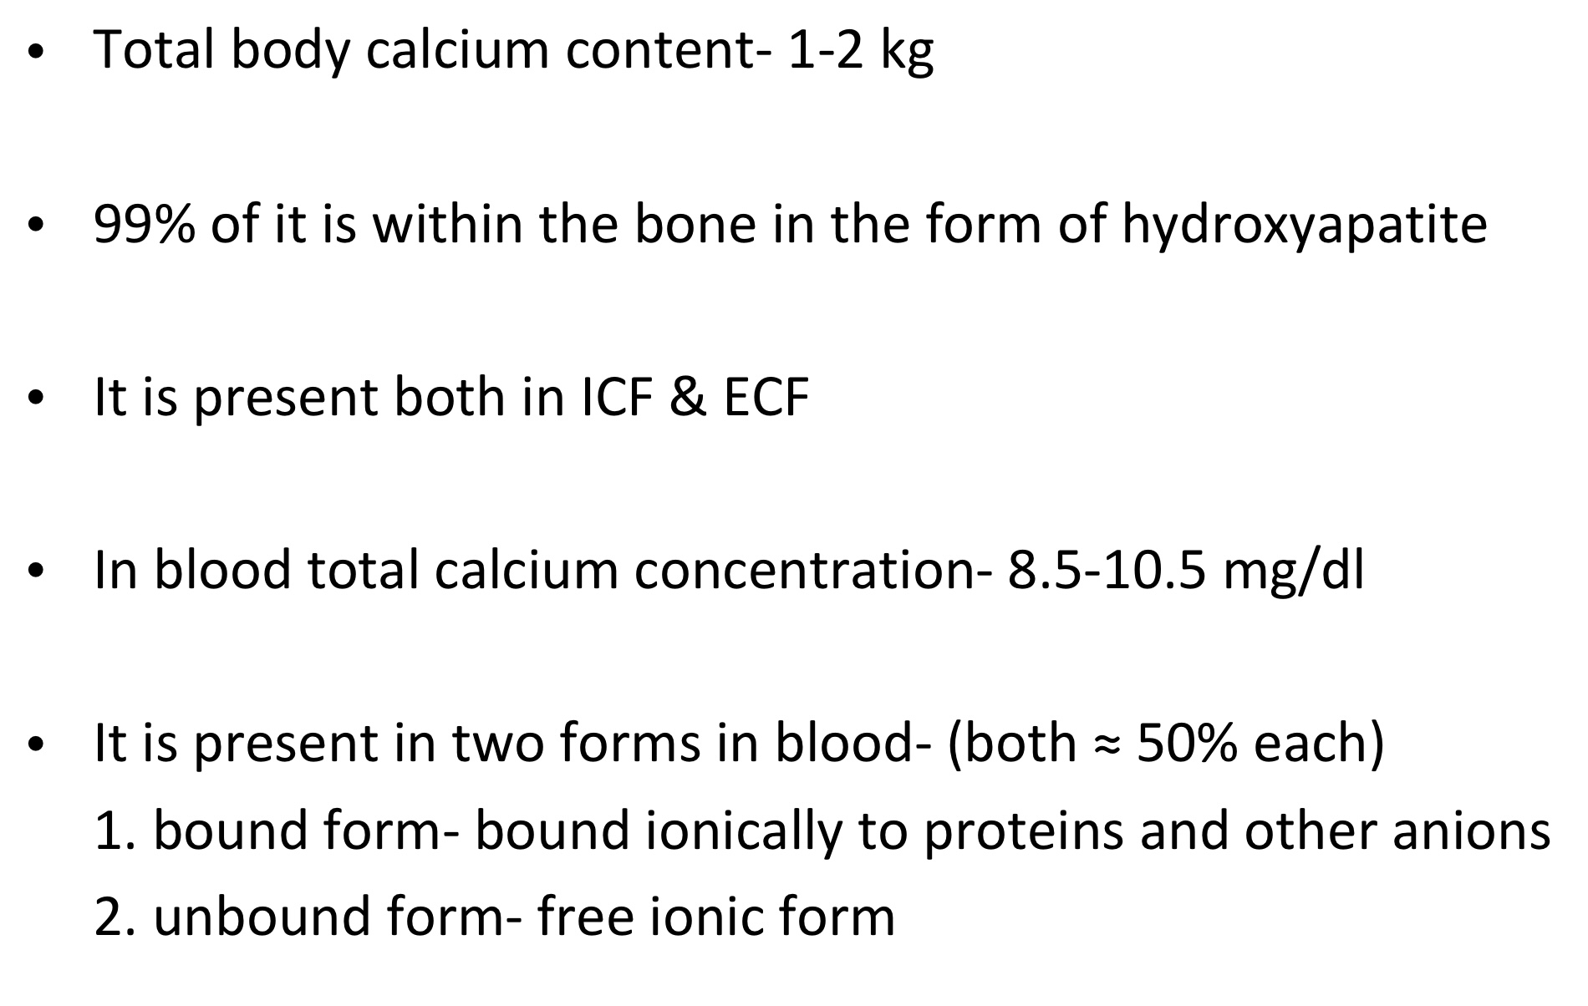
CALCIUM

Slide 22
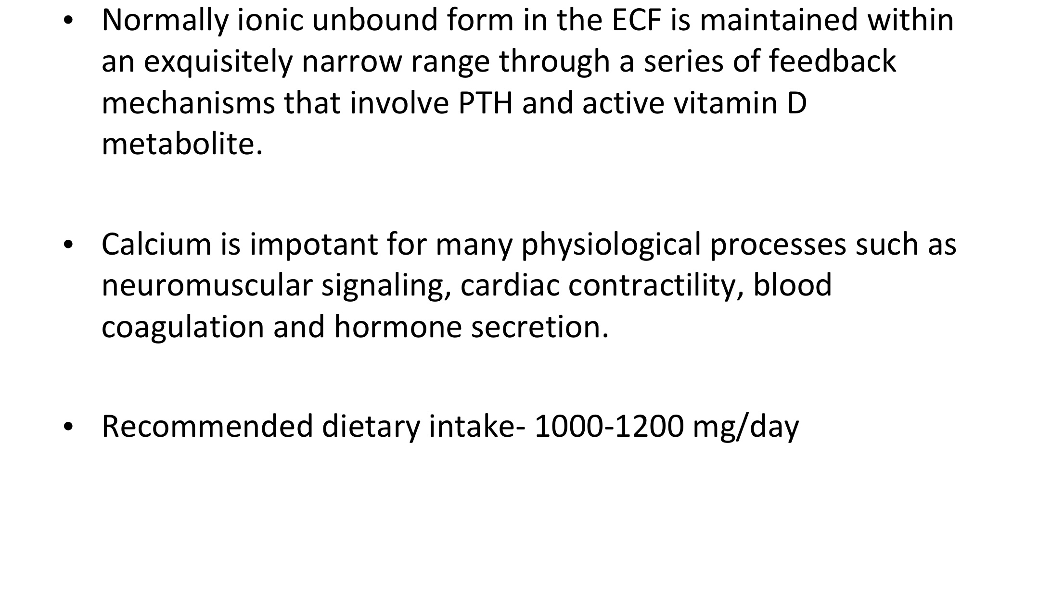

Slide 23
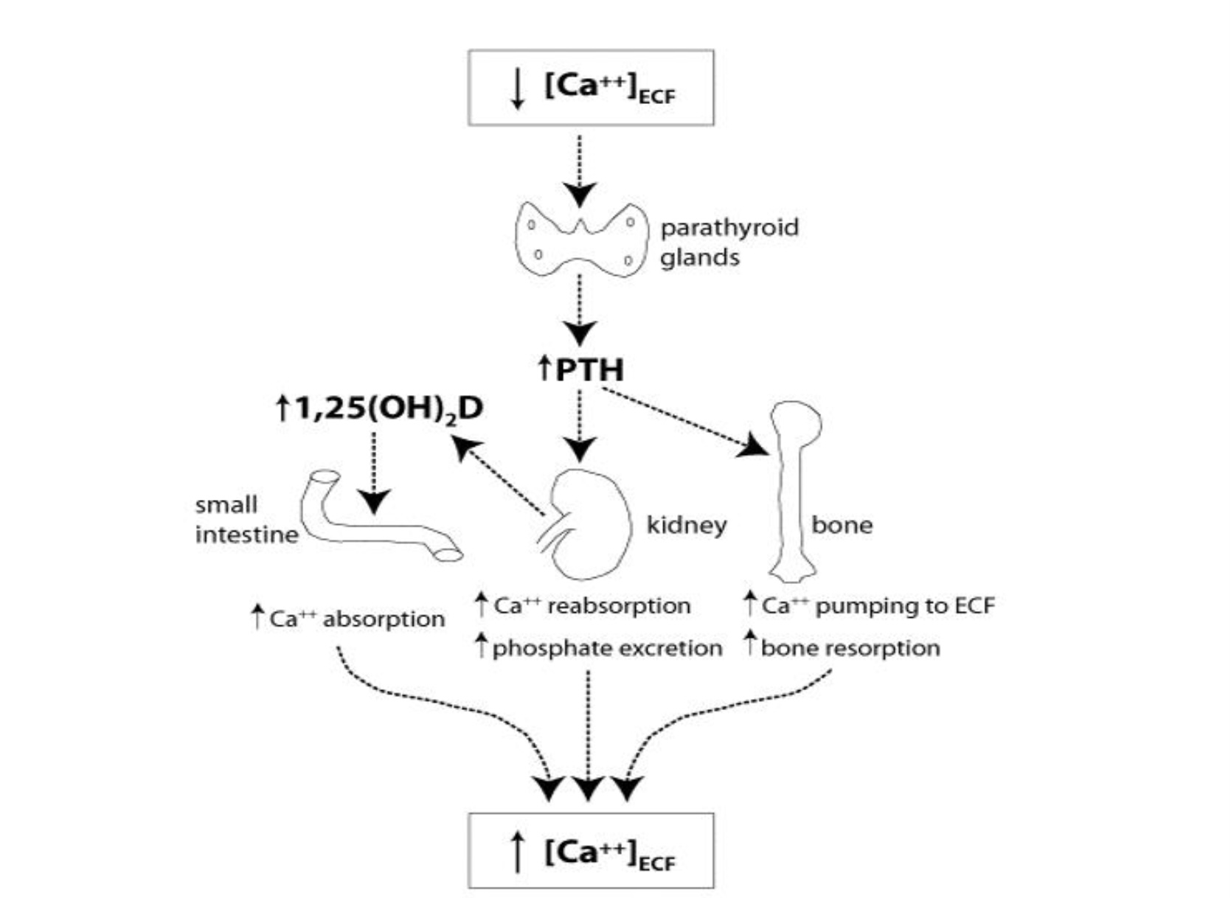
CALCIUM HOMEOSTASIS

Slide 24
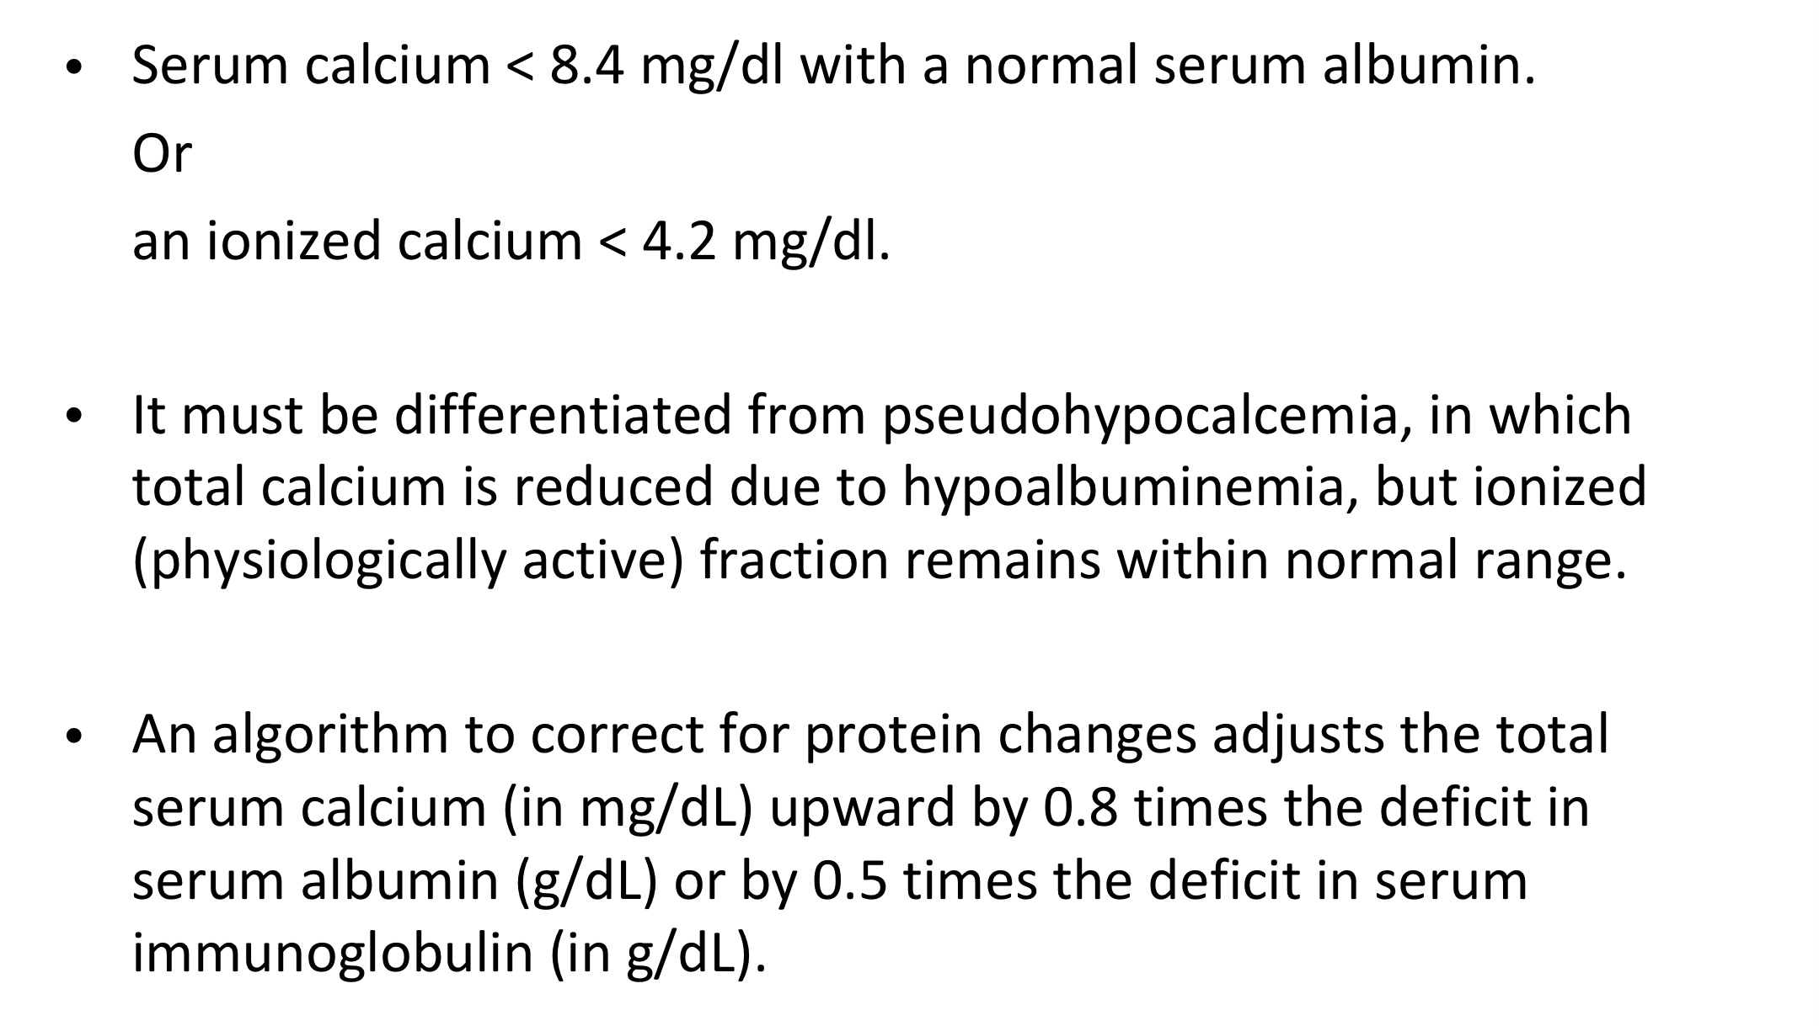
HYPOCALCEMIA

Slide 25
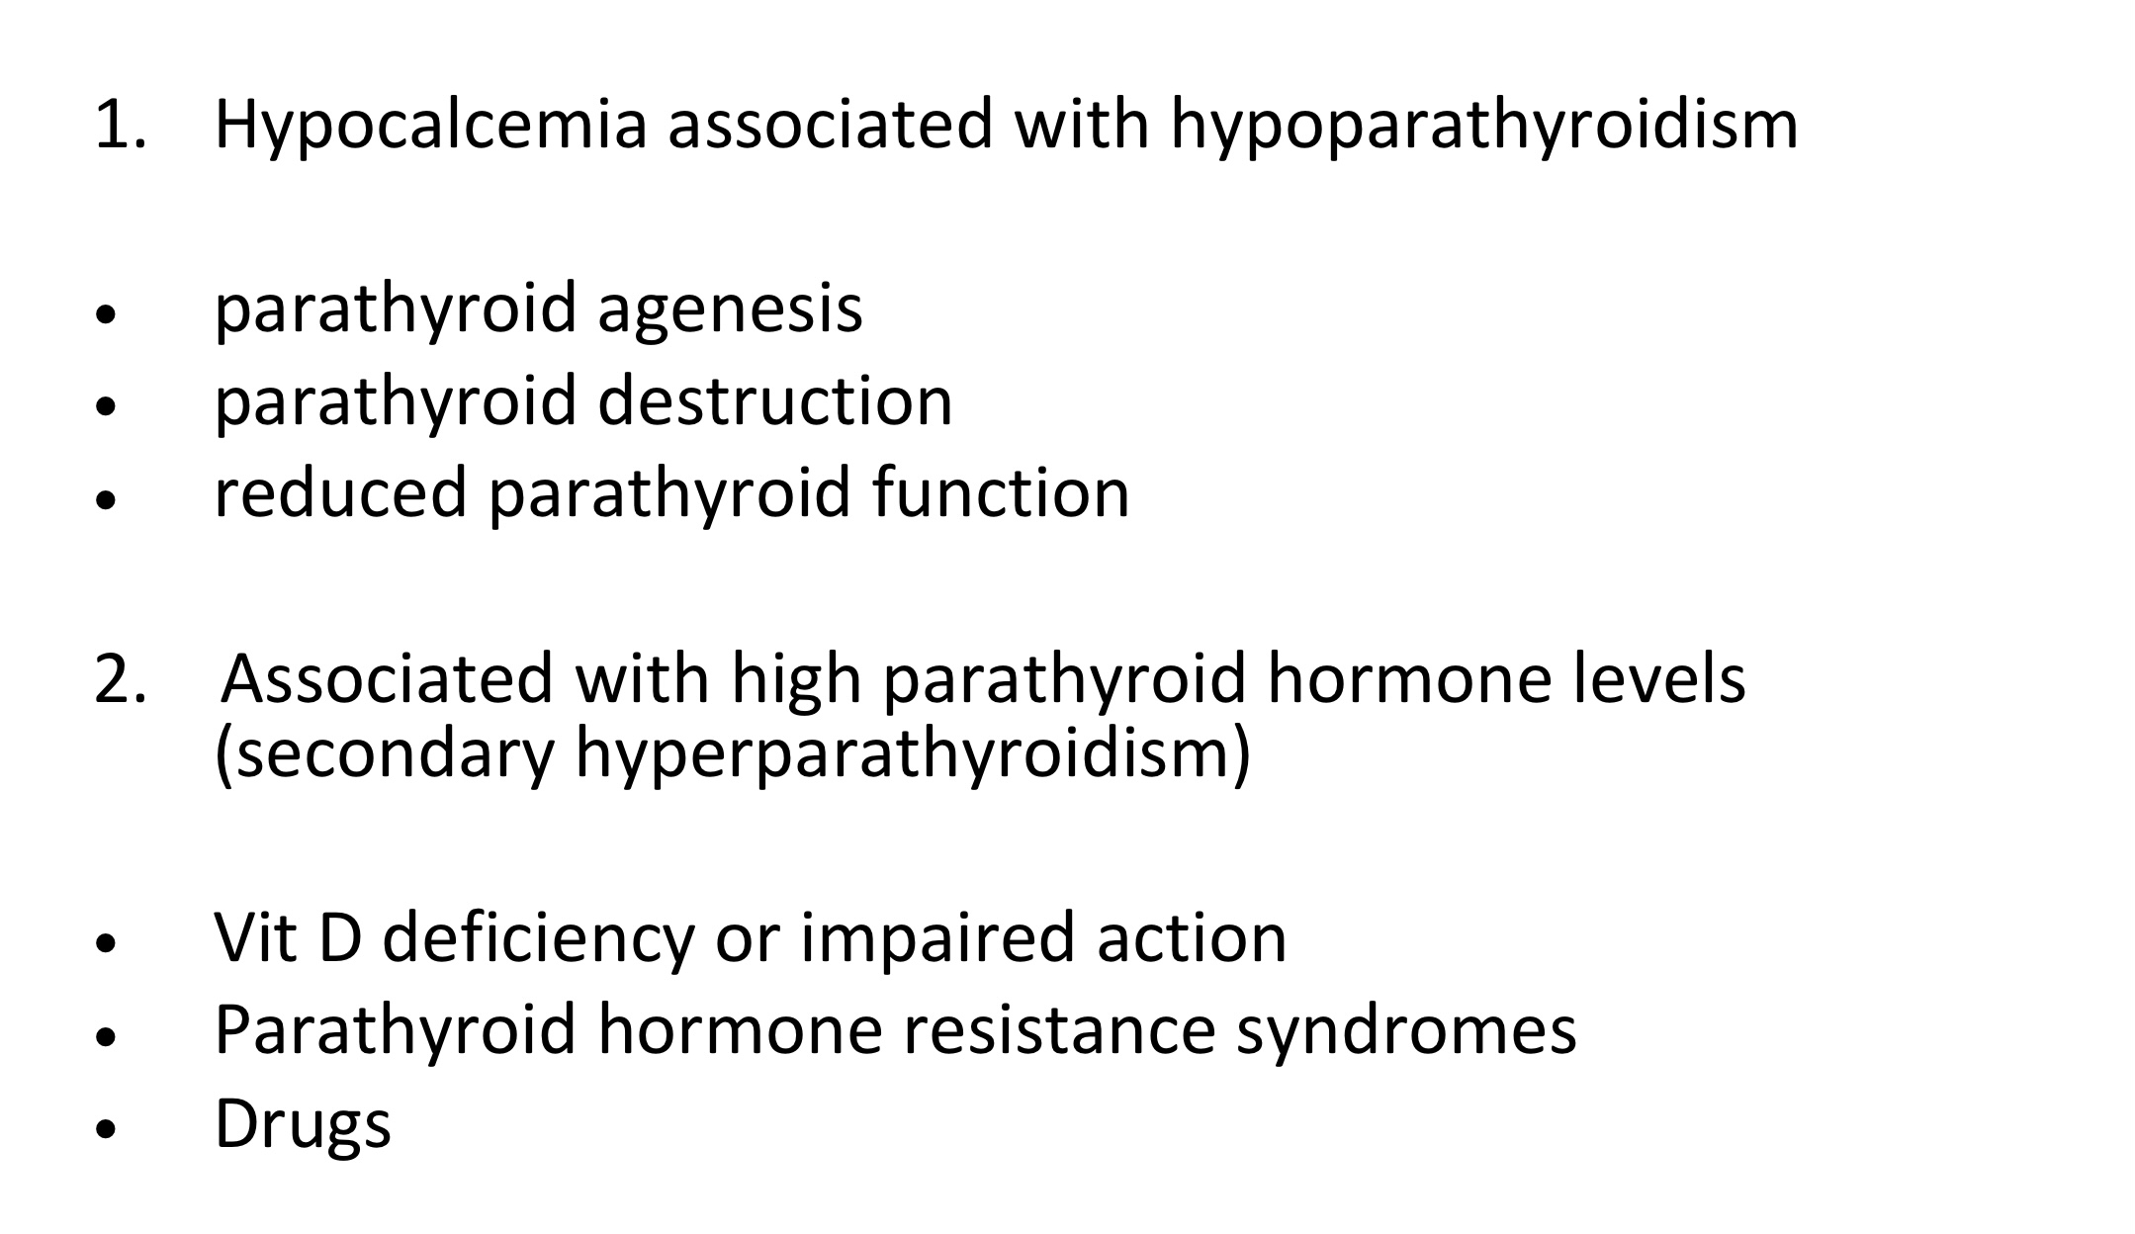
CAUSES

Slide 26
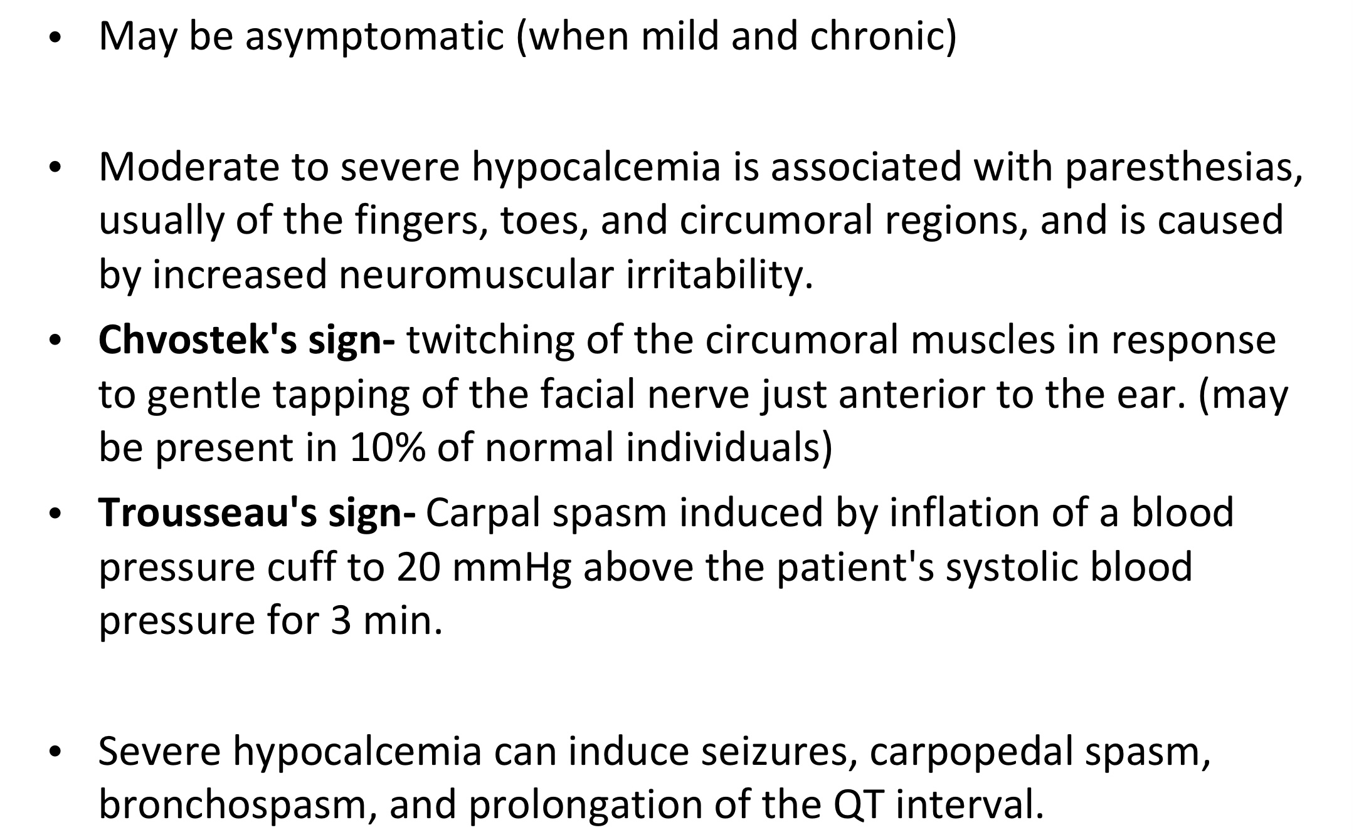
CLINICAL MANIFESTATIONS

Slide 27
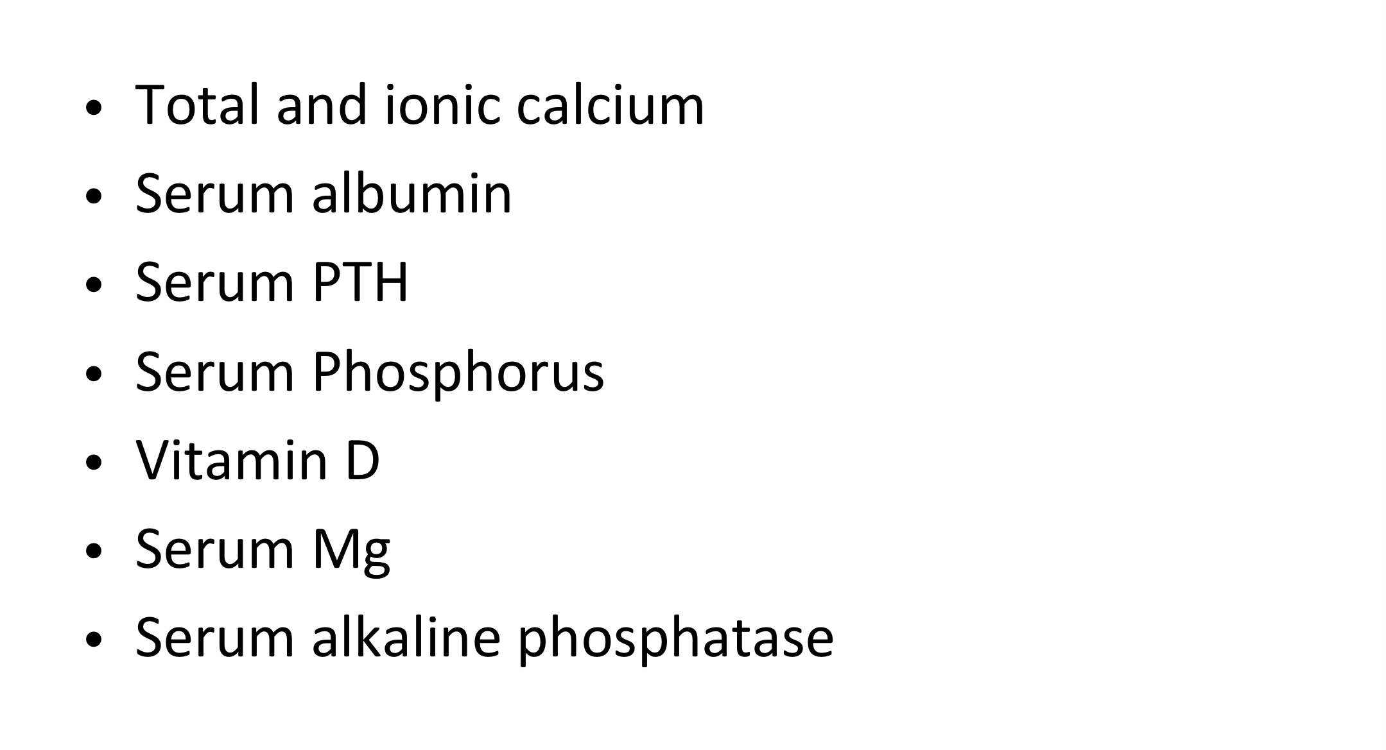
INVESTIGATIONS

Slide 28
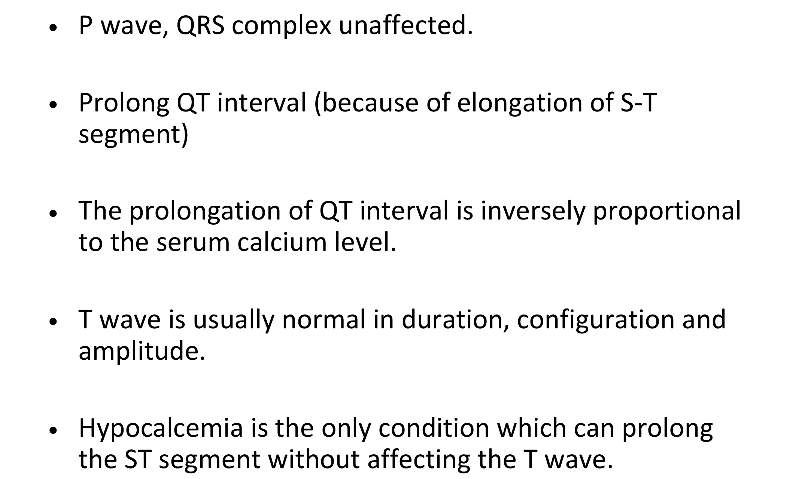
ECG MANIFESTATIONS

Slide 29
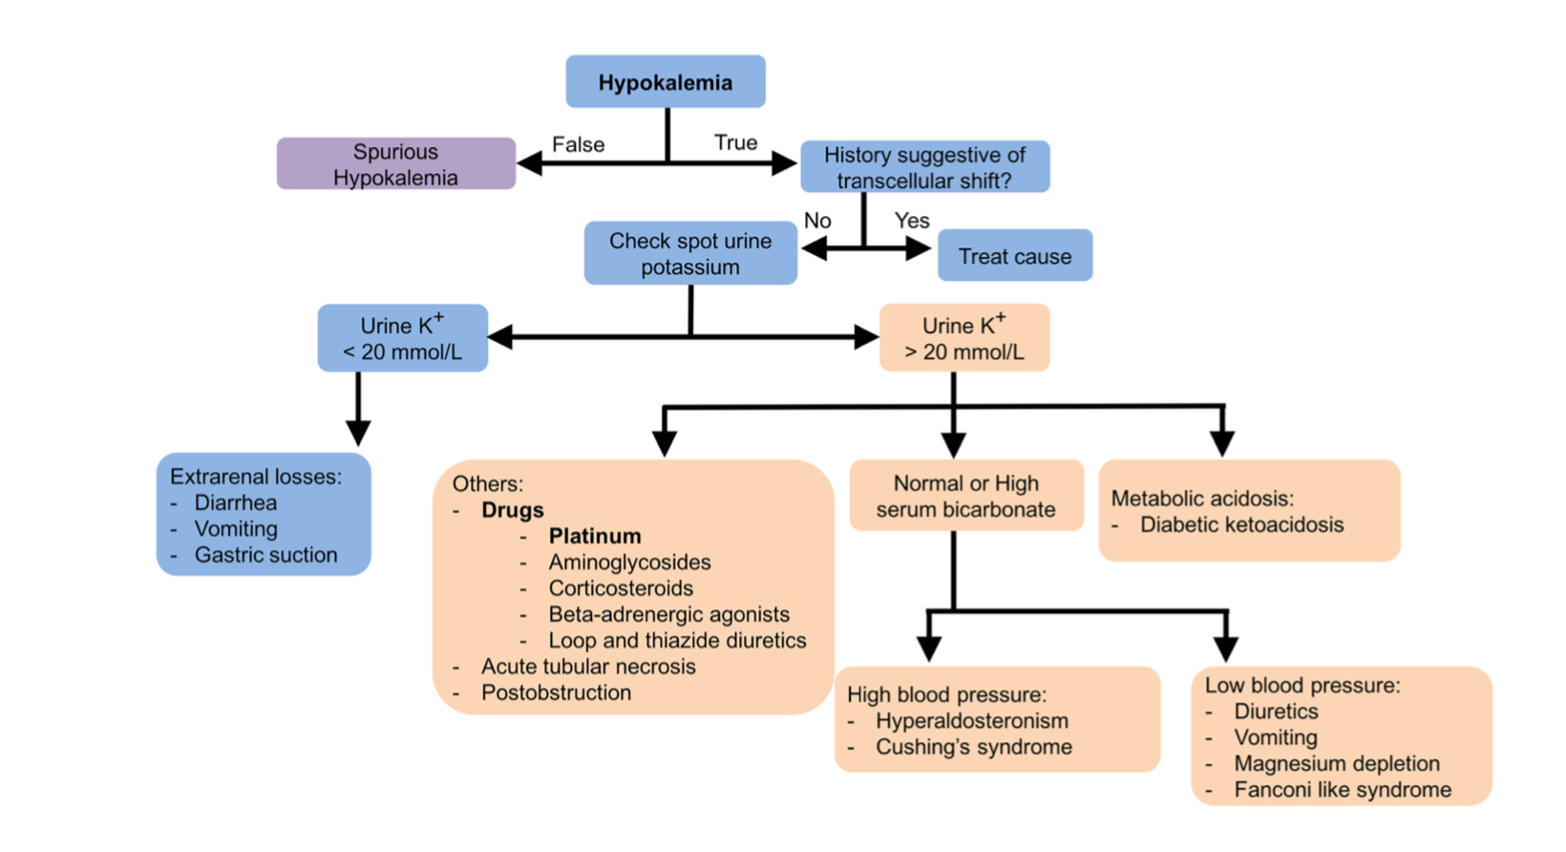
Approach to Hypokalemia

Slide 30
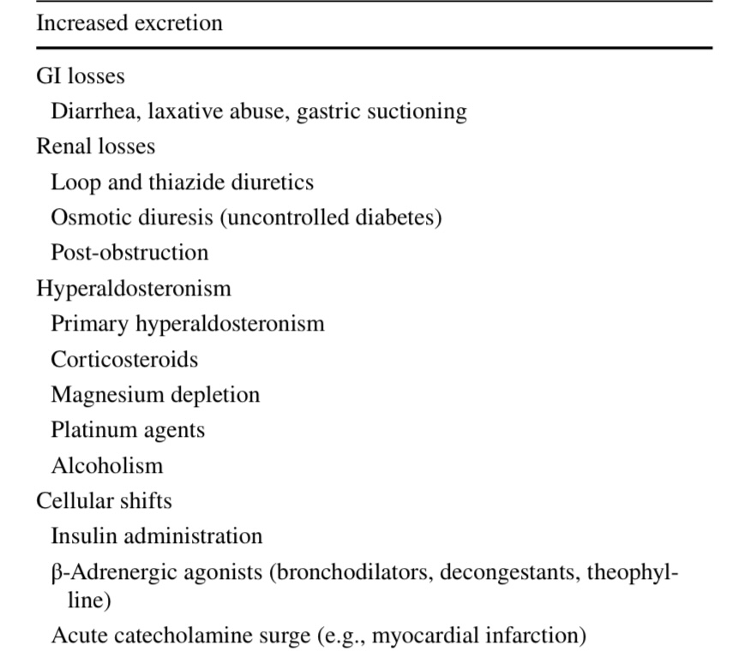
Causes of Hypokalemia

Slide 31
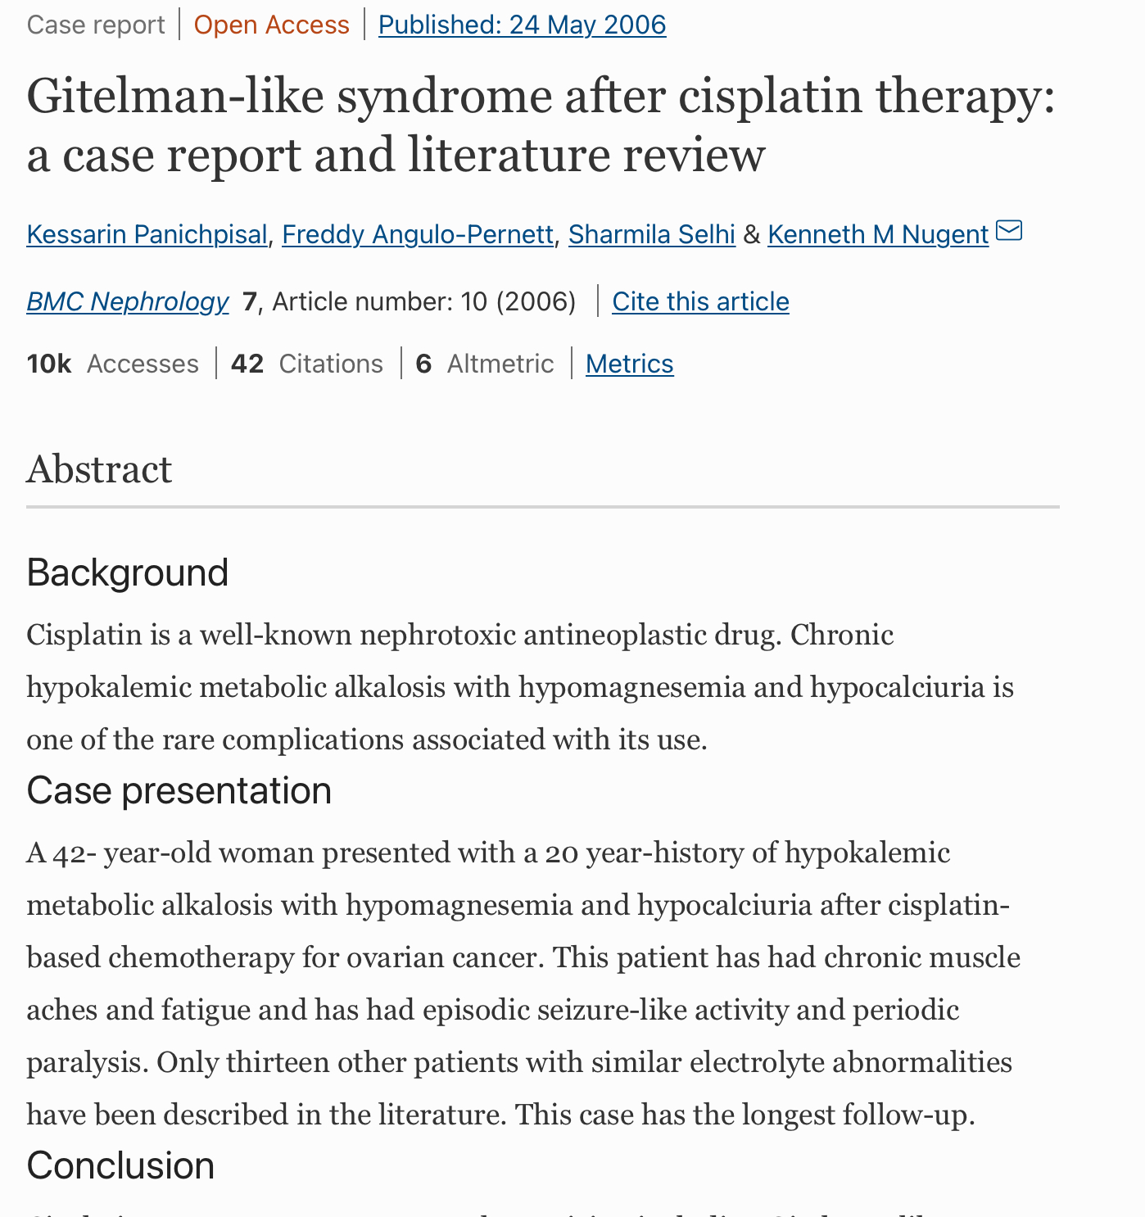

Slide 32
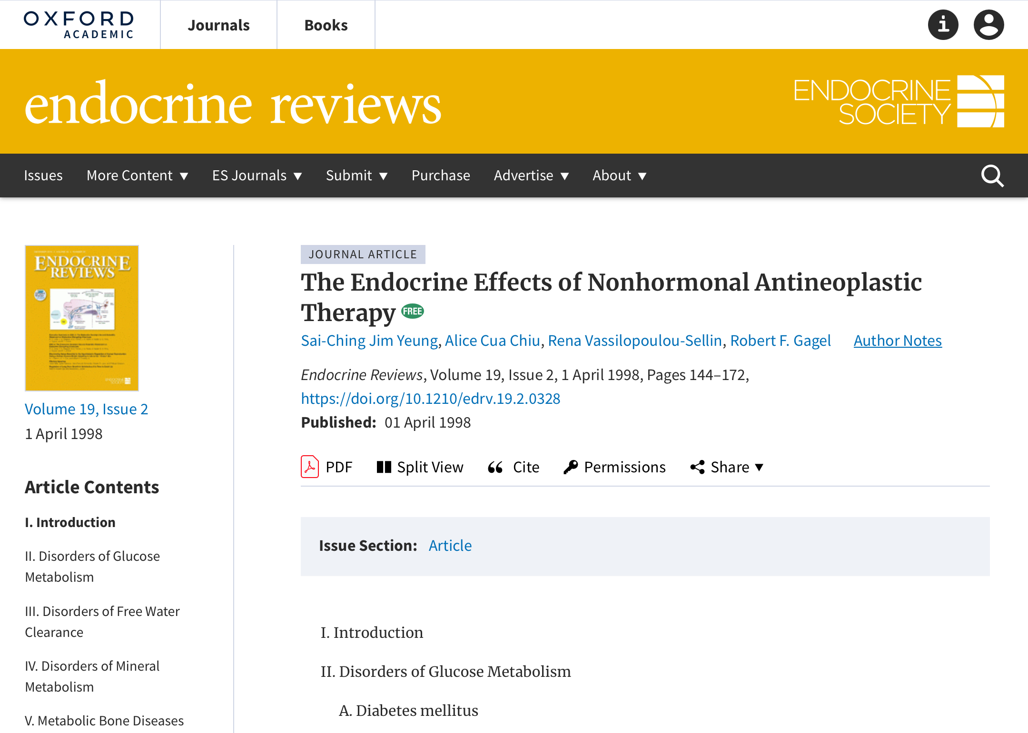

Slide 33
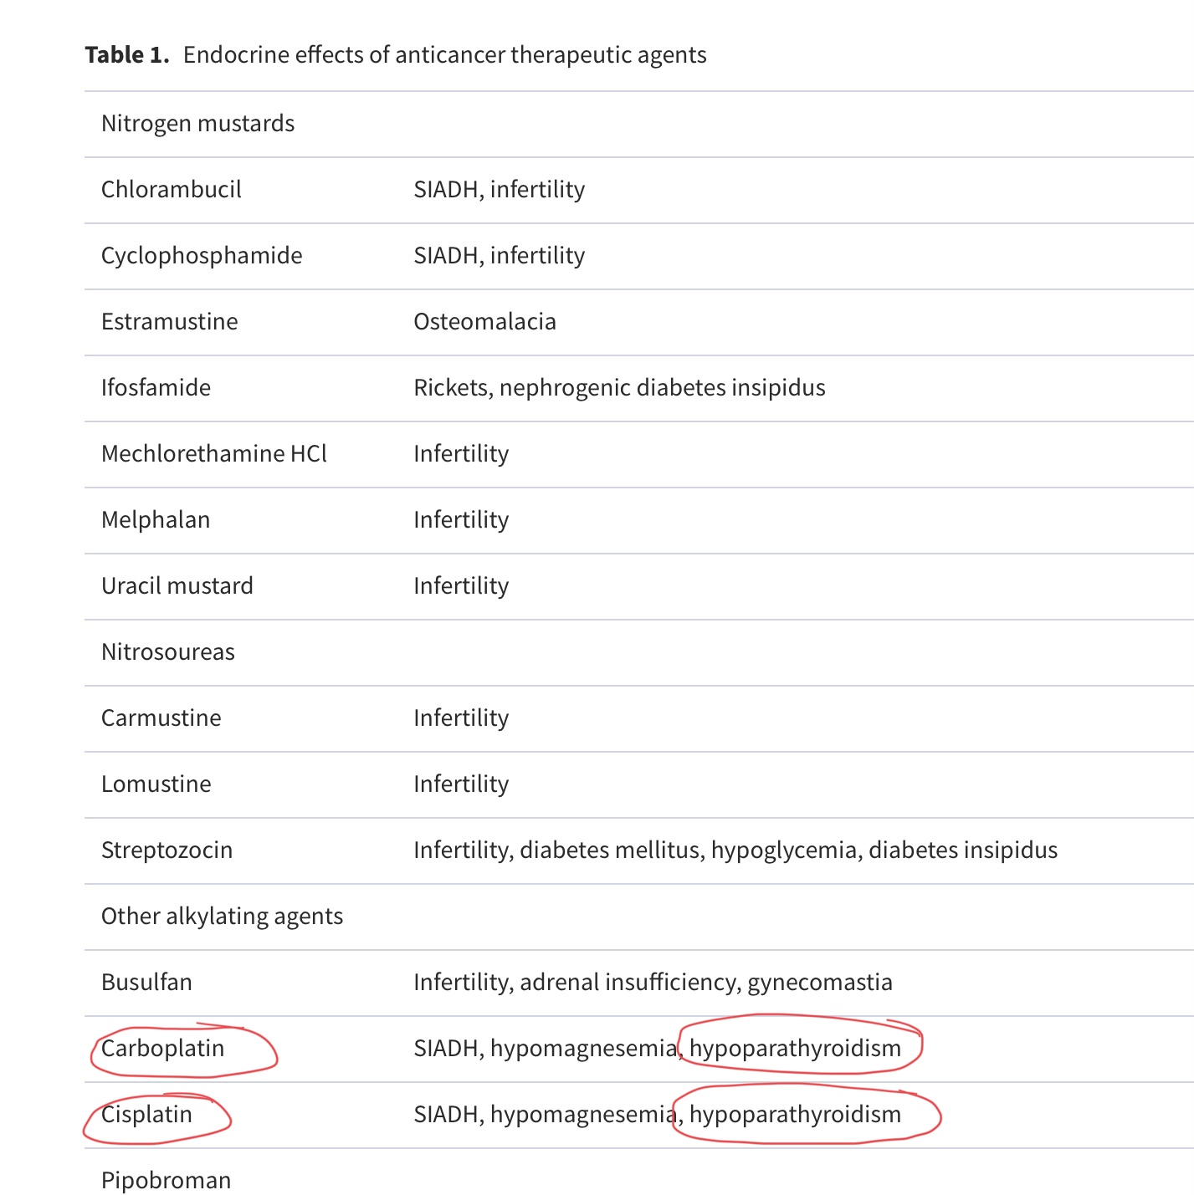

Slide 34
Chemotherapy Induced Tumour lysis Sndrome
Massive cell death resulting from cytotoxic chemotherapy can result in severe hyperuricemia, hyperkalemia, hyperphosphatemia, and hypocalcemia.
Hyperuricemia, hyperkalemia, and hypocalcemia may contribute to the development of cardiac arrhythmia, tetany, and sudden death.
occurs most frequently in hematological malignancies.
The syndrome has been reported in nonhematological malignancies , but these cases are relatively rare.
TLS has been seen with wide variety of therapeutic agents.
Appropriate therapy to prevent complications of tumor lysis includes hydration, alkaline diuresis , inhibition of uric acid synthesis by allopurinol, and oral calcium or aluminum-based compounds to bind intestinal phosphate.
In a hyperphosphatemic patient with hypocalcemia, the addition of an oral calcium-based compound will reduce phosphate and enhance calcium absorption.
Intravenous calcium administration can potentially cause calcium phosphate precipitation in the presence of severe hyperphosphatemia and should be used cautiously. Dialysis may be required for patients with symptomatic hypocalcemia and a serum phosphorus level > 3.3 mmol/liter (>10.2 mg/dl).

Slide 35
Platinum compounds
Hypocalcemia has been reported to occur in 6–20% of cisplatin-treated patients.
Effects of cisplatin on renal tubular function , magnesium metabolism , bone resorption, and vitamin D metabolism may explain the hypocalcemia.
Hypomagnesemia may cause a decrease in PTH secretion and a reduction in the calcium-mobilizing effects of PTH.
Hypomagnesemia also inhibits formation of 1,25-dihydroxyvitamin
cisplatin may have a direct inhibitory effect on bone resorption.
An abnormality in vitamin D metabolism has also been observed in patients who received chemotherapy that included cisplatin .
The level of 1,25-dihydroxyvitamin D decreased significantly after chemotherapy, whereas its precursors remained unchanged.
The effect was attributed to inhibition of mitochondrial function in the kidney by cisplatin .

Slide 36
Take Home Message

