Slide 1
CLINICAL ASPECTS OF PULMONARY NONTUBERCULOUS MYCOBACTERIOSIS
Review article
Hiroshi moro, toshiyaki kikuchi
The Japanese society of internal medicine
2022

Slide 2
Nontuberculous mycobacteria (NTM) - all mycobacteria except Mycobacterium tuberculosis.
Common -M. avium, M. intracellulare, M. kansasii, M. avium intracellulare complex (MAC) [M. avium and M. intracellulare]
Etiologies- purely environmental
Primarily affect the lungs

Slide 3
CLINICAL FEATURES
Cough
Sputum
Malaise
Bloody sputum
Dyspnea
Weight loss, fatigue, appetite loss (chronic inflammation)

Slide 4
DIAGNOSIS OF NTM LUNG DISEASE
American Thoracic Society (ATS) and Infectious Disease Society of America (IDSA), diagnostic criteria
Based on characteristic radiographic findings
Positive culture results from at least two separate expectorated sputum samples
Without the need for a clinical manifestation

Slide 5
RADIOGRAPHIC FINDINGS
Vary depending on the causative organism
Findings consistent with NTM lung disease on chest X-ray or HRCT
Infiltration (usually nodular or reticular nodular)
Cavity
Multifocal bronchiectasis
Multiple nodules
Pleural exudate (rare)
Reactive pleural thickening

Slide 6
Pulmonary MAC diseases characteristic imaging findings
Nodular/ bronchiectatic (NB)
Majority of cases
Middle aged and older women
Without a history of smoking
Nodules and bronchiectasis- right middle lobe, left lingular segment
HRCT chest useful for diagnosing this pattern
Prognosis is relatively good

Slide 7
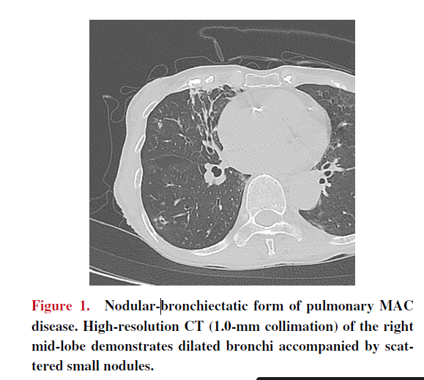
Also observed in other NTM pathogens (M. abscessus)

Slide 8
2. Fibrocavitory
Elderly men
Preexisting lung diseases (emphysema, obsolete tuberculosis)
Progresses rapidly
Poor prognosis
Cavities- thinner walls than those caused by tuberculosis

Slide 9
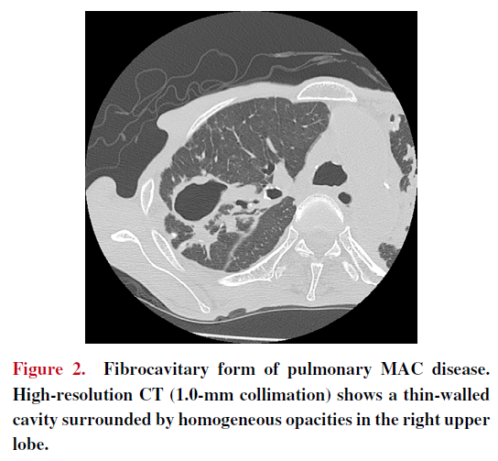

Slide 10
3. Isolated nodule type
4. Systemic dissemination type
5. Hypersensitive pneumonia type
Host factors, pathogen virulence, conditions of exposure →determine the type of disease

Slide 11
M. kansasii- and M. szulgai- clinical symptoms and imaging findings similar to pulmonary tuberculosis (e.g. cavities and nodules in the apex of the lung)

Slide 12
MICROBIOLOGIC EVALUATION
Microbiological confirmation is essential- ubiquitous environmental organisms
A positive sputum culture- environmental contamination or noninvasive colonization in patients with chronic lung disease
Positive culture results- at least two separate expectorated sputum samples required

Slide 13
Good-quality sputum essential
Sputum induction with hypertonic saline (esp in patients unable to expectorate sputum)
Bronchial lavage
If smear results are positive and tuberculosis cannot be ruled out, consider an additional NAAT

Slide 14
SERODIAGNOSIS
Serologic test to detect IgA antibodies against MAC-specific glycopeptidyl lipid core antigen using an enzyme immunoassay- available in Japan since 2011
A study previously demonstrated favorable results for both the sensitivity and specificity of this assay
Further research is needed to verify

Slide 15
SUSCEPTIBILITY TESTING
Usefulness of drug susceptibility tests for pulmonary NTM diseases not fully established
Drug susceptibility test method – ”M24” established by the United States Clinical and Laboratory Standards Institute, adopted in the guidelines of both the US and Japan
The international guidelines revised in 2020 recommend treatment based on macrolide and amikacin susceptibility rather than empiric therapy for MAC lung disease
For M. kansasii lung disease, treatment based on rifampicin susceptibility is recommended over empiric therapy

Slide 16
TREATMENT
Assessment of risk and benefits
Important to consider the immune status in immunocompromised hosts
Treatment of pulmonary NTM infection depends on the infectious organism species
Generally, the reports on effective drugs is limited, need for long-term management with multiple drugs

Slide 17
PULMONARY MAC DISEASE
Multidrug therapy including clarithromycin is essential
Clarithromycin is considered a key drug
Monotherapy should be strictly avoided due to concerns regarding drug-resistant strains
ATS/IDSA guideline and ATS/ERS/ESCMID/IDSA guideline recommend a three-drug, macrolide based regimen
A minimum of one year of therapy after consecutive negative sputum cultures

Slide 18
Nodular bronchiectatic disease
Clarithromycin (500 mg BD)
Ethambutol (25 mg/kg per day) 3 times per week
Rifampin (600 mg)
FC disease and severe nodular bronchiectatic disease
Clarithromycin (500 mg BD)
Ethambutol (15 mg/kg per day) daily dosing
Rifampin(10 mg/kg, 450 mg to 600 mg per day)

Slide 19
Streptomycin or amikacin (10-15 mg/kg, 3 times per week) for the first 2 to 3 months should be considered in patients with FC disease
These drugs are particularly effective for extracellular bacillus
Clarithromycin and rifampin may be replaced by azithromycin and rifabutin
Dose modification- elderly, those with renal dysfunction and a low body weight to avoid adverse effects
Japanese guideline recommends a similar treatment regimen with lower daily doses of clarithromycin (600 to 800 mg)

Slide 20
Because of long-term nature of combination therapy, side effects and drug interactions
Rifampin reduces the blood concentration levels of clarithromycin, lead to a decline in therapeutic efficacy
Rifampin also modifies the levels of the corticosteroid administered to the patient
Hence, a therapeutic regimen without rifampin is currently being explored
A previous study suggested that a two-drug regimen with clarithromycin and ethambutol can achieve clinical efficacy equivalent to or better than a three-drug regimen with rifampin

Slide 21
M. KANSASII INFECTION
Rifampin (600 mg/day)
Isoniazid (300 mg/day)
Ethambutol (600 mg/day)
Duration -12 months after negative sputum cultures
Better therapeutic effects are expected than with pulmonary MAC diseases
M. kansasii infection may deteriorate in the absence of an appropriate treatment
Recurrence is typically seen, concern of rifampin-resistant strains
The international guidelines revised in 2020 - either isoniazid or macrolides to be used in combination with rifampicin and ethambutol

Slide 22
SURGICAL MANAGEMENT
Lung resection :
ATS/IDSA guideline -in patients with limited (focal) disease, sufficient cardiopulmonary reserve to tolerate partial or complete lung resection. Successful with multidrug treatment regimens
Cases refractory to drug therapy
With macrolide-resistant strains
With serious complications (hemoptysis)
Severe perioperative complications
Several single-institution retrospective studies including a few patients -good treatment outcome for surgical intervention

Slide 23
PROGNOSIS
A meta-analysis of HIV-negative patients with pulmonary MAC disease- treatment success rate of 38%
60% of patients with pulmonary MAC disease- demonstrated consecutively negative sputum cultures with a standard regimen
Still definitive treatment for pulmonary MAC disease not yet identified
Poor prognostic factors→ FC form, positive sputum smear, and M. intracellulare as the causative organism

Slide 24
SPECIAL CONSIDERATION IN RA PATIENTS
Recent studies- patients with rheumatoid arthritis (RA), and anti-TNF-alpha therapy are at increased risk for NTM diseases
Epidemiological study performed in Asia - the incidence of NTM diseases was 4.22 times greater in RA group than in the non-RA group
Study in North America - the adjusted hazard ratio for NTM disease was 2.08 in the RA group, relative to the non- RA group

Slide 25
Review of the US FDA Med Watch database for patients receiving anti-TNF-alpha therapy- 44% of these patients had been diagnosed with NTM diseases
Median patient age- 62 years
Most patients (65%) were women
Most (70%) had RA
M. avium (50%) was the most commonly implicated bacteria
Pulmonary region was the most frequently reported site of disease (56%)

Slide 26
Frequent occurrence of pulmonary NTM disease in RA patients→ associated with preexisting structural abnormalities (extraarticular involvement by RA)
Pretreatment screening and appropriate management of NTM diseases are required in RA patients undergoing anti-TNF-alpha therapy
Important to perform HRCT before administering biological agents in order to evaluate the presence of airway disease
If the NTM diseases is suspected, multiple sputum examinations or sampling by bronchoscopy- considered
A serological assay is a promising technique

Slide 27
Imaging findings of airway diseases commonly complicating RA are similar to the NTM disease on HRCT (difficult to differentiate)
Colonization of NTM in the airway is not very rare in RA patients
NTM diseases should be strictly diagnosed according to the diagnostic criteria
The use of biologics in patients with confirmed pulmonary NTM disease is contraindicated
In cases with NB forms of MAC lung disease, the use of biologics may be considered aseessing the risks and benefits

Slide 28
THANK YOU

