Slide 1
Capsular Warning Syndrome - A Case Series and Discussion on Management Dilemmas
Dr. Alby Maria Mathews

Slide 2
PUBLISHED IN:
Journal of The Association of Physicians of India . Vol. 69 . August 2021

Slide 3
INTRODUCTION
The Capsular warning syndrome (CWS) is defined as the occurrence of at least three recurrent stereotyped transient ischemic attacks in 24 hours, being purely motor, sensory or both, involving 2 of the 3 regions of face, arm and leg.
No cortical symptoms or signs should be present.
Among these patients, 42-71% go on to develop a capsular infarct.

Slide 4
The pathogenesis of this syndrome is largely hypothetical, with mention of hemodynamic impairment, vasospasm, artery-to-artery embolism, peri-infarct depolarization, and cardio-embolic source as putative etiologies.
Hence, optimal treatment in acute stage as well as for further prevention of strokes, is controversial.
Herein, we report our experience of 9 cases of CWS and discuss the management conundrum.

Slide 5
Patients and Methods
We describe 9 cases that fulfilled the definition of CWS that were treated at our centre in the past 2 years.
CT brain and CT angiography were done at time of presentation to look for intracranial bleed and occlusion of a large vessel whilst MRI brain was done 24 to 48 hours later for most of the patients.

Slide 6
Seven patients were treated with intravenous thrombolysis with tPA.
This was followed by treatment with dual antiplatelet agents starting 24 hours post thrombolysis, after ruling out intracerebral hemorrhage on repeat CT brain.

Slide 7
Case 1:
A 38 year old male was brought at 12 noon to Emergency room with a 3 hour history of right hemiparesis. He had no prior TIAs, HT, DM or cardiac history, was not a substance abuser, and was on no medications.
His BP in left UL was 120/88 mm Hg, and he had a regular pulse rate of 110/m. He was alert, fully oriented, dysarthric due to right UMN facial weakness, and had Rt hemiparesis of Gd 0.
His NIHSS was 14 at 3 hrs 15 min after onset of symptoms. CT brain and angiography were normal and ASPECTS score was 10.

Slide 8
He was thrombolysed at 12.54 pm with IV tissue plasminogen activator (tPA).
Within 20 minutes, his power improved to Gd 4, and facial weakness resolved. However, in the next 20 minutes, power fluctuated twice from Gd 4 to 0 and back again to Gd 4.
We repeated a CT brain and Angiogram, and performed a 2D Echo, all of which were normal. At 1 hour post- thrombolysis, power was Gd 0 on the hemiparetic side. MRI done at that point showed showed a left gangliocapsular infarct (DWI-ADC concordant), with FLAIR images already showing concordant signal abnormalities . No bleeding was seen.

Slide 9
Patient had a complete hemorheological investigation including sickling test, thrombophilia workup, and homocysteine level, and had a bubble Echo study performed, all of which were normal.
He made a complete recovery over 2 weeks and was discharged on double antiplatelets with statins.

Slide 10
Case 2:
An 18 year old girl was brought with recurrent left hemiparesis, totaling 14-15 episodes over 2 days, each episode lasting 5-8 mins. She had had no recent viral exanthematous fevers or vaccinations.
At presentation to us, she had Left hemiparesis of 3/5 power with a left UMN facial weakness, NIHSS score being 8.
Her vital parameters were normal, including cardiac examination and carotid pulsations.

Slide 11
ASPECTS score was 10 on CT brain with a normal angiography. She recovered to normal power in 20 mins.
She was thrombolysed with tPA at 3 hours after her last episode. Repeat CT at 24 hours, and Echocardiogram were normal.
MRI showed diffusion restriction with concordance on ADC, in right posterior limb of internal capsule

Slide 12
All hemorheological, and structural causes were ruled out on investigation.
She continued to be asymptomatic over the next 3 weeks, on antiplatelets and statins.

Slide 13
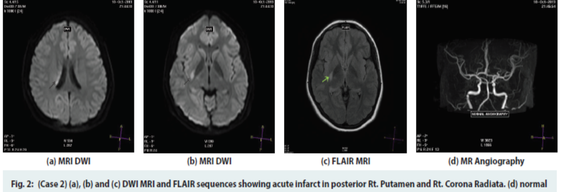

Slide 14
Case 3:
A 13 year old boy presented with 5 episodes 5 days ago, and 1 episode on day of presentation, comprising headache, body pain progressing to Right hemiparesis, and slurred speech lasting 5 minutes each time.
He had no past history of migraine or seizures, and had had no recent vaccinations or exanthematous fevers.
His blood pressure was 100/70 mm Hg and pulse was regular at 80/m. He had a widely split S2.

Slide 15
Possible diagnoses considered were CWS, hemiplegic migraine, or seizures with Todd’s palsy. While his CT brain and Angiography were normal, MRI showed an acute infarct in left Centrum semiovale and posterior limb of Internal capsule .
He was managed conservatively with antiplatelets, and continued to have 1 daily episode of weakness lasting a few minutes, while in the ward.
He was detected to have a Bicuspid Aortic valve with commissures at 10 and 4 O’clock positions. Thrombophilia workup showed no abnormality.

Slide 16
Her CT and MRI brain were normal.
MR angiography showed long-segment narrowing of left vertebral artery, narrowing of left internal carotid in cavernous portion, and absence of left A1 segment of ACA.
Additionally, occipitalisation of atlas and fusion of C2, C3 vertebrae on the left side, were seen.

Slide 17
Echocardiography and hematological tests were all normal.
She was started on double antiplatelet therapy with Statins.

Slide 18
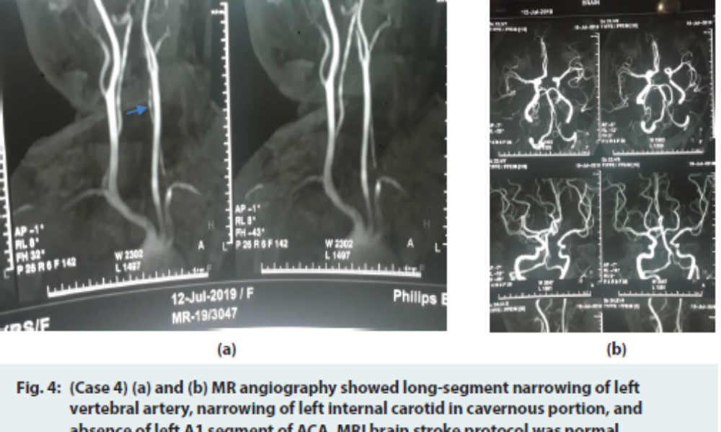

Slide 19
Case 5:
A 17 year old girl presented with 2 episodes of left Hemiparesis without facial involvement, in Jan 2020, lasting 6 minutes each, over 3 hours. She had 2 prior episodes in the previous month, each lasting 5-15 minutes, over 4 hours.
She had had no recent vaccinations or exanthems.

Slide 20
At presentation, she was on Aspirin 150 mg daily for the previous 2 wks.
All investigations, including sickle testing, bubble echo, Lipoprotein levels, and thrombophilia workup, were normal.
MRI done the previous month had shown an acute infarct in deep white matter on the right side, with some restricted diffusion in right frontal cortex, and a possible M2 narrowing, However, at present episode, CT brain and angiography and MRI were normal.

Slide 21
She had a history of migraine without aura, of 2-3 years duration.
A combination of Aspirin and Clopidogrel was started, and Flunarizine was added.
She continued to be asymptomatic over the next 3 months.

Slide 22
Case 6 :
A 50 yr old man presented with a flurry of 5 episodes of left sided hemiparesis with UMN facial weakness over the past 12 hours. During presentation, he had an NIHSS score of 11, but the deficit recovered fully within 10 minutes.
CT brain and CT angiography were normal, and the patient was thrombolysed with tPA at 1 hour post the last episode.

Slide 23
He remained asymptomatic till discharge 4 days later. Repeat CT at 24 hours post thrombolysis showed a gangliocapsular infarct on the right side.

Slide 24
Case 7:
A 30 yr old male, newly detected to have hypertension, presented with 3 TIAs over 3 hours, each lasting 5-10 mins. He had had a similar episode a week ago. The deficit included a right hemiparesis with facial weakness
At presentation, his NIHSS fluctuated from 0-6. His ECG showed inferolateral ST- T changes, and 2 D Echo was normal.
His plain CT brain showed an evolving leftstriatocapsular infarct, with CT angiogram showing complete left Internal Carotid block.

Slide 25
H e was thrombolysed with intravenous bolus iv tPA at 2 hrs after last fluctuation, with a plan to do a conventional angiography as soon as possible.
But patient worsened to Gd 1 power clinically, and took a discharge against medical advice.

Slide 26
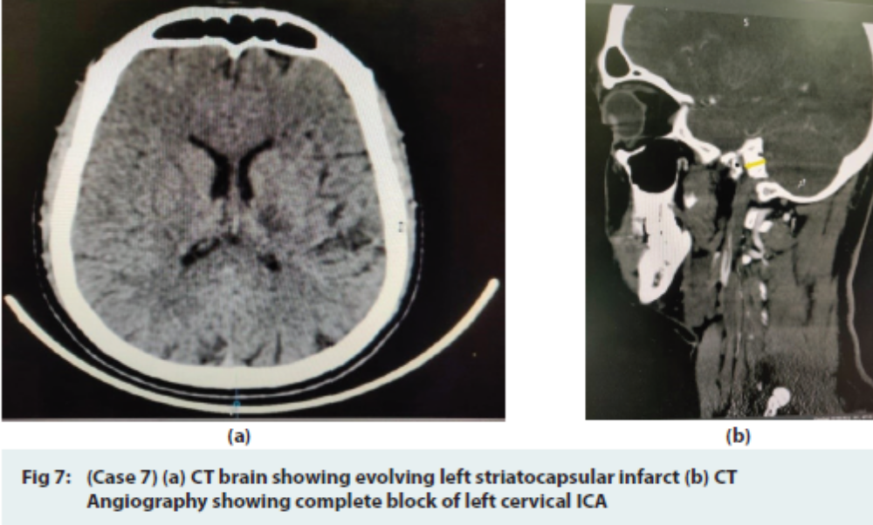

Slide 27
Case 8:
A 64 year old male presented with 6 episodes of right sided hemiparesis with right UMN facial palsy lasting about half an hour each, with complete recovery after each episode. These episodes occurred over 12 hours, with NIHSS of 7 to 8 during each episode. After admission, he had 2 more similar episodes.
CT brain was normal.

Slide 28
Patient could not be thrombolysed due to financial constraints.
He was started on low molecular weight heparin 60mg subcutaneously 12 hourly.
His MRI done on 6th day showed an established left gangliocapsular infarct on FLAIR with diffusion restriction and corresponding low ADC.
His ECG showed poor R progression in precordial leads but echocardiography was normal.

Slide 29
After the last episode his weakness lasted around 4-5 hours, followed by complete recovery.
Thereafter he remained symptom free till discharge 7 days later.

Slide 30
Case 9:
A 28 year old man presented with recurrent right faciobrachial weakness, having had 4 episodes over 7 hours, lasting 5-7 minutes each time.
His NIHSS was 3 during 1 such episode in the emergency room. CT brain and CT angiography were normal.
His Hb was 17 gm %, with no clinical signs of dehydration.

Slide 31
He was thrombolysed at 4 hours after the last episode. The decision to thrombolyse despite low NIHSS was taken in view of dominant upper limb being involved, and young age of patient. MRI brain done at 14 hours after thrombolysis showed a left Internal Capsule acute infarct .
He had recovered partially at discharge, with no further episodes.

Slide 32
Discussion
When there is a single dominant Lenticulostriate artery supplying the deep motor tracts, instead of multiple small penetrating vessels, then a proximal MCA stenosis can result in this syndrome.
Atherosclerotic plaques on the ventral wall of MCA at the origin of the lenticulostriate arteries, demonstrated by high resolution MRI, have also been proposed as the causation of CWS.
Anterior choroidal artery stenosis may also cause CWS.

Slide 33
In this series, 7/9 patients were under 40 years of age
Since the majority of patients were young, without traditional vascular risk factors, it was important to investigate fully for a cause, despite the infarcts being subcortical.
Cerebral CT Angiography , 2 D Echocardiogram (Transesophageal Echo may be required), cardiac rhythm recording, and hemorrheology would be mandatory in younger patients.

Slide 34
Among the 9 patients, 3 had definite concordant angiographic abnormalities on CT angiography.
Patient no. 5 had been documented to have a concordant M2 narrowing at a previous episode. She also had a history of migraine, and had had the present episode while on Aspirin.
It was possible that migraine induced vasospasm, or Reversible vasoconstriction syndrome was the cause of her deficit, although CT angiography at the present episode was normal.

Slide 35
Flunarizine was added to the Aspirin- Clopidogrel combination at the present episode for this patient.
All except one patient had a normal Echocardiogram, the single exception being patient 3, who had a bicuspid aortic valve, with no arrhythmia

Slide 36
The commonest presentation in this series was a pure motor syndrome.
An infarct was almost always seen on CT/MRI in our patients in the first few hours after presentation or on a repeat CT at 24 hours after presentation.
Site of infarct was distributed between Striatocapsular area, posterior limb of Internal capsule,Corona radiata and Centrum semiovale in our patients.

Slide 37
Treatment is controversial.
There are anecdotal reports of successful stenting of the proximal arterial stenosis with a good outcome.
In the majority of cases, the question is whether to thrombolyse or not, in the fluctuating scenario.

Slide 38
In a retrospective analysis of ischemic strokes over a 5 year period, it is found that 18/967 patients had a “Stroke warning syndrome’, and that 9 of them received IV tPA, with a good outcome in one third of these patients at 3 months.
However, 55% in the ‘no tPA group’ of this subset also had a good outcome.
Another group has reported a short case series of 4 patients with CWS who received IV tPA within 4 hours of onset, with ¾ patients showing complete clinical recovery, and a normal MRI, at 1 week.

Slide 39
Overall, IV thrombolysis appears to be as safe in CWS as in general acute ischemic stroke.
Intravenous thrombolysis was done in 5/9 patients in our series, with excellent clinical outcome in most patients.

Slide 40
Various case reports have mentioned efficacy of individual or combinations of antiplatelet agents in the treatment of CWS.
Fahey et al found a loading dose of Clopidogrel to be efficacious in 2 patients who were ‘ Aspirin resistant’.
Kawano et al, and Asil et al, in separate case reports, also reported combination antiplatelet agents to be of benefit.
Jiao et al reported favorable outcome in CWS with combination of clopidogrel, aspirin, heparin and a plasma expander.

Slide 41
Lalive et al, reporting on 6 patients with Lacunar syndrome preceded by TIAs, suggest that frequent BP monitoring, and pharmacological raising of BP if necessary, is key to a good outcome.
Wei Li et al have used intravenous Tirofiban in combination with standard medications and demonstrated reduction in early fluctuations and shortening of duration of functional deficits in CWS.

Slide 42
Following the reported data from the Austrian stroke registry which shows equal benefit of intravenous thrombolysis in lacunar and non-lacunar strokes, there should be no hesitation in thrombolysing lacunar syndromes.
Thus, as a large percentage of patients with CWS will end up with a disabling stroke if not thrombolysed, there should be no hesitation in thrombolysing a fluctuating CWS either.

Slide 43
There is no definite recommendation on the role of Heparin in CWS, or a definite recommendation on secondary prophylaxis in these patients.

Slide 44
Conclusion
In conclusion the pathogenesis of CWS continues to be debated.
It is essential to look for any underlying angiographic, cardiac or hemorheological factors, especially in younger patients with no vascular risk factors.
Intravenous thrombolysis is safe and should be done early, despite ongoing clinical fluctuations, to prevent a resultant disabling stroke.

Slide 45
THANK YOU

