Slide 1
THE EYES CAN’T SEE WHAT THE MIND DOESN’T KNOW
DR. MEERA G. KOOTTUMMEL
JUNIOR RESIDENT
DEPT. OF INTERNAL MEDICINE

Slide 2
history
65 year old gentleman
H/o T2DM and recent Inferior wall MI (Thrombolysed 1 month back)
Pain and swelling left hand *2 weeks
Unable to do routine work due to pain
Altered sensation while touching

Slide 3
history
No history of diurnal or postural variation of pain
No history of fever
No history of trauma
No history of recent IV cannulation
No history of insect bites
No history of similar illness in past

Slide 4
examination
On examination:
Vitals normal
Systemic examination - WNL except:
  Local examination of left-hand showing swelling over left distal forearm and dorsum including fingers

Slide 5
examination
Palmar aspect of hand and volar aspect of forearm spared
Peripheral pulses normal(no variation with movt. of limb)
Movements limited due to pain
Swelling +
Edema+
Hyperaemia+
No local rise of temperature**
Dysesthesia and hyperesthesia +

Slide 6
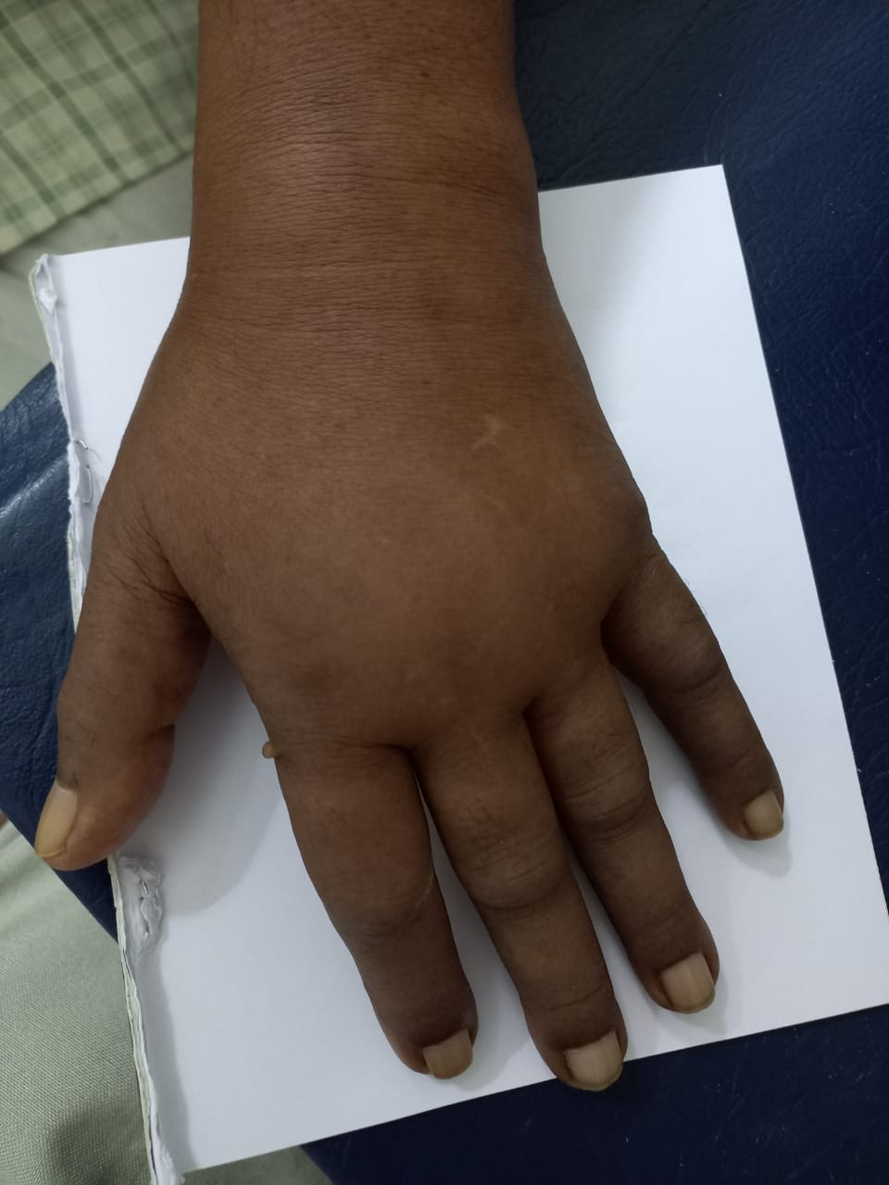

Slide 7
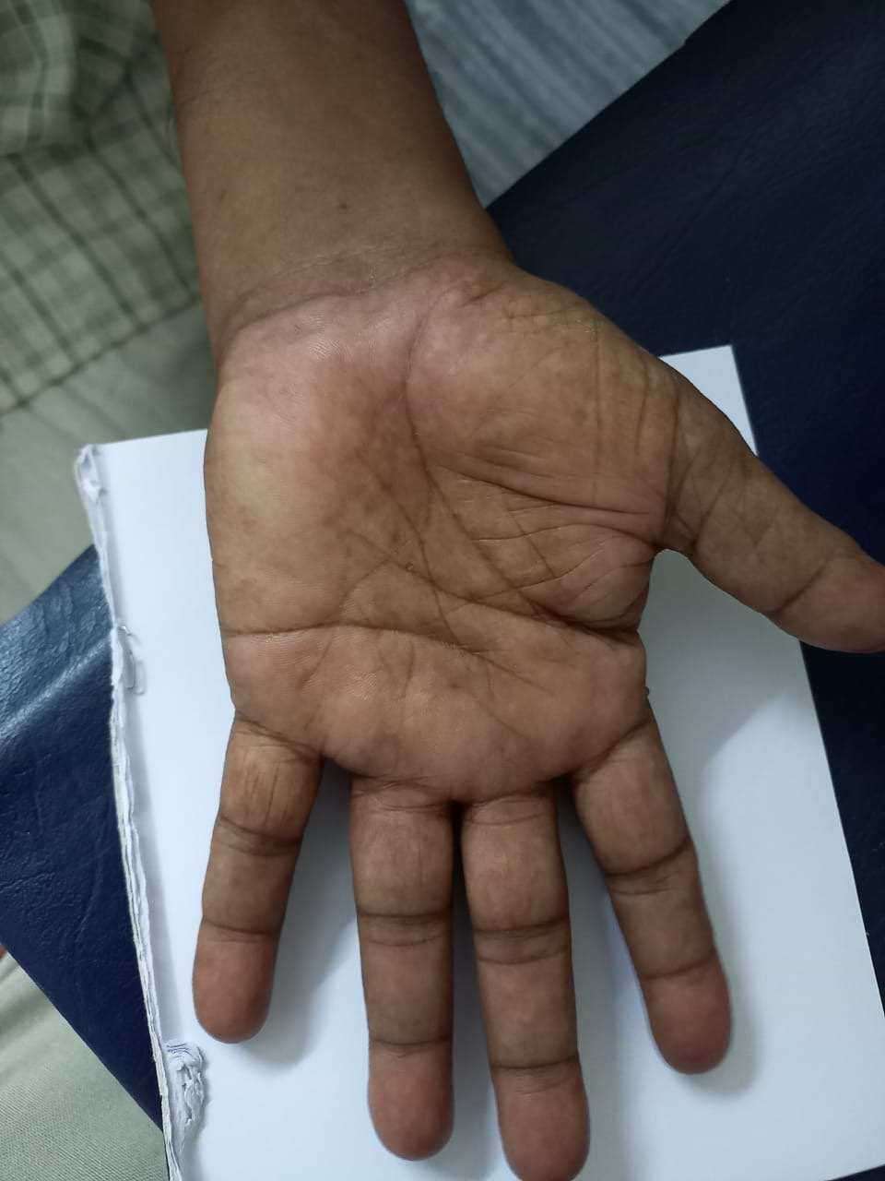

Slide 8

Possibilities???

Slide 9
Investigations
HB | 13.6
TC | 11,000
DC | P60L38
PLT | 3.8L
ESR | 20
S.UA | 6
RUE | NAD
ECG | S/O Old IWMI
CXR | WNL
XRAY of both hands | NAD
Mantoux Test | Negative
Notes:
Hb-13.6
Tc:11,000
Dc:P60l38
Plt: 3.8l
Esr: 20
S.Ua:6
Rue-nad
Ecg-s/o old iwmi
Cxr-wnl
X-ray of both hands-nad
Mantoux test-negative

Slide 10
Investigations
LFT | Normal
RFT | Normal
Serum Electrolytes | Normal

Slide 11
Differentials…
1. Cellulitis
Against:
No fever
No local rise of temperature
Presence of sensory symptoms in the form of hyperesthesia and hyperalgesia

Slide 12
Differentials…
2. Cervical Spondylosis:
Against:
Swelling is rare
No neck pain
Also involvement of C8 distribution isn’t common
Not following a specific dermatomal pattern
Reflexes normal

Slide 13
Differentials…
3. Thoracic Outlet Syndrome
Against:
Swelling is localised to the hand here
Adson’s test negative

Slide 14
Differentials…
4. Arthritis
  Crystalopathy
    Against:
    Crystallopathies have a lower limb predominance
    S.Uric acid was normal
  Tuberculous tenosynovitis/arthritis
  Against:
    No history of fever or other systemic symptoms
    Onset is usually gradual
    Mantoux negative
    ESR elevated

Slide 15
Differentials…
5. Frozen shoulder and subsequent swelling:
Against:
No limitation of shoulder movements
No shoulder pain

Slide 16
Differentials…
6. Diabetic Peripheral Neuropathy
Against:
Doesn’t follow the typical length dependent pattern
Not following a typical nerve distribution

Slide 17
Differentials…
7. Deep Vein Thrombosis
Against:
Localised to the hand only
Unlikely presentation

Slide 18
diagnosis
In view of the localised pattern, swelling, limitation of movements and dysesthesia, a diagnosis of CRPS was made…

Slide 19
What is crps???
A disorder of a body region, usually of the distal limbs
Char. By pain, swelling, limited range of motion, vasomotor instability, skin changes and patchy bone demineralisation
Frequently begins following a fracture, soft tissue injury or surgery

Slide 20
Older names
Reflex Sympathetic Dystrophy
Algodystrophy
Causalgia
Sudeck Atrophy
Transient Osteoporosis
Acute Atrophy of Bone
Shoulder Hand Syndrome

Slide 21
Pathogenesis
Unknown
Proposed mechanisms:
  Classic inflammation
  Neurogenic inflammation
  Maladaptive changes in pain perception
  Genetic factors
  Autoimmune

Slide 22
Budapest consensus criteria
Continuing pain, disproportionate to inciting event
At least 1 in 3 of the following 4 categories:
  Sensory: HYPERAESTHESIA &/OR ALLODYNIA
  Vasomotor: temperature asymmetry &/or skin color changes &/or skin color asymmetry
  Sudomotor/edema: Edema &/or sweating changes &/or sweating asymmetry
  Motor/trophic: Decreased range of motion &/or motor dysfunction (weakness, tremors, dystonia)

Slide 23
TREATMENT
Patient education
Physical therapy and occupational therapy
Symptomatic pain management

Slide 24
BACK TO OUR PATIENT…
He was started on :
Tab. Methyl Prednisolone 8mg BD
Tab. Gabapentin 100mg HS

Slide 25


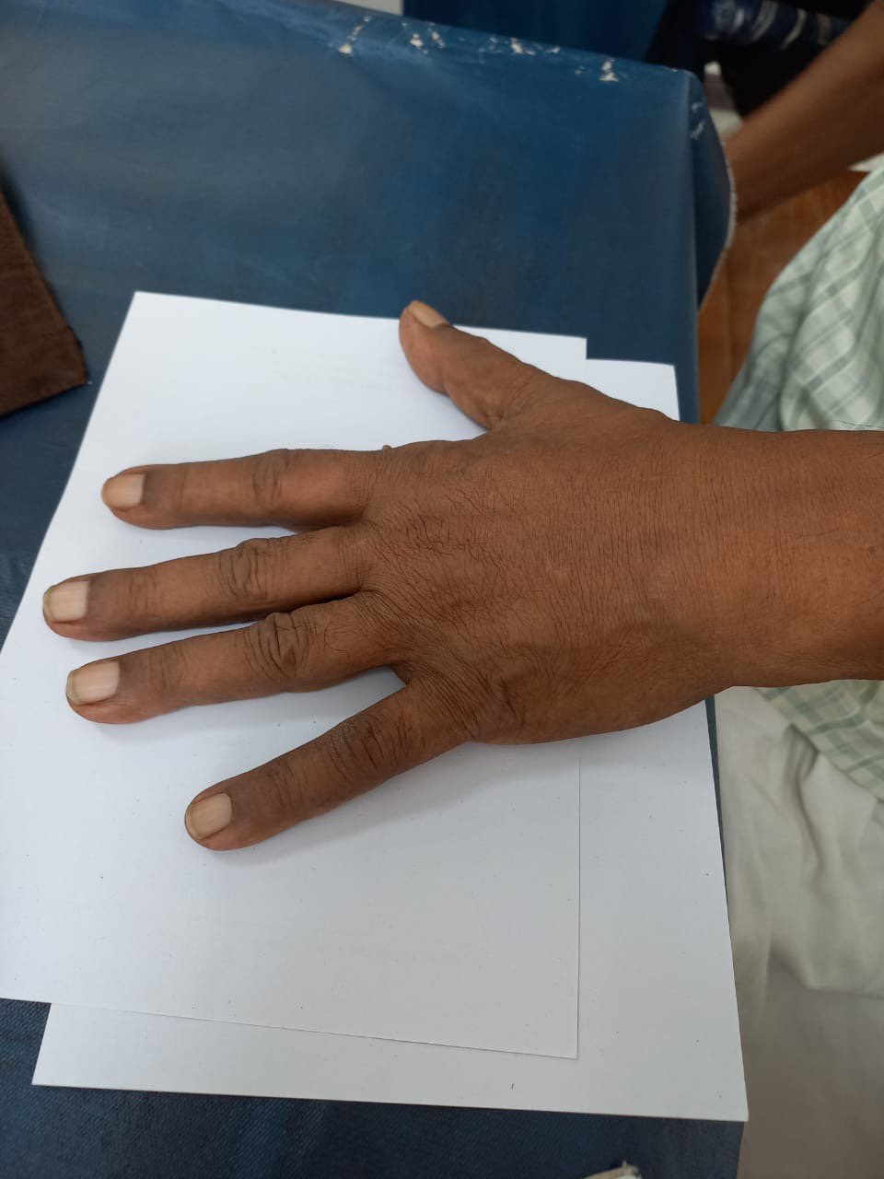
1 WEEK LATER

Slide 26
TAKE HOME MESSAGE
Treatment is more effective when begun early
  Ideally, as soon as diagnosis is established
  Will decrease disability and increase quality of life

Slide 27
Thank you

