Slide 1
CONUS MEDULLARIS & CAUDA EQUINA SYNDROME
DR NITHYA RAMANUJAN
JR3 GENERAL MEDICINE

Slide 2
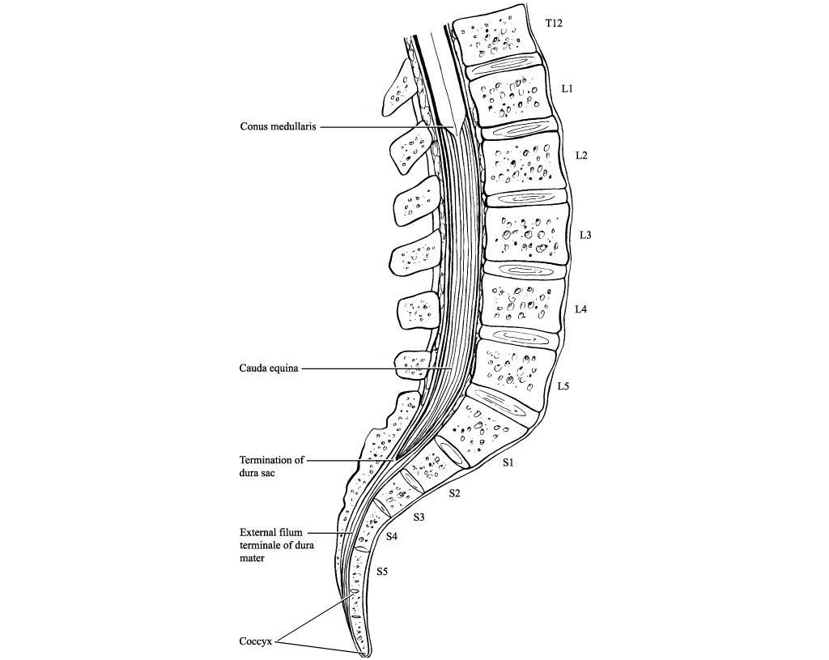
ANATOMY
Conus medullaris
spinal cord ends at L1-L2 intervertebral disc
tapered structure
sacral spinal segments(S2-S5)
Cauda equina
Bundle of nerve roots
Contain L3 root and below

Slide 3
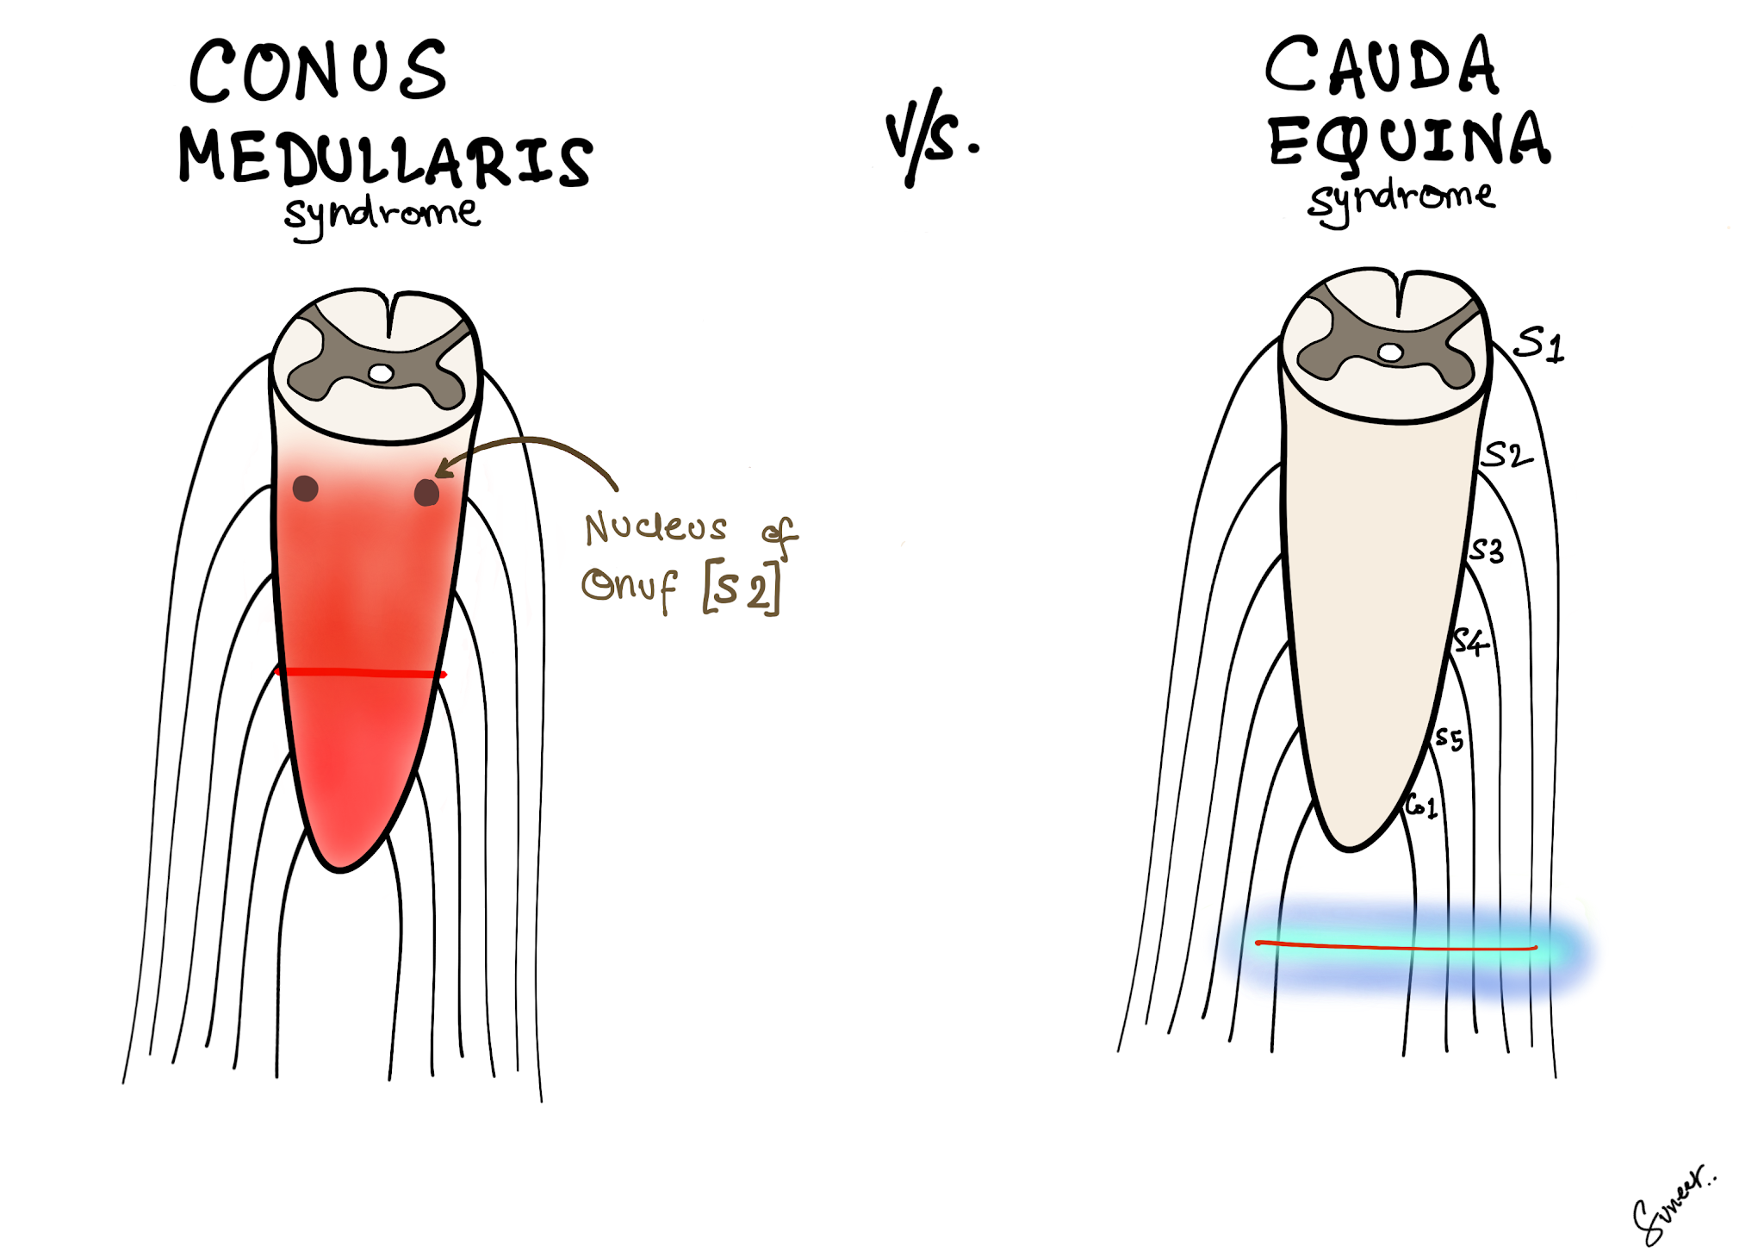

Slide 4
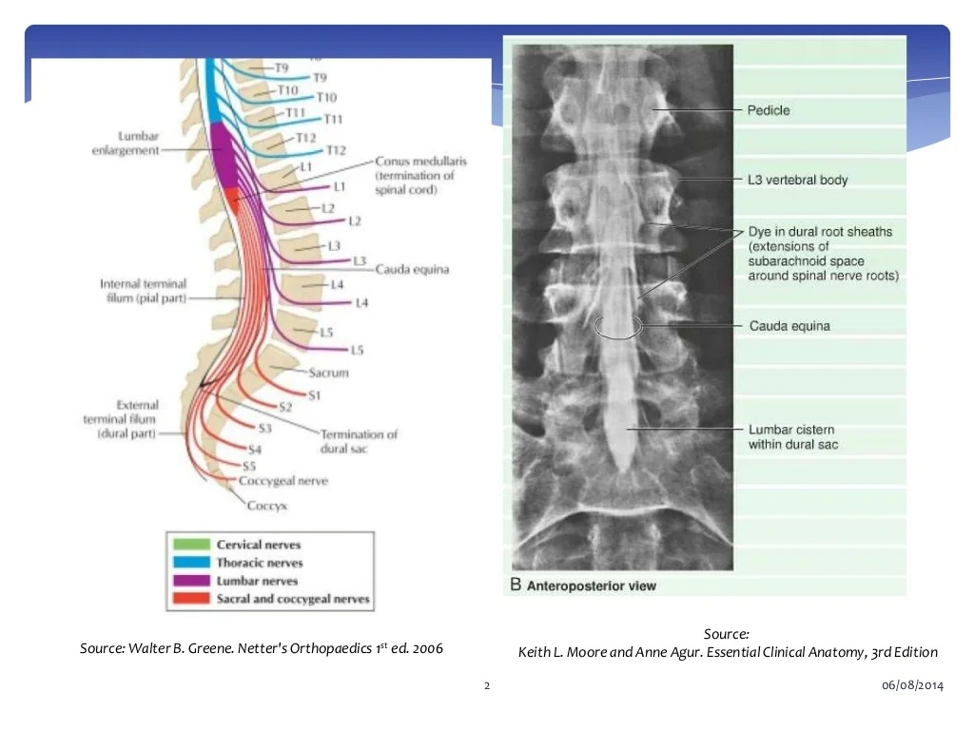

Slide 5
EPICONUS
Spinal card above conus medullaris
L4,L5,S1
Buckling pt
UMN bladder
Extensor plantar

Slide 6
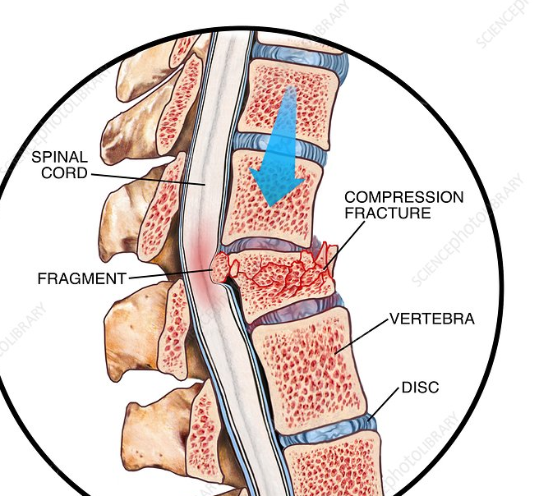
ETIOLOGY
Trauma
Fracture of vertebra
Subluxation
Penetrating trauma

Slide 7
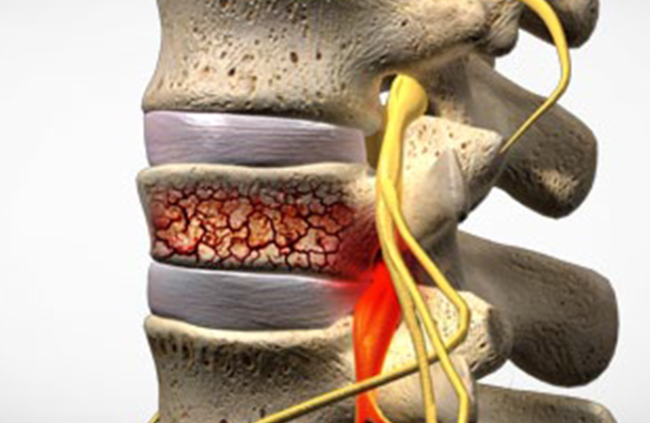

Slide 8
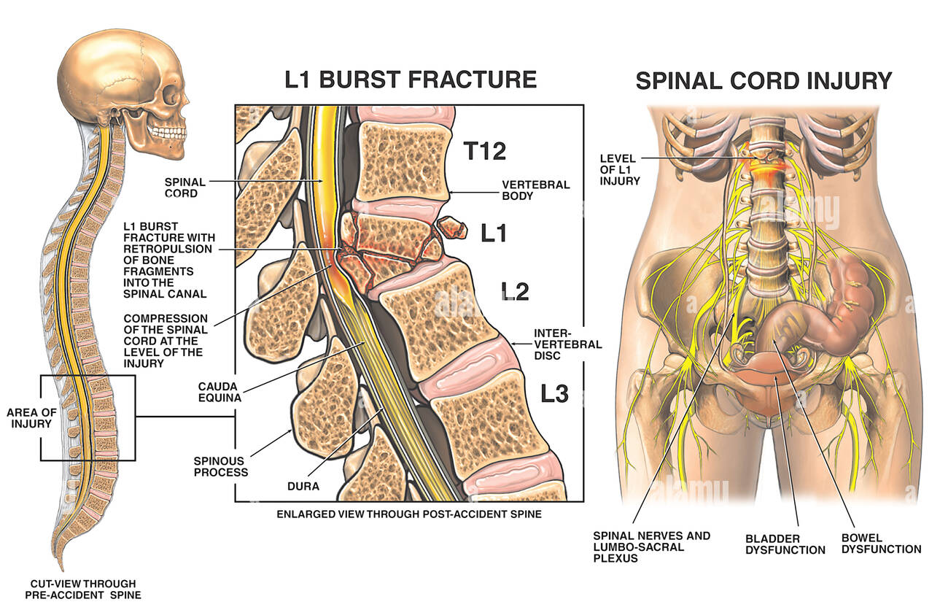

Slide 9
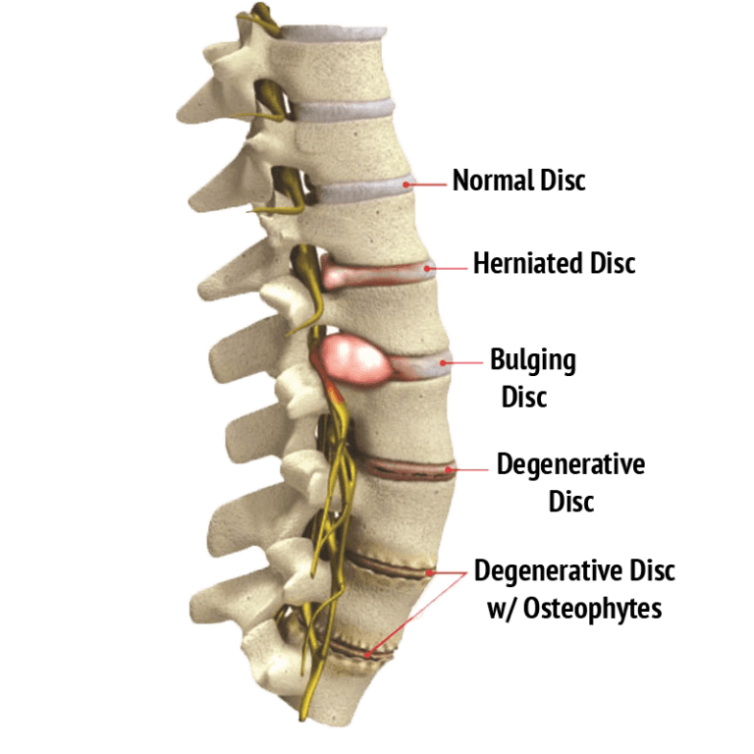
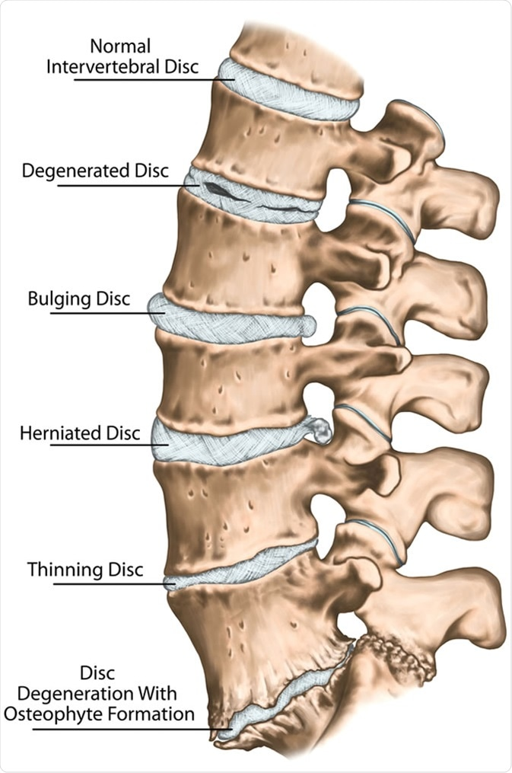
Herniated disc
L4-L5 and L5-S1
Disc fragment herniation

Slide 10
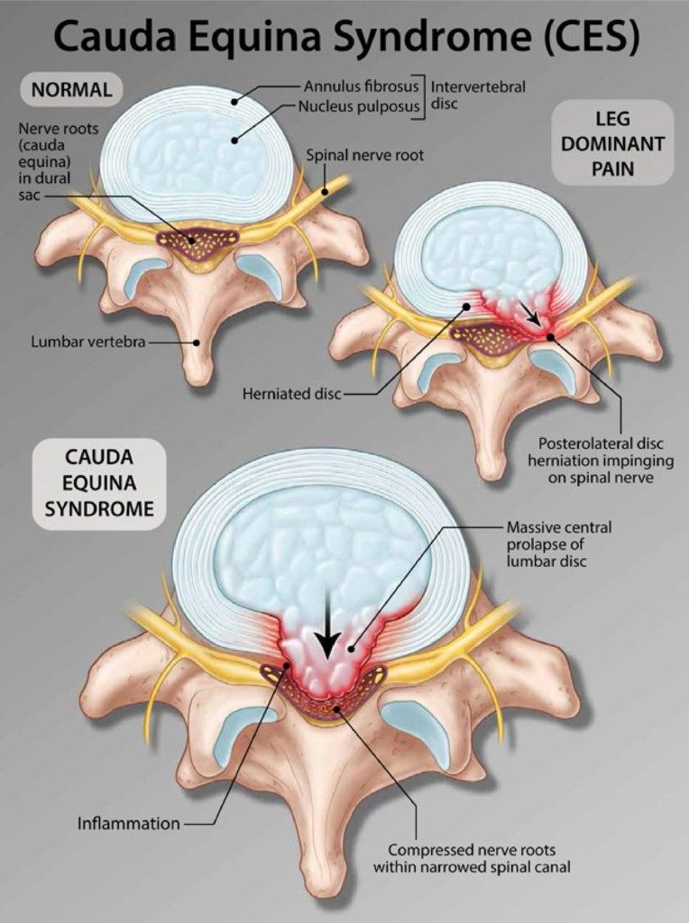

Slide 11
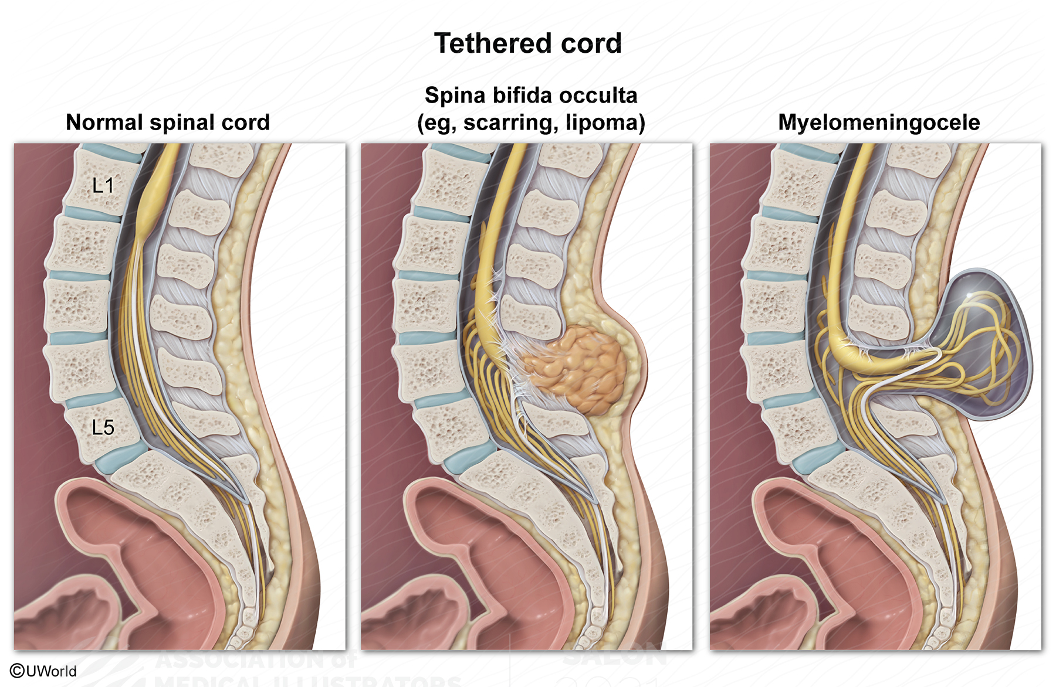
Spinal stenosis
Developmental abnormality
Degenerative changes

Slide 12
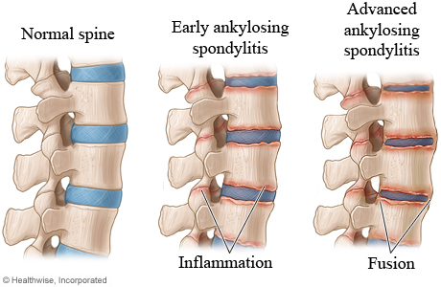

Slide 13
Neoplasms
Primary-myxopapillary ependymoma, schwannoma, paraganglioma, astrocytoma, neurofibroma, meningioma
Metastatic- intracranial, lung, breast, renal cell ca(rare)

Slide 14
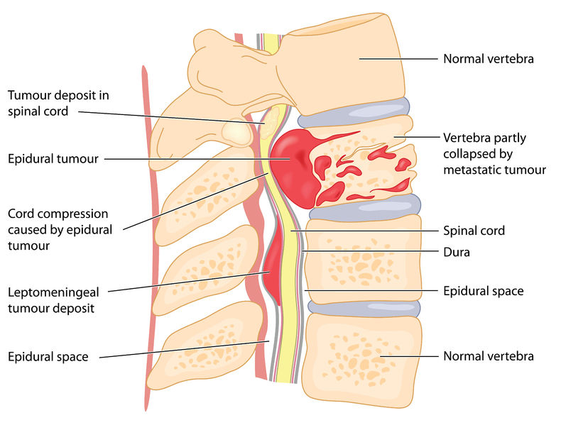
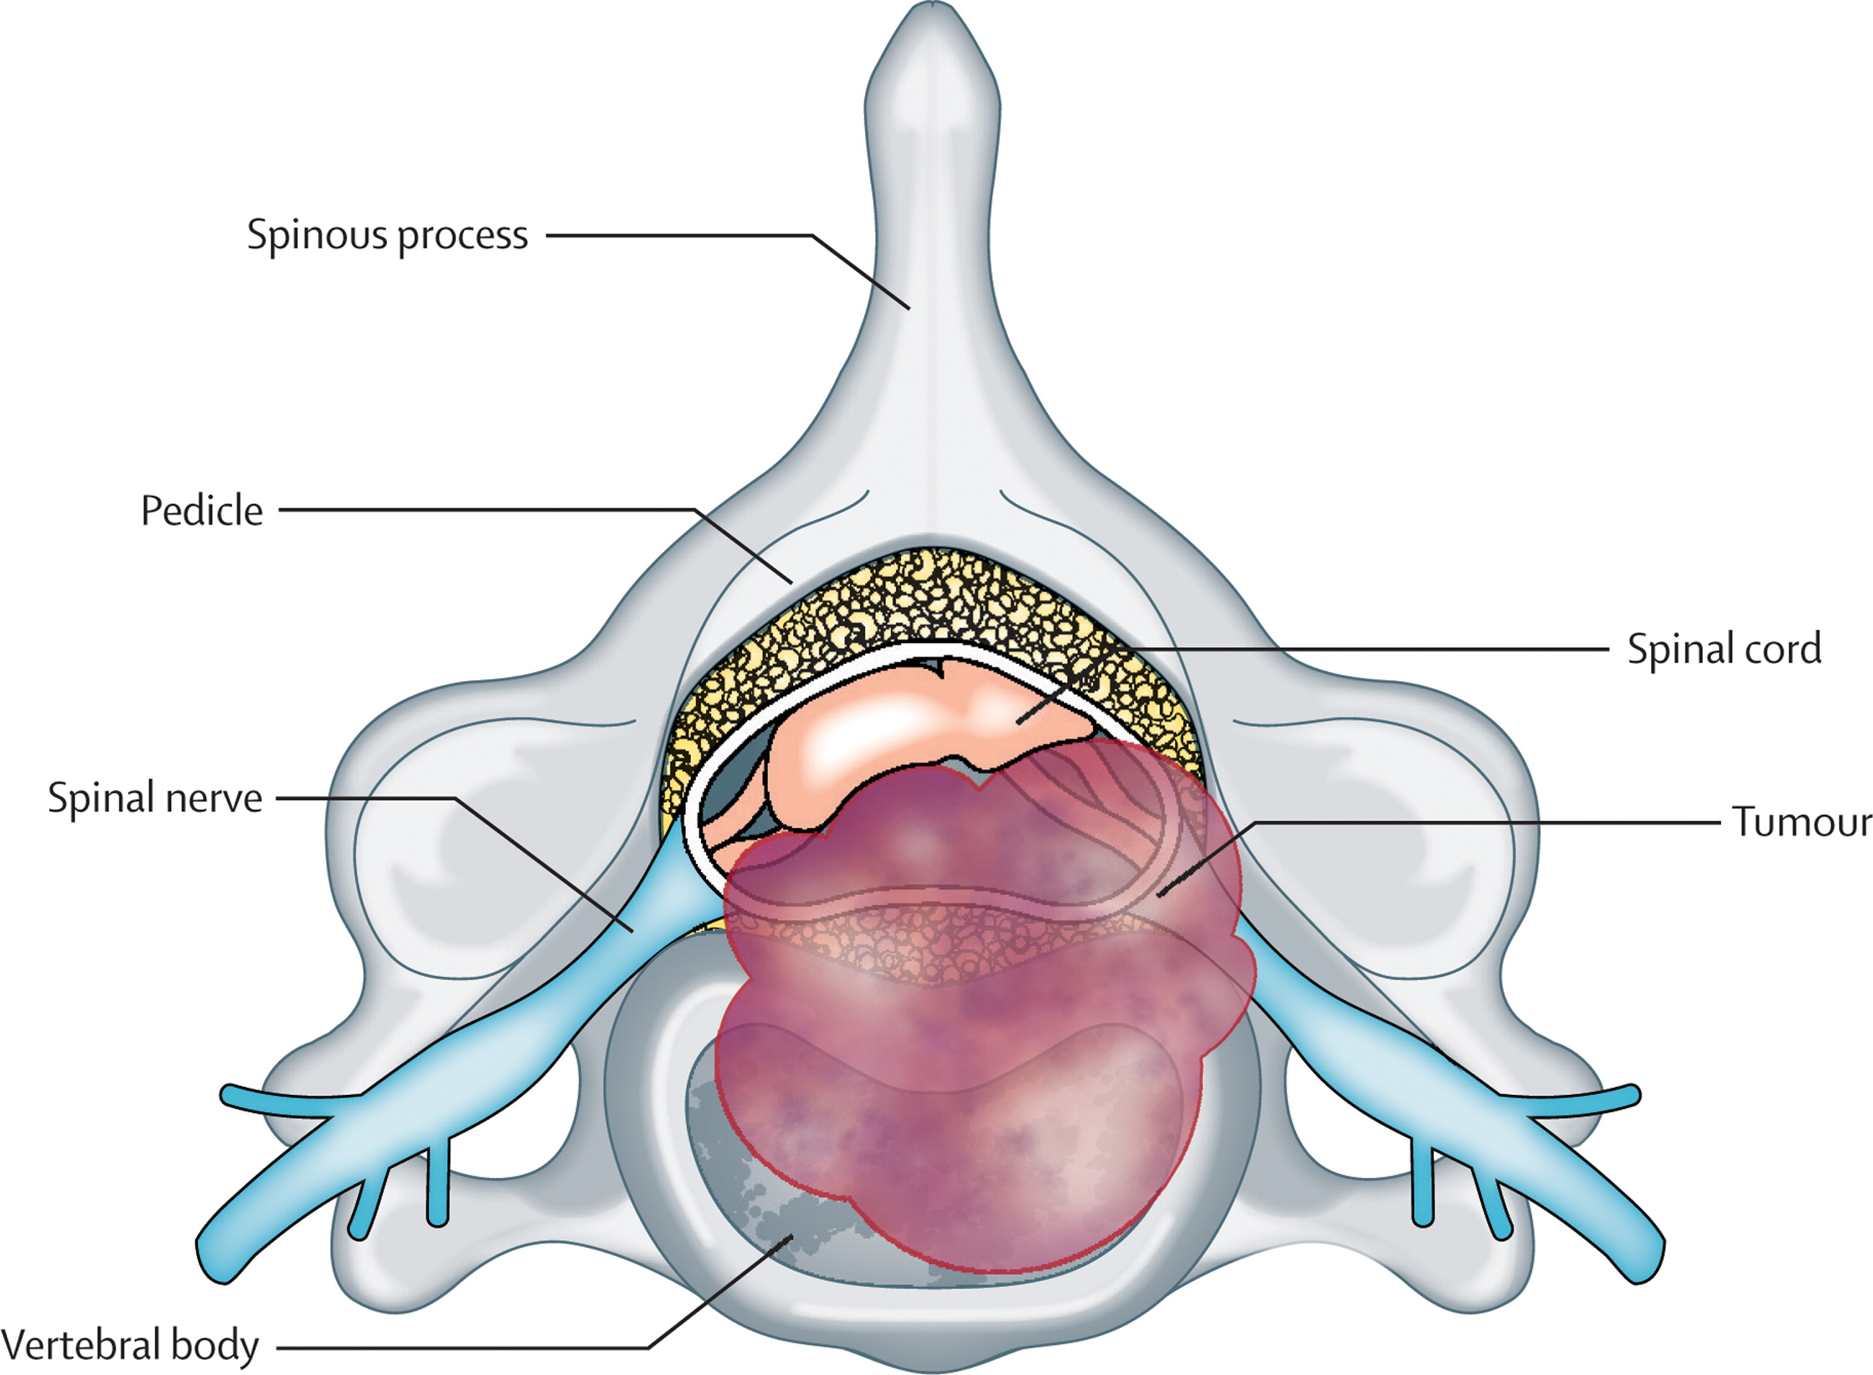

Slide 15
Inflammation
Ankylosing spondylitis
Pagets disease
Infections
Pyogenic- Staph, MRSA, Pseudomonas, E coli
non pyogenic- TB, HSV, meningiovascular syphilis, CMV, schistosomiasis
Epidural abscess
Arachnoditis

Slide 16
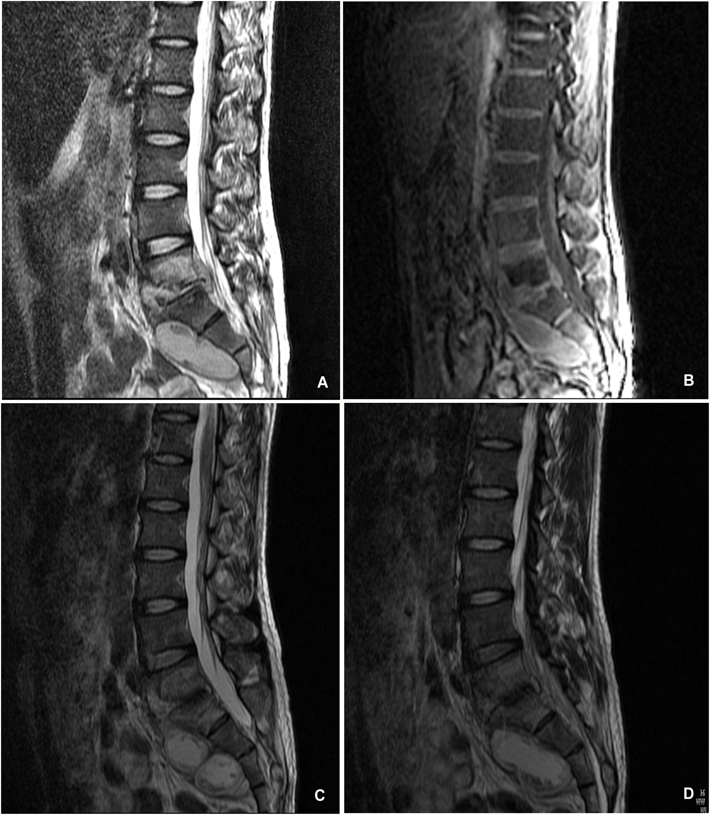

Slide 17
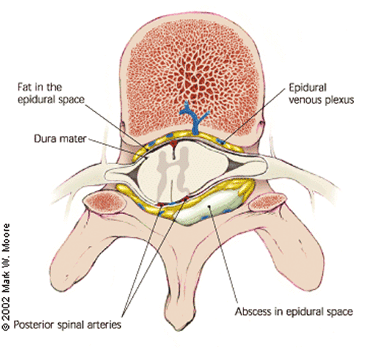

Slide 18
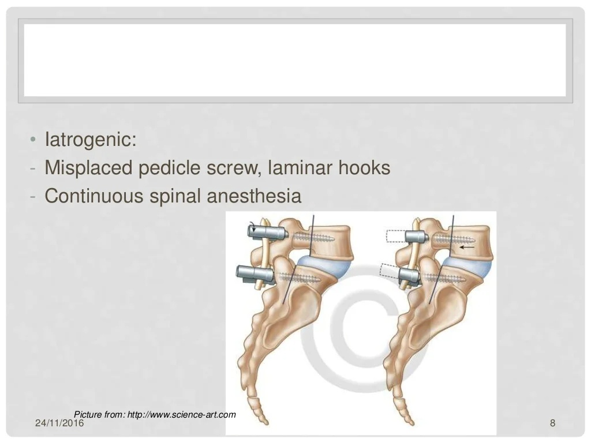
Iatrogenic
Misplaced pedicle screw, laminar hooks
Continuous spinal anesthesia
Epidural hematoma- post LP, spinal anesthesia

Slide 19
Rare causes
Spinal haemorrhage-subdural/epidural
Multiple sclerosis
Conus medullaris lipoma

Slide 20
PRESENTATION
CONUS MEDULLARIS SYNDROME
Back pain
U/L or B/L leg pain
Bladder dysfunction- LMN bladder
Bowel dysfunction
Sexual dysfunction early
Perianal sensory loss

Slide 21
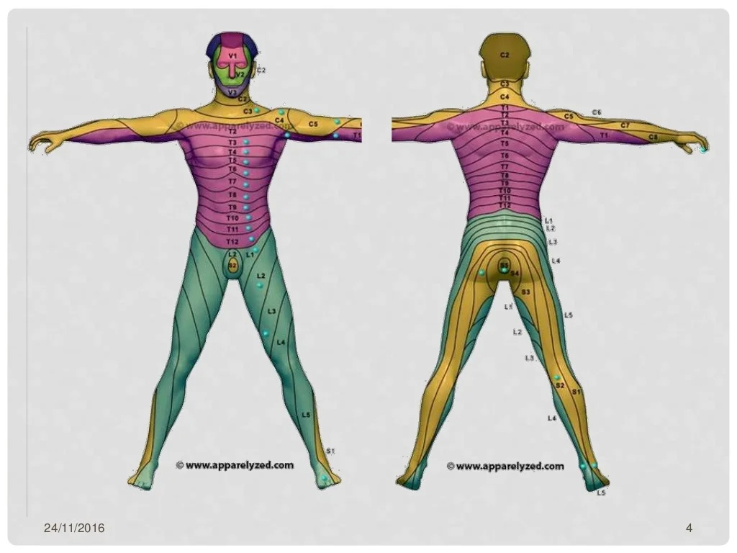

Slide 22
Saddle anesthesia- S3-S5
Symmetrical- as most lesion involve conus bilaterally
Loss of bulbocavernous reflex- S2-S4
Loss of anal reflex- S4-S5

Slide 23
CAUDA EQUINA SYNDROME
Compression of cauda equina
Centrally located nerve roots are from caudal segments
LMN symptoms only
Radicular pain- prominent, usually U/L
Sensory symptoms along nerve root

Slide 24
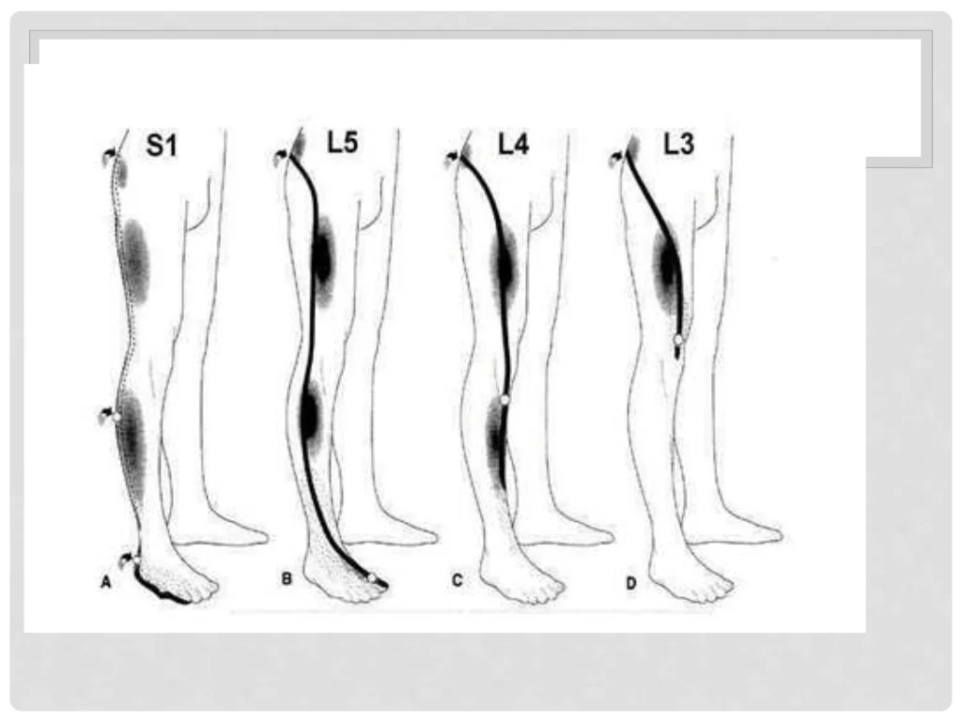

Slide 25
Extensive lesion- flaccid, hypotonic, areflexic lowerlimbs
Sensory loss: saddle region- asymmetric (as nerve roots are asymetrically involved)
Sensory loss along dorsal aspect of thigh, anterolateral leg, dorsal aspect of foot
Bladder – retension, difficulty in initiation, decreased urethral sensation, overflow incontinence
Bowel- constipation, incontinence

Slide 26
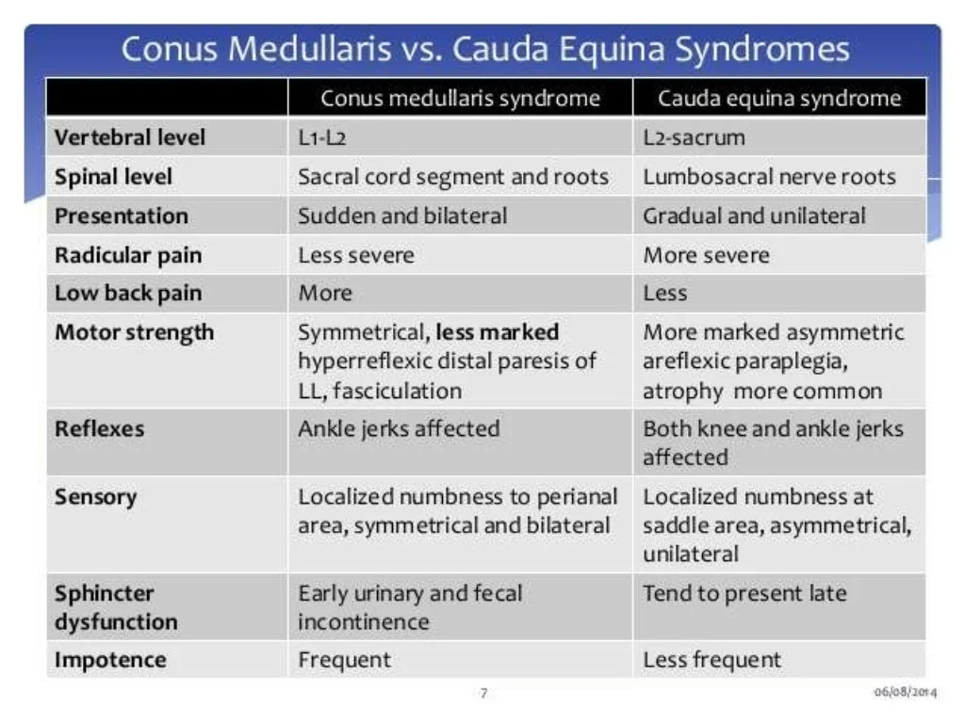

Slide 27
COMPLICATIONS
Neurogenic bladder/bowel
Recurent UTI
Bladder calculi
Erectile dysfunction
Pressure ulcers
Chronic neuropathic pain

Slide 28
INVESTIGATION
Routine –CBC, ESR, serology
CSF study- arachnoiditis
X-ray LS spine
USG abdomen- PVRU
MRI spine - IOC
NCS lowerlimb
Needle electromyography of B/L external anal sphincter- acute denervation
CT myelography- spinal tumors, if MRI C/I

Slide 29
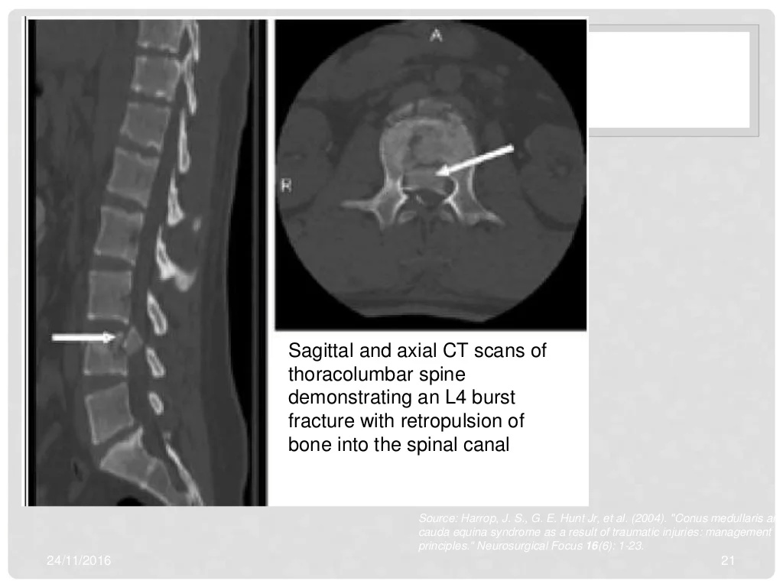

Slide 30
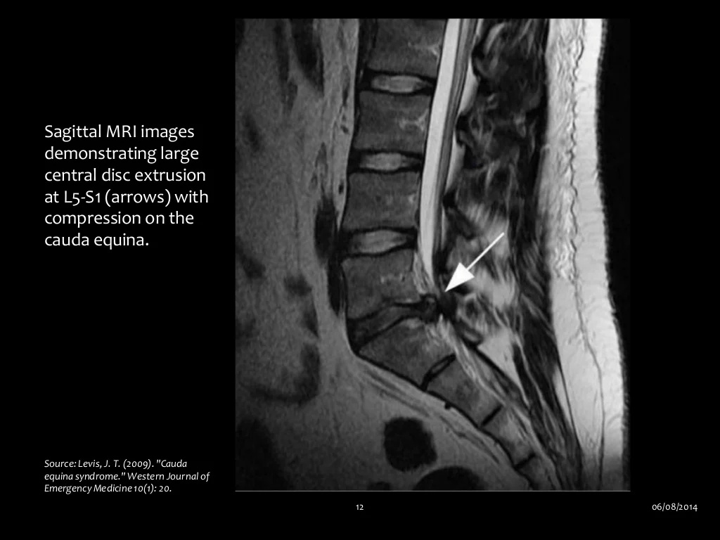

Slide 31
Management
Treatment of cause
Inflammatory- steroids, NSAIDS
Antibiotics
ATT
Chemotherapy/ radiotherapy

Slide 32
Pain
Narcotics/opioids- acute
TCA’s
Inj. Methylpredinisolone- within 8hrs

Slide 33
SURGICAL MANAGEMENT
METHODS TO RELIEVE COMPRESSION
Discectomy
Laminectomy
Corpectomy
Acute cauda equina- within 48hrs
Chronic case- medically feasible

Slide 34
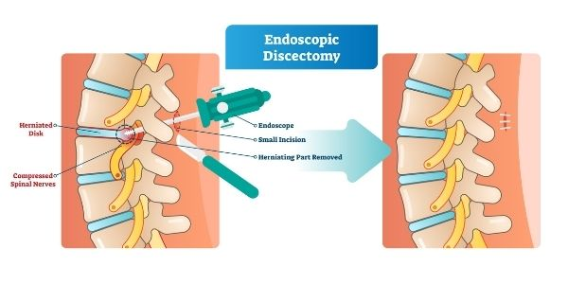

Slide 35
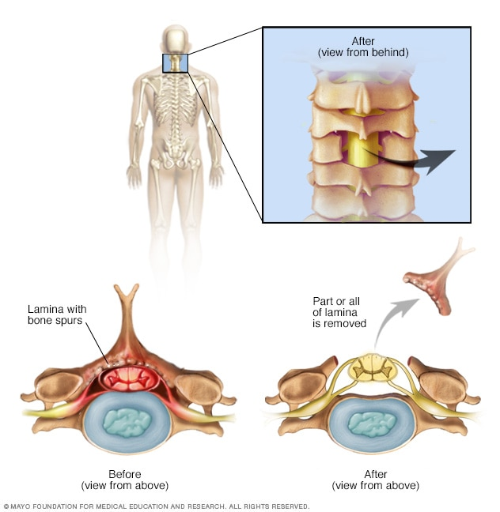
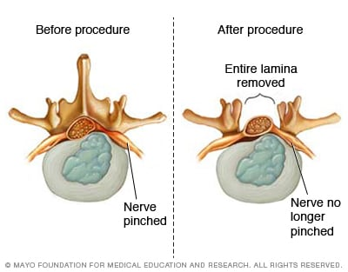

Slide 36
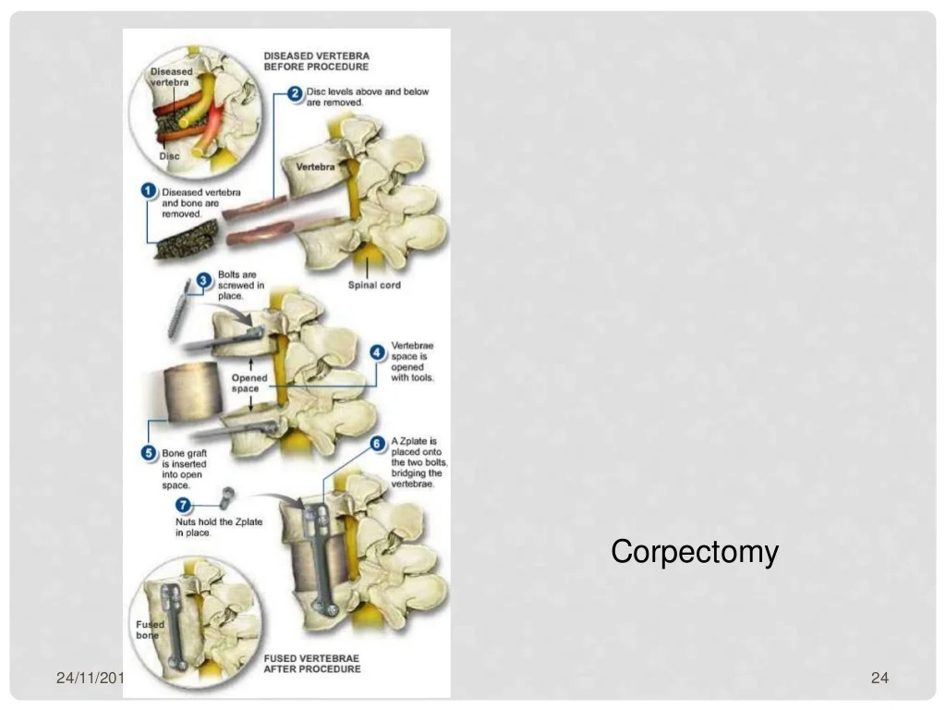
Corpectomy

Slide 37
Rehabilitation
Physical therapy
Occupational therapy
Orthoses- prevent contactures
Patient education
Self catheterisation
Prevention of pressure ulcers
Endurance and strength training exercises

Slide 38
PROGNOSIS
Extent of perianal sensory deficits- most important
Complete perineal anesthesia- permanent paralysis of bladder
Bilateral deficits- poor prognosis
Females poor prognosis postop
Bowel dysfunction

Slide 39
THANK YOU

