Slide 1
COMPRESSIVE MYELOPATHY-
INTRAMEDULLARY
DR. VARSHA S NAIR

Slide 2
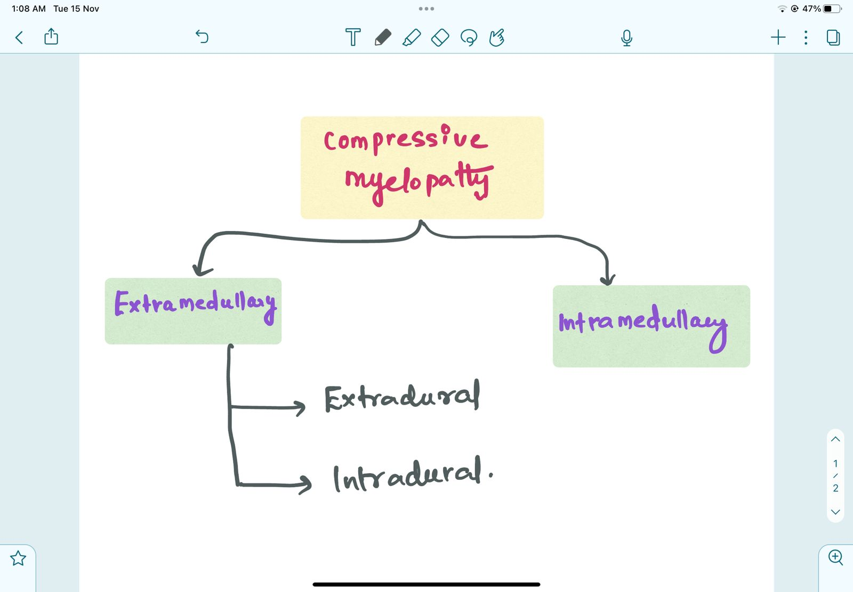
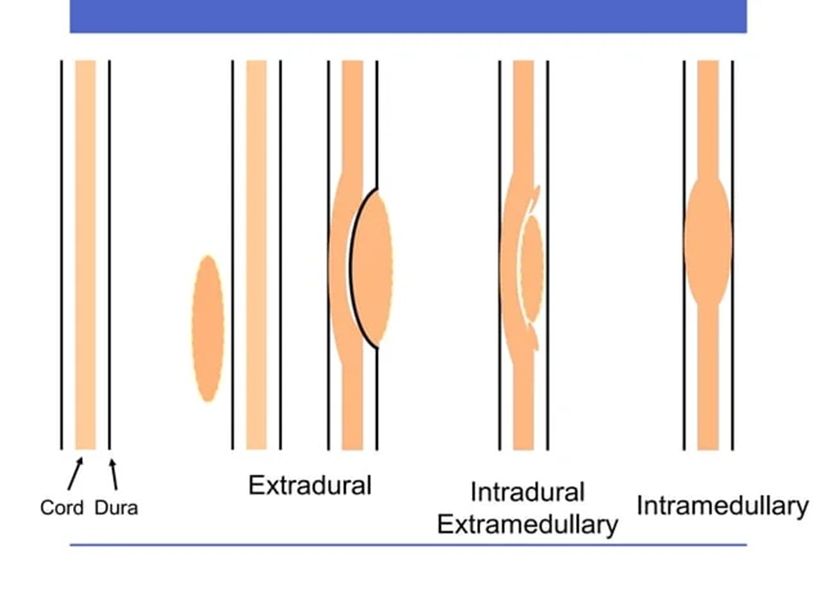
CLASSIFICATION OF ETIOLOGY

Slide 3
EXTRAMEDULLARY |  | INTRAMEDULLARY
EXTRADURAL | INTRADURAL
Spondylosis | Tumours: Neurofibroma, Meningioma, Lipoma, Sarcoma | Syrinx
Disc prolapse | Metastasis | Tumors : Ependymoma Astrocytoma Hemangioblastoma Hematomyelia
Trauma | Arachnoiditis
Tumour: Metastasis, Multiple myeloma | AV malformation
CVJ anomalies | Leukemic infiltration
Fluorosis | Arachnoid cyst
TB spine | Sarcoidosis
Epidural abscess
Epidural Hematoma

Slide 4
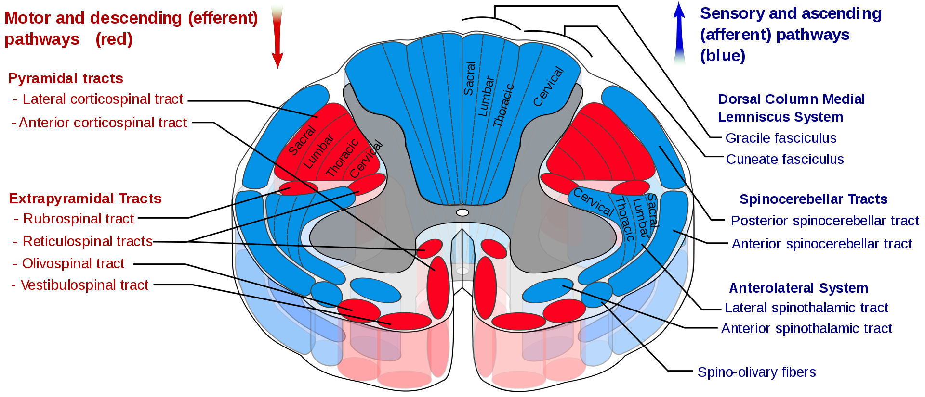

Slide 5
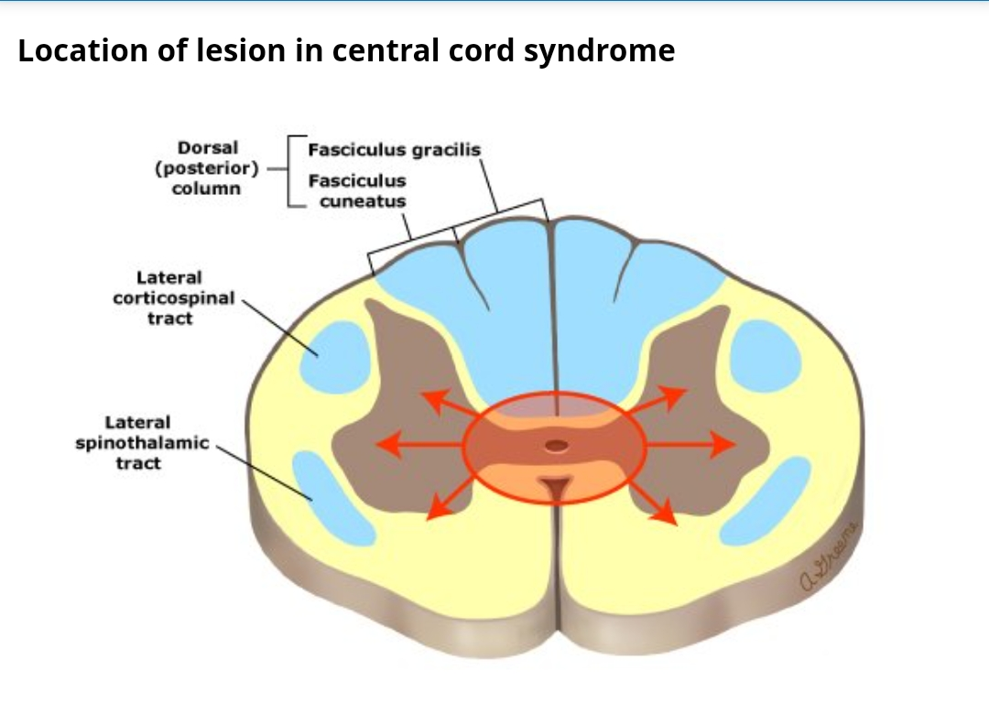

Slide 6
CENTRAL CORD SYNDROME
A symptomatic central cord lesion typically encroaches on the medial aspect of the CSTs or on the anterior horn gray matter- weakness that is more prominent in the arms than the legs.
Fibers mediating the deep tendon reflexes are interrupted as they pass from the dorsal to the ventral horn, thus causing tendon reflex loss at the level of the spinal cord lesion.

Slide 7

The classic causes of a central cord syndrome are slow-growing lesions such as syringomyelia or intramedullary tumor.
Most frequently - hyperextension injury in individuals with long-standing cervical spondylosis.
Disproportionately greater motor impairment in upper compared with lower extremities, bladder dysfunction, and a variable degree of sensory loss below the level of injury. (Man in barrel syndrome)

Slide 8
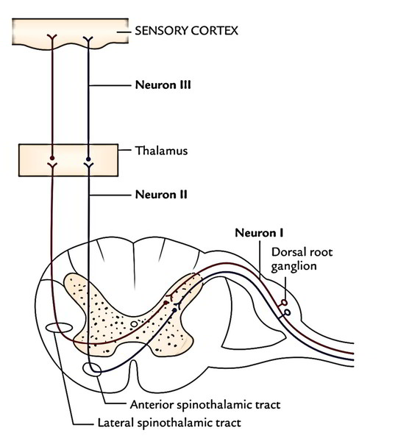
Loss of pain and temperature sensation in the distribution of one or several adjacent dermatomes at the site of the spinal cord lesion is caused by disruption of crossing spinothalamic fibers in the ventral commissure

Slide 9
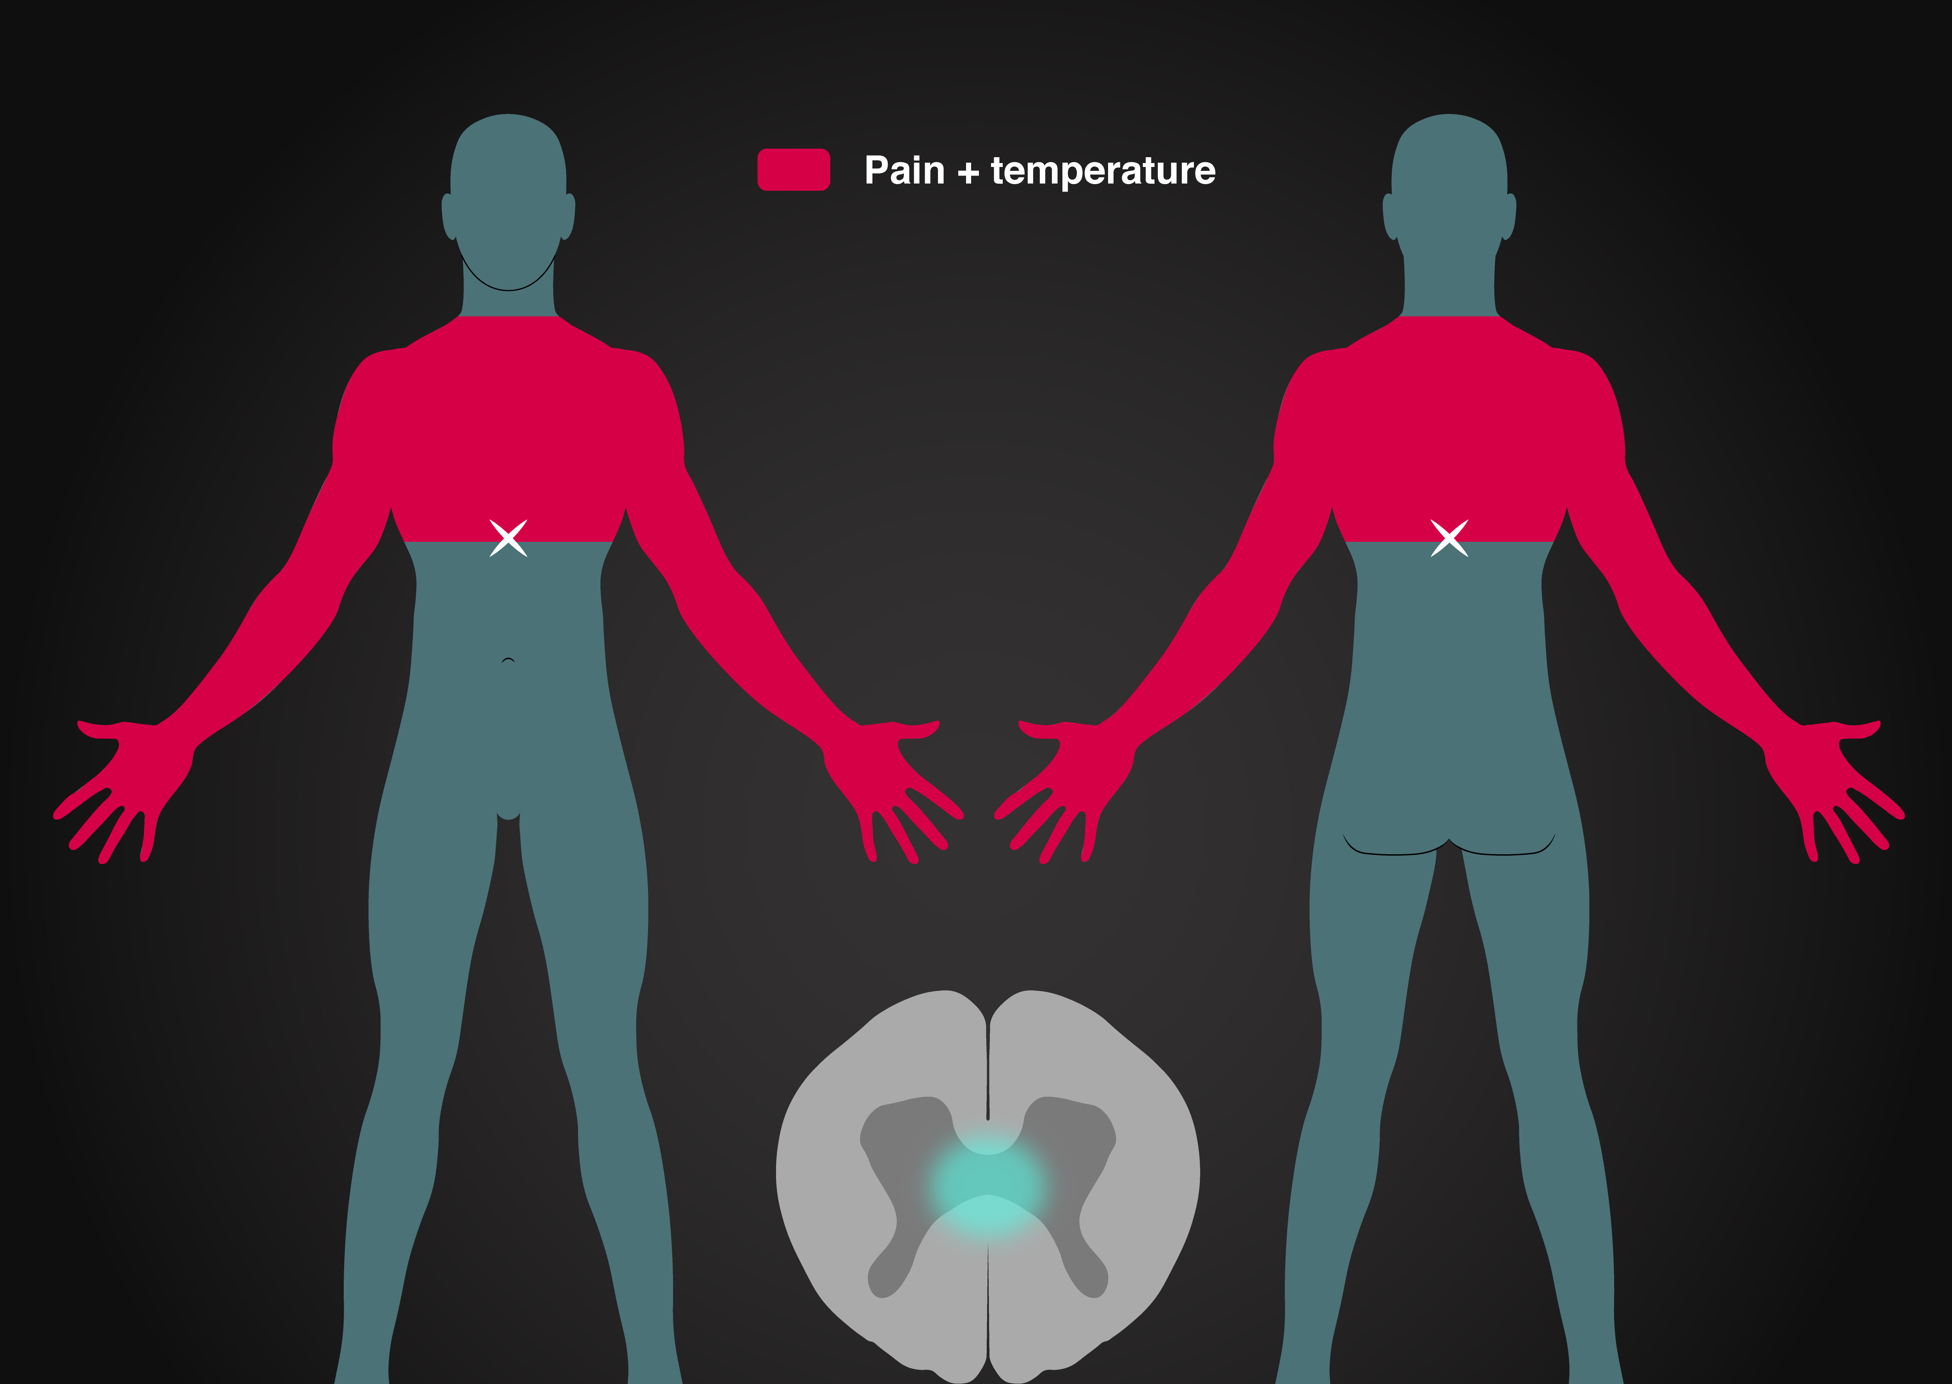
CAPE distribution of dissociated sensory loss
Dermatomes above and below the level of the lesion have relatively normal pain and temperature sensation, "suspended sensory level ”
Vibration and proprioception are often spared.

Slide 10
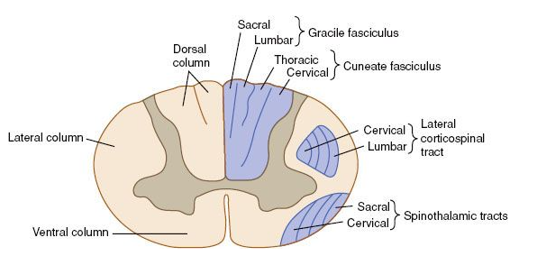
Bladder involvement is early
Sacral sparing .

Slide 11
FEATURES | EXTRAMEDULLARY | INTRAMEDULLARY
VERTEBRAL PAIN & ROOT PAIN | EARLY & COMMON | RARE
FUNICULAR | RARE | MORE COMMON
PROGRESSION OF PAIN | ASCENDING | DESCENDING
SENSORY DEFICIT | NO DISSOCIATION OF SENSATION | DISSOCIATED SENSORY LOSS ( EARLY LOSS OF PAIN)
SUSPENDED SENSORY LOSS | NOT SEEN | SEEN
SACRAL SENSATION | LOST EARLY | SACRAL SPARING
TROPHIC CHANGES,BURNS | NOT SEEN | COMMON
CHARCOT JOINT ARTHROPATHY | NOT SEEN | COMMON

Slide 12
FEATURES | EXTRAMEDULLARY | INTRAMEDULLARY
UMN FEATURES | EARLY & PROMINENT | LATE, LESS PRONOUNCED
LMN SIGNS | LATE | EARLY LONG SEGMENT LMN
BLADDER & BOWEL | LATE | EARLY
AUTONOMIC INVOLVEMENT | LATE | EARLY
CHANGES IN CSF | FREQUENT | RARE

Slide 13
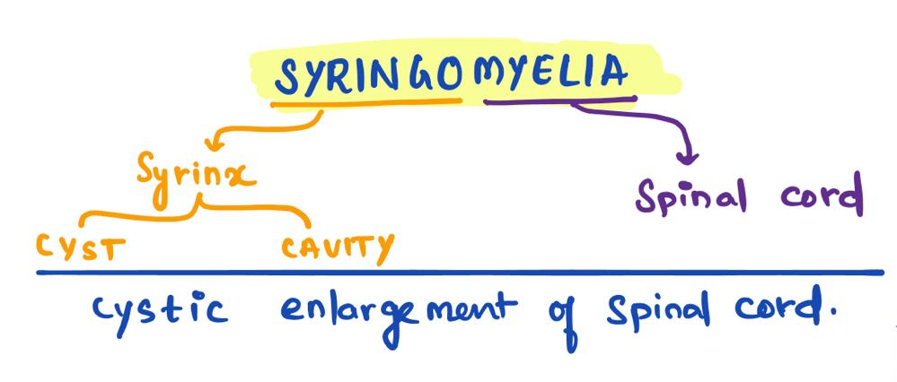

Slide 14

Cystic dilatation of the central canal.
Lined by ependyma .
Centrally located in the axial plane.
HYDROMYELIA –

Slide 15
Syringomyelia
Fluid-filled, cavity within the spinal cord lined by glial cells.
Most lesions are between C2 and T9.
Descend down or extend upward into the brainstem (syringobulbia).
A syrinx can represent a focal dilation of the central canal, or it may lie separately, within the spinal cord parenchyma

Slide 16
Usually expands in all directions and destroys the centre of the cord, and may expand into adjacent areas such as the ventral horns and lateral columns.
Different combination of symptoms - pain, weakness, and stiffness in the back, shoulders, arms, or legs.
Syrinx- around the central canal of the spinal cord. This
Sudden exacerbations - rupture of the syrinx because of raised venous pressure, as in sneezing or violent coughing.
Other symptoms – headache, loss of the ability to feel extremes of hot or cold, especially in the hands.
Progresses very slowly, over many years.

Slide 17
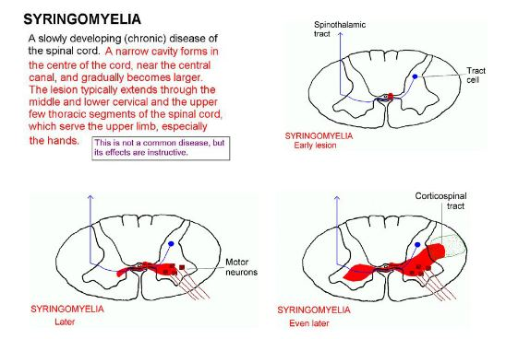

Slide 18
Most commonly - Chiari malformation type I
  Other causes
  Other congenital malformations (eg, Klippel-Feil syndrome,dandy walker malformation,tethered spinal cord etc)
  Postinfectious
  Postinflammatory (transverse myelitis and multiple sclerosis)
  Spinal neoplasms (especially ependymoma and hemangioblastoma)
  Post-traumatic

Slide 19
Sensory features
Pain and temperature sensation are lost - spinothalamic tract damage.
One side may be affected more than the other.
Classically, the sensation loss is experienced in a shawl-like distribution over the arms, shoulders and upper body.
Spares the dorsal column/medial lemniscus of the spinal cord, leaving pressure, vibration, touch and proprioception intact in the upper extremities.
Light touch, vibration and position senses in the feet are affected as the syrinx enlarges into the dorsal columns.

Slide 20
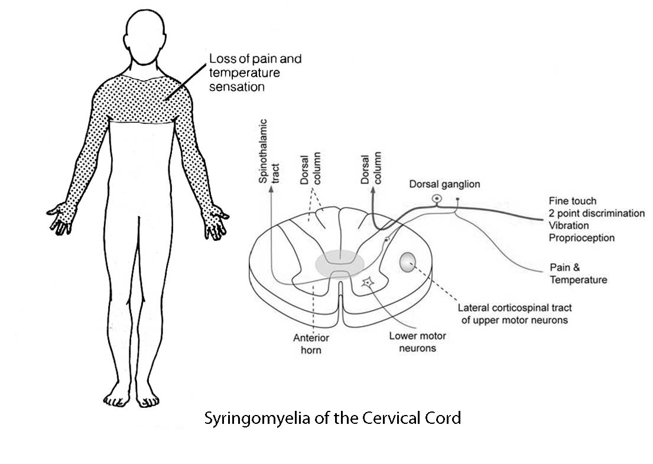

Slide 21
Motor features
Occur when the syrinx extends and damages AHC , ventral horn causing LMN lesion at that site,
Eg; in the cervical cord, muscle wasting and weakness usually begins in the hands and then affects the forearms and shoulders. Tendon reflexes may be lost
Later develop spastic paresis below the syrinx temporarily or permanently, as a result of damage to the pyramidal (corticospinal) tract.
Respiratory - intercostal -muscles may be involved, and if the syrinx affects C4,5 the phrenic nerve may be involved causing paralysis of the diaphragm.

Slide 22
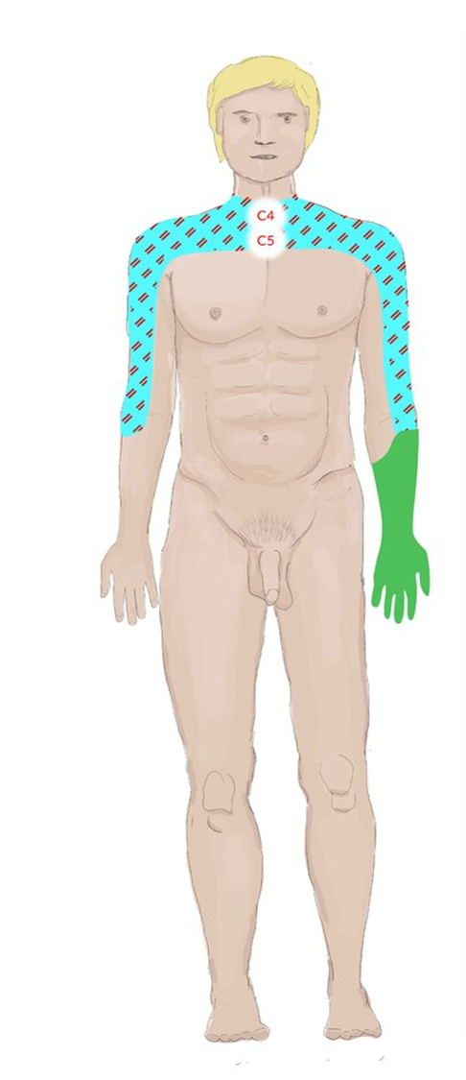
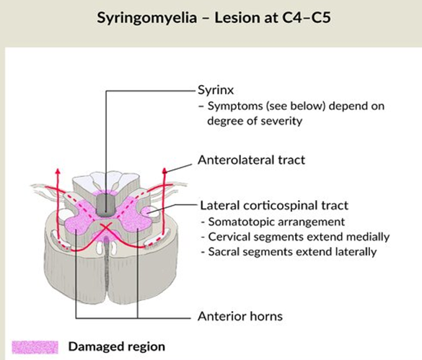
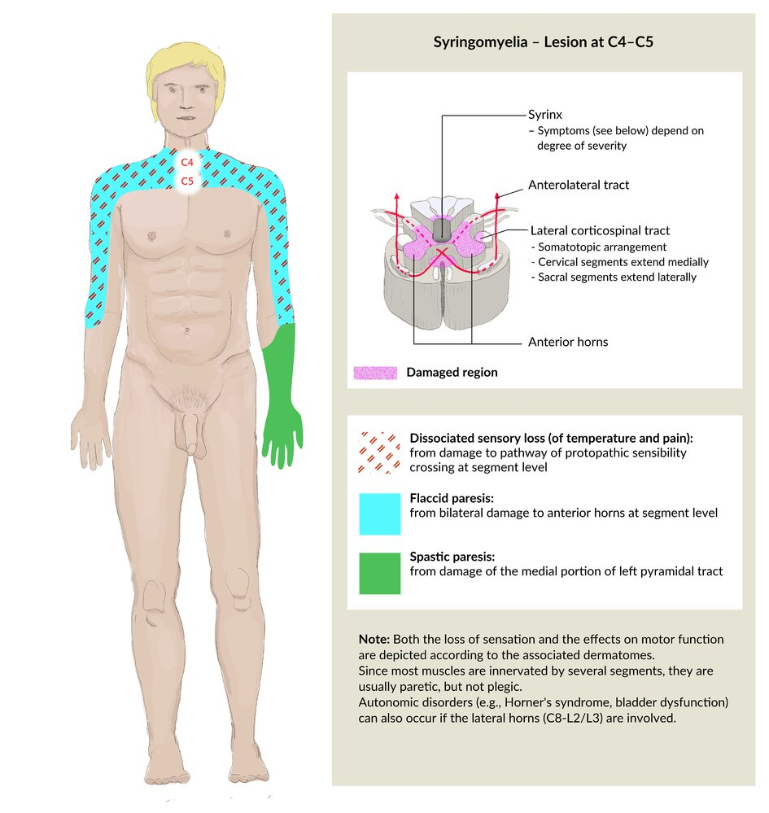

Slide 23
Severity depends on rate of enlargement rather than size.
Cervical syrinx – claw hand (LMN involvement)
Autonomic features
Abnormal body temperature or sweating, bowel, bladder or sexual functions.
HORNERS SYNDROME can develop. – damage of the descending autonomic fibres in the reticulospinal tracts .

Slide 24
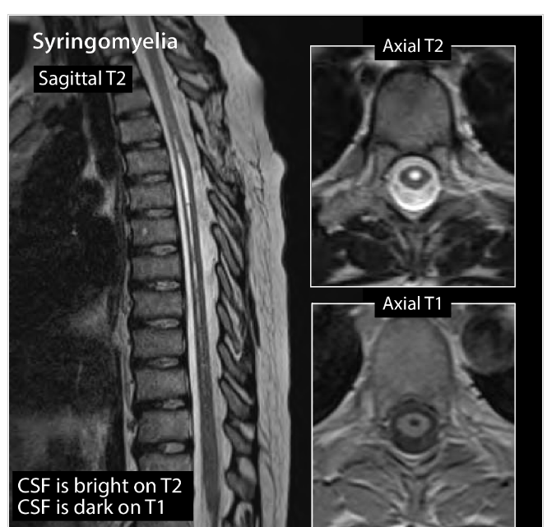
SYRINGOMYELIA

Slide 25
Syringomyelia
Communicating
Non communicating
  Enlargement of central canal in continuity with the 4 th ventricle.
  a/w hydrocephalus
  Trauma
  tumors

Slide 26
RX
MRI- identify the intramedullary cavity; gadolinium administration increases the sensitivity of finding an associated tumor.
Surgical decompression with fenestration and/or shunt placement is recommended for patients with neurologic deterioration or intractable central pain
Neurologic deficits usually stabilize after intervention and sometimes improve.

Slide 27
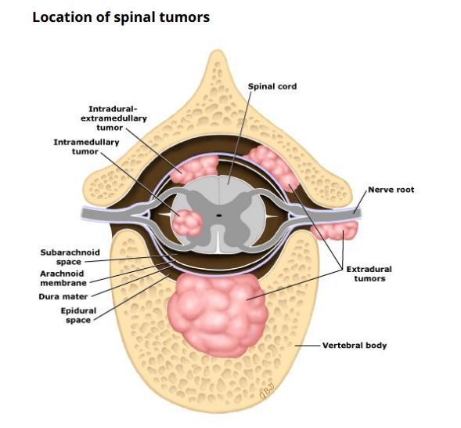
Intramedullary arise within the spinal cord itself.
Most primary intramedullary tumors are either ependymomas or astrocytomas.
Metastases
Intradural extramedullary – Tumors arising within the dura but outside the actual spinal cord
meningiomas and nerve sheath tumors
Extradural – Extradural tumors are usually metastatic and most often arise in the vertebral bodies.

Slide 28
Intraaxial in location and can be either primary or metastatic.
Primary spinal cord tumors account for 2 to 4 % of all primary central nervous system (CNS) tumors, one-third of which are located in the intramedullary compartment.

Slide 29
Intramedullary spinal tumours are rare, representing 4-10% of all CNS tumours and <10% of all paediatric CNS neoplasms ⁵.
They account for 20% of all intraspinal tumours in adults and 35% of all intraspinal tumours in children .
A long duration of symptoms prior to diagnosis is typical.

Slide 30
Intramedullary neoplastic lesion
Glial neoplasms: 90-95% of all intramedullary tumours
  spinal ependymoma: 60%
  spinal astrocytoma: 33%
  spinal ganglioglioma: 1%
Spinal glioblastoma multiforme (primary): 7.5% of all intramedullary gliomas

Slide 31
  Non-glial neoplasms
    highly vascular lesions
      spinal haemangioblastoma
      spinal paraganglioma
    other rare lesions
      intramedullary metastasis
      primary lymphoma of the spinal cord
      spinal primitive neuroectodermal tumour
      solitary fibrous tumour
  Intramedullary benign masses
    spinal canal epidermoid cyst
    spinal canal lipoma

Slide 32
Associations
Syringomyelia occurs in approximately 50% of all intramedullary tumours but is most frequently associated with haemangioblastomas
Intramedullary spinal neoplasms are more common in patients with neurofibromatosis:
  ependymomas occur more often in patients with NF2
  astrocytomas occur more often in patients with NF1

Slide 33
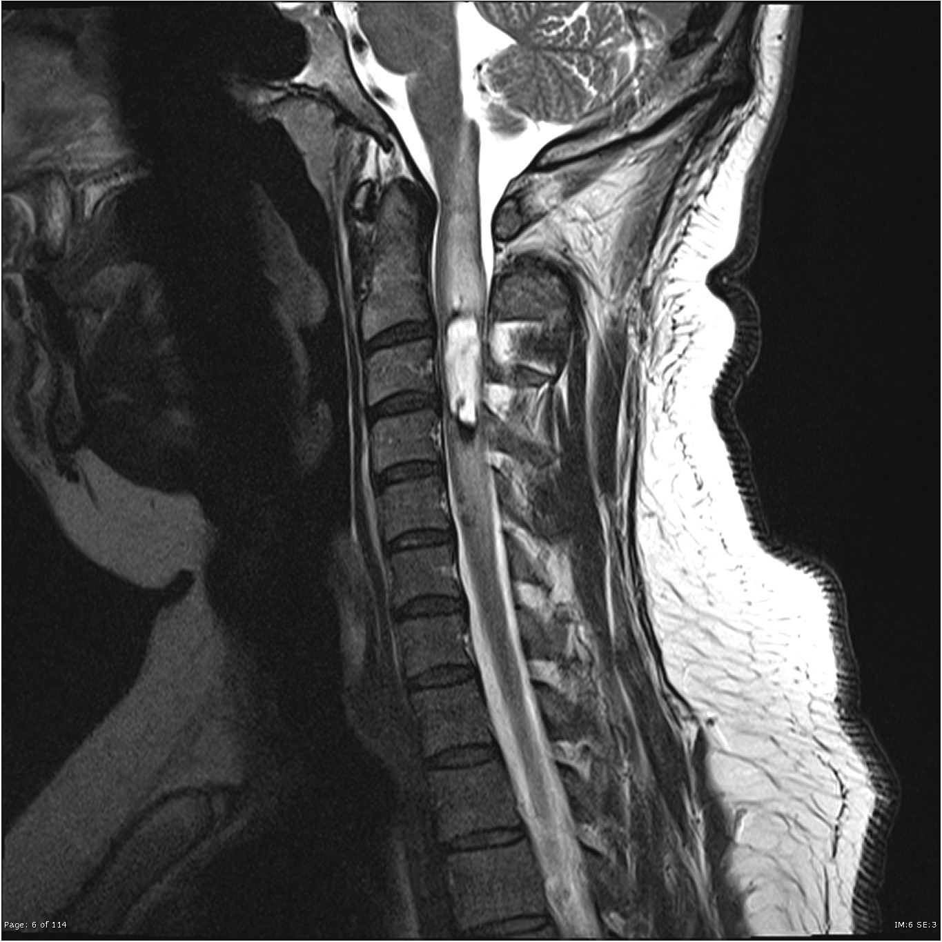
SPINAL EPENDYMOMA

Slide 34
One third of primary ependymomas arise in the spinal cord. The other two thirds arise from the brain parenchyma in the ependymal cells lining the ventricles.
May be located anywhere along the spinal cord.
Approximately 50% occur in the lumbosacral spinal cord or filum terminale
50 % occur anywhere in the cervical or thoracic spinal cord.

Slide 35

most frequently in middle-aged men,
Ependymomas, especially the myxopapillary type, are the most common tumors to involve the distal cord/conus and filum.
Presenting signs and symptoms of ependymomas include back pain, radicular pain, progressive myelopathy, and bowel and bladder dysfunction.
As with astrocytomas, ependymomas usually are slow-growing neoplasms that cause symmetric enlargement of the cord

Slide 36

Enhancement of ependymomas on MRI tends to be homogeneous and focal with sharp margins to the adjacent normal parenchyma
Sharp demarcation is consistent with a well-defined capsule that often allows for complete removal of the tumor nidus.

Slide 37
Astrocytomas
It represent 36% to 54% of all gliomas involving the spine and occur in the pediatric and middle aged adult populations with equal sexual predilection.
m/c intramedullary mass in childhood.
m/c location is in the upper thoracic cord.
As with most intramedullary neoplasms, fusiform expansion of the cord is almost always present.
A well-defined capsule is lacking, reflecting the infiltrating character of astrocytomas.

Slide 38
Approximately one-half of spinal cord astrocytomas are pilocytic and one-half are infiltrative astrocytomas
Pilocytic astrocytomas are well circumscribed and low grade with nonaggressive clinical behavior. On MRI these tumors enhance intensely with gadolinium
Diffuse fibrillary astrocytomas of the spinal cord usually appear as nonencapsulated lesions that enhance minimally or heterogeneously on MRI. Approximately one-third are histologically high grade (anaplastic astrocytoma or glioblastoma)

Slide 39
The most important factor associated with a better prognosis was low tumor grade (WHO grade I). Other factors associated with a better prognosis included tumor location other than the cervical region, limited extent of tumor involvement along the spinal cord, and longer (>180 days) duration of symptoms.
Postoperative RT did not affect outcomes in patients with pilocytic astrocytomas, although it did appear to improve the outcome for infiltrative astrocytomas.
Chemotherapy ineffective.

Slide 40

The initial step in the management of a patient with a symptomatic or enlarging presumed primary intramedullary spinal cord tumor is a surgical procedure for tissue diagnosis and resection to the maximum extent possible.
Pilocytic astrocytomas can often be completely or near-completely resected without causing further neurologic deficits.
Diffuse fibrillary astrocytomas are more infiltrative, and meaningful resection is often precluded by lack of clear tissue planes and risk of neurologic morbidity.

Slide 41

HEMANGIOBLASTOMA
Solitary hemangioblastomas of the spinal cord are less common than those arising in the posterior fossa.
Presentation is in middle age and occurs equally in males and females.
Approximately one third of hemangioblastomas are associated with von Hippel-Lindau syndrome (may present at a slightly younger age).

Slide 42
VHL - cerebellar hemangioblastomas, retinal angiomatosis, renal cell carcinomas, pheochromocytoma, or spinal cord hemangioblastomas.
In the spine, the most common locations are the intramedullary cervical and thoracic spinal cord, although they can occur in any space
Approximately two thirds of intramedullary hemangioblastomas are associated with syringomyelia.
Hemangiomas are highly vascular tumors thus engorged vessels may be seen, particularly along the dorsal surface of the cord.
Spinal angiography often shows large feeding vessels and draining veins, as well as a prominent vascular blush

Slide 43

Recommended that patients with VHL and their immediate family members be screened for both cerebellar and spinal hemangioblastomas, as well as associated visceral abnormalities.
Treatment of hemangioblastomas varies.
In the more common solitary lesion, complete excision is possible, sometimes in association with neuro interventional procedures such as embolization.
Often the entire lesion cannot be removed and there will be a recurrence.

Slide 44
Metastases —
rare, although the increased use of MRI has resulted in more frequent recognition of such lesions
Approximately one-half of cases are associated with lung cancer.
Breast cancer, renal cell carcinoma, lymphoma, and melanoma

Slide 45
Differential diagnosis
Various lesions may mimic intramedullary tumours.
vascular lesions
  cavernous malformation (cavernoma)
  dural arteriovenous fistula (DAVF)-(type I AVM)
  spinal cord infarction
inflammatory lesions
  demyelination (e.g. multiple sclerosis)
  transverse myelitis
  spinal cord abscess
  spinal cord tuberculoma
  spinal cord contusion (acute)

Slide 46
Radiographic features
Plain radiograph
Widening of the interpedicular distance may be seen in less than 10% of cases
CT
Generally not useful because bony changes are relatively rare.
Myelography
The spinal cord can be enlarged
Gradual subarachnoid space effacement

Slide 47
MRI
Three general characteristics of intramedullary neoplasms are recognised on MRI:
They cause either focal or diffuse spinal cord expansion
They produce high signal intensity on proton density and T2 weighted images
Vast majority show at least some contrast enhancement, in contrast to intracranial neoplasms, even low-grade intramedullary tumours enhance to some degree; however, the absence of enhancement does not exclude an intramedullary neoplasm in the presence of cord expansion

Slide 48





HEMATOMYELIA
Hemorrhage into the substance of spinal cord.
Present as acute painful transverse myelopathy ---→ SAH
SURGICAL intervention not useful.
Causes – trauma, intraparenchymal vascular malformation,vasculitis ( PAN,SLE),bleeding disorders,spinal cord neoplasm.
Surgical evacuation OR spinal angiography and endovascular occlusion- AVM

Slide 49
THANK YOU .

